Slide 1
Abstract Class
An abstract class is a class that is declared abstract
  It may or may not include abstract methods.
Abstract classes cannot be instantiated
  They can be subclassed.
  They Cannot be final
  They Can have constructors
Vehicle
Vehicle
Abstract superclass
Concrete subclasses
Car
Car
Truck

Slide 2
Use case for abstract classes
Share code among several closely related classes.
Provides a template for subclasses to extend
Override the abstract methods
Can declare an abstract method protected
  To restrict its access to the class and its subclasses.

Slide 3
Defining Abstract Classes in Java
  Use the abstract keyword to declare a method as abstract
    Only provide the method signature
    Class must also be abstract
  Must be implemented by a concrete subclass
    Each concrete subclass can implement the method differently
public abstract class Vehicle {
private String regNum;
public String getRegNum()…
public abstract boolean isRoadWorthy();
}
public class Car
extends Vehicle{
private int numSeats;
public void fitRack()…
public class Truck
extends Vehicle{
private int axles;
public void setLoad()…

Slide 4
The Abstract Class-Super Class
Note
this
  public abstract class BankAccount {
  public abstract void deposit(double amount);
  public abstract void withdraw(double amount);
  public void sayHello() {
  System.out.println("Thanks-Come Again");
  }
  }

Slide 5
Child Class –Its alsoAbstract
  public abstract class Savingaccount extends BankAccount {
  public abstract void getDetails();
  }

Slide 6
The Concrete Class
  public class Supersavings extends Savingaccount {
  private double balance,amount ;
  private String custname;
  private int accno;
  public void deposit(double amt)
  {
  balance+=amt;
  }
  public void withdraw(double amt)
  {
  balance-=amt;
  }
  public void getDetails()
  {
  System.out.println(custname);
  System.out.println(accno);
  System.out.println(amount);
  System.out.println(balance);
  }
  }

Slide 7
Interfaces & Polymorphism

Slide 8
Interfaces
  An interface is like a fully abstract class
    All the methods are public and abstract- Till Java 8
      No instance variables if present they are public static final
  Defines a set of methods that other classes can implement
    A class can implement many interfaces,
      but can extend only one class
      can extend other interfaces and extend multiple interfaces

Slide 9
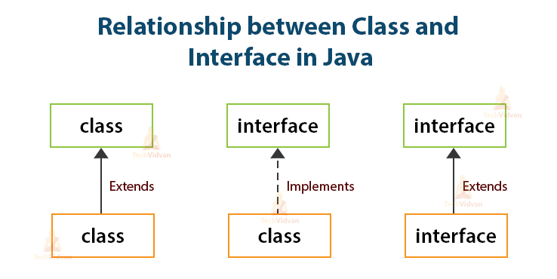

Slide 10



Example of Interfaces
  Interfaces describe an aspect of behavior that different classes can support
    Any class that supports the “Steerable” interface can be steered:
Steerable
Not Steerable

Slide 11
Interface
Interfaces define types in an abstract form
  Allows the specification of a reference type without providing an implementation
  The class that implements the interface decides how to implement
  Use interface keyword instead of class
  public interface Function {
  public double apply(double arg);
  }

Slide 12
Implement the Interface
  public class CurrencyConverter implements Function {
  @Override
  public double apply(double arg) {
  return arg * 45;
  }
  }
  Function usdToInr = new CurrencyConverter();
  System.out.println(usdToInr.apply(100));

Slide 13
Implementing an Interface
public interface Steerable {
int maxTurn = 135;
void turnLeft(int deg);
void turnRight(int deg);
}
public class Car
extends Vehicle
implements Steerable {
public void turnLeft(int deg)
{…}
public void turnRight(int deg)
{…}

Slide 14
Partial Implementation of an Interface
Declare the class as abstract if the class does not implement all the methods of an interface
Implement the methods in the sub class level
Public abstract class Car
extends Vehicle
implements Steerable {
public void turnLeft(int deg)
{…}
}

Slide 15
Using instanceof with Interfaces
  The instanceof operator can be used to check if an object implements an interface
  Downcasting can be used if necessary, to call methods defined in the interface
public void aMethod(Object obj) {
…
if (obj instanceof Steerable)
((Steerable)obj).turnLeft();
}

Slide 16
Extending an Interface
One Interface can extend another Interface
public interface Steerable {
int maxTurn = 135;
void turnLeft(int deg);
void turnRight(int deg);
}
public interface Navigator
extends Steerable {
void calcSpeed(int distance);
}

Slide 17
Polymorphism
This OO Principle allows the programmer to program abstractly
Objects of a subclass can be treated as objects of its superclass
The base class of a hierarchy is usually an abstract class or an Interface
  They define the common behavior (functionality)
Classes and Subclasses inherit this behavior and extend it according to their own properties by overriding the methods of the super class
Subclass objects can be treated as super class objects through references,
  But, super class objects are not subclass objects

Slide 18
Polymorphism
Allows for hierarchies to be highly extensible
New classes can be introduced and can still be processed without changing other parts of the program
Same method can do different things, depending on the class that implements it.
Method invoked is associated with OBJECT and not with reference.
Types of Polymorphism -
  Method Overloading.
  Method Overriding.

Slide 19
Polymorphism
  public interface Conditional {
  public boolean test();
  }

Slide 20
Implementation -One
  public class Professor implements Conditional {
  private String qualification;
  @Override
  public boolean test() {
  return this.qualification.equalsIgnoreCase("phd");
  }
  }

Slide 21
Implementation -Two
  public class Student implements Conditional {
  private double markScored;
  @Override
  public boolean test() {
  return this.markScored>90;
  }
  }

Slide 22
Polymorphism
  public static void print(Conditional poly) {
  System.out.println(poly.test());
  }
  public static void main(String[] args) {
  Student ramesh = new Student(101,"Ramesh",67);
  Professor prof = new Professor(201, "manish", "ece", "phd");
  print(ramesh);
  print(prof);
  }

Slide 23
Substitution of Object References in Method Calls
A subclass object can be passed into any method that expects a superclass object
The method that got invoked, is the version that's present in the object type and NOT the reference type.
public static void main(String[] args) {
Taxi t = new Taxi("ABC123", 2000, 79);
displayDetails(t);
public static void displayDetails(Car c) {
System.out.println(c.details());
}
Notes:
The same object reference (that is, an object reference of the same reference type) is capable of behaving differently at runtime, depending on the object that it points to.

Slide 24
Dynamic Method Dispatch
subclass=
(subclass)superclass
Valid at both Compile ,RunTime
  class First
  {
  public void show()
  {
  System.out.println("ShowFirst");
  }
  }
  class Second extends First
  {
  public void show()
  {
  System.out.println("Show Second");
  }
  }
First fst = new Second();
Second sec = (Second)fst;
sec.show();
First fst2 = new First();
Second sec2 = (Second)fst2;
sec2.show();
subclass=
(subclass)superclass
Valid at Compile time exception at ,RunTime

Slide 25
Dynamic Method Dispatch
Related Through Inheritance
superclass = subclass
  always valid
subclass = superclass
  not valid at compile time, needs a cast
subclass=(subclass)superclass
  valid at compile time, checked at runtime.
  if INVALID then ClassCastException is thrown.
Unrelated Classes – Not Allowed
someClass = someUnrelatedClass
  not valid, won’t compile
somcClass = (someClass)someUnrelatedClass
  not valid, won’t compile

Slide 26
Layered Architecture
Modern Applications are built using several components
  Each connected to one another, providing a specific functionality.
Components that perform similar functions are generally grouped into layers.
Components in a higher layer use the services of components in a lower layer.

Slide 27
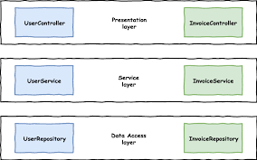
Layered Architecture

