Slide 1
Multi Threads

Slide 2
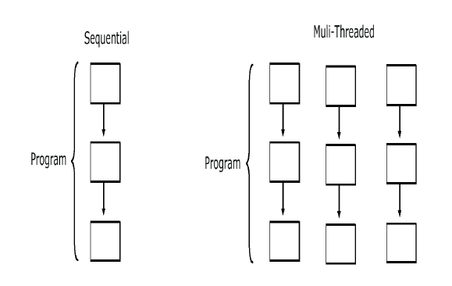
Why threads
Need to handle concurrent processes
Definition
  Single sequential flow of control within a program
Threads are like a processes executed by a program
Example:
  Operating System
  HotJava web browser

Slide 3
Multi-threading in Java Platform
Java Application start with just one thread, called the main thread.
  This thread has the ability to create additional threads
When a new thread is started , a new stack materializes and methods called from that thread run in a call stack that’s separate from the main() call stack.
That second new call stack runs concurrently with the main thread
A thread of execution is an individual process (a “lightweight” process) that has its own call stack.
one thread per call stack—one call stack per thread.

Slide 4
The Main Thread
Every java program has at least one thread called main thread
Thread.currentThread().getName()
  Returns the name current thread
  setName() is used to set the name for the thread

Slide 5
Making a Thread
Done by extend the java.lang.Thread class
  To have specialized version of a thread class.
  That class can’t extend another class
Done By Implementing the Runnable interface
  Leaves class free to extend from some other class
  Define behavior that will be run by a separate thread.
  Thread Class is created with a Runnable argument.
  The Runnable object is the target of the thread.
    .

Slide 6
Making a Thread
A thread begins as an instance of java.lang.Thread.
public void run()
  Has the Code that needs to be run in a separate thread
  It can call other methods,
  The thread of execution begins with the call to this method

Slide 7
Example
  public class NumberService {
  public NumberService() {
  super();
  }
  public void sumNumbers(int countTo) {
  int count =0;
  for(int i=0;i<=countTo;i++) {
  count =count +i;
  }
  System.out.println( " Sum of Number upto" + countTo +"Is ="+count +"Done By"+Thread.currentThread().getName());
  }
  }

Slide 8
Implementing java.lang.Runnable
  public class NumberAddingService implements Runnable{
  private int countTo;
  private NumberService service;
  public NumberAddingService(int countTo,String name) {
  this.countTo = countTo;
  this.service = new NumberService();
  Thread t1 = new Thread(this,name);
  t1.start();
  }
  @Override
  public void run() {
  this.service.sumNumbers(countTo);
  }
  }

Slide 9
Starting a Thread
start()
  Creates a new thread and makes it runnable
  A new thread of execution starts (with a new call stack).
  The thread moves from the new state to the runnable state.
  When the thread gets a chance to execute, its target run() method will run.

Slide 10
Starting Multiple Thread
  public static void main(String[] args) {
  new NumberAddingService(50,"Fifty Count");
  new NumberAddingService(500,"Five Hundred Count");
  new NumberAddingService(5000,"Five Thousand Count");
  try {
  System.out.println("Enter the Number");
  int ch =System.in.read();
  System.out.println(ch);
  } catch (IOException e) {
  e.printStackTrace();
  }
  }

Slide 11
The Thread Scheduler
The thread scheduler is the part of the JVM
Any thread in the runnable state can be chosen by the scheduler to be the one and only running thread.
java.lang.Thread Class
  public static void sleep(long millis) throws InterruptedException
  public final void join()
java.lang.Object Class
  public final void wait()
  public final void notify()
  public final void notifyAll()

Slide 12
Thread States
New
  When the Thread has been instantiated
    The start() method has not been invoked on the thread.
  It is a live Thread object, but not yet a thread of execution.
  At this point, the thread is considered not alive.
Runnable
  The state a thread is in when it’s eligible to run,
  Scheduler has not selected it to be the running thread.
  A thread first enters the runnable state when the start() method is invoked
  A thread can also return to the runnable state after either running or coming back from a blocked, waiting, or sleeping state.
  When the thread is in the runnable state, it is considered alive.

Slide 13
Thread States
Running
  This is the state a thread is in when the thread scheduler selects it from the runnable pool to be the currently executing process.
  A thread can transition out of a running state for several reasons, including because “the thread scheduler felt like it.”
Waiting/blocked/sleeping
  The thread is still alive, but is currently not eligible to run.
  A thread may be blocked waiting for a resource
  A thread may be sleeping because the thread’s run code tells it to sleep for some period of time
  waiting, because the thread’s run code causes it to wait

Slide 14
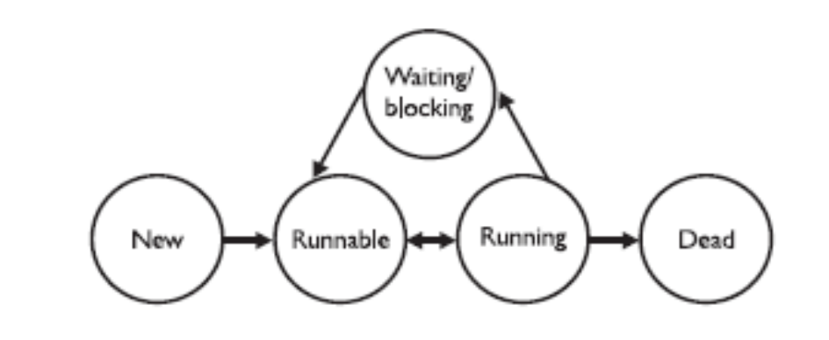
Thread States
Dead
A thread is considered dead when its run() method completes.
It may still be a viable Thread object, but it is no longer a separate thread of execution. Once a thread is dead, it can never be brought back to life
A runtime exception will be thrown

Slide 15
Leave the running state
sleep()
Guaranteed to cause the current thread to stop executing
  Duration is specified in milli seconds
  It might be interrupted before its specified time
join()
Guaranteed to cause the current thread to stop executing until the thread it joins with the thread it calls wait on completes.
Leave the Running State:
Following scenarios
  The thread’s run() method completes..
  A thread can’t acquire the lock on the object whose method code it’s attempting to run

Slide 16
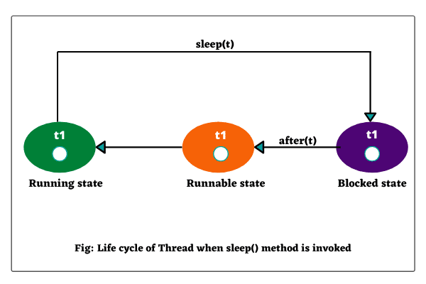
The sleep() method
Static method of Thread Class
Can be Placed anywhere in the Code
Throws a Checked Exception – Interrupted Exception
  try {
Thread.sleep(5*60*1000); // Sleep for 5 minutes
} catch (InterruptedException ex) { }

Slide 17
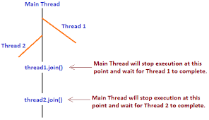
The Join() Method
The non-static join() method of class Thread lets one thread “join onto the end” of another thread.
The thread class join method waits until a thread is finished executing or waiting for a thread to die before returning .

Slide 18
Joining Thread
  public class TaskForJoin implements Runnable {
  public void run() {
  System.out.println("Reading");
  try {
  System.in.read( );
  } catch (java.io.IOException ex) {
  }
  System.out.println("Thread Finished.");
  }
  }

Slide 19
Joining Thread
  public class ParentThread {
  public static void main(String[] args) {
  System.out.println("Starting");
  TaskForJoin task = new TaskForJoin();
  Thread t = new Thread(task);
  t.start( );
  System.out.println("Joining");

Slide 20
Joining Thread
    try {
    t.join( );
    } catch (InterruptedException ex) {
    ex.printStackTrace();
    }
    System.out.println("Main Finished.");
    }
    }

Slide 21
Synchronizing Code
Threads can share resources.
Sometimes it is desirable that only one thread at a time has access to a shared resource.
Achieved by using the keyword: synchronized, Only methods can be synchronized, not variables.
Protects access to code, not to data
  Make data members private
  Synchronize accessor methods
A lock can be associated with a shared resource. Threads gain access to a shared resource by first acquiring the lock associated with the resource.
one thread can hold the lock and thereby have access to the shared resource.

Slide 22
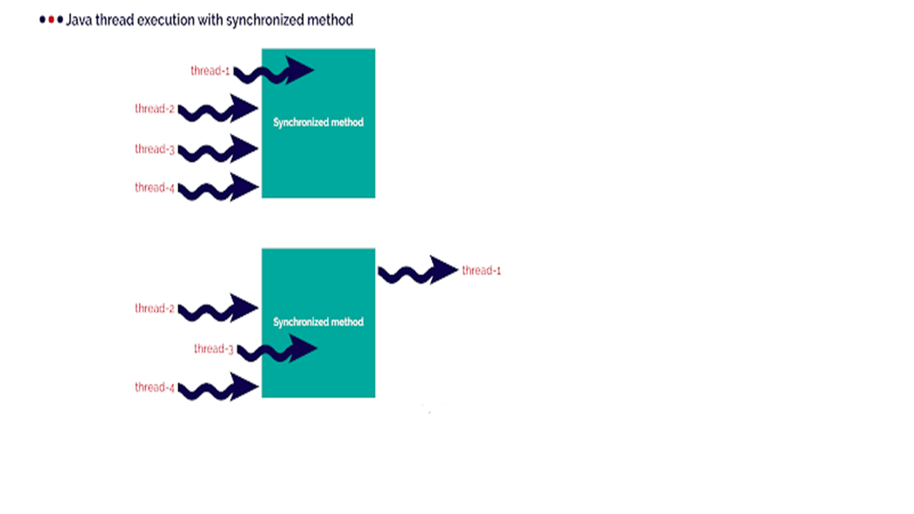
Synchronizing Code

Slide 23
Synchronizing Code
A class can have both synchronized and no synchronized methods.
If a class has both synchronized and nonsynchronized methods, multiple threads can still access the nonsynchronized methods of the class!
A thread can acquire more than one lock.
A thread can enter a synchronized method, thus acquiring a lock, and then immediately invoke a synchronized method on a different object, thus acquiring that lock as well.
As the stack unwinds, locks are released again.

Slide 24
Thread Synchronization
  class TwoStrings {
  synchronized static void print(String str1, String str2) {
  System.out.print(str1);
  try {
  Thread.sleep(500);
  } catch (InterruptedException ie)
  {
  ie.printStackTrace();
  }
  System.out.println(str2);
  }
  }

Slide 25
Thread Synchronization
  class PrintStringsThread implements Runnable {
  String str1, str2;
  PrintStringsThread(String str1, String str2) {
  this.str1 = str1;
  this.str2 = str2;
  Thread thread = new Thread(this);
  thread.start();
  }
  public void run() {
  TwoStrings.print(str1, str2);
  }
  }

Slide 26
Thread Synchronization
  public class Test {
  public static void main(String args[])
  {
  new PrintStringsThread("Hello ", "there.");
  new PrintStringsThread("How are ", "you?");
  new PrintStringsThread("Thank you ","very much!");
  new PrintStringsThread("Bye ","Bye!");
  }
  }
  Output- May be in Different Order
  Hello there
  How are you
  Thank you very much
  Bye,Bye

Slide 27
Thread Interaction
The java.lang.Object class has three methods—wait(), notify(), and notifyAll()—that help threads communicate
wait(), notify(), and notifyAll() must be called from within a synchronized context!
If many threads are waiting on the same object, only one will be chosen (in no guaranteed order) to proceed with its execution.
If there are no threads waiting, then no particular action is taken

Slide 28
notifyAll()
This notifies all waiting threads and they start competing to get the lock. As the lock is used and released by each thread, all of them will get into action without a need for further notification.
Object can have many threads waiting on it, and using notify() will affect only one of them.
Which one exactly is not specified and depends on the JVM implementation,
never rely on a particular thread In cases in which there might be a lot more waiting, the best way to do this is by using notifyAll().

Slide 29
Notify -Example
  class BankAccount {
  private double balance=2000;
  public synchronized double deposit(double amount){
  balance=balance+amount;
  notify();
  return balance;
  }

Slide 30
Notify -Example
public synchronized double withdraw(double amount)
{
if(balance <amount) {
System.out.println("In sufficent Balance ");
try {
wait();
} catch (InterruptedException e) {
e.printStackTrace();
}
}
balance =balance-amount;
return balance;
}

Slide 31
Notify -Example
  public static void main(String[] args) {
  final BankAccount bk1 =new BankAccount();
  Thread t1=new Thread(){
  public void run(){
  bk1.withdraw(4000);
  } };
  t1.start();
  Thread t2=new Thread(){
  public void run(){
  bk1.deposit(3000);
  }
  };
  t2.start();
  }

Slide 32
Notify and notifyAll()
notify
Object can have many threads waiting on it, and using notify() will affect only one of them.
  Which one exactly is not specified and depends on the JVM implementation,
  The thread that receives notification may not able to proceed and starts waiting again application cannot progress further.
  May result in deadlock if the thread which calls notify() goes into waiting for state after sending a notification because then there is no active thread to notify all waiting threads.
notifyAll()
  A better option than notify()
  It sends a notification to all the threads.
  If one is not able to proceed, there is still some more threads to do the job

Slide 33

Notify and notifyAll()

Slide 34
EXECUTOR FRAMEWORK

Slide 35
Executor Framework
Released with the JDK 5
  Classes and Interfaces are part of java.util.concurrent package
Helps to decouple a command submission from command execution.

Slide 36
Executor Framework
Thread Creation
  Provides methods for creating a pool of threads
Task submission and execution
  Provides methods for submitting tasks for execution in the thread pool
  Can also schedule task to be executed later
  Can also make them execute periodically.

Slide 37
Executor Service
ExecutorService
  A sub interface of Executor
  Used to manage lifecycle of threads
  Used for running the submitted tasks
  Provides Methods that produce a Future
    Used to get a result from an asynchronous computation.

Slide 38
Executor Service
Methods to start and terminate thread.
  execute()
  Used for threads which are Runnable
  submit()
  Used for Callable threads.
shutdown()
  Stops accepting new tasks, waits for previously submitted tasks to execute,
  Then terminates the executor.
shutdownNow()
  Interrupts the running task and shuts down the executor immediately.

Slide 39
Thread Pool
A pool of worker threads
  Executors use thread pools to execute tasks.
Need for Thread Pool
  Creating a new thread for a new task leads to overhead of thread creation and tear-down.
    Managing thread life-cycle adds to the execution time.
  New thread for each process without any throttling leads to the creation of many threads.
    They occupy memory and cause wastage of resources.

Slide 40
Executors
Executors
  Class that Provides Factory methods to create Thread Pools of worker threads.
  Tasks are submitted for execution.
    Schedules and executes the submitted tasks
    Return the results from the thread pool.

Slide 41

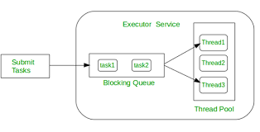
Working of Executors

Slide 42
Types of Executors –Single Thread Executor
newSingleThreadExecutor()
  Executor has only a single thread.
  Used to execute tasks in a sequential manner.
  When the submitted task is in execution
    The new task will wait in a queue until the thread is free to execute it.
    If the thread dies due to an exception while executing a task, a new thread is created to replace the old thread and the subsequent tasks are executed in the new one.
  ExecutorService executorService =
  Executors.newSingleThreadExecutor()

Slide 43
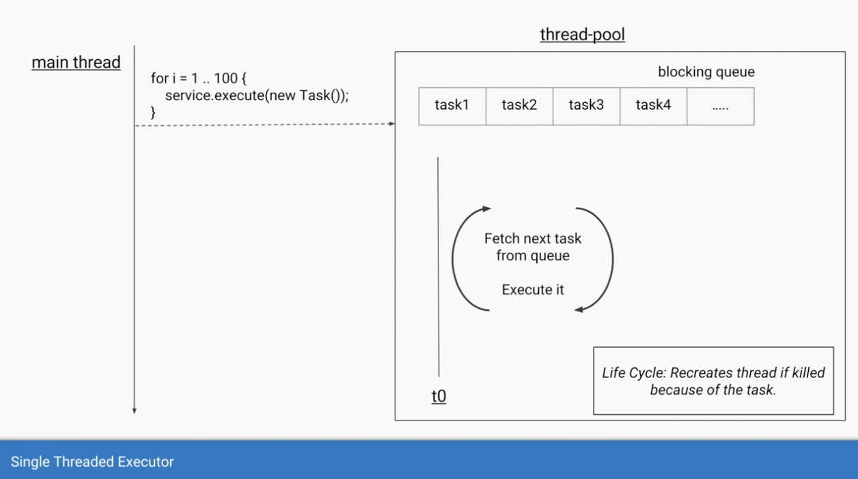
Single Threaded Executor

Slide 44
Task
  public class PrintNames {
  public synchronized static void print(String str1,String str2) {
  System.out.println(str1);
  try {
  Thread.sleep(200);
  } catch (InterruptedException e) {
  e.printStackTrace();
  }
  System.out.println(str2);
  }
  }

Slide 45
Runnable
  public class ExecutorPrintService implements Runnable {
  private String str1;
  private String str2;
  public ExecutorPrintService(String str1, String str2) {
  super();
  this.str1 = str1;
  this.str2 = str2;
  }
  @Override
  public void run() {
  PrintNames.print(str1, str2);
  }
  }

Slide 46
Submit to Executor
  public static void main(String[] args) {
  ExecutorService executor = Executors.newSingleThreadExecutor();
  ExecutorPrintService tasks[] = {
  new ExecutorPrintService("Idly","sambar"),
  new ExecutorPrintService("Parantha","achar"),
  new ExecutorPrintService("pizza","coke")};
  for(int i=0;i<tasks.length;i++) {
  executor.submit(tasks[i]);
  }
  executor.shutdown();
  }

Slide 47
Runnable Task
  public class NameManager implements Runnable {
  private List<String> list;
  private List<String> nameToAdd ;
  public NameManager(List<String> list,String ... names) {
  this.list = list;
  this.nameToAdd = Arrays.asList(names);
  }
  public List<String> getList() {
  return list;
  }
  @Override
  public void run() {
  this.list.addAll(nameToAdd);
  }
  }

Slide 48
Single Thread Executor
    ExecutorService service = Executors.newSingleThreadExecutor();
  List<String> list = new ArrayList<>();
  NameManager task1 =new NameManager(list,"Ram",“Vijay",”Vicky");
  NameManager task2 =new NameManager(list,"Vidya","vani","Rani");
  service.submit(task1);
  service.submit(task2);
  task1.getList().forEach(System.out::println);
  service.shutdown();

Slide 49
Executors.newFixedThreadPool
  Create a thread pool of fixed size,
  Executor service picks one of the available threads from the pool and executes the task on that thread.
  Makes sure that the pool always has the specified number of threads running.
  If any thread dies it is replaced by a new thread immediately.
  If all the threads are busy , the new tasks will wait for their turn in a queue.

Slide 50
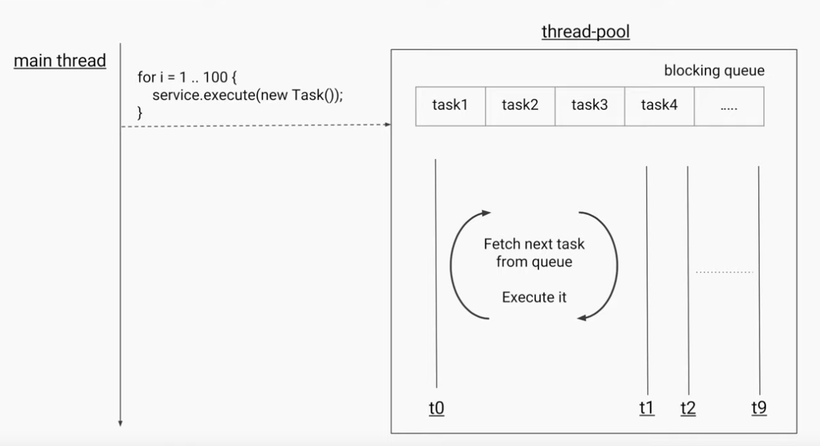
Fixed Thread Pool

Slide 51
Submit to Executor
  public static void main(String[] args) {
int poolSize = Runtime.getRuntime().availableProcessors();
  ExecutorService executor = Executors.newFixedThreadPool(poolSize);
  ExecutorPrintService tasks[] = {
  new ExecutorPrintService("Idly","sambar"),
  new ExecutorPrintService("Parantha","achar"),
  new ExecutorPrintService("pizza","coke")};
  for(int i=0;i<tasks.length;i++) {
  executor.submit(tasks[i]);
  }
  executor.shutdown();
  }

Slide 52
Size of the Fixed Thread Pool
Decided based on the use-case of the java program.
It also depends on number of CPU cores
CPU Bound
  Tasks which involves mathematical calculations.
  Ideal size is same as number of CPU cores.
IO Bound
  Tasks which involve communication to other application through network calls like database, web services
  Ideal size depends on the wait time of the IO task.
  More number of threads can be used to ensure maximum CPU utilization.

Slide 53
SingleThreadExecutor vs FixedThreadPool
Similarity
  Returns ExecutorService
  If thread terminates, new thread will be created.
Difference
  newSingleThreadExecutor()
    can never increase its thread pool size more than one.
  newFixedThreadPool(1)
    (1) stands for the number of threads in the pool
    can increase its thread pool size more than one at run time
  Done by setCorePoolSize() of the class ThreadPoolExecutor.

Slide 54
Difference between execute and submit
execute
  Starts the task
  Used for fire and forget calls
  Throws un-handled Exception.
    submit
  returns a Future object to manage the task.
  Can be Used to submit a Callable
  Callable can return a value
  Hides un-handled Exception in framework itself.
  Can Wait for the Callable task to finish executing
  Can get the return value on completion , with get.

Slide 55
CALLABLE

Slide 56
Callable
Similar to Runnable
Can be used with an executor service for execution.
A functional Interface with one Method
call()
  Method contains the code that is executed by a thread.
  Can return a result and throws a checked exception.

Slide 57
Callable With Executor
submit()
  submits the task for execution by a thread.
  returns a java.util.concurrent.Future
A task submitted to the executor
  Submitted task must implement Callable.
  Whenever the task execution is completed, it is set to Future object by the executor.

Slide 58
Future
Future
  Object returned by the executor.
  The result of the task submitted for execution to an executor
  Its like a promise made to the caller by the executor.
  Future.isDone
  Returns a boolean value true if the task completed.

Slide 59
Future.get()
Future.get()
  Waits for the computation to complete, and then retrieves its result.
  This method is used to get the result of the submitted task when its completed
get(long timeout, TimeUnit unit)
  Throws a TimeoutException if the result is not returned in the stipulated timeframe.
  The caller can handle this exception and continue with the further execution of the program.

Slide 60
Cancelling a Future
Future.cancel(boolean mayInterruptIfRunning)
  Used to cancel a future
  returns true if it is cancelled successfully, otherwise, it returns false.
mayInterruptIfRunning.
  True
    the thread that is currently executing the task will be interrupted
  False
    in-progress tasks will be allowed to complete.
Future.isCancelled()
  To check if a task is cancelled or not.

Slide 61
Callable Example
public class Task implements Callable<String> {
private String message;
public Task(String message) {
this.message = message;
}
@Override
public String call() throws Exception {
return "Hello " + message + "!";
}
}

Slide 62
Callable Example
public class ExecutorExample {
public static void main(String[] args) {
Task task = new Task("World");
ExecutorService executorService = Executors.newFixedThreadPool(4);
Future<String> result = executorService.submit(task);
try {
System.out.println(result.get());
} catch (InterruptedException | ExecutionException e) {
System.out.println("Error occured while executing the submitted task");
e.printStackTrace();
}
executorService.shutdown();
}
}

Slide 63
Callable Example
  public class FactorialCalculator implements Callable<Integer> {
  private Integer number;
  public FactorialCalculator(Integer number) {
  this.number = number; }
  @Override
  public Integer call() throws Exception {
  int result = 1;
  if ((number == 0) || (number == 1)) {
  result = 1;
  } else {
  for (int i = 2; i <= number; i++) {
  result *= i;
  TimeUnit.MILLISECONDS.sleep(20);
  }
  }
  return result;
  } }

Slide 64
Callable Example
  ExecutorService executor = Executors.newFixedThreadPool(2);
  FactorialCalculator calculator = new FactorialCalculator(5);
  try {
  Future<Integer> task = executor.submit(calculator);
  System.out.println("Future result is - " + " - " + task.get() + "; And Task done is " + task.isDone());
  }
  catch ( ExecutionException | InterruptedException e)
  {
  e.printStackTrace();
  }
  executor.shutdown ();

Slide 65
Cancelling the Future
  public static void main(String[] args) {
  ExecutorService executorService = Executors.newSingleThreadExecutor();
  long startTime = System.nanoTime();
  Future<String> future = executorService.submit(() -> {
  Thread.sleep(2000); return "Hello from Callable"; });
  while(!future.isDone()) {
  System.out.println("Task is still not done...");
  try {
  Thread.sleep(200);
  double elapsedTimeInSec = (System.nanoTime() - startTime)/1000000000.0;
  if(elapsedTimeInSec > 1) {
  future.cancel(true);
  }
  } catch (InterruptedException e) {
  e.printStackTrace(); }

Slide 66
Cancelling the Future
  System.out.println("Task completed! Retrieving the result");
  String result;
  try {
  result = future.get();
  System.out.println(result);
  } catch (InterruptedException e) {
  e.printStackTrace();
  } catch (ExecutionException e) {
  e.printStackTrace();
  }
  executorService.shutdown();
  }
  }

Slide 67
Cancelling the Future
  if(!future.isCancelled()) {
  System.out.println("Task completed! Retrieving the result");
  String result = future.get();
  System.out.println(result);
  } else {
  System.out.println("Task was cancelled");
  }

