Slide 1

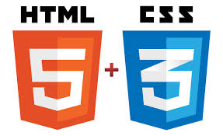
Tim Berners-Lee

Slide 2
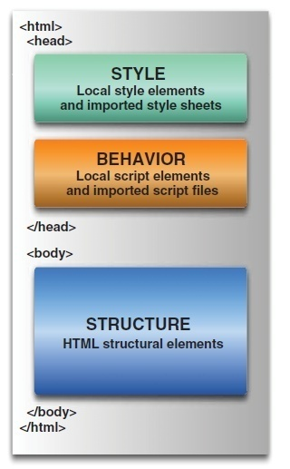
Web page

Slide 3
What is HTML
Hypertext Markup Language.
Based on the Standard Generalized Markup Language (SGML)
Defines a set of common styles for web pages:
  headings, paragraphs, lists, and tables.
  defines character styles such as boldface
These styles are indicated inside HTML documents using tags.
  <h1>Hello World</h1>
HTML element encompasses opening tag, closing tag, content

Slide 4
Evolution of HTML
Tim Berners-Lee made major contribution in Creating HTML in 1989
He Founded the W3C , refined and updated HTML with HTML4 in 1997.,
Growing need for richer Web content
  audio, video and interactivity ,Plug-in applications such as Flash
Web Hypertext Application Technology Working Group (WHATWG) in 2004,
  Created with the involvement of Apple, the Mozilla Foundation and Opera
In 2006 WHATWG developed the new standard named HTML5
  released in 2008, web browsers have increasingly incorporated the new standard

Slide 5
What is HTML5?
Latest standard for HTML.
Designed to replace both HTML 4, XHTML, HTML DOM Level 2.
Designed to deliver rich content without the need for additional plugins.
Animation to graphics, music to movies, and can also be used to build complicated web applications.
Cross-platform.
It is designed to work with PC, or a Tablet, a Smartphone, or a Smart TV.

Slide 6
Structuring HTML
HTML defines page's overall structure
  <html>
  <head>
  <body>
These tags don't affect what the page looks like when it's displayed;
Helps the tools that interpret or filter HTML files.

Slide 7
Meta Tags
Charset:
  Instruction to the browser to use the UTF-8 character encoding
  Method of converting typed characters into machine-readable code.
View Port :
  Added to Ensure rendering and Touch Zooming

Slide 8
Meta Tags
http-equiv:
  Used to simulate an HTTP response header
    <meta http-equiv="refresh" content="300">
    <meta http-equiv="X-UA-Compatible" content="IE=edge">
X-UA-Compatible
  To choose the version of Internet Explorer the page should be rendered as IE7,IE8 or Edge
Initial-Scale
  The initial zoom level for the page when its opened in browser

Slide 9
Basic HTML
<!DOCTYPE html>
<html lang="en">
<head>
<meta charset="UTF-8">
<meta http-equiv="X-UA-Compatible" content="IE=edge">
<meta name="viewport" content="width=device-width, initial- scale=1.0">
<title>Document</title>
</head>
  <body>
  <header>
  <h1> HTML 5 and CSS 3</h1>
  </header>
  </body>
  </html>

Slide 10
HTML Global Attributes
Global attributes may be specified on all HTML elements
Class
  Specifies one or more classnames for an element (refers to a class in a style sheet)
Id
  Specifies a unique id for an element
Style
  Specifies an inline CSS style for an element
Accesskey
  specifies a shortcut key to activate/focus an element
Tabindex
  Specifies the tabbing order of an element
Title
  Specifies extra information about an element

Slide 11
<link>
TO link document to other resources.
The destination of the link(s) is given by the href attribute
The types of link indicated (the relationships) are given by the value of the rel attribute
The possible supported tokens are icon, stylesheet.
  Should only include the tokens from this list that the user agent implements the processing model for.

Slide 12
Headings
Headings are used to add titles to sections of a page
. HTML defines six levels of headings.
  <h1>Installing Your Safety Lock</h1>
The numbers indicate heading levels (H1 through H6).
They're displayed in larger or bolder text, are centered or underlined, or are capitalized so that they stand out from regular text.

Slide 13
Paragraphs
<p> tag was used to indicate the end of a paragraph and not the beginning.
Multiple <P>'s do not create blank lines
Use <BR> for blank line
Fully-specified text uses <P> and </P> ,but </P> is optional

Slide 14
List Tags- Unordered List
List tags begin and end the entire list.
Creates a list with bullets next to the list items.
The <li> tag, followed by text, then closed with </li> tag.
  <ul type=“disc”>
  <li>I am item one</li>
  <li>I am item two</li>
  </ul>
Type attribute: disc, circle, square
  <ol type="I">
  <li>Roman I</li>
  <li>Roman II</li>
  </ol>
Type Attribue : “1” , “A”,”a”,”I”

Slide 15
Comments
Comments in HTML pages to describe the page itself or to provide some kind of indication of the status of the page.
Text in comments is ignored when the HTML file is parsed;
Comments don't ever show up on screen
  <!-- This is a comment -->

Slide 16
Creating Links
<a href="http://www.someplace.com">Display Text</a>
“a” stands for anchor, and the href="" is asking for a location to link to. The </a> is the closing tag.
The text between the tags is what will show up on your Web page as a link.
"local url".
  Any file for which the to create a local url link , the file should be in the same directory as the page you are editing.
  <a href="linking.htm">Linking to Other Pages</a>

Slide 17
Horizontal Rules & Line Break
The <hr> tag, which has no closing tag in HTML and no text associated with it, creates a horizontal line on the page.
Rule lines are used to visually separate sections of a web pagejust before headings,
  To separate body text from a list of items.
Line Break
The <br> tag breaks a line of text at the point where it appears.
When a web browser encounters a <br> tag, it restarts the text after the tag at the left margin

Slide 18
Physical Character Style
    <H1>Physical Character Styles</H1>
    <B>Bold</B><BR>
    <I>Italic</I><BR>
    <U>Underlined</U><BR>
    Subscripts: f<SUB>0</SUB> + f<SUB>1</SUB><BR>
    Superscripts: x<SUP>2</SUP> + y<SUP>2</SUP><BR>
    <SMALL>Smaller</SMALL><BR>
    <BIG>Bigger</BIG><BR>
    <STRIKE>Strike Through</STRIKE><BR>

Slide 19
Inline Images in HTML: The <img> Tag
Inline images are placed in HTML documents using the <img> tag.
Adding Alternative Text to Images
When client cannot present then there is graceful degradation
  Providing an alternative version or making the user aware of shortcomings of a product as a safety measure to ensure that the product is usable
<img src="myimage.gif" alt=“picture of a cat" />

Slide 20
Images and Links
Image can serve as a link
Add an <img> tag inside a link tag (<a>), that image serves as a link itself:
<a href="index.html"><img src="uparrow.gif" alt="Up" /></a>
Both an image and text in the link tag, they become links to the same page:
<a href="index.html">
  <img src="uparrow.gif" alt="Up" />Up to Index</a>

Slide 21
<A> Anchors (HyperLinks)
Link to an absolute URL:
  If you get spam, contact
  <A HREF="htttp:www.microsoft.com“>Microsoft </A> to report the problem.
Link to a relative URL:
  See these <A HREF="#references"> references </A>
  concerning our fine products.
Link to a section within a URL:
  Amazon provided a <A HREF="www.amazon.com/#reference">
  reference for our company. </A>

Slide 22
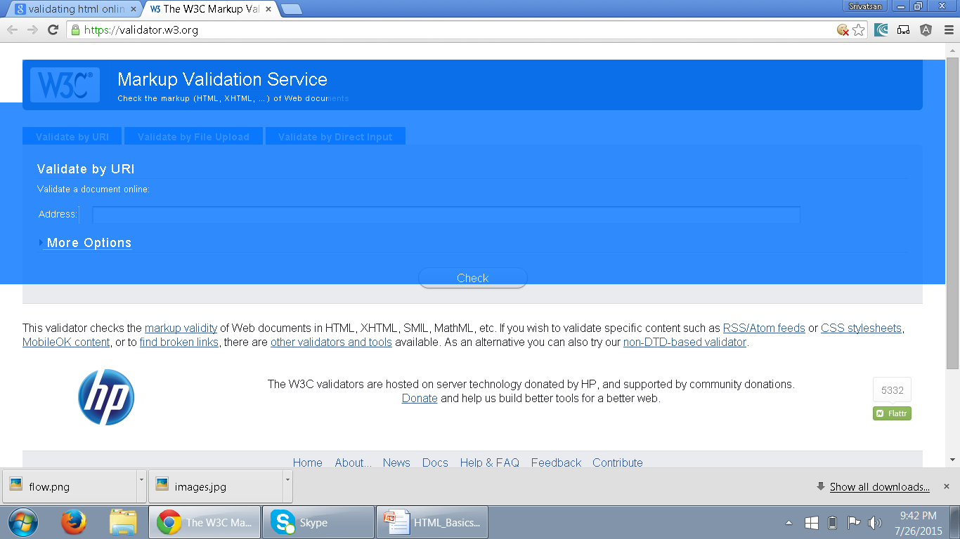
Validating HTML
The validator service checks the markup validity of Web documents in HTML, XHTML, SMIL, MathML, etc
https://validator.w3.org/
.

Slide 23
Cascading StyleSheets (CSS)
The Goal of HTML was to create content for a web page.
  CSS is a W3C Specification
From HTML 4.0
  Only CSS is used for all formatting
  It can also be added from a separate external .css file.

Slide 24
CSS Usage
Specify point size and font of text;
Set margins within a web page;
Create a distinctive style for individual web pages or sets of web pages;
Format style to one element of a web page or to a numerous pages;
Control color of different elements of a web page;

Slide 25
Style Rule
A Style Rule is composed of two parts: a selector and a declaration.
TH {color: red;}.
The Selector indicates the element to which the rule is applied.
The Declaration determines the property values of a selector.
  Property specifies a characteristic
    color, font-family, position
  Value expresses specification of a property
    RED for color, 12 pt for font-size
    {color: red;}
Selector
Declaration
Value
Property

Slide 26
External Style Sheet
Can also expressed in an external Style Sheet
    Used to apply styles to number of pages
External Style Sheet has a .css extension.
<link rel="stylesheet" type="text/css" href=“my_style.css" />
href:
  URL Specifies the location of the linked document
rel
  Specifies the relationship between the current document and the linked document
  Author,Icon,external,Help,search,sidebar,stylesheet

Slide 27
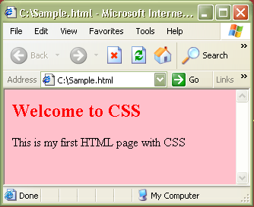
CSS – External StyleSheet Example
<html>
<link rel="stylesheet" type="text/css" href=“my_style.css" />
<h2> Welcome to CSS </h2>
<body> This is my first HTML page with CSS </body>
</html>
Sample.html
Path to the .css file
h2 {color:red}
body {background-color:pink}
my_style.css
Output:

Slide 28
CSS – Internal StyleSheet
Included in the head section of HTML page
    <style> tag is used to hold the values for formatting
Can contain <type> attribute with a value “text/css”
Style that can be applied to a page that needs a unique format.

Slide 29
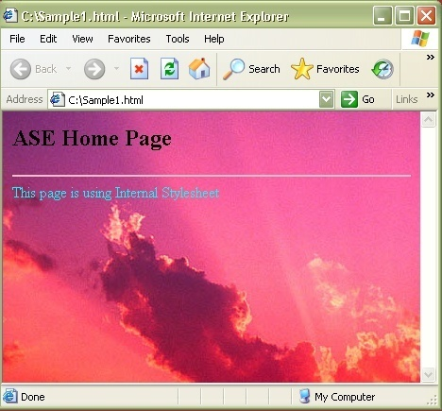
CSS – Internal StyleSheet Example
<html>
<head>
<style type="text/css">
hr{color:pink}
body {background- image:url(‘images\Sunset.jpg')}
</style>
</head>
<hr>
<body>
<h2> Home Page</h2>
<p>This page is using Internal Stylesheet</p>
</body>
</html>

Slide 30
CSS – Inline StyleSheet
    style attribute is used in the relevant tag.
    style attribute can contain any CSS property.
    <html>
    <p style="color:blue">This is a example of inline stylesheet</p>
    </html>

Slide 31
Working with Tables

Slide 32
Head and Body
<thead>
  Can semantically indicate that the first row was the header of the table.
  must appear after any <caption> element
  Must appear before any <tbody>, <tfoot> and <tr> element
<tfoot>
  defines a set of rows summarizing the columns of the table.
  Can be used as a child of a <table> element, after any <caption>, and <thead>
  Can be used before any <tbody> and <tr> elements.
.

Slide 33
<table> - Element
To tabulate data in columns and rows as in a spreadsheet
Used for displaying tabular data.
Its inappropriate to use tables for layout.
  <table>
  <tr>
  <th>Name</th>
  <th>ID</th>
  </tr>
  <tr>
  <td>Ramesh</td>
  <td>10000</td>
  </tr>
  </table>

Slide 34
Table
Elements used to create data within each row
<th>...</th>
  Used for heading cells.
  Browsers center the contents
  text is rendered in the boldface.
<td>...</td>
  Used to render table data.

Slide 35
Basic Styling With CSS
Width
  Can be applied to individual cells <th> or <td>
  width attribute in cells can be pixel or a percentage
  Useful when multiple columns of identical widths, regardless of their contents
border-collapse
  To specify whether a table's borders are separated
  cells can have distinct borders from each other
  Adjacent cells can share borders.
  border-collapse: collapse;
  border-collapse: separate;

Slide 36
Basic Styling With CSS
border
  A shorthand property for setting following property values
  Any value that is not specified is set to its corresponding initial value.
  border-width,
  border-style,
  border-color.
border: 1px;
border: 2px dotted;
border: medium dashed green;

Slide 37
Basic Styling
  table{
  border: 2px solid blue;
  border-collapse:collapse;
  }
  th,tr,td{
  border: 2px solid blue;
  }
  td{
  padding:0px 10px 0px 10px;
  width: 30px;
  }

Slide 38
colSpan and rowSpan
Create a cell that spans multiple rows or columns
  Can be added to both <th> or <td>
The data within that cell then fills the entire width or length of the combined cells
rowspan
  similar to colspan,
  it will span across rows rather than columns.

Slide 39
Table Example
  <table>
  <caption>Conference Schedule</caption>
  <thead>
  <tr>
    <th>Item Number</th>
    <th>Item Name</th>
    <th>Quantity</th>
    <th>Rate</th>
    <th>Amount</th>
  </tr>
  </thead>

Slide 40
Table Example
  <tbody>
  <tr>
    <td>101</td>
    <td>Cake</td>
    <td>1</td>
    <td>200</td>
    <td>200</td>
  </tr>
  </tbody>
  <tfoot>
        <tr>
        <td colspan="4">Total</td>
        <td>200</td>
        </tr>
  </tfoot>
  </table>

Slide 41
Basic Styling
  table{
  border: 2px solid blue;
  border-collapse: collapse;
  margin: auto;
  }
  thead {
  background-color: grey;
  }
  tfoot {
  background-color: lightgray;
  }
  caption{
  font-style: 'Arial';
  }
  tr,td {
  border: 2px solid blue;
  text-align: center;
  }

Slide 42
Using the <form> Tag
To accept input from a user, input fields are placed inside a <form> tag.
Its purpose is to indicate where and how the user's input should be sent.
The two most used attributes of the <form> tag are
  Action
  method.
Both of these attributes are optional.
  <form action="someaction" method="get or post">
  </form>
Action specifies the URL to which the form is submitted.

Slide 43
Creating Form Controls with the <input> Tag
Text Boxes
  These tags allows the user to enter a single line of text.
  <input type="text" name=“userName" size="25" maxlength="60" />
The type=" "
  specifies the type of input we want from the user, the type is "text".
The name=" "
  attribute is name of the line of text to be recognized when the form is submitted

Slide 44
label
Defines a label for an <input> element.
Usability improvement for mouse users, because if the user clicks on the text within the <label> element, it toggles the control.
The for attribute of the <label> tag should be equal to the id attribute of the related element to bind them together.
  <label for="email">EMAIL-ID</label>
  <input type="email" value="" name="emailid" size="30" placeholder="Enter a valid email address“ id=“email”>

Slide 45
Creating Password Controls
The password field used when data entered is masked
  <input type="password" name="userpassword" size="8" maxlength="8" />
Text Area
  used to create text area where lines of text could be inserted
  <textarea name="comments" rows="5" cols="30"></textarea>

Slide 46
Radio Buttons and Check Box
Little button for user to click on :
  <label>Pizza</label>
  <input type="radio" name="foodchoice" value="pizza" />
The name=" "
  To name the section of choices.,If its group all the button share the same value
The value=" “
  To assign the value of the individual button when it is selected.
  This is going to be the text sent back as the user's choice

Slide 47
Checkboxes
  <label>Pizza</label>
    <input type="checkbox" name="foodchoice" value="pizza" />
A little square is displayed instead of small circle
type="checkbox"
  tells the browser to display the little box.
name=" "
  allows to give the section of choices a name,
value=" "
  allows to give the individual checkbox its value

Slide 48
Drop-Down Menus
They are created with the <select> tag:
  <select name="bestcolor">
  <option selected="selected">blue</option>
  <option>red</option>
  <option>black</option>
  <option>green</option>
  <option>polka dots!</option>
  </select>
<option selected="selected">
  To specify which option will be displayed as the default value on the screen.
<option>
  To add another choice to the list.

Slide 49
Creating Submit Buttons
Submit buttons are used to indicate that the user is finished filling out the form.
Submit button is displayed with the text “Submit Query. “
value attribute used enter custom label,
  <input type="submit" value="Send Form Data" />
Creating Reset Buttons
Reset buttons set all the form controls to their default values.
  <input type="reset" value="Clear Form" />

Slide 50
Creating Generic Buttons
<input type="button" name="verify" value="verify" onclick="verifydata()" />
Button can be created such a way it runs a function when clicked
Label for the Button is provided with the value attribute
Unlike Submit buttons, regular buttons don't submit the form when they're clicked.

Slide 51
Search
Provides a search field—a one-line text input control for entering one or more search terms.
The difference is primarily stylistic:
Browsers have added the ability to clear the input with the click of a mouse, by providing an x icon once text is entered into the field.

Slide 52
Email Addresses and Telephone Number
Used for specifying one or more email addresses.
  It supports the Boolean multiple attribute, allowing for multiple, comma-separated email addresses.
  <label for=“email">Email </label>
  <input type="email" id="email" name="email“ multiple=“multiple”>
  <label for="telNo">Telephone number (xxx-xxx-xxxx) </label>
  <input id="telNo" name="telNo" type="tel" required
  pattern="[0-9]{3}-[0-9]{3}-[0-9]{4}">

Slide 53
Dates and Times
There are several new date and time input types,
  date, datetime, datetime-local, month, time, and week.
  <input type=“date” name=“birthdate” >
date
  This comprises the date (year, month, and day), but no time
month
  Only includes the year and month; January 2015.

Slide 54
The required Attribute
The Boolean required attribute tells the browser to submit the form if the field in question is filled out correctly.
The focus will move to the first invalid form element.
Default error messages are shown on the page
<input type="text" title="First Name should not be blank" name="firstName“ required="required“ />

Slide 55
Place Holder Attribute
To show a short hint inside the form element, space permitting,
Text disappears when the field gains focus, and reappears on blur if no data was entered
  <label for="url">My website is located at:</label>
  <input type="text" id="url" name="url“
  placeholder="http://example.com">
  </li>
Can also be Styled with CSS
input::-webkit-input-placeholder { color: #ccc; }

Slide 56
The disabled Attribute
Can be used with any form control except the output element
If set on a fieldset apply to all the contained form elements
They aren’t submitted along with the form to the server side
<button disabled="disabled">Register</button>

Slide 57
The readonly Attribute
Similar to the disabled attribute: it makes it impossible for the user to edit the form field.
Unlike disabled, however, the field can receive focus, and its value is submitted with the form.
Used to let the user know that we are collecting this data without allowing them to change it:
  <label for="about">Article Title</label>
  <input type="text" name="about" id="about" readonly=“readOnly”/>

Slide 58
COMMENTS IN CSS
<style>
/*
p {
font-family: sans-serif;
font-size: 15pt;
}
*/
</style>

Slide 59
SELECTORS

Slide 60
CSS Selectors
Selectors are at the heart of CSS.
CSS allowed the matching of elements by type, class, and/or id.
CSS2.1 added pseudo-elements, pseudo-classes, and combinators.
With CSS3, we can target almost any element on the page with a wide range of selectors.

Slide 61
Select by Id
#container {
width: 960px;
margin: auto;
}
Prefixing the hash symbol to a selector allows us to target by id.
Most common usage
id selectors are rigid and don't allow for reuse.
Can use a pseudo-class.

Slide 62
Class Selector
.error {
color: red;
}
This is a class selector.
The difference between ids and classes is that, with the latter, you can target multiple elements.
Use classes when you want your styling to apply to a group of elements.

Slide 63
Selector Grouping
Can be grouped using a comma (,) separator.
Any element that matches either of the selectors in the group:
td, th { ⋮ declarations }
  Similar to the logical OR operator,
  but it’s important to remember that each selector in a group is autonomous.
#foo td, th { ⋮ declarations }
#foo td { ⋮ declarations } th { ⋮ declarations }

Slide 64
Attribute Selector
a[title] {
color: green;
}
Select the anchor tags that have a title attribute.
a[href=“Welcome.html”] {
color: green;
}
* appear somewhere in the attribute's value.
^ for Beginning of the String
$ is used for end of the String

Slide 65
Attribute selectors
Attribute selectors selects elements based upon the attributes present in the HTML Tags and their value.
  IMG[src="small.gif"] {
  border: 1px solid #000;
  }
  will work for
  <img src=“small.gif” />

Slide 66
Adjacent Selector
ul + p {
color: red;
}
This is referred to as an adjacent selector.
It will select only the element that is immediately preceded by the former element.
In this case, only the first paragraph after each ul will have red text.

Slide 67
CSS-Pseudo classes
Pseudo classes are used to include special effects to some selectors.
Syntax : selector:pseudo-class {property:value}
For example: a:link {color:#00FF00}
CSS classes can be used with pseudo-classes.
Syntax: selector.class:pseudo-class {property:value}
For example: a.red:visited {color:#FF0000}
<a class="red" href=“c:\css_syntax.html">CSS Syntax</a>

Slide 68
CSS-Pseudo classes
Some of the pseudo classes are
  :active Adds a style to an activated element
  :first-child Adds a style to the first element that is the included in another element
  :focus Adds a style to an element that has keyboard input focus
  :hover Adds a style to an element when mouse moves over it
  :lang Adds a style to an element with the specific lang attribute
  :link Adds a style to an unvisited link
  :visited Adds a style to a visited link

Slide 69
Pseudo Class
A user interface element that has been checked
  input[type=radio]:checked+label {
  border: 1px solid blue;
  }
div:hover {
background: #e3e3e3;
}

Slide 70
CSS3 Psuedo Classes
:nth-child(N)
matches elements on the basis of their positions within a parent element’s list of child elements
:nth-last-child(N)
matches elements on the basis of their positions within a parent element’s list of child elements
:nth-of-type(N)
matches elements on the basis of their positions within a parent element’s list of child elements of the same type
:nth-last-of-type(N)
matches elements on the basis of their positions within a parent element’s list of child elements of the same type

Slide 71
JAVA SCRIPT

Slide 72
Java Script
It’s a scripting language, to design interactive web page
it is interpreted by the browser engine while the page is loaded.
  HTML, gives structure to the web pages
  CSS, controls the appearance of web pages
  JavaScript gives the behavior for the page.
Created by Brendan Eich at Netscape and was first introduced in December 1995 under the name of LiveScript.
Its official name is ECMAScript,

Slide 73
Features of JavaScript
Syntax similar to C++ and Java
Loosely typed
Object-based language
  Programming Tool for interactive HTML pages
  Interpreted Language
  Saves time as validation is done on Client side
  Event-Driven Programming
  Detects Client browser, hence platform independent

Slide 74


JavaScript Execution
Other files
Server side code
HTML files
HTML file
JavaScript
Request
Web Server
Response
Client
Script executes locally and interacts with the browser
Server side code executes on the server and sends the response
So JavaScripts on client side executes faster than server-side code.

Slide 75
JAVA SCRIPT FUNCTIONS

Slide 76
Functions
JavaScript has a great many built-in functions like write(), alert(), getElementById(), random(), floor(), and several others.
JavaScript also gives you the option to craft your own functions.
A function is a way of packaging your JavaScript commands so you can easily reuse them every time you need the same piece of functionality implemented in your website.
This suggests that there are 2 distinct phases to a function:
The phase where the function is declared (created);
The phase where the function is called (used).

Slide 77
Function
A function can be defined inside <head> , <body> or in a external file and can be called from anywhere after it has been read.
Syntax
  function functionname(var1,var2,...,varX)
  {
  //some code
  }
Functions can be invoked by name of function()
  Function can take arguments (or parameters).
  Can have return statement too.

Slide 78
Functions
  <body>
  <script type="text/javascript”>
  function display(x)
  {
    if(x==null){
    x="Greetings";}
    alert(x) ;
  }
  function display1(){
  alert("Greet") ;
  }
  </script>
  </body>

Slide 79
Calling a function
The above function can be called as
  display();
  display(“hello”);
  Or display with any number of arguments
  function display(x){
  if(x==null)
  x=“Greetings”;
  alert(x) ;
  }
You can also pass values to a function that does not take any arguments!

Slide 80
Named function
var func1 =function(person,greeting){
var text=greeting+”-”+person;
Console.log(text);
}
func1(“ram”,”Hello’)

Slide 81
Window Object -Alert boxes
An alert box is a small window that pops up with a yellow warning sign and a (usually) important message.
With JavaScript we can either show a message to the user either before a page loads or in response to a user action.
  alert (“Welcome to the Test Site!”);

Slide 82
Confirm Boxes
Confirm box
User will have to click either "OK" or "Cancel" to proceed
  <form>
  <input type = ''button" value = “submit" onClick = "confirm(‘are u Sure to submit ' ) ; " >
  </form>
The onClick event handler means that when click on the button, a confirm box pops up.

Slide 83
Message input boxes
Prompt box
User will have to click either "OK" or "Cancel" to proceed after entering an input value
prompt("sometext","defaultvalue")
  var yourname = prompt('Type your name here');
  document.writeln("<center>Welcome, "+ yourname+"</center>");

Slide 84
EVENTS

Slide 85
Java Script Events
Events are occurrences taking place in the context of the interactions between web server, web browser, and web user.
Every element on a web page has certain events which can trigger invocation of event handlers
Attributes are inserted into HTML tags to define events and event handlers
  A mouse click
  A web page or an image loading
  Mouse over a hot spot on the web page
  Selecting an input box in an HTML form
  Submitting an HTML form
  A keystroke

Slide 86
Event Handling
Common events dealt in JavaScript are:
onLoad :triggered by the browser as the new web page content is loaded
onClick;
onSubmit (triggered by the user submitting a form);
onFocus / onBlur (triggered by a user as, for example, she clicks in a textbox or clicks away from a textbox respectively);
onMouseOver / onMouseOut (triggered by the user moving the mouse over or away from an HTML element respectively).

Slide 87
Event Handling
  var app ={};
  app.attachEvents = function(){
  var links = document.getElementsByTagName('a’);
  for(var i=0;i<links.length;i++)
  {
  links[i].addEventListener('click',function(event){
alert(this.getAttribute('href’));
  event.preventDefault();
  });
  }
  }

Slide 88
Validate Form Fields
  function validate()
  {
  var firstname =document.getElementById(“firstName”)
  var surName = document.getElementById(“surName”)
  if (firstName.value=="") {
  alert ("User Name should not be blank");
  return false;
  }
  if(surName.value=="") {
  alert("Password should not be blank");
  return false;
  }

Slide 89
Ajax – for Java Developers
Notes:
Welcoem to AJAX Basics Training , My Name is Srivatsan , I am a Freelance Corporate Trainer .

Slide 90
Overview of Ajax
Issues of Conventional Web Application
Rich Internet Applications
What is Ajax
Ajax, JavaScript, and DHTML
How Ajax Works
Overview of Ajax Technologies
Demo

Slide 91
Issues of Conventional Web Application
Interruption of user operation
  Users cannot perform any operation while waiting for a response
Loss of operational context during refresh
  Loss of information on the screen
  Loss of scrolled position
No instant feedback's to user activities
  A user has to wait for the next page
  Constrained by HTML
  Lack of useful widgets
Notes:
The conventional behavior of web application we talked in the
previous slide has several limitations. First of all, it is slow
both in terms of actual and especially in perceived
responsiveness because the user simply cannot do anything
until a response is received.
The second issue is loss of operational context during refresh.
Because the total page has to be refreshed, in a sense your
brain has to start from scratch in understanding each page.
Another example is loss of scrolled position. If you have a
page in which you have scrolled down, the next time the
same page get refreshed, you have to scroll it down again.
There is no instant feedback to user activities since the user
has to wait for the response from the server.
Now there have been several so called Rich Internet Application
technologies that addressed some of these problems.

Slide 92
Why AJAX?
Ajax a Rich Internet Application Is solution
Asynchronous communication replaces "synchronous request/response model.“
Intuitive and natural user interaction
  No clicking required
  Mouse movement is a sufficient event trigger
"Partial screen update" replaces the "click, wait, and refresh" user interaction model
Data-driven (as opposed to page-driven)
  UI is handled in the client while the server provides data
Notes:
As you have seen, AJAX based web applications allow more
intuitive and natural user interaction. For example, unlike
conventional web application, you don't need to do a click a link
or button to trigger an event. A mouse movement or typing a
character into a input form field could be a sufficient event
trigger.
Under AJAX-based application, partial screen update replaces
the old “click, wait a refresh the whole page” model. Partial
screen update means only the element that contain new
information is updated while the rest of the page remains the
same so that you do not lose the operational context.
Another aspect of AJAX is AJAX enables the interaction between the
client and server to be data-driven rather than page-driven. In other
words, the UI is handled by the client while the data is provided by
the server. This generally results in higher performance,reduced
bandwidth, reduced work load on the server, and a better end user
experience

Slide 93
Usage cases for AJAX
Real-time server-side input form data validation
  User IDs, serial numbers, postal codes
  Removes the need to have validation logic at both client side for user responsiveness and at server side for security and other reasons
Auto-completion
  Email address, name, or city name may be auto-completed as the user types
Master detail operation
  Based on a user selection, more detailed information can be fetched and displayed
Notes:
Some usage cases for AJAX interactions are the following:
* Real-Time Server side input form Data Validation: Form
data such as user IDs, serial numbers, postal codes, or even
special coupon codes that require server-side validation can
be performed through AJAX. Now in general, applications
have to have both client side validation and server side
validation, the former for the purpose of user responsiveness
and the latter due to security and other reasons such as the
validation has to use backend data. Now having validation
logic in two different places causes the maintenance problem
of the application. Now using AJAX, you removes the need to
have validation logic in two different places.
* Auto-completion: A specific portion of form data such as an
email address, name, or city name may be autocompleted as
a user types.
* Master Details Operations: Based on what a user selects,
more detailed information can be retrieved and displayed. For
example, if a user selects a product on a online shopping
page, detailed information on that product can be retrieved
and displayed without refreshing the page.

Slide 94
Usage cases for AJAX
Advanced GUI widgets and controls
  Controls such as tree controls, menus, and progress bars may be provided that do not require page refreshes
Refreshing data
  HTML pages may poll data from a server for up-to-date data such as scores, stock quotes, weather, or application-specific data
Simulating server side notification
  An HTML page may simulate a server-side notification by polling the server in the background
Notes:
This is the more example usage cases of AJAX technology.
* Advanced User Interface Controls: Controls such as tree
controls, menus, and progress bars may be provided that do
not require page refreshes.
* Refreshing Data on the Page: HTML pages may poll data
from a server for up-to-date data such as scores, stock
quotes, weather, or application-specific data.
* Server-side Notifications: An HTML page may simulate a
server-side notification by polling the server for event
notifications that may notify the client with a message, refresh
page data, or redirect the client to another page.

Slide 95
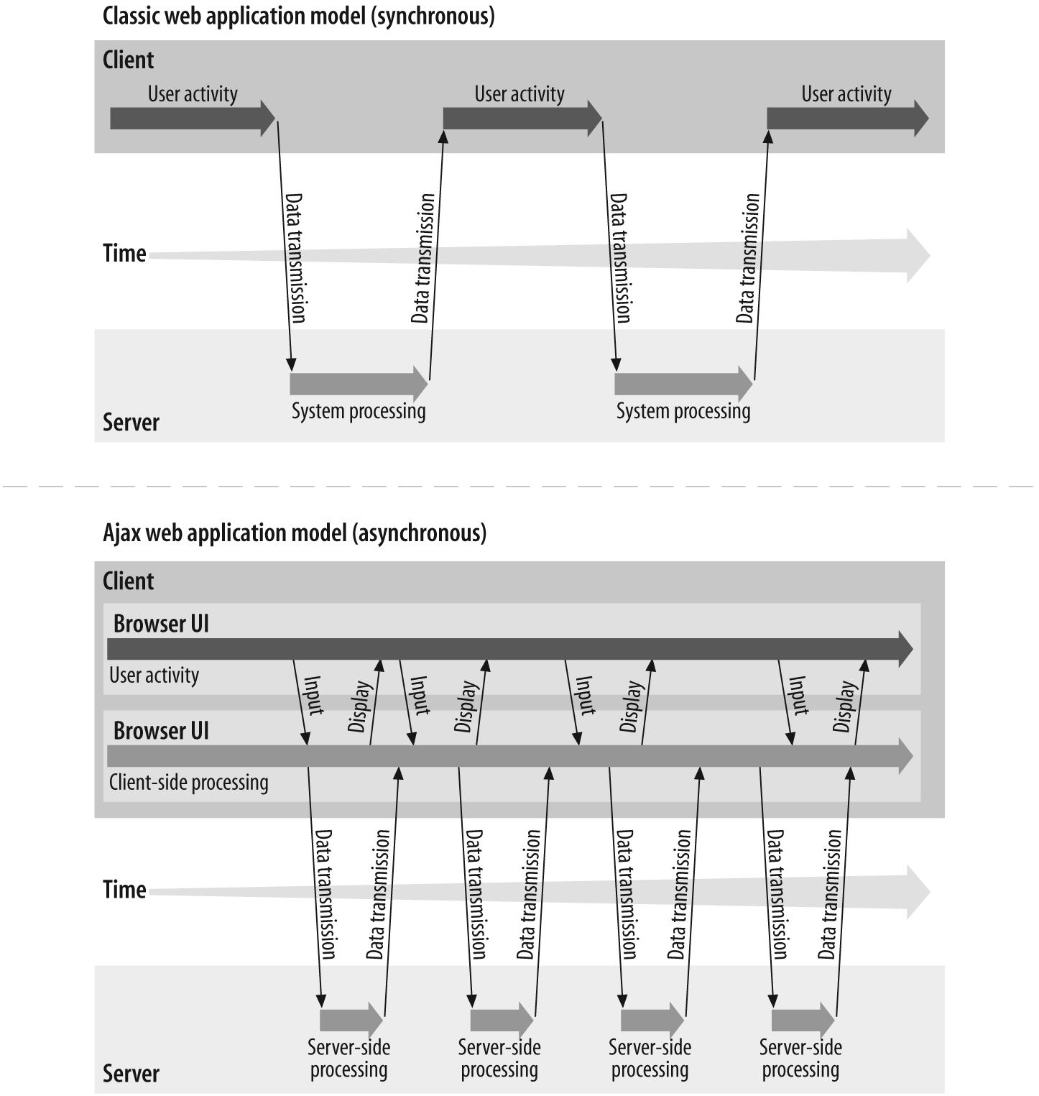
Ajax Interaction
Notes:
I assume some of you have seen this picture before. This picture
compares the user interaction models of conventional web
application in the top half of the slide against AJAX-fied web
application in the bottom part of the slide.
On the top, it is how a user interaction occurs when conventional
web application is used. Here a user has to stop and wait until a
response is received. What this means is that data fetching activity
interrupts the user operation.
The bottom picture shows how a user interaction occurs for AJAX
application. In this model, a user keeps operating since the data
fetching occurs in the background.

Slide 96
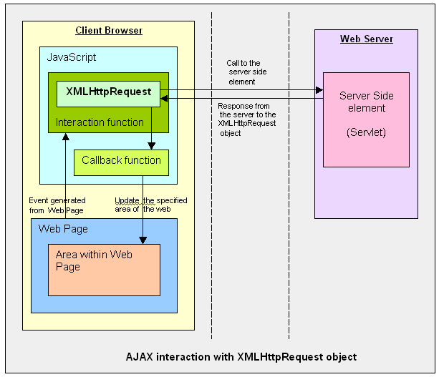

Ajax Interaction
Notes:
So how does AJAX application performs the asynchronous
communication with the server?
This slide also compares conventional web application and AJAX
application. In the left side, which shows the conventional web
application, HTTP request/response interaction occurs directly
between a browser and a backend web application.
In the right side, which shows AJAX based web application, within
a browser, there is AJAX engine, which is actually represented by a
JavaScript object called XMLHttpRequest which handles the HTTP
request/response interaction in an asynchronous fashion.

Slide 97
getElementById
To create a section or division in HTML div tag is used.
div tag can be associated with an id.
document.getElementById(‘name’) can be used to get to the section referred to by the div.
(It can also be used on any html element which is associated with id like <input> tag etc.)
To change the content of div, innerHTML propery comes very handy.

Slide 98
XMLHttpRequest
JavaScript object
Exchange data with a server behind the scenes.
The XMLHttpRequest object is a developer's dream, because you can:
  Update a web page without reloading the page
  Request data from a server after the page has loaded
  Receive data from a server after the page has loaded
  Send data to a server in the background
Notes:
Now let's talk about XMLHttpRequest a bit. It is a JavaScript object,
which means it gets created within a JavaScript code.
The XMLHttpRequest JavaScript object is supported in most modern
browsers.
It is the AJAX engine that performs the HTTP request/response
interaction with the backend web application in asynchronous
fashion.

Slide 99
Server-Side AJAX Request Processing
Server programming model remains the same
  It receives standard HTTP GETs/POSTs
  Can use Servlet, JSP, JSF, ...
With minor constraints
  More frequent and finer-grained requests from client
  Response content type can be
    text/xml
    text/plain
    text/json
    text/javascript
Notes:
Now, how does server side web application handle the AJAX
interaction with the browser? Well as far as Server side code is
concerned, it is just another HTTP request that comes in. The server
side does not even know the browser is sending the HTTP request
in asynchronous fashion and it should not.
What this means is that the server side web application can use any
server side technology of its choice such as servlet, JSP, JSF,
Struts, or whatever.
The server side application however has minor constraints. First, it is
possible the client might send more frequent and finer grained
requests. The response type can be text/xml, text/plain, text/json, or
text/javascript.

Slide 100
Steps of AJAX Operation
A client event occurs
An XMLHttpRequest object is created
The XMLHttpRequest object is configured
The XMLHttpRequest object makes an async. request
The Servlet/JSP returns an XML document containing the result
The XMLHttpRequest object calls the callback() function and processes the result
The HTML DOM is updated

Slide 101
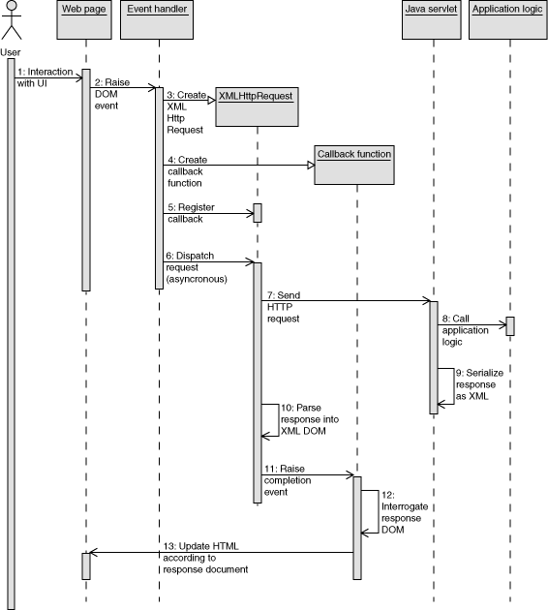
AJAX –SEQUENCE

Slide 102
An XMLHttpRequest object is configured with a callback function
CallBack Funcation Name
  function validateUserId() {
  initRequest();
  req.onreadystatechange = processRequest;
  if (!target) target = document.getElementById("userid");
  var url = "validate?id=" + escape(target.value);
  req.open("GET", url, true);
  req.send(null);
  }
True to indicate Async Call.
Post Data ,Always “null” for GET

Slide 103
XMLHttpRequest object makes an async. request
The “open” method of the XMLHttpRequest requires three parameters:
  HTTP method, which is GET or POST;
  URL of the server-side component to nteract with;
  Boolean indicating – the call is asynchronous or not.
Most cases, it is set to “true”, which means the HTTP request/response interaction occurs in asynchronous fashion.

Slide 104
XMLHttpRequest Properties
onreadystatechange
  Set with an JavaScript event handler that fires at each state change
readyState – current status of request
  0 = uninitialized
  1 = loading
  2 = loaded
  3 = interactive (some data has been returned)
  4 = complete
status
  HTTP Status returned from server: 200 = OK

Slide 105
Ajax Example
  <script type="text/javascript">
  var xhr = new XMLHttpRequest();
  function callBookService(){
  xhr.open("GET","http://localhost:8080/api/v1/books/srch/pages/400",true);
  xhr.onreadystatechange=processResponse;
  xhr.send(null);
  }

Slide 106
Ajax Example
  function processResponse(){
  if(xhr.readyState == 4 && xhr.status == 200)
  {
  var element = document.getElementById("placeHolder");
  element.innerHTML= xhr.responseText;
  }
  }
  </script>
  </head>

Slide 107
Continued
  <body>
  <h1>Local Library - Attached to Gandhi Library</h1>
  <div id="placeHolder"></div>
  <form action="#">
  <input type="file" id="file" name="menu">
  <input type="submit">
  </form>
  <script type="text/javascript">
  callBookService();
  </script>
  </body>
  </html>

Slide 108
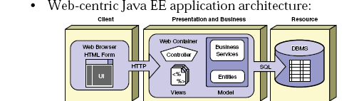
Role of Web Component JEE

Slide 109
Servlets
Java technology for serving HTTP requests.
Used for serving HTTP requests
Basic servlet functionalities implemented by the basic HTTP servlet classes have the features for accessing HTTP request data and managing cookies and sessions.
User interface or representation part is done with other technolgies.

Slide 110
Idea of Web Application
  Servlets, JSP pages, HTML files, utility classes, beans, tag libraries, etc. are bundled together in a single directory hierarchy or file
Access to content in the Web app is always through a URL that has a common prefix
  – http://host/webAppPrefix/abc
  Many aspects of Web application behavior controlled through deployment descriptor- web.xml till servlet version 2.3
  Web.xml is replaced with Annotation based Configuration from version 3.0

Slide 111
APPLICATION SERVER
A server computer on a computer network dedicated to running certain software applications
A software engine that delivers applications to client computers.
Should handle most, if not all, of the business logic and data access of the application.
Ease of application development and centralization.
Ex: Weblogic Server, WebSphere, JBOSS

Slide 112
Client calls a program
server returns the Response
Client
(Browser)
App
server
WEB
server
html
dB

Slide 113
Java Servlets
Released in 1997 , used to Create web pages with dynamic content
Standard, server-side Java application that extends the capabilities of a Web Server.
Mapped to URLs and Deployed in a Web container of an application server which provides a runtime environment for servlets.
Executed when the J2EE application server receives a client request that is passed to the Web container, which in turn invokes the servlet.
Platform and server independent

Slide 114
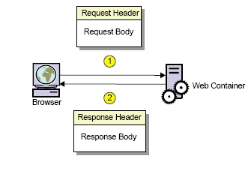
Request and Response

Slide 115
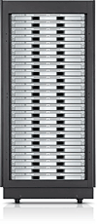

Web Apps with Servlets
GET …
Servlet
doGet()
…
…
HEADERS
BODY
Web Container

Slide 116
The Key Players
WebServer
  Gets the Response from the container
  Uses HTTP to talk to the Client Browser
  Knows how to forward to container
Container
  Find the Correct Servlet Using URL in DD
  Manages life cycle of the servlets
  Creates request and response objects just before starting the thread
  Starts a Servlet Thread and gives that to the Servlet
  Call the Service() Method and then doGet or doPost()
  Destroys the Request,Response Objects
Servlet
  Has a public class name
  Uses request Object to read the parameter from the user
  Dynamic content for the Client
  Uses response object to print a response

Slide 117
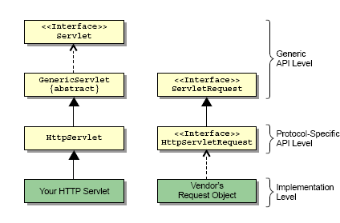
Servlet API

Slide 118
Steps for Creating Java Servlets
Subclass of HttpServlet
2. Override doGet(....) method
3. HttpServletRequest
  read the request parameters
4. HttpServletResponse
  set Content Type
  get PrintWriter
  send text to client via PrintWriter

Slide 119
Example
  public class GreetingServlet extends HttpServlet {
  public GreetingServlet() {
  super();
  }
  @Override
  public void init(ServletConfig config) throws ServletException {
  }
  protected void doGet(HttpServletRequest request, HttpServletResponse response) throws ServletException, IOException { }
  protected void doPost(HttpServletRequest request, HttpServletResponse response) throws ServletException, IOException { }
  }

Slide 120
@WebServlet
Used to define a Servlet component in a web application.
Specified on the Servlet class
Contains metadata about the Servlet being declared.
String[] value
  Array of URL patterns
  Either this or urlPatterns should be present
String[] urlPatterns -
  Array of URL patterns to which this Filter applies
  Required Annotation
int loadOnStartup
  Integer value denoted the startup ordering hint

Slide 121
@WebServlet
  @WebServlet(urlPatterns = {"/greeting","/greet"})
  public class GreetingServlet extends HttpServlet {
  }

