Slide 1
SPRING FRAMEWORK

Slide 2
Spring Framework
Light-weight comprehensive framework for building Java SE and Java EE applications
Created by Rod Johnson
Java Bean-based configuration management,
Uses Inversion-of-Control principles, specifically using the Dependency Injection technique

Slide 3
Key Features
Suite for Both Java SE and EE
IoC Container
Integration with persistence frameworks.
MVC web application framework
Java Transaction API and a single JDBC Data Source
  This removes the dependency on a Java EE environment for transaction support.
Aspect-oriented programming (AOP) framework

Slide 4
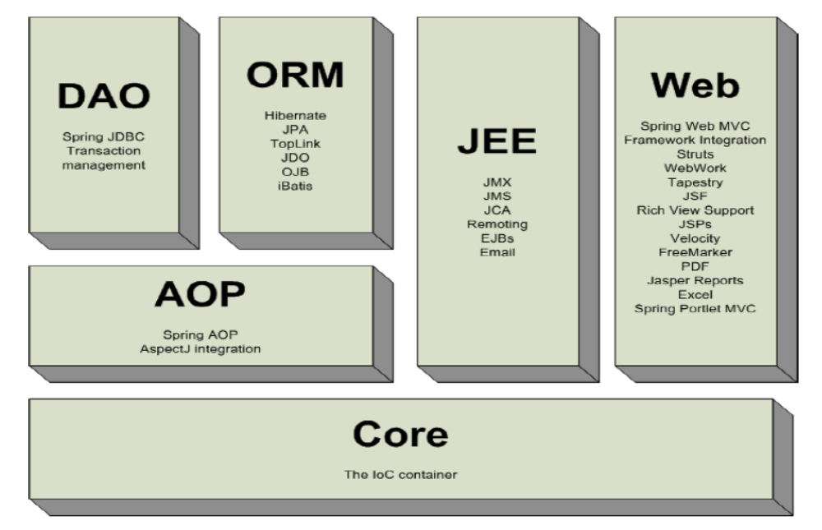
Spring Framework

Slide 5
IoC Container
Introduction
Basic Containers and Beans
Dependencies
Bean Scope
The Application Context
Quick Start Spring Application Using Eclipse IDE

Slide 6
Dependency Injection
A pattern of injecting a class’s dependencies into it at runtime.
Achieved by defining the dependencies and then injecting in a concrete class
Can swap in different implementations without having to modify the main class.
Promotes high cohesion by promoting the Single Responsibility Principle (SRP)

Slide 7
Dependency Inversion Principle
  High level modules should not depend upon low level modules.
  Low and High Modules should depend upon abstractions.
  Low modules should NOT define a interface that Higher Level module depend on
  Higher Level Module should define an interface that lower level module must implement
This gives the flexibility at the cost of increased effort.

Slide 8
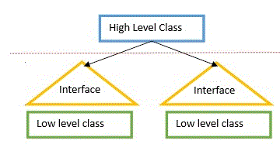

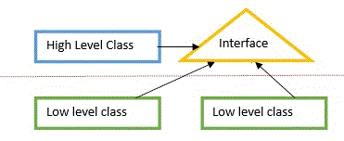

Dependency Inversion Principle

Slide 9
Dependency Inversion Principle
public class Messaging {
MessageService service;
public void sendMssage(){
service.sendMessage();
} }
public interface MessageService {
public String sendMessage();
}
public class Email implements MessageService {
public String sendMessage() { }
}
High-level modules should not depend on low-level modules.
Both should depend on abstractions.
High Level Module
Abstraction
Low Level Module

Slide 10
Inversion of Control Container(IoC)
A container that supports Dependency Injection.
No Need to create objects but describe how they should be created.
Describe which services are needed by which components in a configuration file.
Objects are given their dependencies at creation time by the IoC
IoC - inversion of responsibility with regard to how an object obtains references to collaborating objects.

Slide 11
Container and Beans
org.springframework.beans.factory.BeanFactory is the representation of the Spring IoC container
  containing and managing beans,
  instantiating or sourcing application objects
  configuring such objects
  assembling the dependencies between objects.
A bean is an object that is instantiated, assembled, and otherwise managed by a Spring IoC container.
Beans, and the dependencies among them, are reflected in the configuration metadata used by a container

Slide 12

The Container
There are more than one implementations of the BeanFactory interface
The most commonly used BeanFactory implementation is the XmlBeanFactory class.
The XmlBeanFactory takes the XML configuration metadata and uses it to create a fully configured system or application.

Slide 13
Beans
The term “bean” is used to refer any component managed by the BeanFactory
The “beans” are in the form of JavaBeans (in most cases)
  Present in a Named Package
  No Argument constructor
  getter and setter methods for the properties
  Can be controlled for scope, life cycle and callbacks.
Beans are singletons by default
Properties the beans may be simple values or references to other beans

Slide 14
Configuration Meta Data
Instructs the Spring container to instantiate, configure, and assemble the objects
Supplied in a simple and intuitive XML format
Other formats are also available
  Annotation Based
  Java Based

Slide 15
Application Context
ClassPathXmlApplicationContext:
  Loads a context definition from an XML file located in the classpath,
  context definition files as classpath resources.
FileSystemXmlApplicationContext
  Loads a context definition from an XML file in the file system.
XmlWebApplicationContext
  Loads context definitions from an XML file contained within a web application.

Slide 16
The Bean – A Java Class
  public class Customer {
  private int customerNumber;
  private String customerName;
  private long handPhone;
  public Customer() {
  super();
  }
    //SET/GET Methods
    }

Slide 17
Simple XML Configuration
  <?xml version="1.0" encoding="UTF-8"?>
  <beans xmlns="http://www.springframework.org/schema/beans"
  xmlns:xsi="http://www.w3.org/2001/XMLSchema-instance"
  xsi:schemaLocation="http://www.springframework.org/schema/beans
  http://www.springframework.org/schema/beans/spring-beans-2.5.xsd">
  <bean id="..." class="...">
  <!-- collaborators and configuration for this bean go here -->
  </bean>
  <bean id="..." class="...">
  <!-- collaborators and configuration for this bean go here -->
  </bean>
  <!-- more bean definitions go here -->
  </beans>

Slide 18
XML NAMESPACES

Slide 19
Namespace-Beans
Bean Namespace provides the elements used in the dentition of beans.
Used as a default namespace inside the top-level element
  <?xml version ="1.0 " encoding ="UTF -8"?>
  <beans xmlns =" http: // www . springframework .org / schema /beans “
  xmlns:xsi =" http: // www.w3.org /2001/ XMLSchema -instance “
  xsi:schemaLocation =" http: // www. springframework .org/schema / beans
  http: // www. springframework .org/ schema / beans /spring -beans -3.0. xsd">
  ....
  </ beans >

Slide 20
Namespace- context
Context denotes elements used for configuration of the bean by tags <context:*>.
<context:property-placeholder> is used to load a properties
<context:property - placeholder location =" filename .properties " />
<context:annotation-config> : Activate annotations processing
<context:component-scan base -package="mypackage“>
  To specify where a Bean container should look for @Component annotation,

Slide 21
“p”- Name Space
A namespace used to set the properties using attributes, rather than elements.
For injecting the simple types we use property name in the "p" namespace d
To inject references "-ref" is suffixed to attribute value.
  <beans xmlns=http://www.springframework.org/schema/beans
  xmlns:p=http://www.springframework.org/schema/p
  ……….
  ……………
  http://www.springframework.org/schema/context">
  <bean id="p_nameSpcBean" class="com.training.beans.NameSpaceBean"
  p:productCode="101" p:productName="LCD TV"/>
  </beans>

Slide 22
C- Constructor NameSpace
  <?xml version="1.0" encoding="UTF-8"?>
  <beans xmlns="http://www.springframework.org/schema/beans"
  xmlns:c="http://www.springframework.org/schema/c"
  xmlns:xsi="http://www.w3.org/2001/XMLSchema-instance"
  xsi:schemaLocation="http://www.springframework.org/schema/beans
  http://www.springframework.org/schema/beans/spring-beans.xsd">
  <bean id="setterBean" class="com.training.SimpleBean"
  c:name=“Rakesh"
  c:handPhone=“98405989"/>
  </beans>

Slide 23
Configuration Meta-Data
Spring Container uses the meta-data to instantiate, configure, and assemble the objects of the Application
XML-based metadata and Annotation Based metadata can be used to form configuration metadata.
Configuration consists of one or more bean definition.
Beans are configured as <bean/> elements inside a top-level <beans/> element.

Slide 24
Setter Injection
All dependencies injected via setter methods
  No need for constructors
Allows flexible initialization
  Any set of properties can be initialized
Named properties allow for readable configuration data
  Clear what is being injected
Requires Java Bean conventions to be followed
  Non standard method names are problematic
Can result in invalid object configurations
  Need post initialization checking methods

Slide 25
Setter Dependency Injection
  <?xml version="1.0" encoding="UTF-8"?>
  <beans xmlns="http://www.springframework.org/schema/beans"
  xmlns:xsi="http://www.w3.org/2001/XMLSchema-instance"
  xsi:schemaLocation="http://www.springframework.org/schema/beans http://www.springframework.org/schema/beans/spring-beans.xsd">
  <bean id="custBean" class="com.training.domains.Customer">
  <property name="customerNumber" value="1010“/> <property name="customerName" value="Ramesh“/> <property name="handPhone" value="90898989“/>
  </bean>
</beans>

Slide 26
Bean Lookup
To interact directly with the bean Container to get a specific bean according to its name, type, or both.
This is done with overloaded methods getBean() defined in interface FactoryBean.
This interface is implemented by ApplicationContext classes.
ApplicationContext ctx = ...
  MyBean beanRef = (Bean) ctx. getBean (" beanID");
  MyBean beanRef = ctx. getBean (" beanID ", MyBean. class );
  MyBean a = ctx. getBean (MyBean. class );

Slide 27
Spring Application
package com.training.applications;
import org.springframework.beans.factory.BeanFactory;
Import org.springframework.context.support.FileSystemXmlApplicationContext;
import com.training.domains.Customer;
public class QuickStart {
  public static void main(String[] args) {
BeanFactory fact =new FileSystemXmlApplicationContext("bean.xml");
Customer cust =(Customer)fact.getBean("custBean2");
System.out.println(cust);
  }
  }

Slide 28
Bean Factory and Application Context
Application Context
Bean Factory
Can have more than one config files
Publish events to beans that are registered as listeners
Support internationalization (I18N) messages
Support application lifecycle events, and validation.
Support for JNDI , EJB, remoting
In this only one config file or .xml file
Doesn’t support.
Doesn’t support
Doesn’t support.
Doesn’t support.

Slide 29
Constructor argument name and type
<bean id="exampleBean" class="examples.ExampleBean">
<constructor-arg name="years" value="7500000"/>
<constructor-arg name="ultimateanswer" value="42"/>
</bean>
The container can use type matching with simple types if types are explicitly specified
<bean id="exampleBean" class="examples.ExampleBean">
<constructor-arg type="int" value="7500000"/>
<constructor-arg type="java.lang.String" value="42"/>

Slide 30
Constructor argument index
Use the index attribute to specify explicitly the index of constructor arguments
<bean id="exampleBean" class="examples.ExampleBean">
<constructor-arg index="0" value="7500000"/>
<constructor-arg index="1" value="42"/>
</bean>
Resolving the ambiguity of multiple simple values,
Resolves ambiguity of two arguments of the same type.
The index is 0 based.

Slide 31
Constructor-based or setter-based DI?
Constructor arguments for mandatory dependencies and setters for optional dependencies.
Constructor dependency , disadvantage is that the object becomes less amenable to reconfiguration and re-injection.
A legacy class may not expose any setter methods, and so constructor injection is the only available DI.

Slide 32
Bean scopes
Collaborators – ref
Collection Injection
Inner Beans
Auto Wiring Beans
Bean Scopes
  Singleton
  Prototype

Slide 33
Bean Scope
The Bean Score for Standard Java SE Beans are singleton:
Scopes a single bean definition to a single object instance per Spring IoC container, per container and per bean.
Single instance will be stored in a cache and all subsequent requests and references will result in cached object being returned.
prototype:
  Scopes a single bean definition to any number of object instances.
@Scope(value=ConfigurableBeanFactory.SCOPE_PROTOTYPE)

Slide 34

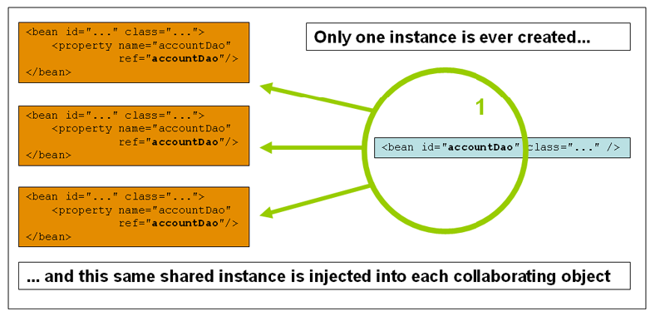
Singleton

Slide 35
Prototype Bean
Used for all beans that are stateful, while the singleton scope should be used for stateless beans.
<bean id="accountService" class="com.foo.DefaultAccountService" scope="prototype"/>
The client code must clean up prototype-scoped objects and release expensive resources that the prototype bean(s) are holding.

Slide 36
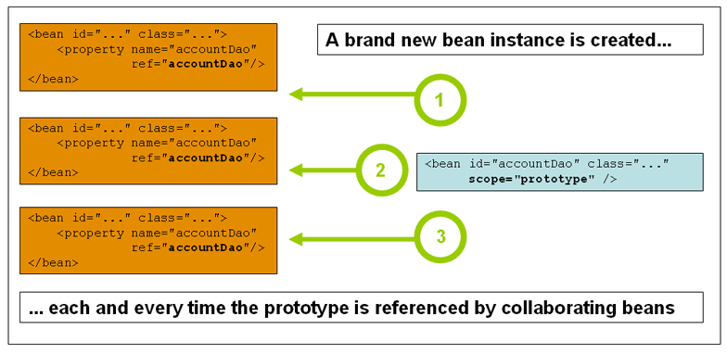
Prototype Scope

Slide 37
Method Injection
Spring overrides a given abstract method of a class and provides an implementation of the overridden method.
  Used when a Prototype bean needs to used within a Singleton
Singletons are instantiated at context creation, it changes the way prototype-scoped are handled, from injection to created by an abstract method.
Spring uses the CGILIB to change the Bytecode.

Slide 38
Example
  public abstract class VendingMachine {
  public abstract Item generateItem();
  }
  public class Item {
  private int itemNumber;
  private String itemName;
  private double ratePerUnit;
  }

Slide 39
XML Configuration
  <bean id="vendMachine" class="com.training.methodInjection.VendingMachine">
  <lookup-method name="generateItem" bean="item"/>
  </bean>
  <bean id="item" class="com.training.methodInjection.Item"
  p:itemNumber="101" p:itemName="Tv"
  p:ratePerUnit="19000.00"
  scope="prototype“/>

Slide 40
Reference to Other Beans
The ref element is used to set the value of the specified property to be a reference to another bean managed by the container
The value of the 'bean' attribute may be the same as either the 'id' attribute of the target bean, or one of the values in the 'name‘ attribute of the target bean.
<bean id="custBean2" class="com.training.domains.Customer">
<property name="customerNumber" value="1010"></property>
<property name="addr" ref="addBean"></property>
</bean>
<bean id="addBean" class="com.training.domains.Address">
<property name="addLine1" value="2 Gandhi St"></property>
<property name="pincode" value="200202"></property>
</bean>

Slide 41
InnerBean
A <bean/> element inside the <property/> or <constructor-arg/> elements defines a so-called inner bean.
instead of using a reference to a target bean, simply define the target bean inline
<bean class="com.training.beans.Flight">
<property name="flightId" value="2020"></property>
<property name="engine">
<bean class="com.training.beans.Engine">
<property name="engineCode" value="1010"></property>
<property name="engType" value="Diesel"></property>
<property name="horsePower" value="40hp"></property>
</bean>
</property>
</bean>

Slide 42
Inheritance of Beans Definitions
  <bean id="bean" name="parentBean" class="com.training.beans.Reserve"
  abstract="true“/>
  <bean id="bean1" name="reservationBean"
  class="com.training.beans.Reservation" parent="parentBean">
  <property name="customerCode" value="101"></property>
  </bean>
  <bean id="bean2" name="trainReservation"
  class="com.training.beans.TrainReservation" parent="bean1">
  <property name="trainNumber" value="1401"></property>
  </bean>

Slide 43
Autowiring Properties
Beans may be auto-wired (rather than using <ref>)
  Per-bean attribute autowire
  Explicit settings override
autowire=“name”
  Bean identifier matches property name
autowire=“type”
  Type matches other defined bean
autowire=”constructor”
  Match constructor argument types

Slide 44
Auto wiring -byName
public class Bill {
private Customer cust;
private Invoice inv;
}
<bean id="bill_Bean" class="com.training.Bill" autowire="byName"/>
</bean>
<bean id="cust" class="com.training.Customer"> </bean>
<bean id="inv" class="com.training.Invoice"> </bean>

Slide 45
Auto wiring -byType
public class Bill {
private Customer obj1;
private Invoice obj2;
}
<bean id="bill_Bean" class="com.training.Bill" autowire="byType"/>
<bean id="cust" class="com.training.Customer "> </bean>
<bean id="inv" class="com.training.Invoice"> </bean>

Slide 46
Auto wiring –by Constructor
  public class Employee {
    private Integer empId;
    private String employeeName;
  public Employee(Integer empId, String employeeName) {
    this.empId = empId;
    this.employeeName = employeeName;
    } }
<bean id="empBean" class="com.training.Employee“ autowire="constructor"/>
<bean id="id" class="java.lang.Integer">
<constructor-arg value="101"/> </bean>
<bean id="name" class="java.lang.String">
<constructor-arg value="Ramesh"/> </bean>

Slide 47
BEAN INITIALIZATION

Slide 48
Using Factory Method
Spring supports creating instance of legacy code that can't change/touch
It creates an instance by using a call to the method to create the object.
Some times objects are created from factories.
There are two ways to achieve the same - via a static factory method or via an instance factory method.

Slide 49
Bean Class
  public class CustomerStaticFactory {
  public static Customer createCustomer(int a)
  {
  Customer cust=null;
  if(a==1)
  {
  cust =new Customer();
  }
  else
  {
  cust=new RuralCustomer();
  }
  return cust;
  } }

Slide 50
Static Factory
  <bean id="statFact" class="com.training.utils.CustomerStaticFactory"
  factory-method="createCustomer">
  <constructor-arg value="1"></constructor-arg>
  <property name="customerNumber" value="7777"/>
  <property name="customerName" value="Suresh"/>
  <property name="handPhone" value="884540787"/>
  </bean>

Slide 51
Application
  try {
  ApplicationContext ctx = new ClassPathXmlApplicationContext("factBean.xml");
  Customer cust =(Customer)ctx.getBean("statFact");
  System.out.println(cust);
  } catch (Exception e) {
  }

Slide 52
Instance Factory Method
A non-static method of an existing bean is invoked from the container to create a new bean.
The Class attribute is left free
In the factory-bean attribute, the name of a bean with the instance method that is to be invoked to create the object.
Set the name of the factory method itself with the factory-method attribute.

Slide 53
Instance Factory
  public class CustomerInstanceFactory {
  public Customer createCustomer(int a)
  {
  Customer cust=null;
  if(a==1)
  {
  cust =new Customer();
  }
  else
  {
  cust=new RuralCustomer();
  }
  return cust;
  } }

Slide 54
Instance Factory
  <bean id="instFact" class="com.training.utils.CustomerInstanceFactory" />
  <bean id="if" factory-bean="instFact" factory-method="createCustomer" >
  <constructor-arg value="1"></constructor-arg>
  <property name="customerNumber" value="76677"/>
  <property name="customerName" value="Vinay"/>
  <property name="handPhone" value="1234587"/>
  </bean>

Slide 55
Application
  public static void main(String[] args) {
  try {
  ApplicationContext ctx = new ClassPathXmlApplicationContext("InstFactBean.xml");
  Customer cust =(Customer)ctx.getBean("if");
  System.out.println(cust);
  } catch (Exception e) {
  e.printStackTrace();
  }
  }

Slide 56
ANNOTATION BASED CONFIGURATIONS

Slide 57
@ Component
Bean are defined in the bean configuration file.
Spring can scan all the beans through auto scan
The @Component in class indicates that it is an auto scan component.
By default the First character of the component is lower Cased
  ‘CustomerService’ to ‘customerService’.
CustomerService cust = (CustomerService)context.getBean("customerService");

Slide 58
Using Annotations
Can Use Annotation to defined the dependency and Initializes beans from the spring bean configuration file.
<beans >
  <context:annotation-config/>
  <context:component-scan base-package="com.training.domains“/>
</beans>
Registering AutowiredAnnotationBeanPostProcessor
<bean class="org.springframework.beans.factory.annotation.
AutowiredAnnotationBeanPostProcessor"/>

Slide 59
Using Annotations
In Java Based Configurations Annotations functionality can be enabled
@Autowire to reference beans from other @Configuration classes, XML, etc
@Configuration
@AnnotationDrivenConfig
public class AppConfig {
}

Slide 60
Setter Injection
  @Component(“inv”)
  public class Annot_Invoice {
  @Value("101")
  private int invoiceNumber;
  @Value("Raja")
  private String customerName;
  @Value("3450.00")
  private double amount;
  }

Slide 61
@Value
  public class SystemConfig {
  @Value("#{systemProperties['java.vm.version']}")
  private String operatingSystem;
  @Value("#{systemProperties['java.vm.version']}")
  private String javaVersion;
  }

Slide 62
Simple XML Configuration
  <?xml version="1.0" encoding="UTF-8"?>
  <beans xmlns="http://www.springframework.org/schema/beans"
  xmlns:xsi="http://www.w3.org/2001/XMLSchema-instance"
  xmlns:context="http://www.springframework.org/schema/context"
  xsi:schemaLocation="http://www.springframework.org/schema/beans http://www.springframework.org/schema/beans/spring-beans.xsd
  http://www.springframework.org/schema/context http://www.springframework.org/schema/context/spring-context-3.1.xsd">
  <context:component-scan base-package="com.training.domains"/>
  </beans>

Slide 63
Application
  ApplicationContext ctx =new ClassPathXmlApplicationContext("bean.xml");
  Invoice inv=(Invoice)ctx.getBean("inv");
  System.out.println(inv);
  System.out.println(inv.getItem());
  System.out.println(inv.getAddr());

Slide 64
Constructor Injection
@Component("custBean")
public class Customer {
  private int customerId;
  private String customerName;
  private long phoneNumber;
@Autowired
public Customer(@Value("101") int customerId, @Value("Siva") String customerName,@Value("9484848") long phoneNumber) {
  this.customerId = customerId;
  this.customerName = customerName;
  this.phoneNumber = phoneNumber;
}

Slide 65
Auto Wiring Collaborators
  @Component(“myBean2”)
  public class AutoWireBean {
    @Value("120")
    private int productCode;
    @Value("Laptop")
    private String productName;
  }
  @Component
  public class WiredBean {
  @Autowired
  @Qualifier("myBean2")
  private AutoWireBean bean;
  }

Slide 66
Auto Wiring of Bean
@Autowired :
  Used to auto wire bean on the setter method, constructor or a field.
  It uses auto wire bean by matching data type.
@Qualifier
  Is used to control which bean should be autowired on a field.
  If the bean configuration file has two similar beans, can specify the bean to be wired by giving the bean name
  @Required
  . When matching bean to wire is not found , it will throw an exception.
  To disable this checking setting the “required” to false.
  it will leave the property unset.

