Slide 1
Spring Security

Slide 2
Spring Security
Highly customizable authentication and access-control framework.
Focuses on providing both authentication and authorization
“Authentication”
The process of establishing a user, device or some other system which can perform an action in the application
“Authorization”
The process of deciding whether a principal is allowed to perform an action within the application.
authorization is done after authentication process.
Once the user is authenticated they may have one or more “roles”

Slide 3
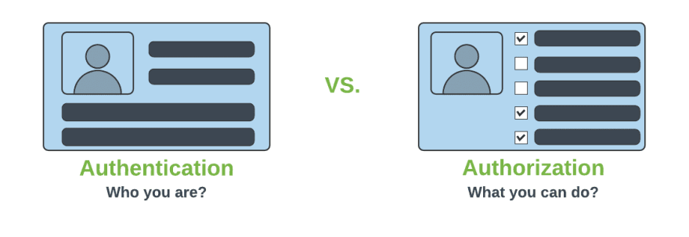
Authentication & Authorization

Slide 4
Add Spring Security Module
Update the pom.xml file with the following entry, can also add spring security while use starter project.
<dependency>
<groupId>org.springframework.boot</groupId>
<artifactId>spring-boot-starter-security</artifactId>
</dependency>

Slide 5
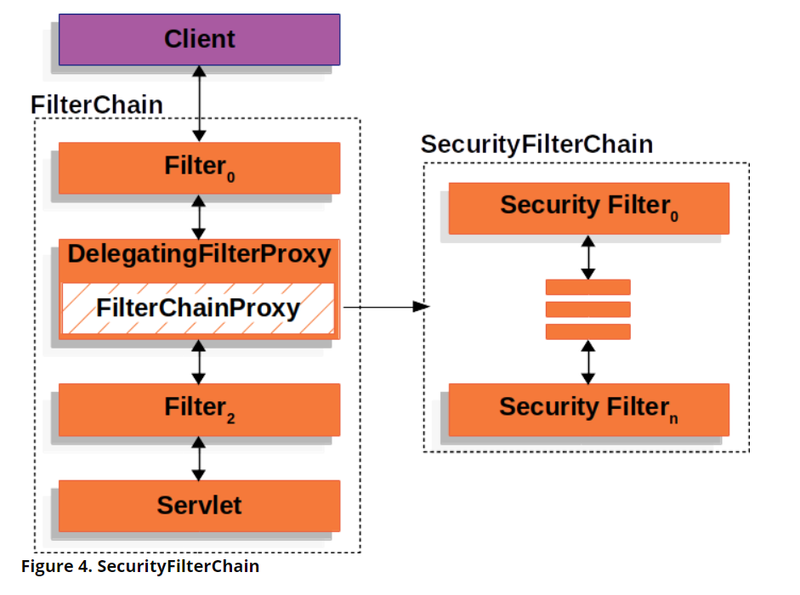
Spring Security Architecture

Slide 6
Spring Security Architecture
DelegatingFilterProxy
Servlet filter embedded in the spring context.
It delegates the incoming request to a bunch of filters
FilterChainProxy
A servlet filter which invokes the relevant filters that would work on the incoming request.
SecurityFilters
Contains a list of filters that need to be invoked before the controller can handle the request.
SecurityContextPersistenceFilter, HeaderWriterFilter, CsrfFilter, LogoutFilter, UsernamePasswordAuthenticationFilter etc.
FilterChainProxy queries this class to invoke each filter in a loop.

Slide 7
Authorizations
permitAll
No need of any authorization to access current page.
authenticated
Requires Login(username/password) and no authorization(role based access) is required.
hasAuthority
Requires that user should have both authentication and role based authorization access.
hasAnyAuthority
It represents that user should have authentication and multiple role based authorization access.

Slide 8
BCryptPasswordEncoder
An encryption class of Spring Security.
Spring provides a variety of encryption methods for passwords.
The official recommendation is to use BCryptPasswordEncoder, which uses the BCrypt strong hash function.
@Bean
PasswordEncoder passwordEncoder() {
return new BCryptPasswordEncoder();
}

Slide 9
HttpSecurity
HttpSecurity
Provides a Method authoriseRequests()
authorizeRequests()
To Define custom requirements for URLs
Can add multiple children to this method.
The matchers are considered in the order they were declared.
http.authorizeRequests()
.anyRequest().authenticated()
.and().httpBasic();

Slide 10
Security Filter chain
Takes an HttpSecurity object as an argument.
Uses builder pattern to onfigure HTTP security.
authorizeHttpRequests():
To configure authorization rules for HTTP requests.
requestMatchers("/public/**": ).permitAll()
Specifies that any request matching the /public/** pattern
Accessible without requiring authentication.
anyRequest().authenticated():
Specifies that all other requests (not matching /public/**) require authentication.

Slide 11
Customizing
return http.build():
Returns the SecurityFilterChain object based on the configured HttpSecurity.
Customizer.withDefaults()
Used to access basic authentication in incoming request header
Makes spring use the default internal configuration with BasicAuthenticationFilter without any custom modifications.

Slide 12
Security Config
import static org.springframework.security.config.Customizer.withDefaults;
@Configuration
@EnableWebSecurity
public class SecurityConfig {
@Bean
BCryptPasswordEncoder encoder() {
return new BCryptPasswordEncoder();
}
@Bean
UserDetailsService userDetails(BCryptPasswordEncoder encoder) {
UserDetails adminUser =User.builder().username("india").password(encoder.encode("india")).roles("ADMIN").build();
return new InMemoryUserDetailsManager(adminUser);
}

Slide 13
Security Config
@Bean
SecurityFilterChain securityFilterChain(HttpSecurity http) throws Exception {
http
.csrf(csrf -> csrf.disable())
.authorizeHttpRequests(auth -> auth
.requestMatchers("/api/v1/auth/**").permitAll()
.anyRequest().authenticated()
)
.httpBasic(Customizer.withDefaults());
return http.build();
}
.requestMatchers(HttpMethod.GET, "/api/v1/cards").permitAll()

Slide 14
Security Config-H2 Specific
@Bean
SecurityFilterChain securityFilterChain(HttpSecurity http) throws Exception {
http
.csrf(csrf -> csrf.disable())
.authorizeHttpRequests(auth -> auth
.requestMatchers(PathRequest.toH2Console()).permitAll()
.requestMatchers("/api/v1/auth/**").permitAll()
.requestMatchers("/admin/**").hasRole("ADMIN")
.anyRequest().authenticated()
)
.headers(headers -> headers
.frameOptions(frame -> frame.sameOrigin())
)
.httpBasic(Customizer.withDefaults());
return http.build();
}

Slide 15
Capture Authentication Details
ResponseEntity<Collection<ResponseDto>> findAll(Authentication auth){
System.out.println("User Details ===>"+auth.getName());
System.out.println("Is Authenticated"+auth.isAuthenticated());
auth.getAuthorities().forEach(System.out::println);;
return ResponseEntity.ok(this.service.findAll());
}

Slide 16
Method Level Annotation-SPEL
@EnableMethodSecurity
Restricting access to specific methods
To ensure that only authorized users can perform critical operations.
@PreAuthorize
Access control is evaluated prior to method invocation.
It leverages Spring Expression Language (SpEL) expressions
Dynamically determine access permissions.
@PreAuthorize("hasRole('ADMIN')")
@PreAuthorize("#id == authentication.principal.id").
@PostAuthorize
Evaluates an expression after the method executes
Used to check the returned object.
@PostAuthorize("returnObject.owner == authentication.name").

Slide 17
CSRF
Its a web security vulnerability that allows an attacker to induce users to perform actions that they do not intend to perform.
It allows an attacker to partly circumvent the same origin policy, which is designed to prevent different websites from interfering with each other.
Should be used for protecting any request that could be processed by a browser by normal users.
If a service is used by non-browser clients, CSRF protection can be disabled

Slide 18
Entity and Repository
@Entity
@Table(name = "user")
public class UserEntity {
@Id
@GeneratedValue(strategy = GenerationType.IDENTITY)
private Long id;
private String username;
private String password;
private String role;
}
public interface UserRepository extends JpaRepository<UserEntity ,Long> {
Optional<UserEntity> findByUsername(String username);
}

Slide 19
User Details Service
Key Interface used for user authentication.
Has One Method
UserDetails loadUserByUsername(String username)
UserDetails
Encapsulates username, password, authorities (roles), and account status (enabled, locked, expired).
Called by AuthenticationProvider to obtain the necessary user information for authentication.
Method should throw a UsernameNotFoundException.

Slide 20
User Details Service
@Service
public class UserDetailServiceImpl implements UserDetailsService {
private final UserRepository userRepository;
private final BCryptPasswordEncoder passwordEncoder;
public UserServiceImpl(UserRepository userRepository, BCryptPasswordEncoder passwordEncoder) {
this.userRepository = userRepository;
this.passwordEncoder = passwordEncoder;
}

Slide 21
User Details Service
public void registerNewUser(RegistrationRequest request) throws UserAlreadyExistsException {
if (userRepository.existsByUsername(request.username())) {
throw new UserAlreadyExistsException("Username is already taken!");
}
if (userRepository.existsByEmail(request.email())) {
throw new UserAlreadyExistsException("Email is already in use!");
}
WebUser user = new WebUser();
user.setUsername(request.username());
user.setEmail(request.email());
user.setPassword(passwordEncoder.encode(request.password()));
user.setRole(request.role());
userRepository.save(user);
}

Slide 22
User Details Service
@Override
@Transactional(readOnly = true)
public UserDetails loadUserByUsername(String username) throws UsernameNotFoundException {
WebUser portalUser = userRepository.findByUsername(username)
.orElseThrow(() -> new UsernameNotFoundException("User Not Found: " + username));
return User.builder()
.username(portalUser.getUsername())
.password(portalUser.getPassword())
.roles(portalUser.getRole())
.build();
}

Slide 23
Spring actuator

Slide 24
Spring Boot Actuator
Exposes REST endpoints that can be consumed to manage and monitor application.
Monitor application health, application bean details, version details, thread dumps, logger details etc
Can restrict these endpoints to be consumed by authorized users only and Spring provides easy way to secure your REST endpoints.

Slide 25
actuator End Point
actuator
It provides a hypermedia-based discovery page for the other endpoints.
By default it is sensitive and hence requires username/password for access or may be disabled if web security is not enabled.
Beans
It displays complete beans configured in the app.
Configprops
It displays a collated list of all @ConfigurationProperties.

Slide 26
actuator End Point
Health
It shows application health information
management.endpoint.health.show-details:=always
Info
It displays arbitrary application info.
Loggers
It shows and modifies the configuration of loggers in the application.
metrics:
It shows metrics information for the current application.
Mappings
It displays a collated list of all @RequestMapping paths.

Slide 27
Actuator Endpoints
health and info can be accessed
Other endpoints are disabled by default
management.endpoints.web.exposure.include=*.
Will enable all of them
Can also list endpoints which should be enabled
To expose all enabled endpoints except one (for example /loggers), we use:
management.endpoints.web.exposure.include=*
management.endpoints.web.exposure.exclude=loggers
management.security.enabled=false

Slide 28
Info and Health Endpoint
Reads the Information from the pom.xml
info:
app:
name: ${spring.application.name}
build:
artificatId: '@project.artifact@'
groupId: '@project.groupId@'
version: '@project.version@'
java:
version:@java.version@
info:
env:
enabled: true

Slide 29
Health Endpoint
management:
endpoint:
health:
show-details: always

Slide 30
Logger Endpoint
http://localhost:8787/actuator/metrics
http://localhost:8787/actuator/loggers
To Change the Log level make a post request
http://localhost:8787/actuator/loggers/org.springframework.boot.SpringApplication
{ "configuredLevel": "trace“ }
To reset the logging level back to the original value
{ "configuredLevel": null }

Slide 31
Shut Down End Point
Endpoint is used to shut down the Spring Boot application
Need to enable by adding a property in the application.yml
Done By Making a POST call.
http://localhost:7070/actuator/shutdown
management:
endpoint:
shutdown:
enabled: true

Slide 32
Extending Info End Point
@Component
public class CustomInfoEndPoint implements InfoContributor {
@Autowired
private ConfigurableApplicationContext ctx;
@Override
public void contribute(Info.Builder builder) {
Map<String, Object> details = new HashMap<>();
details.put("bean-definition-count", ctx.getBeanDefinitionCount());
details.put("startup-date", ctx.getStartupDate());
builder.withDetail("context", details);
}
}

Slide 33
Extending Health Point
@Component
public class CustomHealthInfoEndPoint implements HealthIndicator {
private final OrderRepository repository;
@Override
public Health health() {
try {
long number = this.repository.count(); return Health.status("UP").withDetail("DB Service", "DB service is UP").build();
} catch (Exception exception){
return Health.outOfService().withDetail("DB Service", "DB service is DOWN").build();
}
}
}

