Slide 1
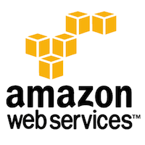

Slide 2
Topics
AWS Global Infrastructure (Regions, Availability Zones)
Identity and Access Management (IAM)
Amazon EC2 (Instances, AMIs, Auto Scaling)
AWS Lambda (Serverless Computing)
Amazon S3 (Buckets, Versioning, Lifecycle Policies)
Amazon VPC (Subnets, Route Tables, NAT)
Security Groups & NACLs
AWS KMS (Key Management Service)
AWS Secrets Manager
AWS Shield & WAF
Amazon CloudWatch
AWS CloudTrail

Slide 3
Amazon Web Service
Known as AWS, subsidiary of Amazon.com
Offering cloud-computing services at very affordable rates
  Used by small scale companies to big enterprises
  Provides servers and other IT infrastructure
  Can instantly spin up hundreds or thousands of servers and deliver results faster.
  Need to pay only for what is being used with no up-front expenses and no long-term commitments

Slide 4
Cloud Computing
Using remote servers on the internet to store, manage and process data rather than a local server or personal computer.
Clouds can be categorized into three types:
Public
  Managed by an organization which is open to use by the general public
    Amazon Web Services,Microsoft Azure,IBM Cloud.
Private
  Virtualizes and shares IT infrastructure within a single organization
    HPE,DELL EMC,Vmware
Hybrid
  A mix of a public and a private cloud
    AWS Outposts, Azure Stack, Azure Arc, Google Anthos and VMware Cloud on AWS.

Slide 5
Cloud Computing
SaaS (Software as a Service)
  It allows companies to use software without having to purchase them
  Reduces the expenditure of the company drastically
    Since they are already installed on the cloud server they can be quickly deployed and therefore saves time.
  Many of them run directly through web browser
  Example : Dropbox, Salesforce, Cisco WebEx, GoToMeeting

Slide 6
Advantages of Cloud Computing
Cost-Efficient
  Using cloud computing, only pay for the amount that’s used
Reliability
  A cloud computing platform provides much more managed, reliable and consistent service than an in-house IT infrastructure.
Unlimited Storage
  Cloud computing provides almost unlimited storage capacity
  Can access as much or as little as we need.
Backup & Recovery
  Storing data in the cloud, backing it up and restoring the same is relatively easier than storing it on a physical device.
  The cloud service providers also have enough technology to recover our data, so there is the convenience of recovering our data anytime.
Easy Access to Information
  Can access account from anywhere in the world

Slide 7
Cloud Computing
PaaS (Platform as a Service)
  It allows developers to build applications, collaborate on projects without having to purchase or maintain infrastructure.
  Delivers a framework for developers that they can build upon and use to create customized applications.
  All servers, storage, and networking can be managed by the enterprise or a third-party provider while the developers can maintain management of the applications.
  Example : AWS Elastic Beanstalk, Windows Azure, Heroku

Slide 8
Cloud Computing
IaaS (Infrastructure as a Service)
  It allows companies to rent servers, storage space, etc. from a cloud provider.
  Businesses can purchase resources on-demand and as-needed instead of having to buy hardware outright.
Example :
  DigitalOcean, ,Google Compute Engine (GCE),Amazon Web Services (AWS)
AWS, is a mixture of SaaS ,PaaS and IaaS

Slide 9
Key benefits of AWS
Most mature cloud platform
Support to number of SDK languages
Larger community support

Slide 10
AWS Global Infrastructure
Designed for high availability, security, and low latency
It consists of more than 400 geographic Regions and 123 Availability Zones
  Regions are physically isolated, separate geographic areas
AWS Regions
  A physical location usually containing three or more Availability Zones.
  Used to minimize latency, comply with data sovereignty regulations, and manage costs
  Regions are independent of others to ensure maximum fault tolerance.

Slide 11
Availability Zones
One or more discrete data centres with power, networking, and connectivity within an AWS Region.
They are physically separated from one another, providing fault isolation
  If one fails, others continue to operate.
Zones within a region are connected by low-latency, high-bandwidth networking.
Designated by the region code followed by a letter
  us-east-2a, us-east-2b.

Slide 12
IAM
Identity and Access Management
Security framework of policies, processes, and technologies
  To authorize users, devices, apps to access the right resources for the right reasons at the right time.
Controlling access via authentication and authorization managing digital identities across hybrid/cloud environments.
Provides IT teams with visibility and control over access to applications, data, and systems.

Slide 13
Key Benefits of IAM
Protects sensitive data by limiting access to authorized personnel and reducing the attack surface, particularly regarding credential theft.
Helps organizations meet regulatory requirements by auditing and controlling access.
Streamlines user access and reduces administrative burdens.
Automates manual processes, saving time and resources.
It supports many types including the following
  Multi-Factor Authentication (MFA)
  Role-Based Access Control (RBAC)
  Single Sign-On (SSO)

Slide 14
AWS Lambda
Lambda is a serverless computing service
“serverless” computing
  AWS Lambda is a fully managed service that takes care of the infrastructure
  Servers, the operating systems, the network layer and the rest of the infrastructure are provided by Lambda
  Just need to write application code.
Lambda functions
  Serving web pages
  Processing streams of data
  Calling APIs
  Integration other AWS services.

Slide 15
AWS Lambda
Each Lambda function runs in its own container.
Lambda packages functions into a new container
  Executes that container on a multi-tenant cluster of machines managed by AWS.
Before the functions start running, each function’s container is allocated its necessary RAM and CPU capacity.
Once the functions finish running, the RAM allocated at the beginning is multiplied by the amount of time the function spent running.
The customers then get charged based on the allocated memory and the amount of run time the function took to complete.

Slide 16
Supported Languages and Runtimes
AWS Lambda support following programming languages,
    Node.js
    Python
    Ruby
    Java
    Go
    C#

Slide 17
Amazon Virtual Private Cloud
Consists of the following Components
Subnets
Route tables
NAT gateways
Subnets
  Divisions of VPC's IP address range.
Route Tables
  Routes that determine where network traffic from a subnet is directed.
NAT Gateways
  Instances in a private subnet to connect to external services without allowing unsolicited inbound connections from the internet.

Slide 18
Amazon Virtual Private Cloud
Subnets
  Range of IP addresses within VPC
  Available within a specific Availability Zone (AZ).
  It can be either public or private:
Public Subnet:
  "public" if its associated route table contains a route to an Internet Gateway (IGW) for all non-local traffic (destination 0.0.0.0/0 for IPv4).
  Resources like web servers, can have public IP addresses and communicate directly with the internet.
Private Subnet:
  Does not have a direct route to an Internet Gateway.
  Resources such as databases or application servers, remain isolated from unsolicited inbound internet traffic
  May achieve outbound connectivity through a NAT gateway.

Slide 19
Route Tables
A route table is a set of rules that dictates the flow of traffic leaving a subnet.
Main Route Table:
  When a VPC is created, a main (default) route table is automatically generated and implicitly associated with all subnets that do not have an explicit association.
Custom Route Tables:
  Can create custom route tables for more granular control over routing.
  It is a best practice to create custom route tables and explicitly associate each subnet with one
  Can define different routing rules for different subnets (e.g., public vs. private).
Routes:
  Each route specifies a destination which can be an Internet Gateway, NAT Gateway, VPC Peering connection, or other network components.
  A default "local" route is always present, enabling communication among all subnets within the same VPC.
Notes:
Security groups and NACL both act as virtual firewalls, which control the traffic from Inbound and Outbound of the resources. In this article, we will discuss the difference between Security Groups and NACL on Amazon Web Services.
Security Group
Security groups are virtual shields or protectors of EC2 instances. Unless specifically allowed By default all inbound traffic is blocked, whereas all outbound traffic is allowed from the instance. To know more about security groups in AWS, refer to What is security group in AWS and how to create it.
We can edit inbound and outbound rules after creating the Security Group. Here is an example of default outbound rules which allow all traffic for all protocols.
Limitations of Security Groups
Here are some Limitations of Security Groups in AWS:
For a specific Security Group, the maximum Inbound and Outbound rules is 60
For any region the default limit of security groups is 2,500 and it can be extended 10,000 Maximum for any further extension we have to do service requests.
Cannot be applied to the multiple VPCs.
NACL
Network Access Control List is also a virtual firewall for subnets, which controls the Inbound and Outbound traffic of Subnets. After the creation of VPC, a Default NACL will be associated and allow all Inbound and Outbound Traffic.
In NACL just like Security Groups, it contains set of Inbound and Outbound Rules , that can either allow or deny Traffic into or out of subnets. Since we have option to allow or deny traffic the order of the rules becomes important so that AWS uses a concept of rule number.

Slide 20
NAT Gateways
A Network Address Translation (NAT) gateway is an AWS-managed service that allows instances in private subnets to initiate outbound IPv4 traffic to the internet or other AWS services
A NAT gateway must be created in a public subnet.
The private subnet's route table must be configured with a default route (0.0.0.0/0) that targets the NAT gateway.
Traffic from a private instance destined for the internet is routed to the NAT gateway, which translates the instance's private IP address to its own public IP address and then sends the traffic through the Internet Gateway.

Slide 21
AWS Services
Compute
  It is used to process data on the cloud by making use of powerful processors which serve multiple instances at a time.
Storage and Content Delivery
  The storage as the name suggests, is used to store data in the cloud, this data can be stored anywhere but content delivery on the other hand is used to cache data nearer to the user so as to provide low latency.
Database
  The database domain is used to provide reliable relational and non relational database instances managed by AWS.

Slide 22
AWS Service
Networking
  It includes services which provide a variety of networking features such as security, faster access etc.
Management Tools
  It includes services which can be used to manage and monitor your AWS instances.
Security and Identity
  It includes services for user authentication or limiting access to a certain set of audience on your AWS resources.
Application Services
  It includes simple services like notifications, emailing and queuing.

Slide 23
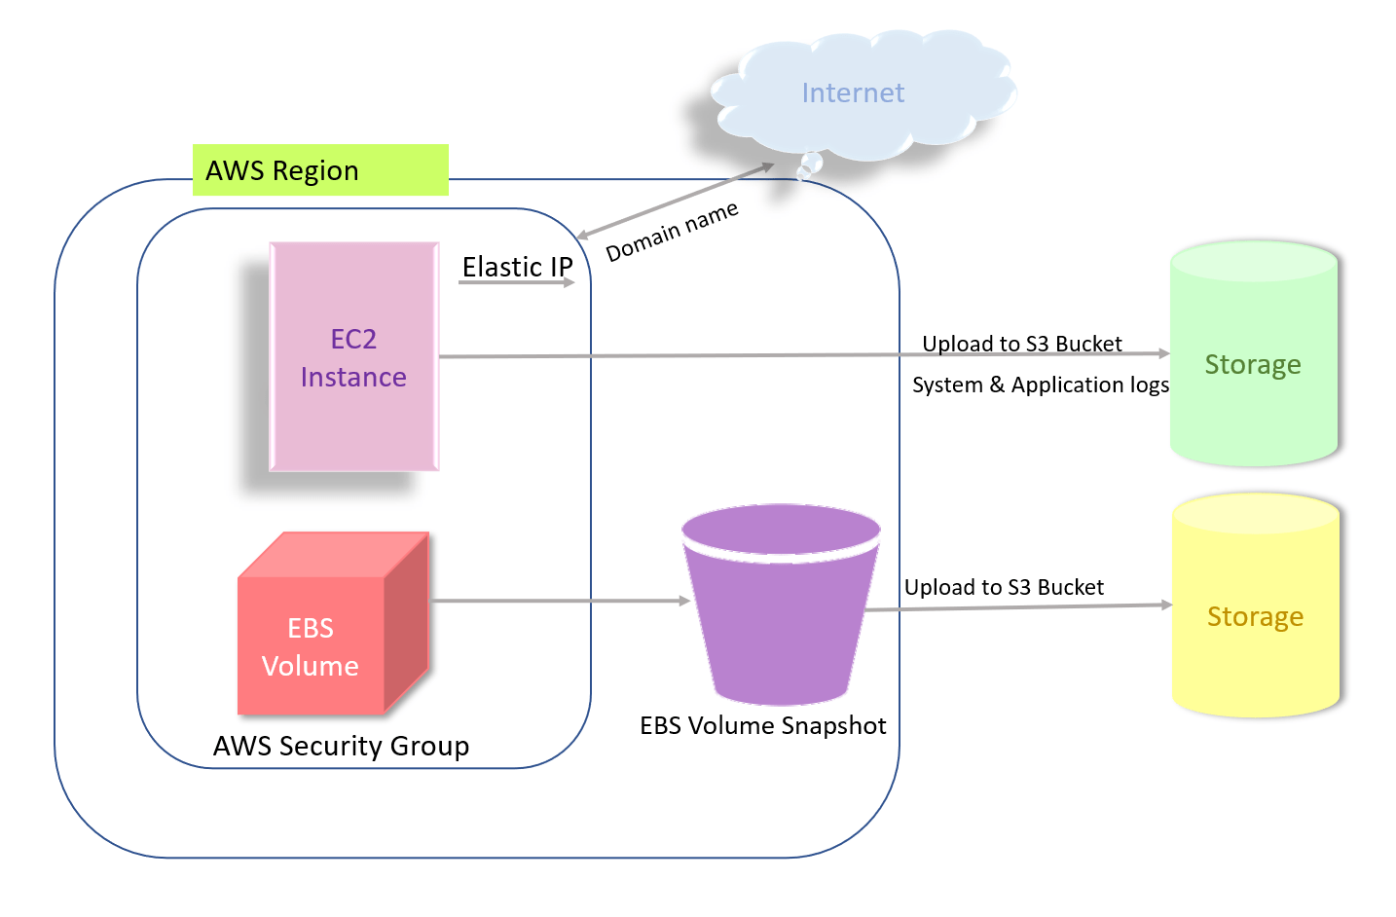
AWS Architecture

Slide 24
Elastic Compute Cloud-EC2

Slide 25
Elastic Compute Cloud
EC2 is short for Elastic Compute Cloud.
It is a service which provides with a virtual server called an instance.
With EC2, can set up and configure the OS and install applications on this instance.
EC2 instances can be resized, and the number of instances scaled up or down as per our requirement.

Slide 26
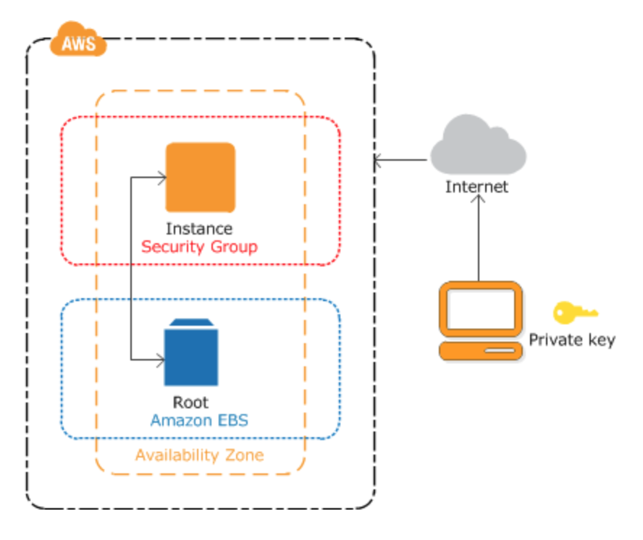
EC2 Instance

Slide 27
EC2 Instance
Instance is an Amazon Elastic Block Storage backed instance,
  i.e., root is an EBS volume.
EBS provides persistent block storage volumes for use to the instance.
  Protects instance from component failure
  High availability and durability
  Consistent and low-latency performance
  Scale usage up or down within minutes

Slide 28
EC2 Instance
Can be created by using the Admin Console
Instance Creation involved three main steps
  Launch an Instance
  Connect to your Instance
  Terminate your Instance
Connecting to the instance
  Through the browser
  Through a standalone SSH client

Slide 29
AWS - Management Console
A web application for managing Amazon Web Services.
AWS Management Console consists of list of various services to choose from.
It also provides all information related to our account like billing.
This console provides an inbuilt user interface to perform AWS tasks like working with Amazon S3 buckets, launching and connecting to Amazon EC2 instances

Slide 30
Simple storage service-s3

Slide 31
Simple Storage Service (S3)
Storage service for large-capacity, low-cost across multiple geographical regions.
Provides Secure, Durable and Highly Scalable object storage.
Object
  Fundamental entity in S3
  Consists of data, key and metadata.
  Can store any kind of data, in any format
Uses the bucket to store and retrieve data at any time from anywhere on any device.

Slide 32
Buckets
Data in S3 is organized in the form of buckets.
Bucket is a logical unit of storage in S3.
A Bucket contains objects which contain the data and metadata.
Before adding any data in S3 the user must create a bucket which will be used to store objects.

Slide 33
Amazon RDS
Amazon Relational Database Service
  A fully-managed Relational Database cloud service,
  Facilitates the deployment and maintenance of relational databases in the cloud.
Features of Amazon RDS
  Scalable
  Automatic backups
  Software patching
  Management Console,
  Command Line Interface.

Slide 34
Amazon RDS
Supports an array of database engines to store and organize data.
Amazon RDS is not itself a database; it is a service used to manage relational databases.
Supports six types of database engines
  Amazon Aurora
  RDS for MariaDB
  RDS for MySQL
  RDS for Oracle Database
  RDS for PostgreSQL
  RDS for SQL Server

Slide 35
RDS Benefits
Ease of use.
  Admins don't need to learn specific database management tools.
  They also can manage multiple database instances using the management console.
  RDS is compatible with database engines that users may already be familiar with, such as MySQL and Oracle
  Automates manual backup and recovery processes.
Cost-effectiveness.
  Customers only pay for what they use.
  Time spent maintaining instances is reduced,
    because maintenance tasks, such as backups and patching, are automated.

Slide 36
Elastic bean stalk

Slide 37
Elastic Bean Stalk
A platform within AWS that is used for deploying and scaling web applications.
  Reference to the fairy tale Jack and the Beanstalk.
It’s like a Pre-configured EC2 server
Platform as a service (PaaS)
Takes application code and deploys it while provisioning the supporting architecture and compute resources required for the code to run

Slide 38
Features of Elastic Bean
Stalk
To quickly deploy and manage applications in the AWS Cloud
Reduces management complexity without restricting choice or control.
Once the application is uploaded automatically handles the following details
    Capacity provisioning,
    load balancing,
    scaling,
    application health monitoring.
Supports applications developed in Go, Java, .NET, Node.js, PHP, Python, and Ruby.

Slide 39
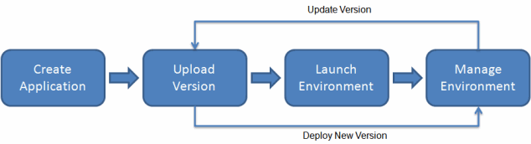
Working with Elastic Bean Stalk
Can use Elastic Beanstalk console
Eb Command Line Interface ,a high-level CLI designed specifically for Elastic Beanstalk.

Slide 40
Elastic Bean Stalk
Application
  A logical collection of Elastic Beanstalk components,
  environments, versions, and environment configurations.
  Application is conceptually like a folder.
Environment
  Collection of AWS resources running an application version.
  Each environment runs only one application version at a time,
  Elastic Beanstalk provisions the resources needed to run the application version specified.

Slide 41
Elastic Bean Stalk
Environment tier
Designates the type of application that the environment runs
  An application that serves HTTP requests runs in a web server environment tier.
  Amazon Simple Queue Service (Amazon SQS) queue runs in a worker environment tier.
Platform
  Combination of an operating system, programming language runtime, web server, application server, and Elastic Beanstalk components.
  Provides a variety of platforms on which applications can be built
  Platforms for different programming languages, application servers, and Docker containers

Slide 42
WS Key Management Services
Used to create, control and manage the cryptographic keys that encrypt and protect their data.
Organizations can use the encryption keys and functionality provided by AWS KMS to protect data in all their applications that use AWS.
It can generate data keys that can be used outside of AWS KMS.

Slide 43
AWS Secrets Manager
A Service that helps protect, manage, and retrieve secrets—such as database credentials, API keys, and OAuth tokens—throughout their lifecycle.
Securely store and manage credentials for applications, services, and IT resources, including multi-region replication for disaster recovery.
Encrypts secrets at rest using AWS KMS and provides granular access control through IAM policies.
Integrates with many AWS services (e.g., RDS, Redshift) and supports retrieval through SDKs and APIs.

Slide 44
WS WAF and AWS Shield
AWS WAF
  Used for application-level security, such as blocking malicious web traffic or preventing SQL injection.
AWS Shield Standard
  Used for basic protection against volumetric DDoS attacks on any public-facing AWS resource.
They are often used together for maximum protection.
Shield Advanced specifically helps protect against increased AWS bills during a DDoS attack.
Notes:
A

Slide 45
Amazon CloudWatch
Monitoring and observability service for resources and applications,
  It provides real-time metrics, log collection, and automated alerts to optimize performance.
  It allows developers and IT teams to track CPU, network, and application health, creating dashboards and setting alarms to proactively respond to changes.
Provides a unified, customizable view to visualize performance, resource utilization, and operational health.

Slide 46
AWS Cloud Trails
AWS CloudTrail is a core management and governance service that records API calls and user activity across AWS infrastructure, essential for security auditing, compliance, and troubleshooting.
It logs who made a request, the action, source IP, and time, saving these as immutable, encrypted files in Amazon S3.
Automatically tracks activity from the AWS Console, CLI, and SDKs, providing 90 days of history for management events.
Its "always on" for AWS accounts, providing a 90-day history by default, with additional costs for advanced features, long-term storage
https://console.aws.amazon.com/cloudtrail/.

