Slide 1
REST SERVICE USING SPRING DATA JPA

Slide 2
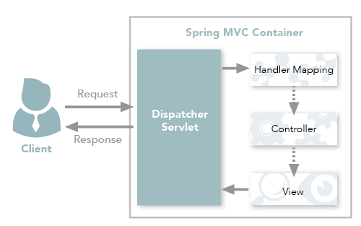
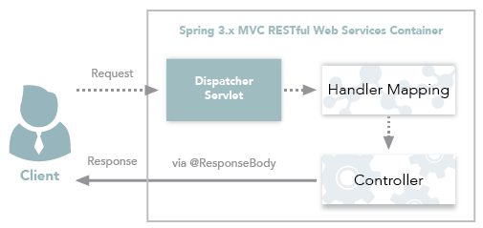
Spring MVC and Spring REST

Slide 3
REST
Representational State Transfer
  Architectural style for building web services that interact via an HTTP protocol.
  Formulated in 2000 by computer scientist Roy Fielding
  Gained popularity as a scalable and flexible alternative to older methods of machine-to-machine communication.
  It still remains the gold standard for public APIs.

Slide 4
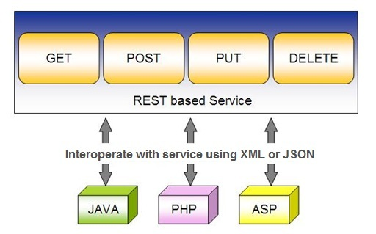
Spring RESTful Services
REST does not require the client to know anything about the structure of the API.
Server needs to provide whatever information the client needs to interact with the service.

Slide 5
REST API Concepts
Client
  Software that runs on a user’s computer or smartphone
  It initiates communication;
Server
  That offers an API as a means of access to its data or features
Resource
  Content that the server can provide to the client
    A Text file or video

Slide 6
REST API Concepts
Client access a resource by sending HTTP request.
  The server generates an HTTP response with encoded data on the resource.
  REST messages are self-descriptive, meaning they contain information on how to interpret and process them.

Slide 7
REST API Methods
REST request includes four essential parts:
  HTTP method,
  Endpoint,
  Headers
  Body.

Slide 8
Http Method
Method describes what is to be done with a resource.
The four basic methods named as CRUD
  POST to Create a resource,
  GET to Retrieve a resource,
  PUT to Update a resource, and
  DELETE to Delete a resource.

Slide 9
EndPoint
Endpoint
  Contains a Uniform Resource Identifier (URI) indicating where and how to find the resource on the Internet.
  The most common type of URI is a Unique Resource Location (URL), serving as a complete web address.
Headers
  Store information relevant to both the client and server.
  May provide authentication data — such as an API key, the name or IP address of the computer where the server is installed
  Information about the response format.
Body
  Data you want to get, add or replace.

Slide 10
Rest Response Sturcture
The server sends not the sought-for resource itself, but its representation
  A machine-readable description of current state.
  Resource can be represented in different formats
  The most popular ones are JSON and XML
Server could include response hyperlinks or hypermedia that links to other related resources.
Server gives instructions on what the client can do next and what further requests it can make.

Slide 11
Using appropriate Request Methods
GET :
  Should not update anything.
  Should be idempotent (same result in multiple calls).
  Possible Return Codes 200 (OK) + 404 (NOT FOUND) +400 (BAD REQUEST)
POST :
  Should create new resource.
  Ideally return JSON with link to newly created resource.
  Same return codes as get possible.
  In addition : Return code 201 (CREATED) is possible.

Slide 12
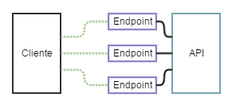
API and Endpoint

Slide 13
API
“Application Programming Interface.
A set of rules that allow an application to share its data with other applications.
API will enable to “share representation” between applications
Endpoint
  It is a digital location exposed via the API from where the API receives requests and sends out responses.
  Each endpoint is a URL that provides the location of a resource on the API server.
All APIs have endpoints. to interact with an API.

Slide 14
SPRING DATA REST WITH JPA

Slide 15
Spring RESTful Services
A RESTful architecture may expose multiple representations of a resource.
From Spring 4 @RestController annotation is added to controller
  A combination of @Controller and @ResponseBody
A Rest Controller method returns a domain object instead of a view.

Slide 16
REST Stereotypes
@RestController
  An implicit @ResponseBody is being added to the methods.
  Allows Spring to render the returned HttpEntity and its payload, directly to the response.
@GetMapping
  To map HTTP GET requests onto specific handler methods.
  Composed annotation for @RequestMapping(method = RequestMethod.GET).

Slide 17
REST Stereotypes
@PathVariable
  Indicates that the Method parameter should be bound to a URI template variable.
  @GetMapping("/members/{id}")
  public String getById(@PathVariable String id) { }
@PostMapping
  Combined shortcut for @RequestMapping(method = RequestMethod.POST).
  @PostMapping("/members“)
  public void addMember(@RequestBody Member member) { }

Slide 18
@RequestBody
Used to map the HttpRequest body to a transfer or domain object
  Spring automatically deserializes the JSON into a Java type
  The type of @RequestBody annotation must correspond to the JSON sent from client-side
HttpMessageConverter
  Internally Used by Spring to perform Serialization/deserialization
@Valid
  To perform automatic validation by adding to method argument

Slide 19
ResponseEntity
Represents Complete HTTP response, gives more flexibility
  May be required in some special cases
  Can be used to send Status Code,Response Body,Location to the resource which was altered
  @GetMapping(path = "/api/v1/invoices")
  public ResponseEntity<Invoice> getInvoices() {
  HttpHeaders responseHeaders = new HttpHeaders();
  return ResponseEntity.ok().headers(responseHeaders).body(dao.findAll());
  }

Slide 20
Response Entity
  @PostMapping(“/invoices)
  public ResponseEntity<Object> addInfo(@RequestBody Invoice entity){
  URI location=
  ServletUriComponentsBuilder
  .fromCurrentRequest()
  .path("/{id}")
  .buildAndExpand(entity.getId())
  .toUri();
  return ResponseEntity.created(location).body(entity);
  }

Slide 21
Put Method
The entity doesn’t exist, and the server creates a new entity for the requested resource and responds with a success code 201 to the client
The entity already exists; the server updates the entity and responds with a success code 200 or 204 to the client.
If an error happens while processing a PUT request, the server should respond to the client with the proper error code, typically a 4xx or 5xx

Slide 22
Patch Method
Applies partial modifications to entities of a resource.
If the request is successfully executed, the server returns the success code 204 to the client. Otherwise, the server returns an error code.

Slide 23
Put Mapping
@PutMapping(path = "/api/v1/invoice")
  public Invoice update(@RequestBody Invoice entity) {
  return this.service.add(entity);
  }
  @PatchMapping(path = "/api/v1/invoice")
  public ResponseEntity<String> updateAmount() {
  return ResponseEntity.status(HttpStatus.CREATED)
  .body("Updated Amount:="+this.service.updateAmount());
  }

Slide 24
Remove Method in Service
  public Invoice remove(Invoice entity) {
  Optional<Invoice> optional = Optional.empty();
  if(this.repository.existsById(entity.getId())) {
  this.repository.delete(entity);
  optional = Optional.of(entity);
  }
return optional;
}

Slide 25
Delete Mapping in Controller
  @DeleteMapping(path = "/api/v1/invoice")
  public ResponseEntity<Invoice> remove(@RequestBody Invoice entity) {
  Invoice invoice = this.service.removeInvoice(entity).orElseThrow(()-> new RuntimeException("Element NOT FOUND"));
  return ResponseEntity.ok().body(invoice);
  }

Slide 26
@RestControllerAdvice
Used for Exception handling in Rest API’s
Used to handle exceptions across the whole application
Like an interceptor of exceptions thrown by methods annotated with @RequestMapping or one of the shortcuts.
It’s a combination of @ContollerAdvice and @ResponseBody.
@ExceptionHandler
  Annotation for handling exceptions in specific handler classes and/or handler methods.

Slide 27
@RestControllerAdvice
  @RestControllerAdvice
  public class ErrorHandler {
  @ExceptionHandler(value = Exception.class)
  public ErrorDetails handleAllExceptions(Exception ex, WebRequest request){
  return new ErrorDetails(LocalDateTime.now(),
  ex.getMessage(), request.getDescription(false));
  }
  }
  request.getDescription(false):
  Whether to include client-specific information like session id and user name

Slide 28
application.yml
  logging:
  level:
  org.hibernate.sql: debug
  org.hibernate.type.descriptor.sql.BasicBinder: trace

Slide 29
DOCUMENTING REST API

Slide 30
Documentation
Essential part of building REST APIs
Open Api Documentation
  Standard, programming language-agnostic interface description for REST APIs,
  Allows both humans and computers to discover and understand the capabilities of a service
  No need to access source code,
  Can add additional documentation, or inspect network traffic

Slide 31
Spring Documentation
  A tool that simplifies the generation and maintenance of API docs
  Based on the OpenAPI 3 specification, for Spring Boot 1.x and 2.x applications.
  Required dependency are added to pom.xml:
  <dependency>
  <groupId>org.springdoc</groupId>
  <artifactId>springdoc-openapi-starter-webmvc-ui</artifactId>
  <version>3.0.1</version>
  <scope>compile</scope>
  </dependency>

Slide 32
View the Documentation
Can be viewed after executing the application
Its rendered in the browser in JSON format by default.
Default Path : http://localhost:8080/v3/api-docs/
Can be Customised using application.properties file:
  springdoc.api-docs.path=/api-docs
Custom Path : http://localhost:8080/api-docs/

Slide 33
Swagger
  springdoc-openapi is integrated with Swagger UI
  Access from the folowing URL
  http://localhost:8080/swagger-ui.html
Can be customized using application.properties
  springdoc.swagger-ui.path=/swagger-ui-custom.html

Slide 34
Updates
springdoc.api-docs.version=OPENAPI_3_0
The above entry in application.yml , allows Swagger UI client JSON structure that SpringDoc 3.0.1 produces by default.
It cannot handle Open Api 3.1 that is produced by Spring

Slide 35
Best practices
Use Nouns for Resource Identification
Use Proper Http Headers for Serialization formats
Get Method and Query Parameter should not alter the state
Always use plurals when you name resources.
Use Appropriate Http Response Status Codes
Field Name casing Conventions
Provide Searching, Sorting and Pagination
Use Versioning of API
Provide Links for Navigating through API – Hateos
Handle Error Properly
Using DTO to Handle the Request and Response

Slide 36
SPRING REST CLIENT-REST TEMPLATE

Slide 37
Consuming REST with REST Template
REST web service can be comsumed programmatically.
Spring convenient template class is called RestTemplate.
  one-line that can bind the data to custom domain types.
It leverages the same marshallers that the server uses.
Can use JAXB marshaller,as well as JSON marshaller

Slide 38
Rest Template
Rest Template is used to create applications that consume REST
Its Autowired to the controller class.
exchange()
  Returns ResponseEntity containing an object mapped from the response body
  Can Communicate with any HTTP Method
  Takes the following arguments
    URL,
    HttpMethod,
    Return type for Exchange() method.

Slide 39
Rest Template
  getForObject(url, java.lang.Class<T>)
    Retrieve a representation by doing a GET on the specified URL.
    Class<T> is the response class Type
getForEntity(url, java.lang.Class<T>)
  Retrieve a representation by doing a GET on the URL
  Class<T> is the response class Type

Slide 40
Rest Template
headForHeaders() :
  Retrieves all headers
delete()
  Deletes the resources at the given URL.
put()
  Creates the new resource for the given URL.
postForEntity():
  Creates a news resource using HTTP POST method.

Slide 41
Rest Template -Exchange
  HttpHeaders headers = new HttpHeaders();
  headers.setAccept(Arrays.asList(MediaType.APPLICATION_JSON));
  HttpEntity <String> entity = new HttpEntity<String>(headers);
  restTemplate.exchange(" http://localhost:8080/products",
  HttpMethod.GET, entity, String.class).getBody();

Slide 42
getForObject
  @Autowired
  RestTemplate restTemplate;
  String obj =
  restTemplate.getForObject("http://localhost:4040/person/all", String.class);
  System.out.println(obj);

Slide 43
PostForObject
Used to create a new Resource
postForLocation()
  returns the URI of the newly created Resource
postForObject()
  Returns the Resource itself.
RestTemplate restTemplate = new RestTemplate();
HttpEntity<Book> request = new HttpEntity<>(new Book(“Java"));
Book bk = restTemplate.postForObject(url, request,Book.class);

Slide 44
PostForLocation
Returns the Location of that newly created Resource:
  HttpEntity<Book> request = new HttpEntity<>(new Book("bar"));
  URI location = restTemplate.postForLocation(url, request);

Slide 45
XML Response
Done with Jackson XML extension can also be done with JAXB
  jackson-dataformat-xml
    <dependency>
    <groupId>com.fasterxml.jackson.dataformat</groupId>
    <artifactId>jackson-dataformat-xml</artifactId>
    </dependency>

Slide 46
XML Response
    @GetMapping(produces = "application/xml")
    public List<Product> getAll(){
    return this.service.findAll();
    }
    @PostMapping(consumes = "application/xml")
    public ResponseEntity<Product> save(@RequestBody Product entity) throws URISyntaxException{
    Product added = this.service.add(entity)
    return ResponseEntity.created(new URI("/api/v1/products/"+entity.getProductId())).body(added);
    }

Slide 47
Multipart File
Files are commonly uploaded using POST method.
File is sent in the body of the HTTP request, along associated information such as the filename or description.
The response object indicates whether the upload was successful or not, along with any additional metadata related to the file.

Slide 48
Configuring File Size
  Done in the application.yml
spring.servlet.multipart.max-file-size
  specifies the maximum size permitted for uploaded files.
  The default is 1MB
  If the size of any uploaded file is greater than this size, will throw an exception
spring.servlet.multipart.max-request-size
  The maximum size allowed for a multipart/form-data request
  Exception will be thrown if the overall size of all uploaded files exceeds this threshold
  The default value is 10MB.

Slide 49
Multipart File
MultipartFile
  Represents the file to be saved
StringUtils
  Used to extract the file name
  Checks if the file size exceeds the maximum limit

Slide 50
UUID
Universal Unique Identifier
  128-bit value to uniquely identify an object or entity on the internet.
  Is guaranteed to be different or is, at least, extremely likely to be different from any other UUID generated until A.D. 3400.
  Can be generated to refer to primary keys, Bluetooth profiles or Objects with short lifetimes.
  Generated using an algorithm based on a timestamp and other factors such as the network address.
  Its represented in hexadecimal digits

Slide 51
Document
    public class Document {
    @GeneratedValue(strategy = GenerationType.UUID)
    @Id
    private String id;
    private String name;
    private String type;
    @Lob
    private byte[] data;
    }

Slide 52
Service
  public Document store(MultipartFile file) throws IOException {
  String fileName = StringUtils.cleanPath(file.getOriginalFilename());
  Document document = Document.builder()
  .name(fileName)
  .type(file.getContentType())
  .data(file.getBytes())
  .build()
  return repo.save(document);
  }

Slide 53
Upload File
@PostMapping("/upload")
public ResponseEntity<String> uploadFile(@RequestParam("file")
MultipartFile file) throws IOException {
service.store(file);
message = "Uploaded the file successfully: " +
file.getOriginalFilename();
return ResponseEntity.status(200).body(message);
}

Slide 54
Download File
  Service Layer
    public Stream<Document> getAllFiles() {
    return repo.findAll().stream();
    }
    public Document getFile(String id) {
    return repo.findById(id).get();
    }

Slide 55
Download File Controller
    @GetMapping("/files/{id}")
    public ResponseEntity<byte[]> getFile(@PathVariable String id) {
    Document file = service.getFile(id);
    return ResponseEntity.ok()
    .header(HttpHeaders.CONTENT_DISPOSITION, "attachment; filename=\"" + file.getName() + "\"")
    .body(file.getData());
    }

Slide 56
Rest Controller Advice
  @ExceptionHandler(IOException.class)
  public ErrorMessage handleIOException(){
  String message = "Could not upload the file: " ;
  return new ErrorMessage(message);
  }

Slide 57
SPRING SECURITY

Slide 58
Spring Security
Highly customizable authentication and access-control framework.
Focuses on providing both authentication and authorization
“Authentication”
  The process of establishing a user, device or some other system which can perform an action in the application
“Authorization”
  The process of deciding whether a principal is allowed to perform an action within the application.
  authorization is done after authentication process.
  Once the user is authenticated they may have one or more “roles”

Slide 59
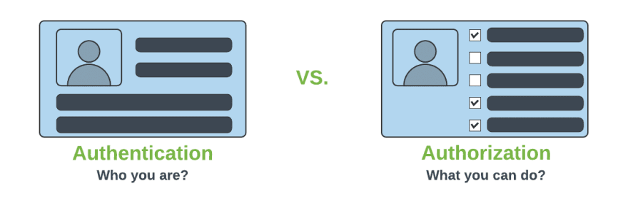
Authentication & Authorization

Slide 60
Add Spring Security Module
  Update the pom.xml file with the following entry, can also add spring security while use starter project.
  <dependency>
  <groupId>org.springframework.boot</groupId>
  <artifactId>spring-boot-starter-security</artifactId>
  </dependency>

Slide 61
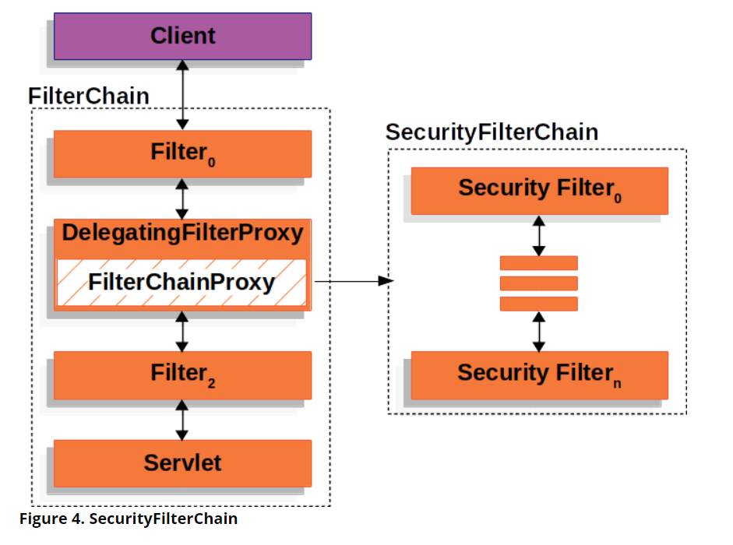
Spring Security Architecture

Slide 62
Spring Security Architecture
DelegatingFilterProxy
  Servlet filter embedded in the spring context.
  It delegates the incoming request to a bunch of filters
FilterChainProxy
  A servlet filter which invokes the relevant filters that would work on the incoming request.
SecurityFilters
  Contains a list of filters that need to be invoked before the controller can handle the request.
  SecurityContextPersistenceFilter, HeaderWriterFilter, CsrfFilter, LogoutFilter, UsernamePasswordAuthenticationFilter etc.
  FilterChainProxy queries this class to invoke each filter in a loop.

Slide 63
Configuring Security
Can Configure the default username, password and role in application.properties
  spring.security.user.name=india
  spring.security.user.password=india

Slide 64
Controller
  @RestController
  public class ProjectController {
  @GetMapping("/first")
  public String getSecuredMessage() {
  return "Welcome to Secured Page";
  }
  }

Slide 65
Authorizations
permitAll
  No need of any authorization to access current page.
authenticated
  Requires Login(username/password) and no authorization(role based access) is required.
hasAuthority
  Requires that user should have both authentication and role based authorization access.
hasAnyAuthority
  It represents that user should have authentication and multiple role based authorization access.

Slide 66
BCryptPasswordEncoder
An encryption class of Spring Security.
Spring provides a variety of encryption methods for passwords.
The official recommendation is to use BCryptPasswordEncoder, which uses the BCrypt strong hash function.
  @Bean
  PasswordEncoder passwordEncoder() {
  return new BCryptPasswordEncoder();
  }

Slide 67
HttpSecurity
HttpSecurity
  Provides a Method authoriseRequests()
authorizeRequests()
  To Define custom requirements for URLs
  Can add multiple children to this method.
  The matchers are considered in the order they were declared.
  http.authorizeRequests()
  .anyRequest().authenticated()
  .and().httpBasic();

Slide 68
In-memory UserDetailsService
The AuthenticationProvider uses UserDetailsService that implements the user management responsibility.
It finds a user by its username from the cache or underlying storage.
UserDetailsService is always associated with a PasswordEncoder that encodes a supplied password and verifies if the password matches an existing encoding.
It stores credentials in the memory, which can then be used by Spring Security to authenticate an incoming request.

Slide 69
Spring Boot Application
  @SpringBootApplication
  public class SpringSecurityApplication {
  public static void main(String[] args) {
  SpringApplication.run(SpringSecurityApplication.class, args);
  }
  @Bean
  BCryptPasswordEncoder encoder() {
  return new BCryptPasswordEncoder();
  }
  }

Slide 70
Security Configuration
  @Configuration
  public class SecurityConfig {
  @Autowired
  private BCryptPasswordEncoder encoder;
  @Bean
  public UserDetailsManager details() {
  UserDetails indiaUser = User.withUsername("india")
  .password(encoder.encode("india")).authorities("ADMIN").build();
  UserDetails nepalUser = User.withUsername("nepal")
  .password(encoder.encode("nepal")).authorities("USER").build();
  return new InMemoryUserDetailsManager(indiaUser,nepalUser);
  }

Slide 71
CSRF
  Its a web security vulnerability that allows an attacker to induce users to perform actions that they do not intend to perform.
  It allows an attacker to partly circumvent the same origin policy, which is designed to prevent different websites from interfering with each other.
Should be used for protecting any request that could be processed by a browser by normal users.
If a service is used by non-browser clients, CSRF protection can be disabled
csrf(AbstractHttpConfigurer::disable)

Slide 72
Security Configuration
  import static org.springframework.security.config.Customizer.withDefaults;
  @Bean
  public SecurityFilterChain filterChain(HttpSecurity http) throws Exception {
  http.authorizeHttpRequests(auth -> auth.requestMatchers("/second").permitAll())
  .authorizeHttpRequests( auth -> auth.requestMatchers("/first")
  .authenticated()).csrf(AbstractHttpConfigurer::disable)
  .httpBasic(withDefaults());
  return http.build();
  }

Slide 73
Spring Validation
JSR-303 Bean Validation API is used by Spring.
The standardized validation constraint declaration and metadata
Annotate domain model properties with declarative validation constraints and the runtime enforces them.
Can define own custom constraints.
<dependency>
<groupId>org.springframework.boot</groupId>
<artifactId>spring-boot-starter-validation</artifactId>
</dependency>

Slide 74
Spring Boot Validation
Spring Boot provides seamless integration with the Bean Validation API with Hibernate Validator.
Hibernate Validator
  Engine that performs the actual validation based on the Bean Validation API.
Spring Boot
  Provides the framework and integration that makes it easy to incorporate and use Hibernate Validator

Slide 75
Validation With Records
  public record BloodDonorDto(
  @NotBlank(message = "Name cannot be blank")
  String donorName,
  @Email(message = "Invalid email format")
  @NotBlank(message = "Email cannot be blank")
  String email,
  @Min(value = 18, message = "Age must be at least 18")
  @Max(value = 100, message = "Age must be at most 100")
  Integer age
  ) {}

Slide 76
Handle Validation Errors
  @ExceptionHandler(exception = MethodArgumentNotValidException.class)
  public ResponseEntity<Map<String,String>> entityValidationException(BindException ex, WebRequest request) {
  Map<String, String> errors = new HashMap<>();
  ex.getBindingResult().getFieldErrors().forEach(error ->
  errors.put(error.getField(), error.getDefaultMessage())
  );
  return ResponseEntity.status(HttpStatus.BAD_REQUEST).body(errors);
  }

Slide 77
Controller
  @PostMapping
  ResponseEntity<StudentDto> save(@Valid @RequestBody StudentDto dto){
  StudentDto saved = this.service.save(dto);
  return ResponseEntity.status(HttpStatus.CREATED).body(saved);
  }

Slide 78
SPRING ACTUATOR

Slide 79
Spring Boot Actuator
Exposes REST endpoints that can be consumed to manage and monitor application.
Monitor application health, application bean details, version details, thread dumps, logger details etc
Can restrict these endpoints to be consumed by authorized users only and Spring provides easy way to secure your REST endpoints.

Slide 80
actuator End Point
actuator
  It provides a hypermedia-based discovery page for the other endpoints.
  By default it is sensitive and hence requires username/password for access or may be disabled if web security is not enabled.
Beans
  It displays complete beans configured in the app.
Configprops
  It displays a collated list of all @ConfigurationProperties.

Slide 81
actuator End Point
Health
    It shows application health information
  management.endpoint.health.show-details:=always
Info
  It displays arbitrary application info.
Loggers
  It shows and modifies the configuration of loggers in the application.
metrics:
  It shows metrics information for the current application.
Mappings
  It displays a collated list of all @RequestMapping paths.

Slide 82
Actuator Endpoints
health and info can be accessed
  Other endpoints are disabled by default
management.endpoints.web.exposure.include=*.
  Will enable all of them
  Can also list endpoints which should be enabled
To expose all enabled endpoints except one (for example /loggers), we use:
  management.endpoints.web.exposure.include=*
  management.endpoints.web.exposure.exclude=loggers
  management.security.enabled=false

Slide 83
Info and Health Endpoint
Reads the Information from the pom.xml
  info:
  app:
  name: ${spring.application.name}
  build:
  artificatId: '@project.artifact@'
  groupId: '@project.groupId@'
  version: '@project.version@'
  java:
  version:@java.version@
info:
env:
enabled: true

Slide 84
Health Endpoint
  management:
  endpoint:
  health:
  show-details: always

Slide 85
Logger Endpoint
http://localhost:8787/actuator/metrics
http://localhost:8787/actuator/loggers
To Change the Log level make a post request
  http://localhost:8787/actuator/loggers/org.springframework.boot.SpringApplication
  { "configuredLevel": "trace“ }
To reset the logging level back to the original value
  { "configuredLevel": null }

Slide 86
Shut Down End Point
Endpoint is used to shut down the Spring Boot application
Need to enable by adding a property in the application.yml
Done By Making a POST call.
  http://localhost:7070/actuator/shutdown
  management:
  endpoint:
  shutdown:
  enabled: true

Slide 87
Extending Info End Point
  @Component
  public class CustomInfoEndPoint implements InfoContributor {
  @Autowired
  private ConfigurableApplicationContext ctx;
  @Override
  public void contribute(Info.Builder builder) {
  Map<String, Object> details = new HashMap<>();
  details.put("bean-definition-count", ctx.getBeanDefinitionCount());
  details.put("startup-date", ctx.getStartupDate());
  builder.withDetail("context", details);
  }
  }

Slide 88
Extending Health Point
  @Component
  public class CustomHealthInfoEndPoint implements HealthIndicator {
  private final OrderRepository repository;
  @Override
  public Health health() {
  try {
  long number = this.repository.count(); return Health.status("UP").withDetail("DB Service", "DB service is UP").build();
  } catch (Exception exception){
  return Health.outOfService().withDetail("DB Service", "DB service is DOWN").build();
  }
  }
  }

Slide 89
Custom End Points
Created by Adding one of the following annotations
  @EndPoint
  @WebEndPoint
  @JmxEndPoint
Can Add Methods for Read ,Write and Delete Operations with following annotations
  @ReadOperation
  @WriteOperation
  @DeleteOperation

Slide 90
JPA INHERITANCE-ASSOCIATION

Slide 91
Mapping Inheritance
Joined Subclass
  The root of the class hierarchy is represented by a table.
  Each subclass is represented by a separate table that contains the columns that are specific to the subclass as well as the column that represent the subclass’s primary key.
  If the subclass table has primary key column, it serves as a foreign key to the primary key of the superclass table.
Single Table for Each Class Hierarchy
  All the classes in a hierarchy are mapped to a single table.
  The table has a column that serves as a discriminator column.

Slide 92
Using Single Table
@Entity
@Table(name="USERS")
@Inheritance(strategy=InheritanceType.SINGLE)
@DiscriminatorColumn(name="USER_TYPE",
discriminatorType=DiscriminatorType.STRING,
length=1)
public class User { }
@Entity
@DiscriminatorValue(value="S")
public class Seller extends User{ ..}

Slide 93
JPA Inheritance
  @Entity
  @Table(name = "teacher_2026")
  @Inheritance(strategy = InheritanceType.JOINED)
  public class Teacher {
  @Id
  @Column(name = "teacher_id")
  @GeneratedValue(strategy = GenerationType.AUTO)
  private int teacherId;
  @Column(name = "teacher_name")
  private String teacherName;
    // constructor/setter/getter
    }

Slide 94
JPA Inheritance
  @Entity
  @Table(name = "professor_2026")
  @PrimaryKeyJoinColumn(name="teacher_ref",referencedColumnName = "teacher_id")
  public class Professor extends Teacher {
  @Column(name = "department")
  private String department;
  @Column(name = "salary")
  private double salary;
  public Professor(int teacherId, String name, String department, double salary) {
  super(teacherId, name);
  this.department = department;
  this.salary = salary;
  }
  }

Slide 95
Inheritance
  public interface JoinTableRepo<T extends Teacher> extends JpaRepository<T, Integer> {
  }
  @Autowired
  JoinTableRepo<Teacher> repo;
  repo.save(new Professor("Prof Priya", "biology", 35000));

Slide 96
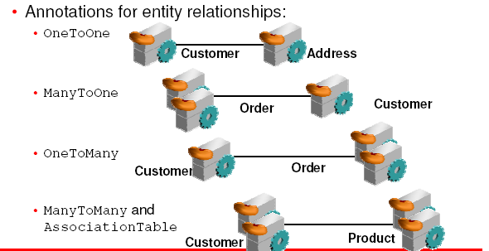
Mapping Relationship Between Entities

Slide 97
JPA Relationships
Relationships can be either unidirectional or bidirectional.
Defining the direction of the relationship between entities has no impact on the database mapping.
  It only defines the directions in domain model.
Bidirectional relationship requires
  The owning side
  inverse or the referencing side

Slide 98
ONE TO MANY RELATIONS

Slide 99
Fetch Types
Depends on the cardinality of the relationship.
FetchType.EAGER
  Fetch immediately
  To get all elements of a relationship when selecting the root entity.
FetchType.LAZY.
  fetch when needed
  The elements of a relationship are fetched only when its requested for

Slide 100
Fetch type
Default Fetch type in case of the below annotations.
  @OneToOne –EAGER.
  @OneToMany –LAZY.
  @ManyToOne –EAGER.
  @ManyToMany –LAZY.

Slide 101
@JoinColumn
Used to specify the column used for joining an entity association
  Indicates that this entity is the owner of the relationship
Name :
  The name of the foreign key column.
Referenced column
  The name of the column referenced by this foreign key column.
  @JoinColumn(name = "patient_ref" , referencedColumnName = "doctorId")

Slide 102
@OneToMany
Defines a many-valued association with one-to-many multiplicity.
  Unidirectional One-to-Many association using a foreign key mapping
targetEntity
  The entity class that is the target of the association.
cascade
  The operations that must be cascaded to the target of the association.
  PERSIST, MERGE, DETACH,REFRESH,,ALL
fetch
  Whether the association should be lazily loaded or must be eagerly fetched.
  @OneToMany(targetEntity =Patient.class,
  cascade = CascadeType.ALL,
  fetch=FetchType.EAGER)

Slide 103
Entity -1
  @Entity
  @Table(name = "patient")
  public class Patient {
  @Id
  int patientId;
  String patientName;
  String caseHistory;
  // constructor/set/get/toString etc.,
}

Slide 104
Entity 2
  @Entity
  @Table(name = "doctor")
  public class Doctor {
  @Id
  int doctorId;
  String doctorName;
  @OneToMany(targetEntity =Patient.class,
  cascade = CascadeType.ALL,
  fetch=FetchType.EAGER)
  @JoinColumn(name = “doctor_ref" , referencedColumnName = "doctorId")
  @JsonIgnore
  Set<Patient> patientList;
  }

Slide 105
Tables
doctor_id int PK
department varchar(25)
doctor_name varchar(25)
phone_number bigint
patient_id int PK
mobile_number bigint
patient_name varchar(25)
doctor_ref int FK

Slide 106
Repositories
  @Repository
  public interface DoctorRepository extends JpaRepository<Doctor, Integer> { }

Slide 107
Service
  @Service
  public class DoctorService {
  @Autowired
  Set<Patient> patientList;
  @Autowired
  Doctor doctor;
  public Doctor createDoctor(){
  doctor.setDoctorId(800);
  doctor.setDoctorName("Rajesh Kanna");
  doctor.setPatientList(this.patientList);
  return this.doctor;
  }
}

Slide 108
Main Method
  DoctorRepository repo= ctx.getBean(DoctorRepository.class);
  DoctorService service = ctx.getBean(DoctorService.class);
  Doctor doctor = service.createDoctor();
  Doctor added= repo.save(doctor);
  System.out.println(added);

Slide 109
ONE TO ONE

Slide 110
One to One
  @Entity
  @Table(name = "company")
  public class Company {
  @Id
  @Column(name = "id")
  private int id;
  @Column(name = "companyname")
  private String companyName;
  @OneToOne(cascade = CascadeType.ALL)
  @JoinColumn(name = "vendor_ref")
  private Vendor vendor;
}

Slide 111
One to One Mapping
  @Entity
  @Table(name = "vendor")
  public class Vendor {
  @Id
  @Column(name = "vendorid")
  private int vendorid;
  @Column(name = "vendorname")
  private String vendorName;
  @Column(name = "phonenumber")
  private long mobileNumber;
}

Slide 112
One To Many
  @Autowired
  Vendor vendor;
  @Autowired
  Company company;
  public Company createCompany(){
  this.company.setCompanyName("Sharechart Inc");
  this.company.setId(4959);
  this.company.setVendor(vendor);
  return this.company;
  }

Slide 113
BI-DIRECTIONAL

Slide 114
One to Many Bi Directional
A Doctor can have multiple patient
A Patient can belong exactly to a single Doctor.
RDBMS model, will have foreign key doctor_ref in Patient
vats_doctor_2021
doctor_id int PK
department varchar(25)
doctor_name varchar(25)
phone_number bigint
vats_patient_2021
patient_id int PK
email varchar(20)
patient_name varchar(25)
doctor_ref int FK

Slide 115
One To Many
  Inverse Side
  public class Doctor {
    @Id
    int doctorId;
    String doctorName;
    String department;
    long phoneNumber;
    @OneToMany(fetch = FetchType.EAGER, mappedBy = "doctor")
  List<Patient> patientList;
  }
  Owning Side
public class Patient {
@Id
@Column(name = "patient_id")
int patientId;
String patientName;
String email;
@ManyToOne(fetch = FetchType.EAGER)
@JoinColumn(name = "doctor_ref")
Doctor doctor;
}

Slide 116
Owning Side
Owning Side: @ManyToOne
  ManyToOne is always the owning side of a bidirectional association.
  Side in which the single-valued back reference is present
  The side with the foreign key.
  Responsible for propagating the update of the relationship to the database.

Slide 117
mappedBy Attribute
Inverse Side: @OneToMany
  Used on the side which has the collection reference, Inverse Side
  OneToMany is always the inverse side of a bidirectional association.
  Will have the “mappedBy” element defined.
  Value of mappedBy is the name of the association-mapping attribute on the owning side, and not table name or class Name
  Represents the relationship in the object model but leaves the database management to the owning side.

Slide 118
Add
  Doctor added =repo.save(doc);
  for(Patient eachPatient : patientList) {
  eachPatient.setDoctor(doc);
  patientRepo.save(eachPatient);
  }
  if(added!=null) {
  System.out.println("One Record Added");
  }

Slide 119
One to Many Bi-Directional
  DoctorService service = ctx.getBean(DoctorService.class);
  List<Doctor> docList =service.findAll();
  for(Doctor eachDoctor:docList) {
  System.out.println(eachDoctor.getDoctorId());
  System.out.println(eachDoctor.getDoctorName());
  eachDoctor.getPatientList().forEach(System.out::println);

Slide 120
One to Many Bi-Directional
  PatientRepository repo = ctx.getBean(PatientRepository.class);
  Patient patient =repo.findById(203).get();
  System.out.println(patient.getPatientName());
  System.out.println(patient.getDoctor().getDoctorName());

Slide 121
Entity Life Cycle Events
JPA, provides several events to notify an entity’s lifecycle.
@PrePersist,@PostPersist
@PreRemove,@PostRemove
@PreUpdate,@PostUpdate
@PostLoad
  Used for custom logic within methods, such as data validation, logging, or triggering other actions.

Slide 122
Entity Life Cycle Events
Class with annotated callback methods.
  public class EntityListener {
  Logger log = LoggerFactory.getLogger(EntityListener.class);
  @PrePersist
  @PreUpdate
  @PreRemove
  private void beforeUpdate(Employee emp) {
  if (emp.getId() == 0) {
  log.info("About to add ");
  } else {
  log.info("About to update/delete " + emp.getId());
  }
  }

Slide 123
JDBC SECURITY

Slide 124
Sql Statements
  CREATE TABLE users( `username` varchar(50) NOT NULL, `password` varchar(200) NOT NULL, `enabled` tinyint(1) NOT NULL, PRIMARY KEY (`username`))
  CREATE TABLE authorities ( `username` varchar(50) NOT NULL, `authority` varchar(50) NOT NULL, KEY `fk_authorities_users` (`username`), CONSTRAINT `fk_authorities_users` FOREIGN KEY (`username`) REFERENCES `users` (`username`))

Slide 125
SQL Statements
  insert into users (username, password,enabled) values ('india','$2a$10$P.9MaemE6x38wnZer4qauO8Dl9pixQEZ27.yEQglTtyjdmJBRtTFS',true);
  insert into authorities (username, authority) values ('india', 'ROLE_USER');
  insert into test.users (username, password, enabled) values ('nepal','$2a10$t4kkrerTgJlcvTj7QresWuBqAsnxVxMxaJ6UzlXCaP/HSdDraO5QC',true);
  insert into authorities (username, authority) values ('nepal', 'ROLE_ADMIN');

Slide 126
Application.properties
  spring.datasource.url=jdbc:mysql://localhost:3306/test
  spring.datasource.username=root
  spring.datasource.password=srivatsan
  spring.datasource.driver-class-name=com.mysql.cj.jdbc.Driver

Slide 127
Pass Word Encoder
  public static void main(String[] args) {
  BCryptPasswordEncoder encoder = new BCryptPasswordEncoder();
  String encoded = encoder.encode("india");
  System.out.println(encoded);
  encoded = encoder.encode("nepal");
  System.out.println(encoded);
  }

Slide 128
Security Config
  @Configuration
  public class SecurityConfiguration {
  @Autowired
  private DataSource dataSource;
  @Bean
  public BCryptPasswordEncoder encoder() {
  return new BCryptPasswordEncoder();
  }

Slide 129
Security Config
  @Bean
  public UserDetailsService jdbcUserDetailsService(DataSource dataSource) {
  String usersByUsernameQuery = "select username, password, enabled from users where username = ?";
  String authsByUserQuery = "select username, authority from authorities where username = ?";
  JdbcUserDetailsManager mgr = new JdbcUserDetailsManager(dataSource);
  mgr.setUsersByUsernameQuery(usersByUsernameQuery);
  mgr.setAuthoritiesByUsernameQuery(authsByUserQuery);
  return mgr;
  }

Slide 130
Method Level Security
@EnableMethodSecurity(prePostEnabled = true,jsr250Enabled = true)
@PreAuthorize("hasRole('ADMIN’)”)
@Secured
@RolesAllowed("ADMIN")

Slide 131
  @PostMapping
  @PreAuthorize("hasRole('ADMIN')")
  @RolesAllowed("ADMIN")
  public ResponseEntity<LoanApplication> save(@RequestBody LoanApplication entity, Principal principal){
  log.info("accessed by user "+principal.getName());
  }

Slide 132
REST TEMPLATE WITH SECURITY

Slide 133
Using Rest Template-With Security
  @Bean
  public BasicAuthenticationInterceptor interceptor() {
  return new BasicAuthenticationInterceptor("india", "india");
  }
  @Bean
  public RestTemplate template() {
  RestTemplate template = new RestTemplate();
  template.getInterceptors().add(interceptor());
  return template;
  }

Slide 134
Using Rest Template-With Security
  public String useGetAll() {
  return this.template.exchange(url,HttpMethod.GET,entity,String.class).getBody();
  }

