Slide 1
Spring Security

Slide 2
Spring Security
Highly customizable authentication and access-control framework.
Focuses on providing both authentication and authorization
“Authentication”
  The process of establishing a user, device or some other system which can perform an action in the application
“Authorization”
  The process of deciding whether a principal is allowed to perform an action within the application.
  authorization is done after authentication process.
  Once the user is authenticated they may have one or more “roles”

Slide 3
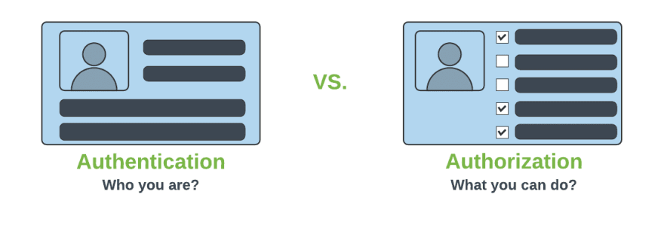
Authentication & Authorization

Slide 4
Add Spring Security Module
  Update the pom.xml file with the following entry, can also add spring security while use starter project.
  <dependency>
  <groupId>org.springframework.boot</groupId>
  <artifactId>spring-boot-starter-security</artifactId>
  </dependency>

Slide 5
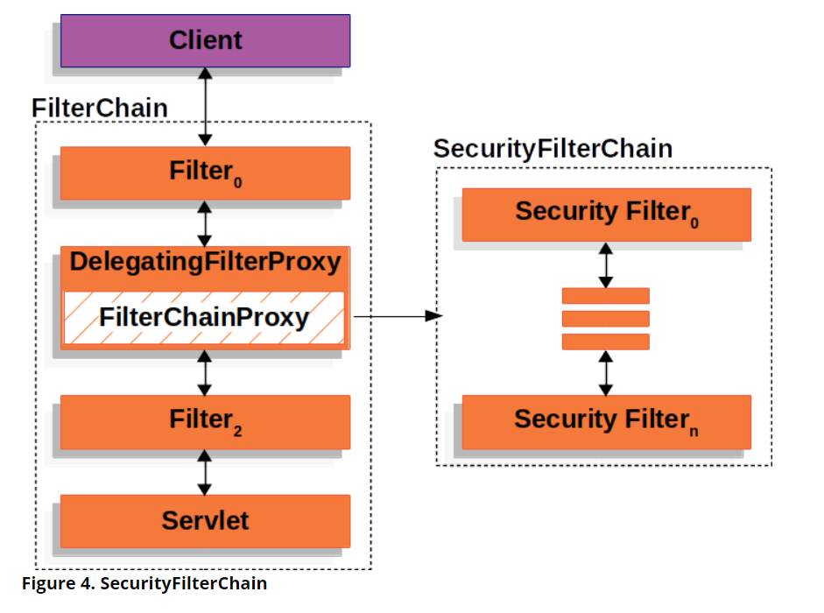
Spring Security Architecture

Slide 6
Spring Security Architecture
DelegatingFilterProxy
  Servlet filter embedded in the spring context.
  It delegates the incoming request to a bunch of filters
FilterChainProxy
  A servlet filter which invokes the relevant filters that would work on the incoming request.
SecurityFilters
  Contains a list of filters that need to be invoked before the controller can handle the request.
  SecurityContextPersistenceFilter, HeaderWriterFilter, CsrfFilter, LogoutFilter, UsernamePasswordAuthenticationFilter etc.
  FilterChainProxy queries this class to invoke each filter in a loop.

Slide 7
Authorizations
permitAll
  No need of any authorization to access current page.
authenticated
  Requires Login(username/password) and no authorization(role based access) is required.
hasAuthority
  Requires that user should have both authentication and role based authorization access.
hasAnyAuthority
  It represents that user should have authentication and multiple role based authorization access.

Slide 8
BCryptPasswordEncoder
An encryption class of Spring Security.
Spring provides a variety of encryption methods for passwords.
The official recommendation is to use BCryptPasswordEncoder, which uses the BCrypt strong hash function.
  @Bean
  PasswordEncoder passwordEncoder() {
  return new BCryptPasswordEncoder();
  }

Slide 9
HttpSecurity
HttpSecurity
  Provides a Method authoriseRequests()
authorizeRequests()
  To Define custom requirements for URLs
  Can add multiple children to this method.
  The matchers are considered in the order they were declared.
  http.authorizeRequests()
  .anyRequest().authenticated()
  .and().httpBasic();

Slide 10
Entity and Repository
  @Entity
  @Table(name = "user")
  public class UserEntity {
  @Id
  @GeneratedValue(strategy = GenerationType.IDENTITY)
  private Long id;
  private String username;
  private String password;
  private String role;
    }
  public interface UserRepository extends JpaRepository<UserEntity ,Long> {
  Optional<UserEntity> findByUsername(String username);
  }

Slide 11
User Details Service
Key Interface used for user authentication.
Has One Method
  UserDetails loadUserByUsername(String username)
UserDetails
  Encapsulates username, password, authorities (roles), and account status (enabled, locked, expired).
Called by AuthenticationProvider to obtain the necessary user information for authentication.
Method should throw a UsernameNotFoundException.

Slide 12
User Details Service
  @Service
  public class UserDetailServiceImpl implements UserDetailsService {
  @AutoWired
  private final UserRepository userRepository;
  public UserDetails loadUserByUsername(String username) throws UsernameNotFoundException {
  UserEntity user = userRepository.findByUsername(username)
  .orElseThrow(() -> new UsernameNotFoundException("User not found"));
  ArrayList<GrantedAuthority> authorites = new ArrayList<>();
  authorites.add(() -> user.getRole());
  return new User(user.getUsername(), user.getPassword(),authorites);
  }
  }
  }
  }

Slide 13
Security Filter chain
  Takes an HttpSecurity object as an argument.
  A builder that can be used configure HTTP security.
  authorizeHttpRequests():
  To configure authorization rules for HTTP requests.
  requestMatchers("/public/": ).permitAll()`**:
    Specifies that any request matching the /public/** pattern
  anyRequest().authenticated():
    Specifies that all other requests (not matching /public/**) require authentication.
permitAll():
  Accessible without requiring authentication.
return http.build():
  Returns the SecurityFilterChain object based on the configured HttpSecurity.

Slide 14
Security Config
  import static org.springframework.security.config.Customizer.withDefaults;
  @Configuration
  @EnableWebSecurity
  public class SecurityConfig {
  private final UserDetailSecurity userDetailsService;
  public SecurityConfig(UserDetailSecurity userDetailsService) {
  this.userDetailsService = userDetailsService;
  }

Slide 15
Security Config
  @Bean
  SecurityFilterChain securityFilterChain(HttpSecurity http) throws Exception {
  http
  .csrf(AbstractHttpConfigurer::disable)
  .authorizeHttpRequests(
  configurer -> configurer
  .requestMatchers("/api/v1/unsecured/**").permitAll()
  .anyRequest().authenticated()).httpBasic(Customizer.withDefaults());
  return http.build();
  }
  }

Slide 16
Method Level Annoation
@EnableMethodSecurity
  Restricting access to specific methods
  To ensure that only authorized users can perform critical operations.
@PreAuthorize("hasRole('ROLE_GUEST’)”)
  Access control is evaluated prior to method invocation.
  It leverages Spring Expression Language (SpEL) expressions
  Dynamically determine access permissions.

Slide 17
CSRF
  Its a web security vulnerability that allows an attacker to induce users to perform actions that they do not intend to perform.
  It allows an attacker to partly circumvent the same origin policy, which is designed to prevent different websites from interfering with each other.
Should be used for protecting any request that could be processed by a browser by normal users.
If a service is used by non-browser clients, CSRF protection can be disabled

Slide 18
Client Application
  WebClient client = ctx.getBean(WebClient.class);
  client.get().uri("http://localhost:8080/")
  .header(HttpHeaders.AUTHORIZATION,
  "Basic " + Base64.getEncoder()
  .encodeToString("ramesh:@3456".getBytes()))
  .retrieve()
  .onStatus(HttpStatusCode::is4xxClientError, clientResponse ->
  Mono.error(new RuntimeException("Exception-Check Credentials")))
  .bodyToFlux(String.class).subscribe(System.out::println);

Slide 19
Json Web Token
A secure way to send information between a client and a server.
It is mainly used in web applications and APIs to verify users and prevent unauthorized access.
A JWT is JSON data secured with a cryptographic signature.
The signing can be done using these cryptographic methods:
  HMAC (Hash-based Message Authentication Code)
  RSA or ECDSA (Asymmetric cryptographic algorithms)

Slide 20
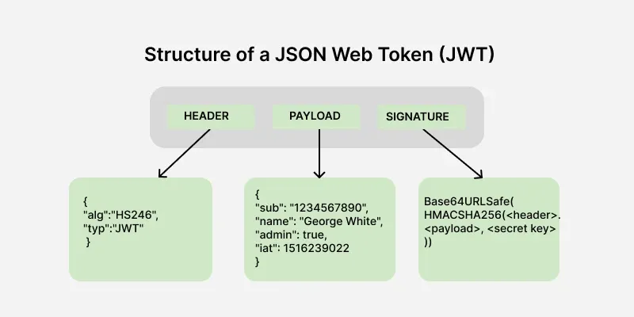

Slide 21
Part of JWT
  Header:
  Contains metadata about the token, such as the algorithm used for signing.
  Payload:
  Stores the claims, i.e., data being transmitted.
  Signature:
  Ensures the token's integrity and authenticity.
  The header contains meta data about the token, including the signing algorithm and token type here metadata means data about data.
  {
  "alg": "HS256",
  "typ": "JWT"
  }
  alg: Algorithm used for signing (e.g., HS256, RS256).
  typ: Token type, always "JWT".

Slide 22
Payload
Information about the user known as a claim
The timestamp at which it was issued and the expiry time of the token.
{
"userId": 123,
"role": "admin",
"exp": 1672531199
}

Slide 23
Signature
To ensures token integrity and is generated using the header, payload, and a secret key.
Using HS256 algorithm
HMACSHA256(
base64UrlEncode(header) + "." + base64UrlEncode(payload),
secret
)

Slide 24
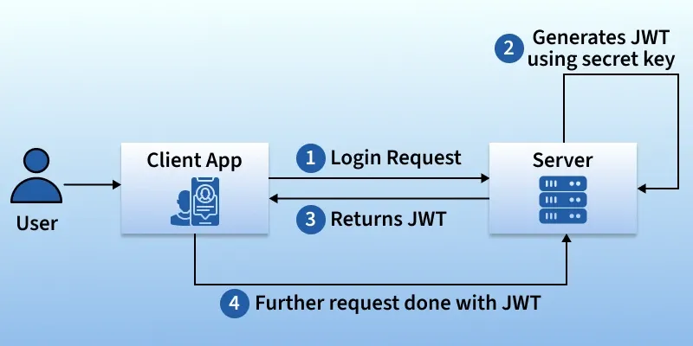

Slide 25
JWT Token
SecretKey :
  A long, random string that acts like a password or digital signature key.
  Used to sign the JWT. Only someone who knows this secret can verify that the token is authentic and hasn't been tampered with.
  It must be kept private and secure.
  private Key getSignInKey() {
  byte[] keyBytes = Decoders.BASE64.decode(SECRET);
  return Keys.hmacShaKeyFor(keyBytes);
  }

Slide 26
JWT Token
  The SECRET string is often encoded in a format called Base64.
  Decoders.BASE64.decode(SECRET) converts the Base64 string back into its raw byte array format.
  Keys.hmacShaKeyFor(keyBytes)
    Create a secure Key object that the JWT library can use to perform the digital signature (HMAC-SHA).

Slide 27
Simple Code To Generate JWT
  @Service
  public class JwtService {
  public static final String SECRET = "at34werthbasdfaestrjr67uywaewrqwegwerytjetgbvawefw46u45ytnbserfgw465u467irythqgergt3465u457ie45yw34tqq23rq23r2";
  public String generateToken(String username) {
    return Jwts.builder().issuer("myorg")
    .subject("srivatsan")
    .claim("name", "trainer srivatsan")
    .claim("scope", "read ,write")
    .signWith(getSignInKey()) .compact();
  }

Slide 28
JWT Creation
  private Key getSignInKey() {
  byte[] keyBytes = Decoders.BASE64.decode(SECRET);
  return Keys.hmacShaKeyFor(keyBytes);
  }
  }
System.out.println(ctx.getBean(JwtService.class).generateToken("ramesh"));

Slide 29
Dependencies
  <dependency>
    <groupId>io.jsonwebtoken</groupId>
    <artifactId>jjwt-api</artifactId>
    <version>0.11.5</version>
  </dependency>
  <dependency>
    <groupId>io.jsonwebtoken</groupId>
    <artifactId>jjwt-impl</artifactId>
    <version>0.11.5</version>
    <scope>runtime</scope>
  </dependency>
  <dependency>
    <groupId>io.jsonwebtoken</groupId>
    <artifactId>jjwt-jackson</artifactId>
    <version>0.11.5</version>
    <scope>runtime</scope>
  </dependency>

Slide 30
JWT Security Config
Client must send token with every request and it gets validated to determine identity and permissions.
sessionManagement(sess -> sess.sessionCreationPolicy(SessionCreationPolicy.STATELESS));
.sessionManagement(...):
  To Configure sessions handling
sess -> sess.sessionCreationPolicy(...):
  Method to set the session creation policy.
SessionCreationPolicy.STATELESS:
  Will not create or use HTTP sessions to store security context

Slide 31
Keys.hmacShaKeyFor
  this.key = Keys.hmacShaKeyFor(secret.getBytes());
To create a cryptographic Key object
Used with HMAC (Hash-based Message Authentication Code)
  HS256 (HMAC using SHA-256)
  HS384 (HMAC using SHA-384)
  HS512 (HMAC using SHA-512)
With secret key as bytes generates a configured Key instance that can be passed to the JWT builder or parser for signing or verifying a JSON Web Token.

Slide 32
Validate JWT Token
  @Value("${jwt.secret}")
  private String secret;
  private Key key;
  @PostConstruct
  public void init(){
  this.key = Keys.hmacShaKeyFor(secret.getBytes());
  }
  private Claims getAllClaimsFromToken(String token) {
  return Jwts.parserBuilder()
  .setSigningKey(key)
  .build()
  .parseClaimsJws(token)
  .getBody();
  }

Slide 33
Validte JWT Token
  public boolean isTokenExpired(String token) {
  return this.getAllClaimsFromToken(token).getExpiration().before(new Date());
  }
  public boolean isTokenValid(String token) {
  try {
  this.getAllClaimsFromToken(token);
  return !isTokenExpired(token);
  } catch (Exception e) {
  return false;
  }
  }
  public String extractUsername(String token) {
  return getAllClaimsFromToken(token).getSubject();
  }

Slide 34
Secret Key
JWT tokens are signed using secret key.
When the client sends the JWT back to the server in subsequent requests, the server uses the same secret key to regenerate the signature.
If the newly generated signature matches the one in the token, the server knows that the token has not been tampered with during transit.
The server doesn't need to store session information because it can verify the token's authenticity with only the token and the secret key.
jwt.secret-key=${JWT_SECRET_KEY}
openssl rand -base64 32

Slide 35
JWT Service
@Service
public class JwtService {
@Value("${jwt.secret-key}")
private String secretString;
private SecretKey getSigningKey() {
return Keys.hmacShaKeyFor(secretString.getBytes(StandardCharsets.UTF_8));
}
}

Slide 36
Configuration-1
  public class AuthConfig {
  @Bean
  PasswordEncoder passwordEncoder() {
  return new BCryptPasswordEncoder();
  }
  @Bean
  AuthenticationManager authenticationManager(AuthenticationConfiguration config) throws Exception {
  return config.getAuthenticationManager();
  }
  }

Slide 37
Security Configuration
  public class SecurityConfig {
  private final JwtAuthenticationFilter jwtAuthFilter;
  private final UserDetailsService userDetailsService;
  private final PasswordEncoder passwordEncoder;
  @Bean
  AuthenticationProvider authenticationProvider() {
  DaoAuthenticationProvider authProvider = new DaoAuthenticationProvider(userDetailsService);
  authProvider.setPasswordEncoder(passwordEncoder);
  return authProvider;
  }

Slide 38
Security Configuration
  @Bean
  SecurityFilterChain securityFilterChain(HttpSecurity http) throws Exception {
  http
  .csrf(csrf -> csrf.disable())
  .authorizeHttpRequests(auth -> auth
  .requestMatchers("/api/v1/auth/**", "/error").permitAll()
  .anyRequest().authenticated()
  )
  .sessionManagement(sess -> sess.sessionCreationPolicy(SessionCreationPolicy.STATELESS))
  .authenticationProvider(authenticationProvider())
  .addFilterBefore(jwtAuthFilter, UsernamePasswordAuthenticationFilter.class);
  return http.build();
  }
  }

Slide 39
Authentication Service
  Service
  @RequiredArgsConstructor
  public class AuthService {
  private final AuthenticationManager authenticationManager;
  private final JwtGeneratorUtil jwtGeneratorUtil;
  public String authenticate(String username, String password) {
  Authentication authentication =
  authenticationManager.authenticate(
  new UsernamePasswordAuthenticationToken(username, password)
  );
  return jwtGeneratorUtil.generateToken(authentication.getName());
  }
  }

Slide 40
UserDetailsService -Implementation
  public class UserServiceImpl implements UserDetailsService {
  private final UserRepository userRepository;
  private final PasswordEncoder passwordEncoder;
  @Override
  public UserDetails loadUserByUsername(String username)
  throws UsernameNotFoundException {
  PortalUser portalUser = userRepository.findByUsername(username)
  .orElseThrow(() ->
  new UsernameNotFoundException("User not found: " + username));
  return User.builder()
  .username(portalUser.getUsername())
  .password(portalUser.getPassword())
  .roles(portalUser.getRole())
  .build();
  }\

Slide 41
UserDetailsService -Implementation
  public boolean existsByUsername(String username) {
  return this.userRepository.existsByUsername(username);
  }
  public boolean existsByEmail(String email) {
  return this.userRepository.existsByEmail(email);
  }
  public PortalUser registerUser(RegistrationRequest request) {
  PortalUser user = new PortalUser();
  user.setUsername(request.username());
  user.setEmail(request.email());
  user.setPassword(passwordEncoder.encode(request.password()));
  user.setRole(request.role());
  return userRepository.save(user);
  }
  }

