Slide 1
java -9 and 10

Slide 2
Local Variable Type Inference
Local variables can be declared with the var identifier
Can help write code that’s easier to read.
Eliminates redundant information.
Could also make code less readable use with proper judgment;
No strict rule exists about when it should and shouldn't be used.
var
Reserved type name, not a keyword
Existing code that uses var as a variable, method, or package name is not affected.
Code that uses var as a class or interface name is affected needs to be renamed.

Slide 3
LVTI - Var
var list = new ArrayList<String>();
var stream = list.stream();
List<String> myList = Arrays.asList("a", "b", "c");
for (var element : myList) {...}
for (var counter = 0; counter < 10; counter++) {...}
try (var input =
new FileInputStream("validation.txt")) {...}
(var a, var b) -> a + b;
(var x, y) -> x.process(y) // NOT ALLOWED var and inferred formal parameters
(var x, int y) -> x.process(y) // Cannot mix var and manifest types

Slide 4
Jshell

Slide 5
Introduction
JShell is a Read-Evaluate-Print-Loop (REPL), a command line tool
Can input specific JShell commands or Java code –(snippets)
Expressions
Statements
Class declarations
Method declarations
Import declarations
Used for interacting quickly with Java from the command line without the need to compile and run.
Can test new coding concepts quickly without the IDE environment

Slide 6
Need for Jshell
Immediate feedback is important when learning a programming language and its APIs.
Try out things with a minimal effort and have immediate feedback.
No need to create a class, add a main method, add lines of code, perhaps add dependencies, compile, and run the code.
Can quickly prototype and experiment with libraries
Find the return type of a method
Format pattern to show the time zone for a date

Slide 7
Starting and Stopping JShell
Running JShell
Jshell [options] [load-files]
Options
Command-line options separated by spaces.
load-files
One or more scripts to run when the tool is started
F:\>jshell
| Welcome to JShell -- Version 9
| For an introduction type: /help intro
Exit the Jshell
/exit
| Goodbye $

Slide 8
Expressions and Scratch Variables
Scratch Variable:
Created when a result of an expression is not assigned to a variable
It stores the output of expression to be used later.
Created by name of $ (eg $1, $2, $3) and so on.
Can be run as a snippet by using /4
JShell won't execute a statement until it knows the statement is completed.
We'll be prompted to continue entering snippets until a valid statement or block is completed
jshell> "Hello World"
$1 ==> "Hello World"

Slide 9
Identifiers
It's not required to use a semicolon for single statements.
Need a semicolon between statements
The use of semicolon (;) is optional at the end of a statement.
int x = 20;
x ==> 20
String hello = $1 hello ==> "Hello World again"
System.out.println(hello) Hello World again
int sum = 1 + 2 ;
System.out.println(sum)

Slide 10
Basic Calculations
jshell> 1+2 $1 ==> 3
jshell> 2+5 $2 ==> 7
jshell> System.out.println("sum of the two scratch variables is:"+($1+$2)) sum of the two scratch variables is:10
jshell> $1+$2 $4 ==> 10
jshell> $2 // we got variable number two!
$2 ==> 5

Slide 11
Defining Function
Can define function also
int doubleThis(int i) { return i*2; }
| created method doubleThis(int)
doubleThis(5)
$7 ==> 10
int getNegativeValue(int number) {
...> return -number;
...> }
| created method getNegativeValue(int)
getNegativeValue(10)
$5 ==> -10

Slide 12
Calling Methods
jshell> Math.random()
Creates a scratch variable
$1 ==> 0.8564017451278595
jshell> $1
$1 ==> 0.8564017451278595

Slide 13
Control Flow
Can use control flows (for, if, while, …).
Done by entering condition, using return for each new line:
jshell> if ("Hello World".equals($1)) {
...> System.out.println(“success");
...> }
// success

Slide 14
Exceptions – Unchecked
Will automatically catches exceptions
Will display information about them
Allows to continue the session
This works for unchecked exceptions:
jshell> 1/0
| java.lang.ArithmeticException thrown: / by zero | at (#24:1)

Slide 15
Exceptions –Checked
Checked exceptions, without wrapping them in a try/catch statement:
jshell> FileInputStream fis = new FileInputStream("nonexistentfile.txt")
| java.io.FileNotFoundException thrown:
nonexistentfile.txt (The system cannot find the file specified) | at FileInputStream.open0 (Native Method) | at FileInputStream.open (FileInputStream.java:196) | at FileInputStream.<init> (FileInputStream.java:139) | at FileInputStream.<init> (FileInputStream.java:94) | at (#25:1)

Slide 16
Creating a Class
Can also declare classes
Modifiers of methods and fields defined inside a class are applied
If the code incomplete then hitting enter will not submit the code but the editing will continue on the next line.
class BonusCalc { ...> private int rate; ...> ...> BonusCalc(int rate) { ...> this.rate = rate; ...> } ...> ...> int calc(int salary) { ...> return salary + (salary * rate) / 100; ...> } ...> }
| created class BonusCalc

Slide 17
Creating Instance
BonusCalc threePercentBonusCalc = new BonusCalc(3);
threePercentBonusCalc ==> BonusCalc@6093dd95
| created variable threePercentBonusCalc : BonusCalc
Using the instance:
threePercentBonusCalc.calc(1500);
$11 ==> 1545
| created scratch variable $11 : int

Slide 18
Forward Referencing
Accepts method definitions that reference methods, variables, or classes that aren’t yet defined.
double volume(double radius) { ...> return 4.0 / 3.0 * PI * cube(radius); ...> }
| created method volume(double), however, it cannot be invoked until variable PI, and method cube(double) are declared
Jshell code is entered and evaluated sequentially,
JShell supports forward references in:
Methods
The type of
Return statements
Parameters
Variables
Doesn't support forward references in variable initializes

Slide 19
Auto Complete
Can use ‘.’ (dot) after the variable and press TAB to get the list all available methods.
Can make JShell auto-complete by typing the beginning of a method and then hit the TAB button.

Slide 20
Declarations Rules
Declarations outside a class or interface are created under the following rules:
Access modifiers (public, protected, and private) are ignored.
All declaration snippets are accessible to all other snippets:
'final' not permitted in top-level declarations, ignored
The modifiers default and synchronized are not allowed:
The modifier abstract is allowed only on classes:

Slide 21
imports
Gives you a list of all the current imported packages.
jshell> /imports
Can import Additional packages
Jshell> import java.time.*;
Now we can use Java Date Time API:
Jshell>LocalTime.now();
Create a Scratch Variable $3 $13 ==> 15:29:25.512759800

Slide 22
Command line
/list
list the source typed
lists by default, all the valid statements
Shows a numeric identifier for each snippet
Can execute again with identifier
/history.
history presents all the statements (valid or not) and commands typed:
- retain
If you want the settings to be the default for future sessions,

Slide 23
Command Line
/vars
List only variables
/methods
To List only Methods
/drop 2
Delete with the /drop command
/drop x will remove the variable named x.

Slide 24
Command Line
‘/edit varname’
popup window appears on screen to edit variable!
For Implicit variables creates another one with the new value:
This doesn't happen with explicitly named variables or types.
‘/edit’
Same screen but, it lists all the variables
/set editor -retain notepad.exe
| Editor set to: notepad.exe
| Editor setting retained: notepad.exe

Slide 25
Saving Files
All the statements typed in Jshell are lost on exit
/save command,
/save <file>.
Save the commands and snippets currently active to the provided file path.
/save -all <file>.
Save all commands and snippets, including overwritten, start-up, and failed commands and snippets to the provided file path.

Slide 26
Saving Files
A script can be created externally in an editor
It can also be generated from items entered in JShell.
Can use import statements and code
/save mysnippets.jsh
To save the current active snippets to mysnippets.jsh.
/save -history myhistory.jsh
To save the history of all of the snippets and commands,
Saves both valid and invalid snippets
/save -start mystartup.jsh
To save the contents of the current startup script setting
The file name provided can be any valid file path and name.

Slide 27
Saving Files
save my-session.txt
A text file named my-session.txt will be saved in the current directory with the following content:
/open my-session.txt
All the statements defined in the text file will be executed:
/open my-session.txt Hello World
/open Book.java

Slide 28
Loading Scripts
Scripts can be loaded from the command line when a JShell session is started:
jshell mysnippets.jsh
Scripts can also be loaded within a JShell session by using the /open command:
/open PRINTING

Slide 29
Feed Back Mode
Can change the feedback mode to a different value
The default feedback mode is normal.
Using the /set feedback command
Available feedback modes: | concise | normal | silent | verbose
default mode is 'normal’
set feedback verbose
Shows that that variable has been modified and overwritten
/set feedback concise
int myvar = 3
/set feedback verbose

Slide 30
Module system

Slide 31
Topics
Introduction to the Java Module Platform System
Motivation and Goals of the Java Platform Module System
What is a Module?
The requires and exports Module Directives
The Modular JDK

Slide 32
Need for Modules
Java has strong support for encapsulation and abstraction.
‘packages‘ are used to group related classes as per business capabilities.
Packages had ‘access modifiers‘ to control what will be visible and what will be hidden to other classes or packages.
Dependencies are declared with ‘import‘ statements; but they are strictly ‘compile time’ constructs.
Once code is compiled, there is no mechanism to clearly state it’s runtime dependencies.
Runtime dependency resolution Need special tools like maven.
Frameworks also started bundling their complete runtime dependencies as in Spring boot

Slide 33
What is a module
A Module is a group of closely related packages and resources along with a module descriptor file.
it’s a “package of Java Packages”
abstraction that allows to make code even more reusable
Packages
Module is a container of packages
Module, is organized with the code internally in packages
Helps in organizing code
Used to determine what code is publicly accessible outside of the module.

Slide 34
Module System
Core highlight of new Java 9 release.
Also known as Project Jigshaw.
Module system has a “java.base” Module.
It’s known as Base Module.
Every application gets java.base
packages java.lang, io, math, net, nio, util, security, text, time
Separate Modules exisit for other packges
Modules are split into some major groups:
java
modules are the implementation classes for the core SE Language Specification.
JDK
Anything needed by the JDK itself is kept in the jdk modules.

Slide 35
Module
Modules are artifacts containing code, with metadata describing the module and also its relation to other modules.
These are recognizable from compile-time all the way through run-time.
Application is a combination of multiple modules
A module represent a specific business capability.
They are self-sufficient for that capability, and should expose only interfaces to use the module functionality.
A Module may be dependent on other modules, which it should declare explicitly to complete its tasks

Slide 36
Module Principle
Strong Encapsulation
Encapsulation means to hide implementation details, which are not essential to know to use the module correctly.
The purpose is that encapsulated code may change freely without affecting users of the module.
Stable Abstraction
Abstraction helps to expose module functionality
Its exposed through interfaces which are public APIs.
When there is change the business logic or implementation inside module code, changes will be transparent to the module users.

Slide 37
Module Principle
Explicit dependencies
Modules can be dependent on other modules
These external dependencies must be part of the module definition itself.
These dependencies between modules are often represented as graphs.
Graph at application level, will give better understanding of the application’s architecture.

Slide 38
Packaging Modules
A module can be packaged as a jar file that has a module-info.class file at the root.
To use a module, Need to include the jar file into modulepath instead of the classpath.
A modular jar file added to classpath is normal jar file and module-info.class file will be ignored.

Slide 39
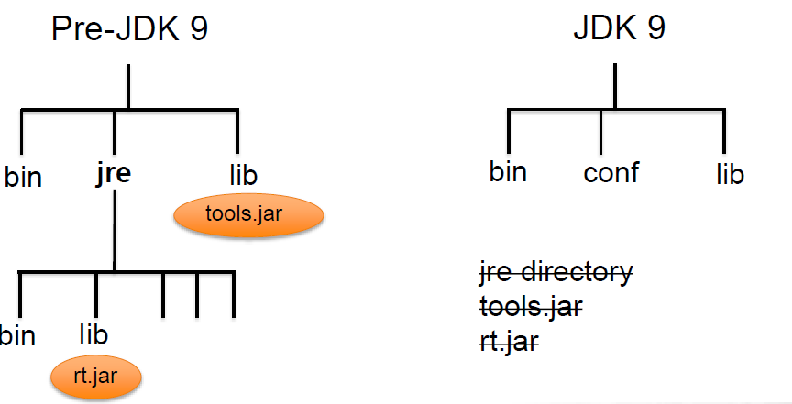
JDK / JRE File Structure

Slide 40
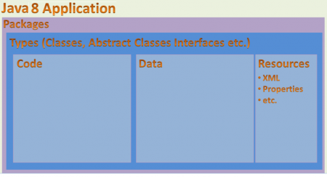
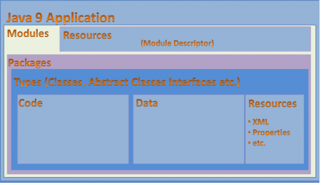
Java 8 and 9 Comparison

Slide 41
Modular JDK
JDK modules always run in module mode
Classpath sees whole JDK
Modules specify which JDK modules they need
Changes JDK structure
no more rt.jar
packaged as .jmod files
no more boot classpath
no more extension classpath
Creating a module
What modules does it depend on
depends on java.base by default
What packages does it export
nothing exported by default

Slide 42
Resources
Each module is responsible for its resources, like media or configuration files.
In Earlier versions all resources are put into the root level of project and manually managed
resources belonged to different parts of the application.
Modules, can ship required images and XML files
Making projects much easier to manage.

Slide 43
Module Types
There are four types of modules in the new module system:
System Modules
They include the Java SE and JDK modules.
Application Modules
Modules that are build by the application developers.
These are named and defined in the compiled module-info.class file
Included in the assembled JAR.
Automatic Modules
Can include unofficial modules by adding existing JAR files to the module path
The name of the module will be derived from the name of the JAR.
Will have full read access to every other module loaded by the path.
Unnamed Module
When a class or JAR is loaded onto the classpath, but not the module path, it’s automatically added to the unnamed module.
It’s a catch-all module to maintain backward compatibility with previously-written Java code.

Slide 44
Module Naming Rules
Similar to naming packages
dots are allowed, dashes are not
Can use project-style (my.module)
Can use Reverse-DNS (com.training.mymodule).
Module names should follow package names
The module name should be the root package:
com.training
Module Name
com.greetings.hello
com.greetings.hello // file system Naming
Package Name
com.greetings.hello
com/greetings/hello // file system naming

Slide 45
Distribution
Can be distributed one of two ways: as a JAR file or as an “exploded” compiled project.
Can create multi-module projects comprised of a “main application” and several library modules.
Can have only one module per JAR file.
Need to make sure to bundle each module in project as a separate jar.

Slide 46
Module Descriptor
A module includes a descriptor file
Has several aspects defined in it:
Name
The name of the module
Dependencies
A list of other modules that this module depends on
Public Packages
A list of all packages to be accessible from outside the module
Services Offered
Can provide service implementations that can be consumed by other modules
Services Consumed
Allows the current module to be a consumer of a service
Reflection Permissions
Explicitly allows other classes to use reflection to access the private members of a package

Slide 47
module-info.java.
Module Descriptor file contains Module Directive with following information
Requires
Exports
provides…with
uses and opens
Module declaration begins with the keyword module
Followed by a unique module name and a module body enclosed in braces
Body can also be empty
module modulename { }

Slide 48
Requires
requires modulename;
specifies that the module depends on another module
required module is needed at compile and run time.
Modules in JDK are searched then module in module path
Throws an error if it doesn't find the module.
module com.training.base {
requires java.sql;
}

Slide 49
Exports
By default, a module doesn’t expose any of its API to other modules.
directive to expose all public members and their nested public and protected types
The strong encapsulation ,Code is significantly more secure,
Need to explicitly open the API to make it usable.
module my.module {
exports com.my.package.name;
}
Calling requires my.module, will have access to the public types in com.my.package.name package,

Slide 50
Quick Start Project – First Example
package com.training;
import java.util.ArrayList;
public class FirstExample {
public static void main(String[] args) {
System.out.println("Hello World from Module");
ArrayList<String> list = new ArrayList<>();
list.add("ramesh");
System.out.println(list);
}
}

Slide 51
Quick Start Project –Show Details
Class is in a Different Package
package org.exercise;
public class ShowDetails {
public double show() {
return 52.25;
}
}
module.info.java
module com.training.base {
exports com.training;
}

Slide 52
FristExample-Client Project
package com.training.client;
//import org.exercise.ShowDetails;
import com.training.FirstExample;
public class Example {
public static void main(String[] args) {
try {
String arr[] = {"a", "b" ,"c"};
FirstExample.main(arr);
//ShowDetails obj = new ShowDetails();
// System.out.println(obj.show());
} catch (Exception e) {
e.printStackTrace();
} } }

Slide 53
Client – module-info.java
module com.training.client {
requires com.training.base;
}

Slide 54
Exports … To
Opens up public classes
But can restrict which modules have access to the APIs
Effectively a kind of "friend" access
To specify in a comma-separated list precisely which module’s or modules’ code can access the exported package
module my.module {
exports my.package to other.module, another.module;
}

Slide 55
Exports to
package com.training.one;
public class FirstExample {
public static void show() {
System.out.println("Inside Module One");
}
}
module com.training.reqstatic.one {
exports com.training.one to com.training.reqstatic.two;
}

Slide 56
Requires
package com.training.two;
import com.training.one.*;
public class ExampleTwo {
public double getDiscount() {
FirstExample.show();
return 10;
}
module com.training.reqstatic.two {
requires com.training.reqstatic.one;
}

Slide 57
exports
public static void main(String[] args) {
ExampleTwo two = new ExampleTwo();
System.out.println(two.getDiscount());
}
}

Slide 58
Visibility
A lot of libraries depend on reflection to work their magic
Junit ,Spring
By default in Java 9, gives access to public classes, methods, and fields in exported packages.
By Using reflection also can not access non-public members
open, opens, and opens…to options are used to grant access for reflection during runtime

Slide 59
Opens
Before Java 9, it was possible to use reflection to examine every type and member in a package, even the private ones.
Nothing was truly encapsulated, which can open up all kinds of problems for developers of the libraries.
Java 9 enforces strong encapsulation, Can explicitly grant permission for other modules to reflect our classes.

Slide 60
Opens
To allow full reflection open the package up to all other modules
module my.module {
opens com.my.package;
}
Opens … To
Can selectively open our packages to a pre-approved list of modules, in this case, using the opens…to directive:
module my.module {
opens com.my.package to moduleOne, moduleTwo, etc.;
}

Slide 61
Open Example
package org.reflect.client;
public class MyObject {
private int anInt;
private String aString;
public MyObject(int anInt, String aString) {
this.anInt = anInt;
this.aString = aString;
}
}
module org.refl.client {
opens org.reflect.client to org.reflection ;
requires org.reflection;
}

Slide 62
Open Example
package org.reflect.client;
import java.util.*;
import com.training.utils.*;
public class Application {
public static void main(String[] args) {
MyObject obj = new MyObject(4, "test string");
Map<String, Object> map;
try {
map = PropsUtil.getProperties(obj);
System.out.println(map);
} catch (IllegalAccessException e) {
e.printStackTrace();
}
}
}

Slide 63
Props Util
package com.training.utils;
import java.util.*;
import java.lang.reflect.*;
public class PropsUtil {
public static Map<String, Object> getProperties(Object object) throws IllegalAccessException {
Class<?> theClass = object.getClass();
Field[] declaredFields = theClass.getDeclaredFields();
Map<String, Object> fieldsMap = new HashMap<>();
for (Field declaredField : declaredFields) {
declaredField.setAccessible(true);
Object o = declaredField.get(object);
fieldsMap.put(declaredField.getName(), o);
}
return fieldsMap;
}
}

Slide 64
Opens
module org.reflection {
exports com.training.utils;
}

Slide 65
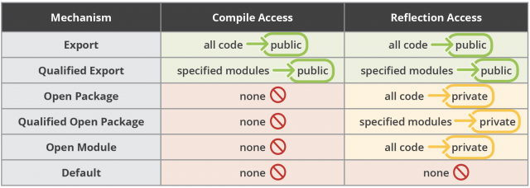
Summary

Slide 66
takeWhile
Takes all the values until the predicate returns false.
It returns a stream consisting of the longest prefix of elements taken from this stream matching the given predicate.
Stream.of("a","b","c","","e","f").takeWhile(s->!s.isEmpty()) .forEach(System.out::print);
Print abc
Takes all a, b, and c values, then once string is empty
Stopped executing.

Slide 67
Drop While
dropWhile(Predicate Interface)
Throw away all the values at the start until the predicate returns true.
In case of ordered stream, a stream consisting of the remaining elements of this stream after dropping the longest prefix of elements matching the given predicate.

Slide 68
Drop While
Drops a,b and c values, then once string is empty, it takes all the values.
Stream.of("a","b","c","","e","f").dropWhile(s-> !s.isEmpty()) .forEach(System.out::print); System.out.println();
Output => ef ef

Slide 69
Iterate
iterate(T seed, Predicate<? super T> hasNext, UnaryOperator<T> next)
Got hasNext with predicate as parameter which stops the loop once hasNext predicate returns false.
IntStream.iterate(3, x -> x < 10, x -> x+3).forEach(System.out::println);
}
Prints 3,6,9

Slide 70
ofNullable
static <T> Stream<T> ofNullable(T t)
Used to prevent NullPointerExceptions and to avoid null checks for streams.
returns a sequential Stream containing single element, if non-null, otherwise returns an empty Stream.
long count = Stream.ofNullable(100).count(); System.out.println(count);
count = Stream.ofNullable(null).count(); System.out.println(count);

