Slide 1
Azure App Services
Fully managed Platform as a Service (PaaS) for hosting web apps, APIs, and mobile backends.
It is language-agnostic and supports various languages, including Java, .NET, Node.js, and Python.
  Server management, Scaling, Security and operations are taken care by Azure ,
It also supports
  CI/CD integration
  Custom domains
  SSL
  Autoscaling
  Staging environments

Slide 2
Azure Container Instances (ACI)
Can execute programs in containers using Azure Container Instances without having to build servers or other infrastructure.
Best for: Short-lived tasks, background jobs, quick container deployment
A application to handle PDFs uploaded by users.
On-demand container spinning, file processing, and automated shutdown are all possible with ACI.

Slide 3
Azure Container Apps
Used to work with several microservices, or tiny apps, that scale on their own according to demand.
Used for creating adaptable, event-driven systems without having to handle intricate infrastructure.
Best for: Microservices, event-driven apps, background processing
A microservices design, in which each service manages a distinct task—like inventory control, payment processing, or shipping updates—is frequently used in modern systems.
Each microservice may be set up in its own container using Azure Container Apps, allowing for autonomous lifecycle management and scaling.

Slide 4
Azure Kubernetes Service (AKS)
Azure Kubernetes Service to have a complete control over the operation and management of several containers across numerous computers.
Large, intricate programs that require great speed, scalability, and customization are best suited for the program.
Best for: Complex, large-scale containerized applications
AKS provides enterprise-grade orchestration for containers with complete control over configuration and scaling. Features include:
  Ingress controllers
  Helm charts
  Azure DevOps pipelines
  Full Kubernetes API access

Slide 5
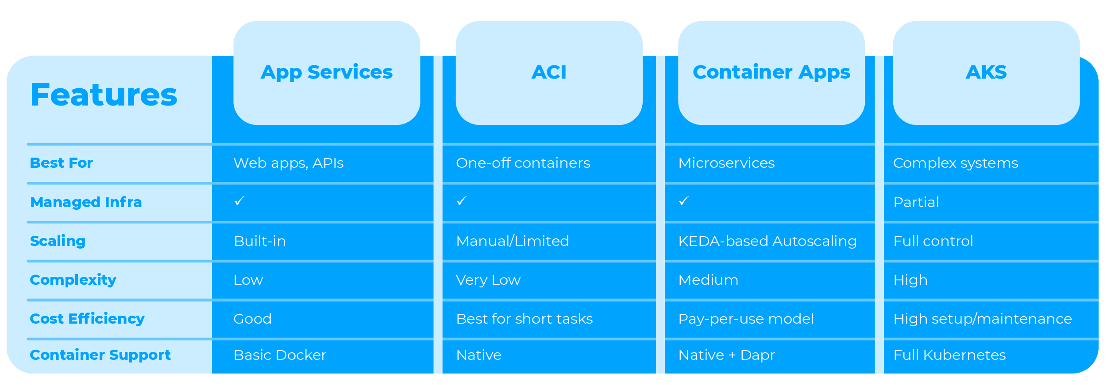
Comparison

Slide 6
Azure Web App
Maven Plugin for Azure App Service
  Automates the Process to create and deploy a Spring Boot application to an Azure Web App
Prepare Your Spring Boot Application
  mvn clean package
  java -jar target/<your-app-name>-*.jar
  mvn com.microsoft.azure:azure-webapp-maven-plugin:2.14.1:config

Slide 7
Azure Webapp Plugin
  Add this entries to pom.xml and invoke the maven goal
  <build>
  <plugins>
  <plugin>
  <groupId>com.microsoft.azure</groupId>
  <artifactId>>azure-webapp-maven-plugin</artifactId>
  <version>2.14.1</version>
  </plugin>
  </plugins>
  </build>
  azure-webapp:config

Slide 8
pom.xml
  Update the following properties in the generated content , as per the requirements
  <resourceGroup>myrg</resourceGroup>
  <appName>dockerize-spring-app-1770025294212</appName>
  <pricingTier>F1</pricingTier>
  <region>southindia</region>
  <runtime>
  <os>Linux</os>
  <javaVersion>Java 17</javaVersion>
  <webContainer>Java SE</webContainer>
  </runtime>
mvn clean package
mvn azure-webapp:deploy
Visit the azure portal and access resource group and web app and invoke the endpoint using default domain

Slide 9
Push a Docker Image
Azure Container Apps supports images built for the linux/amd64 (x86-64) architecture.
  In Apple Silicon (M1/M2/M3), Docker defaults to creating a linux/arm64 image,
  docker build --platform linux/amd64 -t vatsank/springrest:1.0 .

Slide 10
Common Deployment Sources in Azure:
Azure Container Registry (ACR):
  Ideal for private, production-grade deployments with robust security and management features.
Docker Hub:
  Suitable for both public and private images. For private images, you'll need to provide credentials to Azure services like App Service or ACI.
Other Private Registries:
  You can use other third-party container registries by specifying the login server, username, and password during deployment configuration.
Quickstart Images:
  For testing purposes, Azure services often provide quickstart images (e.g., mcr.microsoft.com/azuredocs/aci-helloworld) which are publicly available.
  ACR is considered a best practice for production and private container image management within the Azure ecosystem.

Slide 11
Azure CLI
Cross-platform command-line tool to connect to Azure and execute administrative commands
  Fast, efficient way to manage cloud resources
  Used for repetitive or automated tasks.
brew install azure-cli
On successful installation
  az version
  az login

Slide 12
Azure Container Registry
docker build --platform linux/amd64 -t vatsank/springrest:1.0 .
az acr login --name myuniqueregistry
docker build -t spring-boot-app .
docker tag spring-boot-app myuniqueregistry.azurecr.io/spring-boot-app:v1
docker push myuniqueregistry.azurecr.io/spring-boot-app:v1
az acr repository list --name myuniqueregistry --output table
az acr repository list –name vatsandemoreg –output table

Slide 13
Azure Container Repository vs Docker Registry
ACR is a private registry for managing proprietary container images, whereas Docker Hub is primarily for public sharing even though it supports private images
ACR offers enhanced security features like Azure role-based access control (Azure RBAC), geo-replication, and seamless integration with other Azure services like Azure Kubernetes Service (AKS), Azure Container Instances (ACI), and Azure DevOps.
Keeping registry network-close to your container deployment in the same Azure region can reduce latency and network egress fees.
Using a private, managed registry like ACR avoids potential issues with public registry rate limits and external network dependencies, ensuring more reliable deployments.

Slide 14
Azure Container Registry
Can deploy and connect to an Azure App Service, two ways
  Azure Portal or the Azure CLI.
In the Azure Portal select Create a Resource > Web App.
Basics: Choose subscription and resource group.
Select Container as the publish option and Linux as the OS.
Container Tab:
  Image Source: Select Azure Container Registry.
  Registry Details: Select your registry from the dropdown.
Review + Create

Slide 15
Azure API Management
A Platform-as-a-Service (PaaS) offering from Microsoft t
  Can publish, secure, transform, maintain, and monitor APIs.
A façade between API consumers and back-end services, centralizing the management of the entire API lifecycle cloud environments.
API Gateway:
  Single entry point for all API calls.
  It intercepts incoming requests, enforces policies (like authentication, rate limits, and caching)
  Routes requests to the appropriate back-end services, and emits metrics and logs for monitoring.
  Managed by Azure

Slide 16
Azure API Management
Management Plane:
  The administrative interface
  Used in Azure portal, CLI, PowerShel
  API configurations , API settings, policies, and get analytics insights.
Developer Portal:
  An automatically generated, customizable website that serves as the main presence for developers.
  Discover available APIs, view documentation, subscribe to products to get API keys, and test APIs via an interactive console.

Slide 17
API Gateways vs Application Gateways
An API Gateway manages the full lifecycle and exposure of APIs to developers, handling tasks like authentication, rate limiting, and documentation,
Application Gateway is primarily a Layer 7 load balancer with a Web Application Firewall (WAF) for general web traffic security and distribution.
API Gateway
  To expose backend services as managed, versioned APIs to internal or external developers.
  It is ideal for microservices architectures, enabling consistent policy enforcement, detailed analytics, and partner onboarding.
Use an Application Gateway
  To provide high-performance load balancing and robust security for general web applications.

Slide 18
API Policies
API policies
  Define the rules and guidelines for how APIs are designed, secured, and managed,
  Provide structure and control across the API lifecycle.
API versioning
  Process of handling and communicating changes to an API over time without disrupting existing users.
  Ensures stability and predictability as an API evolves.

Slide 19
Developer Portal
A centralized hub for API documentation, testing, and performance monitoring, allowing developers to track usage patterns, error rates (e.g., 500 errors), and latency.
These portals improve developer experience by offering interactive dashboards, API key management, and insights into API adoption.
IBM API Connect
Kong Konnect
Azure API Management

Slide 20
API Composition Pattern
Used to aggregate responses from multiple microservices into a single API endpoint.
The API Composition Pattern creates intermediary layer that orchestrates calls to the relevant microservices, compiles their responses, and presents a unified response to the client.
This pattern can be implemented using a dedicated API gateway or a composition service that fetches data asynchronously, ensuring that the client receives all necessary information in one call.

Slide 21
API Composition
Client Request:
Request Parsing:
Service Calls: The composition layer makes calls to the relevant microservices. These calls can be done in parallel or sequentially, depending on the dependencies between the services and the design of the composition layer.
Data Aggregation: .
Response Formatting:
Return Response:
Caching:
Security and Monitoring: Can enforce security protocols (like authentication and authorization) and monitor requests for performance metrics, enabling centralized control over these aspects.

