Slide 1
Kubernetes

Slide 2
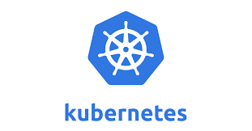
Kubernetes
An open-source system for automating deployment, scaling, and management of containerized applications.
It's Greek for Helmsman, the person who steers the ship.
  It is written in Go-language and Released by 2015
Also called K8s
  K ubernete s, 8 characters in the middle are removed.

Slide 3
Orchestration
Containers can create repeatable environments
  Dev, staging, and prod all looked and functioned the same way.
  They are light-weight ,drew resources from the host operating system.
Larger systems might consist many containers
  Managing, scheduling , load balancing and distribution are a challenge to look into
Kubernetes does the Orchestration of all the container instances.

Slide 4
Need for K8
Developers expect to deploy new versions of applications several times a day.
Containerization helps package software enabling applications to be released and updated without downtime.
Kubernetes helps to make sure the containerized applications run and helps them find the resources and tools they need to work.
Used by many companies including Google, Amazon

Slide 5
Kubernetes Clusters
Works with a cluster of computers that are connected to work as a single unit.
  Helps to deploy containerized applications to a cluster without tying them specifically to individual machines.
The applications needs to be containerized.
  Hence its decoupled from individual hosts
Kubernetes automates the distribution and scheduling of application containers across a cluster in a more efficient way.
A Kubernetes cluster consists of two types of resources:
  The Control Plane coordinates the cluster
  Nodes are the workers that run applications

Slide 6
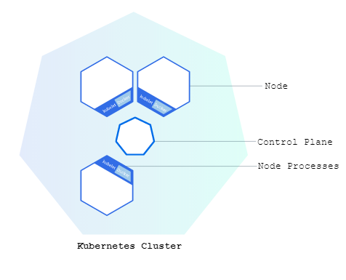
Kubernetes Clusters

Slide 7
Kubernetes Clusters
Control Plane
  Responsible for managing the cluster and Nodes
  Coordinates scheduling applications, maintaining applications' desired state, scaling applications, and rolling out new updates.
Node
  Its VM or a physical computer that serves as a worker machine in a Kubernetes cluster.
  Each node has a Kubelet, which is an agent for managing the node and communicating with the Kubernetes control plane.
  The node has tools for handling container operations, such as Docker.

Slide 8
Kubernetes Clusters
A Kubernetes cluster can be deployed on either physical or virtual machines.
The following command is used to get cluster information
kubectl cluster-info
kubectl get nodes

Slide 9
Kubernetes Deployments
Containerized Applications can be deployed on a running Kubernetes cluster
  The Deployment instructs Kubernetes how to create and update instances of application.
  Deployment Controller continuously monitors those instances.
Self Healing
  If the Node hosting an instance goes down or is deleted, the Deployment controller replaces the instance with an instance on another Node in the cluster.

Slide 10
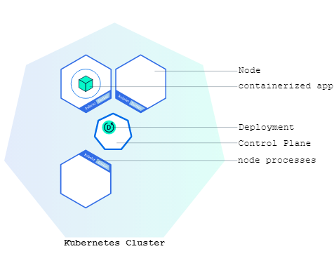
Deploying Application

Slide 11
kubectl
A command line program to interact with Clusters
  Also used to deploy and manage applications on Clusters.
Check installation of kubectl
  kubectl version

Slide 12
Deployments
Deployment:
  Done by specifying a container image of the application
    Applications need to be packaged into container format to be deployed on Kubernetes
kubectl create deployment
  kubectl create deployment kubernetes-bootcamp –image
  =gcr.io/google-samples/kubernetes-bootcamp:v1
Will Search for a node to run the application and schedule the application to run on that node. Will also configure the cluster
kubectl get deployments
  To list deployments

Slide 13
Kubernetes Pods
Pod represents a group of one or more application containers
  Example : Docker
  It also has some shared resources for those containers.
Share Resource are :
  Shared storage, as Volumes
  Networking, as a unique cluster IP address
  Information about how to run each container, such as the container image version or specific ports to use
  In case of a Node failure, identical Pods are scheduled on other available Nodes in the cluster.

Slide 14
Pods
A pod’s life-cycle has 3 stages:
Pending → Running → Succeeded/Failed
If a Pod died without completing his task, a new Pod will be created to replace the dead Pod.
The new pod’s IP and all other factors will be different from old one

Slide 15
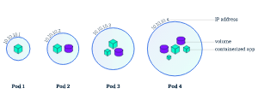
Pods

Slide 16
Nodes
Node
  Worker machine may be either a virtual or a physical machine
  A Pod always runs on a Node
  Node can have multiple pods
Kubernetes Node runs the following:
Kubelet:
  Process responsible for communication between the Kubernetes control plane and the Node;
  Manages the Pods and the containers running on a machine.
A container runtime (Docker)
  Responsible for pulling the container image from a registry, unpacking the container, and running the application.

Slide 17
kubectl
kubectl commands:
kubectl get
  Kubectl get deployments
    list resources
kubectl describe
  kubectl describe pods
    show detailed information about a resource
kubectl logs
  Kubectl logs k8s-training-57978f5f5d-xfk4n
    print the logs from a container in a pod

Slide 18
Service
Services have own IP address and DNS which are stable.
  They are High-level stable abstract point for multiple pods.
Service discover Pods by labels
  Pods belong to a Service via labels.
  It will append its endpoint list and add the pod to the list.

Slide 19
Services
The Services will Receive a Request
  They then forward the request to a pod
  Uses Round-Robin or Random method for forwarding to pod.
  Will use only healthy pods, will do load balancing, roll-back of versions, etc.
  Service decouples System components.

Slide 20
Types of Services
ClusterIP:
  Exposes the service on a cluster-internal IP.
  Makes the service only reachable from within the cluster.
  This is the default ServiceType.
NodePort:
  Exposes the service on each Node’s IP at a static port called as NodePort
  A ClusterIP service, to which the NodePort service will route, is automatically created.
  Can contact the NodePort service, from outside the cluster, by requesting <NodeIP>:<NodePort>.

Slide 21
Types of Services
LoadBalancer:
  Exposes the service externally using a cloud provider’s load balancer.
  NodePort and ClusterIP services,are automatically created.
Service Discovery
  They are exposed to the outside world using the expose command

Slide 22
Deploy Service Using kubectl
create a spring-boot starter project => server.port =3535
  Add a finalName to pom.xml
  Test the application by invoking http://localhost:3535/<path>
  Add a Docker File in the contextPath: Dockerfile
  mvn clean package
Dockerizing
  Create a repository in dockerhub -> vatsank/driver-service
  docker build --tag vatsank/driver-service:1.0 .
  docker run -it -p:2025:3535 vatsank/driver-service:1.0
  docker push vatsank/driver-service:1.0

Slide 23
Create a Deployment
Deployments are the recommended way to manage the creation and scaling of Pods.
  Created with kubectl command
  kubectl create deployment NAME --image=image -- [COMMAND] [args...]
  kubectl create deployment student-depo --image=vatsank/student-service:1.0 --replicas=3
The Pod runs a Container based on the provided Docker image.
View the Deployment:
  kubectl get deployments

Slide 24
Deploy Service Using kubectl
docker build --tag vatsank/payment-service:1.0 .
docker push vatsank/payment-service
note
  kubectl get deployments
kubectl expose deployment personal-expenses --type=LoadBalancer --name=payment-service --port=2020
  kubectl get services
Curl –v http://localhost:2020/payments

Slide 25
Node Port
kubectl create deployment teacher-demo2 --image=vatsank/professor-service:1.0 --replicas=3
kubectl expose deployment teacher-demo2 --type=NodePort --name=prof-service --port=5050
kubectl get svc
Note the External IP and port number
curl -v http://localhost:30892/api/v1/teachers

Slide 26
Kubectl Commands
kubectl get nodes
  kubectl get pods
  kubectl get services –o wide
  kubectl get deployments
kubectl describe pod
kubectl delete service hello-node
  kubectl delete deployment hello-node
kubectl scale deployment userapi --replicas=2

Slide 27
Spring Boot Client
Create a Spring Boot Starter Project with following Modules
  spring-boot-starter-web
  spring-cloud-starter
Additionally Update the pom.xml file with following Modules
  <dependency>
  <groupId>org.springframework.cloud</groupId>
  <artifactId>spring-cloud-starter-kubernetes</artifactId>
  <version>1.1.10.RELEASE</version>
  </dependency>

Slide 28
Discovery Client
  @SpringBootApplication
  @EnableDiscoveryClient
  public class ClientForKubeServiceApplication {
  public static void main(String[] args) {
  SpringApplication.run(ClientForKubeServiceApplication.class, args);
  }
  @Bean
  public RestTemplate restTemplate() {
  return new RestTemplate();
  }
  }

Slide 29
Client Controller
  private final WebClient webClient = WebClient.create("http://52.140.56.101");
  public void getHotelHeaders() {
  webClient.get()
  .uri("/api/v1/hotels")
  .retrieve()
  .subscribe(response -> {
  System.out.println("Status Code: " + response.getStatusCode());
  });
  }

Slide 30
Deployment
Responsible for managing the lifecycle of application's Pods
  Defines a desired state for application, and the Kubernetes controller ensures that the actual state matches that desire.
It guarantees a specified number of replica Pods are always running
  If a Pod crashes or a Node fails, the Deployment controller automatically replaces it.
  To scale the number of application replicas up or down, manually or automatically.
It ensures running and managing application workloads reliably.

Slide 31
Deployment With File
Deployment can also be done with file configurations
apiVersion
  Which version of the Kubernetes API you're using to create this object
kind
  What kind of object you want to create
metadata
  Data that helps uniquely identify the object, including a name string, UID, and optional namespace
spec
  The state desired for the object

Slide 32
Deployment With File
selector
  specifies that as the matchLabels.
  spec.selector.matchLabels must match the spec.template.metadata.labels.
replicas
  The Number of pods to be created,
selector
  The One which the controller will select the targeted pods.
label
  is used to select the necessary pods using the matchLabels field.
template
  Actual template for the pod.
  Metadata that each pod will have with the specs

Slide 33
deployment.yaml
  apiVersion: apps/v1
  kind: Deployment
  metadata:
  name: teacher-k8s
  spec:
  selector:
  matchLabels:
  app: teacher-k8s
  replicas: 2

Slide 34
Deployment.yaml
  template:
  metadata:
  labels:
  app: teacher-k8s
  spec:
  containers:
  - name: teacher-service
  image: vatsank/teacher-service:2.0
  imagePullPolicy: IfNotPresent
  ports:
  - containerPort: 6065
  kubectl apply -f deployment.yaml

Slide 35
Service
A Servicedefines a logical set of Pods and a consistent policy for accessing them.
Pods can be created and destroyed, and their IP addresses change frequently.
A Service solves this problem by providing a stable, persistent IP address and DNS name.
It automatically load-balances incoming network requests across all the healthy Pods that match its defined label selector.
Other components within the cluster can easily discover and communicate with the application using the Service's stable DNS name.
Service is networking and exposing application via a stable entry point.

Slide 36
Service.yaml
  apiVersion: v1
  kind: Service
  metadata:
  name: my-service
  spec:
  selector:
  app: teacher-k8s
  ports:
  - protocol: "TCP"
  port: 7070
  targetPort:
  type: LoadBalancer

Slide 37
Resource Specificity
For a Pod
  Spec defines the containers to run, the images to use, ports to expose, volumes, and restart policies.
For a Deployment
  Spec defines the number of replicas , the selector to find the pods it manages, and a template which contains the pod's own specification
For a Service
  Spec defines how to expose the application to the network, including the selector to match pods, ports, and the type of service

Slide 38
Kompose
brew install kompose
kompose convert -f compose.yaml
  By default it creates separate yaml file for each resource service,deployment etc.,
  To get to single consolidated output file use –o option
  kompose convert -f docker-compose.yaml -o output.yaml
kubectl apply -f . Note the dot applies all the file
Kubectl apply –f output.yaml

Slide 39
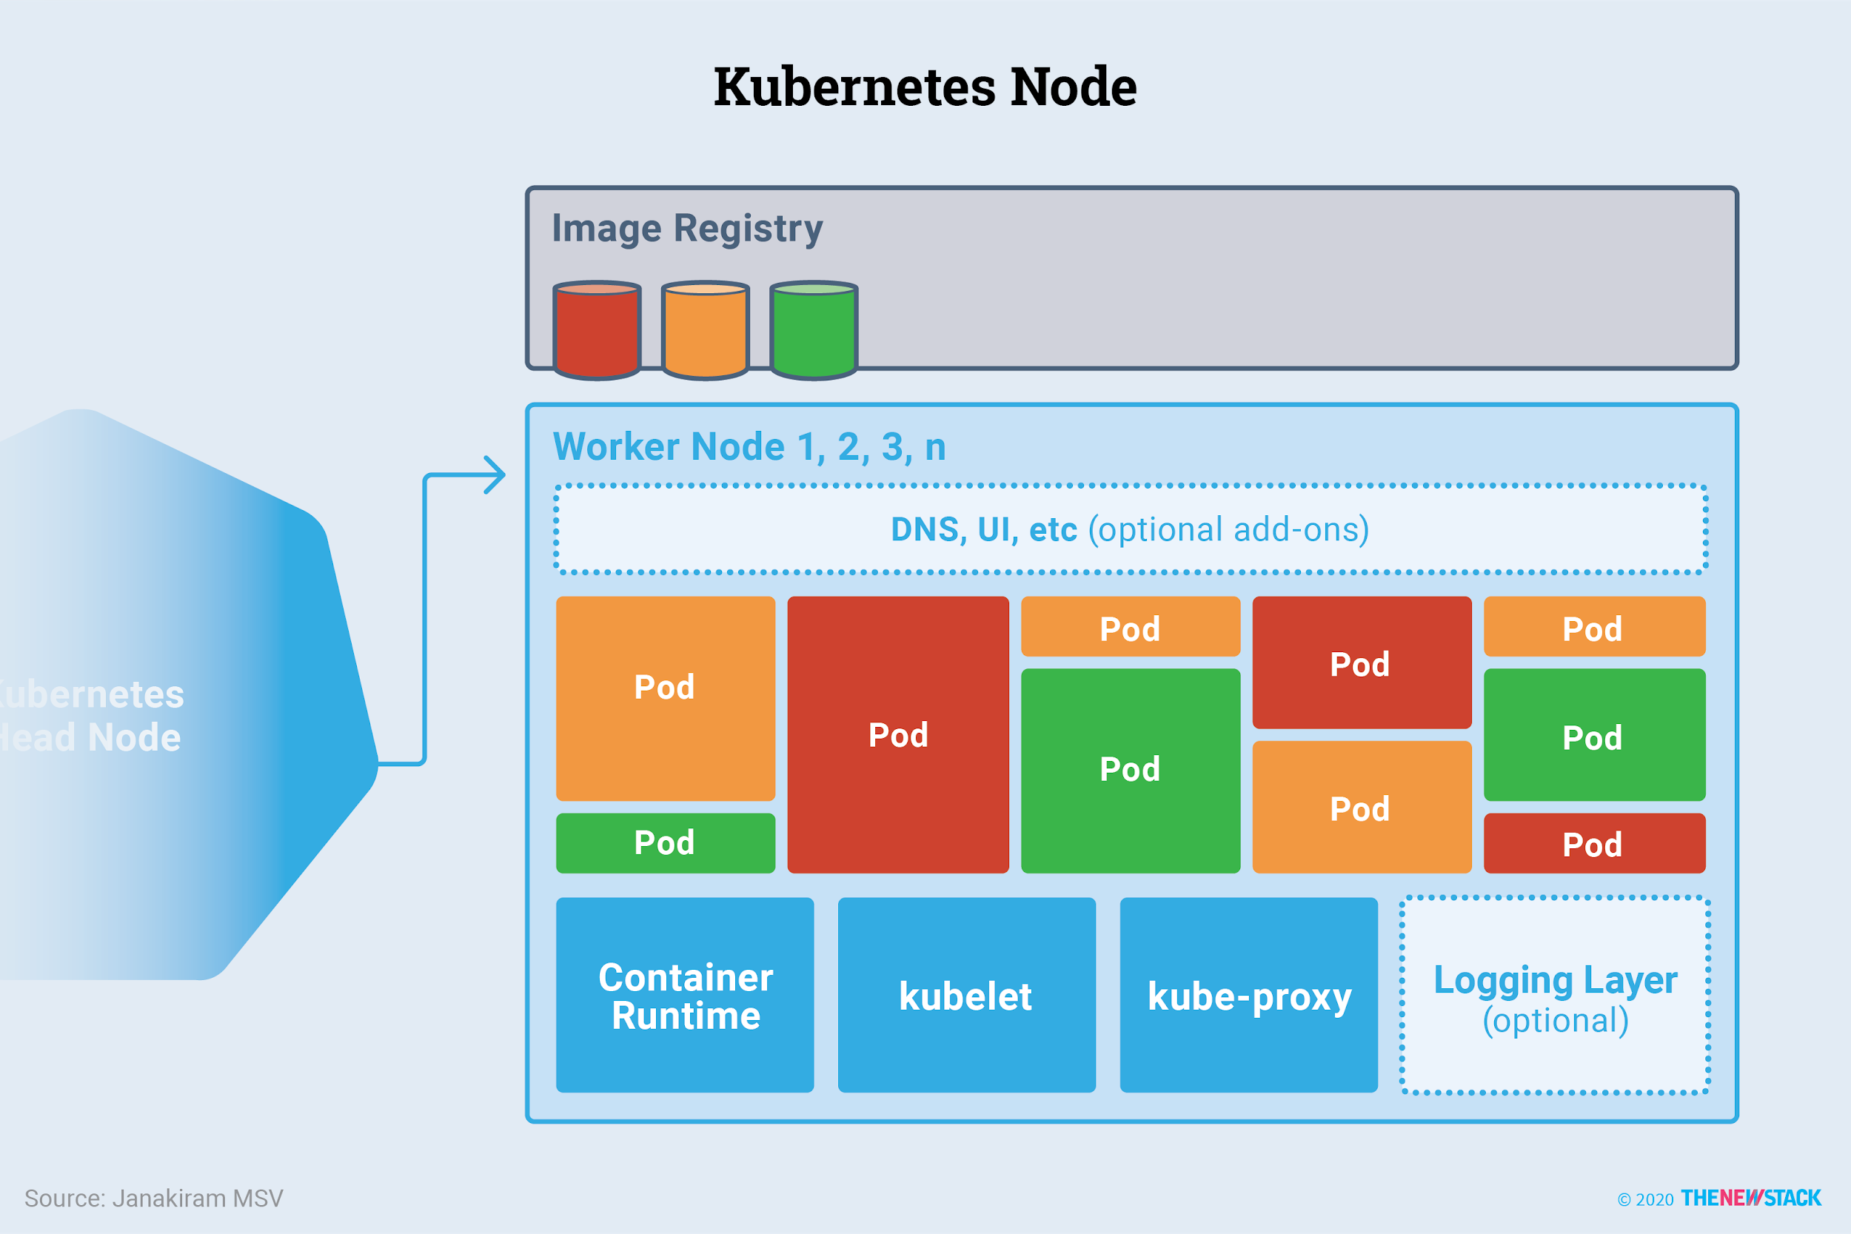

Slide 40
Kubernetes –Node Port
kubectl apply -f deployment.yml
kubectl get deployments
Kubectl get pods
kubectl logs <podname>spring-boot-k8s-56d8869685-864cx
kubectl apply -f service.yml
Kubectl get services
Minikube service list
minikube service springboot-k8s-svc –url
http://url/endpoint
kubectl logs deployment/springboot-crud-deployment

