Slide 1


Slide 2
INTRODUCTION TO MICRO SERVICES

Slide 3
Micro Services
Problems with Monolithic Application
What is Microservices
Advantages and disadvantages
When not to use Microservice
Use case for MicroServices

Slide 4
Monolith Application
A monolithic application is a single-tiered software application
  Has user interface and data access code combined into a single program from a single platform.
Its characteristics
  Doesn’t have Module but Modularized using object-based approach to be distributed across multiple computers
  Deployed together as a single deployment unit- EAR or WAR.
  Long Release Cycles
  Large Teams

Slide 5
Challenges to Monolith
  Large codebases become mess over the time
  Multiple teams working on single codebase become tedious
  Difficulty in Adapting to Device Explosion
  Scaling up certain parts of the application
  Technology updates/rewrites become complex and expensive tasks

Slide 6
Micro Services
An engineering approach focused on decomposing applications with well-defined interfaces - service contracts such as a JSON schema or WSDL
  Deployed independently as services and operated by small teams who own the entire lifecycle of the service.
  Each service handles a specific business domain (logging, auth, orders, customers)
  Each Service provides the implementation for user interface, business logic, and connection to database.
  Each Service can be scaled up Individually

Slide 7
Micro Service
  class UserApp() {
  User getUser() {
  // 1. auth user
  // 2. get user data
  // 3. log user actions
  }
  }
  class UserApp() {
  void authUser(User user) { ... }
  User getUserData() { ... }
  void logUserActions() { ... }
  }

Slide 8
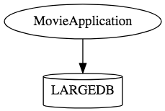
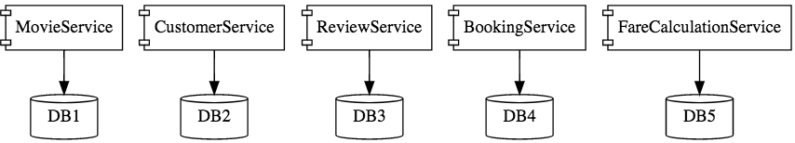
Micro Services

Slide 9
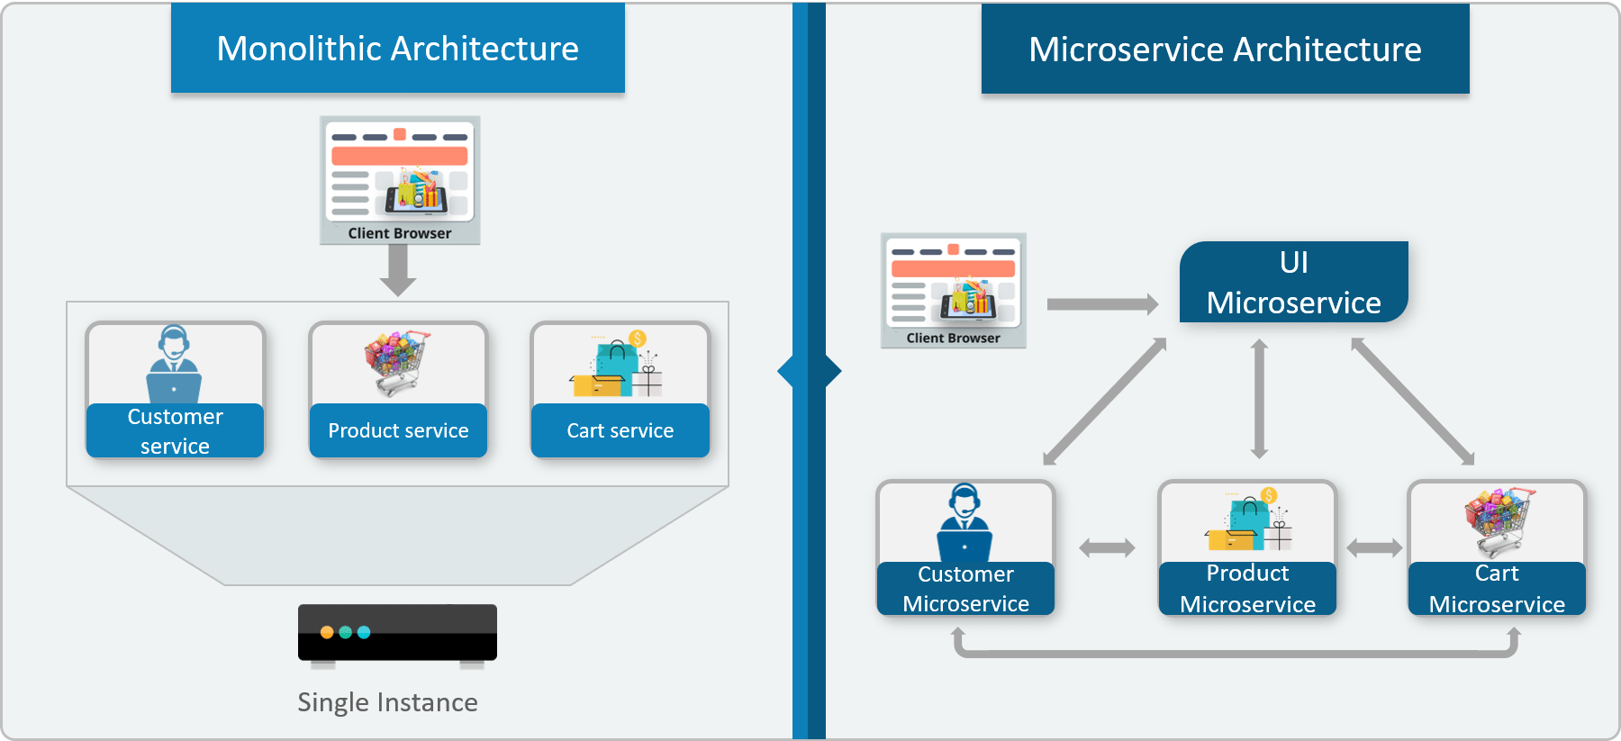

Monolithic vs Micro Service

Slide 10
When Not to use Micro Services
Complexity is a key factor
  "...don't even consider microservices unless you have a system that's too complex to manage as a monolith...“ –Martin Fowler
If complexity isn't problem, microservices aren't the solution.
Micro service architecture also brings with it significant overhead
  Design
  Interoperability of services
  Management
  Use of system resources.

Slide 11
Twelve Factor App
Twelve-factor app is a methodology for building software-as-a-service apps
  Use declarative formats for setup automation, to minimize time and cost for new developers joining the project;
  Have a clean contract with the underlying operating system, offering maximum portability between execution environments;
  Suitable for deployment on modern cloud platforms, obviating the need for servers and systems administration;
  Minimize divergence between development and production, enabling continuous deployment for maximum agility;
  scale up without significant changes to tooling, architecture, or development practices.
https://12factor.net/

Slide 12
Challenges with Micro service
Development has some inherent complexities
Quick Setup needed
  Should be able to create micro services quickly.
Automation
  Smaller component build ,deployment, monitoring etc should automated
Visibility :
  Should be able to monitor and identify problems automatically.
  Need great visibility around all the components.
Debugging
  Centralized Logging and Dashboards are essential to debug problems.

Slide 13
Challenges with Micro service
Configuration Management
  Need to maintain configurations for hundreds of components across environments.
  Should Have Configuration Management solution
Dynamic Scale Up and Scale Down
  Applications should be easily scaled up and down
Pack of Cards :
  If a Service at the bottom of the call chain fails, it can have knock on effects on all other services.
  Services should be fault tolerant by Design.
Consistency
  Should have some decentralized governance around the languages, platforms, technology and tools used for implementing/deploying/monitoring

Slide 14
Solutions to Challenges
Spring Boot
  Enable building production ready applications quickly
  Provide non-functional features
  embedded servers (easy deployment with containers)
  metrics (monitoring)
  health checks (monitoring)
  externalized configuration

Slide 15
Solutions to Challenges
Spring Cloud
  Cloud solutions – From Spring and Open Sourced
Dynamic Scale Up and Down.
  Using a combination of Naming Server (Eureka)
  Client Side Load Balancing
  Feign (Easier REST Clients)
Visibility and Monitoring
  Zipkin Distributed Tracing
  API Gateway
Configuration Management
  Spring Cloud Config Server
Fault Tolerance
  Cloud Circuit Breaker

Slide 16
SPRING CLOUD EUREKA

Slide 17
Service Register and Discovery
Application is decomposed into Many Microservices.
  Each deployed in different servers and different ports.
Services may need to communicate with each other to execute some tasks
  Using ip address and port number has many limitations on invoking the services

Slide 18
Service Register and Discovery
“Service Registration“.
  Services are registered in a centralized location with an identifier and server details.
“Service Discovery”
  Microservice should be able to look up the list of registered services from the centralized location
Implementations of Service Registration and Discovery Server
  Netflix Eureka
  Consul
  Zookeeper

Slide 19
Netflix Eureka Server
Micro services will register with Eureka server
Services provide the following details
  host name, ip address, port, and health indicators etc…
serviceId.
  The Unique Id given to the registered Services
    Also Used to by other services for access

Slide 20
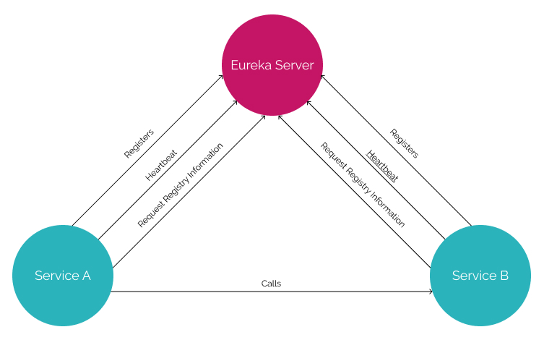
Service Registry

Slide 21
Service Registry
Handles only Registration
  Not communication between the two servers
  Communication is directly between the two services
Cache
  If Eureka is down, the client uses a cached copy of the remote service's address
  Can handle temporary network failures.

Slide 22
Netflix Eureka Server
@EnableEurekaServer
  Added to the main Spring Boot Application configuration class
  Used to Notify the Spring Container that this application is a registration service by Netflix technology
  It also activates Eureka Server related configurations
  @EnableEurekaServer
  @SpringBootApplication
  public class EurekaServerApplication {
  public static void main(String[] args) {
  SpringApplication.run(EurekaServerApplication.class, args);
  }
  }

Slide 23
Server Config Properties
  server:
  port: 8761
  spring:
  application:
  name: eureka-server-registry
  eureka:
  client:
  fetch-registry: false
  register-with-eureka: false
  service-url:
  defaultZone: http://localhost:8761/eureka

Slide 24
Configuration Properties
fetch-registry=false (default: true)
  A Eureka instance is also a Eureka client
  It can fetch the registry containing the details of other instances.
  “false” means it will not be fetching the registry information
register-with-eureka=false (default: true)
  Should this server register itself as a client;
  “false” means it prevents itself from acting as a client.

Slide 25
Configuration Properties
eureka.client.serviceUrl.defaultZone
  In a standalone mode
    points to the local server address.
    Switch off the client-side behavior
    Does not keep trying and failing to reach its peers.

Slide 26
Detailed Eureka Server Config
spring.application.name=eureka_registry
eureka.server.enable-self-preservation=false
eureka.server.eviction-interval-timer-in-ms=10000
eureka.client.register-with-eureka=false
eureka.client.fetch-registry=false
eureka.client.initial-instance-info-replication-interval-seconds=0
eureka.client.should-enforce-registration-at-init=false
eureka.client.service-url.defaultZone=http://localhost:8761/eureka/
eureka.instance.hostname=localhost
server.port=8761

Slide 27
EUREKA DISCOVERY CLIENT

Slide 28
Discovery From Eureka Server
EurekaClientConfigBean
    Implementation of EurekaClientConfig.
    Properties are prefixed by eureka.client.
Discovery clients
  Clients can look up and fetch information of other services
  Can communicate without IP addresses and port numbers

Slide 29
Discovery Clients
@EnableDiscoveryClient
  Added in the main spring boot configuration class
  Works with any Discovery Client implementations
  Example : Eureka, Consul, Zookeeper
@EnableEurekaClient
  Works only with Eureka

Slide 30
Discovery Client Service
  @SpringBootApplication
  @EnableEurekaClient
  public class BloodDonarServiceApplication {
  public static void main(String[] args) {
  SpringApplication.run(BloodDonarServiceApplication.class, args);
  }
  }

Slide 31
application.yml
  spring:
  application:
  name: product-service
  server:
  port: 5454
  eureka:
  client:
  service-url:
  defaultZone: http://localhost:8761/eureka

Slide 32
To Map the Port and Return It
  @AutoWired
  private final Environment env;
  @GetMapping("/info")
  public String getClients() {
  String port = env.getProperty(”local.server.port");
  return "Data from Producer running on port: " + port;
  }

Slide 33
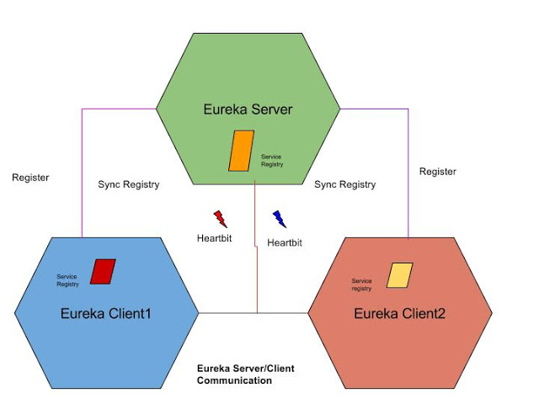
Eureka Working

Slide 34
Load Balancing
The process of distributing network traffic across multiple servers.
  Ensures no single server bears too much demand.
  Spreads the work evenly
  Improves application responsiveness.
  Increases availability of applications and websites for users.
When the number of users is large, a service is created multiple replicas.
  Each replica runs on a different computer.

Slide 35
Feign Client
Declarative web service client.
It makes writing web service clients easier.
Need to create a an interface and annotate it.
It has pluggable annotation support including Feign annotations and JAX-RS annotations.
Spring Cloud adds support for Spring MVC annotations
It integrates Eureka, Spring Cloud CircuitBreaker, as well as Spring Cloud LoadBalancer to provide a load-balanced http client
@EnableFeignClients : To Unable Feign Client

Slide 36
Feign Client
  @FeignClient(name = "DATA-JPA-DSL-MULTIPART")
  public interface MyClient {
  @GetMapping("/api/v1/customers")
  List<CustomerResponse> findAll();
  @GetMapping("/api/v1/customers/info")
  String findPort();
  }

Slide 37
DTO
  public record CustomerResponse(
  long customerId,
  String customerName,
  long phoneNumber,
  String email
  ) {}

Slide 38
Rest Controller
  @AutoWired
  private final MyClient client;
  @GetMapping
  public ResponseEntity<?> getDataFromOtherService() {
  var response = client.findAll();
  return ResponseEntity.ok(response);
  }
  @GetMapping("/info")
  public ResponseEntity<?> getPortInfo() {
  var response = client.findPort();
  return ResponseEntity.ok(response);
  }
}

Slide 39
Load Balancing
A distributed system may consist of many services running on different computers.
When the number of users is large, a service is created multiple replicas.
Each replica runs on a different computer.
A Load Balancer” helps to distribute incoming traffic equally among servers.

Slide 40
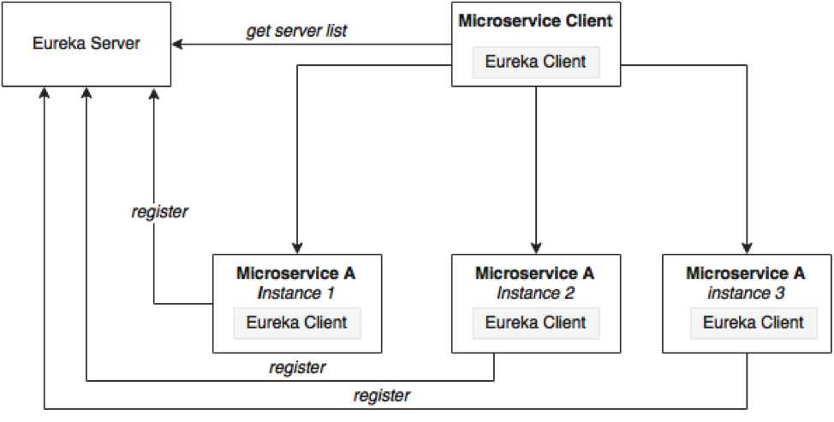
Load Balancing

Slide 41
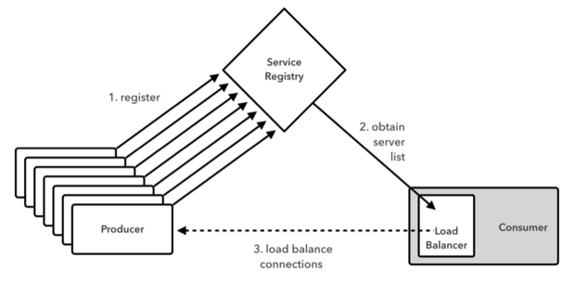
Working of Load Balancer

Slide 42
Load Balancing on Server Side
Load Balancers are components placed at the Server Side.
When the requests come from the Client, they will go to the load balancer, and the load balancer will designate a Server for the request.
It may use algorithm like random designation.
Most load balancers are hardware, integrated with software to control load balancing.
Need a separate server to host the load balancer instance which has the impact on cost and maintenance.

Slide 43
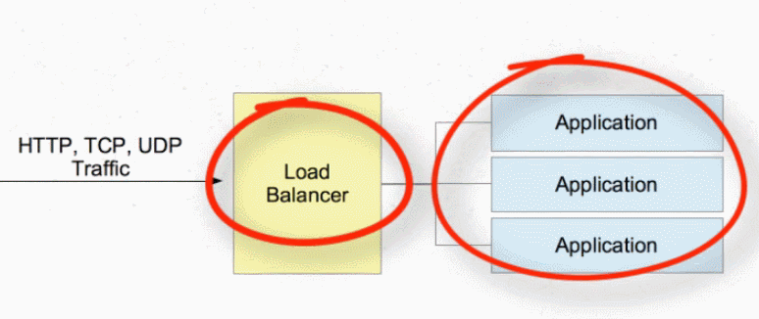
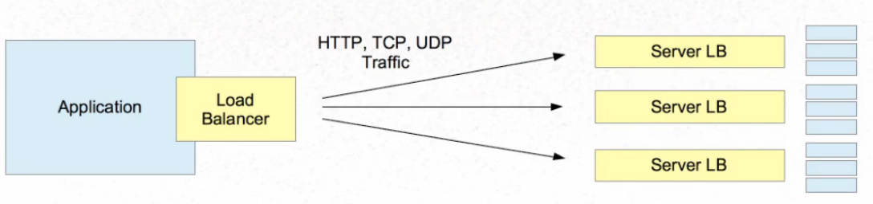
Server Side and Client Side

Slide 44
Load Balancing with Web Client
Add spring-cloud-starter-load balancer dependencies
Web Client can be configured to work with Load Balancer client
WebClient.Builder
  Used to create a load-balanced WebClient
  Add the @Bean annotation

Slide 45
Load Balancing with Web Client
@Bean
@LoadBalanced
WebClient.Builder loadBalanced(){
return WebClient.builder();
}
@Bean
WebClient client(WebClient.Builder builder) {
return builder.build();
}

