Slide 1
Spring cloud gateway

Slide 2
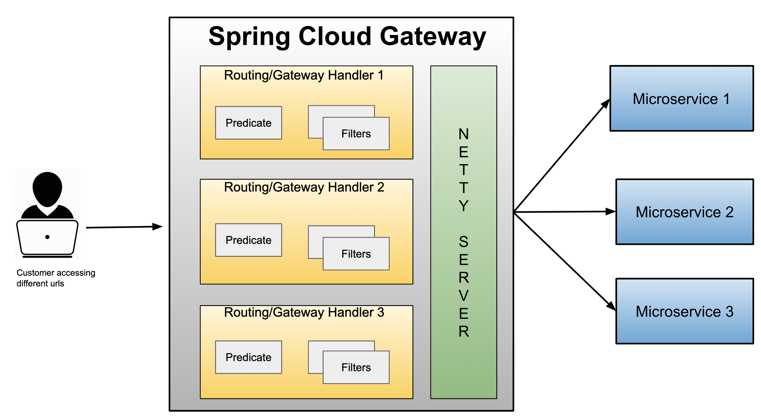
Spring cloud gateway

Slide 3
Gateway
Micro Services require a unified interface to the consumers.
  Services are split into small composable apps
  It shouldn’t be visible to users
  Should have less development effort.
Gateway handles requests to multiple backing services.
  It provides a unified “front door”
  Browser, Mobile Application or other user interface can consume services from multiple hosts
  Can mange the cross-origin resource sharing and authentication

Slide 4
Cloud Gateway
Gateway is an intermediate layer between the users and services.
  Eureka server solved the problem of giving names to services instead of hard coding their IP addresses.
It Maps between a prefix path and a service or more than one service running on different ports
Can Use Eureka server to route the requested service.
Load balances instances
Can filter requests, add authentication, etc.

Slide 5
Spring Cloud Gateway
Provides a simple and effective way to route incoming requests to the appropriate destination using Gateway Handler Mapping.
Uses Netty server to provide non-blocking asynchronous request processing.
Route configuration
Programmatically
  Using Spring RouteLocator.
Properties
  application.yml

Slide 6
Gateway Routing
Has Three Main parts
Route:
  The Destination of a particular request.
  It will have destination URI
  It has a condition to be satisfied
  It has one or more filters.
Predicate
  A condition to match like an “if” condition.
  Java 8 Function Predicate
Filter:
  Instances of Spring Framework WebFilter.
  Can modify request or response.
  Spring Provides many WebFilters

Slide 7
For Version 6.0 onwards
  spring:
  application:
  name: api-gateway
  cloud:
  gateway:
  server:
  webflux:
  routes:
  - id: customer-service
  uri: lb://DATA-JPA-DSL-MULTIPART
  predicates:
  - Path=/api/v1/customers/**
  server:
  port: 8060

Slide 8
application.yml
  management:
  endpoints:
  web:
  exposure:
  include: '*'
  endpoint:
  gateway:
  access: unrestricted
  health:
  show-details: always

Slide 9
application.yml- Older Version
  spring:
  cloud:
  gateway:
  routes:
  - id: review-module
  uri: lb://REVIEW-SERVICE
  predicates:
  - Path=/api/v1/reviews/**
  application:
  name: cloud-gateway
  Invoke the service :
  http://localhost:8080/api/v1/reviews

Slide 10
Actuator Endpoints
Base Path :
  /actuator/gateway
/actuator/gateway/routefilters
  Displays the list of global filters applied to the routes.
/actuator/gateway/routes
  Displays the list of routes defined in the gateway.
/actuator/gateway/routes/{id}
  Displays information about a particular route.

Slide 11
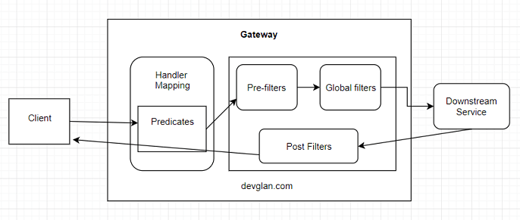
Cloud Gateway Filters

Slide 12
Global Filter
Its applied to every request that matches a route in the gateway.
Used for cross-cutting concerns like universal logging, global security (JWT validation), and metrics collection.
Create a class implementing GlobalFilter and Ordered interfaces and define it as a @Bean.
  Since its registered as a bean, it is automatically active for all routes.

Slide 13
Gateway Filter
It’s a Route-Specific Filter
  Applied only to specific routes
Used for route-specific tasks, such as adding a header to a specific service, stripping a URL prefix
Created using a GatewayFilter or GatewayFilterFactory.
Listed under the filters section for a specific route in configuration file.
Notes:
A GatewayFilter (also called a Route-Specific Filter) is applied only to specific routes where it is explicitly configured.
Purpose: Used for route-specific tasks, such as adding a header to a specific service, stripping a URL prefix, or rate-limiting a specific API.
Implementation: These are typically created using a GatewayFilterFactory.
Configuration: You must list them under the filters section for a specific route in your configuration file.

Slide 14
Global Filters
Created by implementing the Interface GlobalFilter with one Method filter()
public Mono<Void> filter(ServerWebExchange exchange, GatewayFilterChain chain)
ServerWebExchange
  Contract for an HTTP request-response interaction.
  Provides access to the HTTP request and response
  Exposes Properties for server-side processing
GatewayFilterChain
  An inteface that allows a WebFilter to delegate to the next in the chain.

Slide 15
Global Filters- Pre Filter
  @Component
  public class MyGlobalFilter implements GlobalFilter {
  public Mono<Void> filter(ServerWebExchange exchange, GatewayFilterChain chain) {
  boolean result =
  exchange.getRequest().getURI().
  getRawPath().contains("reviews");
  if(result) {
  exchange.getResponse().setStatusCode(HttpStatus.UNAUTHORIZED);
  return exchange.getResponse().setComplete();
  }
  return chain.filter(exchange);
  }
  }

Slide 16
Global Filter – Post Filter
  @Bean
  public GlobalFilter postGlobalFilter() {
  return new GlobalFilter() {
  @Override
  public Mono<Void> filter(ServerWebExchange exchange, GatewayFilterChain chain) {
  return chain.filter(exchange)
  .then(Mono.fromRunnable(new Runnable() {
  @Override
  public void run() {
  log.info("Global Post Filter executed");
  }
  }));
  }
  }

Slide 17
Route Locator Builder
Gateway configuration can also be done using java route api
RouteLocatorBuilder
  Used to configure related routing information
  To add predicates and filters
  Provides a Static Method Builder()
    Builder() method is used to construct routes and return a RouteLocator

Slide 18
RouteLocator
RouteLocator
  public interface RouteLocator {
  Flux<Route> getRoutes();
  }
  @Bean
  public RouteLocator gatewayRoutes(RouteLocatorBuilder builder) {
  }

Slide 19
Routing Object
Route
  Defines the routes information such as route assertions, filters, routing addresses, and route priorities.
  When the request arrives, it is processed by the Gateway filter
    And then its forwarded to the proxy service.
  public class Route implements Ordered {
  private final String id;
  private final URI uri;
  private final int order;
  private final AsyncPredicate<ServerWebExchange> predicate;
  private final List<GatewayFilter> gatewayFilters;
  }

Slide 20
Configuring Route Locator
  @Configuration
  public class MyRouteConfig {
  @Bean
  public RouteLocator gatewayRoutes(RouteLocatorBuilder builder) {
return builder.routes()
.route(p -> p.path("/api/v1/reviews/**")
.filters(f -> f.addResponseHeader("Hello", "World"))
.uri("lb://REVIEW-SERVICE") )
.route(p -> p.path("/api/v1/choices/**")
.uri("http://localhost:7575/"))
.build();
  }
  }

Slide 21
Gateway Filter
  @Component
  public class LoggingFilter implements GatewayFilter {
  @Override
  public Mono<Void> filter(ServerWebExchange exchange, GatewayFilterChain chain) {
  ServerHttpRequest request = exchange.getRequest();
  Log.info(request.getPath().toString());
  return chain.filter(exchange);}
  }

Slide 22
Global Filter
@Component
public class AuthFilter implements GlobalFilter {
@Override
public Mono<Void> filter(ServerWebExchange exchange, GatewayFilterChain chain) {
if (!exchange.getRequest().getHeaders().containsKey(HttpHeaders.AUTHORIZATION)) {
throw new RuntimeException("Missing authorization information");
}

Slide 23
Global Filter
List<String> authorization = exchange.getRequest().getHeaders().get("Authorization");
if(exchange.getRequest().getHeaders().get(HttpHeaders.AUTHORIZATION).get(0)!=null) {

Slide 24
Global Filter
ServerHttpRequest modifiedRequest = exchange.getRequest().mutate().
header("Authorization", authorization.get(0)).build();
return chain.filter(exchange.mutate().request(modifiedRequest).build());
} else {
return chain.filter(exchange);
}
}
}
curl -u india:india http://localhost:8080/driver-service/api/v1/drivers

Slide 25
Spring webclient

Slide 26
WebClient
Introduced from Spring 5
  Its a non-blocking client with support for Reactive Streams.
  It’s a replacement for RestTemplate .
  Its more functional and is fully reactive.
  It's included in the spring-boot-starter-weblux dependency

Slide 27
Reactive Load Balancer
ReactiveLoadBalancer
  The Implementation of the interface uses a Round-Robin
  It gets instance from reactive ServiceInstanceListSupplier
  It retrieves available instances from Service Discovery using a Discovery Client available in the classpath.
@LoadBalanced
  Need to have a load balancer implementation in the classpath.
  If the Spring Cloud LoadBalancer is in the class path Then, ReactiveLoadBalancer is used
    Helps to use "logical identifiers" for the URLs passed

Slide 28
Http Methods
get()
  indicates that we are making a GET request.
  We know that the response will be a single object, so we're using a Mono as explained before.
  client.get()
  Client.post()

Slide 29
WebClient
client.get().uri("lb://PRODUCT-SERVICE/api/v1/items")
URI
  Takes a service name => lb://PRODUCT-SERVICE
The “lb“ in the “uri” will use the LoadBalancerClient
  Load Balancer Client will resolve to an actual host and port
  Replaces the URI

Slide 30
Rest Client - Controller
  @RestController
  public class ClientController {
  @Autowired
  private WebClient client;
  @GetMapping(path = "/hotels")
  public Flux<String> getAllHotels(){
  return client.get()
  .uri("lb://HOTEL-SERVICE/api/v1/hotels")
  .retrieve()
  .bodyToFlux(String.class);
  }
  }

Slide 31
Rest Client - Controller
  @PostMapping(path = "/hotels")
  public Mono<HotelDto> create(@RequestBody HotelDto dto)
  {
  return client.post()
  .uri("lb://HOTEL-SERVICE/api/v1/hotels/{id}")
  .body(Mono.just(dto), HotelDto.class)
  .retrieve()
  .bodyToMono(HotelDto.class);
  }

Slide 32
Rest Client - Controller
  @DeleteMapping(path = "/hotels/{id}")
  public Mono<Void> removeHotelById(@PathVariable("id") int id){
  return client.delete()
  .uri("lb://HOTEL-SERVICE/api/v1/hotels/{id}" ,id)
  .retrieve()
  .bodyToMono(Void.class);
  }
  }

Slide 33
Rest Client - Controller
  @GetMapping(path = "/hotels/{id}")
  public Mono<String> getHotelById(@PathVariable("id") int id){
  return client.get()
  .uri("lb://HOTEL-SERVICE/api/v1/hotels/{id}",id)
  .retrieve()
  .bodyToMono(String.class);
  }

Slide 34
Zipwhen
Used to Wait for the result from first mono,
  uses it to create a second mono provided by rightGenerator
  when both sources complete Returns a new combined Mono
  Combine both results into defined by the provided combinator function.
Mono.zipWhen(
Function<First, Mono<? extends Second>> rightGenerator,
BiFunction<First,Second, ResponseDto> combinator)

Slide 35
ZipWhen
  @GetMapping(path = "/srch/{id}")
  public Mono<ResponseDto> getDetails(@PathVariable("id") int id){
  return client.get()
  .uri("http://localhost:4042",uriBuilder -> uriBuilder.path("/api/v1/customers/{id}")
  .build(id)).retrieve().bodyToMono(Customer.class)
  .zipWhen(custResp -> client.get()
  .uri("http://localhost:3042" ,uriBuilder -> uriBuilder.path("/api/v1/payments/{name}")
  .build(custResp.getCustomerName())).retrieve().bodyToMono(Payment.class), (custResp,payResp) -> {
  dto.setCustomer(custResp);
  dto.setPayment(payResp);
  return dto;
  });}

Slide 36
Spring cloud circuit breaker

Slide 37
Circuit Breaker
Used to stop the communication to the application that may slow down or fail
  It interrupts the current flow after a fault is detected
  When it is is reset (manually or automatically), it can resume its normal operation.
Services will fail fast and have some fallback functionality.
It prevents the failure from cascading and giving the failing service time to recover.

Slide 38
Spring Cloud Circuit Breaker
Spring Cloud Circuit Breaker
  An abstraction API for adding circuit breakers to your application.
  There are few supported implementations:
Resilience4J
Resilience4J Reactive
Spring Retry

Slide 39
Resilience4j
Fault tolerance library designed for Java 8 and functional programming.
It is lightweight, modular and fast.
  resilience4j-circuitbreaker
  resilience4j-ratelimiter
  resilience4j-bulkhead
  resilience4j-retry
  resilience4j-cache
Fault Tolerance
  The ability of a system to operate properly in case of the failure of some of its components.
  Done at all levels and also in subsystems as a part of the design.

Slide 40
Circuit Breaker
Wrap a protected function call in a circuit breaker object
  Circuit Breaker will monitor for failures.
Once the failures reach a certain threshold, the circuit breaker trips,
All further calls to the circuit breaker return with an error, without the protected call being made at all.

Slide 41
Need For Circuit Breaker
In case we have serviceB down, serviceA should still try to recover from this and try to do one of the followings:
Custom fallback:
  Try to get the same data from some other source. If not possible, use its own cache value.
Fail fast:
  If serviceA knows that serviceB is down, there is no point waiting for the timeout and consuming its own resources. It should return ASAP “knowing” that serviceB is down
Don’t crash:
  As we saw in this case, serviceA should not have crashed.
Heal automatic:
  Periodically check if serviceB is working again.
Other APIs should work:
  All other APIs should continue to work.

Slide 42
Configuring With Web Client
  import org.springframework.cloud.circuitbreaker.resilience4j.*;
  @Bean
  public Customizer<ReactiveResilience4JCircuitBreakerFactory> defaultCustomizer(){
  return factory -> factory.configureDefault(id -> new Resilience4JConfigBuilder(id)
  .circuitBreakerConfig(CircuitBreakerConfig.ofDefaults()).build());
  }

Slide 43
Configuring Circuit Breaker
  public class OrderController {
  private WebClient client;
  private ReactiveResilience4JCircuitBreakerFactory cbFactory;
  private ReactiveCircuitBreaker circuitBreaker;
  // Two Args Constructor
  public OrderController(
  WebClient client,
  ReactiveResilience4JCircuitBreakerFactory cbFactory) {
  this.client = client
  this.cbFactory = cbFactory;
  this.circuitBreaker = cbFactory.create(“orderService");
  }

Slide 44
Configuring With Web Client
  @GetMapping(path = "/order")
  public Mono<String> slow() {
  return circuitBreaker.run(
  client.get()
  .uri("lb://ORDER-SERVICE/orders")
  .retrieve()
  .bodyToMono(String.class),
  throwable -> Mono.just("fallback"));
  } }
  Can also add timeout : timeout(Duration.ofMinutes(5));

Slide 45
Stages of Circuit Breaker
Circuit Breaker has the following three stages:
  Closed
  Open
  Half-Open

Slide 46
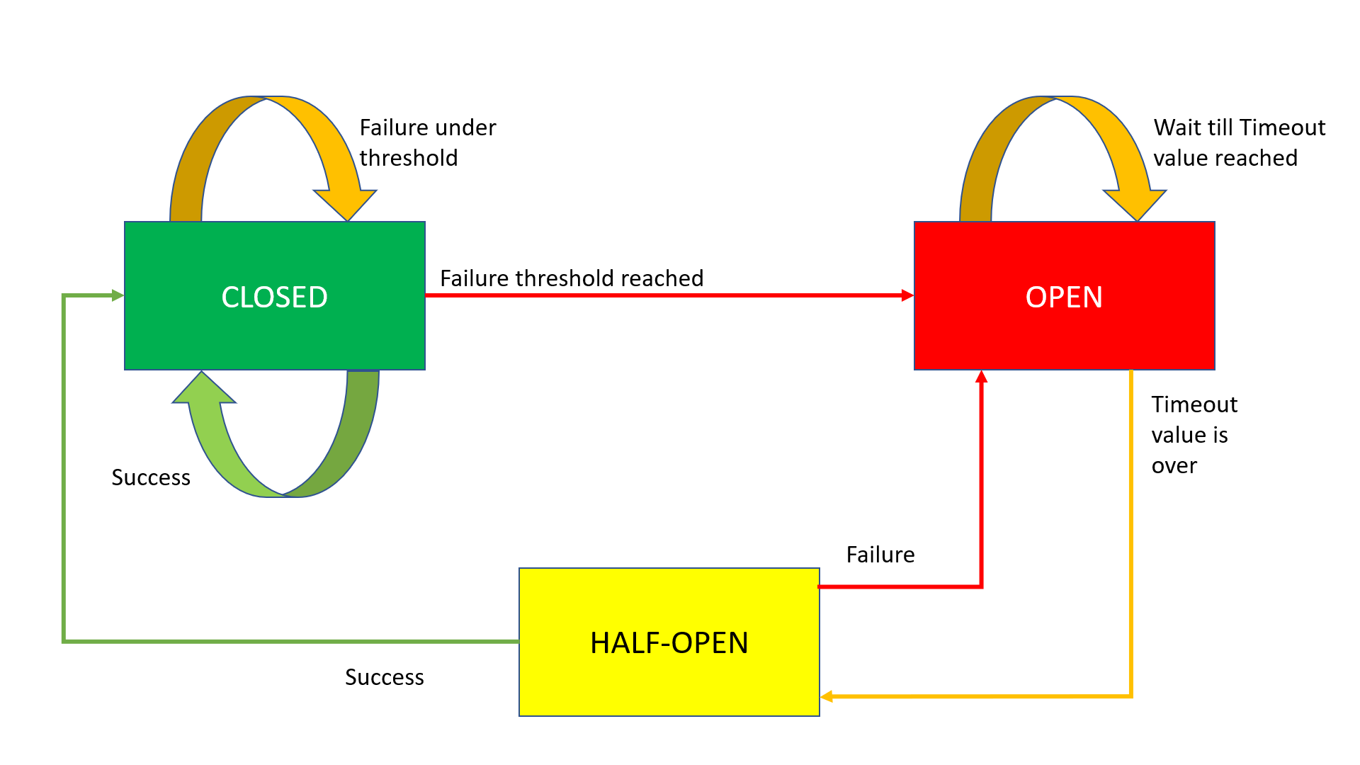
Circuit Breaker Working

Slide 47
Closed State
The Circuit Breaker enters a CLOSED state and waits for Client Requests.
In the CLOSED state, it does the following things:
  It receives Client Requests and makes a call to the Service
  If it succeeds and receives the response from that Service, it will reset the failure count to 0 and send that response back to the end user.
  If it fails to receive the response from that Service, it will increment the failure count by one and check whether that count is greater than the predefined failure threshold
  If the failure count is greater than the failure threshold, then that Circuit Breaker component trips or enters into the OPEN state
  CLOSED state means flow goes as expected,

Slide 48
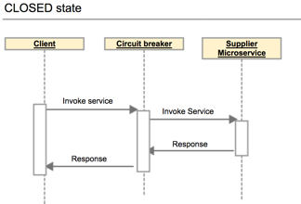
Closed State

Slide 49
OPEN state
In the OPEN state, it does the following things:
  Enters into this state when the failure count is greater than the failure threshold
  It does not make a call to the Service
  If the Client sends any requests to it, it won’t make a call to the Service; it just sends an Exception and waits for some time
  i.e. the Timeout value specified
  Once the Timeout value expires, it will enter into the HALF-OPEN state
OPEN means situation is not good and moving to fallback mode

Slide 50
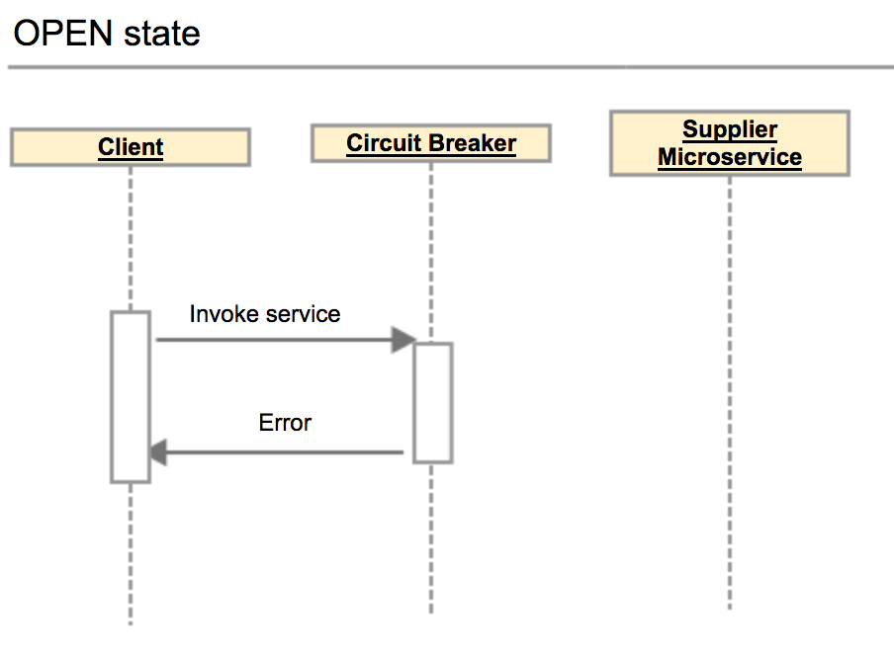
Open State

Slide 51
HALF-OPEN state
In the HALF-OPEN state, it does the following things:
  Enters into this state when it finishes the predefined waiting time.
  It sends the first request to the Service.
  If it receives a success response, then it will enter into the CLOSED state to process further Client Requests. Before picking up the first client request, it will reset the failure count to 0 again.
  If it receives a failure response, then it will re-trip to the OPEN state and wait for a predefined Timeout value to expire.

Slide 52
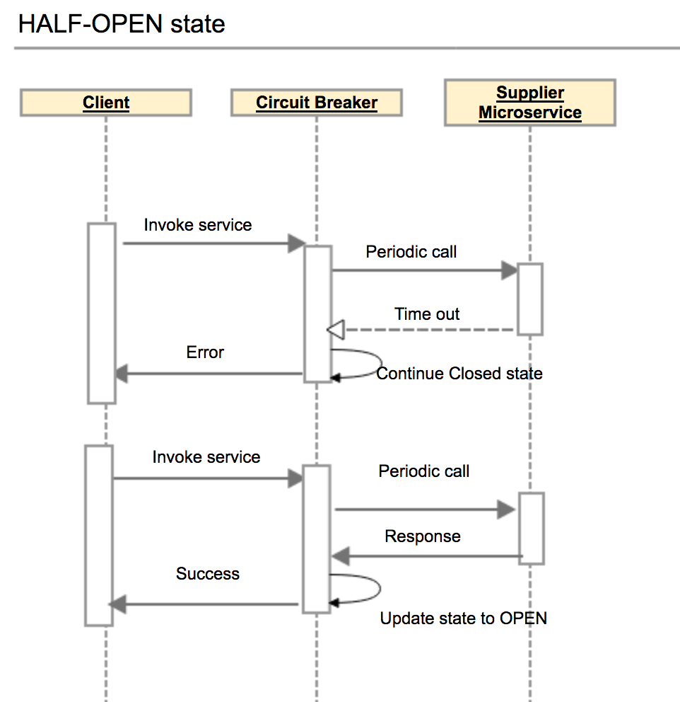
Half Open State

Slide 53
Configuring Circuit Breaker
failureRateThreshold:
  Failure threshold value of 50 which means if the 50 requests are failing in the 100 requests, keep the circuit breaker in CLOSED state.
permittedNumberOfCallsInHalfOpenState
  Default Value : 10
  Configures the number of permitted calls when the CircuitBreaker is half open.

Slide 54
Configuring Circuit Breaker
slidingWindowType : COUNT_BASED
  Used to store and count the results of calls
  Circuit breaker always keeps the total number of invoke equals to slidingWindowSize.
  COUNT_BASED:
    The last slidingWindowSize calls are recorded and aggregated.
  TIME_BASED:
    The calls of the last slidingWindowSize seconds recorded and aggregated
slidingWindowSize
  Default value is100
  Deciding the number of calls to decide when closing a circuit breaker.

Slide 55
Failure rate formula
Count based sliding window
FailureRate = numberOfFailureInvoke / totalNumber X 100%.
Total number =Number of failures invoke + number of successes invoke.
The total number of invoke never exceed the slidingWindowSize .
If the slidingWindowSize is 10 and the number of successes invoke is Nine.
If the 10th invoke is a failure invoke, then circuit breaker will decrease the number of successes invoke by one, and increases the number of failures invoke by one.
Circuit breaker always keeps the total number of invoke equals to slidingWindowSize.

Slide 56
Configuring Circuit Breaker
waitDurationInOpenState:
  The time in millisecond that breaker should wait before transitioning from open to half-open
  Default value is 60000 (1 Minute)
automaticTransitionFromOpenToHalfOpenEnabled
  True: CircuitBreaker will automatically transition from open to half-open state and no call is needed to trigger the transition.
  A thread is created to monitor all the instances of CircuitBreakers to transition them to HALF_OPEN once waitDurationInOpenState passes.
  False : the transition to HALF_OPEN only happens if a call is made, even after waitDurationInOpenState is passed.
  The advantage here is no thread monitors the state of all CircuitBreakers

Slide 57
Configuring Circuit Breaker
minimumNumberOfCalls Default :100
Used for failure rate calculation.
  If minimumNumberOfCalls is 10, then at least 10 calls must be recorded, before the failure rate can be calculated.
  If only 9 calls have been recorded the CircuitBreaker will not transition to open even if all 9 calls have failed.

Slide 58
circuitbreaker
resilience4j:
circuitbreaker:
instances:
orderService:
registerHealthIndicator: true
automaticTransitionFromOpenToHalfOpenEnabled: false
failureRateThreshold: 50
minimumNumberOfCalls: 3
permittedNumberOfCallsInHalfOpenState: 2
slidingWindowSize: 10
waitDurationInOpenState: 5s
slidingWindowType: COUNT_BASED

Slide 59
circuitbreaker
  management:
  endpoints:
  web:
  exposure:
  include:
  - "*"
  endpoint:
  health:
  show-details: always
  circuitbreakers:
  enabled: true
  health:
  circuitbreakers:
  enabled: true

Slide 60
Actuator Endpoints
  http://localhost:9020/actuator/circuitbreakerevents
  http://localhost:8080/actuator/health
  http://localhost:6565/actuator/circuitbreakers
  http://localhost:6565/actuator/metrics/resilience4j.circuitbreaker.calls

Slide 61
Retry
Service may fail due to a network outage, server being down, network glitch, rate limit, etc.
  Can try to retry the operation a few times before sending an error response to the client.
  It increase the chance of getting a response back from a remote service when it’s momentarily overloaded or unresponsive.

Slide 62
Retry
Limit the number of retries:
  Retry should not be done indefinitely.
  If the API call is still failing after the set number of retries, it’s better to communicate the failure.
Retry only for transient/server-side errors:
  Transient errors are temporary and are most likely resolved by retrying a few times.
  Should not retry for failures caused by invalid data or authentication errors
Watch out for time spent:
  Resilience and user experience should be balanced.
  Users should not be made to wait too long while retrying the request behind the scenes.

Slide 63
Retry
Retry Three Time before failing
  webClient.get().retrieve().bodyToMono(String.class).retry(3).log();
Retry 3 times, and add a delay of 2 seconds before 2nd and 3rd retries.
  . retryWhen(Retry.fixedDelay(3, Duration.ofSeconds(2)));
  return client.get()
  .uri("http://localhost:9090/api/v1/info")
  .retrieve()
  .bodyToMono(String.class)
  .retryWhen(Retry.max(6)
  .doBeforeRetry(retrySignal -> {
  System.out.println("Retry attempt #" + (retrySignal.totalRetries() + 1));
  })
  );

