Slide 1

Spring JDBC

Slide 2
Spring JDBC
Database handling made easy with JDBC Template.
The advantages compared with standard JDBC.
  Allows to clean-up the resources automatically, e.g. release the database connections.
  Converts the standard JDBC SQLExceptions into RuntimeExceptions.
  This allows the programmer to react more flexible to the errors.
  Also the vendor specific error messages into better understandable error messages.

Slide 3
Spring JDBC
Spring Task
  Connection Management
  Statement Management
  ResultSet Management
  Transaction Management
  Exception Handling
Developer Task
  SQL
  Row Data Retrieval
  Parameter Setting

Slide 4
DAO – Advantages and Best practices
Advantages:
Application is independent of the Data access techniques and database dependency.
Offers loose coupling with the other layers of application.
Allows to unit test the service layer using mock objects with out connecting to database
Best practices :
Always DAO classes should adhere to interfaces.
Interfaces should expose the functionality that are needed by the Service layers.
Keep the database related configurations outside the code as configurable items.

Slide 5
DAO Layer
Service Layer
DAO Interfaces
DAO Implementations
DB

Slide 6
Spring JDBC – Template pattern
Defines the skeleton of an algorithm in an operation, deferring some steps to subclasses.
Template Method lets subclasses redefine certain steps of an algorithm without letting them to change the algorithms structure.
Register the Dao Implementation class and add the JdbcTemplate as Dependency

Slide 7
Spring JDBC Template
Has many helpful methods for performing CRUD operations
execute(String sql)
  To Issue a single SQL execute, typically a DDL statement.
queryForList(String sql, Object[] args)
  Query given SQL to create a prepared statement from SQL and a list of arguments to bind to the query, expecting a result list.
update(String sql)
  Issue a single SQL update operation (such as an insert, update or delete statement).

Slide 8
Scripts
Spring Boot applications using Spring JDBC can use script files to automatically initializing a database on startup.
  By default, files are placed in “src/main/resources”
  They are executed sequentially.
Database-specific files like schema-mysql.sql or data-h2.sql can also be used
Production-grade database migrations,can use dedicated tools like Flyway or Liquibase
  spring.sql.init.enabled=false:
  Disables the automatic execution of these scripts.

Slide 9
schema.sql
It contains DDL statements used to define the database structure, such as creating tables, columns, and constraints.
Its executed first, ensuring that the necessary table structure is in place before any data manipulation occurs.
  CREATE TABLE IF NOT EXISTS employee (
  id INTEGER PRIMARY KEY AUTO_INCREMENT,
  name VARCHAR(255) NOT NULL,
  department VARCHAR(255)
  );

Slide 10
data.sql
Contains DML statements used to populate the database with initial, test, or default data.
Its executed after schema.sql, allowing the application to have pre-filled data ready when it starts up.
  INSERT INTO employee (name, department) VALUES ('John Doe', 'Engineering');

Slide 11
DAO
  public interface MyDao<T> {
  List<T> findAll();
  boolean save(Doctor doctor);
  Doctor findById(int id);
  }

Slide 12
Repository
  @Repository
  public class DoctorDaoImpl implements MyDao<Doctor> {
  private JdbcTemplate template;
  public DoctorDaoImpl(JdbcTemplate template) {
  super();
  this.template = template;
  }

Slide 13
Find All
  @Override
  public List<Doctor> findAll(){
  List<Doctor> doctorList =null;
  String sql = "select * from doctor_2025";
  doctorList = template.query(sql,rowMapper());
  return doctorList;
  }

Slide 14
Save
  @Override
  public boolean save(Doctor doctor) {
  String sql ="insert into doctor_2025 values(?,?,?)";
  return this.template.update(sql,doctor.doctorId(),doctor.doctorName(),doctor.department())==0?true:false;
  }

Slide 15
Find By Id
  @Override
  public Doctor findById(int id) {
  return this.template.queryForObject("select * from doctor_2025 where doctor_id=?",rowMapper(),id);
  }
  private RowMapper<Doctor> rowMapper(){
  return (rs,rowNum)->
  new Doctor(rs.getInt("doctor_id"), rs.getString("doctor_name"), rs.getString("depaartment"));
  }
  }

Slide 16
Configuration
  spring:
  application:
  name: spring-jdbc-h2
  h2:
  console:
  enabled: true
  path: /h2-console
  sql:
  init:
  mode: always
  datasource:
  url: jdbc:h2:file:~/testdb
  username: sa
  password:
  driver-class-name: org.h2.Driver

Slide 17
Logging
  logging:
  level:
  {'[org.h2.core]' :TRACE ,
  '[org.springframework.jdbc.core]':TRACE,
  '[org.springframework.jdbc.core.StatementCreatorUtils]':TRACE}

Slide 18
Spring
Aspect Oriented Programming

Slide 19
Aspect Oriented Programming
It’s a Programming technique that promotes separation of concerns within a software system
It is not a replacement for Object Oriented Programming.
AOP is another way of organizing Program Structure
An aspect of a program which affect (crosscut) other concerns.
Cross Cutting Concerns
  Transaction management
  Security
  Auditing
  Event handling

Slide 20
Sample Code
  public class Account {
  public long deposit(long depositAmount){
  newAmount = existingAccount + depositAccount;
  currentAmount = newAmount;
  return currentAmount;
  }
  public long withdraw(long withdrawalAmount){
  if (withdrawalAmount <= currentAmount){
  currentAmount = currentAmount – withdrawalAmount;
  }
  return currentAmount;
  }
  }

Slide 21
AOP Terminologies-Aspect
public void deposit(){
// Transaction Management
// Logging
// Checking for the Privileged User
// Actual Deposit Logic comes here
}
The above logic that cross-cuts or overlaps the existing business logic as Concerns or Cross-Cutting Concerns.
These cross-cutting concerns from the application code can be modularized as different entities.
An Aspect is a functionality or a feature that cross-cuts over objects.
Logging and Transaction Management are the aspects.

Slide 22
AOP Terminologies-Joint Point
Join Points defines the various Execution Points where an Aspect can be applied.
In Spring AOP, a join point always represents a method execution.
  public void someBusinessOperation(BusinessData data){
  //Method Start - > Possible aspect code here like logging.
  try{
  // Original Business Logic here.
  } catch(Exception exception) {
  // Exception -> Aspect code here when some exception is raised. }
  finally{
  // Finally -> Even possible to have aspect code at this point too.
  }
  // Method End -> Aspect code here in the end of a method.
  }

Slide 23
AOP Terminologies-JoinPoints
Points in the execution of the program
  Start of the Method,
  End of the Method,
  Exception Block,
  Finally Block
In these points an Aspect can be made to execute.
These Execution Points embedding Aspects are called Join Points.
An Aspect need not be applied to all the possible Join Points.

Slide 24
AOP Terminologies-Pointcut
Join Points refer to the Logical Points wherein a particular Aspect or a Set of Aspects can be applied.
A Pointcut or a Pointcut Definition will exactly tell on which Join Points the Aspects will be applied.
pointcut method_start_end_pointcut(){
// This point cut applies the aspects, logging and transaction, before the beginning and the end of the method.
}
pointcut catch_and_finally_pointcut(){
// This point cut applies the aspects, logging and transaction, in the catch block (whenever an exception raises) and the finally block.
}

Slide 25
Advice
Advice is the code that implements the Aspect.
Aspect defines the functionality in a more abstract manner.
Advice provides a Concrete code Implementation for the Aspect.
Creating Advices in Spring
Spring provides support only for Method Aspect and not for Field Aspect
Before Advice
After Advice
Throws Advice
Around Advice

Slide 26
Around Advice
Represented by org.aopalliance.intercept.MethodInterceptor.
Provides finer control whether the target method has to be called or not.
Around Advice can even change the return type, thereby returning a brand new object of other type if needed.
Can be used to check arguments and execute rather than having it in the actual method implementation.

Slide 27
Spring AOP-Architecture
ProxyFactory - programmatic approach to create proxies
ProxyFaxctoryBean -Declarative proxy Creation, for advisors when using the Spring IoC container.
Requires:
  A target bean to proxy
  An advisor
  An interceptor
  An AOP proxy bean definition
ProxyFactory class
  Used to Get a reference for an advised instance of a class and contains all aspects to be woven into the proxy
  If the target object to be proxied implements at least one interface then a JDK dynamic proxy will be used
  If the target object does not implement any interfaces then a CGLIB proxy will be created

Slide 28

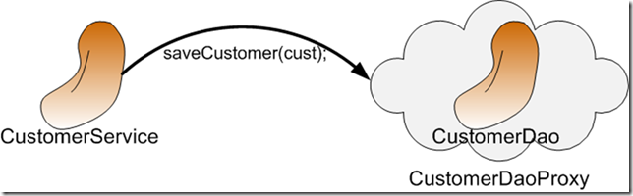
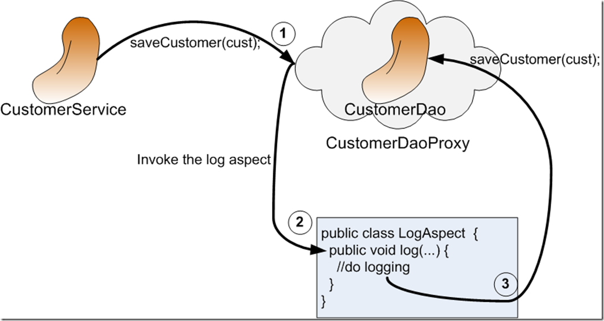
AOP Proxy Mechanism

Slide 29
Declaring a pointcut
Point cut declaration has two parts:
a signature comprising a name and any parameters,
point cut expression that determines exactly which method
execution(public * *(..)) or within(com.xyz.service.*)
execution – for matching method execution join points
within – execution of a method declared within a matching type

Slide 30
Execution vs within
execution :
  To target methods based on their specific signature (return type, name, parameters, and where they are declared).
within
  Applying a rule to an entire building or a specific room, regardless of who or what is inside it.
  To target a "service package" using within, that rule will affect every method, constructor, or field access within any class in that package.

Slide 31
Currency Converter
  public class CurrencyConverter implements MyInterface {
  public double dollorToRupess(double dlrAmt) {
  return dlrAmt * 49.0d;
  }
  public double dollorToEuro(String dlrAmt)
  {
  double val =Double.parseDouble(dlrAmt);
  return val * 70.00d;
  }

Slide 32
Declaring a pointcut
execution(public * *(..))
the execution of any public method:
execution(* set*(..)) -
the execution of any methods beginning with "set":
execution(* com.xyz.service.AccountService.*(..))
the execution of any method defined by the named interface:
execution(* com.xyz.service.*.*(..))
the execution of any method defined in the service package:
within(com.xyz.service.*)
any join point within the service package:

Slide 33
AOP-Spring
  @Aspect
  @Component
  public class LoggingAdvice {
  Logger logger = LoggerFactory.getLogger(this.getClass());
  @Around("execution(* com.example.demo.*.*(..))")
  public Object logging(ProceedingJoinPoint joinPoint) throws Throwable {
  logger.info(joinPoint.getSignature().getName()+"called");
  Object obj =joinPoint.proceed();
  return obj;
  }
  }

Slide 34
pom.xml
  <dependency>
  <groupId>org.springframework.boot</groupId>
  <artifactId>spring-boot-starter-aop</artifactId>
  <version>4.0.0-M2</version>
  </dependency>

