Slide 1

Java Script
Brenden Eich

Slide 2

K.Srivatsan
IT Trainer Since 1991
Conducting Java Training Since 2004
About 40+ Corporate Clients

Slide 3
INTRODUCTION
Module -1

Slide 4
Java Script
A scripting language Created by Brendan Eich at Netscape
Developed under the name Mocha, and officially called LiveScript
Renamed to JavaScript
  When Netscape added support for Java technology in its Netscape Navigator web browser.
Its official name is ECMAScript,
It’s interpreted by the browser engine while the page is loaded.
  HTML, gives structure to the web pages
  CSS, controls the appearance of web pages
  JavaScript gives the behavior for the page.

Slide 5
Java Script
Its lightweight, interpreted, or just-in-time compiled programming language with first-class functions.
Well-known as the scripting language for Web pages
  Non-browser environments also use it
  Node.js, Apache CouchDB
JavaScript is a prototype-based, multi-paradigm, single-threaded, dynamic language, supporting object-oriented and functional programming) styles.

Slide 6
Scripts vs. programs
A scripting language is a simple, interpreted programming language
  scripts are embedded as plain text, interpreted by application
  simpler execution model: don't need compiler or development environment
  saves bandwidth: source code is downloaded, not compiled executable
  platform-independence: code interpreted by any script-enabled browser
  but: slower than compiled code, not as powerful/full-featured

Slide 7
Features of JavaScript
Syntax similar to C++ and Java
Loosely typed
Object-based language
    Programming Tool for interactive HTML pages
    Interpreted Language
    Saves time as validation is done on Client side
    Event-Driven Programming
    Detects Client browser, hence platform independent
    Runtime object construction,
    variable parameter lists
    object introspection Using Object utilities)

Slide 8
Common scripting tasks
The core client-side JavaScript language allow to do things like:
Adding dynamic features to Web pages
  validation of form data
  image rollovers
  time-sensitive or random page elements
  handling cookies
Defining programs with Web interfaces
  utilize buttons, text boxes, clickable images, prompts, frames
limitations of client-side scripting
  since script code is embedded in the page, viewable to the world
  for security reasons, scripts are limited in what they can do
  can't access the client's hard drive
  since designed to run on any machine platform, scripts do not contain platform specific commands

Slide 9


JavaScript Execution
Other files
Server side code
HTML files
HTML file
JavaScript
Request
Web Server
Response
Client
Script executes locally and interacts with the browser
Server side code executes on the server and sends the response
So JavaScripts on client side executes faster than server-side code.

Slide 10
Visual Studio Code
A lightweight but powerful source code editor
Available for Windows, macOS and Linux.
Built-in support for JavaScript, TypeScript and Node.js
Has rich extensions for other languages (C++, C#, Python, PHP, Go)
Download :
https://code.visualstudio.com/download

Slide 11
Java Script Object
Everything in JavaScript is an object
Most familiar Javascript Objects are
Document object that you used to print your JavaScript messages on the web page;
Math object, that you used to generate random numbers and round off decimals;
HTML elements like the button object that you used to manipulate its value attribute;
the Date object that you used to retrieve the current date.

Slide 12
getElementById
Many HTML Elements tags are associated with an id.
document.getElementById(‘name’) can be used to get the reference of the HTML Element
innerHTML: property comes very handy to set Contents into a section of the HTML Tags

Slide 13
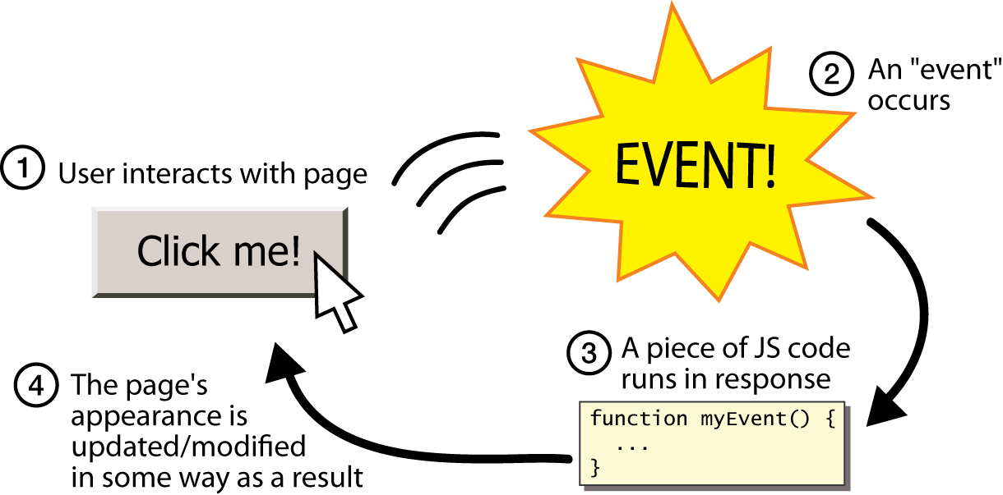
Java Script Events
Occurrences in the context of the interactions between web server, web browser, and web user.
Every element on a web page has certain events which can trigger invocation of event handlers

Slide 14
addEventListener
Method is used to separate JavaScript is from the HTML markup
Method to attach an event handler to the specified element.
Can add many event handlers to one element.
Events are attached without overwriting existing handlers.
Easier to control how the event reacts to bubbling.
  <button id='btn2'>Click</button>
  var clickButton= document.getElementById("btn2");
  clickButton.addEventListener('click', function(){
  console.log("I am added");
  });

Slide 15
Placeholders for scripts within HTML
Inside head
  only declarations. Declarations could for variables or functions.
  No standalone executable statements must appear
Inside the body
  any statements can appear
  standalone executable statements inside the body are interpreted in place where it appears.
Along with the event handler
  Script expression can be written as a value when an event like button click happens.

Slide 16
Script Execution – Head Section
Scripts, placed in the head section will be executed
  When they are called or
  When an event is triggered.
  <html>
  <head>
  <script type=“text/javascript">
  some statements
  </script>
  </head>
  </html>
Advantage →
The script will be loaded before anyone uses it.

Slide 17
Script Execution
  <head>
  <script type="text/javascript">
  function show(){
  document.writeln("<h1 align=center>Hello From Java Script</h1>");
  }
  </script>
  </head>
  <body>
  <script type="text/javascript">
  show();
  </script>
  </body>

Slide 18
Scripts Execution - Body Section
A script to be executed while the page is being loaded is placed in the body section.
  <html>
  <head> </head>
  <body>
    <script type=“javascript">
    some statements
    </script>
  </body>
  </html>
Advantage →  The script generates the content of the page.

Slide 19
Script Execution
  <body>
  <INPUT TYPE="BUTTON" id="b1" VALUE="Click">
  <script type="text/javascript">
ele = document.getElementById("b1");
ele.onclick = function () {
alert("Hello From Java Script");
}
  </script>
  </body>

Slide 20
In lining of JavaScript
  <html>
  <head>
  <title>Example</title>
  </head>
  <body>
  <input type="button" value="Click"
  onclick="javascript:alert('Wrong Button Clicked')"/>
  </body>
  </html>

Slide 21
Calling Java Script From .js Files
Creating a Separate Java Script File
  function showMessage() {
  console.log("Hello World");
  }
  var element = document.getElementById("btn1");
  element.onclick = showMessage;
Create a HTML File to invoke the same
  <button id="btn1">Click</button>
  <script src="QuickStart.js"></script>

Slide 22
Demo/Hands-on Exercise

Slide 23
QuickStart
  <body>
  <button>Click me</button>
  </body>

Slide 24
Java Script
  document.addEventListener("DOMContentLoaded", function(){
  const button = document.querySelector("button");
  button.addEventListener("click", function(){
  const heading = document.createElement("h1");
  heading.textContent = "Java Script Training ";
  document.body.appendChild(heading);
  });
  });

Slide 25
  function createParagraph() {
  const para = document.createElement("p");
  para.textContent = "You clicked the button!";
  document.body.appendChild(para);
  }
  const button = document.querySelector("button");
  button.addEventListener("click", createParagraph);
  <script src='../scripts/myscript.js' defer></script>

Slide 26
Script Loading
The HTML on a page is loaded in the order in which it appears.
Its important load scripts at the right time.
  If the script is to manipulate elements on the page ,the code won't work if the JavaScript is loaded and parsed before the HTML you are trying to do something to.
DOMContentLoaded event,
  which signifies that the HTML body is completely loaded and parsed.
  The JavaScript inside this block will not run until after that event is fired, therefore the error is avoided

Slide 27
defer
<script src='../scripts/myscript.js' defer></script>
defer
  The more modern JavaScript feature is to use the defer attribute,
  which tells the browser to continue downloading the HTML content once the <script> tag element has been reached.

Slide 28
VARIABLES AND CONSTANTS
Module 3

Slide 29
What is a Variable?
Information is stored in variables.
It’s value can be changed during the execution of script.
It can be referenced by its name to see its value or to change its value.
Datatype supported – Variant.
Variant can store any type of data.

Slide 30
JavaScript data types & variables
JavaScript has only three primitive data types
  strings
  Numbers
  Booleans
variable names are sequences of letters, digits, and underscores: start with a letter
variables names are case-sensitive

Slide 31
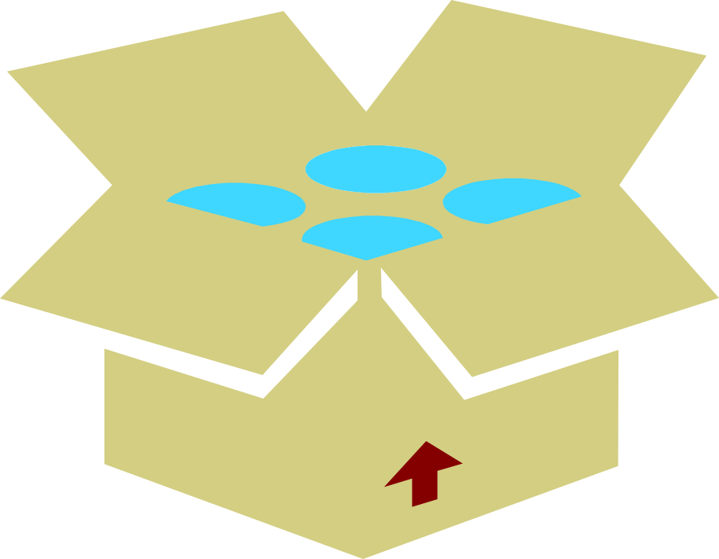
Variant
Integer
Float
Boolean
Char
Variant

Slide 32
Declaring Variables
There are two ways of declaring a variable.
  Implicit Declaration
  Explicit Declaration
Implicit Declaration –
Declare variables by using its name directly in the script.
For example : name=“Tom”
Explicit declaration -
Using ‘var’ keyword
For example : var name
name=“Tom”

Slide 33
Scope of variables
A variable can have local or global scope on the basis of whether it's declared inside or outside a function block..
Local Scope:
  Created using var inside the function
  visible, or accessible, only within the function in which it lives.
  var a = 1;
  function two(a) {
  alert(a); // prints 2
  }
  function three() {
  var a = 3;
  alert(a); //prints 3
  }
  two(2);
  three();

Slide 34
Scope of Variables
global scope means that it's accessible, anywhere in script..
  var a = 1;
  function one() {
  alert(a); //prints 1
  }

Slide 35
Local and Global Variables
  (function () {
  glbl_total = 0;
  var glbl_z = 50;
  function sum() {
  glbl_y = 20;
  var local_x = 10;
  glbl_total = local_x + glbl_y;
  alert(glbl_z); // print 50
  }
  sum();
  alert("Total"+glbl_total); // prints 30
  alert("Value of y" + glbl_y); // prints 20
  alert(glbl_z); //prints 50
  alert("Reference Error -x" + local_x); // error
  })();

Slide 36
Variable Declaration
Hoisting is moving all declarations to the top of the current scope (to the top of the current script or the current function)
JavaScript only hoists declarations, not initializations.
variable declaration
  var state;
variable definition (assignment)
  state = "ready";
declaration plus definition(Initialization)
  var state = "ready";
Best Practice is to declare all variables at the beginning of every scope.

Slide 37
Variable Scope
JavaScript's doesn't have a block scope.
Unlike other popular languages like C or Java, blocks ({...})
Variables in JavaScript are scoped to their nearest parent function or globally if there is no function present.
The JavaScript interpreter make two passes on a section of JavaScript code. The first pass processes variables and function declarations and lifts them to the top (the ‘hoisting’). The second pass processes the function expressions and undeclared variables.

Slide 38
Hoisting
variable can be declared after it has been used.
variable can be used before it has been declared.
x = 5; // Assign 5 to x
elem = document.getElementById("demo");
elem.innerHTML = x;
var x; // Declare x
var foo = 10; is hoisted up to the nearest parent function.
Alerts to 10 and not 1, as expected.
Initial value assignment foo = 10 is not affected

Slide 39
Hoisting
  var foo = 1;
  function bar() {
  if (!foo) {
  var foo = 10;
  }
  alert(foo);
  }
bar();
Will display 10
  var foo = 1;
  function bar() {
  if (!foo) {
  foo = 10;
  }
  alert(foo);
  }
bar();
Will Display 1
Foo is NOT hoisted up to the nearest parent as its defined WITHOUT var
Foo is hoisted up to the nearest parent as its defined with var

Slide 40
Operators
Arithmetic:
+ - * / % += -= *= /= %= ++ --
Logical:
& | ! && ||
Relational:
> >= < <= == != === !==
String concatenation: +
Bit wise:
>> << >>> >>= <<= >>>=
Ternary: ?:
Conversion functions:
parseInt() and parseFloat()
To convert string to int and float respectively

Slide 41
=== and !==
alert("34"==34); Returns true
alert("34"===34); Returns false
  alert(true===1); returns false
  The ( = ) operator is used to assign or give a value to a variable. It is not a sign for equality.
( == ) compares only values, ( === ) compares both values and data type.

Slide 42
Control statements
Same as in C++ or Java
  if else
  for
  for..in
  while
  do .. while
  switch

Slide 43
If-else
The if statement executes a statement if a specified condition is true.
If the condition is false, another statement can be executed.
if (condition)
statement1
[else statement2]
conditionAn expression that evaluates to true or false.

Slide 44
Switch Statement
  switch (expression) {
  case value1:
  [break;]
  case value2:
  [break;]
  case valueN:
  [break;]
  default:
  }

Slide 45
For Loop
All three expressions in the head of the for loop are optional.
for (var i = 0; i < 9; i++) { console.log(i); // more statements }
Iin the initialization block it is not required to initialize variables:
  var i = 0;
  for (; i < 9; i++) {
  console.log(i);
  // more statements
  }

Slide 46
For Loop
Like the initialization block, the condition block is also optional.
Loop is broken condition infinite loop.
  for (var i = 0;; i++) {
  console.log(i);
  if (i > 3) break;
  // more statements
  }

Slide 47
For Loop
Can omit all three blocks.
A break statement to end the loop and also modify (increase) a variable,
  var i = 0;
  for (;;) {
  if (i > 3)
  break;
  console.log(i);
  i++;
  }

Slide 48
Do-while
he do...while statement creates a loop that executes a specified statement until the test condition evaluates to false.
The condition is evaluated after executing the statement, resulting in the specified statement executing at least once.
  var i = 0;
  do {
  i += 1;
  console.log(i);
  }
  while (i < 5);

Slide 49
While Statement
The while statement creates a loop that executes a specified statement as long as the test condition evaluates to true.
The condition is evaluated before executing the statement.
  var n = 0;
  var x = 0;
  while (n < 3) {
  n++; x += n;
  }

Slide 50
Demo/Hands-on Exercise

Slide 51
JAVA SCRIPT FUNCTIONS
Module 3

Slide 52
Functions
JavaScript has a great many built-in functions like write(), alert(), getElementById(), random(), floor(), and several others.
JavaScript also gives you the option to craft your own functions.
A function is a way of packaging your JavaScript commands so you can easily reuse them every time you need the same piece of functionality implemented in your website.
This suggests that there are 2 distinct phases to a function:
The phase where the function is declared (created);
The phase where the function is called (used).

Slide 53
Function
A function can be defined inside <head> , <body> or in a external file and can be called from anywhere after it has been read.
Syntax
  function functionname(var1,var2,...,varX)
  {
  //some code
  }
Functions can be invoked by name of function()
  Function can take arguments (or parameters).
  Can have return statement too.

Slide 54
Functions
  <body>
  <script type="text/javascript”>
  function display(x)
  {
    if(x==null)
    x="Greetings";
    alert(x) ;
  }
  function display1(){
  alert("Greet") ;
  }
  </script>
  </body>

Slide 55
Calling a function
The above function can be called as
  display();
  display(“hello”);
  Or display with any number of arguments
  function display(x){
  if(x==null)
  x=“Greetings”;
  alert(x) ;
  }
You can also pass values to a function that does not take any arguments!

Slide 56
Named function
function showState() {} // function declaration
var showState = function() {}; // function expression
var Greet=function(person,greeting){
var text=greeting+”-”+person};
Console.log(text);
;
}
Greet(“ram”,”Hello’)

Slide 57
Function that returns value
Function that Retuns Value
  function fun1(){
  return "Hello";
  }
Function with Parameter
  function fun2(name){
  return "Hello :"+name;
  }

Slide 58
Self executing annonymous function
  function invoke(){
  var msg=fun2('Ramesh');
  console.log(msg);
  document.write(msg);
  }
  (function(){
  invoke();
  })();

Slide 59
Function as arguments
Passing functions as arguments is an externly common idiom in jQuery
  function fun1(){
  return "Hello";
  }
  function fun4(myfunc){
  var funRef=myfunc();
  console.log("Function as arguments"+ funRef);
  }
fun4(fun1);
  fun4(function(){return "I am from Annon function"});

Slide 60
Closures
Closures are functions that refer to independent (free) variables
  variables that are used locally, but defined in an enclosing scope
Functions 'remember' the environment in which they were created.
Functions Stay Connected to Their Birth Scopes
Using closures provides benefits data hiding and encapsulation.

Slide 61
Closures
Its formed when a function is defined inside of another function,
Returning the nested function allows to maintain access to the local variables, arguments
  function init() {
  var localName = "Java Script";
  function innerDisplayName() {
  console.log("Nested Method"+localName);
  }
  }
  function display(){
  console.log("Name :"+localName);
  }
  display(); =>localName Becomes undefined

Slide 62
Closure Example
  function init() {
  var localName = "Java Script";
  return function(){
  console.log("Local Name"+localName)
  return localName;
  }
  }
  function display(){
  var funcRef= init();
  var capturedPrivate = funcRef();
  console.log("Name :"+capturedPrivate);
  }
  display();

Slide 63
EVENTS

Slide 64
Java Script Events
Events are occurrences taking place in the context of the interactions between web server, web browser, and web user.
Every element on a web page has certain events which can trigger invocation of event handlers
Attributes are inserted into HTML tags to define events and event handlers
  A mouse click
  A web page or an image loading
  Mouse over a hot spot on the web page
  Selecting an input box in an HTML form
  Submitting an HTML form
  A keystroke

Slide 65
Event Handling
Common events dealt in JavaScript are:
onLoad/onUnload;
onClick;
onSubmit (triggered by the user submitting a form);
onFocus / onBlur (triggered by a user as, for example, she clicks in a textbox or clicks away from a textbox respectively);
onMouseOver / onMouseOut (triggered by the user moving the mouse over or away from an HTML element respectively).

Slide 66
The Mouse Over
A mouseover can be used to make an image change when the user rolls their mouse over it.
The browser displays a different image when the mouse is over the text or image.
To specify a mouse rollover the onMouseOver or the onMouseOut attributes into the appropriate tag.

Slide 67
The Mouse Over
<a href="First.html"
onmouseover="document.pict.src ='images/B.GIF'"
onmouseout="document.pict.src='images/A.GIF'">
<img name="pict" alt="An Image" src="images/A.GIF">
</a>

Slide 68
JAVA SCRIPT OBJECTS

Slide 69
Window Object -Alert boxes
An alert box is a small window that pops up with a yellow warning sign and a (usually) important message.
With JavaScript we can either show a message to the user either before a page loads or in response to a user action.
  alert (“Welcome to the Test Site!”);

Slide 70
Confirm Boxes
Confirm box
User will have to click either "OK" or "Cancel" to proceed
  <form>
  <input type = ''button" value = “submit" onClick = "confirm(‘are u Sure to submit ' ) ; " >
  </form>
The onClick event handler means that when click on the button, a confirm box pops up.

Slide 71
Message input boxes
Prompt box
User will have to click either "OK" or "Cancel" to proceed after entering an input value
prompt("sometext","defaultvalue")
  var yourname = prompt('Type your name here');
  document.writeln("<center>Welcome, "+ yourname+"</center>");

Slide 72
Window Object-Redirection
To redirect using JavaScript at client side add a line in head section
  <head>
  <script type="text/javascript">
  window.location="http://www.newlocation.com";
  </script>
  </head>
Can do the same with a message and timeout
  function Redirect()
  {
  window.location="http://www.newlocation.com";
  }
  document.write("You will be redirected in 10 sec.");
  setTimeout('Redirect()', 10000);

Slide 73
Opening Linked Windows with JavaScript
  <script type="text/javascript" language="javascript">
  function popup(url) {
  mywindow = window.open(url, 'name', 'height=200,width=400');
  return false;
  }
  </script>
  </head>
  <body>
  <h1>Popup Example</h1>
  <p><a href="popup.html" onclick="popup('popup.html')">Launch popup</a>
  </p>
  </body>
  </html>

Slide 74
History Object
back()
  Loads the previous URL in the history list
forward()
  Loads the next URL in the history list
go()
  Loads a specific URL from the history list

Slide 75
String Object
Length
  contains the number of characters (including spaces) in the text value of a string.
toUpperCase()
  The toUpperCase() method of the string object turns the text value of a string into, uppercase letters.
  toLowerCase() does the opposite: it turns the text value of a string into lowercase letters.

Slide 76
Date Object
var today = new Date();
var date = new Date(1000);
you pass a millisecond argument that starts at 1970/01/01: //new Date(milliseconds)
var date = new Date("10 November, 2011");
date.toLocaleDateString();

Slide 77
Date Object
getDate() to extract the day of the month
document.write(myDate.getDate());
document.write(myTime.getTime());
Setdate()
var myDate = new Date();
mySetDate = myDate.setFullYear(2011, 9, 31);
date var mySetDay = myDate.getDay(mySetDate);

Slide 78
Array
Can be created by using new Array()
  var colors = new Array();
  colors[0] = "green"; colors[1] = "red";
Can Use constructor
  var colors = new Array("green", "red");
Shortcut way of creating Array
  var colors = ["green", "red"];
The index position of an item inside an array starts at 0.

Slide 79
Using Arrays
  var names = new Array("Ramesh","Suresh","Ganesh“);
  for(var i =0;i<3;i++)
  {
  document.writeln(names[i]);
  }

Slide 80
Iteration of Array
var colors = ["green", "red", "yellow", "orange", "blue"];
for (idxPos in colors) {
document.write(colors[idxPos] + "<br />"); }
Sorting an Array
var colors = ["green", "red", "yellow", "orange", "blue"];
var ascendingColors = colors.sort();

Slide 81
Push()
Push()
  adding an item to the end of an array,
var colors = ["green", "red", "yellow", "orange", "blue"];
colors.push("pink");
unshift()
  to add new items to the start index position of an array.

Slide 82
Array Utility Methods
slice()
  Used to create a copy of an array or return a portion of an array.
  Does not alter the original array but instead creates a shallow copy.
  slice(optional start parameter, optional end parameter)
splice()
  Used to change the contents of the original array.
  It can be used to add or remove elements of an existing array
  splice(start, optional delete count, optional items to add)

Slide 83
Slice
const cities = ["Tokyo","Cairo","Los Angeles","Paris","Seattle"];
console.log(cities.slice())
const newCityArr = cities.slice(2); //first two
const newCityArr = cities.slice(-2); // last two
const newCityArr = cities.slice(2,4); //start and end index

Slide 84
Splice
  const food = ['pizza', 'cake', 'salad', 'cookie'];
  food.splice(1,0,"burger")
  console.log(food)
  food.splice(2,1)

Slide 85
Array Utility Methods
The following array functions transform the array according to the applied function and return the updated array.
  map(),
  reduce()
  filter()

Slide 86
Map()
It applies a given function on all the elements of the array and returns the updated array.
  array.map(function (args) {
  // code;
  })

Slide 87
Map
  function triple(n){
  return n*3;
  }
  numbers = new Array(1, 2, 3, 6, 5, 4);
  var new_array = numbers.map(triple)
  console.log(new_array);
  Output:
  [ 3, 6, 9, 18, 15, 12 ]

Slide 88
filter()
Filters the elements of the array that return false for the applied condition
  Returns the array which contains elements that satisfy the applied condition.
  array.filter(function (args) {
  // condition;
  })

Slide 89
filter()
  numbers = new Array(1, 2, 3, 6, 5, 4);
  var new_numbers = numbers.filter(function (x){
  return x % 2==0;
  });
  console.log(new_numbers)
  Output:
  [ 2, 6, 4 ]

Slide 90
reduce()
It reduces all the elements of the array to a single value by repeatedly applying a function.
  array.reduce(function (args) {
  // code;
  })

Slide 91
reduce()
  function product(a, b){
  return a * b;
  }
  numbers = new Array(1, 2, 3, 6, 5, 4);
  var product_of_numbers = numbers.reduce(product)
  console.log(product_of_numbers)
  Output:
  [720]

Slide 92
CREATING OBJECTS
Module 9

Slide 93
Object-based language
Object-based language
  JavaScript objects are associative arrays
  functions as object constructors and methods
  prototypes instead of classes for inheritance.

Slide 94
JavaScript Object vs. Java Object
Similarities
  Both has properties and methods
Differences
  JavaScript object can be dynamically typed while Java object is statically typed
  In JavaScript, properties and methods are dynamically added

Slide 95
Java Script Object
Objects can be Created in Different Ways
Properties and Functions can be added dynamically to the Object
var obj = {};
  obj.firstName = “Ramesh”;
  obj.lastName:”Kumar”;
  obj.conact=function(){
  return firstName + lastName;
  }
fullName=obj.concat();

Slide 96
Creating Objects with JSON Notation
  var userDefObject= {
  greet:function(name) {
  console.log('hello'+name);
  },
  name:'suresh'
  };
  userDefObject.greet('ganesh');
  console.log(userDefObject.name);

Slide 97
Creating Objects
Can use the “new” operator to create instances of objects of a particular class or object type.
Object() Constructor
  special constructor to build the object.
  The return value of the Object() constructor is assigned to a variable.
  var book = new Object();
  book.author = “Kathy Sierra”;

Slide 98
Object Creation
  var Product =function (productName,image,price){
  this.productName=productName;
  this.image=image;
  this.price=price;
  this.showDetails=function(){
  return this.productName+":"+this.image+":"+this.price;
  };
  };
  function showProduct(){
  var computer= new Product("desktop","images/desktop","4500");
  alert(computer.showDetails());
  }
  (function(){
  showProduct();
  })();

Slide 99
Constructor Functions
A function may act as a constructor and new objects can be created using the constructor function.
The advantage of using constructor function is
  Ability to create as many objects with predefined properties and methods.
Constructor function makes it possible to define object once and create instances anytime where it is required.
Arguments passed are treated as the names of the identifiers of the parameters in the function to be created

Slide 100
New Key Word
new
  keyword to create new objects from constructor.
Creating Objects without “new”
    var computer= Product("desktop","images/desktop","4500");
Adds all the properties and methods to global window object
  ‘this’ points to global window object unless specified explicitly.
Using new sets ‘this’ context to the current object being created.

Slide 101
Dynamic Properties
Can add properties and functions defined dynamically
  var Book = new Object();
  Book.author ='Ramesh';
  console.log(Book.author);
  var Book2 = 'Mastering Java Script';
  Book2.price = 200;
  console.log(Book2.price); => undefined

Slide 102
Determining Type
The “typeof” operator can be used to determine if a variable is a primitive type.
The “instanceof” operator returns true if the variable is an instance of the given reference type.
  var Book = new Object();
  console.log(Book instanceof Object); => returns true
  var author ='Ganesh';
  console.log(typeof author); =>returns string

Slide 103
Call and Apply
Objects can have their own properties and methods.
  Objects 1 cannot use the methods of object2 and vice versa.
Can use call(), apply(), and bind() methods to tie a function into an object
Then the function can be called as if it belonged to that object.

Slide 104
Call()
Can tie a function into an object as if it belonged to the object.
    var obj = { num: 2 };
    function add(a){
    return this.num + a;
    }
  But there is no property num inside the function.
add.call(obj, 3);
add() gets its this from obj where it’s bound to.
  this.num refers to the num of the obj.
  returns 5 => 2 + 3 = 5

Slide 105
Call with Multiple Arguments
  var obj = { num: 2 };
  function add(a, b){
  return this.num + a + b;
  }
  console.log(add.call(obj, 3, 5));

Slide 106
Apply()
The apply() method does the exact same as call().
call() accepts an argument list,
  apply() accepts an array of arguments.
  var obj = { num: 2 };
  function add(a, b){
  return this.num + a + b;
  }
  console.log(add.apply(obj, [3, 5]));

Slide 107
Apply and Call
  function showMark(mark, graceMark) {
  this.mark = mark;
  this.graceMark = graceMark;
  return this.mark + this.graceMark
  }
  var ganesh = {};
  console.log('Ganesh Mark :=' + showMark.call(ganesh, 45, 20));
  var suresh = {};
  console.log('Suresh Mark :=' + showMark.apply(suresh, [50, 20]));

Slide 108
Bind()
Call and apply executed the function immediately when called and returned a value.
bind()
  Instead of executing a function immediately, bind() returns a function that can be executed later on.
  var obj = { num: 2 };
  function add(a, b){
  return this.num + a + b;
  }
  const func = add.bind(obj, 3, 5);
  func(); // Returns 10

Slide 109
Precedence
Precedence:
  check whether a function is being called as callback function using bind()
  If not then check whether a function is being called using call() or apply() with parameter?
  If not then check whether a function is being called as an object function?
  Otherwise check whether a function is being called in the global scope without dot notation or using window object.

Slide 110
Prototype
JavaScript is based on prototypes, rather than being class-based.
Class-based object-oriented languages
  Has distinct entities: classes and instances.
    Employee class , Gourav an instance of the Employee class
Prototype-based language
  Has objects.
  Objects can specify its own properties, both at creation and run time.
  prototypical object, used as a template from which to get the initial properties for a new object.
  Object can be associated as the prototype for another object

Slide 111
prototype
A prototype is a property of every JavaScript object
The property specifies the constructor from which an object was instantiated.
  points to the object’s “parent”—the object it inherited its properties from
Functions and properties can be associated with this property
All properties and methods of the prototype are attached to the resulting object

Slide 112
Prototype Property
Adding Methods Dynamically and Prototype
Methods and Property can be added to an Object that has been instantiated
  Adding this makes them only available to that specific object
  They are not available to the constructor function or to any other objects that were instantiated from the same constructor function.
Using prototype any new properties will also be available to the constructor function and any objects instantiated from it.
All instances will have access to that method.

Slide 113
Prototype
Adding Methods using “this” in constructor function and Prototype
Using “this” adds to an instance of a function object.
Methods will get re-declared for every new instance created,
It affect the memory usage of the application when many instances are created

Slide 114
Moving shared properties to the prototype
Object created with Constructor Functions
  Properties are added using “this”
May be inefficient in cases where properties don't change across instances.
Property can be added to the prototype and shared among all the instances:
Should be used for properties that don't change from one instance to another
Methods are ideal for this type of sharing.

Slide 115
Prototype Performance
Prototype is faster in execution when creating new object instances
  Less time is spent on re-declaring any methods.
Prototype will be a slight decrease in the speed of invoking a method
  Runtime will check for the method on the instance of the Object
  If it is not found there directly it will then check the prototype to find it.
  Not very significant other than a deep prototype hierarchy.
isPrototypeOf()
  To test for an object in another object's prototype chain.
FullAutoMachine.prototype.isPrototypeOf(lgmachine)

Slide 116
Prototype Example
  function employee(name,jobtitle,born) {
  this.name=name;
  this.jobtitle=jobtitle;
  this.born=born;
  }
  var ram=new employee("Ramesh","developer",1970);
  ram.location ="chennai";
  employee.prototype.salary=300;
  console.log(ram.salary);
  console.log(ram.location);
  var shyam=new employee("Ramesh","developer",1970);
  console.log(shyam.salary);
  console.log(shyam.location);

Slide 117
prototype
  var Item = function (name, price,qty){
  this.name = name;
  this.price = price;
  this.calculate = function(){
  var amount = this.price * 20.0;
  return amount;
  }
  }
  Item.prototype.findTax= function() {
  return this.price *.10;
  }
  var item = new Item("rice",45.00,2);
  console.log(item.calculate());
  console.log(item.findTax());

Slide 118
Over Writing Prototype Property
  function employee(name,jobtitle,born) { }
  var ram=new employee("Ramesh","developer",1970);
  ram.location ="chennai";
  employee.prototype.salary=300;
  employee.prototype.greet=function(){
  return "Hello";
  }
  console.log(ram.salary);
  console.log(ram.location);

Slide 119
Over Writing Prototype Property
  var shyam=new employee("Ramesh","developer",1970);
  shyam.greet=function(){
  return "Hello World";
  }
  shyam.salary=5000;
  console.log(shyam.salary);
  console.log(shyam.greet());

Slide 120
USEFUL TASKS-PRINTING

Slide 121
Window.print() Method
<form> <input type="button" value="Print this page" onClick="window.print()">
</form
:
Can print by Using "return false" in an image link:
<a href="whatever.htm"
onClick="window.print();return false">
<img src="print.gif">
</a>
Return false cancels the default action
the image becomes exclusively a button that prints a document,

Slide 122
Javascript Url
Printing can be done using a "JavaScript url".
A JavaScript url is a special kind of url that executes a command, instead of loading the specified url.
<a href="javascript:window.print()“><img src="print.gif"></a>
<a href="javascript:alert('hi there!')">Click here</a>

