Slide 1
PROMISES

Slide 2
Promise
An object that encapsulates the result of an asynchronous operation.
Its a placeholder for an asynchronous task which is yet to be completed.
It can be in one of the following state
  Pending
  Fulfilled with a value
  Rejected for a reason

Slide 3
Promise State
pending
  Initial state of a promise
  The asynchronous operation is in progress.
  State changes to either fulfilled or rejected.
fulfilled
  Indicates that the asynchronous operation was completed successfully:
rejected
  Indicates that the asynchronous operation has failed for whatsoever reason

Slide 4
Creating a Promise
Created by calling the Promise class Constructor
resolve()
  "resolves" a given value to a Promise.
  const myPromise = new Promise((resolve, reject) => {
  resolve({'accountNumber':10230,'balance':4500});
  });
Output
  [Promise { { accountNumber: 10230, balance: 4500 } }]

Slide 5
catch()
reject ()
  Called because encountered some kind of error while running the Asynchronous code.
  catch()
    Schedules a function to be called when the promise is rejected.
  const mypromise = new Promise((resolve, reject) => {
  reject('No Details Found');
  // reject(new Error('No Details Found'));
  }).catch(err => console.log(err));
  console.log(mypromise)

Slide 6
Promise.then()
then()
The method takes two arguments:
  callback functions for the fulfilled
  Callback for rejected
  const pendingPromise = new Promise((resolve, reject) => {
  setTimeout(() => {
  resolve({'accountNumber':10230,'balance':4500});
  }, 300);
  });
  pendingPromise.then(data => console.log(data))

Slide 7
then()
  const rejectPromise = new Promise((resolve, reject) => {
  let a = false;
  return (a) ? resolve({'accountNumber':2233,'balance':5500})
  : reject('Detail Not Found')
  });
  rejectPromise.then(
  err=> console.log(err),
  data =>console.log(data)
  )

Slide 8
Why AJAX?
Asynchronous communication replaces "synchronous request/response model.“
Intuitive and natural user interaction
  No clicking required
  Mouse movement is a sufficient event trigger
"Partial screen update" replaces the "click, wait, and refresh" user interaction model
Data-driven (as opposed to page-driven)
  UI is handled in the client while the server provides data
Notes:
As you have seen, AJAX based web applications allow more
intuitive and natural user interaction. For example, unlike
conventional web application, you don't need to do a click a link
or button to trigger an event. A mouse movement or typing a
character into a input form field could be a sufficient event
trigger.
Under AJAX-based application, partial screen update replaces
the old “click, wait a refresh the whole page” model. Partial
screen update means only the element that contain new
information is updated while the rest of the page remains the
same so that you do not lose the operational context.
Another aspect of AJAX is AJAX enables the interaction between the
client and server to be data-driven rather than page-driven. In other
words, the UI is handled by the client while the data is provided by
the server. This generally results in higher performance,reduced
bandwidth, reduced work load on the server, and a better end user
experience

Slide 9
Usage cases for AJAX
Real-time server-side input form data validation
  User IDs, serial numbers, postal codes
  Removes the need to have validation logic at both client side for user responsiveness and at server side for security and other reasons
Auto-completion
  Email address, name, or city name may be auto-completed as the user types
Master detail operation
  Based on a user selection, more detailed information can be fetched and displayed
Notes:
Some usage cases for AJAX interactions are the following:
* Real-Time Server side input form Data Validation: Form
data such as user IDs, serial numbers, postal codes, or even
special coupon codes that require server-side validation can
be performed through AJAX. Now in general, applications
have to have both client side validation and server side
validation, the former for the purpose of user responsiveness
and the latter due to security and other reasons such as the
validation has to use backend data. Now having validation
logic in two different places causes the maintenance problem
of the application. Now using AJAX, you removes the need to
have validation logic in two different places.
* Auto-completion: A specific portion of form data such as an
email address, name, or city name may be autocompleted as
a user types.
* Master Details Operations: Based on what a user selects,
more detailed information can be retrieved and displayed. For
example, if a user selects a product on a online shopping
page, detailed information on that product can be retrieved
and displayed without refreshing the page.

Slide 10
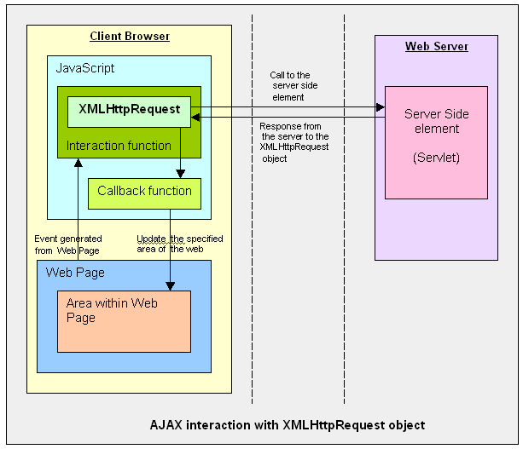

Ajax Interaction
Notes:
So how does AJAX application performs the asynchronous
communication with the server?
This slide also compares conventional web application and AJAX
application. In the left side, which shows the conventional web
application, HTTP request/response interaction occurs directly
between a browser and a backend web application.
In the right side, which shows AJAX based web application, within
a browser, there is AJAX engine, which is actually represented by a
JavaScript object called XMLHttpRequest which handles the HTTP
request/response interaction in an asynchronous fashion.

Slide 11
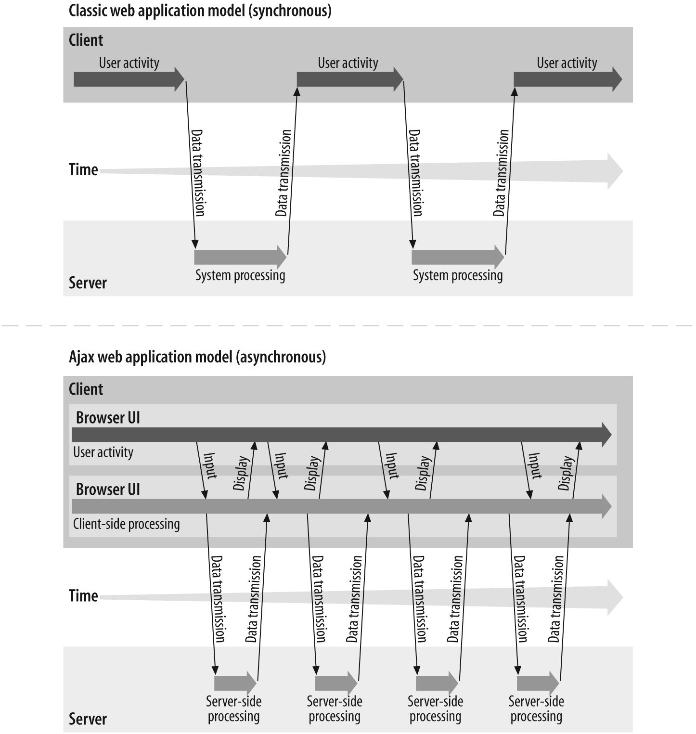
Ajax Interaction
Notes:
I assume some of you have seen this picture before. This picture
compares the user interaction models of conventional web
application in the top half of the slide against AJAX-fied web
application in the bottom part of the slide.
On the top, it is how a user interaction occurs when conventional
web application is used. Here a user has to stop and wait until a
response is received. What this means is that data fetching activity
interrupts the user operation.
The bottom picture shows how a user interaction occurs for AJAX
application. In this model, a user keeps operating since the data
fetching occurs in the background.

Slide 12
XMLHttpRequest
Its JavaScript object
To exchange data with a server behind the scenes.
It Can be Used
  Update a web page without reloading the page
  Request data from a server after the page has loaded
  Receive data from a server after the page has loaded
  Send data to a server in the background
Notes:
Now let's talk about XMLHttpRequest a bit. It is a JavaScript object,
which means it gets created within a JavaScript code.
The XMLHttpRequest JavaScript object is supported in most modern
browsers.
It is the AJAX engine that performs the HTTP request/response
interaction with the backend web application in asynchronous
fashion.

Slide 13
Server-Side AJAX Request Processing
Server programming model remains the same
  It receives standard HTTP GETs/POSTs
  Can use Servlet, JSP, JSF, ...
With minor constraints
  More frequent and finer-grained requests from client
  Response content type can be
    text/xml
    text/plain
    text/json
    text/javascript
Notes:
Now, how does server side web application handle the AJAX
interaction with the browser? Well as far as Server side code is
concerned, it is just another HTTP request that comes in. The server
side does not even know the browser is sending the HTTP request
in asynchronous fashion and it should not.
What this means is that the server side web application can use any
server side technology of its choice such as servlet, JSP, JSF,
Struts, or whatever.
The server side application however has minor constraints. First, it is
possible the client might send more frequent and finer grained
requests. The response type can be text/xml, text/plain, text/json, or
text/javascript.

Slide 14
Steps of AJAX Operation
A client event occurs
An XMLHttpRequest object is created
The XMLHttpRequest object is configured
The XMLHttpRequest object makes an async. request
The Servlet/JSP returns an XML document containing the result
The XMLHttpRequest object calls the callback() function and processes the result
The HTML DOM is updated

Slide 15
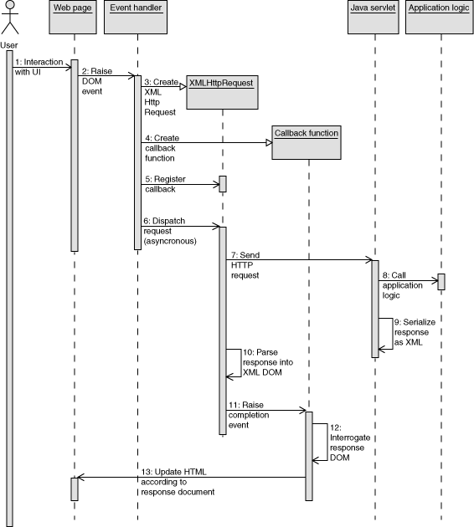
AJAX –SEQUENCE

Slide 16
XMLHttpRequest Properties
onreadystatechange
  Set with an JavaScript event handler that fires at each state change
readyState – current status of request
  0 = uninitialized
  1 = loading
  2 = loaded
  3 = interactive (some data has been returned)
  4 = complete
status
  HTTP Status returned from server: 200 = OK

Slide 17
Creating XMLHttpRequest
  All Modern Browsers has built-in XMLHttpRequest object.
  var makeRequest = function (url, method) {
  var request = new XMLHttpRequest();
  };

Slide 18
Create a Promise
  var makeRequest = function (url, method) {
  var request = new XMLHttpRequest();
  return new Promise(function (resolve, reject) {
  // XHR process code
  });
  };

Slide 19
Managing With Promise
  return new Promise(function (resolve, reject) {
  request.onreadystatechange = function () {
  if (request.readyState !== 4) return;
  if (request.status == 200) {
  resolve(request);
  } else {
  reject({
  status: request.status,
  statusText: request.statusText
  });
  }
  };
  request.open(method || 'GET', url, true);
  request.send();
  });

Slide 20
Invoke the Method
  makeRequest('https://jsonplaceholder.typicode.com/todos/1')
  .then(function (posts) {
  console.log('Success!’, JSON.parse(posts.responseText);
  })
  .catch(function (error) {
  console.log('Something went wrong', error);
  });

Slide 21
Async-Await
Async/await
  Special syntax to work with promises
  Easy to understand and use.
Async functions
  Starts with the async keyword.
  Placed before a function
  The Function always returns a promise.
  Values are wrapped in a resolved promise automatically.
  async function f() {
  return 1;
  }
  f().then(data =>console.log(data)); // 1

Slide 22
Async-Await
Await
  Works only inside async functions
  Makes JavaScript wait until that promise settles and returns its result.
  async function f() {
  let promise = new Promise((resolve, reject) => {
  setTimeout(() => resolve("done!"), 1000)
  });
  let result = await promise; // wait until the promise resolves
  console.log(result); // "done!"
  }
  f();

Slide 23
Fetch
Fetch API is an asynchronous web API with JavaScrip
  It returns the data in the form of promises.
const response = fetch(resource[, options]);
resource:
  the URL string, or a Request object
options:
  The configuration object with properties like method, headers, body, credentials.

Slide 24
Fetch
async/await
  Can work with fetch() because it simplifies the work with promises
Supports multiple functions for different data formats
response.json:
  Returns data as a JSON Object.
response.text:
  Returns data in raw text.
response.formData:
  Returns data as FormData.

Slide 25
Async-Await
  async function fetchData() {
  const response = await fetch('https://jsonplaceholder.typicode.com/todos/2');
  const todolist = await response.json();
  return todolist;
  }
  fetchData().then(data => {
  console.log(data)
  });

Slide 26
Exception Handling
Can Handle the error and continue the execution.
Done Using the try...catch statement
  try {
  // Error Causing Code
  } catch(error){
  // Handle the Error
  }

Slide 27
Example
  try {
  let response = calculate(10000, 2,0.5);
  console.log(result);
  } catch (e) {
  console.log({ name: e.name, message: e.message });
  }
  console.log('Done');

Slide 28
Symbol
A symbol is a unique and immutable data type.
  It may be used as an identifier for object properties.
  Its an implicit object wrapper for the symbol primitive data type.
  Used to enable private properties.
  Can be found via reflection, using Object.getOwnPropertySymbols or proxies.
  Used to avoid name clashes between properties.

Slide 29
Symbol
Can not create an explicit Symbol wrapper object
  var sym = new Symbol(); // TypeError
Can Create new primitive symbol value
  const MY_KEY = Symbol();
  const obj = {};
  obj[MY_KEY] = 123;
  console.log(obj[MY_KEY]); // 123

Slide 30
Symbol.toPrimitive
Used to convert an object to a primitive value.
The function is called with a string argument hint
It specifies the preferred type of the result primitive value.
The hint argument can be one of "number", "string", and "default".

Slide 31
Symbols
  var Product = {
  name:"TV",
  price: 40000,
  [Symbol.toPrimitive](hint){
  switch(hint){
  case "number": return this.price;
  case "string": return this.name;
  default: return this;
  }
  }
  };
  console.log(Product*2);
  console.log("Product is ".concat(Product));

Slide 32
Symbol
  const VALUE = Symbol('value')
  class Secret {
  constructor(val,city) {
  this[VALUE] = val
  this.city =city
  }
  get() { return this[VALUE] }
  }
  let mySecret = new Secret('password','chennai’)

Slide 33
Symbol
  console.log(mySecret['VALUE']) // undefined
  console.log(mySecret[Symbol('value')]) // undefined
  console.log(mySecret[Symbol.for('value')]) // undefined
  console.log(Object.getOwnPropertyNames(mySecret)) // []
  console.log(mySecret.get()) // "password"
  console.log(mySecret.city) //chennai

Slide 34
// An object without Symbol.toPrimitive property.
const obj1 = {};
console.log(+obj1); // NaN
console.log(`${obj1}`); // "[object Object]"
console.log(obj1 + ""); // "[object Object]"
// An object with Symbol.toPrimitive property.
const obj2 = {
[Symbol.toPrimitive](hint) {
if (hint === "number") {
return 10;
}
if (hint === "string") {
return "hello";
}
return true;
},
};
console.log(+obj2); // 10 — hint is "number"
console.log(`${obj2}`); // "hello" — hint is "string"
console.log(obj2 + ""); // "true" — hint is "default"
Copy to Clipboard

