Slide 1
SPRING ACTUATOR

Slide 2
Spring Boot Actuator
Exposes REST endpoints that can be consumed to manage and monitor application.
Monitor application health, application bean details, version details, thread dumps, logger details etc
Can restrict these endpoints to be consumed by authorized users only and Spring provides easy way to secure your REST endpoints.

Slide 3
actuator End Point
actuator
  It provides a hypermedia-based discovery page for the other endpoints.
  By default it is sensitive and hence requires username/password for access or may be disabled if web security is not enabled.
Beans
  It displays complete beans configured in the app.
Configprops
  It displays a collated list of all @ConfigurationProperties.

Slide 4
actuator End Point
Health
    It shows application health information
  management.endpoint.health.show-details:=always
Info
  It displays arbitrary application info.
Loggers
  It shows and modifies the configuration of loggers in the application.
metrics:
  It shows metrics information for the current application.
Mappings
  It displays a collated list of all @RequestMapping paths.

Slide 5
Actuator Endpoints
health and info can be accessed
  Other endpoints are disabled by default
management.endpoints.web.exposure.include=*.
  Will enable all of them
  Can also list endpoints which should be enabled
To expose all enabled endpoints except one (for example /loggers), we use:
  management.endpoints.web.exposure.include=*
  management.endpoints.web.exposure.exclude=loggers
  management.security.enabled=false

Slide 6
Info Endpoint
  info:
  app:
  name: ${spring.application.name}
  build:
  artificatId: '@project.artifactId@'
  groupId: '@project.groupId@'
  version: '@project.version@'
  java:
  version:@java.version@
  management:
  info:
  java:
  enabled: true
  env:
  enabled: true

Slide 7
Health Endpoint
  management:
  endpoint:
  health:
  show-details: always

Slide 8
Logger Endpoint
http://localhost:8787/actuator/metrics
http://localhost:8787/actuator/loggers
To Change the Log level make a post request
  http://localhost:8787/actuator/loggers/org.springframework.boot.SpringApplication
  { "configuredLevel": "trace“ }
To reset the logging level back to the original value
  { "configuredLevel": null }

Slide 9
Shut Down End Point
Endpoint is used to shut down the Spring Boot application
Need to enable by adding a property in the application.yml
Done By Making a POST call.
  http://localhost:7070/actuator/shutdown
  management:
  endpoint:
  shutdown:
  enabled: true

Slide 10
Extending Info End Point
  @Component
  public class CustomInfoEndPoint implements InfoContributor {
  @Autowired
  private ConfigurableApplicationContext ctx;
  @Override
  public void contribute(Info.Builder builder) {
  Map<String, Object> details = new HashMap<>();
  details.put("bean-definition-count", ctx.getBeanDefinitionCount());
  details.put("startup-date", ctx.getStartupDate());
  builder.withDetail("context", details);
  }
  }

Slide 11
SPRING CLOUD CONFIG SERVER

Slide 12
Move configuration away from application
Cloud Applications requires a way to maintain and distribute the Configuration data to all services
Auditing changes:
  Look at the history of what changes were done by whom and when they were applied.
Approval of changes:
  Lot of issues are caused by the wrong configuration.
  Changes should be approved by some one
Resiliency:
  Issues related to configuration tool being not available
Synchronization:
  Way to know that there is a change in the configuration

Slide 13
Spring-cloud-config
Server
  Pulls configuration for remote clients from various sources.
  Repositories can resolve the Environment that applies for a specific application, profile, and label.
  There are different implementations to pull ,that can connect to Git, SVN, or Vault.
Client
  The client which will connect to the server through HTTP.
  It adds a PropertySourceLocator that will call the server to load up the applicable configuration.

Slide 14
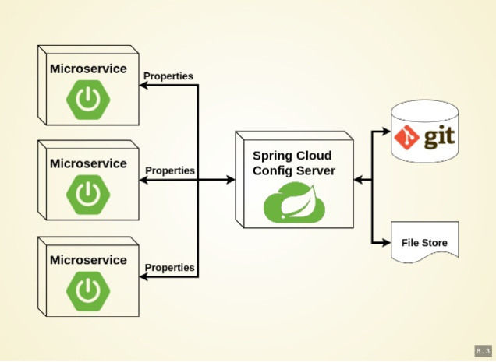
Working of Configuration Server

Slide 15
Types of Configuration
Global Configuration
  By Using application.yml or application.propeties
Application-Specific Configuration
  Serving only to a specific app.
  [APP-NAME].yml or [APP-NAME].properties
. Profile-Specific Configuration
  [APP-NAME]-[PROFILE-NAME].yml or [APP-NAME]-[PROFILE-NAME].properties

Slide 16
Git Repository
Can store the properties in git repository
Create or update a git repository.
Can Create and place the external property files
  Micro Service will be using external configuration of properties.
Can maintain same property name for different environment
It can be details of urls, credentials, database details etc.

Slide 17
Git Repository Directory Structure
https://github.com/vatsanTraining/spring-cloud-config
  customer-service
    application.yml
  payment-service
    application.yml

Slide 18
Config Server
Spring Cloud Config Server provides an HTTP resource-based API for external configuration
@EnableConfigServer
  The server is embeddable in a Spring Boot application
  @SpringBootApplication
  @EnableConfigServer
  public class ConfigServer {
  public static void main(String[] args) { SpringApplication.run(ConfigServer.class, args);
  }
  }

Slide 19
Spring Cloud Configuration Server
searchPaths
  Repository can also optionally store config files in sub-directories, and patterns to search for those directories can be specified as
  spring:
  cloud:
  config:
  server:
  git:
  uri: https://github.com/vatsank/spring-cloud-config
  search-paths:
  - '{application}’
  http://localhost:8888/actuator/default

Slide 20
Config Client Configuration
  spring:
  application:
  name: customer-service
  config:
  import: configserver:http://localhost:8888
  management:
  endpoints:
  web:
  exposure:
  include:
  - "*“
  http://localhost:8080/actuator/configprops

Slide 21
Refresh Scope
@RefreshScope
  Can do dynamic configuration of properties by reloading.
  If a property is modified in the configuration server,
  Spring Boot will automatically reload the new values without needing to restart it.
  Need to make a POST request to the “/actuator/refresh” endpoint
POST: localhost:8080/actuator/refresh

Slide 22
REACTIVE SPRING

Slide 23
Introduction
A programming paradigm that promotes
  asynchronous, non-blocking, event-driven approach to data processing.
Thread per request model to more requests with few number of threads
  Prevent threads from blocking while waiting for I/O operations to complete

Slide 24
Subscription
Subscription made by the subscriber
With the publisher
  To fetch data.
  public interface Subscription {
  public void request(long n);
  public void cancel();
  }

Slide 25
Subscriber
Represents the consumer of the stream data.
  public interface Subscriber<T> {
  public void onSubscribe(Subscription s);
  public void onNext(T t);
  public void onError(Throwable t);
  public void onComplete();
  }

Slide 26
Publisher
Represents the data source
  database, external service, etc.
  public interface Publisher<T> {
  public void subscribe(Subscriber<? super T> s);
  }

Slide 27
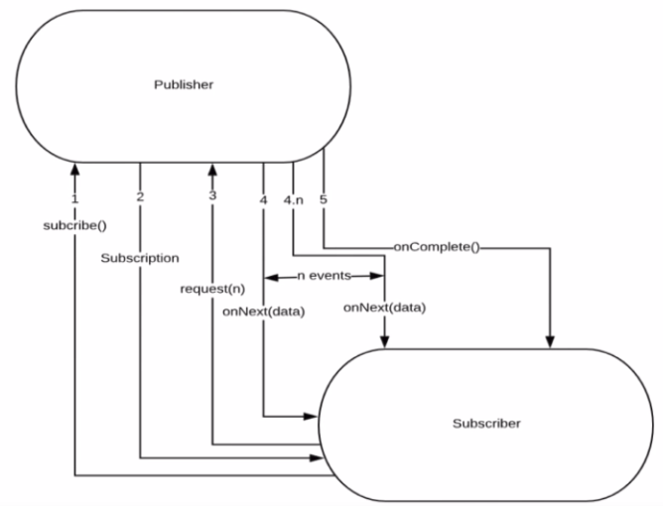
Flow Between Publisher and Subscriber

Slide 28
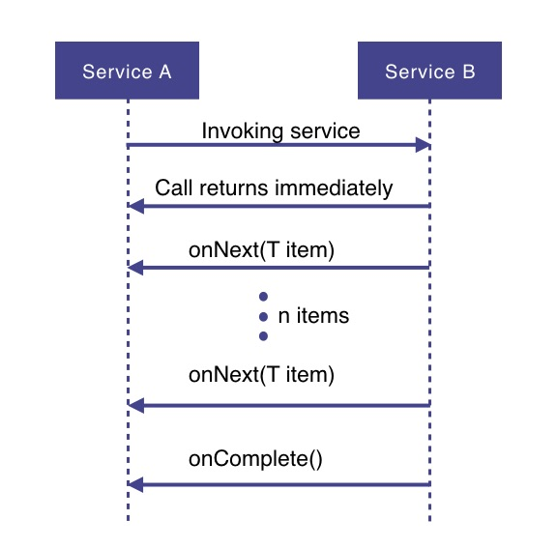
How Does it Work

Slide 29
How Does it Work
Service A wants to retrieve some data from service B.
Service A will make a request to service B which returns immediately
  Non-blocking and asynchronous.
Data requested will be made available to service A as a data stream,
  Service B will publish an onNext-event for each data item one by one.
When all the data has been published
  onComplete event is fired
In case of an error, an onError event would be published
  Items would not be emitted.

Slide 30
PROJECT REACTOR

Slide 31
PROJECT REACTOR
Spring Framework supports reactive programming since version 5.
  That support is build on top of Project Reactor.
WebFlux, Spring's reactive-stack web framework, requires Reactor as a core dependency.
Suited for Microservices Architecture
Offers backpressure-ready network engines for HTTP (including Websockets), TCP, and UDP.
Built and maintained by Pivotal
Recommended Library to work with Spring Boot
Runs on Java 8 and above.

Slide 32
Setting up a Project
Spring Boot application using Spring Initializr.
  Add Spring Reactive Web as dependecy
The spring-boot-starter-webflux dependency is added
  It will bring in the reactor-core dependency.
  The reactor-test has been added as a dependency.
Spring Webflux
  A reactive-stack web framework
  Runs on Netty, and Servlet 3.1+ containers.

Slide 33
Types of Publishers
Spring Webflux uses two Publishers
Mono
  To publish 0..1 element
  Mono is like the Optional type provided in Java 8.
  Mono to return a single object or VOid
Flux
  To publish 0..N element.
  Used to return lists.

Slide 34
Flux and Mono
They are both terminated either by a completion signal or an error
They call a downstream Subscriber's onNext, onComplete and onError methods.
Both provide a set of operators to support transformations, filtering, and error handling.

Slide 35
Creating Flux
Just (T... data)
  Overloaded method
  Create a new Flux that will only emit a single element then onComplete.
  Returns a new Flux
Flux<String> fluxColors = Flux.just("red", "green", "blue");
fluxColors.subscribe(System.out::println);

Slide 36
SPRING WEBCLIENT

Slide 37
WebClient
Introduced from Spring 5
  Its a non-blocking client with support for Reactive Streams.
  It’s a replacement for RestTemplate .
  Its more functional and is fully reactive.
  It's included in the spring-boot-starter-weblux dependency

Slide 38
Load Balancing
A distributed system may consist of many services running on different computers.
When the number of users is large, a service is created multiple replicas.
Each replica runs on a different computer.
A Load Balancer” helps to distribute incoming traffic equally among servers.

Slide 39
Load Balancing with Web Client
Add spring-cloud-starter-load balancer dependencies
Web Client can be configured to work with Load Balancer client
WebClient.Builder
  Used to create a load-balanced WebClient
  Add the @Bean annotation

Slide 40
Load Balancing with Web Client
  @Bean
  @LoadBalanced
  WebClient.Builder builder() {
  return WebClient.builder();
  }
  @Bean
  WebClient client(WebClient.Builder builderRef) {
  return builderRef.build();
  }

Slide 41
To Register Multiple Instances
  server:
  port: ${port:0}
  eureka:
  instance:
  instance-id:
  ${spring.application.name}:
  ${spring.application.instance_id:${random.value}}

Slide 42
Get the Instance’s Port Number
  @Service
  @Getter
  @Slf4j
  public class ServerPortService {
  private int port;
  @EventListener
  public void onApplicationEvent(ServletWebServerInitializedEvent event) {
  log.info("Server Port :="+event.getWebServer().getPort());
  }
  }

Slide 43
Reactive Load Balancer
ReactiveLoadBalancer
  The Implementation of the interface uses a Round-Robin
  It gets instance from reactive ServiceInstanceListSupplier
  It retrieves available instances from Service Discovery using a Discovery Client available in the classpath.
@LoadBalanced
  Need to have a load balancer implementation in the classpath.
  If the Spring Cloud LoadBalancer is in the class path Then, ReactiveLoadBalancer is used
    Helps to use "logical identifiers" for the URLs passed

Slide 44
Http Methods
get()
  indicates that we are making a GET request.
  We know that the response will be a single object, so we're using a Mono as explained before.
  client.get()
  Client.post()

Slide 45
WebClient
client.get().uri("lb://PRODUCT-SERVICE/api/v1/items")
URI
  Takes a service name => lb://PRODUCT-SERVICE
The “lb“ in the “uri” will use the LoadBalancerClient
  Load Balancer Client will resolve to an actual host and port
  Replaces the URI

Slide 46
Rest Client - Controller
  @RestController
  public class ClientController {
  @Autowired
  private WebClient client;
  @GetMapping(path = "/hotels")
  public Flux<String> getAllHotels(){
  return client.get()
  .uri("lb://HOTEL-SERVICE/api/v1/hotels")
  .retrieve()
  .bodyToFlux(String.class);
  }
  }

Slide 47
Rest Client - Controller
  @PostMapping(path = "/hotels")
  public Mono<HotelDto> create(@RequestBody HotelDto dto)
  {
  return client.post()
  .uri("lb://HOTEL-SERVICE/api/v1/hotels/{id}")
  .body(Mono.just(dto), HotelDto.class)
  .retrieve()
  .bodyToMono(HotelDto.class);
  }

Slide 48
Rest Client - Controller
  @DeleteMapping(path = "/hotels/{id}")
  public Mono<Void> removeHotelById(@PathVariable("id") int id){
  return client.delete()
  .uri("lb://HOTEL-SERVICE/api/v1/hotels/{id}" ,id)
  .retrieve()
  .bodyToMono(Void.class);
  }
  }

Slide 49
Rest Client - Controller
  @GetMapping(path = "/hotels/{id}")
  public Mono<String> getHotelById(@PathVariable("id") int id){
  return client.get()
  .uri("lb://HOTEL-SERVICE/api/v1/hotels/{id}",id)
  .retrieve()
  .bodyToMono(String.class);
  }

Slide 50
Zipwhen
Used to Wait for the result from first mono,
  uses it to create a second mono provided by rightGenerator
  when both sources complete Returns a new combined Mono
  Combine both results into defined by the provided combinator function.
Mono.zipWhen(
Function<First, Mono<? extends Second>> rightGenerator,
BiFunction<First,Second, ResponseDto> combinator)

Slide 51
ZipWhen
  @GetMapping(path = "/srch/{id}")
  public Mono<ResponseDto> getDetails(@PathVariable("id") int id){
  return client.get()
  .uri("http://localhost:4042",uriBuilder -> uriBuilder.path("/api/v1/customers/{id}")
  .build(id)).retrieve().bodyToMono(Customer.class)
  .zipWhen(custResp -> client.get()
  .uri("http://localhost:3042" ,uriBuilder -> uriBuilder.path("/api/v1/payments/{name}")
  .build(custResp.getCustomerName())).retrieve().bodyToMono(Payment.class), (custResp,payResp) -> {
  dto.setCustomer(custResp);
  dto.setPayment(payResp);
  return dto;
  });}

Slide 52
SPRING CLOUD CIRCUIT BREAKER

Slide 53
Circuit Breaker
Used to stop the communication to the application may slow down or fail
  It interrupts the current flow after a fault is detected
  When it is is reset (manually or automatically), it can resume its normal operation.
Services will fail fast and have some fallback functionality.
It prevents the failure from cascading and giving the failing service time to recover.

Slide 54
Spring Cloud Circuit Breaker
Spring Cloud Circuit Breaker
  An abstraction API for adding circuit breakers to your application.
  There are few supported implementations:
Resilience4J
Resilience4J Reactive
Spring Retry

Slide 55
Resilience4j
Fault tolerance library designed for Java 8 and functional programming.
It is lightweight, modular and fast.
  resilience4j-circuitbreaker
  resilience4j-ratelimiter
  resilience4j-bulkhead
  resilience4j-retry
  resilience4j-cache
Fault Tolerance
  The ability of a system to operate properly in case of the failure of some of its components.
  Done at all levels and also in subsystems as a part of the design.

Slide 56
Circuit Breaker
Wrap a protected function call in a circuit breaker object
  Circuit Breaker will monitor for failures.
Once the failures reach a certain threshold, the circuit breaker trips,
All further calls to the circuit breaker return with an error, without the protected call being made at all.

Slide 57
Need For Circuit Breaker
In case we have serviceB down, serviceA should still try to recover from this and try to do one of the followings:
Custom fallback:
  Try to get the same data from some other source. If not possible, use its own cache value.
Fail fast:
  If serviceA knows that serviceB is down, there is no point waiting for the timeout and consuming its own resources. It should return ASAP “knowing” that serviceB is down
Don’t crash:
  As we saw in this case, serviceA should not have crashed.
Heal automatic:
  Periodically check if serviceB is working again.
Other APIs should work:
  All other APIs should continue to work.

Slide 58
Configuring Circuit Breaker
  public class OrderController {
  private WebClient client;
  private ReactiveResilience4JCircuitBreakerFactory cbFactory;
  private ReactiveCircuitBreaker circuitBreaker;
  // Two Args Constructor
  public OrderController(
  WebClient client,
  ReactiveResilience4JCircuitBreakerFactory cbFactory) {
  this.client = client
  this.cbFactory = cbFactory;
  this.circuitBreaker = cbFactory.create(“orderService");
  }

Slide 59
Configuring With Web Client
  @GetMapping(path = "/order")
  public Mono<String> slow() {
  return circuitBreaker.run(
  client.get()
  .uri("lb://ORDER-SERVICE/orders")
  .retrieve()
  .bodyToMono(String.class),
  throwable -> Mono.just("fallback"));
  } }
  Can also add timeout : timeout(Duration.ofMinutes(5));

Slide 60
Configuring With Web Client
  import org.springframework.cloud.circuitbreaker.resilience4j.*;
  @Bean
  public Customizer<ReactiveResilience4JCircuitBreakerFactory> defaultCustomizer(){
  return factory -> factory.configureDefault(id -> new Resilience4JConfigBuilder(id)
  .circuitBreakerConfig(CircuitBreakerConfig.ofDefaults()).build());
  }

Slide 61
Stages of Circuit Breaker
Circuit Breaker has the following three stages:
  Closed
  Open
  Half-Open

Slide 62
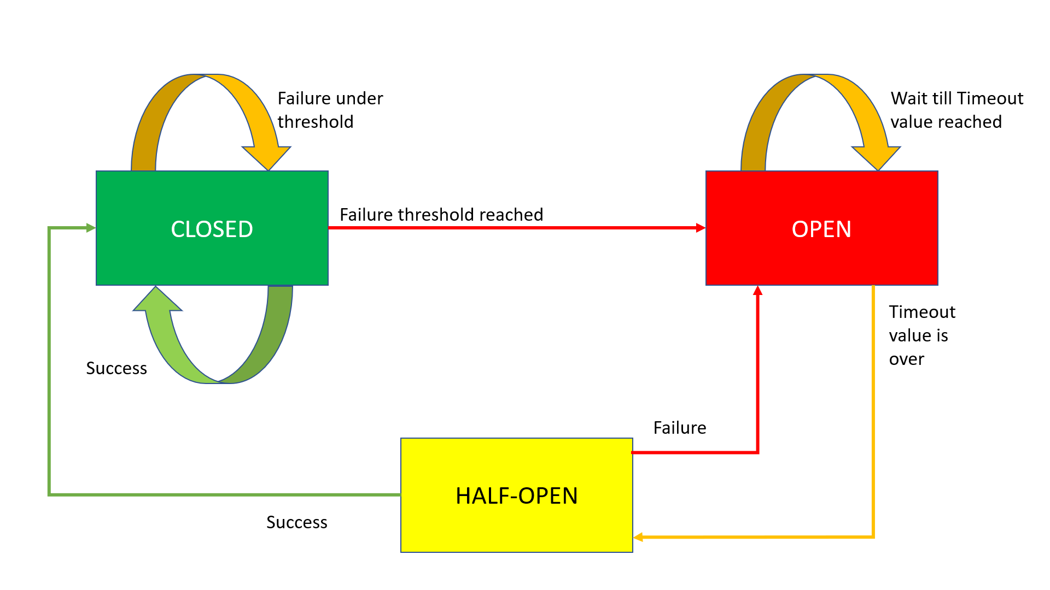
Circuit Breaker Working

Slide 63
Closed State
The Circuit Breaker enters a CLOSED state and waits for Client Requests.
In the CLOSED state, it does the following things:
  It receives Client Requests and makes a call to the Service
  If it succeeds and receives the response from that Service, it will reset the failure count to 0 and send that response back to the end user.
  If it fails to receive the response from that Service, it will increment the failure count by one and check whether that count is greater than the predefined failure threshold
  If the failure count is greater than the failure threshold, then that Circuit Breaker component trips or enters into the OPEN state
  CLOSED state means flow goes as expected,

Slide 64
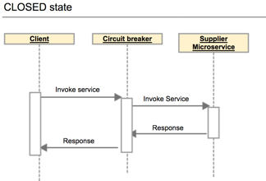
Closed State

Slide 65
OPEN state
In the OPEN state, it does the following things:
  Enters into this state when the failure count is greater than the failure threshold
  It does not make a call to the Service
  If the Client sends any requests to it, it won’t make a call to the Service; it just sends an Exception and waits for some time
  i.e. the Timeout value specified
  Once the Timeout value expires, it will enter into the HALF-OPEN state
OPEN means situation is not good and moving to fallback mode

Slide 66
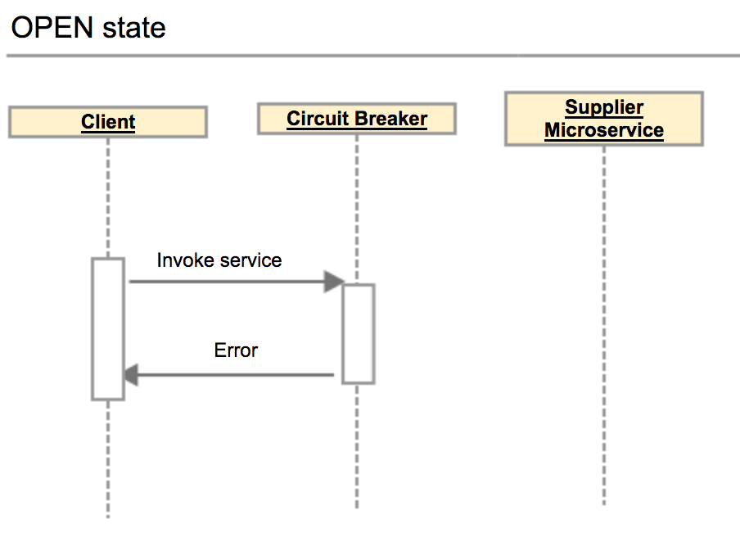
Open State

Slide 67
HALF-OPEN state
In the HALF-OPEN state, it does the following things:
  Enters into this state when it finishes the predefined waiting time.
  It sends the first request to the Service.
  If it receives a success response, then it will enter into the CLOSED state to process further Client Requests. Before picking up the first client request, it will reset the failure count to 0 again.
  If it receives a failure response, then it will re-trip to the OPEN state and wait for a predefined Timeout value to expire.

Slide 68
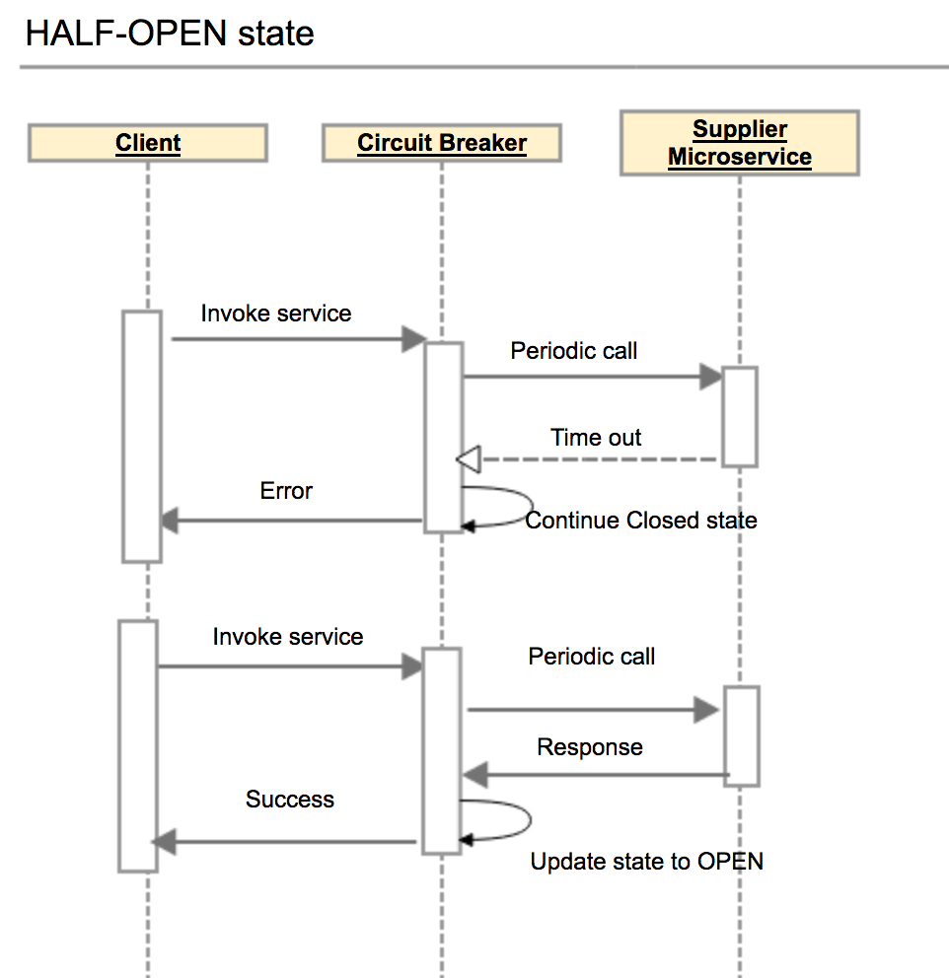
Half Open State

Slide 69
Configuring Circuit Breaker
failureRateThreshold:
  Failure threshold value of 50 which means if the 50 requests are failing in the 100 requests, keep the circuit breaker in CLOSED state.
permittedNumberOfCallsInHalfOpenState
  Default Value : 10
  Configures the number of permitted calls when the CircuitBreaker is half open.

Slide 70
Configuring Circuit Breaker
slidingWindowType : COUNT_BASED
  Used to store and count the results of calls
  Circuit breaker always keeps the total number of invoke equals to slidingWindowSize.
  COUNT_BASED:
    The last slidingWindowSize calls are recorded and aggregated.
  TIME_BASED:
    The calls of the last slidingWindowSize seconds recorded and aggregated
slidingWindowSize
  Default value is100
  Deciding the number of calls to decide when closing a circuit breaker.

Slide 71
Failure rate formula
Count based sliding window
FailureRate = numberOfFailureInvoke / totalNumber X 100%.
Total number =Number of failures invoke + number of successes invoke.
The total number of invoke never exceed the slidingWindowSize .
If the slidingWindowSize is 10 and the number of successes invoke is Nine.
If the 10th invoke is a failure invoke, then circuit breaker will decrease the number of successes invoke by one, and increases the number of failures invoke by one.
Circuit breaker always keeps the total number of invoke equals to slidingWindowSize.

Slide 72
Configuring Circuit Breaker
waitDurationInOpenState:
  The time in millisecond that breaker should wait before transitioning from open to half-open
  Default value is 60000 (1 Minute)
automaticTransitionFromOpenToHalfOpenEnabled
  True: CircuitBreaker will automatically transition from open to half-open state and no call is needed to trigger the transition.
  A thread is created to monitor all the instances of CircuitBreakers to transition them to HALF_OPEN once waitDurationInOpenState passes.
  False : the transition to HALF_OPEN only happens if a call is made, even after waitDurationInOpenState is passed.
  The advantage here is no thread monitors the state of all CircuitBreakers

Slide 73
Configuring Circuit Breaker
minimumNumberOfCalls Default :100
Used for failure rate calculation.
  If minimumNumberOfCalls is 10, then at least 10 calls must be recorded, before the failure rate can be calculated.
  If only 9 calls have been recorded the CircuitBreaker will not transition to open even if all 9 calls have failed.

Slide 74
circuitbreaker
resilience4j:
circuitbreaker:
instances:
orderService:
registerHealthIndicator: true
automaticTransitionFromOpenToHalfOpenEnabled: false
failureRateThreshold: 50
minimumNumberOfCalls: 3
permittedNumberOfCallsInHalfOpenState: 2
slidingWindowSize: 10
waitDurationInOpenState: 5s
slidingWindowType: COUNT_BASED

Slide 75
circuitbreaker
  management:
  endpoints:
  web:
  exposure:
  include:
  - "*"
  endpoint:
  health:
  show-details: always
  circuitbreakers:
  enabled: true
  health:
  circuitbreakers:
  enabled: true

Slide 76
Actuator Endpoints
  http://localhost:6565/actuator/circuitbreakerevents
  http://localhost:8080/actuator/health
  http://localhost:6565/actuator/circuitbreakers
  http://localhost:6565/actuator/metrics/resilience4j.circuitbreaker.calls

Slide 77
SPRING CLOUD GATEWAY

Slide 78
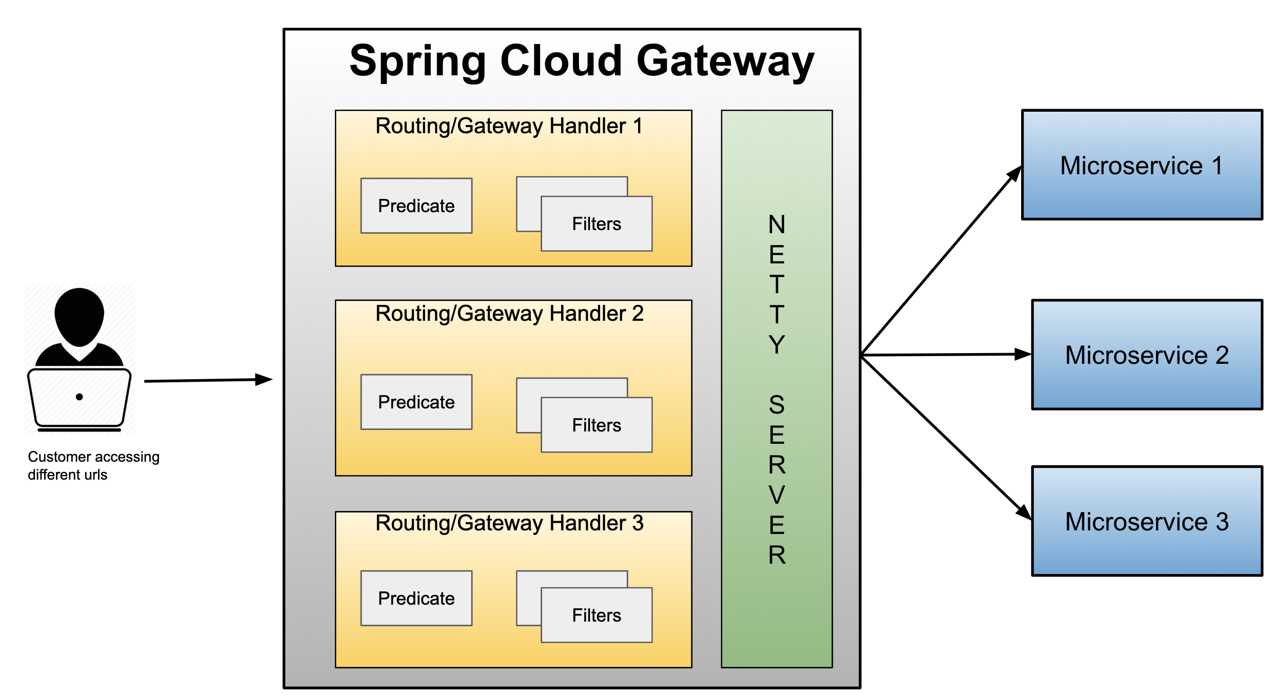
Spring cloud gateway

Slide 79
Gateway
Micro Services require a unified interface to the consumers.
  Services are split into small composable apps
  It shouldn’t be visible to users
  Should have less development effort.
Gateway handles requests to multiple backing services.
  It provides a unified “front door”
  Browser, Mobile Application or other user interface can consume services from multiple hosts
  Can mange the cross-origin resource sharing and authentication

Slide 80
Cloud Gateway
Gateway is an intermediate layer between the users and services.
  Eureka server solved the problem of giving names to services instead of hard coding their IP addresses.
It Maps between a prefix path and a service or more than one service running on different ports
Can Use Eureka server to route the requested service.
Load balances instances
Can filter requests, add authentication, etc.

Slide 81
Spring Cloud Gateway
Provides a simple and effective way to route incoming requests to the appropriate destination using Gateway Handler Mapping.
Uses Netty server to provide non-blocking asynchronous request processing.
Route configuration
Programmatically
  Using Spring RouteLocator.
Properties
  application.yml

Slide 82
Enable Discovery Locator
Can configure routes to the services registered with eureka
Can skip creating API Gateway routes manually.
  spring:
  application:
  name: api-gateway
  cloud:
  gateway:
  discovery:
  locator:
  enabled: true
  lower-case-service-id: true
To access a service with “serviceId” PRODUCT_SERVICE
  http://localhost:8080/product-service/api/v1/items

Slide 83
application.yml
  spring:
  cloud:
  gateway:
  routes:
  - id: review-module
  uri: lb://REVIEW-SERVICE
  predicates:
  - Path=/api/v1/reviews/**
  application:
  name: cloud-gateway
  Invoke the service :
  http://localhost:8080/api/v1/reviews

Slide 84
Actuator Endpoints
Base Path :
  /actuator/gateway
/actuator/gateway/routefilters
  Displays the list of global filters applied to the routes.
/actuator/gateway/routes
  Displays the list of routes defined in the gateway.
/actuator/gateway/routes/{id}
  Displays information about a particular route.

Slide 85
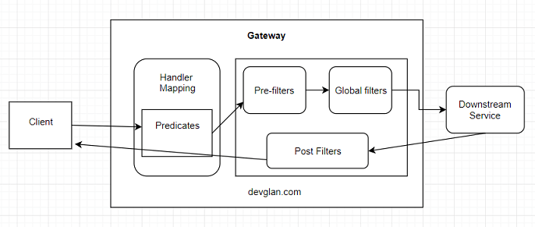
Cloud Gateway Filters

Slide 86
Global Filters
Created by implementing the Interface GlobalFilter with one Method filter()
public Mono<Void> filter(ServerWebExchange exchange, GatewayFilterChain chain)
ServerWebExchange
  Contract for an HTTP request-response interaction.
  Provides access to the HTTP request and response
  Exposes Properties for server-side processing
GatewayFilterChain
  An inteface that allows a WebFilter to delegate to the next in the chain.

Slide 87
Global Filters- Pre Filter
  @Component
  public class MyGlobalFilter implements GlobalFilter {
  public Mono<Void> filter(ServerWebExchange exchange, GatewayFilterChain chain) {
  boolean result =
  exchange.getRequest().getURI().
  getRawPath().contains("reviews");
  if(result) {
  exchange.getResponse().setStatusCode(HttpStatus.UNAUTHORIZED);
  return exchange.getResponse().setComplete();
  }
  return chain.filter(exchange);
  }
  }

Slide 88
Global Filter – Post Filter
@Bean
public GlobalFilter postGlobalFilter() {
return (exchange, chain) -> {
return chain.filter(exchange)
.then(Mono.fromRunnable(() -> {
log.info("Global Post Filter executed");
}));
};

Slide 89
Ordering the Filter
Can Use the Ordered interface to control the multiple filters Order of execution
Can give low value for High precedence by overriding getOrder() Method
  The filter with order as Integer.MIN_VALUE will be executed first in the pre-filter phase and last in post-filter phase .
  Filter with order as Integer.MAX_VALUE will be executed first in the post-filter phase and execute last in the pre-filter phase.

Slide 90
Ordering Filters
  @Component
  public class PreFilter implements GlobalFilter, Ordered {
  @Override
  public int getOrder() {
  return -1;
  }
  }

Slide 91
Gateway Routing
Has Three Main parts
Route:
  The Destination of a particular request.
  It will have destination URI
  It has a condition to be satisfied
  It has one or more filters.
Predicate
  A condition to match like an “if” condition.
  Java 8 Function Predicate
Filter:
  Instances of Spring Framework WebFilter.
  Can modify request or response.
  Spring Provides many WebFilters

Slide 92
Route Locator Builder
Gateway configuration can also be done using java route api
RouteLocatorBuilder
  Used to configure related routing information
  To add predicates and filters
  Provides a Static Method Builder()
    Builder() method is used to construct routes and return a RouteLocator

Slide 93
RouteLocator
RouteLocator
  public interface RouteLocator {
  Flux<Route> getRoutes();
  }
  @Bean
  public RouteLocator gatewayRoutes(RouteLocatorBuilder builder) {
  }

Slide 94
Routing Object
Route
  Defines the routes information such as route assertions, filters, routing addresses, and route priorities.
  When the request arrives, it is processed by the Gateway filter
    And then its forwarded to the proxy service.
  public class Route implements Ordered {
  private final String id;
  private final URI uri;
  private final int order;
  private final AsyncPredicate<ServerWebExchange> predicate;
  private final List<GatewayFilter> gatewayFilters;
  }

Slide 95
Configuring Route Locator
  @Configuration
  public class MyRouteConfig {
  @Bean
  public RouteLocator gatewayRoutes(RouteLocatorBuilder builder) {
return builder.routes()
.route(p -> p.path("/api/v1/reviews/**")
.filters(f -> f.addResponseHeader("Hello", "World"))
.uri("lb://REVIEW-SERVICE") )
.route(p -> p.path("/api/v1/choices/**")
.uri("http://localhost:7575/"))
.build();
  }
  }

Slide 96
Gateway Filter
  @Component
  public class LoggingFilter implements GatewayFilter {
  @Override
  public Mono<Void> filter(ServerWebExchange exchange, GatewayFilterChain chain) {
  ServerHttpRequest request = exchange.getRequest();
  Log.info(request.getPath().toString());
  return chain.filter(exchange);}
  }

Slide 97
Filters With Java Configuration
  @Bean
  public RouteLocator gatewayRoutes(RouteLocatorBuilder builder,LoggingFilter logger) {
  return builder.routes()
  .route(p -> p.path("/api/v1/restaurants/**")
  .filters(f -> f.filter(logger, 0))
  .uri("lb://RESTAURANT-INFO-SERVICE") )
  .route(p -> p.path("/accounts/**")
  .uri("lb://ACCOUNT-SERVICE"))
  .build();
  }

Slide 98
Filter with Circuit Breaker
  @Bean
  public RouteLocator myRoutes(RouteLocatorBuilder routeBuilder) {
  return routeBuilder.routes().
  route(p->p
  .path("/api/v1/payments")
  .filters(f->f.circuitBreaker(
  c->c.setName("custom").setFallbackUri("/default") ))
  .uri("http://localhost:3050"))
  .build();
  }

Slide 99
Filter with Circuit Breaker
  @Bean
  public Customizer<ReactiveResilience4JCircuitBreakerFactory> defaultCustomizer(){
  return factory -> factory.configureDefault(id -> new Resilience4JConfigBuilder(id)
  .circuitBreakerConfig(CircuitBreakerConfig.ofDefaults())
  .timeLimiterConfig(TimeLimiterConfig.custom()
  .timeoutDuration(Duration.ofSeconds(20)).build()).build());
  }

Slide 100
Rest Controller
  @GetMapping(path = "/default")
  public String message() {
  return "Default Message";
  }

Slide 101
Reactive Security
  @Configuration
  @EnableWebFluxSecurity
  public class InMemorySecurityConfig {
  @Bean
  public MapReactiveUserDetailsService userDetailsService() {
  UserDetails user1 = User
  .withUsername("india")
  .password(encoder.encode("india"))
  .roles("ADMIN")
  .build();
  return new MapReactiveUserDetailsService(user1);
}

Slide 102
Reactive Security
  @Bean
  public SecurityWebFilterChain springSecurityFilterChain(ServerHttpSecurity http) {
  http
  .authorizeExchange()
  .anyExchange().authenticated()
  .and()
  .httpBasic();
  return http.build();
  }
  }

Slide 103
Global Filter
@Component
public class AuthFilter implements GlobalFilter {
@Override
public Mono<Void> filter(ServerWebExchange exchange, GatewayFilterChain chain) {
if (!exchange.getRequest().getHeaders().containsKey(HttpHeaders.AUTHORIZATION)) {
throw new RuntimeException("Missing authorization information");
}

Slide 104
Global Filter
List<String> authorization = exchange.getRequest().getHeaders().get("Authorization");
if(exchange.getRequest().getHeaders().get(HttpHeaders.AUTHORIZATION).get(0)!=null) {

Slide 105
Global Filter
ServerHttpRequest modifiedRequest = exchange.getRequest().mutate().
header("Authorization", authorization.get(0)).build();
return chain.filter(exchange.mutate().request(modifiedRequest).build());
} else {
return chain.filter(exchange);
}
}
}
curl -u india:india http://localhost:8080/driver-service/api/v1/drivers

