Slide 1
Flow Control

Slide 2
Objectives
Decision control structures (if, else, switch)
Repetition control structures (while, do-while, for)
Branching statements (break, continue, return)

Slide 3
Control Structures
To change the ordering of the statements in a program
Two types of Control Structures
decision control structures ,
  allows us to select specific sections of code to be executed
    if -- else , if – else if
    switch -- case
repetition control structures
  allows us to execute specific sections of the code a number of times
    while
    do -- while
    for

Slide 4
Decision Control Structures
Types:
  if-statement
  if-else-statement
  If-else if-statement
If Specifies that a statement or block of code will be executed if and only if a certain boolean statement is true.
      if( boolean_expression )
      statement;
    or
      if( boolean_expression ){
      statement1;
      statement2;
      }
boolean_expression : can be an expression or variable.

Slide 5
if-else statement
if(age==12){
Statement(s)
} else {
Statement(s)
}
  if(boolean_exp1 )
  statement1;
  else if(boolean_exp2)
  statement2;
  else
  statement3;
if(str.equals(“ok”)){
Statement(s)
} else {
Statement(s)
}
For Comparison == used instead =
= being an assignment operator
equals Method Should Be Used for Objects comparison

Slide 6
switch-statement
Allows branching on multiple outcomes.
switch expression is an integer ,character expression or variable
case_selector1, case_selector2 and unique integer or character constants.
If none of the cases are satisfied, the optional default block if present is executed.
    switch( switch_expression ){
    case case_selector1:
    Statement(s);
    break;
    case case_selector2:
    Statement(s);
    break;
    default:
    statement1;
    }

Slide 7
switch-statement
When a switch is encountered,
  evaluates the switch_expression,
  jumps to the case whose selector matches the value of the expression.
  executes the statements in order from that point on until a break statement is encountered
  break statement stops executing statements in the subsequent cases, it will be last statement in a case.
  Used to make decisions based only on a single integer or character value.
  The value provided to each case statement must be unique

Slide 8
switch-statement
  public double CalculateDiscount(int pCode)
  {
  double discountPercentage=0.0d;
  switch(pCode)
  {
  case 1:
  discountPercentage=0.10d;
  break;
  case 2:
  discountPercentage=0.15d;
  break;
  case 3:
  discountPercentage=0.20d;
  break;
  default:
  discountPercentage=0.0;
  }
  return discountPercentage;
  }

Slide 9
Switch-Case in a Method
Can have Either Return or Break if present inside a Method, but should provide a default Value
    public String switchExample(int key) {
    switch (key) {
    case 1:
    return "Good Morning";
    case 2:
    return "Good AfterNoon";
    case 3:
    return "Good Evening";
    default:
    return "Good Night";
    }

Slide 10
Switch-Case Java 7.0
From In Java SE 7 and later, can use a String object in the switch statement's expression.
The String in the switch expression is compared with the expressions associated with each case label as if the String.equals method were being used.
Will Throw a Null pointer Expression if the expression is NULL
  String color = "red";
  switch (color) {
  case "red":
  System.out.println("Color is Red");
  break;
  default:
  System.out.println("Color not found");
  }

Slide 11
Repetition Control Structures
while-loop
  The statements inside the while loop are executed as long as the Boolean expression evaluates to true
do-while loop
  statements inside a do-while loop are executed several times as long as the condition is satisfied, the statements inside a do-while loop are executed at least once
Watch this
  while(boolean_expression){
  statement1;
  statement2;
  }
do{
statement1;
statement2;
}while(boolean_expression);

Slide 12
Loop and Branching
Same code a number of times.
for(Initialexpr;LoopCondition;StepExpr) {
  statement1;
  }
Branching statements allows to redirect the flow of program execution.
  break
  continue
  return.
System.exit() All program execution stops; the VM shuts down.

Slide 13
Arrays

Slide 14
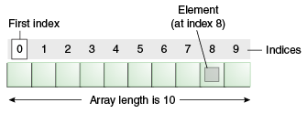
Introduction to Arrays
Array is one variable is used to store a list of data and manipulate
This type of variable is called an array.
It stores multiple data items of the same data type, in a contiguous block of memory, divided into a number of slots.
The new keyword to create an array object.
Need to tell the compiler how many elements will be stored in it.

Slide 15
Creating Arrays
There are three steps to creating an array,
declaring
  int[] k;
  float[] yt;
  String[] names;
allocating
  k = new int[3];
  yt = new float[7];
  names = new String[50];
initializing
  int[ ] k = {1, 2, 3};
  float[ ] yt = {0.0f, 1.2f, 3.4f, -9.87f, 65.4f, 0.0f, 567.9f};

Slide 16
Enhanced For Loop
The enhanced for loop, simplifies looping through an array or a collection.
Instead of having three components, the enhanced for has two.
for(data_type variable : array | collection){}
int [] a = {1,2,3,4};
for(int n : a)
System.out.print(n);.

Slide 17
Array Bounds
All array subscripts begin with 0 and ends with n-1
In order to get the number of elements in an array, can use the length field of an array.
The length field of an array returns the size of the array.
  int list [] = new int[10];
  for (int i = 0; i< list.length; i++)
  {
    System.out.println(list[i]);
    }
There is no array element arr[n]! This will result in an array-index-out-of bounds exception.
Notes:
Special care should be taken while accessing an array element, using the length variable of array objects. In the example shown above list.length gives 10, and if we try to access list[10], we will get an exception.

Slide 18
Array of Objects
public class ArrayofObject {
public void displaybooks(Book[] bks)
{
for(int i=0;i<bks.length;i++)
{
System.out.println("Book Number :="+bks[i].getBookno());
System.out.println("Book Name :="+bks[i].getBookname());
}
}
public static void main(String args[])
{
Book[] bk = new Book[2];
Book b1 = new Book(100,"java");
Book b2= new Book(101,"j2ee");
bk[0]=b1;
bk[1]=b2;
ArrayofObject ab= new ArrayofObject();
ab.displaybooks(bk);
}
}

Slide 19
INHERITANCE

Slide 20
Overview
  A class can inherit from another class
    Original class is the “superclass”
    New class is called the “subclass”
Inheritance is a fundamental OO concept
Superclass
Car
Subclasses
SportsCar
Taxi
PoliceCar

Slide 21
Example of Inheritance
  The Car class defines certain methods and variables
  Taxi extends Car, and can:
    Add new variables
    Add new methods
    Override methods of the Car class
Car
Taxi

Slide 22
Specifying Inheritance in Java
  Inheritance is achieved by specifying which superclass the subclass
  “extends”
Taxi inherits all the variables and methods of Car
public class Car {
…
}
public class Taxi extends Car {
…
}

Slide 23
What Does an Object Look Like?
A subclass inherits all the instance variables of its superclass
Car object
public class Car {
String regNum;
int engineSize; …
}
regNum
engineSize
Taxi object
public class Taxi extends Car {
private int cabNum; …
}
regNum
engineSize
cabNum

Slide 24
Default Initialization
  What happens when a subclass object is created?
  If no constructors are defined:
  No-arg constructor is called in superclass
    No-arg constructor called in subclass
Taxi object
regNum
engineSize
Taxi taxi1 = new Taxi();
cabNum

Slide 25
Nondefault Initialization
Specific initialization can be performed as follows:
public class Car {
Car(String r, int e) {
regNum = r;
engineSize = e;
} …
public class Taxi extends Car {
Taxi(String r, int e, int c) {
super(r, e);
cabNum = c;
} …
Use super() to call superclass constructor

Slide 26
Specifying Additional Methods
  The superclass defines methods that are applicable for all kinds of Car
  The subclass can specify additional methods that are specific to Taxis
public class Car {
public int getReg()…
public void changeOwner()…
…
public class Taxi extends Car {
public void renewCabLicense()…
public boolean isBooked()…
…

Slide 27
Overriding Superclass Methods
  A subclass inherits all the methods of its superclass
  The subclass can override a method with a specialized version, if it needs to:
public class Car {
public String details() {
return "Reg:" + getReg();
}
public class Taxi extends Car {
public String details() {
return "Reg:" + getReg() + cabNum;
}

Slide 28
Overriding
When a sub-class defines a
  “method with same method name, argument types, argument order and return type as a method in its super class, its called method overriding. “
Methods declared as final, static and private cannot be overridden.
An overriding method can be declared as final
The method can’t be less accessible
  Public => only public
  Protected => Both Public and Protected
  Default => default, public and protected

Slide 29
Overriding with Compatible Return type
Arguments must be same and return type must be compatible
  class Base
  {
  private int i = 5;
  public Number getNumber()
  {
  return i;
  }
  }
  class Derived extends Base
  {
  @Override
  public Integer getNumber()
  {
  return new Integer(10);
  }
  }

Slide 30
Invoking Superclass Methods
  If a subclass overrides a method, it can still call the original superclass method
  Use super.method()to call a superclass method from the subclass
  Though keyword super is used to refer super class, method call super.super.method() is invalid.
public class Car {
public String details() {
return "Reg:" + getReg();
}
public class Taxi extends Car {
public String details() {
return super.details() + cabNum;
}

Slide 31
super keyword
The keyword super refers to the base class
  super( )
    invokes the base class constructor
    base class constructors are automatically invoked
  super.method( )
    invokes the specified method in the base class
  super.variable
    to access the specified variable in the base class
super must be the first statement in a constructor

Slide 32
Abstract Class
An abstract class is a shared superclass
  Provides a high-level partial implementation of some concept
Use the abstract keyword to declare a class as abstract
Vehicle
Vehicle
Abstract superclass
Concrete subclasses
Car
Car
Truck

Slide 33
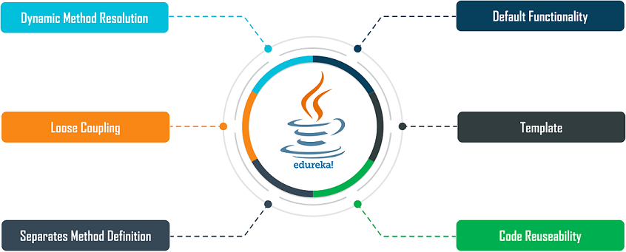
Need for Abstract Class

Slide 34
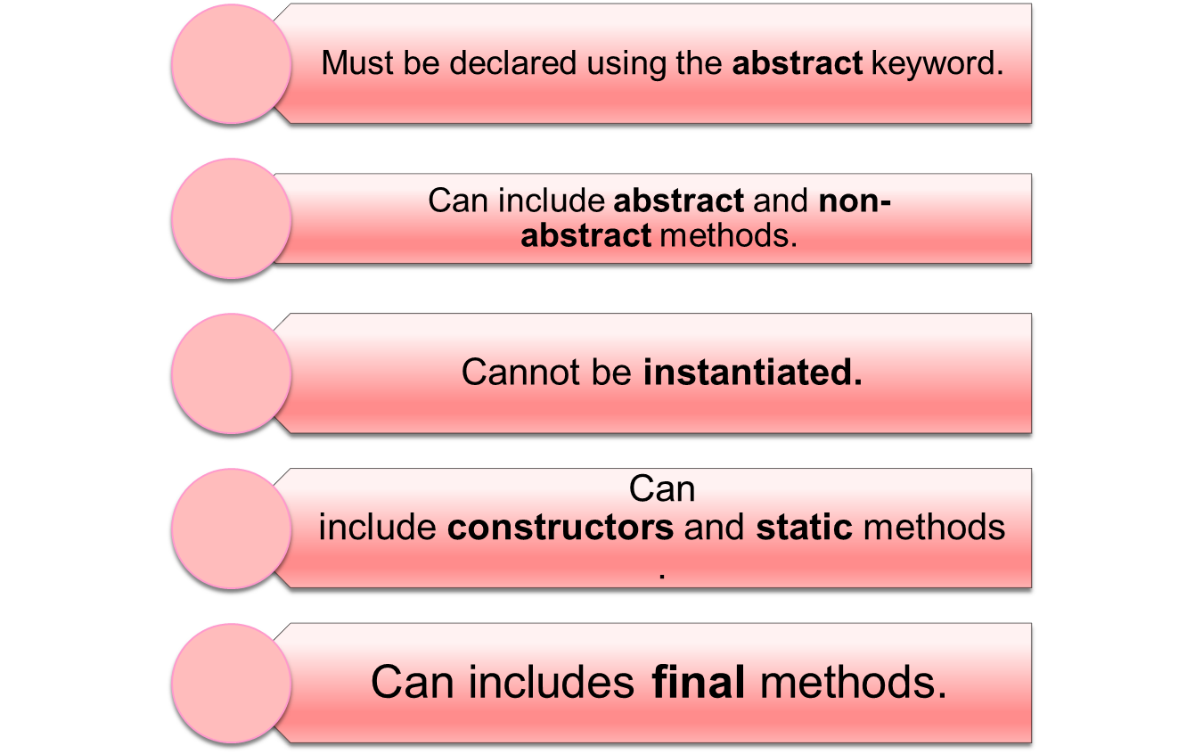
Rules for Abstract Class

Slide 35
Defining Abstract Classes in Java
  Use the abstract keyword to declare a method as abstract
    Only provide the method signature
    Class must also be abstract
  Must be implemented by a concrete subclass
    Each concrete subclass can implement the method differently
public abstract class Vehicle {
private String regNum;
public String getRegNum()…
public abstract boolean isRoadWorthy();
}
public class Car
extends Vehicle{
private int numSeats;
public void fitRack()…
public class Truck
extends Vehicle{
private int axles;
public void setLoad()…

Slide 36
Interfaces & Polymorphism

Slide 37
Interfaces
  An interface is like a fully abstract class
    All the methods are public and abstract- Till Java 8
      No instance variables if present they are public static final
  Defines a set of methods that other classes can implement
    A class can implement many interfaces,
      but can extend only one class
      can extend other interfaces and extend multiple interfaces

Slide 38
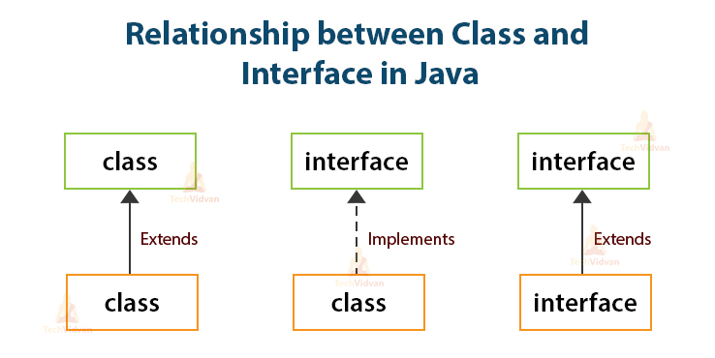

Slide 39



Example of Interfaces
  Interfaces describe an aspect of behavior that different classes can support
    Any class that supports the “Steerable” interface can be steered:
Steerable
Not Steerable

Slide 40
Interface
Interfaces define types in an abstract form
  Allows the specification of a reference type without providing an implementation
  The class that implements the interface decides how to implement
  Use interface keyword instead of class
  public interface Function {
  public double apply(double arg);
  }

Slide 41
Implement the Interface
  public class CurrencyConverter implements Function {
  @Override
  public double apply(double arg) {
  return arg * 45;
  }
  }
  Function usdToInr = new CurrencyConverter();
  System.out.println(usdToInr.apply(100));

Slide 42
Implementing an Interface
public interface Steerable {
int maxTurn = 135;
void turnLeft(int deg);
void turnRight(int deg);
}
public class Car
extends Vehicle
implements Steerable {
public void turnLeft(int deg)
{…}
public void turnRight(int deg)
{…}

Slide 43
Partial Implementation of an Interface
Declare the class as abstract if the class does not implement all the methods of an interface
Implement the methods in the sub class level
Public abstract class Car
extends Vehicle
implements Steerable {
public void turnLeft(int deg)
{…}
}

Slide 44
Using instanceof with Interfaces
  The instanceof operator can be used to check if an object implements an interface
  Downcasting can be used if necessary, to call methods defined in the interface
public void aMethod(Object obj) {
…
if (obj instanceof Steerable)
((Steerable)obj).turnLeft();
}

Slide 45
Extending an Interface
One Interface can extend another Interface
public interface Steerable {
int maxTurn = 135;
void turnLeft(int deg);
void turnRight(int deg);
}
public interface Navigator
extends Steerable {
void calcSpeed(int distance);
}

Slide 46
Polymorphism
This OO Principle allows the programmer to program abstractly
Objects of a subclass can be treated as objects of its superclass
The base class of a hierarchy is usually an abstract class or an Interface
  They define the common behavior (functionality)
Classes and Subclasses inherit this behavior and extend it according to their own properties by overriding the methods of the super class
Subclass objects can be treated as super class objects through references,
  But, super class objects are not subclass objects

Slide 47
Polymorphism
Allows for hierarchies to be highly extensible
New classes can be introduced and can still be processed without changing other parts of the program
Same method can do different things, depending on the class that implements it.
Method invoked is associated with OBJECT and not with reference.
Types of Polymorphism -
  Method Overloading.
  Method Overriding.

Slide 48
Polymorphism
  public interface Conditional {
  public boolean test();
  }

Slide 49
Implementation -One
  public class Professor implements Conditional {
  private String qualification;
  @Override
  public boolean test() {
  return this.qualification.equalsIgnoreCase("phd");
  }
  }

Slide 50
Implementation -Two
  public class Student implements Conditional {
  private double markScored;
  @Override
  public boolean test() {
  return this.markScored>90;
  }
  }

Slide 51
Polymorphism
  public static void print(Conditional poly) {
  System.out.println(poly.test());
  }
  public static void main(String[] args) {
  Student ramesh = new Student(101,"Ramesh",67);
  Professor prof = new Professor(201, "manish", "ece", "phd");
  print(ramesh);
  print(prof);
  }

Slide 52
Substitution of Object References in Method Calls
A subclass object can be passed into any method that expects a superclass object
The method that got invoked, is the version that's present in the object type and NOT the reference type.
public static void main(String[] args) {
Taxi t = new Taxi("ABC123", 2000, 79);
displayDetails(t);
public static void displayDetails(Car c) {
System.out.println(c.details());
}
Notes:
The same object reference (that is, an object reference of the same reference type) is capable of behaving differently at runtime, depending on the object that it points to.

Slide 53
Dynamic Method Dispatch
subclass=
(subclass)superclass
Valid at both Compile ,RunTime
  class First
  {
  public void show()
  {
  System.out.println("ShowFirst");
  }
  }
  class Second extends First
  {
  public void show()
  {
  System.out.println("Show Second");
  }
  }
First fst = new Second();
Second sec = (Second)fst;
sec.show();
First fst2 = new First();
Second sec2 = (Second)fst2;
sec2.show();
subclass=
(subclass)superclass
Valid at Compile time exception at ,RunTime

Slide 54
Dynamic Method Dispatch
Related Through Inheritance
superclass = subclass
  always valid
subclass = superclass
  not valid at compile time, needs a cast
subclass=(subclass)superclass
  valid at compile time, checked at runtime.
  if INVALID then ClassCastException is thrown.
Unrelated Classes – Not Allowed
someClass = someUnrelatedClass
  not valid, won’t compile
somcClass = (someClass)someUnrelatedClass
  not valid, won’t compile

Slide 55
Interface vs Abstract Class
A class may implement several interface
An interface cannot provide any code at all
Interfaces are often used to describe the peripheral abilities of a class, not its central identity,
A class may extend only one class
An abstract class can provide complete or partial code
An abstract class defines the core identity of its descendants.

Slide 56
Interface, Abstract Class,Subclass,Class
A plain class is designed when in doesn't pass the “is-a” test.
A Plain class is designed when its not extending any other class other than object class
Make a subclass , when it needs to extend a super class
Make a subclass, when it needs to override or add new behaviors
Make an abstract class , when there is a requirement for a kind of “template” for a group of subclasses, and there are some implementation in the class which the subclass can use .
Make an abstract class , to guarantee that nobody can make objects of that type.
Design an interface , to define a role that other classes can play, regardless of the inheritance tree,

Slide 57
final keyword
A final method or class is Java’s way of prohibiting inheritance and/or overriding
Final methods cannot be overridden by subclasses
All private methods are implicitly final
Final classes Cannot be extended and their methods are implicitly final
Can be applied to variables too
  The value of a final variable cannot be altered
  final int max_limit = 23
  final void method( )
  final class last_class

Slide 58
Math Class
The methods in the Math class don’t use any instance variable values
The Methods are “static” methods , and they don’t need to have an instance of the Math class
Some of the Methods in the class are
  Math.random() – returna double number between 0.0 to 1.0
  Math.abs() – absolute value of the argument
  Math.round() – returns int or long based on float,double rounded to nearest integer value
  Math.min() and Math.max() – maximum or minimum of two args
  Math.sqrt() – return the sqaure root of the given argument

Slide 59
Exception handling

Slide 60
Exception Handling
An exception is a problem that arises during the execution of a program.
When an Exception occurs the normal flow of the program is disrupted and the program terminates abnormally, which is not recommended
  Exceptions are to be handled.

Slide 61
Exception Handling
java.lang.Object
java.lang.Throwable
java.lang.Error
java.lang.Exception
java.io.IOException
java.lang.RuntimeException
Notes:
The class Object is the root of the class hierarchy. Every class has Object as a superclass. All objects, including arrays, implement the methods of this class.
The Throwable class is the superclass of all errors and exceptions in the Java language. Only objects that are instances of this class (or of one of its subclasses) are thrown by the Java Virtual Machine or can be thrown by the Java throw statement. Similarly, only this class or one of its subclasses can be the argument type in a catch clause.
An Error is a subclass of Throwable that indicates serious problems that a reasonable application should not try to catch. Most such errors are abnormal conditions. The ThreadDeath error, though a "normal" condition, is also a subclass of Error because most applications should not try to catch it.
The class Exception and its subclasses are a form of Throwable that indicates conditions that a reasonable application might want to catch.
RuntimeException is the superclass of those exceptions that can be thrown during the normal operation of the Java Virtual Machine. A method is not required to declare in its throws clause any subclasses of RuntimeException that might be thrown during the execution of the method but not caught.
IOException signals that an I/O exception of some sort has occurred. This class is the general class of exceptions produced by failed or interrupted I/O operations.

Slide 62
Exceptions
checked exceptions
  Conditions that can readily occur in a correct program
  Includes all subtypes of Exception
  Excluding classes that extend Runtime Exception.
  Subject to the handle or declare rule
unchecked exceptions
  Problems that reflect program bugs
  Probable bugs are represented by the RuntimeException class.
  Compiler doesn’t enforce the handle or declare rule.
Error
  Fatal situations are represented by the Error class.

Slide 63
Handle or Declare Rule
Handle the exception by using the try-catch-finally block.
  try{
  // some code
  } catch(Exception e){
  }
Declare that the code causes an exception by using the throws clause.
  void trouble() throws IOException { ... }
  void trouble() throws IOException, MyException { ... }
Other Principles
  You do not need to declare runtime exceptions or errors.
  You can choose to handle runtime exceptions

Slide 64
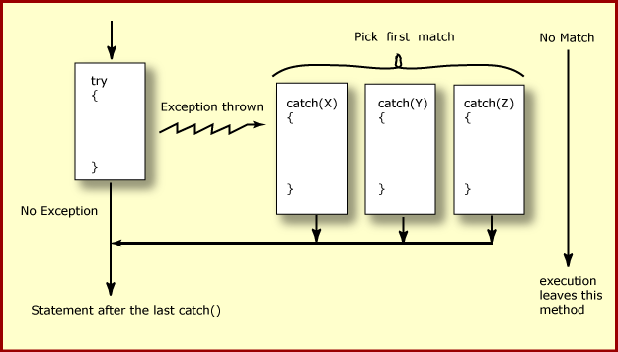
How try catch Work

Slide 65
Exception Handling
  try {
    Object value = "twenty";
    Integer number = (Integer) value;
  }
  catch ( ClassCastException ex ) {
  ex.printStackTrace();
  }
  System.out.println("Good-bye" );
  }

Slide 66
Nested Try Catch
  try {
  Object value = "twenty";
  Integer number = (Integer) value;
    try {
    String mark ="50";
    Integer.parseInt(mark);
    } catch (NumberFormatException e) {
    e.printStackTrace();
    }
  }
  catch ( ClassCastException ex ) {
  ex.printStackTrace();
  }

Slide 67
Catching Exception –Multiple Catch
  try {
  Object value = "twenty";
  Integer number = (Integer) value;
  String mark ="50";
  Integer.parseInt(mark);
  }
  catch ( ClassCastException ex ) {
  ex.printStackTrace();
  }
  catch (NumberFormatException e) {
  e.printStackTrace();
  }

Slide 68
Effective Exception Hierarchy
The exception classes are arranged in a hierarchy.
Catches for specific exceptions should always be written prior to the generic handler.
A generic handler for Exception would cover any missing situation.
  try
  {
  }
  catch (NumberFormatException e) {
  }
  catch (Exception ex2) {
  }
  try
  {
  }
  catch (Exception e1) {
  }
  catch(NumberFormatException e2) {
  }

Slide 69
Multiple Catch
  try {
  Object value = "twenty";
  Integer number = (Integer) value;
  String mark ="50";
  Integer.parseInt(mark);
  }
  catch ( ClassCastException| NumberFormatException ex ) {
  ex.printStackTrace();
  }

Slide 70
Multiple Catch
  try {
  } catch (RangeCheckException | RuntimeException e) {
  }
  try {
  } catch (RangeCheckException | Exception e) {
  }

Slide 71
Finally block
Its optional and will always be invoked,
  whether an exception in the corresponding try is thrown or not,
  whether a thrown exception is caught or not.
finally-will-always-be-called except if the JVM shuts down.
  When the try or catch blocks may call System.exit();
Finally Block is always executed despite of different scenarios:
  Forced exit occurs using a return, a continue or a break statement
  Normal completion
  Caught exception thrown
  Exception was thrown and caught in the method
  Uncaught exception thrown
  Exception thrown was not specified in any catch block in the method

Slide 72
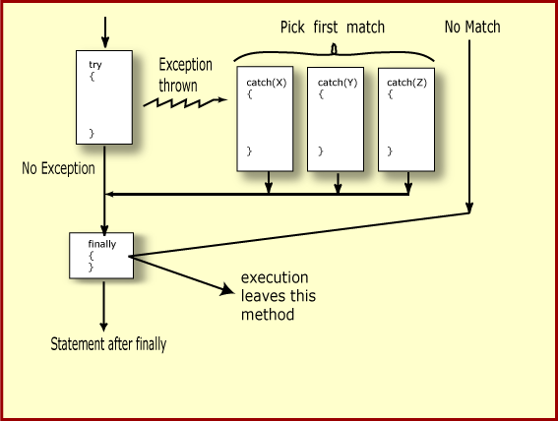
Finally Block

Slide 73
Finally Block
  public static String tryblkWithReturn(String data ) {
  try {
  int no = Integer.parseInt(data);
  }
  catch (NumberFormatException e) {
  System.out.println("Entering Catch Block");
  return "Hello";
  }
  finally {
  System.out.println("Inside finally");
  }
  System.out.println("I am back");
  return "Hi";
  }

Slide 74
Finally Block
  public static String tryblkWithNewException(String data ) throws Exception {
  try {
  int no = Integer.parseInt(data);
  }
  catch (NumberFormatException e) {
  System.out.println("Entering Catch Block");
  throw new Exception();
  }
  finally {
  System.out.println("Inside finally");
  }
  System.out.println("I am back");
  return "Hi“;
  }

Slide 75
Throws Clause
A method is required to either catch or list all exceptions it might throw
  Except for Error or RuntimeException, or their subclasses
If a method may cause an exception to occur but does not catch it, then it must say so using the throws keyword
Applies to checked exceptions only
  <type> <methodName> (<parameterList>) throws <exceptionList>
  {
  <methodBody>
}

Slide 76
The try-with-resources Statement
A try statement that declares one or more resources.
A resource is an object that must be closed after the program is finished with it.
Ensures the resource is closed at the end of the statement.
Any object that implements java.lang.AutoCloseable, and java.io.Closeable, can be used as a resource.

Slide 77
Exception Handling- Closing the Resource
  Scanner scan = new Scanner( System.in );
  int num ;
  System.out.print("Enter an integer: ");
  try {
  num = scan.nextInt();
  System.out.println("The square of " + num + " is " + num*num );
  }
  catch ( InputMismatchException ex ) {
    System.err.println("You entered bad data." );
    System.err.println("Run the program again." );
  }
  System.err.println("Good-bye" );
  scan.close();
  }

Slide 78
The try-with-resources Statement
  System.out.print("Enter an integer: ");
  try(Scanner scan = new Scanner( System.in )) {
  int num = scan.nextInt();
  System.out.println("square" + num + "is" + num*num );
  }
  catch ( InputMismatchException ex ) {
    System.err.println("You entered bad data." );
    System.err.println("Run the program again." );
  }
  System.out.println("Good-bye" );
  }

Slide 79
Throwing Exceptions
The throw Keyword
Java allows you to throw exceptions (generate exceptions)
  throw <exception object>
An exception you throw is an object
  You have to create an exception object in the same way you create any other object
Example:
  throw new ArithmeticException(“testing...”);

Slide 80
Re-throw Exception
Exception of the Catch Parameter type is the one that is rethrown
To intercept all exceptions and rethrow them
  Can catch with super class Exception
  Declare method as throwing an Exception.
"imprecise rethrow“
  Throwing a general Exception type (instead of specific ones)

Slide 81
Re-Throw Exception
Java 7, can be more precise about the exception types being rethrown from a method.
This leads to improved checking for rethrown exceptions.
Can handle them a lot better at the calling side

Slide 82
Re-throw Exceptions
  public static void myExample() throws ParseException,IOException {
  try {
  new SimpleDateFormat("yyyyMMdd").parse("date");
  new FileReader("Abc.txt").read();
  } catch (Exception e) {
  throw e;
  }
  }

Slide 83
Method Overriding and Exceptions
The overriding method can throw:
  No exceptions
  One or more of the exceptions thrown by the overridden method
  One or more subclasses of the exceptions thrown by the overridden method
The overriding method cannot throw:
  Additional exceptions not thrown by the overridden method
  Superclasses of the exceptions thrown by the overridden method

Slide 84
Overriding –When Method Has Exceptions
Any exceptions declared in overriding method must be of the same type as those thrown by the super class, or a subclass of that type.
  class MyBase {
  public void method1() throws Exception
  { }
  public void method2() throws RuntimeException
  { }
  }
  class Sub extends MyBase
  {
  public void method1() throws Throwable {
  }
  public void method2() throws ArithmeticException {
  }
  }
This is compile Time Exception
This is Allowed

Slide 85
User Defined Exception
User Defined Exception must be a child of Throwable.
To write a checked exception that is automatically enforced by the Handle or Declare Rule, need to extend the Exception class.
To write a runtime exception, need to extend the RuntimeException class.

