Slide 1
Day-14

Slide 2
Topics
.Existence and Finder Operations -> findFirst,Findany
Parallel computing with stream, Reduction operations
Asynchronousfilechannel in javanio
Random access file
Creating index
Prepared statement,callable, metadata
Transcation commit/rollback
Servlet life cycle
Servlet filter
Session management and cookies
Java.net
Networking basics
Tcp,udp,ports
Networking classes
url connection , server socket
Completable
Resource Class
Virtual threads

Slide 3
Streams
An Interface defined in java.util.stream package.
Streams are a sequence of elements from a source that supports aggregate operations.
filter, map, reduce, find, match, sort.
Operations can be executed in series or in parallel.
The source can be a Collection, IO Operation or Arrays
Java collections has methods that return Stream.
These Methods are added as default methods.

Slide 4
FindFirst()
findFirst()
Returns an Optional describing the first element of this stream
Else an empty Optional .
String item = gadgets.stream() .filter(s -> s.length() > 10) .findFirst() .orElse("");
findAny()
returns an Optional describing some element of the stream
Empty Optional if the stream is empty.
Stream<String> stream =
Stream.of("a", "b", "c").filter(element -> element.contains("b"));
Optional<String> anyElement = stream.findAny();

Slide 5
groupingBy()
Collectors.groupingBy()
Similar to the ‘GROUP BY’ clause in the SQL language.
Need to specify a property, by which the grouping be performed.
Takes a classification function as its parameter.
It is applied to each element of the stream.
The value that is returned by the function is used as a key to the map

Slide 6
groupingBy()
List<BloodDonar> donarList = new BloodDonarManager().findAll();
Map<String, List<BloodDonar>> donarsPerType =
donarList.stream().collect(Collectors.groupingBy(BloodDonar::getBloodGroup));
List<BloodDonar> list = donarsPerType.get("a+");
list.forEach(System.out::println);

Slide 7
RecursiveTask
A RecursiveTask is a task that returns a result.
It may split its work up into smaller tasks, and merge the result of these smaller tasks into a collective result.
The splitting and merging may take place on several levels

Slide 8
Parallel Streams

Slide 9
Parallel Streams
The Stream API can be used create parallel streams
Takes advantage of multi-core architectures
Parallel stream are created in two ways
parallelStream() on a collection
parallel() on a stream
Should be with stateless and associative operations
Stateless operation : State of one element does not affect another element
Associative : The result is not affected by the order of operands

Slide 10
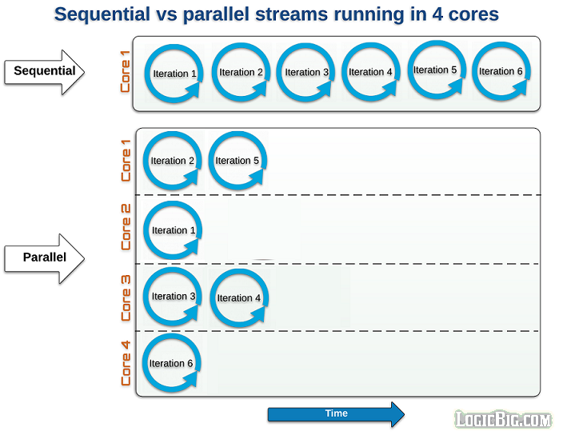
Parallel Stream Working
Stream are sequential by default
When a stream executes in parallel, the Java runtime partitions the stream into multiple sub-streams.
Aggregate operations iterate over and process these sub-streams in parallel and then combine the results.

Slide 11
Creating Parallel Streams
Stream.of("Ramesh", "Suresh", "Ganesh", "Magesh", "Rajesh", "Sudan", "Jagan", "Madan").
parallel().
forEach(System.out::println);
Stream parallelStream = Arrays.asList("Ramesh", "Suresh", "Ganesh", "Magesh", "Rajesh", "Sudan", "Jagan", "Madan").
parallelStream().
forEach(System.out::println);
Serial stream the order is guaranteed.
Parallel Stream the order is not guaranteed

Slide 12
Reduction
A reduction operation takes a sequence of input elements and combines them into a single summary result by repeated application of a combining operation
Finding the sum or maximum of a set of numbers
Accumulating elements into a list.
Reduce operation is inherently parallelizable
Function(s) used to process the elements should be associative and stateless.

Slide 13
Reduce Operation
Identity
Both an initial seed value for the reduction
A default result if there are no input elements.
accumulator
Takes a partial result and the next element, and produces a new partial result.
combiner
combines two partial results to produce a new partial result.

Slide 14
Reduction
Optional<T> reduce(BinaryOperator<T> accumulator)
Performs a reduction on the elements of this stream
Returns an Optional describing the reduced value, if any.
Accepts a BinaryOperator accumulator function.
Acts on subsets of the data in parallel, and then combine the intermediate results to get the final.
int sum = numbers. parallelStream().reduce(0, (x,y) -> x+y);
int sum = numbers.parallelStream().reduce(0, Integer::sum);

Slide 15
Reduction
List<Employee> empList = getEmployee();
To Find the Maximum Salary
empList.parallelStream().map(e -> e.getSalary())
.reduce((e1,e2) -> e1 > e2 ? e1 :e2)
.ifPresent(System.out::println);

Slide 16
Reduction
T reduce(T identity, BinaryOperator<T> accumulator)
Performs a reduction on the elements of this stream,
Has identity value and an associative accumulation function
Returns the reduced value
.

Slide 17
Reduction
int total = Stream.of("2", "3", "4", "5")
.parallel()
.reduce(0, (integer, s) -> Integer.sum(integer, Integer.parseInt(s)),
(integer, integer2) -> Integer.sum(integer, integer2));
// accumulator maps strings to integers and then returns sum.
// Combiner is adding the two split results
System.out.println(total);

Slide 18
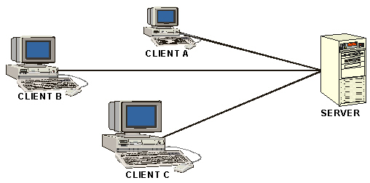
Network Communication

Slide 19
Java.net
Java provides a rich library of network-enabled classes that allow applications to readily access network resources.
Client/Server Architecture
An application architecture designed to separate the presentation of data from its internal processing and storage.
The client requests the services and the server handles these requests.
The processing that is done by the server is hidden from the client.
One server can service multiple clients.

Slide 20
Protocols
A set of rules and conventions followed by systems that communicate over a network.
Rules govern packaging of data into packets, speed of transmission, and reassembling of data into its original form.
Networking software’s usually implement multiple levels of protocols layered one on top of another.

Slide 21
URL
Represents the location of a resource on the Internet.
Has three components:
Protocol identifier:
Represents the protocol used to access a resource from the Internet.
Host identifier:
Represents the IP address of host computer.
Resource name:
Represents the file name to be accessed from a host computer.

Slide 22
URL Class
URL url = new URL("https://www.example.com");
BufferedReader reader = new BufferedReader(new InputStreamReader(url.openStream())); String line; while ((line = reader.readLine()) != null) { System.out.println(line); } reader.close();

Slide 23
Sockets
To handle the communication links between applications in network.
Connection is established by binding to a a socket
InetAddress:
Represents an IP address.
ServerSocket:
Represents a TCP/IP server socket object that receives connection requests from the clients.
Socket:
Represents a TCP/IP client socket that interacts with the server sockets.

Slide 24
Using TCP Scokets
TCP is a connection-oriented protocol, which ensures reliable connectivity between client and server applications.
The Socket class is used to create a client socket and the ServerSocket class is used to create a server socket.
Socket class:
Provides methods for stream I/O, which makes reading from and writing to a socket easy.
Provides the following constructors:
public Socket(InetAddress IP_address, int port)
public Socket(String hostname, int port)

Slide 25
Socket Programming
Creating TCP/IP Server
Create a server socket using ServerSocket object.
Listen to the client request for the connection.
Start the server.
Create connection thread for clients request.
Creating TCP/IP Client
Create a client socket using Socket object.
Read and write to the socket.
Close the connection.
Create connection thread for clients request.

Slide 26
Asynchronous File Channel
AsynchronousFileChannel
Asynchronous channels are safe for use by multiple concurrent threads
Channel enables file operations to execute asynchronously unlike synchronous I/O operations
A thread enters into action and waits until the request is completed.

Slide 27
Example
AsynchronousFileChannel fileChannel = AsynchronousFileChannel.open(
Paths.get("example.txt"), StandardOpenOption.WRITE);
ByteBuffer buffer = ByteBuffer.wrap("NIO Programming!".getBytes());
System.out.println("Starting the write");
Future<Integer> future = fileChannel.write(buffer, 0);
for(int i=0;i<=10;i++) {
System.out.println(i);
}
future.get();
System.out.println("Data has been written to the file asynchronously.");
fileChannel.close();

Slide 28
Indexes
Indexes are created in an existing table to locate rows more quickly and efficiently
It is possible to create an index on one or more columns of a table and each index is given a name
The users cannot see the indexes, they are just used to speed up queries

Slide 29
Create Index
CREATE INDEX index_name ON
table_name (<column Name>)
CREATE INDEX emp_indx ON emp(ENAME);
CREATE INDEX emp_indx ON emp(ENAME,JOB);
Notes:
An index is a schema object that contains an entry for each value that appears in the indexed column(s) of the table or cluster and provides direct, fast access to rows.
USER_INDEXES meta-data can be used to find out the details about indexes.

Slide 30
Guidelines for Indexing
Create an index if the query statement retrieves less than 15% of the rows in a large table
Indexes are explicitly created on primary keys
Use index columns for joins to improve performance on joins of multiple tables
Notes:
Some RDBMS offer the choice of a clustered index in which the system sorts and re-sorts and rows of a table so that their physical order on the database device is always the same as their logical (indexed) order.

Slide 31
Conditions when an Index will not be Invoked
No WHERE clause
Index key not used in a WHERE clause
Use of operators like ‘NOT’ and ‘IS NULL’
Use of only secondary key in a composite index
Use of functions or expressions with the index key
Use of index key and another column with logical ‘OR’ operator

Slide 32
Completable Future
Implements the Future and CompletionStage Interface.
It represents a future result of an asynchronous computation.
Holds the result of an asynchronous operation that is being executed in a different thread.
supplyAsync
Takes Supplier as an argument.
CompletableFuture<String> futureRef
= CompletableFuture.supplyAsync(() -> {
return "Future Value";
});
System.out.println(futureRef.get());

Slide 33
Composing CompletableFuture
Can compose multiple asynchronous operations.
Can perform operations on the result of one CompletableFuture and create a new CompletableFuture as a result.
The Following methods are used
thenApply
thenCombine
thenCompose
CompletableFuture<String> combinedFuture
= task1.thenCombine(
task2, (m1, m2) -> m1 + " " + m2);
System.out.println(combinedFuture.get());

Slide 34
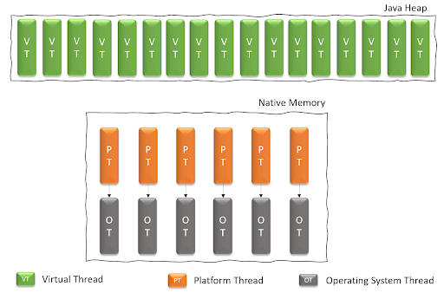
Virtual Threads

Slide 35
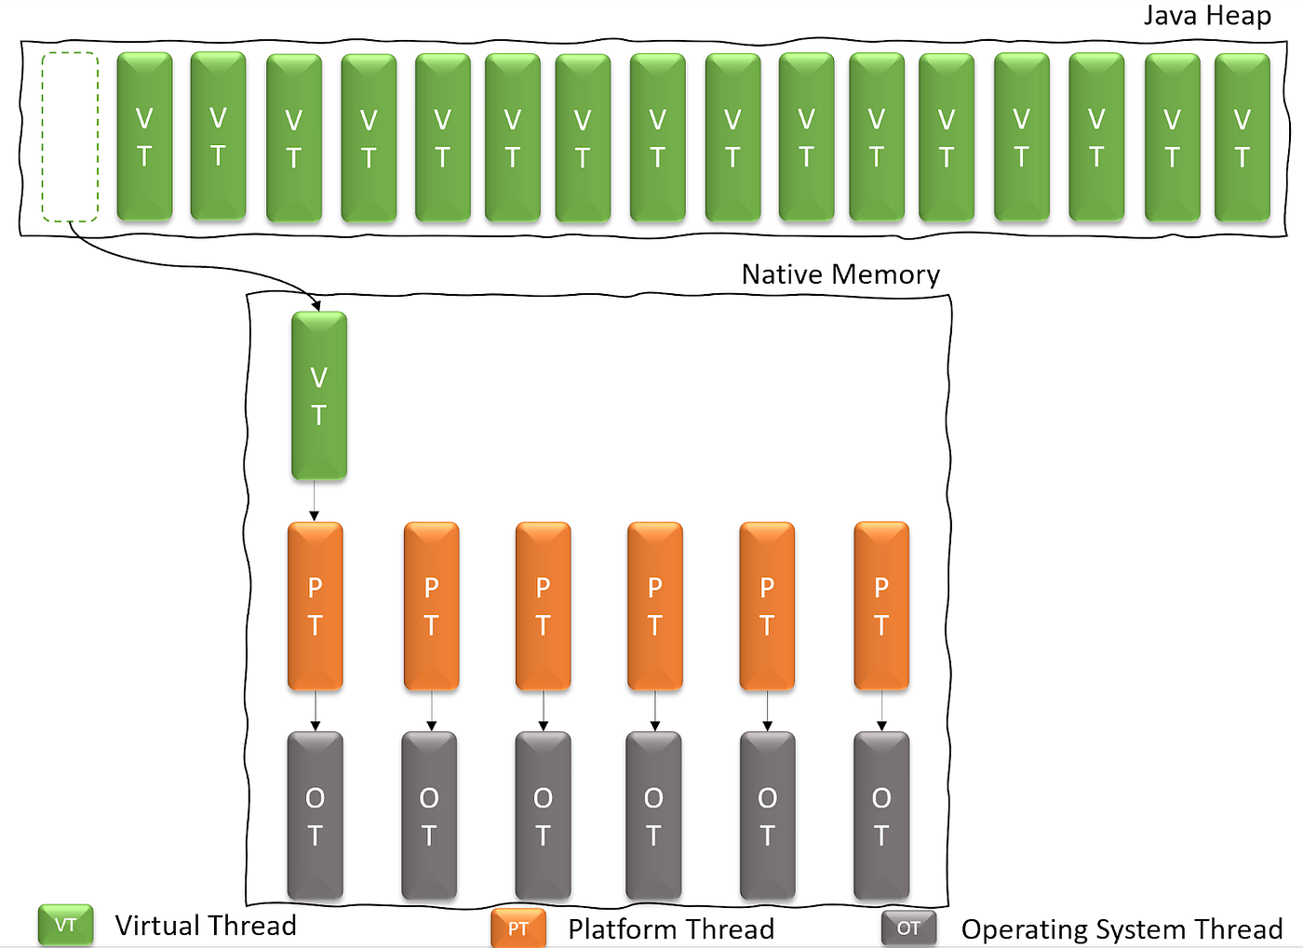
Virtual Threads

Slide 36
Creating Virtual Thread
1. Thread.ofVirtual().start(Runnable);
2. Thread.ofVirtual().unstarted(Runnable);
3. Executors.newVirtualThreadPerTaskExecutor();
4. Executors.newThreadPerTaskExecutor(ThreadFactory);

