Slide 1
Web Component Development - Servlet

Slide 2
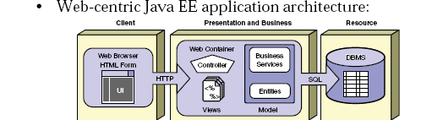
Role of Web Component JEE

Slide 3
Servlets
Java technology for serving HTTP requests.
Used for serving HTTP requests
Basic servlet functionalities implemented by the basic HTTP servlet classes have the features for accessing HTTP request data and managing cookies and sessions.
User interface or representation part is done with other technolgies.

Slide 4
Idea of Web Application
Servlets, JSP pages, HTML files, utility classes, beans, tag libraries, etc. are bundled together in a single directory hierarchy or file
Access to content in the Web app is always through a URL that has a common prefix
– http://host/webAppPrefix/abc
Many aspects of Web application behavior controlled through deployment descriptor- web.xml

Slide 5
APPLICATION SERVER
A server computer on a computer network dedicated to running certain software applications
A software engine that delivers applications to client computers.
Should handle most, if not all, of the business logic and data access of the application.
Ease of application development and centralization.
Ex: Weblogic Server, WebSphere, JBOSS

Slide 6
Client calls a program
server returns the Response
Client
(Browser)
App
server
WEB
server
html
dB

Slide 7
Java Servlets
Released in 1997 , used to Create web pages with dynamic content
Standard, server-side Java application that extends the capabilities of a Web Server.
Mapped to URLs and Deployed in a Web container of an application server which provides a runtime environment for servlets.
Executed when the J2EE application server receives a client request that is passed to the Web container, which in turn invokes the servlet.
Platform and server independent

Slide 8
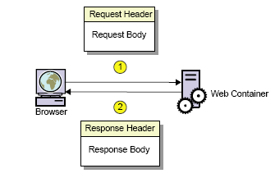
Request and Response

Slide 9
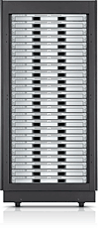

Web Apps with Servlets
GET …
Servlet
doGet()
…
…
HEADERS
BODY
Web Container

Slide 10
The Key Players
WebServer
Gets the Response from the container
Uses HTTP to talk to the Client Browser
Knows how to forward to container
Container
Find the Correct Servlet Using URL in DD
Manages life cycle of the servlets
Creates request and response objects just before starting the thread
Starts a Servlet Thread and gives that to the Servlet
Call the Service() Method and then doGet or doPost()
Destroys the Request,Response Objects
Servlet
Has a public class name
Uses request Object to read the parameter from the user
Dynamic content for the Client
Uses response object to print a response

Slide 11
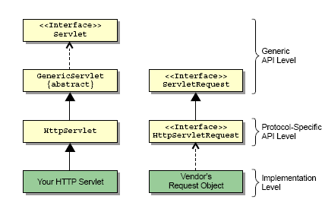
Servlet API

Slide 12
Steps for Creating Java Servlets
Subclass of HttpServlet
2. Override doGet(....) method
3. HttpServletRequest
read the request parameters
4. HttpServletResponse
set Content Type
get PrintWriter
send text to client via PrintWriter

Slide 13
Example
public class GreetingServlet extends HttpServlet {
public GreetingServlet() {
super();
}
@Override
public void init(ServletConfig config) throws ServletException {
}
protected void doGet(HttpServletRequest request, HttpServletResponse response) throws ServletException, IOException { }
protected void doPost(HttpServletRequest request, HttpServletResponse response) throws ServletException, IOException { }
}

Slide 14
@WebServlet
Used to define a Servlet component in a web application.
Specified on the Servlet class
Contains metadata about the Servlet being declared.
String[] value
Array of URL patterns
Either this or urlPatterns should be present
String[] urlPatterns -
Array of URL patterns to which this Filter applies
Required Annotation
int loadOnStartup
Integer value denoted the startup ordering hint

Slide 15
@WebServlet
@WebServlet(urlPatterns = {"/greeting","/greet"})
public class GreetingServlet extends HttpServlet {
}

Slide 16
Inter-Servlet Communication
A process where two or more servlet communicates with each other to process the client request.
A servlet can forward the request to another servlet to process the client request.
A servlet can include the output of another servlet to process the client request.
Implemented using Request Dispatcher
Is an object of the javax.servlet.RequestDispatcher interface

Slide 17
GET Method
protected void doGet(HttpServletRequest request, HttpServletResponse response) throws ServletException, IOException {
RequestDispatcher dispatcher = request.getRequestDispatcher("/welcome.jsp");
dispatcher.forward(request, response);
}

Slide 18
Welcome.jsp
<%@ page language="java" contentType="text/html; charset=ISO-8859-1 pageEncoding="ISO-8859-1"%>
<!DOCTYPE html >
<html>
<head>
<meta http-equiv="Content-Type" content="text/html; charset=ISO-8859-1">
<title>Nalanda Library</title>
</head>
<body>
<h1>Nalanda Library</h1>
</html>

Slide 19
Request Attributes –Request Dispatching
Stores data as attribute to the request object in the first servlet.
Forwards the request to the second servlet using the RequestDispatcher.
Retrieves the data from the request object and displays the result using the second servlet.
request.setAttribute("foundAuthor", author);
RequestDispatcher dispatcher= request.getRequestDispatcher("/ShowAuthor.jsp");
dispatcher.forward(request, response);
The path is a String and can use relative addressing too.

Slide 20
Using Request Parameter
<form action="LibraryServlet" method="post">
<label>Author Id</label>
<input type="text" name="authorId" placeholder="Author Id to Search">
<input type="submit" value="Search">
</form>

Slide 21
Post Method
protected void doPost(HttpServletRequest request, HttpServletResponse response) throws ServletException, IOException {
String strAuthorId = request.getParameter("authorId");
long authorId = Long.parseLong(strAuthorId);
AuthorDao dao =new AuthorDao();
author =dao.findAuthor(authorId);
request.setAttribute(“foundAuthor”,author);
RequestDispatcher dispatcher = request.getRequestDispatcher("/welcome.jsp");
dispatcher.forward(request, response);
}

Slide 22
Welcome.jsp
<%@ page language="java" contentType="text/html; charset=ISO-8859-1 pageEncoding="ISO-8859-1"%>
<!DOCTYPE html >
<html>
<head>
<meta http-equiv="Content-Type" content="text/html; charset=ISO-8859-1">
<title>Nalanda Library</title>
</head>
<body>
${foundAuthor}
</html>

Slide 23
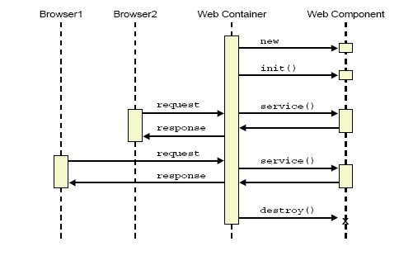
Life Cycle of a Servlet

Slide 24
The init() method
The init() method is called when the servlet is first requested by a browser request.
It is not called again for each request.
Used for one-time initialization.
The init() method is a good place to put any initialization variables

Slide 25
Service() Method
Each time the server receives a request for a servlet, the server spawns a new thread and calls the servlet’s service () method.
Browser
service()
Single Instance
of Servlet
Web Server
service()
Browser
service()
Browser

Slide 26
The Service Method
By default the service() method checks the HTTP Header.
Based on the header, service calls either doPost() or doGet().
doPost and doGet is where you put the majority of your code.
If your servlets needs to handle both get and post identically, have your doPost() method call doGet() or vice versa.

Slide 27
Death of a Servlet
Before a server shuts down, it will call the servlet’s destroy() method.
You can handle any servlet clean up here. For example:
Updating log files.
Closing database connections.
Closing any socket connections.

Slide 28
Java Server Pages - JSP

Slide 29
Introduction to JSP Technology
JSP pages, by virtue of the separate placement of the static and dynamic content, facilitates both Web developers and the Web designer to work independently.
Facilitates the segregation of the work profiles of a Web designer and a Web developer.
A Web designer can design and formulate the layout for a Web page by using HTML.
A Web developer, working independently, can use Java code and other JSP specific tags to code the business logic.

Slide 30
JSP is also a Servlet
Jsp file is Written by the web page author
Jsp file is TRANSLATED to file.java by the container
File.java COMPILED to file.class container
File class is loaded by the container an initialized as Servlet
The container instantiates the servlet and cause the servlets is jspInit() method
The container creates a new thread to handle the clients request and the servlets _jspService() method runs

Slide 31
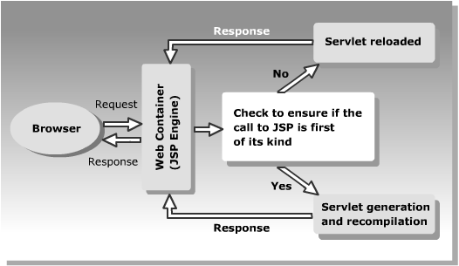
JSP Life Cycle

Slide 32
Jsp Scripting
Scriptlets
Similar to code placed inside the service method
<%
out.println("Hello From Jsp Standard Scriptlet ");
%>

Slide 33
JSTL
Sun and JCP, initiated the JSP-Standard Tag Library (JSTL) project.
The tag libraries are very elegant and simple to use,
However non standard tags and there proliferation creates lot of confusion among the developers
JSTL was introduced in 2003, and now incorporated into JSP-2.
It helps in taking away Java code! From jsp page .
It also provide a standard implementation for typical application functionality
Reusability
Avoid reinventing the wheel

Slide 34
JSTL
<dependency>
<groupId>jakarta.servlet.jsp.jstl</groupId> <artifactId>jakarta.servlet.jsp.jstl-api</artifactId> <version>3.0.0</version>
</dependency>
<dependency>
<groupId>org.glassfish.web</groupId> <artifactId>jakarta.servlet.jsp.jstl</artifactId> <version>3.0.1</version>
</dependency>

Slide 35
Declaration of JSTL Tag Libraries
Core
<%@ taglib prefix="c“ uri="http://java.sun.com/jsp/jstl/core" %>
Delimiters are “${” and “}”
The EL can only be used for specifying attribute values in JSTL tags
<c:out value=”${firstName}”/>
Multiple expressions can be combined and mixed with static text (i.e., implicit string concatenation)
<c:out value=”Hello ${firstName} ${lastName}!”/>

Slide 36
<c:out> & <c:set>
<%@ taglib uri="http://java.sun.com/jsp/jstl/core" prefix="c"%>
<c:set var="message" value="JSTL Programming " scope="page"/>
<c:out value="${message}"/>

Slide 37
Iterate over Objects in Scope
<c:forEach var="name" items="${sessionScope.nameList}">
<c:out value="${name}"/>
</c:forEach>

Slide 38
Listeners and filters

Slide 39
Servlet Listeners
Monitoring and reacting to events in a servlet’s life cycle can be done by defining listener objects
The Methods get invoked when life-cycle events occur.
Defining the Listener Class
Defined as an implementation of a listener interface.
Created by implementing the corresponding interface for a Particular event

Slide 40
Listner Interfaces and Event Class
Web context - Initialization and destruction
ServletContextListener and ServletContextEvent
Attribute added, removed, or replaced
ServletContextAttributeListener and ServletContextAttributeEvent
Session Creation, invalidation, activation, passivation, and timeout
HttpSessionListener, HttpSessionActivationListener, and HttpSessionEvent
Attribute added, removed, or replaced
HttpSessionAttributeListener and HttpSessionBindingEvent

Slide 41
Listeter Interface and Event classes
Request - request start and process
ServletRequestListener and ServletRequestEvent
Attribute added, removed, or replaced
ServletRequestAttributeListener and
ServletRequestAttributeEvent

Slide 42
Listener
@WebListener
public class ContextListener implements ServletContextListener {
Logger log = Logger.getRootLogger();
public void contextInitialized(ServletContextEvent sce) {
log.info("Context Initialzed");
ServletContext ctx = sce.getServletContext();
log.info(“Context Info“+ ctx.toString());
}
}

Slide 43
Filters
Transform the content of HTTP requests, response, and header information
Do not generally create response or responding to requests
Attached to one or more servlets or JSP
Modify or adapt the request/response for a resource
Act on dynamic or static content – web resources

Slide 44
Examples of Filters
Examples of Filters
Authentication
Blocking requests based on user identity
Logging and auditing
Tracking user of a web application
Image conversion
Scaling maps, and so on
Localization
Targeting the request and response to a particular locale

Slide 45
Uses
Access a resource before a request is invoked
Process a request before it is invoked
Modify request headers and data
Modify response headers and data before sending them to client
Intercept an invocation of a resource
Act on a servlet, or servlets or static content by one or more filters in a specific order

Slide 46
Specifying Filter Mappings
A web container uses filter mappings to decide how to apply filters to web resources.
A filter Mapping matches a filter to a web component by name, or to web resources by URL pattern.
Filter is mapped by annotating filter class with @WebFilter
@WebFilter("/*")
public class MyFilter implements Filter {
...
}

Slide 47
Basic Steps to Create Filters
Create a class that implements the Filter interface
Implement three methods doFilter(), init(), and destroy()
Put filtering behavior in doFilter() method
Call doFilter() method of FilterChain object
When doFilter() is invoked from FilterChain object, the next associated filter is invoked
If no other filter is associated, servlets/JSP themselves invoked

Slide 48
Filter
@WebFilter("/*")
public class LogFilter implements Filter {
Logger log = Logger.getRootLogger();
public void doFilter(ServletRequest request, ServletResponse response, FilterChain chain) throws IOException, ServletException {
log.info("Log filter PRE CALLED ");
chain.doFilter(request, response);
log.info("Log filter POST CALLED ");
}
}

