Slide 1
Module system

Slide 2
Need for Modules
Java has strong support for encapsulation and abstraction.
‘packages‘ are used to group related classes as per business capabilities.
Packages had ‘access modifiers‘ to control what will be visible and what will be hidden to other classes or packages.
Dependencies are declared with ‘import‘ statements; but they are strictly ‘compile time’ constructs.
Once code is compiled, there is no mechanism to clearly state it’s runtime dependencies.
Runtime dependency resolution Need special tools like maven.
Frameworks also started bundling their complete runtime dependencies as in Spring boot

Slide 3
Module System
Module system has a “java.base” Module.
It’s known as Base Module.
Every application gets java.base
packages java.lang, io, math, net, nio, util, security, text, time
Separate Modules exisit for other packges
Modules are split into some major groups:
java
modules are the implementation classes for the core SE Language Specification.
JDK
Anything needed by the JDK itself is kept in the jdk modules.

Slide 4
Module
Modules are artifacts containing code, with metadata describing the module and also its relation to other modules.
These are recognizable from compile-time all the way through run-time.
Application is a combination of multiple modules
A module represent a specific business capability.
They are self-sufficient for that capability, and should expose only interfaces to use the module functionality.
A Module may be dependent on other modules, which it should declare explicitly to complete its tasks

Slide 5
module-info.java.
Module Descriptor file contains Module Directive with following information
Requires
Exports
provides…with
uses and opens
Module declaration begins with the keyword module
Followed by a unique module name and a module body enclosed in braces
Body can also be empty
module modulename { }

Slide 6
Requires
requires modulename;
specifies that the module depends on another module
required module is needed at compile and run time.
Modules in JDK are searched then module in module path
Throws an error if it doesn't find the module.
module com.training.base {
requires java.sql;
}

Slide 7
Exports
By default, a module doesn’t expose any of its API to other modules.
directive to expose all public members and their nested public and protected types
The strong encapsulation ,Code is significantly more secure,
Need to explicitly open the API to make it usable.
module my.module {
exports com.my.package.name;
}
Calling requires my.module, will have access to the public types in com.my.package.name package,

Slide 8
Quick Start Project – First Example
package com.training;
import java.util.ArrayList;
public class FirstExample {
public static void main(String[] args) {
System.out.println("Hello World from Module");
ArrayList<String> list = new ArrayList<>();
list.add("ramesh");
System.out.println(list);
}
}

Slide 9
Quick Start Project –Show Details
Class is in a Different Package
package org.exercise;
public class ShowDetails {
public double show() {
return 52.25;
}
}
module.info.java
module com.training.base {
exports com.training;
}

Slide 10
FristExample-Client Project
package com.training.client;
//import org.exercise.ShowDetails;
import com.training.FirstExample;
public class Example {
public static void main(String[] args) {
try {
String arr[] = {"a", "b" ,"c"};
FirstExample.main(arr);
//ShowDetails obj = new ShowDetails();
// System.out.println(obj.show());
} catch (Exception e) {
e.printStackTrace();
} } }

Slide 11
Client – module-info.java
module com.training.client {
requires com.training.base;
}

Slide 12
Text block

Slide 13
Text Blocks
Text Blocks make code more readable.
No need for escaping the double quotes
String concatenation in order to make it more or less readable;
Defined with three double quotes
The ending three double quotes may not be at the same line as the starting one.

Slide 14
Text Block
private static void jsonBlock() {
String text = """
{
"name": ”Ramesh",
"age": 45,
"address": ”Gandhi Street, Chennai"
}
""";
System.out.println(text);
}
{
"name": ”Ramesh",
"age": 45,
"address": ”Gandhi Street, Chennai"
}

Slide 15
records

Slide 16
Records
Records allows to create Immutable data classes
Contains fields, constructor, getters, toString, equals and hashCode methods
Eliminates using the autogenerate functions of IDE’s
No Setters since they are immutable
Used as Data Transfer Objects
A transparent way of defining data as data.
Eliminates the use of Libraries like Lombok
It can be defined in its own file
Can also be defined where it is needed.

Slide 17
Records
public record Employee(int Id, String empName,double salary) {}
The class extends java.lang.Record, which is the base class for all records. It means a record cannot extend the other classes.
The class is marked final, so we cannot create a subclass.
It does not have any setter method, meaning a record instance is designed to be immutable.
The only constraint is that Record::equals rules must not conflict.

Slide 18
What the Compile Does
Compiler generates the class that will have the following:
An all-arguments constructor accepting all fields.
A toString() method that prints the state all fields in the record.
The equals() and hashCode() methods
getter methods whose names are similar to field names without the usual POJO/JavaBean get prefix
i.e. id(), empName(), salary()
These methods can be overridden to perform defensive copies when needed.

Slide 19
Sealed classes

Slide 20
Sealed Classes
Controlled Inheritance
Control classes that may extend another class.
Used by the library owners.
To control which classes can extend a super class,
Can put all classes in the same package and give the super class package visibility.
It is not possible anymore to access the super class from outside the package.

Slide 21
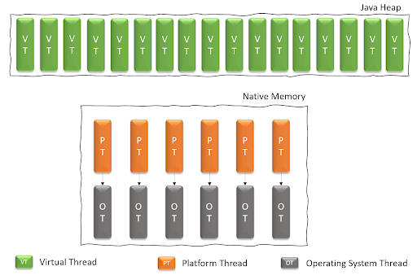
Virtual Threads

Slide 22
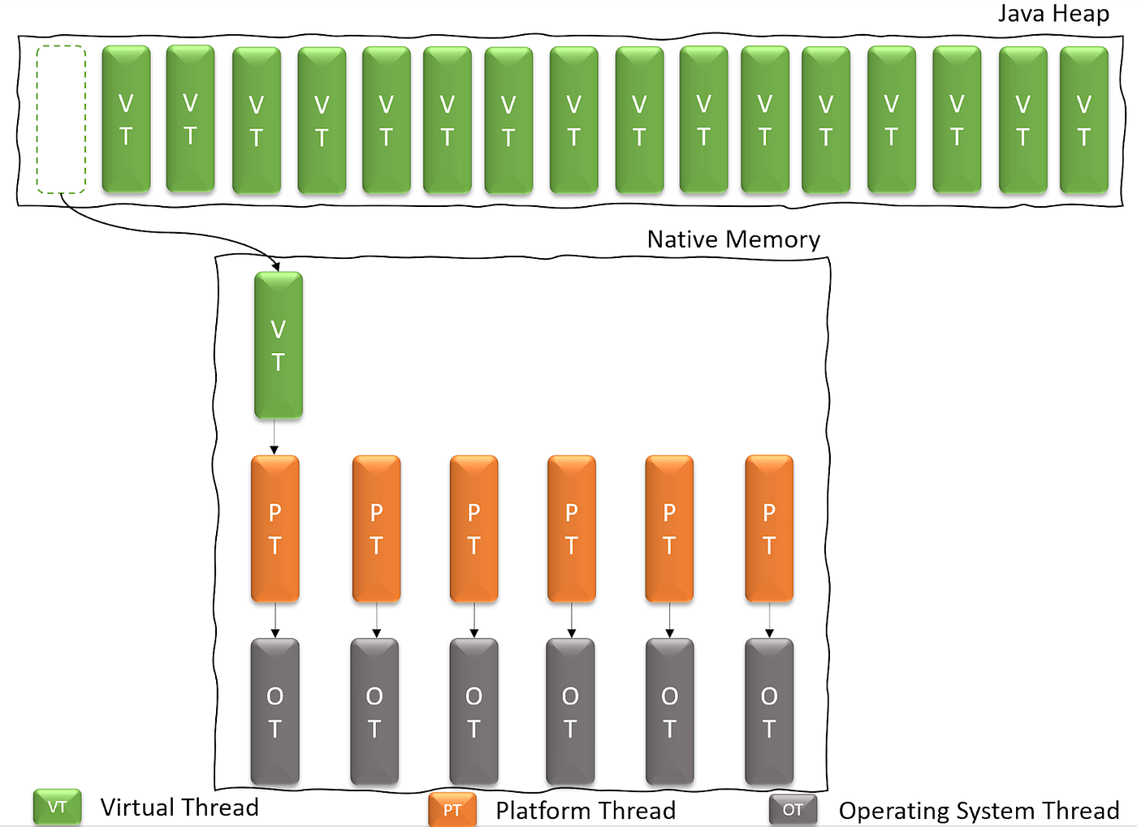
Virtual Threads

Slide 23
Creating Virtual Thread
1. Thread.ofVirtual().start(Runnable);
2. Thread.ofVirtual().unstarted(Runnable);
3. Executors.newVirtualThreadPerTaskExecutor();
4. Executors.newThreadPerTaskExecutor(ThreadFactory);

