Slide 1
Building with Maven

Slide 2
Building with Maven
Introduction to Maven & its objectives
Install and setting up Maven
Maven project structure
POM.xml description

Slide 3
Project Management Tool
A Java build tool
“project management and comprehension tool”
It means - accumulator of knowledge,
An Apache Project
Mostly sponsored by Sonatype
Standard and Easy way to build and Publish the projects
To share JARs across several projects.
Communication among members of a working team.

Slide 4
Installing Maven
Download Maven :http://maven.apache.org/download.html
Unzip the installation archive
Set the M2_HOME and Path environment variables in the following way:
M2_HOME=C:\apache-maven-2.2.1
Path=%M2_HOME%\bin
mvn –version
Will print out installed version of Maven, indicating successful installation .
Maven is Bunded with all Popular IDEs

Slide 5
Pom.xml
Stands for Project Object Model
POM is the fundamental unit of work in Maven.
An XML file that contains information about the project and configuration details used by Maven to build the project.
While executing Maven looks for the POM in the current directory.
It reads the POM, gets the needed configuration information, then executes the goal.

Slide 6
POM
The following Details about the project can be configured in POM
Name and Version
Artifact Type
Dependencies
goals
Plugins
Profiles (Alternate build configurations)
Super POM
Maven's default POM.
All POMs extend the Super POM
Configuration is inherited by the POMs

Slide 7
Minimal POM
<project>
<modelVersion>4.0.0</modelVersion>
<groupId>com.mycompany.app</groupId>
<artifactId>my-app</artifactId>
<version>1</version>
</project>

Slide 8
Minimal Pom.xml
Projects are the top-level element in all pom.xml files.
groupID:
Arbitrary project grouping identifier (no spaces or colons
Loosely based on Java package name
artfiactId:
Arbitrary name of project (no spaces or colons)
Usually base name of the primary artifact
Typically files like a JAR or war
version:
Version of project
Format {Major}.{Minor}.{Maintanence}
Add ‘-SNAPSHOT ‘ to identify in development

Slide 9
Maven Dependency Management
Maven revolutionized Java dependency management
No more checking libraries into version control
Introduced the Repository concept
Established Maven Central
Created a module metadata file (POM)
Introduced concept of transitive dependency

Slide 10
Dependencies
Used to store Dependencies and then downloaded
Via http
Downloaded dependencies are cached in a local repository
Usually found in ${user.home}/.m2/repository
Maven Central is primary community repo
http://repo1.maven.org/maven2
After downloading repository,
Maven will always look for the artifact in the local repository before looking elsewhere.

Slide 11
Dependencies
<project>
...
<dependencies>
<dependency>
<groupId>javax.servlet</groupId>
<artifactId>servlet-api</artifactId>
<version>2.5</version>
<scope>provided</scope>
</dependency>
</dependencies>
</project>

Slide 12
Resolving Dependency
During the build process dependencies are resolved with dependency management engine.
Specified in <dependencies> elements within a pom.xml file.
They are resolved in the following order:
Local repository is checked for the dependency.
A list of remote repositories is checked for the dependency.
In Case 1 and 2 fail and error is reported

Slide 13
Scopes
Compile
default scope
dependencies that are available in all classpaths of a project.
Provided
Indicates the JDK or a container to provide the dependency at runtime.
dependency on the Servlet API
Test
The dependency is not required for normal use
Available for the test compilation and execution phases.

Slide 14
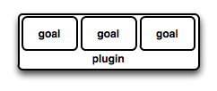
Maven Plugin
Maven is a plugin execution framework
Tasks are done by plugins.
Generally used to :
create jar file
create war file
compile code files
unit testing of code
Plugin provides a set of goals
mvn [plugin-name]:[goal-name]
mvn compiler:compile

Slide 15
Archetype Pluggin
Maven project templating toolkit.
original pattern or model from which all other things of the same kind are made.
Provides a quick consistent way with best practices to create a Project
Developers can have a working Maven project to use as a jumping board
A Directory with the artifact Id is Created along with Some Sample Code
mvn archetype: generate

Slide 16
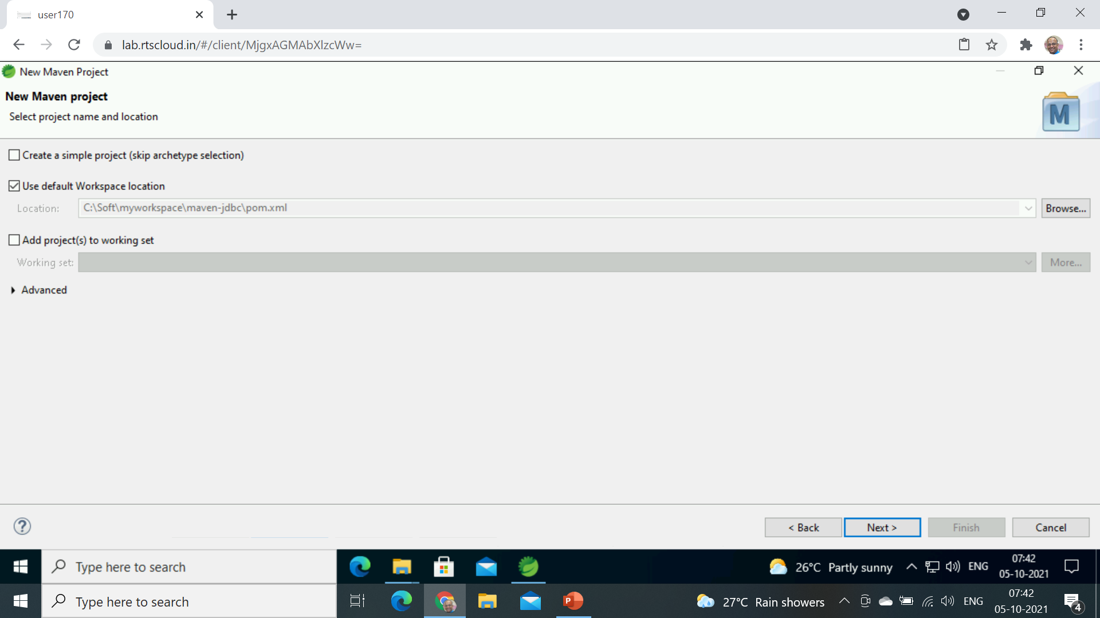
Create Maven Project with Eclise
Select File -> New –Maven Project
Select a Maven Project

Slide 17
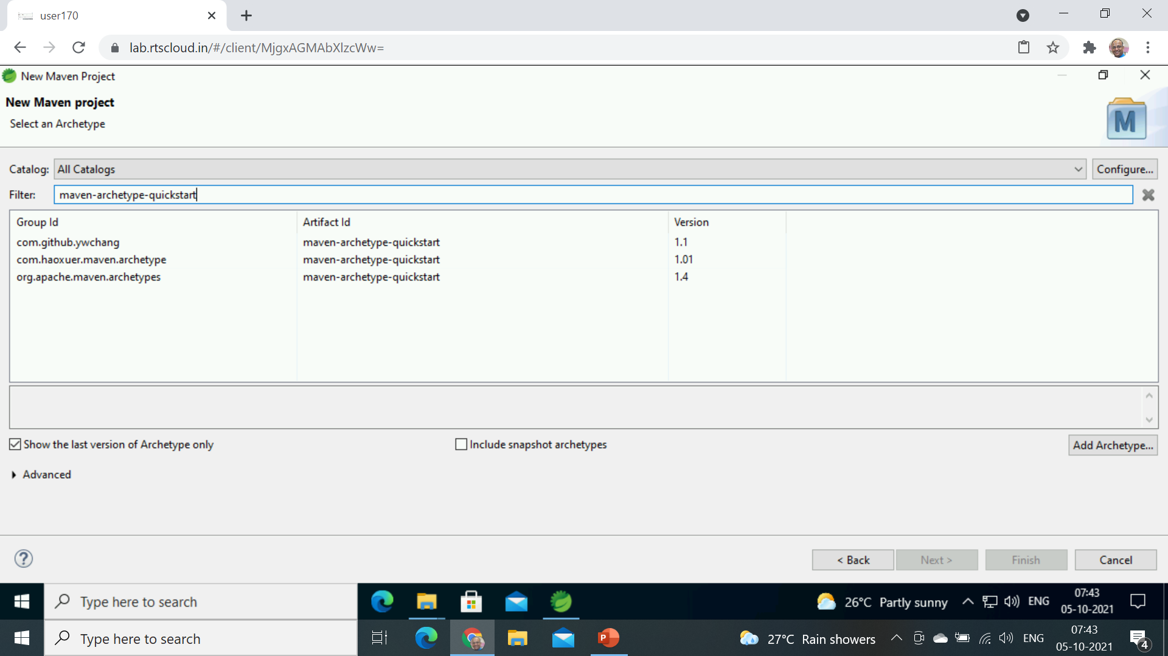
maven-archetype-quickstart

Slide 18
Plugin Goals
A plugin goal represents a specific task to building and managing of a project.
If a build phase has one or more goals bound to it, it will execute all those goals one by one
archetype plugins with Generate Goal will create projects.
mvn [plugin-name]:[goal-name]
mvn archetype: generate
mvn exec:java

Slide 19
Execute Maven Plugin
<plugin>
<groupId>org.codehaus.mojo</groupId>
<artifactId>exec-maven-plugin</artifactId>
<version>1.5.0</version>
<executions>
<execution>
<goals>
<goal>java</goal>
</goals>
</execution>
</executions>
<configuration>
<mainClass>com.example.demo.App</mainClass>
</configuration>
</plugin>

Slide 20
Goals
A goal not bound to any build phase could be executed outside of the build lifecycle by direct invocation.
mvn clean
Invokes just clean
mvn clean compile
Clean old builds and compile
mvn package
A jar file is created inside the project/target directory.

Slide 21
Package
mvn package will execute a series of phases and package to a distributable format, such as a JAR.
Validate
generate-sources
process-sources
generate-resources
process-resources
Compile
java -cp target/my-app-1.0-SNAPSHOT.jar com.mycompany.app.App

Slide 22
Maven Jar Plugin
<plugin>
<groupId>org.apache.maven.plugins</groupId>
<artifactId>maven-jar-plugin</artifactId>
<version>3.2.0</version>
<configuration>
<archive>
<manifest>
<mainClass>com.example.demo.App</mainClass>
</manifest>
</archive>
</configuration>
</plugin>

Slide 23
Variables
Don't repeat yourself.
To assist in ensuring the value is only specified once,
Maven allows variables in the POM.
<properties>
<mavenVersion>2.1</mavenVersion>
</properties>
<dependency>
<groupId>org.apache.maven</groupId>
<artifactId>maven-artifact</artifactId>
<version>${mavenVersion}</version>
</dependency>

Slide 24
Maven Eclipse Java Version
<properties>
<maven.compiler.target>1.8</maven.compiler.target>
<maven.compiler.source>1.8</maven.compiler.source>
</properties>

Slide 25
Packaging
<?xml version="1.0" encoding="UTF-8"?>
<project>
<groupId>com.mycompany.app</groupId>
<artifactId>my-app</artifactId>
<version>1.0-SNAPSHOT</version>
<packaging>jar</packaging>
</project>
Build type identified using the “packaging” element
Tells Maven how to build the project
Example packaging types:
pom, jar, war, ear, custom
Default is jar

Slide 26
Add Dependencies
<dependency>
<groupId>log4j</groupId>
<artifactId>log4j</artifactId>
<version>1.2.17</version>
</dependency>
<dependency>
<groupId>com.oracle.database.jdbc</groupId>
<artifactId>ojdbc8</artifactId>
<scope>runtime</scope>
<version>19.3.0.0</version>
</dependency>

Slide 27
Assembly Plugin
Apache Maven Assembly Plugin
Used to aggregate the project output along with its dependencies, modules, site documentation, and other files into a single, runnable package.
single goal
The only goal in the assembly plugin
Used to generate the JAR file from the project
Run with assembly:single.
mvn assembly:single

Slide 28
Maven Assembly Plugin
<plugin>
<groupId>org.apache.maven.plugins</groupId>
<artifactId>maven-assembly-plugin</artifactId>
<configuration>
<archive>
<manifest>
<mainClass>com.example.demo.Application</mainClass>
</manifest>
</archive>
<descriptorRefs>
<descriptorRef>jar-with-dependencies</descriptorRef>
</descriptorRefs>
</configuration>
</plugin>

