Slide 1


Programming With Java

Slide 2

K.Srivatsan - vatsank@gmail.com
IT Trainer Since 1991
Java Training Since 2004
About 60+ Corporate Clients

Slide 3
Day -1 -Topics
Introduction to Java
JDK,JRE,JVM
Simple Java Program
Using Command Prompt
Path and ClassPath
Introduction to Eclipse
JVM Overview
JVM Overview
Class Loading

Slide 4
Learning Java
Core Java concepts like syntax, OOP principles, and control flow.
Memory management (stack vs heap) and Java’s platform independence.
Deep Dive object-oriented programming, collections, exception handling, and basic multithreading.
Handling files using IO and NIO.
Reflection API, Generics, Java Streams
Building scalable and secure Java applications
Lambda Expressions and Streams
Records, Sealed Classes and Virutal Threads
Build Projects and Fine tune the Learning

Slide 5
Day -1 -Topics
Flow Control
Debugging with Eclipse
Primitives
Class Structure
Construtors
Method Overloading
Instance, Static and Local Variables
Command Line Arguments
Packages and Libraries
Java Docs
Arrays
Data Structure Through Arrays

Slide 6
History of Java
In 1991, a research group at Sun Microsystems, as a part of their Green project, was working to develop software to control consumer electronic devices (embedded systems).
The goal was to connect them in a network and establish communication between them.
The first prototype developed by Sun Microsystems was a device called Star 7 which looked like a remote.
The initial intent was to use C++ to control the Star 7.
  But, James Gosling invented a new language called Oak which was later renamed to Java.

Slide 7
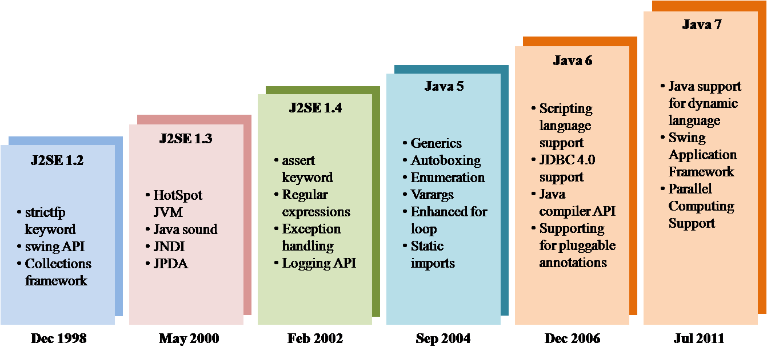
History of Java

Slide 8
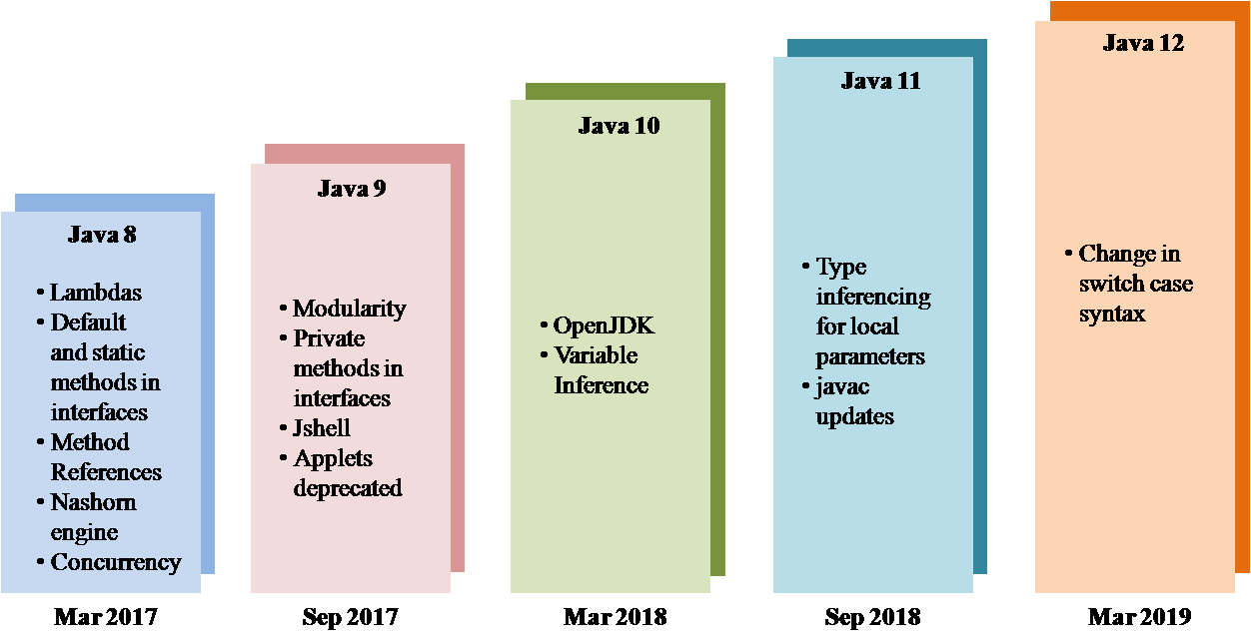
History of Java

Slide 9
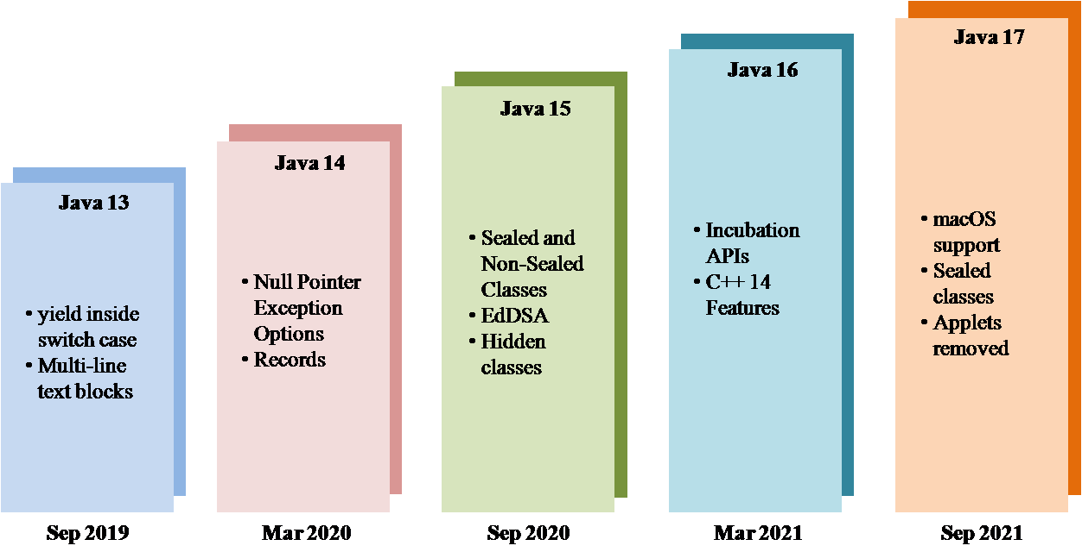
Java History

Slide 10
Java History
Java SE 17 (LTS) | September 14, 2021
Java SE 18 | March 22, 2022
Java SE 19 | September 20, 2022
Java SE 20 | March 21, 2023
Java SE 21 (LTS) | September 19, 2023
Java SE 22 | March 19, 2024
Java SE 23 | September 17, 2024
Java SE 24 | 18 March 2025

Slide 11
When to Use Java
Java is truly portable.
Software libraries and software components like web servers
Good Development environment
To Create Web Services or distributed applications
Good Database support
Networking support

Slide 12
When Not to Use Java
  Applications that are entirely bound by CPU time and need to be as fast as possible should be written in C++
  Applications where a virtual machine would not really work well.
    Database engines for database systems.
  Software that has to interface directly to the hardware (operating systems)
  Language processors that have to be fast (e.g., compilers)

Slide 13
Primary Goals of Java
Provides an easy-to-use language by:
  Avoiding many pitfalls of other languages
  Being object-oriented
  Enabling users to create streamlined and clear code
Provides an interpreted environment for:
  Improved speed of development
  Code portability
  Enables users to run more than one thread of activity
  Loads classes dynamically; that is, at the time they are actually needed
  Supports changing programs dynamically during runtime by loading classes from disparate sources

Slide 14
Features of Java
Features that fulfill the goals:
  The Java Virtual Machine (JVM)
  The Java Runtime Environment (JRE)
  JVM tool interface
  Garbage collection

Slide 15
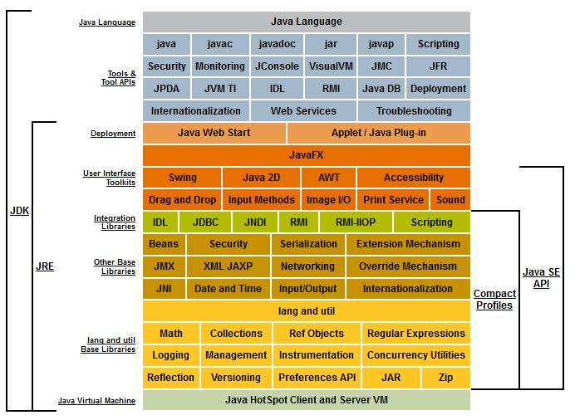
Glance of Java

Slide 16


JAVA COMPILER
(translator)
JAVA BYTE CODE
(same for all platforms)
JAVA
(one for each different system)
Windows
Linux
Mac
Solaris

Slide 17
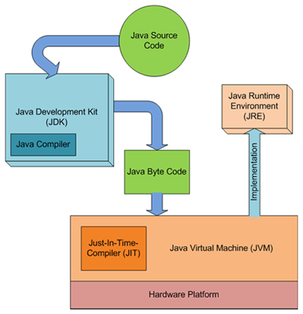
JDK,JVM and JRE

Slide 18
The Java Virtual Machine
Executes instructions that a Java compiler generates.
A runtime environment, embedded in web browsers, servers, and operating systems
Imaginary machine that is implemented by emulating software on a real machine
Reads compiled byte codes that are platform-independent
Bytecode
  a special machine language that can be understood by the JVM independent of any particular computer hardware,
  Java Runtime Environment (JRE) is an implementation of the JVM”.
  “JVM becomes an instance of JRE at runtime”.
    A runtime instance of JVM will born when .class file starts its execution

Slide 19
JVM Tasks
Loads code
  Loads all classes necessary for the execution of a program
  Maintains classes of the local file system in separate namespaces
Verifies code (Bytecode Verifier)
  The code adheres to the JVM specification.
  The code does not violate system integrity.
  The parameter types for all operational code are correct.
  No illegal data conversions have occurred.

Slide 20
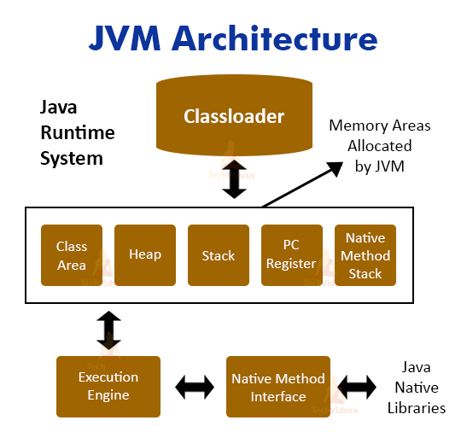
Java Virtual Machine

Slide 21
Class Loader
Bootstrap Class Loader
  Responsible for loading classes from bootstrap classpath
  JAVA_HOME/jre/lib directory.
  Highest priority will be given to this loader.
Extension Class Loader
  This loader is child of Boorstrap class loader.
  It loads classes from JAVA_HOME/jre/lib/ext
  Can be specified by the java.ext.dirs system property.
Application Class Loader
  This loader is child of Extension class loader
  Responsible for loading classes from application level classpath.
  It uses Environment Variable which is mapped to java.class.path.

Slide 22
Custom Class Loader
Used for loading classes from different sources other than local file system.
  FTP server, database or any other persistence store
Applets are mostly loaded from internet rather than local file system and AppletClassLoader is responsible for this loading operation.

Slide 23
Working of Class Loader
JVM invokes loadClass() method of ClassLoader by passing the fully classified name of the class.
loadClass()
  Checks whether the class is already loaded by calling findLoadedClass()
  If the class is not loaded already, the request will be delegated to parent classloader to load the class.
  If the parent classloader fails and if findBootstrapClass() method also fails, the findClass() method is invoked to look for the classes in the file system.
  If findClass() finds the class, then defineClass() method is invoked to convert bytecodes into a .class instance.

Slide 24
Java Virtual Machine
Class Area
  Stores the structure of each class like method data, field data, runtime pool, metadata.
Heap
  Object allocation takes place.
Stacks
  Stacks store the partial results and local variables of a program.
  Whenever a thread is created, there is a simultaneous creation of JVM stack.
PC Registers
  It stores the address of the currently executing JVM instruction.
Native Method Stacks
  It includes all the native methods required in any application. It is not written in java.

Slide 25
Execution Engine-Interpreter
Interpreter
  It interprets the bytecode line by line and it does it very fast, but executes very slow.
  The main disadvantage of interpreter is that if any method is called multiple times, every time a new interpretation is required.

Slide 26
Execution Engine-JIT
  print x;
  print y;
  Repeat the following execution 10 times by changing the values of i from 1 to 10:
  print z;
When .class file is loaded in the memory, JVM will identify code to the interpreter and to JIT compiler so that the performance is better.
The blocks of code given to the JIT compiler are also called hotspots in Java.
This feature in Java language really improves the execution time of the program at runtime, especially when it is to be executed multiple times.
HotSpot VM is widely used in the Java ecosystem alternative JVM implementations are OpenJ9 and GraalVM,

Slide 27
Garbage Collection
Garbage collector is responsible for cleaning the memory.
In other languages, de-allocation is the programmer’s responsibility.
A system-level thread to track memory allocation.
Garbage collection has the following characteristics:
  Checks for and frees memory no longer needed
  Is done automatically
  Can vary dramatically across JVM implementations
Can request JVM to run garbage collection by calling System.gc()

Slide 28
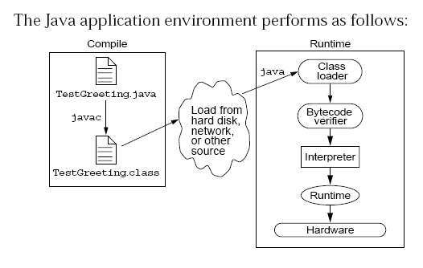
Java Run Time Environment

Slide 29
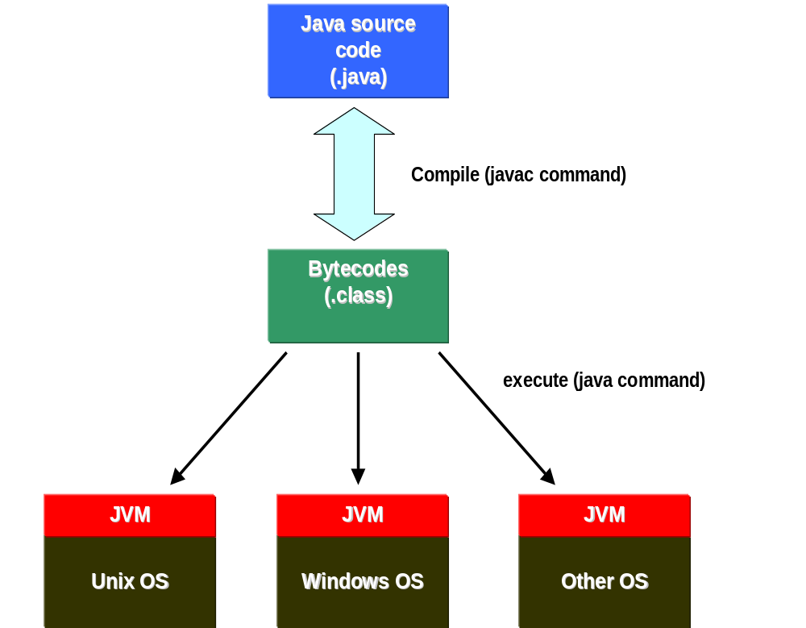

Slide 30
Integrated Development Environments
An IDE is the high-productivity tool
Used to edit, compile, and test programs, manage projects, debugging, building GUI interfaces, etc.
IDE provides extensive programming support for editing and project management,
The Popular IDE’s
  Eclipse
  NetBeans
  IntelliJ
  Visual Studio Code

Slide 31
Java language syntax

Slide 32
Objectives
Identify the basic parts of a Java program
Differentiate among Java literals, primitive data types,
variable types ,identifiers and operators
Develop a simple valid Java program using the concepts learned in this chapter

Slide 33
Program structure
A program in Java consists of one or more class definitions
One of these classes must define a method main(), which is where the program starts running
Java programs should always end with the .java extension.
There can be More than one Class Definition in a class ,but only one public class
Source Filenames should match the name of the public class.

Slide 34
Source File Layout
Basic syntax of a Java source file is:
[<package_declaration>]
<import_declaration>*
<class_declaration>+

Slide 35
Classes
Top-level classes can be declared as
  public
    a public class is globally accessible.
    a single source file can have only one public class or interface
  abstract
    an abstract class cannot be instantiated
  final
    a final class cannot be subclassed
  Default
    With any Modifier
They can’t be declared as protected and private

Slide 36
Software Packages
Packages help manage large software systems.
Packages can contain classes and sub-packages.
package <top_pkg_name>[.<sub_pkg_name>]*;
Specify the package declaration at the beginning of the source file.
Only one package declaration per source file.
If no package is declared, then the class is placed into the default package.
Package names must be hierarchical and separated by dots.

Slide 37
The import Statement
import <pkg_name>[.<sub_pkg_name>]*.<class_name>;
import <pkg_name>[.<sub_pkg_name>]*.*;
import java.util.List;
import java.io.*;
import shipping.gui.reportscreens.*;
The import statement does the following:
  Precedes all class declarations
  Tells the compiler where to find classes

Slide 38
Example 1.1
  package com.training;
  public class Greeting {
  public String getMessage() {
  return "Welcome to Java Programming";
  }
  }

Slide 39
Example 1.1 (contd)
  package com.training;
  public class TestGreeting{
  public static void main(String[] args) {
  Greeting grtObj = new Greeting();
  System.out.println(grtObj.getMessage());
  }
  }

Slide 40
Objectives
Define modeling concepts: abstraction, encapsulation,
Discuss why you can reuse Java technology application code
Define class, member, attribute, method, constructor, and package
Use the access modifiers private and public as appropriate for the guidelines of encapsulation
Invoke a method on a particular object
Use the Java technology application programming interface (API) online documentation

Slide 41
Classes as Blueprints for Objects
In manufacturing, a blueprint describes a device from which many physical devices are constructed.
In software, a class is a description of an object:
  A class describes the data that each object includes.
  A class describes the behaviors that each object exhibits.
In Java technology, classes support three key features OOP
  Encapsulation
  Inheritance
  Polymorphism

Slide 42
Declaring Java Technology Classes
Basic syntax of a Java class:
  <modifier>* class <class_name> {
  <attribute_declaration>*
  <constructor_declaration>*
  <method_declaration>*
  }
Define an attribute:
<modifier>* <type> <name> [ = <initial_value>];

Slide 43
Declaring Methods
Basic syntax of a method:
<modifier>* <return_type> <name> ( <argument>* ) {
<statement>*
}
  public int getWeight() {
  return weight;
  }
  public void setWeight(int newWeight) {
  if ( newWeight > 0 ) {
  weight = newWeight;
  }
  }

Slide 44
Accessing Object Members
The dot notation is: <object>.<member>
  used to access object members, including attributes and methods.
d.setWeight(42);
d.weight = 42; // only permissible if weight is public

Slide 45
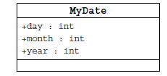
Information Hiding
Client code has direct access to internal data
(d refers to a MyDate object):
d.day = 32; // invalid day
d.month = 2; d.day = 30; // plausible but wrong
d.day = d.day + 1; // no check for wrap around

Slide 46
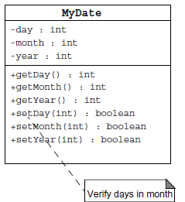
Encapsulation
Hides the implementation details of a class
Forces the user to use an interface to access data
Makes the code more maintainable

Slide 47
Classes
Top-level classes can be declared as
  public
    a public class is globally accessible.
    a single source file can have only one public class or interface
  abstract
    an abstract class cannot be instantiated
  final
    a final class cannot be subclassed
  Default
    With any Modifier
They can’t be declared as protected and private

Slide 48
Constructors
Have no return type
Have the same name as the class
If we don't’ put a constructor the compiler puts a default one
  The default constructor has the same access modifier as the class.
  The default constructor has no arguments.
  The default constructor is always a no-arg constructor, but a no-arg constructor is not necessarily the default constructor
  The default constructor includes a no-arg call to the super constructor (super()).
They are not inherited and hence they are not overridden
It can be Overloaded
It can have any of the Four Access Modifies
It cannot be synchronized
It can have throws clause

Slide 49
Instantiation with new
It is the process by which individual objects are created.
  Class objectReference = new Constructor();
Declaration
  Employee empObj;
Instantiation
  empObj = new Employee()
Declaration and Instantiation
  Employee empObj = new Employee()
  new operator allocates memory for an object.

Slide 50
Constructor Overloading
One constructor can call another overloaded constructor of the same class by using this keyword.
this() is used to call a constructor from another overloaded constructor in the same class
The call to this() can be used only in a constructor ,and must be the first statement in a constructor
A constructor can call its super class constructor by using the super keyword.
A constructor can have a call to super() or this() but never both

Slide 51
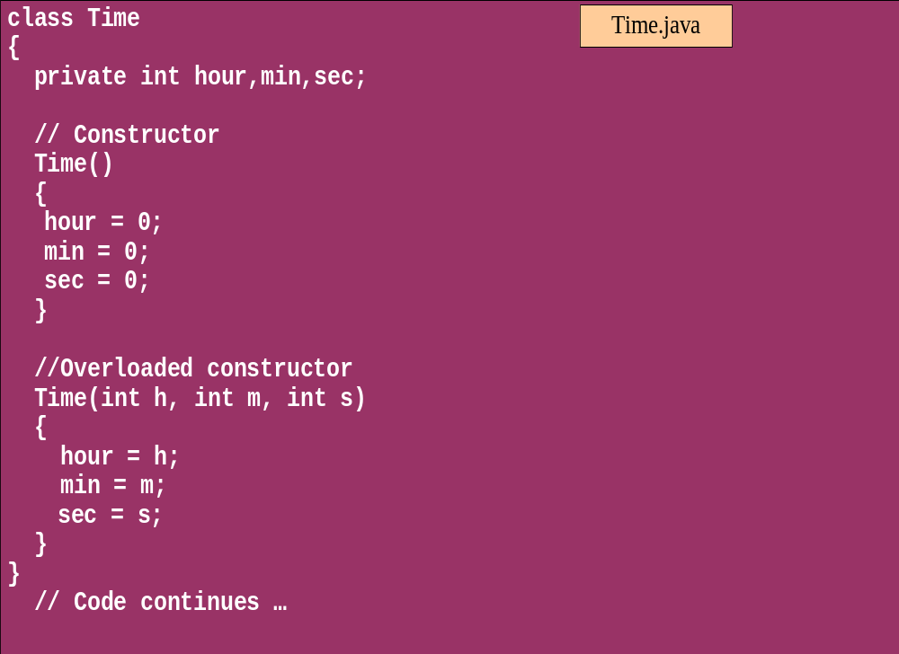
Overloaded Constructor

Slide 52
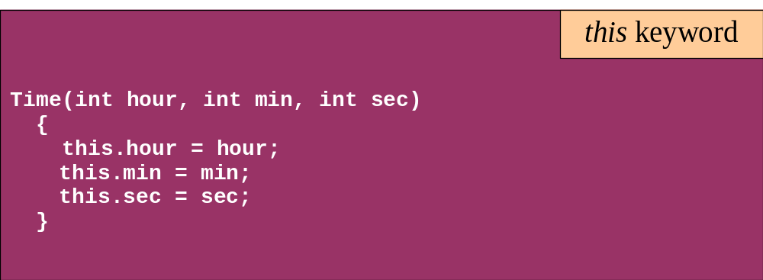
this keyword
Is a reference to the object from which the method was invoked

Slide 53
Comments
Java supports three forms of comments
  // single line comments
  /* multi
    line
    comment
    */
  /** a
    * Javadoc
    * comment
    */

Slide 54
Variables and Methods
A variable, which corresponds to an attribute, is a named memory location that can store a certain type of value.
Variable is a kind of special container that can only hold objects of a certain type.
Primitive type Variable
    Basic, built-in types that are part of the Java language
    Two basic categories
      boolean
      Numeric
        Integral - byte, short, int, long, char
        Floating point - float, double

Slide 55
Variables
Local variables:
  Declared within a method or block of code.
  Their scope is limited to that method or block.
  They are stored on the Stack
Instance variables:
  Declared within a class but outside any method.
  They belong to a specific instance (object) of the class.
  They are Stored in Heap
  They can have any one of the four access levels
Static variables:
  Declared with the static keyword.
  They belong to the class itself and are shared by all instances of the class.
  static variables are stored in the heap.

Slide 56
Variable
Variable scope
Variable scope refers to the region of the program where a variable can be accessed. Local variables have method or block scope, instance variables have class scope, and static variables have class scope as well.
What are default values of variables in Java?
Instance and static variables have default values if they are not explicitly initialized:
  int, short, byte, long: 0
  float, double: 0.0
  boolean: false
  char: '\u0000' (null character)
  Object references (e.g., String): null
Local variables do not have default values and must be explicitly initialized before use.

Slide 57
Example for Variables
  public class VariableTypes {
  private int inst_empid;
  private static String cls_empName
  public void getData() { }
  public static void getSalary() { }
  public void showData(int a)
  {
  int localVariable ;
  }
  }
Instance Variable
Class Variable
Parameter Variable
Local Variable

Slide 58
Assignment of reference variables
int x = 7;
int y = x;
String s = “Hello”;
String t = s;
x
y
s
t
7
7
0x01234
0x01234
Hello

Slide 59
Pass-by-Value
The Java programming language only passes arguments by value for primitive data types.
When an object instance is passed as an argument to a method, the value of the argument is a reference to the object
The contents of the object can be changed in the called method, but the object reference is never changed
For primitives, you pass a copy of the actual value.
For references to objects, you pass a copy of the reference
You never pass the object. All objects are stored on the heap.
Notes:
The Java programming language only passes arguments by value.
When an object instance is passed as an argument to a method, the value of the argument is a reference to the object.
The contents of the object can be changed in the called method, but the object reference is never changed .

Slide 60

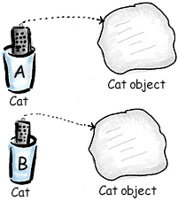
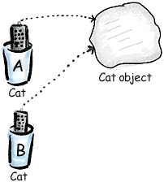
Pass By Value

Slide 61
Casting Primitive Types
Casting creates a new value and allows it to be treated as a different type than its source
JVM can implicitly promote from a narrower type to a wider type
To change to a narrow type explicit casting is required
Byte -> short -> int -> long -> float -> double

Slide 62
Casting Primitive Types
  public class PrimCasting {
  public static void main (String [] args){
  int x = 99;
  double y = 5.77;
  x = (int)y; //Casting
  System.out.println("x = "+ x);
  double y1 = x; //No Casting
  int i =42;
  byte bt;
  bt= (byte)i;
  System.out.println("The Short number"+ bt);
  }
  }

Slide 63
Wrapper Classes
Primitives have no associated methods
Wrapper Classes are used encapsulate primitives
They also provide some static utility methods to work on them
Primitive Type | Wrapper class
-boolean | Boolean
-byte | Byte
-char | Character
-double | Double
-float | Float
-int | Integer
-long | Long
short | Short

Slide 64
Wrapping Primitives
Wrapping a value
  int i = 288
  Integer iwrap = new Integer(i);
unWrapping a value
  int unwrapped = iwrap.intValue();
Methods In Wrapper Class
  parseXxx()
  xxxValue()
  valueOf()

Slide 65
Wrapper Class Method
Convert String to Numbers
public class ParsingStrings
{
public static void main(String args[])
{
int ino=Integer.parseInt(args[0]);
floatfno = Float.parseFloat(args[1]);
double dno = Double.parseDouble(args[2]);
Long lno = Long.parseLong(args[3]);
System.out.println("Integer value" +ino );
String strIno = Integer.toString(ino);
System.out.Println(“String Value”+strIno);
}
}

Slide 66
Auto Boxing
Java 5.0 provided autoboxing
Integer n = new Integer(123) Int m = n.intValue() m++; n=new Integer(m); System.out.println(n); | Integer n = new Integer(123); n++; System.out.println(n);

Slide 67
Auto Boxing
public class ABoxing {
  public void show(int a, float b)
  {
  System.out.println("Integer"+a*2);
  System.out.println("Float"+b*2);
  }
  public static void main(String[] args) {
  ABoxing abObj =new ABoxing ();
  Integer a = 10;
  Float b =20f;
  abObj.show(a,b);
  }
  }

Slide 68
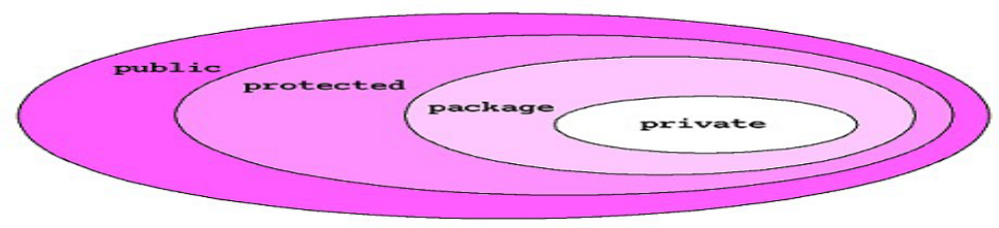
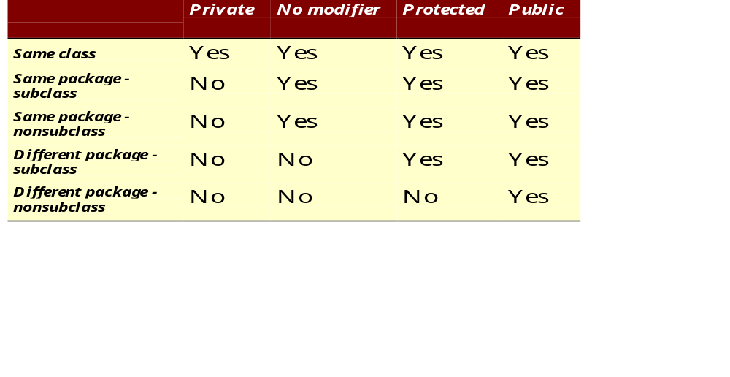
The 4 Access Levels and 3 Modifiers

Slide 69
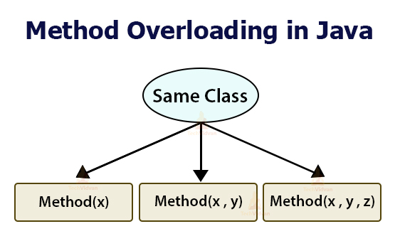

Slide 70
Method Overloading
If two (or more) methods of a class have the same name but different signatures, then the method name is said to be overloaded.
The signature of a method consists of the name of the method and the number and types of formal parameters in particular order.
Method overloading is method name overloading.
Several methods that implement similar behavior but for different data types.
They are independent methods of a class and can call each other just like any other method.
A method can be overloaded in the same class or in a subclass.

Slide 71
Overloading Methods
Overloaded methods MUST change the argument list.
Overloaded methods CAN change the return type.
Overloaded methods CAN change the access modifier.
Overloaded methods CAN declare new or broader checked exceptions.

Slide 72
Static Variables and Methods
A static method belongs to a class and not to its instance objects and hence they are shared between Objects
Static Methods can not be overridden
They can only call other static methods
They can access only static variables and not instance Variables
They cannot refer to this or super
Instance variable : 1 per instance and Static variable : 1 per class
Static final variables are constants
main( ) is defined to be a static method so as to be invoked directly

Slide 73
Static Method access only static
  public class StatClass {
  private int id;
  private static String name;
  private void instMethod()
  {
  staticMethod();
  System.out.println(id);
  System.out.println(name);
  }
  private static void staticMethod()
  {
  System.out.println(id);
  System.out.println(name);
  instMethod();
  }
  }
Can Access Static from Instance Method
Cannot Access Instance Variable From Static
Cannot Access Instance Method From Static

Slide 74
Static Import
  import java.util.*;
  import static java.lang.System.out;
  import static java.lang.System.in;
  public class StaticImport {
  public static void main(String[] args) {
  Scanner kb = new Scanner(in);
  out.print("Enter an integer ");
  int x = kb.nextInt();
  out.print("Enter a double ");
  double d = kb.nextDouble();
  out.println("The sum is " + (x+d));
  }
  }

Slide 75
java.util.Scanner Class
A simple text scanner which can parse primitive types and strings using regular expressions.
A Scanner breaks its input into tokens using a delimiter pattern, which by default matches whitespace.
The resulting tokens may then be converted into values of different types using the various next methods.
  Scanner sc = new Scanner(System.in);
  int i = sc.nextInt();

Slide 76
java.util.Scanner Class
  public static void main(String[] args) {
  String line="Java,is,in,OOP,Language";
  Scanner sc1 = new Scanner(line);
  sc1.useDelimiter(",");
  while (sc1.hasNext())
  {
  System.out.println(sc1.next());
  }
  }

Slide 77
Scanner Class
    Scanner sc = new Scanner(System.in);
    sc.useDelimiter("\\n");
    String name = sc.next();
    String description = sc.next();
    int mark =sc.nextInt();
    System.out.println(name);
    System.out.println(description);
    sc.close();

Slide 78
Scanner Class
Scanner scanner = new Scanner(System.in);
System.out.println("Enter text with line breaks (press Enter twice to finish):");
StringBuilder inputBuilder = new StringBuilder();
String line;
while (true) {
line = scanner.nextLine();
if (line.isEmpty()) {
break; // Exit loop if an empty line is entered
}
inputBuilder.append(line).append("\n");
}
String inputString = inputBuilder.toString();
System.out.println("Entered text:\n" + inputString);
scanner.close();

Slide 79
Flow Control

Slide 80
Objectives
Decision control structures (if, else, switch)
Repetition control structures (while, do-while, for)
Branching statements (break, continue, return)

Slide 81
Control Structures
To change the ordering of the statements in a program
Two types of Control Structures
decision control structures ,
  allows us to select specific sections of code to be executed
    if -- else , if – else if
    switch -- case
repetition control structures
  allows us to execute specific sections of the code a number of times
    while
    do -- while
    for

Slide 82
Decision Control Structures
Types:
  if-statement
  if-else-statement
  If-else if-statement
If Specifies that a statement or block of code will be executed if and only if a certain boolean statement is true.
      if( boolean_expression )
      statement;
    or
      if( boolean_expression ){
      statement1;
      statement2;
      }
boolean_expression : can be an expression or variable.

Slide 83
if-else statement
if( boolean_exp ){
Statement(s)
}
else {
Statement(s)
}
  if(boolean_exp1 )
  statement1;
  else if(boolean_exp2)
  statement2;
  else
  statement3;
For Comparison == used instead =
= being an assignment operator
equals Method Should Be Used for Objects comparison

Slide 84
switch-statement
Allows branching on multiple outcomes.
switch expression is an integer ,character expression or variable
case_selector1, case_selector2 and unique integer or character constants.
If none of the cases are satisfied, the optional default block if present is executed.
    switch( switch_expression ){
    case case_selector1:
    Statement(s);
    break;
    case case_selector2:
    Statement(s);
    break;
    default:
    statement1;
    }

Slide 85
switch-statement
When a switch is encountered,
  evaluates the switch_expression,
  jumps to the case whose selector matches the value of the expression.
  executes the statements in order from that point on until a break statement is encountered
  break statement stops executing statements in the subsequent cases, it will be last statement in a case.
  Used to make decisions based only on a single integer or character value.
  The value provided to each case statement must be unique

Slide 86
switch-statement
  public double CalculateDiscount(int pCode)
  {
  double discountPercentage=0.0d;
  switch(pCode)
  {
  case 1:
  discountPercentage=0.10d;
  break;
  case 2:
  discountPercentage=0.15d;
  break;
  case 3:
  discountPercentage=0.20d;
  break;
  default:
  discountPercentage=0.0;
  }
  return discountPercentage;
  }

Slide 87
Switch-Case in a Method
Can have Either Return or Break if present inside a Method, but should provide a default Value
    public String switchExample(int key) {
    switch (key) {
    case 1:
    return "Good Morning";
    case 2:
    return "Good AfterNoon";
    case 3:
    return "Good Evening";
    default:
    return "Good Night";
    }

Slide 88
Switch-Case Java 7.0
Can use a String object in the switch statement's expression.
The String in the switch expression is compared with the expressions associated with each case label
Will Throw a Null pointer Expression if the expression is NULL
  String color = "red";
  switch (color) {
  case "red":
  System.out.println("Color is Red");
  break;
  default:
  System.out.println("Color not found");
  }

Slide 89
Switch Expressions
Switch Expressions:
  Expressions returning a value based on the case that matches.
  use an arrow -> instead of break statements, simplifying the code.
Multiple Case Labels:
  A single case statement can now handle multiple values, reducing code duplication.
yield Statement:
  Instead of break, the yield statement is used to specify the value returned by a switch expression.
  This means we can assign the value of a switch expression to a variable.

Slide 90
Switch Case Yield
  int value = switch (greeting) {
  case "hi" -> { System.out.println("I yielding!"); yield 1; }
  case "hello" -> { System.out.println("Me too."); yield 2; }
  default -> { System.out.println("OK"); yield -1; } };

Slide 91
Repetition Control Structures
while-loop
  The statements inside the while loop are executed as long as the Boolean expression evaluates to true
do-while loop
  statements inside a do-while loop are executed several times as long as the condition is satisfied, the statements inside a do-while loop are executed at least once
Watch this
  while(boolean_expression){
  statement1;
  statement2;
  }
do{
statement1;
statement2;
}while(boolean_expression);

Slide 92
Loop and Branching
Same code a number of times.
for(Initialexpr;LoopCondition;StepExpr) {
  statement1;
  }
Branching statements allows to redirect the flow of program execution.
  break
  continue
  return.
System.exit() All program execution stops; the VM shuts down.

Slide 93
Arrays

Slide 94
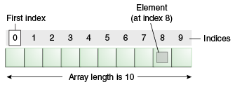
Introduction to Arrays
Array is one variable is used to store a list of data and manipulate
This type of variable is called an array.
It stores multiple data items of the same data type, in a contiguous block of memory, divided into a number of slots.
The new keyword to create an array object.
Need to tell the compiler how many elements will be stored in it.

Slide 95
Creating Arrays
There are three steps to creating an array,
declaring
  int[] k;
  float[] yt;
  String[] names;
allocating
  k = new int[3];
  yt = new float[7];
  names = new String[50];
initializing
  int[ ] k = {1, 2, 3};
  float[ ] yt = {0.0f, 1.2f, 3.4f, -9.87f, 65.4f, 0.0f, 567.9f};

Slide 96
Enhanced For Loop
The enhanced for loop, simplifies looping through an array or a collection.
Instead of having three components, the enhanced for has two.
for(data_type variable : array | collection){}
int [] a = {1,2,3,4};
for(int n : a)
System.out.print(n);.

Slide 97
Array Bounds
All array subscripts begin with 0 and ends with n-1
In order to get the number of elements in an array, can use the length field of an array.
The length field of an array returns the size of the array.
  int list [] = new int[10];
  for (int i = 0; i< list.length; i++)
  {
    System.out.println(list[i]);
    }
There is no array element arr[n]! This will result in an array-index-out-of bounds exception.

Slide 98
Multi Dimension Array
  public static void multiDimension()
  {
  int[][] values={
  {1,100,10},
  {2,200,20},
  {3,300,30},
  {4,400,40}
  };
  for(int i=0;i<4;i++)
  {
  for(int j=0;j<3;j++)
  {
  System.out.println(values[i][j]);
  }
  }

Slide 99
Array of Objects
public class ArrayofObject {
public void displaybooks(Book[] bks)
{
for(int i=0;i<bks.length;i++)
{
System.out.println("Book Number :="+bks[i].getBookno());
System.out.println("Book Name :="+bks[i].getBookname());
}
}
public static void main(String args[])
{
Book[] bk = new Book[2];
Book b1 = new Book(100,"java");
Book b2= new Book(101,"j2ee");
bk[0]=b1;
bk[1]=b2;
ArrayofObject ab= new ArrayofObject();
ab.displaybooks(bk);
}
}

Slide 100
Copying Arrays
System.arraycopy()
  can be used to efficiently copy data from one array into another:
public static void arraycopy(Object src, int srcPos, Object dest, int destPos, int length)
The two Object arguments
  the array to copy from and the array to copy to.
The three int arguments
  starting position in the source array,
  starting position in the destination array,
  number of array elements to copy.

Slide 101
Summary
WHY JAVA IS PLATFORMINDEPENDENT.
DIFFERENCES BETWEEN == AND .EQUALS(),
PRIMITIVE VS REFERENCE TYPES
ENCAPSULATION
STACK VS HEAP
GARBAGE COLLECTIONS
METHOD OVERLOADING,
METHOD OVERRIDING
USE CASES FOR SWITCH VS IF-ELSE
ENHANCED SWITCH YIELD KEYWORD
IMMUTABLE NATURE OF JAVA STRINGS
STATICALLY AND STRONGLY TYPED

