Slide 1
Java Collection Framework
Provides tools to maintain data container of object
Is an alternative to the creation of custom data structures
Consists of interfaces and classes that implement interfaces within the java.util package
Collection is the root interface for most of the Java collections hierarchy

Slide 2
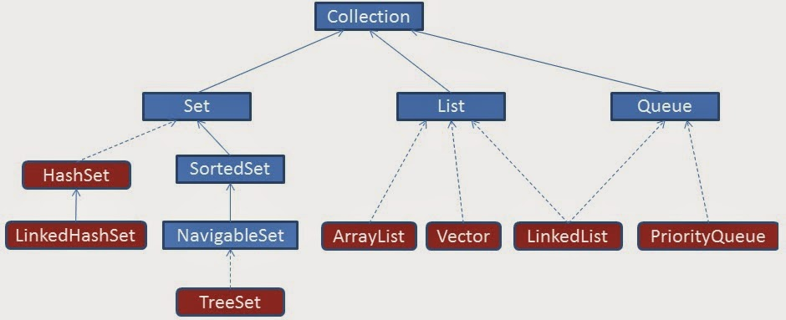
Collection Hierarchy

Slide 3
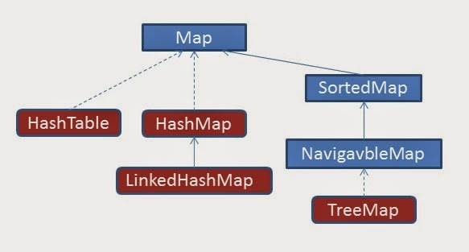
Collection Hierarchy- Map

Slide 4
Collection Interface
The root interface in the collection hierarchy.
Represents a group of objects, known as its elements.
There is no direct implementation the more specific sub-interfaces are Set and List.
This interface is typically used to pass collections around and manipulate them

Slide 5
Why Map is not Extending Collection
Maps work with key/value pairs
They map keys to values.
Its content can be viewed
As a set of keys,
A collection of values
A set of key-value mappings.
Mappings are not collections and collections are not mappings.
Maps can be viewed as Collections of keys, values, or pairs
It has Collection view operations
keySet, entrySet, and values

Slide 6
Collection categories
Ordered Collection
The objects within the collection are maintained in a particular order or not
When an object is added or removed from an ordered collection , the order is automatically maintained
Duplicate Elements
Whether or not the collection allows duplicate objects
Collection will automatically reject an attempt to add an object
Mapping of Key & Value
Whether or not the collection maps a key to a particular object .
This provides a means of quickly locating the object.
Such collections do not allow duplicate objects

Slide 7
Class ArrayList
ArrayList() Constructs an empty list with an initial capacity of ten.
ArrayList(Collection c) Constructs a list containing the elements of the specified collection, in the order they are returned by the collection's iterator.
ArrayList(int initialCapacity) Constructs an empty list with the specified initial capacity.

Slide 8
Generics
Introduced in Java 5.0
Can put any Object in to Collections, because they hold Just Objects
Type-safe Collections are created ,ensuring type-safety at compile time rather than run-time
Creating an Instance of Classes of Generic Type
new ArrayList<Employee>
ArrayList<Employee> mylist = new ArrayList<Employee>();

Slide 9
List Interface
can contain only Objects
An ordered collection
Elements can be accessed by their integer index (position in the list)
Lists typically allow duplicate and null elements.
Iterating over the elements in a list is typically preferable to indexing

Slide 10
Methods in List Interface
void add(object o)
void addAll(Collection c)
void clear()
boolean contains(object)
Object get(int index)
int indexOf(object o)
ListIterator listIterator()
Object set (int index, Object element)

Slide 11
List Implementations
Array List
a resizable-array implementation like Vector
unsynchronized
Linked List
a doubly-linked list implementation
if elements frequently inserted/deleted within the List
May provide better performance than ArrayList
For queues and double-ended queues (deques)
Vector
a synchronized resizable-array implementation of a List with additional "legacy" methods.

Slide 12
Class ArrayList
Resizable-array implementation of the List interface.
permits all elements, including null.
Each ArrayList instance has a capacity. The capacity is the size of the array used to store the elements in the list. , its capacity grows automatically.

Slide 13
Class ArrayList
ArrayList() Constructs an empty list with an initial capacity of ten.
ArrayList(Collection c) Constructs a list containing the elements of the specified collection, in the order they are returned by the collection's iterator.
ArrayList(int initialCapacity) Constructs an empty list with the specified initial capacity.

Slide 14
Generics
Introduced in Java 5.0
Can put any Object in to Collections, because they hold Just Objects
Type-safe Collections are created ,ensuring type-safety at compile time rather than run-time
Creating an Instance of Classes of Generic Type
new ArrayList<Employee>
ArrayList<Employee> mylist = new ArrayList<Employee>();

Slide 15
ArrayList – Creating ArrayList
ArrayList<Employee> alist=new ArrayList<Employee>();
Employee ramesh = new Employee(101,”Ramesh”);
alist.add(ramesh);

Slide 16
Two Schemes of Traversing Collections
for-each
The for-each construct allows you to concisely traverse a collection or array using a for loop
for (Object o: collection)
System.out.println(o);
Iterator
An Iterator is an object that enables you to traverse through a collection and to remove elements from the collection selectively, if desired

Slide 17
ArrayList – Enhanced For Loop
public void printElements()
{
for(Employee employee :list)
{
System.out.println(employee .getEmpname());
System.out.println(employee .getEmpno());
}
}

Slide 18
The Iterator Interface
Provides for the one-way traversal of a Set or SortedSet collection (forward only)
Has several required methods but the most frequently used are:
Method
Usage
hasNext()
Returns true if the iteration has more elements
next()
Returns the next element in the iteration (as a generic Object)

Slide 19
Array List –with Iterator
public void dispalyArrayList()
{
Iterator<Employee> itr = alist.iterator();
while(itr.hasNext())
{
Employee empObj = itr.next();
System.out.println(empObj.getEmpname());
System.out.println(empObj.getEmpno());
}
}

Slide 20
The ListIterator Interface
Extends the Iterator interface to provide for the two-way traversal of a List collection (forward and backward)
The most frequently used are:
Method | Usage
haxNext() | Returns true if this list iterator has more elements when traversing the list in the forward direction
hasPrevious() | Returns true if this list iterator has more elements when traversing the list in the backward direction
next() | Returns the next element in the list (as a generic Object)
previous() | Returns the previous element in the list (as a generic Object)

Slide 21
Iterators
Used for traversing over the collections objects.
They can be of the following two types
fail-safe
fail-fast.
Fail-safe
They will not throw any exception even if the collection is modified while iterating over it.
Fail-fast
Throws an exception ConcurrentModificationException if the collection is modified while iterating over it.

Slide 22
Fail Fast Iterator
Always Checks for any modification in the structure of the underlying collection when accessing the next element.
If there are any modifications found, it throws ConcurrentModificationException.
Iterator of Collections classes are fail-fast

Slide 23
Example – Fail Fast
ArrayList<Integer> integers = new ArrayList<>();
integers.add(1);
integers.add(2);
integers.add(3);
Iterator<Integer> itr = integers.iterator();
while (itr.hasNext()) {
Integer a = itr.next();
integers.remove(a);
}

Slide 24
Fail Fast Working
Fail fast collection has a modCount field
Represent how many times the collection has changed/modified.
The modCount is incremented in below cases:
When one or more elements are removed.
When one or more elements are added.
When the collection is replaced with other collection.
When the collection is sorted.
So when there is some change in the collection structure, the mod count is incremented.

Slide 25
The Four Methods
Collections depends on :
equals,
compare
compareTo,
hashCode
Collection with some sort of membership test uses equals
Collection that depends on sorting requires larger/equal/smaller comparisons (compare or compareTo)
Collection that depends on hashing requires both equality testing and hash codes
While implementing hashCode, implement equals too.

Slide 26
Natural Ordering
Comparable implementations provide a natural ordering for a class, which allows objects of that class to be sorted automatically
If the List consists of String elements, it will be sorted into alphabetical order
String class implements the Comparable interface.
If the elements do not implement Comparable, Collections.sort(list) will throw a ClassCastException.

Slide 27
Comparable Interface
Implementing Comparable interface requires to implement the method compareTo()
Imposes a total ordering on the objects of each class that implements it.
The class's compareTo method is referred to as its natural comparison method.
public int compareTo(Object o)
Compares this object with the specified object for order.
Returns a negative integer, zero, or a positive integer as this object is less than, equal to, or greater than the specified object.

Slide 28
Implementing Comparable
public class Book implements Comparable<Book>{
private int bookno;
private String bookname;
private String author;
public int compareTo(Book otherbook) {
if(this.bookno<otherbook.bookno) return -1;
if(this.bookno>otherbook.bookno) return 1;
return 0;
}
}
To Sort the ArrayList Using Comaprable the static method in the Collectins class is invoked
Collections.sort(arrList);

Slide 29
Using a separate Comparator
Can put the comparison method in a separate class that implements Comparator instead of Comparable
The more flexible Comparator can also be used
Comparator is in java.util, not java.lang
Comparable requires a definition of compareTo but Comparator requires a definition of compare

Slide 30
Implementing Comparator
import java.util.Comparator;
public class BookComparators {
public class BookNumberComp implements Comparator<Book>
{
public int compare(Book obj1, Book obj2) {
if(obj1.getBookno()<obj2.getBookno())return -1;
if(obj1.getBookno()>obj2.getBookno())return 1;
return 0;
}
}

Slide 31
Implementing Multiple Comparators
public class BookNumberComp implements Comparator<Book>
{
public int compare(Book obj1, Book obj2) {
if(obj1.getBookno()<obj2.getBookno())return -1;
if(obj1.getBookno()>obj2.getBookno())return 1;
return 0;
}
}
public class BookNameComp implements Comparator<Book>
{
public int compare(Book obj1, Book obj2) {
String bk1 = obj1.getBookname();
String bk2 = obj2.getBookname();
return bk1.compareTo(bk2);
}
}

Slide 32
Collections.Sort() with Comparator
public static void main(String[] args) {
ArrayList<Book> bkList = new ArrayList<Book>();
Book bk1 = new Book(23,"java","kathy sierra");
Book bk2 = new Book(101,"j2ee","james gosling");
Book bk3 = new Book(11,"struts","haffzel manning");
bkList.add(bk1);
bkList.add(bk2);
bkList.add(bk3);
BookComparators bc = new BookComparators();
Collections.sort(bkList, bc);
for(Book bk:bkList)
{
System.out.println(bk.getBookno());
}
}

Slide 33
When to use each
The Comparable interface is simpler and less work
The Object of the class implements Comparable
A public int compareTo(Object o) method is overriden
When no argument constructor is used in TreeSet or TreeMap
The Comparator interface is more flexible but slightly more work
Many different classes that implement Comparator
Sorting the TreeSet or TreeMap differently with each comparator
TreeSet or TreeMap are Constructed using the comparator

Slide 34
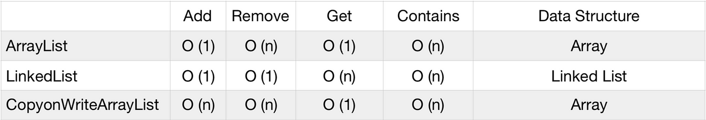
Time Complexity
O(1) => fastest the execution time remains constant.
O(n) => execution time increases directly with the size of the input.

Slide 35
Interface Set
Extends Collection
An unordered collection of objects
can grow as needed
easy to add/delete
API independent of implementation (HashSet, TreeSet)
Elements have no positions
Duplicate entries not allowed

Slide 36
Set Implementations
HashSet
a Set backed by a hash table
This class permits the null element.
HashSet is not sorted in any way.
TreeSet
A balanced binary tree implementation
Imposes an ordering on its elements
The elements in the TreeSet are sorted in ascending element order, sorted according to the natural order of the elements
It can be sorted by the comparator provided at set creation time
TreeSet instance performs all key comparisons using its compareTo (or compare) method,

Slide 37
equals” operation of “Set” Interface
Set also adds a stronger contract on the behavior of the equals and hashCode operations,
Set instances to be compared meaningfully even if their implementation types differ
Two Set instances are equal if they contain the same elements
The equality is determined by equals and hashcode Implementation

Slide 38
Working of Hashset
HashSet uses HashMap internally to store data in the form of Key-Value pair.
Elements are stored using 𝒉𝒂𝒔𝒉𝒊𝒏𝒈 𝒕𝒆𝒄𝒉𝒏𝒊𝒒𝒖𝒆, therefore elements are not stored in an ordered fashion and the elements will be returned in random order.
Elements are stored in the form of key-value pair (internally by HashMap) where key will the actual element value and value will be the 𝑷𝑹𝑬𝑺𝑬𝑵𝑻 Constant.
public boolean add(E e) { return map.put(e, PRESENT)==null; }

Slide 39
Hash Set – Duplicates Not Allowed
public static void main(String args[]) {
HashSet<Book> hs = new HashSet<Book>();
Book b1= new Book(100,"java","herbert");
Book b2 = new Book(101,"j2ee","kathy siera");
Book b3 = new Book(101,"j2ee","kathy siera");
hs.add(b1);
hs.add(b2);
for(Book bk:hs)
{
System.out.println(bk.getBookno());
System.out.println(bk.getBookname());
}
}

Slide 40
Tree Set With Comparators
Tree Set Class overloaded constructors one without argument and another one which takes comparator as arguments.
public static void main(String[] args) {
BookComparators bc = new BookComparators();
TreeSet<Book> tscomp = new TreeSet<Book>(bc.new AuthorComp());
Book bk1 = new Book(23,"java","kathy sierra");
Book bk2 = new Book(101,"j2ee","james gosling");
Book bk3 = new Book(11,"struts","haffzel manning");
tscomp.add(bk1);
tscomp.add(bk2);
tscomp.add(bk3);
}

Slide 41
Map
interface Map (does not extend Collection)
An object that maps keys to values
Ordering may be provided by implementation class, but not guaranteed
Methods to Add and Get Objects
Object put( Object key, Object value)
Object get( Object key)
Iterators for keys, values, (key, value) pairs

Slide 42
Map Implementations
Hash Map
A hash table implementation of Map
Supports null keys & values
Not Ordered
Tree Map
A balanced binary tree implementation
Imposes an ordering on its elements based on comparable/compartor
Hash table
Synchronized hash table implementation of Map interface.
Doesn't support null keys and values

Slide 43
Hash Table
This class implements a hash table, which maps keys to values.
Any non-null object can be used as a key or as a value.
The objects used as keys must implement the hash Code and equals method
The put Method returns the previous value of the specified key in the hashtable, or null if it did not have one

Slide 44
Add To Hash Table
public static void main(String args[]) {
Hashtable<String,Book> abook =
new Hashtable<String,Book>();
Book bk1 = new Book(200,"Java","bglr");
Book bk2 = new Book(201,"J2ee","hyd");
abook.put(new String("ram"),bk1 );
abook.put(new String("shyam"),bk2);
System.out.println(abook.get("ram"));
}

Slide 45
Hashtable with Duplicate Keys
public static void main(String[] args) {
Hashtable<String, String> htable =
new Hashtable<String, String>();
htable.put(new String("101"), new String("ramesh"));
htable.put(new String("102"), new String("ganesh"));
htable.put(new String("102"), new String("suresh"));
Enumeration<String> keys = htable.keys();
while (keys.hasMoreElements())
{
String ky = keys.nextElement();
System.out.println(htable.get(ky));
}
}
Output
suresh
ramesh

Slide 46
Hash Table as Set
The contents of the Map interface can be viewed and manipulated as collections
entrySet – Returns a Set of all the key-value pairs.
keySet – Returns a Set of all the keys in the map.
values – Returns a Collection of all values in the map.
public Set entrySet()
Each element in the returned collection is a Map.Entry.
Map.Entry is an static Interface inside the interface Map
getKey()
Returns the key corresponding to this entry.
getValue()
Returns the value corresponding to this entry.

Slide 47
Hash Table as Set
public static void hashTabletoSet
( Hashtable<String, Book> ht )
{
Set<Entry<String,Book>> htabSet = ht.entrySet();
Iterator<Entry<String,Book>> itr = htabSet.iterator();
while(itr.hasNext())
{
Map.Entry<String, Book> mp = itr.next();
System.out.println(mp.getKey());
System.out.println(mp.getValue());
}
}

Slide 48
Working of Hash Map
HashMap stores key-value pair in Map.Entry static nested class implementation.
works on hashing algorithm and uses hashCode() and equals() method in put and get methods.
put()
Invoked by passing key-value pair,
HashMap uses Key hashCode() with hashing to find out the index to store the key-value pair.
The Entry is stored in the LinkedList, so if there is an already existing entry, it uses equals() method to check if the passed key already exists, if yes it overwrites the value else it creates a new entry and stores this key-value Entry.
get()
Invoked by passing Key,
It uses the hashCode() to find the index in the array and then use equals() method to find the correct Entry and return its value.

Slide 49
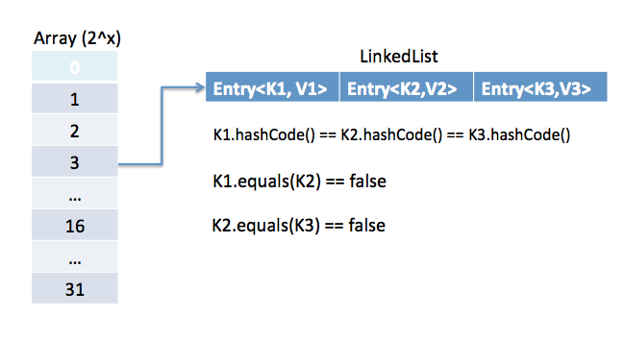
Working of Hash Map

Slide 50
Working of Hash Map
HashMap initial default capacity is 16 and load factor is 0.75.
The threshold is capacity multiplied by load factor and whenever we try to add an entry if map size is greater than the threshold, HashMap rehashes the contents of the map into a new array with a larger capacity.
The capacity is always the power of 2, so if you know that you need to store a large number of key-value pairs, for example in caching data from the database, it’s a good idea to initialize the HashMap with correct capacity and load factor.

Slide 51
Tree Map
TreeMap is a Sorted Map
The keys are guaranteed to be in sorted order
The Order is being controlled by Comparable or Comparator
public static void main(String args[])
{
TreeMap tm = new TreeMap(new LComparator());
MyPerson ov1= new MyPerson("anand","kumar",45);
MyPerson ok1 =new MyPerson("100");
tm.put(ok1,ov1);
System.out.println(tm.containsValue(ov1));
System.out.println(tm.containsKey(ok1));
System.out.println(tm.get(ok1));
}

Slide 52
Arrays Class
Utility Class available part of java.util package
Has some static Methods to work with
equals( )
to compare two arrays for equality;
fill( )
to fill an array with a value;
sort( )
to sort the array;
binarySearch( ),
find an element in a sorted array.
These methods are overloaded for all the primitive types and Objects.

Slide 53
Arrays Class – fill() and equals() Method
public static void main(String[] args) {
int[] aray = new int[5];
Arrays.fill(aray, 55);
for(int a:aray)
System.out.println(a);
int[] array1 = {1,3,4,5};
int[] array2 = {1,23,4,5};
boolean flag = Arrays.equals(array1, array2));
System.out.println("Two Object Equal"+flag);
}

Slide 54
Arrays Class -Sort and Binary Search
Before Calling Binarysearch the Arrays needs to be sorted,else throws an exception.
public static void main(String[] args) {
String[] names = new String[5];
names[0]="ramesh";
names[1]="anand";
names[2]="suresh";
names[3]="dravid";
names[4]="ganesh";
Arrays.sort(names);
int loc =Arrays.binarySearch(names,"ramesh");
}

Slide 55
Arrays Class –toList()
public static void main(String[] args) {
String[] names = {"ramesh","anand","suresh"};
List<String> nameList = new ArrayList<String>();
nameList = Arrays.asList(names);
String[] employees = new String[5];
employees = (String[])nameList.toArray();
}

Slide 56
Arrays Class –asList()
The simple form with no arguments creates a new array of Object
Object[] a = c.toArray();
Suppose that c is known to contain only strings.
Copies the contents of c into a newly allocated array of String whose length is identical to the number of elements in c.
String[] a = c.toArray();
asList( )
that takes any array and turns it into a List container

Slide 57
Unmodifiable Lists, Sets, and Maps
Done with sttatic factory methods on the List, Set, and Map interfaces
Elements cannot be added, removed, or replaced.
Holds the same data as long as a reference to it exists.
Data contained in the collection can be packed much more densely.
Unmodifiable collection instances consume much less memory than modifiable collection instances that contain the same data.

Slide 58
Use Cases
An unmodifiable collection provides space efficiency benefits and prevents the collection from accidentally being modified
Collections that are initialized from constants that are known when the program is written
Collections that are initialized at the beginning of a program from data that is computed or is read from something such as a configuration file

Slide 59
Static Factory Methods
List<String> stringList = List.of("a", "b", "c");
Set<String> stringSet = Set.of("a", "b", "c");
Map<String, Integer> stringMap = Map.of("a", 1, "b", 2, "c", 3);
Creating Unmodifiable Copies of Collections
using the copyOf family of methods.
List<Item> list = new ArrayList<>();
List<Item> snapshot = List.copyOf(list);

Slide 60
Using Generic Class
Can define classes and interfaces with generics type.
A generic type is a class or interface that is parameterized over types.
public class GenericsType<T> {
private T obj;
public T get() {
return this.obj; }
public void set(T t1){
this.obj=t1; }
public static void main(String args[]){
GenericsType<String> type = new GenericsType<>();
type.set(“Ramesh");
String val=type.get(); // No need for Casting
} }

Slide 61
Using Generic Methods
A generic Method means that the method declaration used a type parameter as its signature.
The type declared in the method arguments is replaced with the type of the class instantiated with.
In generics the keyword extends means “is-a” and works for both classes and interfaces
void display (List<Employee> myList) { }
Using a type Parameter that was NOT defined in the class declaration
public <T extends Employee> void addData(List<T> myList){}
Before the Return type.

Slide 62
Generics Type Naming Convention
Type parameter names are single, uppercase letters to make it easily distinguishable from java variables.
E – Element (used extensively by the Java Collections Framework, for example ArrayList, Set etc.)
K – Key (Used in Map)
V – Value (Used in Map)
N – Number
T – Type

Slide 63
PECS -Producer
Producer-extends, consumer-super:
<? extends className>
Used as Producer for pulling elements
Pulling elements of specified class or its subclass
Its Kown as Upper Bound
Go through the collection and do things with each item.
Cannot add a new element or change an existing element
Adding without knowing its exact type could introduce type mismatches and runtime errors.

Slide 64
PECS - Consumer
<? super Superclass>
Lower Bound -> " ? super Type "
Can add elements of type superclass subclass since they are compatible
While retrieving cannot guarantee only holds superclass Object it could be a sub class also

Slide 65
Type Erasure
The generic type in the class, interface, or method is only available at compile time and it is removed at run-time.
Done to ensure backward compatibility, as the older versions of Java (before Java 1.5) do not support it.
The compiler makes use of the generic type information that is available to it to ensure type safety.
In the process of type erasure:
If the type is unbounded, then the parameters get replaced with their bounds or Object type
List<?>
If the type is bounded, then the parameters get replaced by the first bound
List<T extends Student>

Slide 66
<? super T>
Can not but bigger box into smaller one
public void printUsingConsumerWrongWay(List<? super Person> list) {
list.add(new Doctor());
list.get(0);
// not allowed since its super class of Person
//list.set(1, new Object());
}

Slide 67
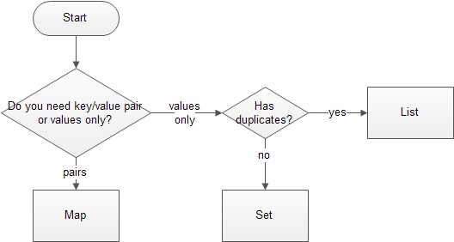
Deciding the Collection Interface

Slide 68
Fail Safe
Fail-safe work with the clone of underlying collection
it’s not affected by any modification in the collection.
Fail-safe iterators never throws ConcurrentModificationException.

Slide 69
Fail Safe Iterator
List<Integer> integers = new CopyOnWriteArrayList<>();
integers.add(1);
integers.add(2);
Iterator<Integer> itr = integers.iterator();
while (itr.hasNext()) {
Integer a = itr.next();
integers.remove(a);
}

Slide 70
Fail Safe – Fail Fast
When the elements are removed or added using the collection, Exception will be thrown
If it done with iterators Object the it reasigns the expectedModCount to new modCount value, and hence exeception will not be thrown

