Slide 1
Multi Threads

Slide 2
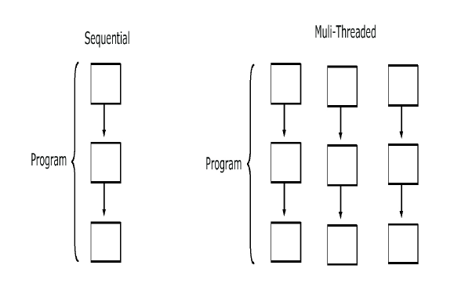
Why threads
Need to handle concurrent processes
Definition
Single sequential flow of control within a program
Threads are like a processes executed by a program
Example:
Operating System
HotJava web browser

Slide 3
Multi-threading in Java Platform
Java Application start with just one thread, called the main thread.
This thread has the ability to create additional threads
When a new thread is started , a new stack materializes and methods called from that thread run in a call stack that’s separate from the main() call stack.
That second new call stack runs concurrently with the main thread
A thread of execution is an individual process (a “lightweight” process) that has its own call stack.
one thread per call stack—one call stack per thread.

Slide 4
The Main Thread
Every java program has at least one thread called main thread
Thread.currentThread().getName()
Returns the name current thread
setName() is used to set the name for the thread

Slide 5
Making a Thread
Done by extend the java.lang.Thread class
To have specialized version of a thread class.
That class can’t extend another class
Done By Implementing the Runnable interface
Leaves class free to extend from some other class
Define behavior that will be run by a separate thread.
Thread Class is created with a Runnable argument.
The Runnable object is the target of the thread.
.

Slide 6
Making a Thread
A thread begins as an instance of java.lang.Thread.
public void run()
Has the Code that needs to be run in a separate thread
It can call other methods,
The thread of execution begins with the call to this method

Slide 7
Example
public class NumberService {
public NumberService() {
super();
}
public void sumNumbers(int countTo) {
int count =0;
for(int i=0;i<=countTo;i++) {
count =count +i;
}
System.out.println( " Sum of Number upto" + countTo +"Is ="+count +"Done By"+Thread.currentThread().getName());
}
}

Slide 8
Implementing java.lang.Runnable
public class NumberAddingService implements Runnable{
private int countTo;
private NumberService service;
public NumberAddingService(int countTo,String name) {
this.countTo = countTo;
this.service = new NumberService();
Thread t1 = new Thread(this,name);
t1.start();
}
@Override
public void run() {
this.service.sumNumbers(countTo);
}
}

Slide 9
Starting a Thread
start()
Creates a new thread and makes it runnable
A new thread of execution starts (with a new call stack).
The thread moves from the new state to the runnable state.
When the thread gets a chance to execute, its target run() method will run.

Slide 10
Starting Multiple Thread
public static void main(String[] args) {
new NumberAddingService(50,"Fifty Count");
new NumberAddingService(500,"Five Hundred Count");
new NumberAddingService(5000,"Five Thousand Count");
try {
System.out.println("Enter the Number");
int ch =System.in.read();
System.out.println(ch);
} catch (IOException e) {
e.printStackTrace();
}
}

Slide 11
The Thread Scheduler
The thread scheduler is the part of the JVM
Any thread in the runnable state can be chosen by the scheduler to be the one and only running thread.
java.lang.Thread Class
public static void sleep(long millis) throws InterruptedException
public final void join()
java.lang.Object Class
public final void wait()
public final void notify()
public final void notifyAll()

Slide 12
Thread States
New
When the Thread has been instantiated
The start() method has not been invoked on the thread.
It is a live Thread object, but not yet a thread of execution.
At this point, the thread is considered not alive.
Runnable
The state a thread is in when it’s eligible to run,
Scheduler has not selected it to be the running thread.
A thread first enters the runnable state when the start() method is invoked
A thread can also return to the runnable state after either running or coming back from a blocked, waiting, or sleeping state.
When the thread is in the runnable state, it is considered alive.

Slide 13
Thread States
Running
This is the state a thread is in when the thread scheduler selects it from the runnable pool to be the currently executing process.
A thread can transition out of a running state for several reasons, including because “the thread scheduler felt like it.”
Waiting/blocked/sleeping
The thread is still alive, but is currently not eligible to run.
A thread may be blocked waiting for a resource
A thread may be sleeping because the thread’s run code tells it to sleep for some period of time
waiting, because the thread’s run code causes it to wait

Slide 14
Thread States
Dead
A thread is considered dead when its run() method completes.
It may still be a viable Thread object, but it is no longer a separate thread of execution. Once a thread is dead, it can never be brought back to life
A runtime exception will be thrown

Slide 15
Leave the running state
sleep()
Guaranteed to cause the current thread to stop executing
Duration is specified in milli seconds
It might be interrupted before its specified time
join()
Guaranteed to cause the current thread to stop executing until the thread it joins with the thread it calls wait on completes.
Leave the Running State:
Following scenarios
The thread’s run() method completes..
A thread can’t acquire the lock on the object whose method code it’s attempting to run

Slide 16
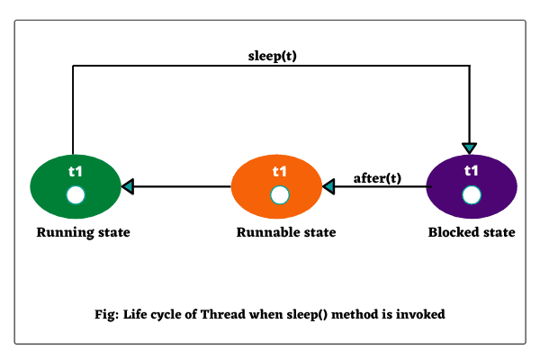
The sleep() method
Static method of Thread Class
Can be Placed anywhere in the Code
Throws a Checked Exception – Interrupted Exception
try {
Thread.sleep(5*60*1000); // Sleep for 5 minutes
} catch (InterruptedException ex) { }

Slide 17
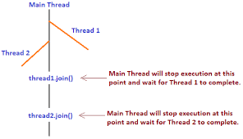
The Join() Method
The non-static join() method of class Thread lets one thread “join onto the end” of another thread.
The thread class join method waits until a thread is finished executing or waiting for a thread to die before returning .

Slide 18
Joining Thread
public class TaskForJoin implements Runnable {
public void run() {
System.out.println("Reading");
try {
System.in.read( );
} catch (java.io.IOException ex) {
}
System.out.println("Thread Finished.");
}
}

Slide 19
Joining Thread
public class ParentThread {
public static void main(String[] args) {
System.out.println("Starting");
TaskForJoin task = new TaskForJoin();
Thread t = new Thread(task);
t.start( );
System.out.println("Joining");

Slide 20
Joining Thread
try {
t.join( );
} catch (InterruptedException ex) {
ex.printStackTrace();
}
System.out.println("Main Finished.");
}
}

Slide 21
Synchronizing Code
Threads can share resources.
Sometimes it is desirable that only one thread at a time has access to a shared resource.
Achieved by using the keyword: synchronized, Only methods can be synchronized, not variables.
Protects access to code, not to data
Make data members private
Synchronize accessor methods
A lock can be associated with a shared resource. Threads gain access to a shared resource by first acquiring the lock associated with the resource.
one thread can hold the lock and thereby have access to the shared resource.

Slide 22
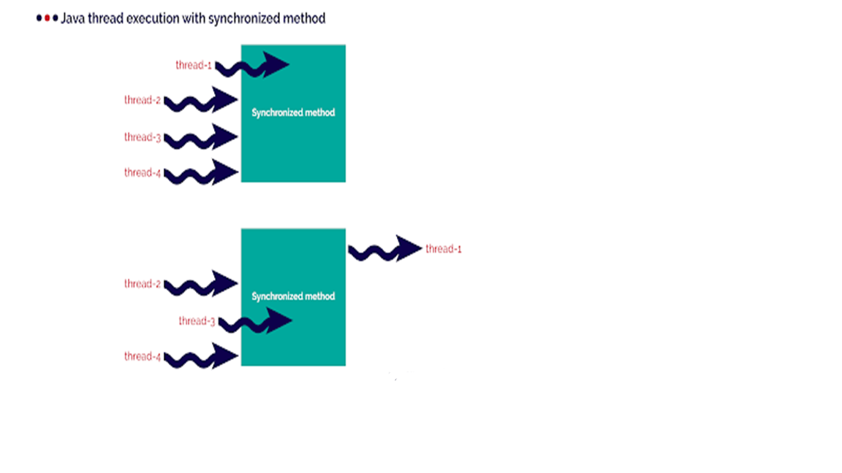
Synchronizing Code

Slide 23
Synchronizing Code
A class can have both synchronized and no synchronized methods.
If a class has both synchronized and nonsynchronized methods, multiple threads can still access the nonsynchronized methods of the class!
A thread can acquire more than one lock.
A thread can enter a synchronized method, thus acquiring a lock, and then immediately invoke a synchronized method on a different object, thus acquiring that lock as well.
As the stack unwinds, locks are released again.

Slide 24
Thread Synchronization
class TwoStrings {
synchronized static void print(String str1, String str2) {
System.out.print(str1);
try {
Thread.sleep(500);
} catch (InterruptedException ie)
{
ie.printStackTrace();
}
System.out.println(str2);
}
}

Slide 25
Thread Synchronization
class PrintStringsThread implements Runnable {
String str1, str2;
PrintStringsThread(String str1, String str2) {
this.str1 = str1;
this.str2 = str2;
Thread thread = new Thread(this);
thread.start();
}
public void run() {
TwoStrings.print(str1, str2);
}
}

Slide 26
Thread Synchronization
public class Test {
public static void main(String args[])
{
new PrintStringsThread("Hello ", "there.");
new PrintStringsThread("How are ", "you?");
new PrintStringsThread("Thank you ","very much!");
new PrintStringsThread("Bye ","Bye!");
}
}
Output- May be in Different Order
Hello there
How are you
Thank you very much
Bye,Bye

Slide 27
Race Condition
Characteristics:
Multiple threads access and modify shared data concurrently.
The final result is unpredictable and may vary depending on which thread "wins" the race.
Can lead to data corruption or unexpected behavior.
Example:
Two threads try to increment the same counter simultaneously.
The final value of the counter may be incorrect, depending on the order in which the operations are executed.
Synchronization is used to avoid the race conditions

Slide 28
Dead Lock
Happens when two or more threads waiting for each other to release lock and get stuck for infinite time .
Common Cause of Dead Lock
When nested synchronized block or calling one synchronized method from other or trying to get lock on different object

Slide 29
Dead Lock
public void method1(){
synchronized(String.class){ System.out.println("Aquired lock on String.class object"); synchronized (Integer.class) { System.out.println("Aquired lock on Integer.class object"); }
}
} public void method2(){ synchronized(Integer.class){ System.out.println("Aquired lock on Integer.class object"); synchronized (String.class) { System.out.println("Aquired lock on String.class object"); } } }

Slide 30
Thead Dead Lock
If method1() and method2() both will be called by two or many threads , there is a good chance of deadlock
if thead 1 aquires lock on Sting object while executing method1() and thread 2 acquires lock on Integer object while executing method2() both will be waiting for each other to release lock on Integer and String to proceed further which will never happen. real reason for deadlock is not multiple threads but the way they access lock , if you provide an ordered access then problem will be resolved , here is the fixed version.

Slide 31
DeadLock
Thread t1 = new Thread() {
public void run() {
ex.method1();
ex.method2();
}
};
Thread t2 = new Thread() {
public void run() {
ex.method2();
ex.method2();
}
};

Slide 32
Fixed Version
public void method1(){ synchronized(Integer.class){ System.out.println("Aquired lock on Integer.class object"); synchronized (String.class) { System.out.println("Aquired lock on String.class object"); } } } public void method2(){ synchronized(Integer.class){ System.out.println("Aquired lock on Integer.class object"); synchronized (String.class) { System.out.println("Aquired lock on String.class object"); } } }

Slide 33
Thread Interaction
The java.lang.Object class has three methods—wait(), notify(), and notifyAll()—that help threads communicate
wait(), notify(), and notifyAll() must be called from within a synchronized context!
If many threads are waiting on the same object, only one will be chosen (in no guaranteed order) to proceed with its execution.
If there are no threads waiting, then no particular action is taken

Slide 34
notifyAll()
This notifies all waiting threads and they start competing to get the lock. As the lock is used and released by each thread, all of them will get into action without a need for further notification.
Object can have many threads waiting on it, and using notify() will affect only one of them.
Which one exactly is not specified and depends on the JVM implementation,
never rely on a particular thread In cases in which there might be a lot more waiting, the best way to do this is by using notifyAll().

Slide 35
Notify -Example
class BankAccount {
private double balance=2000;
public synchronized double deposit(double amount){
balance=balance+amount;
notify();
return balance;
}

Slide 36
Notify -Example
public synchronized double withdraw(double amount)
{
if(balance <amount) {
System.out.println("In sufficent Balance ");
try {
wait();
} catch (InterruptedException e) {
e.printStackTrace();
}
}
balance =balance-amount;
return balance;
}

Slide 37
Notify -Example
public static void main(String[] args) {
final BankAccount bk1 =new BankAccount();
Thread t1=new Thread(){
public void run(){
bk1.withdraw(4000);
} };
t1.start();
Thread t2=new Thread(){
public void run(){
bk1.deposit(3000);
}
};
t2.start();
}

Slide 38
Notify and notifyAll()
notify
Object can have many threads waiting on it, and using notify() will affect only one of them.
Which one exactly is not specified and depends on the JVM implementation,
The thread that receives notification may not able to proceed and starts waiting again application cannot progress further.
May result in deadlock if the thread which calls notify() goes into waiting for state after sending a notification because then there is no active thread to notify all waiting threads.
notifyAll()
A better option than notify()
It sends a notification to all the threads.
If one is not able to proceed, there is still some more threads to do the job

Slide 39
Difference between Blocked-Waiting
Blocked
Thread is waiting to get a lock on the monitor.(or waiting for a blocking i/o method)
Caused by the thread tried to execute some synchronized code. (or a blocking i/o method)
Can move to ready only when the lock is available. ( or the i/o operation is complete)
Wait
Thread has been asked to wait. (by means of wait method)
The thread already acquired the lock and executed some synchronized code before coming across a wait call.
Can move to ready only when it gets notified (by means of notify or notifyAll)

Slide 40
Difference between Sleep and Wait
sleep():
It is a static method on Thread class.
It makes the current thread into the "Not Runnable" state for specified amount of time.
During this time, the thread keeps the lock (monitors) it has acquired.
wait():
It is a method on Object class.
It makes the current thread into the "Not Runnable" state.
Wait is called on a object, not a thread.
Before calling wait() method, the object should be synchronized,
object should be inside synchronized block.
The call to wait() releases the acquired lock.

Slide 41
Executor Framework

Slide 42
Executor Framework
Released with the JDK 5
Classes and Interfaces are part of java.util.concurrent package
Helps to decouple a command submission from command execution.

Slide 43
Executor Framework
Thread Creation
Provides methods for creating a pool of threads
Task submission and execution
Provides methods for submitting tasks for execution in the thread pool
Can also schedule task to be executed later
Can also make them execute periodically.

Slide 44
Executor Service
ExecutorService
A sub interface of Executor
Used to manage lifecycle of threads
Used for running the submitted tasks
Provides Methods that produce a Future
Used to get a result from an asynchronous computation.

Slide 45
Executor Service
Methods to start and terminate thread.
execute()
Used for threads which are Runnable
submit()
Used for Callable threads.
shutdown()
Stops accepting new tasks, waits for previously submitted tasks to execute,
Then terminates the executor.
shutdownNow()
Interrupts the running task and shuts down the executor immediately.

Slide 46
Thread Pool
A pool of worker threads
Executors use thread pools to execute tasks.
Need for Thread Pool
Creating a new thread for a new task leads to overhead of thread creation and tear-down.
Managing thread life-cycle adds to the execution time.
New thread for each process without any throttling leads to the creation of many threads.
They occupy memory and cause wastage of resources.

Slide 47
Executors
Executors
Class that Provides Factory methods to create Thread Pools of worker threads.
Tasks are submitted for execution.
Schedules and executes the submitted tasks
Return the results from the thread pool.

Slide 48
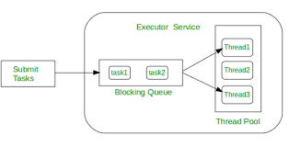
Working of Executors

Slide 49
Types of Executors –Single Thread Executor
newSingleThreadExecutor()
Executor has only a single thread.
Used to execute tasks in a sequential manner.
When the submitted task is in execution
The new task will wait in a queue until the thread is free to execute it.
If the thread dies due to an exception while executing a task, a new thread is created to replace the old thread and the subsequent tasks are executed in the new one.
ExecutorService executorService =
Executors.newSingleThreadExecutor()

Slide 50
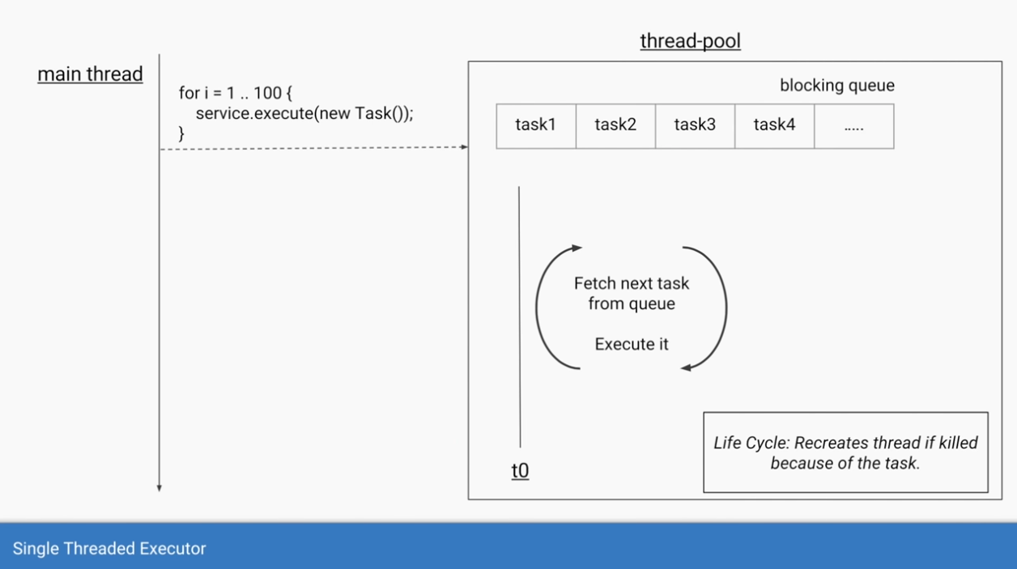
Single Threaded Executor

Slide 51
Task
public class PrintNames {
public synchronized static void print(String str1,String str2) {
System.out.println(str1);
try {
Thread.sleep(200);
} catch (InterruptedException e) {
e.printStackTrace();
}
System.out.println(str2);
}
}

Slide 52
Runnable
public class ExecutorPrintService implements Runnable {
private String str1;
private String str2;
public ExecutorPrintService(String str1, String str2) {
super();
this.str1 = str1;
this.str2 = str2;
}
@Override
public void run() {
PrintNames.print(str1, str2);
}
}

Slide 53
Submit to Executor
public static void main(String[] args) {
ExecutorService executor = Executors.newSingleThreadExecutor();
ExecutorPrintService tasks[] = {
new ExecutorPrintService("Idly","sambar"),
new ExecutorPrintService("Parantha","achar"),
new ExecutorPrintService("pizza","coke")};
for(int i=0;i<tasks.length;i++) {
executor.submit(tasks[i]);
}
executor.shutdown();
}

Slide 54
Runnable Task
public class NameManager implements Runnable {
private List<String> list;
private List<String> nameToAdd ;
public NameManager(List<String> list,String ... names) {
this.list = list;
this.nameToAdd = Arrays.asList(names);
}
public List<String> getList() {
return list;
}
@Override
public void run() {
this.list.addAll(nameToAdd);
}
}

Slide 55
Single Thread Executor
ExecutorService service = Executors.newSingleThreadExecutor();
List<String> list = new ArrayList<>();
NameManager task1 =new NameManager(list,"Ram",“Vijay",”Vicky");
NameManager task2 =new NameManager(list,"Vidya","vani","Rani");
service.submit(task1);
service.submit(task2);
task1.getList().forEach(System.out::println);
service.shutdown();

Slide 56
Executors.newFixedThreadPool
Create a thread pool of fixed size,
Executor service picks one of the available threads from the pool and executes the task on that thread.
Makes sure that the pool always has the specified number of threads running.
If any thread dies it is replaced by a new thread immediately.
If all the threads are busy , the new tasks will wait for their turn in a queue.

Slide 57
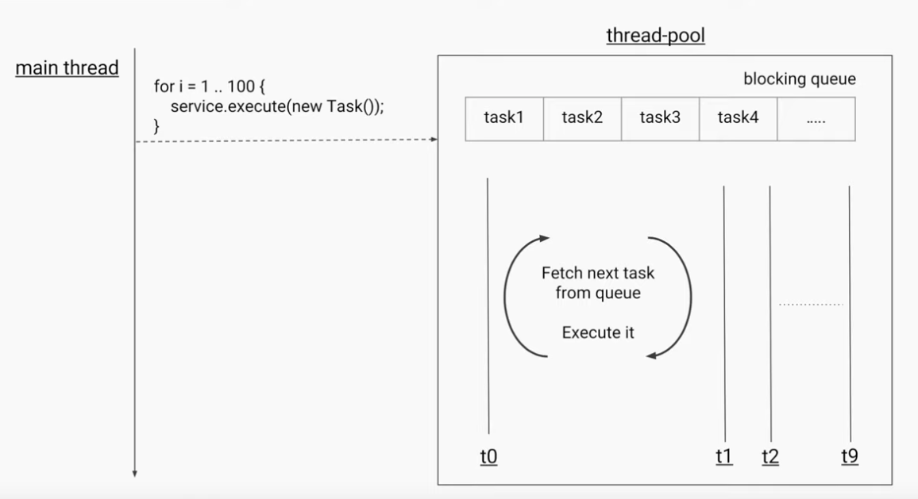
Fixed Thread Pool

Slide 58
Submit to Executor
public static void main(String[] args) {
int poolSize = Runtime.getRuntime().availableProcessors();
ExecutorService executor = Executors.newFixedThreadPool(poolSize);
ExecutorPrintService tasks[] = {
new ExecutorPrintService("Idly","sambar"),
new ExecutorPrintService("Parantha","achar"),
new ExecutorPrintService("pizza","coke")};
for(int i=0;i<tasks.length;i++) {
executor.submit(tasks[i]);
}
executor.shutdown();
}

Slide 59
Size of the Fixed Thread Pool
Decided based on the use-case of the java program.
It also depends on number of CPU cores
CPU Bound
Tasks which involves mathematical calculations.
Ideal size is same as number of CPU cores.
IO Bound
Tasks which involve communication to other application through network calls like database, web services
Ideal size depends on the wait time of the IO task.
More number of threads can be used to ensure maximum CPU utilization.

Slide 60
SingleThreadExecutor vs FixedThreadPool
Similarity
Returns ExecutorService
If thread terminates, new thread will be created.
Difference
newSingleThreadExecutor()
can never increase its thread pool size more than one.
newFixedThreadPool(1)
(1) stands for the number of threads in the pool
can increase its thread pool size more than one at run time
Done by setCorePoolSize() of the class ThreadPoolExecutor.

Slide 61
Difference between execute and submit
execute
Starts the task
Used for fire and forget calls
Throws un-handled Exception.
submit
returns a Future object to manage the task.
Can be Used to submit a Callable
Callable can return a value
Hides un-handled Exception in framework itself.
Can Wait for the Callable task to finish executing
Can get the return value on completion , with get.

Slide 62
callable

Slide 63
Callable
Similar to Runnable
Can be used with an executor service for execution.
A functional Interface with one Method
call()
Method contains the code that is executed by a thread.
Can return a result and throws a checked exception.

Slide 64
Callable With Executor
submit()
submits the task for execution by a thread.
returns a java.util.concurrent.Future
A task submitted to the executor
Submitted task must implement Callable.
Whenever the task execution is completed, it is set to Future object by the executor.

Slide 65
Future
Future
Object returned by the executor.
The result of the task submitted for execution to an executor
Its like a promise made to the caller by the executor.
Future.isDone
Returns a boolean value true if the task completed.

Slide 66
Future.get()
Future.get()
Waits for the computation to complete, and then retrieves its result.
This method is used to get the result of the submitted task when its completed
get(long timeout, TimeUnit unit)
Throws a TimeoutException if the result is not returned in the stipulated timeframe.
The caller can handle this exception and continue with the further execution of the program.

Slide 67
Cancelling a Future
Future.cancel(boolean mayInterruptIfRunning)
Used to cancel a future
returns true if it is cancelled successfully, otherwise, it returns false.
mayInterruptIfRunning.
True
the thread that is currently executing the task will be interrupted
False
in-progress tasks will be allowed to complete.
Future.isCancelled()
To check if a task is cancelled or not.

Slide 68
Callable Example
public class Task implements Callable<String> {
private String message;
public Task(String message) {
this.message = message;
}
@Override
public String call() throws Exception {
return "Hello " + message + "!";
}
}

Slide 69
Callable Example
public class ExecutorExample {
public static void main(String[] args) {
Task task = new Task("World");
ExecutorService executorService = Executors.newFixedThreadPool(4);
Future<String> result = executorService.submit(task);
try {
System.out.println(result.get());
} catch (InterruptedException | ExecutionException e) {
System.out.println("Error occured while executing the submitted task");
e.printStackTrace();
}
executorService.shutdown();
}
}

Slide 70
Callable Example
public class FactorialCalculator implements Callable<Integer> {
private Integer number;
public FactorialCalculator(Integer number) {
this.number = number; }
@Override
public Integer call() throws Exception {
int result = 1;
if ((number == 0) || (number == 1)) {
result = 1;
} else {
for (int i = 2; i <= number; i++) {
result *= i;
TimeUnit.MILLISECONDS.sleep(20);
}
}
return result;
} }

Slide 71
Callable Example
ExecutorService executor = Executors.newFixedThreadPool(2);
FactorialCalculator calculator = new FactorialCalculator(5);
try {
Future<Integer> task = executor.submit(calculator);
System.out.println("Future result is - " + " - " + task.get() + "; And Task done is " + task.isDone());
}
catch ( ExecutionException | InterruptedException e)
{
e.printStackTrace();
}
executor.shutdown ();

Slide 72
Cancelling the Future
public static void main(String[] args) {
ExecutorService executorService = Executors.newSingleThreadExecutor();
long startTime = System.nanoTime();
Future<String> future = executorService.submit(() -> {
Thread.sleep(2000); return "Hello from Callable"; });
while(!future.isDone()) {
System.out.println("Task is still not done...");
try {
Thread.sleep(200);
double elapsedTimeInSec = (System.nanoTime() - startTime)/1000000000.0;
if(elapsedTimeInSec > 1) {
future.cancel(true);
}
} catch (InterruptedException e) {
e.printStackTrace(); }

Slide 73
Cancelling the Future
System.out.println("Task completed! Retrieving the result");
String result;
try {
result = future.get();
System.out.println(result);
} catch (InterruptedException e) {
e.printStackTrace();
} catch (ExecutionException e) {
e.printStackTrace();
}
executorService.shutdown();
}
}

Slide 74
Cancelling the Future
if(!future.isCancelled()) {
System.out.println("Task completed! Retrieving the result");
String result = future.get();
System.out.println(result);
} else {
System.out.println("Task was cancelled");
}

Slide 75
ReentrantLock
Multi-threaded applications need ways to manage resources safely across multiple threads.
ReentrantLock is a class in java.util.concurrent.locks
It provides ways flexible ways compared to synchronized blocks.
If a thread that already holds the lock attempts to acquire it again, it won’t be stopped or placed into a waiting state.
This is especially useful in recursive methods, where a thread might call itself and need to re-acquire the lock each time without deadlocking.
The reentrant nature of this lock allows a thread to enter a locked code section it already controls, making it suitable for complex applications where the same resource may need to be locked repeatedly by the same thread.

Slide 76
Working of lock()
Acquiring the Lock: A thread calls lock() to attempt to gain control of the shared resource. If the lock is not already held by another thread, the thread gains access. If the lock is currently held by another thread, the calling thread will be put into a waiting state until the lock becomes available.
Performing the Action: Once the lock is acquired, the thread can safely perform actions on the shared resource, knowing that other threads are blocked from accessing it.
Releasing the Lock: After the actions are complete, the thread should call unlock() to release the lock, making it available for other threads.

Slide 77
ReentrantLock lock = new ReentrantLock(); public void performTask() { lock.lock(); // Acquire the lock try { // Perform actions on the shared resource } finally { lock.unlock(); // Always release the lock } }
In this code, lock.lock() acquires the lock, and lock.unlock() releases it in the finally block. The finally block ensures that the lock is released no matter what happens within the try block, such as an exception, which is critical for avoiding deadlocks or locked resources that are no longer needed.

Slide 78
Features of ReentrantLock
Fair Locking:
Can specify if the lock should use a fairness policy by setting true in the constructor (new ReentrantLock(true)).
Fair locking ensures that the longest-waiting thread gets the lock next, reducing the risk of starvation, where some threads might never acquire the lock.
Fair locks, however, might introduce more overhead and slower throughput, so their use depends on the requirements of the application.

Slide 79
Features of Lock
Interruptible Locking:
Can choose to acquire a lock in an interruptible way using the lockInterruptibly() method.
This feature lets you interrupt a thread waiting to acquire the lock, which is particularly useful in applications where threads should not be blocked indefinitely.
If the lock cannot be acquired, the waiting thread can be interrupted and freed to perform other tasks.

Slide 80
public void performInterruptibleTask() { try { lock.lockInterruptibly(); // Attempt to acquire the lock, but allow interruption try { // Perform actions on the shared resource } finally { lock.unlock(); } } catch (InterruptedException e) { // Handle the interruption, e.g., cleanup or retry Thread.currentThread().interrupt(); // Restore interrupt status // Additional handling code if needed } }

Slide 81
Features of Lock
tryLock() :
Allows a thread to attempt to acquire the lock without waiting.
If the lock is available, it is acquired immediately; if not, the thread can continue executing other tasks. tryLock() can also be used with a timeout value,
Thread only waits for a set period before moving on if it cannot acquire the lock.

Slide 82
try { if (lock.tryLock(1, TimeUnit.SECONDS)) { // Attempts to lock within 1 second try { // Actions on the shared resource } finally { lock.unlock(); } } else { // Perform alternative actions if lock cannot be acquired } } catch (InterruptedException e) { // Handle interruption, possibly restore the interrupt status Thread.currentThread().interrupt(); // Additional handling code if needed }

Slide 83
Use Cases
ReentrantLock provides valuable flexibility for cases where timed or interruptible locking is needed, or when you require multiple conditions for waiting threads. However, because ReentrantLock requires explicit locking and unlocking, it is crucial to follow best practices to avoid unintentional errors, such as forgetting to release the lock.
Differences Between ReentrantLock and Synchronized Blocks
Both ReentrantLock and synchronized blocks are commonly used mechanisms for managing thread access to shared resources. While they serve similar purposes, there are key differences in functionality and flexibility that set ReentrantLock apart, especially for applications requiring finer control over locking behavior.

Slide 84
Best Practices for Using ReentrantLock and Alternatives
While ReentrantLock provides a powerful tool for handling concurrency in Java, it’s essential to understand when and how to use it effectively, as well as when simpler alternatives might be more suitable. Here are some best practices for using ReentrantLock alongside alternative locking mechanisms like synchronized blocks, ReadWriteLock, and StampedLock, each of which can be applied based on specific concurrency needs.
Using try-finally for Proper Lock Release
When working with ReentrantLock, always release the lock in a finally block to avoid holding the lock longer than necessary. This way, the lock is released regardless of any errors or exceptions that may occur during execution.
lock.lock(); try { // Critical section code } finally { lock.unlock(); }This pattern avoids leaving resources locked if an exception occurs, promoting safe resource management.
Prefer Synchronized Blocks for Simple Cases
For many standard concurrency needs, synchronized blocks are simpler and automatically managed by the JVM. They work well in situations where code doesn’t require advanced features like timed locking or interruptibility. Using synchronized is often more readable and less error-prone because it handles lock acquisition and release automatically.
For example:
public synchronized void performTask() { // Critical section code }In simpler applications, synchronized provides adequate protection and lower overhead, making it an ideal first choice unless specific control features are required.

Slide 85
Utilizing tryLock with Timeouts to Avoid Deadlocks
In applications where deadlocks might be a risk, consider using the tryLock() method with a timeout. This allows a thread to attempt acquiring the lock for a limited period. If the lock isn’t available within that time, the thread can either retry or proceed with alternative actions, avoiding long or indefinite waits that could lead to deadlock scenarios.
if (lock.tryLock(1, TimeUnit.SECONDS)) { try { // Critical section code } finally { lock.unlock(); } } else { // Alternative actions if lock not acquired }This approach is beneficial in applications where long waits should be avoided, or alternative actions can be taken.
Use ReadWriteLock for Read-Heavy Operations
If your application involves read-heavy operations where multiple threads can safely read the same data concurrently, consider using ReadWriteLock instead of ReentrantLock. ReadWriteLock allows multiple threads to acquire a read lock simultaneously, while write locks are exclusive. This provides better performance for scenarios that require frequent reads and occasional writes.
ReadWriteLock lock = new ReentrantReadWriteLock(); Lock readLock = lock.readLock(); Lock writeLock = lock.writeLock(); public void readData() { readLock.lock(); try { // Read-only operations } finally { readLock.unlock(); } } public void writeData() { writeLock.lock(); try { // Write operations } finally { writeLock.unlock(); } }This approach can reduce contention by allowing more threads to access resources for reading while still protecting against conflicting write operations.
Consider StampedLock for Optimistic Reads
StampedLock is another alternative that provides optimistic reads, which can be useful in scenarios with a high volume of reads and relatively fewer writes. Unlike ReentrantLock and ReadWriteLock, StampedLock allows threads to proceed with an optimistic read lock, assuming no concurrent writes. If a write does occur, the lock will validate and revert the read operation.
StampedLock stampedLock = new StampedLock(); public void optimisticRead() { long stamp = stampedLock.tryOptimisticRead(); // Perform read operations, e.g., read shared variables int data = sharedResource.getData(); // Validate that no write occurred during the read if (!stampedLock.validate(stamp)) { // A write occurred, need to read again under a read lock stamp = stampedLock.readLock(); try { data = sharedResource.getData(); // Proceed with consistent data } finally { stampedLock.unlockRead(stamp); } } // Use the data as needed }This mechanism is suitable for applications where it’s likely that concurrent modifications are rare, offering an efficient way to handle reads without strict locking.

Slide 86
Avoiding Nested Locks to Prevent Deadlocks
One common cause of deadlocks is nesting locks in different order across threads. With ReentrantLock and other lock types, avoid acquiring multiple locks simultaneously unless absolutely necessary. If multiple locks must be acquired, always acquire them in a consistent order across threads to minimize the risk of deadlocks.
For instance, if threads require both lock1 and lock2, always acquire lock1 before lock2 in every thread. This predictable order prevents threads from blocking each other indefinitely.
Choosing Condition Variables for Complex Synchronization Needs
When using ReentrantLock in more complex scenarios, consider using condition variables with newCondition(). Condition variables allow finer control over when threads wait and when they proceed, particularly useful when threads need to wait for specific conditions.
In simpler cases, though, synchronized blocks provide wait() and notify() methods which can be adequate for basic signaling. However, if multiple conditions need to be monitored, ReentrantLock with condition variables is a preferred choi

Slide 87
CountDownLatch
Java provides several utilities to help manage synchronization, one of which is CountDownLatch. This powerful synchronization aid allows one or more threads to wait until a set of operations being performed in other threads is complete.
CountDownLatch is a part of the java.util.concurrent package and was introduced in Java 5. It is used to synchronize one or more threads by allowing them to wait for a certain condition to be met before proceeding. The condition is defined by a count, which represents the number of events or operations that must occur before the waiting threads can continue.

Slide 88
CountDownLatch
Key Features of CountDownLatch
Initialization with a Count: CountDownLatch is initialized with a specific count, which represents the number of events to wait for.
Countdown Mechanism: Each event that occurs decrements the count by one.
Waiting for Completion: Threads can wait for the count to reach zero, meaning all events have occurred.
One-Time Use: CountDownLatch cannot be reset; it is a one-time use synchronization aid.

Slide 89
When to Use CountDownLatch?
CountDownLatch is particularly useful in scenarios where you need to wait for a set of operations to complete before proceeding. Here are some common use cases:
Starting Multiple Threads at the Same Time: Ensure multiple threads start running at the same time.
Waiting for Multiple Threads to Complete: Wait for several threads to finish their tasks before proceeding.
Splitting a Task into Subtasks: Divide a task into subtasks and wait for all subtasks to complete.
Simulating Complex Scenarios in Testing: Simulate real-world scenarios in testing environments by coordinating thread execution.

Slide 90
How to Use CountDownLatch?
Using CountDownLatch involves a few key steps:
Initialize the Latch: Create an instance of CountDownLatch with a specified count.
Countdown Events: Decrement the count each time an event occurs using the countDown() method.
Await Completion: Use the await() method to block the current thread until the count reaches zero.

Slide 91
Advantages of CountDownLatch
Simplifies Thread Coordination: CountDownLatch simplifies the coordination of multiple threads by providing a straightforward mechanism to wait for a set of events to complete.
Improves Performance: By allowing threads to proceed only when necessary, CountDownLatch can help improve the performance and responsiveness of applications.
Enhances Readability and Maintainability: Code that uses CountDownLatch is often more readable and maintainable compared to using low-level synchronization constructs like wait and notify.
Disadvantages of CountDownLatch
One-Time Use: CountDownLatch is a one-time use synchronization aid. Once the count reaches zero, it cannot be reset.
Potential for Deadlock: Incorrect usage can lead to deadlocks if the count is not decremented correctly or if threads are not properly synchronized.
Limited Flexibility: Compared to other synchronization tools like CyclicBarrier or Semaphore, CountDownLatch offers limited flexibility in terms of reset and reuse.

Slide 92
Example
public class DataService implements Runnable {
private final String name;
private final CountDownLatch latch;
public DataService(String name, CountDownLatch latch) {
super();
this.name = name;
this.latch = latch;
}
@Override
public void run() {
try {
System.out.println("Setting Up Data Service ===");
TimeUnit.SECONDS.sleep(2);
System.out.println("Completed Data Service Setup ===");
} catch (Exception e) {
e.printStackTrace();
}
finally {
latch.countDown();
}
}
}

Slide 93
Example
public static final int SERVICE_COUNT =2;
public static void main(String[] args) {
CountDownLatch latch = new CountDownLatch(SERVICE_COUNT);
new Thread(new DataService("SQL", latch)).start();
new Thread(new VoiceService("Sound", latch)).start();
try {
latch.await(); // Wait for all services to be initialized
System.out.println("All services are up. System is ready to start.");
} catch (InterruptedException e) {
e.printStackTrace();
}
}

Slide 94
Waiting with Timeout
In some scenarios, you may want to wait for a specific duration and proceed if the count has not reached zero within that time. CountDownLatch provides an overloaded await method that accepts a timeout parameter.
atch.await(1, TimeUnit.SECONDS))

Slide 95
Concurrent collection
Used to ensure safe and concurrent access to data by multiple threads
Vector and Hashtable are synchronized
Can use Collections.synchronizedList()
But one thread locks the entire list
Increases the response time significantly.
Part of java.util.concurrent package
CopyOnWriteArrayList
CopyOnWriteArraySet
ConcurrentHashmap

Slide 96
CopyOnWriteArrayList
Thread safe version of ArrayList.
JVM creates a new copy by Cloning and then does add and update .
Multiple threads can read the data but only one thread can write data at a particular time.
Duplicate elements can be added
Best choice in multithreading, with more read operations.

Slide 97
Example
List<String> list = Arrays.asList("Ramesh", "Harish", "Rajesh");
CopyOnWriteArrayList<String> cowArrayList = new CopyOnWriteArrayList<String>(list);
Iterator<String> iterator1 = cowArrayList.iterator();
while(iterator1.hasNext()) {
String name =iterator1.next();
if(name.equals("Harish")) {
cowArrayList.add("Vikram");
}
} }

Slide 98
Working of CopyOnWriteArrayList
Every write operation (add, set, remove, etc) in a new copy of the list.
JVM creates a new copy of the list and modifications are done in that.
Using this technique, thread-safety is achieved without a need for synchronization.
Any number of reader threads can access CopyOnWriteArrayList simultaneously.
And reader and writer threads do not block each other.
Best Choice When read operations are more and write operations are less.

Slide 99
CopyOnWriteArrayList
Best suited where the list is frequently read but infrequently modified.
Because reads do not require locking
Best in scenarios where the list is accessed by multiple threads for reading far more often than for writing.
For Frequence modifications to the list, the overhead of copying the list for every write operation can degrade performance.
Collections.synchronizedList() or other concurrent collections can be used

Slide 100
ConcurrentHashMap
Thread safe version of HashMap.
It internally maintains a HashTable, which is divided into segments.
The number of segments depend on the level of concurrency specified in the ConcurrentHashMap. By default, it divides it into 16 segments.
It only locks the particular segment of HashMap where write operation is going on.
returns a fail safe iterator. can modify ConcurrentHashMap while iterating it.

Slide 101
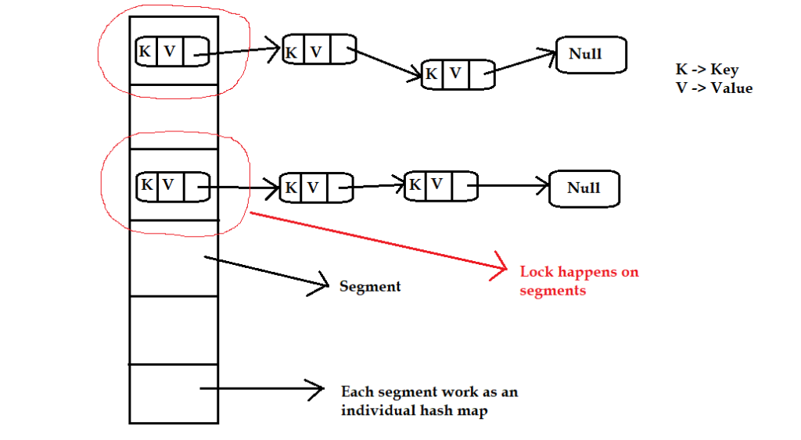
Working of Concurrent HashMap

Slide 102
BlockingQueue
BlockingQueue Introduced in Java 5.
Easy to implement producer-consumer pattern by providing inbuild support
put() and take()
put() will block if the Queue is full
take() will block if the Queue is empty.
Implementations with FIFO
ArrayBlockingQueue
LinkedBlockingQueue,

Slide 103
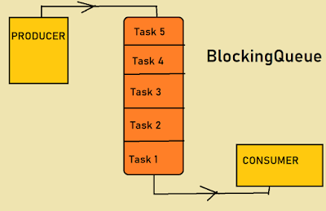
Blocking Queue

