Slide 1
STREAMS

Slide 2
Streams
An Interface defined in java.util.stream package.
Streams are a sequence of elements from a source that supports aggregate operations.
  filter, map, reduce, find, match, sort.
  Operations can be executed in series or in parallel.
The source can be a Collection, IO Operation or Arrays
Java collections has methods that return Stream.
  These Methods are added as default methods.

Slide 3
Characteristics of Streams
Not related to InputStreams, OutputStreams, etc.
These are NOT data structures
  Wrappers around Collection that carry values from a source through a pipeline of operations.
More powerful, faster and more memory efficient than Lists
Designed for lambdas
Employ lazy evaluation
Streams are parallelizable

Slide 4
Collections vs Streams
Collections are in-memory data structures which hold elements within it.
  Each element in the collection is computed before it actually becomes a part of that collection.
  On the other hand Streams are fixed data structures which computes the elements on-demand basis.
Streams are lazily constructed Collections, where the values are computed when user demands for it.
Collections are eagerly computed values

Slide 5
Streams
The Streams also support Pipelining and Internal Iterations.
Streams operations returns Streams only.
  Helps creating chain of various stream operations.
  This is called as pipelining.
The pipelined operations looks similar to a sql query.
In Java, we traditionally use for loops or iterators to iterate through the collections.
  These iterations are called as external iterations and they are clearly visible in the code.
Java 8 Stream uses internal Iterations which are not visible in the code

Slide 6

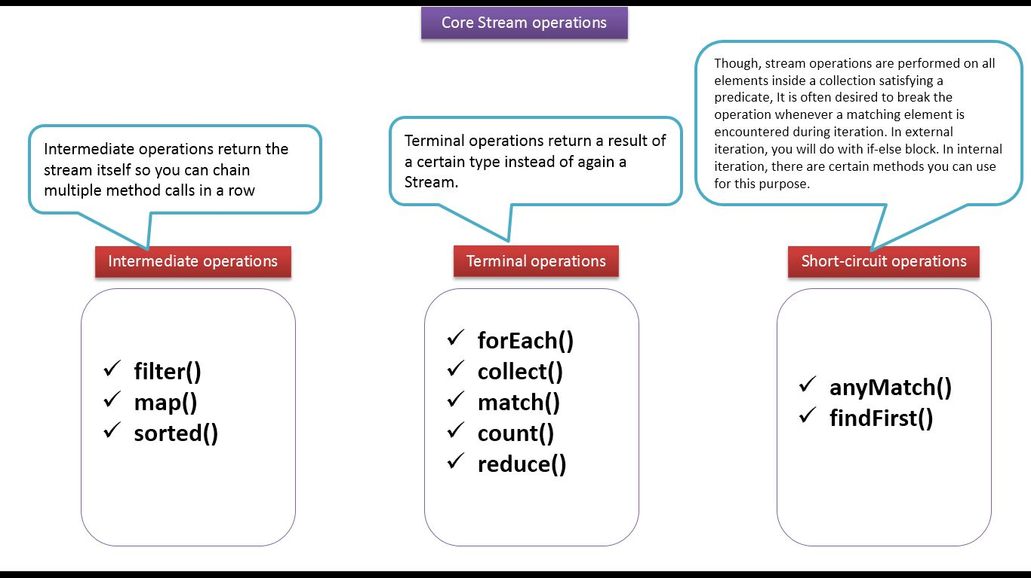
Stream Operations

Slide 7
Operation Categories
Two types of Operations
  Intermediate operations
  Terminal Operations.
Intermediate operations
  intermediate operations are lazy.
    They will not be invoked until the terminal operation is invoked.
    Streams become accessible when intermediate operations were called.
  Return streams can pipeline of operations.
    map, filter, and limit

Slide 8
Operation Categories
The terminal operations
  Used at the end of a pipeline
  They close the stream in some meaningful way.
  Eagerly executed
  Collects the results of stream operations
  Can be collected like lists, integers or simply nothing.
Stream become inaccessible when a terminal operation is called
  Will trigger the IllegalStateException which is a RuntimeException
Example : collect() ,count() ,forEach(), min() ,max()

Slide 9
Short Circuiting Operations
Streams are also generated from infinite dataset.
An intermediate operation is said to be short- circuting if applying on infinite stream should produce finite stream
  Example : limit().
A terminal operation is short-circuuting if, when applying on infinite set of input should produce result in finite time.
  Example : findAny()

Slide 10
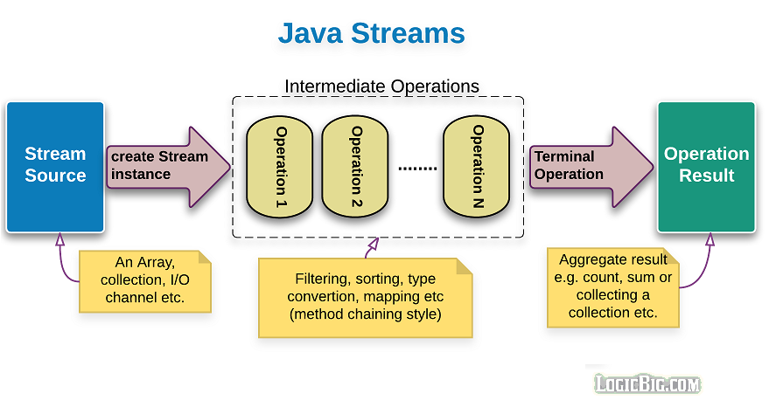
Structure of Java 8 Stream Operations
The three important components to make it work.
  A source
  one or more intermediate operations
  A terminal operation.
The three are pipelined in a sequence to make a stream work.

Slide 11
Creating a Stream
Stream instance can be created from different sources.
  Collection<String> collection = Arrays.asList("a", "b", "c");
  Stream<String> streamOfCollection = collection.stream();
  String[] arr = new String[]{"a", "b", "c"};
  Stream<String> streamOfArrayFull = Arrays.stream(arr);
  Stream<String> streamOfArrayPart = Arrays.stream(arr, 1, 3);

Slide 12
Building Streams
Stream.Of ()
  Creating Stream of hardcoded Strings and printing each String
  Stream.of("This", "is", "Java8", "Stream").forEach(System.out::println);
Stream.builder()
  create an instance of the Stream<Object>
  Can also be used to create desired type
Stream<String> streamBuilder = Stream.<String>builder().add("a").add("b").add("c").build();

Slide 13
Creating Stream -Builder
Stream.generate()
  Accepts a Supplier<T> for element generation.
  Resulting stream is infinite
  Need to specify the desired size
  Stream<Double> numList =
  Stream.generate(()->Math.random() * 1000).limit(20);
  numList.forEach(System.out::println);

Slide 14
Stream.iterate()
Stream.iterate()
  Creates an infinite stream
  Takes a seed and UnanyOperator as arguments
  Stream<Integer> streamIterated =
  Stream.iterate(40, n -> n + 2).limit(20);
The first element of the resulting stream is a first parameter of the iterate()method.
For creating every following element the specified function is applied to the previous element.
In the example above the second element will be 42.

Slide 15
Stream of Primitives
Stream<T> is a generic interface
To create streams of primitive types like int, long and double.
Special interfaces to creates streams of Primives are :
  IntStream, LongStream, DoubleStream.
Need not use auto-boxing
Can increase productivity

Slide 16
Stream of Primitives
range(int startInclusive, int endExclusive)
  Creates an ordered stream from the first parameter to the second parameter.
  Values of subsequent elements are incremented with the step equal to 1.
  The result doesn’t include the last parameter, it is just an upper bound of the sequence.
rangeClosed(int startInclusive, int endInclusive)
  The second element is included.

Slide 17
Stream of Primitives
  IntStream.range(100,120).forEach(System.out::println);
  // print 100 to 119
  IntStream.rangeClosed(100,120).forEach(System.out::println);
  // prints 100 to 120
  IntStream.of(45,67,90,120) forEach(System.out::println);;
  // 45 67 90 120

Slide 18
Stream of Primitives
  public static void print(IntStream stream) {
  stream.forEach(System.out::println);
  }
  IntStream random = IntStream.generate(() -> ThreadLocalRandom.current().nextInt(10)).limit(4);
  print(random); // some random numbers
  IntStream itr = IntStream.iterate(0, i -> i + 2).limit(3);
  print(itr); // print 0,2,4

Slide 19
INTERMEDIATE OPERATIONS

Slide 20
Types of Intermediate Operations
Intermediate operations can be classified into Stateful and Stateless
Stateful Operations
  Operations which maintain information from a previous invocation internally
  It can be used again in a future invocation of the method
  State storage can become huge for instances of infinite streams
  Can potentially affect performance of the whole system.
  Example : distinct() , sorted()

Slide 21
Stateless Intermediate Operations:
  Operations do not store any state across passes.
  Improves the performance of these operations
  Stream operation can be in parallel
    No information to shared, no need for order
  Example : filter(), map(), findAny()

Slide 22
Filter()
Takes predicate as an argument
Applies to the whole stream and returns a filtered stream
  Containing elements which match the Predicate.
  List<Customer> filteredList= customerList.stream().filter((Customer cust ) -> cust.getCustomerId() >200).collect(toList());
  System.out.println("After applying filter method");
  filteredList.forEach(System.out::println);

Slide 23
Performance
  Operates with O(n) time complexity, where n is the number of elements in the stream.
  Time it takes to process the stream increases linearly with the number of elements.
  Using parallel streams can improve performance by distributing the filtering process across multiple threads.
    Managing threads should be considered, as it might outweigh the benefits for smaller datasets.
  The choice of terminal operation can also influence performance.
    findFirst can terminate the stream processing early once a matching element is found
    collect will process all elements.

Slide 24
Map()
Takes an instance of Function <T, R> as parameter
Converts the type of elements in the stream from the current type T to the new type R.
Returns as output a stream of type R or Stream<R>
  List<Customer> customerList = HandleCustomers.getCustomers();
  List<Long> phoneBook = customerList.stream().
  map((eachCust)->eachCust.getPhoneNumber()).collect(toList());
  phoneBook.forEach(System.out::println);

Slide 25
FlatMap()
Used to flatten a Stream of collections to a stream of objects.
The objects are combined from all the collections in the original Stream.
Converting Stream<Collection<T>> to Stream<T>.
flatMap() = Flattening + map()
Takes the instance of Function<T,R>, as an input argument.
  Converts the current type T elements to another stream of type R
  The output stream of type R elements is a flattened stream

Slide 26
FlatMap()
  HashSet<Order> orderBook = new HashSet<>();
  Set<Product> prdList = new HashSet<>();
  prdList.add(new Product(101,"tv",4000));
  prdList.add(new Product(102,"led",5000));
  prdList.add(new Product(101,"fridge",6000));
  orderBook.add(new Order(701,new Customer(300,"Ram",45500L),prdList));
  List<Product> itemList =
  orderBook.stream()
  .map(x -> x.getItems())
  .flatMap(x -> x.stream())
  .collect(Collectors.toList());
  itemList.forEach(System.out::println);

Slide 27
Flat Map Example
  List<String> serviceList = new ArrayList<>();
  serviceList.add("Catering");
  serviceList.add("Band");
  List<Vendors> vendorList = new ArrayList<>();
  vendorList.add(new Vendors(899,serviceList));
  // Converts the current type Stream<List<String>> elements to another stream of type Stream<String>
  vendorList.stream().flatMap(vendor -> vendor.getServices().stream()).forEach(System.out::println);
    services.forEach(System.out::println);

Slide 28
Flat Map Example
  List<String> serviceList = new ArrayList<>();
  serviceList.add("Catering");
  serviceList.add("Band");
  List<Vendors> vendorList = new ArrayList<>();
  vendorList.add(new Vendors(899,serviceList));
  // Converts the current type Stream<List<String>> elements to another stream of type Stream<String>
  vendorList.stream().flatMap(vendor -> vendor.getServices().stream()).forEach(System.out::println);
  List<String> services = vendorList.stream().peek(System.out::println).
  map(v -> v.getServices()).peek(System.out::println).
  flatMap(v -> v.stream()).collect(Collectors.toList());
    services.forEach(System.out::println);

Slide 29
FlatMap
A map of users' names and lists of phones and “flatten” it down to a list of phones of all the users
  Map<String, List<String>> people = new HashMap<>();
  people.put("John", Arrays.asList("555-1123", "555-3389"));
  people.put("Mary", Arrays.asList("555-2243", "555-5264"));
  people.put("Steve", Arrays.asList("555-6654", "555-3242"));
  List<String> phones = people.values().stream()
  .flatMap(Collection::stream)
  .collect(Collectors.toList());

Slide 30
Flat Map Example
  List<String> list1 = Arrays.asList("Ram","Shyam","Shub");
  List<String> list2 = Arrays.asList("Manish","Preetam","David");
  List<List<String>> listOfLists = Arrays.asList(list1, list2);
  List<String> listOfAllNames = listOfLists.stream()
  .flatMap(x -> x.stream())
  .collect(Collectors.toList());
  System.out.println(listOfAllNames);

Slide 31
Stream.map() vs. flatMap()
map()
  Returns a single result value, which is sent to the Output stream
  Used only for modification
flatMap()
  Returns a Stream of elements
  Replaces a value with a Stream and join all Streams together
  Used for both flattening and modification

Slide 32
Distinct()
  returns a stream instance which has all elements unique/distinct.
  The uniqueness is determined by the equals & hashcode
  List<Long> custIds= customerList.stream().map(e -> e.getCustomerId()).distinct().collect(toList());

Slide 33
Sorted
sorted()
  Sorts the elements using natural ordering.
  The element class must implement Comparable interface.
  List<Customer> sortedList = customerList.stream().sorted().collect(toList());
sorted(Comparator<? super T> comparator)
  Sorted using an instance of Comparator using lambda expression.
Comparator.comparing
  A static function that accepts a sort key Function
  Rturns a Comparator for the type which contains the sort key:

Slide 34
Sorted
Comparator.comparing
  List<Customer> slist = customerList.stream().sorted(Comparator.comparing(Customer::getCustomerId)).collect(toList());
reversed()
  To reverse the natural ordering Comparator
  List<Customer> revrseList = customerList.stream().sorted(Comparator.reverseOrder()).collect(toList());
thenComparing()
  To set up lexicographical ordering of values by provisioning multiple sort keys in a particular sequence.

Slide 35
Sorted
    List<Customer> idThenPhone = customerList.stream().sorted(Comparator.comparing(Customer::getCustomerId).thenComparing(Customer::getPhoneNumber)).collect(toList());
  nullFirst,NullLast
  If a property of an Element in the collections is null.
  The Elements with null can be kept in the front or at the the end of the sorted collection.
  List<Customer> listWithNull = customerList.stream().
  sorted(Comparator.comparing(Customer::getCustomerName,Comparator.nullsFirst(String::compareTo))).collect(toList());
  listWithNull.forEach(System.out::println);

Slide 36
Peek()
      Stream<T> peek(Consumer<? super T> action)
        Returns the new stream after applying the consume
        Helps in debugging,
        Peeks the elements as they flow through the certain point in a stream pipeline.
  Stream<Integer> stream = Stream.of(1, 2, -3, 4, 5);
  stream.filter(i -> i%2 == 0).peek(System.out::println).toArray();

Slide 37
Limit(n)
  Puts an upper-limit cap purely based on the number of elements in the stream.
  If the stream had less than n elements, and limit of n has been applied on the stream, then there is no affect on the stream
Skip(n)
  returns a truncated version of the original stream such that the first n elements in the list are skipped and the remaining elements are returned in the resulting stream.

Slide 38
limit(n) & skip(n)
  These two are complimentary
  While limit(n) gives the first n elements from positions 1 to n;
  skip(n) gives elements from positions n+1 to k.
  Given a stream of size k, streams obtained from limit(n) & skip(n) applied on the original stream (where, n<=k) when aggregated together give us the original stream back.
  Joining the streams obtained from limit(n) & skip(n) gives the original stream back

Slide 39
TERMINAL OPERATIONS

Slide 40
Stream Reduction
count(), max(), min(), sum()
  Predefined Terminal Operation implementation.
  Used to aggregate a stream to a type or to a primitive
Can create a custom Stream’s reduction mechanism by using two methods
reduce()
collect()

Slide 41
Max , Min ,Count
count()
  returns the count of elements of a stream.
max()
  returns the maximum element of a stream according to the provided Comparator.
min()
  returns the minimum element of a stream according to the provided Comparator.

Slide 42
Min
  List<Product> catalog = new ArrayList<>();
  Comparator<Product> priceComparator = Comparator.comparing(Product::getRatePerUnit);
  String itemType="TV";
  Optional<Product> minresult = catalog.stream().
  filter((Product prod ) -> prod.getProductName().equalsIgnoreCase(itemType)).
  min(priceComparator);
  double leastPriced=0;
  if(minresult.isPresent())
  {
  leastPriced= minresult.get().getRatePerUnit();
  }

Slide 43
Max
  Optional<Product> maxresult= catalog.stream().
  filter((Product prod ) -> prod.getProductName().equalsIgnoreCase(itemType)).
  max(priceComparator);
  double highPriced=0;
  if(maxresult.isPresent())
  {
  highPriced= maxresult.get().getRatePerUnit();
  }
  System.out.println("Highest Priced :="+itemType + highPriced);

Slide 44
Count()
  long countresult= catalog.stream().
  filter((Product prod ) -> prod.getProductName().equalsIgnoreCase(itemType)).count();
  System.out.println(countresult);

Slide 45
collect()
A terminal operation
It accepts an argument of the type Collector
  Specifies the mechanism of reduction.
Predefined collectors for most common operations.
Accessed with the help of the Collectors type.
Collectors.toList()
  Used for collecting all Stream elements into a List instance.
  Can have more control with toCollection instead.
Collectors.toSet()
  Used for collecting all Stream elements into a Set instance.

Slide 46
collect()
Collectors.toCollection()
  To use a custom implementation
  List<String> result = givenList.stream()
  .collect(toCollection(LinkedList::new))
Collectors.toMap()
  Used to collect Stream elements into a Map instance.
  Map<Long, String> map = customerList.stream()
  .collect(Collectors.toMap(Customer::getPhoneNumber, Customer::getCustomerName));
  map.forEach((x, y) -> System.out.println("Key: " + x +", value: "+ y));

Slide 47
allMatch,anyMatch,noneMatch
These methods are applied on stream object that matches the given Predicate and then returns boolean value.
allMatch()
  Checks if calling stream totally matches to given Predicate,
  Predicate is applied to each element of stream and if each and every element satisfies the given Predicate then it returns true otherwise false.
anyMatch()
  checks if there is any element in the stream which matches the given Predicate.
noneMatch()
  returns true only when no element matches the given Predicate.Stream.

Slide 48
FindFirst()
findFirst()
  Returns an Optional describing the first element of this stream
  Else an empty Optional .
  String item = gadgets.stream() .filter(s -> s.length() > 10) .findFirst() .orElse("");
  findAny()
  returns an Optional describing some element of the stream
  Empty Optional if the stream is empty.
    Stream<String> stream =
    Stream.of("a", "b", "c").filter(element -> element.contains("b"));
    Optional<String> anyElement = stream.findAny();

Slide 49
groupingBy()
Collectors.groupingBy()
  Similar to the ‘GROUP BY’ clause in the SQL language.
  Need to specify a property, by which the grouping be performed.
  Takes a classification function as its parameter.
  It is applied to each element of the stream.
  The value that is returned by the function is used as a key to the map

Slide 50
groupingBy()
  List<BloodDonar> donarList = new BloodDonarManager().findAll();
  Map<String, List<BloodDonar>> donarsPerType =
  donarList.stream().collect(Collectors.groupingBy(BloodDonar::getBloodGroup));
  List<BloodDonar> list = donarsPerType.get("a+");
  list.forEach(System.out::println);

Slide 51
Changing the Returned Map Value Type
Overloaded groupingBy takes an additional second collector that is applied to the results of the first collector.
  When only classification function is defined it uses toList() collector
Can use the toSet() collector
  Map<String, Set<BloodDonar>> donarsPerType =
  donarList.stream().collect(Collectors.groupingBy(
  BloodDonar::getBloodGroup,Collectors.toSet()));

Slide 52
Using Aggregate Functions
To calculate the total sum
To find the average number
  Map<String, Integer> donationsPerGroup =
  donarList.stream().collect(groupingBy(
  BloodDonar::getBloodGroup,
  summingInt(BloodDonar::getTimesDonated)
  ));
  System.out.println(donationsPerGroup.get("a+"));

Slide 53
Collect() Method
<R,A> R collect(Collector<? super T,A,R> collector)
<R> R collect(Supplier<R> supplier,
BiConsumer<R,? super T> accumulator,
BiConsumer<R,R> combiner)
  List<Integer> list =
  Stream.of(1, 2, 3, 4, 5)
  .collect( () -> new ArrayList<>(),
  (List<Integer> l, Integer i) -> l.add(i),
  (List<Integer> l1, List<Integer> l2) -> l1.addAll(l2)
  );
  Or we can also use method references:
  List<Integer> list =
  Stream.of(1, 2, 3, 4, 5)
  .collect(
  ArrayList::new,
  ArrayList::add,
  ArrayList::addAll
  );

Slide 54
partitioningBy
partitioningBy()
  Convenient way to split a collection into two distinct groups based on a condition.
  Categorizing data without loops and if-else structures.
  It returns a Map<Boolean, List<T>>, where each key-value pair represents the results of applying the predicate to each element.
  The keys are true and false, and the values are lists containing elements that satisfy or do not satisfy the predicate.
  Map<Boolean, List<T>> partitionedData =
  stream.collect(Collectors.partitioningBy(predicate));

Slide 55
partitioningBy
  List<Integer> numbers =
  IntStream.rangeClosed(1, 20)
  .boxed()
  .collect(Collectors.toList());
  Map<Boolean, List<Integer>> partitionedByEvenOdd =
    numbers.stream()
    .collect(Collectors.partitioningBy(n -> n % 2 == 0));
    System.out.println("Even Numbers: " + partitionedByEvenOdd.get(true));
  System.out.println("Odd Numbers: " + partitionedByEvenOdd.get(false));

Slide 56
Performance
Time Complexity
  O(n), where n is the number of elements in the stream.
  Each element is processed once to evaluate the predicate, making the method efficient for linear scans.
Space Complexity
  O(n) since it stores elements in two separate lists.
  For large datasets, this may have a significant impact on memory usage.
Parallel Streams for Large Datasets
  For large datasets, using parallel streams can improve performance by distributing the partitioning process across multiple threads.
  When data is being modified concurrently, can use thread-safe data structures or make objects immutable.

Slide 57
FORK/JOIN FRAMEWORK

Slide 58
Fork/Join Framework
Helps speed up parallel processing
Uses all available processor cores
Done through a divide and conquer approach.
Framework first “forks”, recursively breaking the task into smaller independent subtasks
  Does until they are simple enough to be executed asynchronously.
“Join” part Joins the results of all subtasks into a single result
  The program waits until every subtask is executed.

Slide 59
Fork/Join Framework
work-stealing.
Worker threads are not idle
Idle workers steal the work from those workers who are busy,
  if (problem is small)
  directly solve problem
  else {
  split problem into independent parts
  fork new subtasks to solve each part
  join all subtasks
  compose result from subresults
  }

Slide 60
ForkJoinPool
Effective parallel execution is done by using a pool of thread ForkJoinPool
  Manages worker threads of type ForkJoinWorkerThread.
  An implementation of the ExecutorService
  Provides with tools to get information about the thread pool state and performance.
Worker threads can execute only one task at the time
ForkJoinPool doesn’t create a separate thread for every single subtask.

Slide 61
Core Classes- ForkJoinPool
ForkJoinPool and ForkJoinTask.
ForkJoinPool
  is an implementation of ExecutorService that employs the work-stealing algorithm.
ForkJoinPool pool = new ForkJoinPool(int);
  creates a ForkJoinPool with the indicated parallelism level (number of initial threads in the pool)
ForkJoinPool pool = new ForkJoinPool();
  Equivalent to new ForkJoinPool(Runtime.availableProcessors())

Slide 62
Core Classes- ForkJoinTask
An abstract class for creating tasks that run within a ForkJoinPool.
  RecursiveAction and RecursiveTask are its subclasses.
RecursiveAction does not return a value while RecursiveTask does.
The main methods of ForkJoinTask are:
  fork()
    allows a ForkJoinTask to be planned for asynchronous execution.
    A new task can be created with this method.
  join()
    Allows a ForkJoinTask to wait for the completion of another one.

Slide 63
Submitting Task s
Different ways of submitting a task to the ForkJoinPool:
void execute(ForkJoinTask<?> task)
  Arranges for (asynchronous) execution of the given task.
void execute(Runnable task)
  Executes the given command at some time in the future.
<T> T invoke(ForkJoinTask<T> task)
  Performs the given task, returning its result upon completion.
<T> List<Future<T>> invokeAll(Collection<? extends Callable<T>> tasks)

Slide 64
RecursiveAction
A RecursiveAction is a task which does not return any value.
It just does some work, e.g. writing data to disk, and then exits.
A RecursiveAction may still need to break up its work into smaller chunks which can be executed by independent threads or CPUs.
Implemented by subclassing

Slide 65
RecursiveTask
A RecursiveTask is a task that returns a result.
It may split its work up into smaller tasks, and merge the result of these smaller tasks into a collective result.
The splitting and merging may take place on several levels

Slide 66
Generate Fibonacci
  public class Fibonacci extends RecursiveTask<Long> {
  final long n;
  Fibonacci(long n) {
  this.n = n;
  }
  public Long compute() {
  if (n<=10) {
  return do_fibonacci(n);
  }
  ForkJoinTask<Long> subTask = new Fibonacci(n-1).fork();
  return new Fibonacci(n-2).compute() + subTask.join();
  }
  static long do_fibonacci(long n) {
  if ( n<=1 ) return n;
  return do_fibonacci(n-1) + do_fibonacci(n-2);
  }
  }

Slide 67
Application
To calculate 11th element of Fibonacci Series
  public static void main(String[] args) {
  Fibonacci fibonacci = new Fibonacci(11);
  ForkJoinPool pool = new ForkJoinPool();
  System.out.println(pool.invoke(fibonacci));
  // 0, 1, 1, 2, 3, 5, 8, 13, 21, 34, 55, 89
  }

Slide 68
PARALLEL STREAMS

Slide 69
Parallel Streams
The Stream API can be used create parallel streams
  Takes advantage of multi-core architectures
Parallel stream are created in two ways
  parallelStream() on a collection
  parallel() on a stream
Should be with stateless and associative operations
Stateless operation : State of one element does not affect another element
Associative : The result is not affected by the order of operands

Slide 70
Parallel Streams
Parallel streams use a common ForkJoinPool
The size of the underlying thread-pool is dependent on the amount of available physical CPU cores:
  ForkJoinPool commonPool = ForkJoinPool.commonPool();
  System.out.println(commonPool.getParallelism());
It can decreased or increased by JVM parameter:
  -Djava.util.concurrent.ForkJoinPool.common.parallelism=5
Using parallel stream with operations like reduce and collect need combine operations.

Slide 71
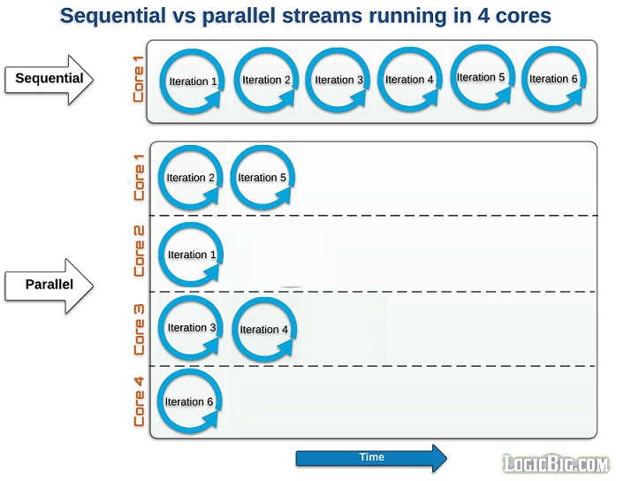
Parallel Stream Working
Stream are sequential by default
When a stream executes in parallel, the Java runtime partitions the stream into multiple sub-streams.
Aggregate operations iterate over and process these sub-streams in parallel and then combine the results.

Slide 72
Creating Parallel Streams
  Stream.of("Ramesh", "Suresh", "Ganesh", "Magesh", "Rajesh", "Sudan", "Jagan", "Madan").
  parallel().
  forEach(System.out::println);
  Stream parallelStream = Arrays.asList("Ramesh", "Suresh", "Ganesh", "Magesh", "Rajesh", "Sudan", "Jagan", "Madan").
  parallelStream().
  forEach(System.out::println);
Serial stream the order is guaranteed.
Parallel Stream the order is not guaranteed

Slide 73
Reduction
A reduction operation takes a sequence of input elements and combines them into a single summary result by repeated application of a combining operation
Finding the sum or maximum of a set of numbers
Accumulating elements into a list.
Reduce operation is inherently parallelizable
  Function(s) used to process the elements should be associative and stateless.

Slide 74
Reduce Operation
Identity
  Both an initial seed value for the reduction
  A default result if there are no input elements.
accumulator
  Takes a partial result and the next element, and produces a new partial result.
combiner
  combines two partial results to produce a new partial result.

Slide 75
Reduction
Optional<T> reduce(BinaryOperator<T> accumulator)
  Performs a reduction on the elements of this stream
  Returns an Optional describing the reduced value, if any.
  Accepts a BinaryOperator accumulator function.
  Acts on subsets of the data in parallel, and then combine the intermediate results to get the final.
  int sum = numbers. parallelStream().reduce(0, (x,y) -> x+y);
  int sum = numbers.parallelStream().reduce(0, Integer::sum);

Slide 76
Reduction
  List<Employee> empList = getEmployee();
To Find the Maximum Salary
  empList.parallelStream().map(e -> e.getSalary())
  .reduce((e1,e2) -> e1 > e2 ? e1 :e2)
  .ifPresent(System.out::println);

Slide 77
Reduction
T reduce(T identity, BinaryOperator<T> accumulator)
  Performs a reduction on the elements of this stream,
  Has identity value and an associative accumulation function
  Returns the reduced value
  .

Slide 78
Reduction
  <U> U reduce(U identity, BiFunction<U,? super T,U> accumulator, BinaryOperator<U> combiner)
  List<Long> marks = Arrays.asList(1L,2L,3L);
  Long result = marks.parallelStream().reduce(3L, Long::sum);
  System.out.println(result); // 15
  Without Stream
  long initial = 3L;
  long sum =0L;
  long result2 = 0L;
  for(Long eachNumber : marks){
  sum =sum +eachNumber ;
  result2 = sum+= inital;
  }
  System.out.println(result2); // 15

Slide 79
Reduction
  int total = Stream.of("2", "3", "4", "5")
  .parallel()
  .reduce(0, (integer, s) -> Integer.sum(integer, Integer.parseInt(s)),
  (integer, integer2) -> Integer.sum(integer, integer2));
  // accumulator maps strings to integers and then returns sum.
  // Combiner is adding the two split results
  System.out.println(total);

Slide 80
Reduction Combiner and Accumulator
In Two Argument version Accumulator itself can works as combiner
  Used when reduction type is the same as stream element type.
In three-argument version the reduction operation may produce an object of another type.
Can provide a rule how to combine two elements of the resulting type.
When result type is the same, accumulator and combiner work on the same object type,

Slide 81
DATE AND TIME

Slide 82
Current Scenerio
Conceptually an instant, not a date
Properties have random offsets
Some zero-based, like month and hours
Some one-based, like day of the month
Year has an offset of 1900
Mutable, not thread-safe
Not internationalizable
Millisecond granularity
Does not reflect UTC

Slide 83
Calendar
Conceptually an instant, not a calendar
But, can’t create a Calendar from a Date
Can’t format a Calendar
Zero-based offsets
Stores internal state in two different ways
  milliseconds from epoch
  set of fields
Mutable, not thread-safe

Slide 84
Date Time API
Classes under the package java.time.
Has two major classes
Local
  Simplified date-time API with no complexity of timezone handling.
Zoned
  Specialized date-time API to deal with various timezones.

Slide 85
Java 8 Date
System.out.println(LocalDate.of(12,12,12))
  ISO 8601 order of fields - year, month, day.
  Month 12 is December.
  Year is 12 CE.
  No time component.
  No time zone
System.out.println(LocalDate.of(12,15,12));
  Throws DateTimeException Invalid Value

Slide 86
Local Date-Time API
LocalDate/LocalTime and LocalDateTime classes simplify the development where timezones are not required.
  LocalDateTime currentTime = LocalDateTime.now();
  System.out.println("Current DateTime: " + currentTime);
  LocalDate date1 = currentTime.toLocalDate();
  System.out.println("date1: " + date1);
  Month month = currentTime.getMonth();
  int day = currentTime.getDayOfMonth();
  int seconds = currentTime.getSecond();
  System.out.println("Month: " + month +"day: " + day +"seconds: " + seconds);

Slide 87
Local Date-Time API
  LocalDateTime date2 = currentTime.withDayOfMonth(10).withYear(2012);
  System.out.println("date2: " + date2);
  LocalDate date3 = LocalDate.of(2014, Month.DECEMBER, 12);
  System.out.println("date3: " + date3);
  LocalTime date4 = LocalTime.of(22, 15);
  System.out.println("date4: " + date4);
  LocalTime date5 = LocalTime.parse("20:15:30");
  System.out.println("date5: " + date5);

Slide 88
Zoned Data –Time API
Zoned date-time API is to be used when time zone is to be considered.
  ZonedDateTime date1 = ZonedDateTime.parse("2007-12-03T10:15:30+05:30[Asia/Karachi]");
  System.out.println("date1: " + date1);
  ZoneId id = ZoneId.of("Europe/Paris");
  System.out.println("ZoneId: " + id);
  ZoneId currentZone = ZoneId.systemDefault();
  System.out.println("CurrentZone: " + currentZone);

Slide 89
Period and Duration
Two specialized classes are introduced to deal with the time differences −
Period − Deals with date based amount of time.
Duration − Deals with time based amount of time.
  LocalDate date1 = LocalDate.now();
  System.out.println("Current date: " + date1);
  LocalDate date2 = date1.plus(1, ChronoUnit.MONTHS);
  System.out.println("Next month: " + date2);
  Period period = Period.between(date2, date1);
  System.out.println("Period: " + period);

Slide 90
Period and Duration
LocalTime time1 = LocalTime.now();
Duration twoHours = Duration.ofHours(2);
LocalTime time2 = time1.plus(twoHours);
Duration duration = Duration.between(time1, time2);
System.out.println("Duration: " + duration);

Slide 91
Get Today’s Date
  LocalDate today = LocalDate.now();
  int year = today.getYear();
  int month = today.getMonthValue();
  int day = today.getDayOfMonth();
  System.out.printf("Year : %d Month : %d day : %d \t %n", year, month, day);

Slide 92
Local Date Example
  LocalDate dateOfBirth = LocalDate.of(2010, 01, 14);
  System.out.println("Your Date of birth is : " + dateOfBirth);
  Your Date of birth is : 2010-01-14
  LocalDate date1 = LocalDate.of(2014, 01, 14);
  if(date1.equals(today)){ System.out.printf("Today %s and date1 %s are same date %n", today, date1);
  }
  today 2014-01-14 and date1 2014-01-14 are same date

Slide 93
Local Date Example
  LocalDate dateOfBirth = LocalDate.of(2010, 01, 14);
  MonthDay birthday = MonthDay.of(dateOfBirth.getMonth(), dateOfBirth.getDayOfMonth());
  MonthDay currentMonthDay = MonthDay.from(today);
  if(currentMonthDay.equals(birthday)){
  System.out.println("Many Many happy returns of the day !!"); }else{
  System.out.println("Sorry, today is not your birthday");
  }

Slide 94
TemporalAdjuster
To find some relative date such as “first Tuesday of the month.”
The TemporalAdjuster class contains a standard set of adjusters,
Find the first or last day of the month.
Find the first or last day of the next or previous month.
Find the first or last day of the year.
Find the first or last day of the next or previous year.
Find the first or last day-of-week within a month, such as “first Wednesday in June.”

Slide 95
Temporal Adjusters
"Next Tuesday".
  LocalDate date1 = LocalDate.now();
  System.out.println("Current date: " + date1);
  LocalDate nextTuesday = date1.with(TemporalAdjusters.next(DayOfWeek.TUESDAY));
  System.out.println("Next Tuesday on : " + nextTuesday);

Slide 96
Backward Compatibility
A toInstant() method is added to the original Date and Calendar objects,
Used to convert them to the new Date-Time API.
  Date currentDate = new Date();
  System.out.println("Current date: " + currentDate);
  Instant now = currentDate.toInstant();

