Slide 1


JUNIT 5.0 with Maven
Kent Beck
Erich Gamma

Slide 2
Test Driven Development
TDD starts with developing test for each one of the features.
The test might fail as the tests are developed even before the development.
Development team then develops and refactors the code to pass the test.
  test-first as part of extreme programming concepts.

Slide 3
Testing phases
Unit Testing
  on individual units of source code (mostly methods)
Integration Testing
  on groups of individual software modules
System testing
  on a complete end-to-end system

Slide 4
Benefits of TDD
Much less debug time
Code proven to meet requirements
Tests become Safety Net
Near zero defects
Shorter development cycles

Slide 5
Development Process
Add a Test
Run all tests and see if the new one fails
Write some code
Run tests and Refactor code
Repeat

Slide 6
What is unit testing
Unit
  A Method , a class, a package, or a subsystem.
Can Test :
  an entire object
  part of an object – a method or some interacting methods
  interaction between several objects
Helps discover failures in the logic and improve the quality of their code.
Used to ensure that the code work as expected in case of future changes.

Slide 7
When to Write Test
During Development
To add new functionality
When adding new features,
During Debugging
While a defect is discovered in code to demonstrates the defect.
write unit tests to thoroughly test a single class
write tests as develop (even before you implement)
write tests for every new piece of functionality

Slide 8
JUNIT

Slide 9
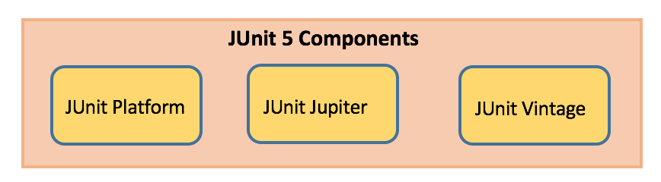
Junit 5
Composed of modules from three different sub-projects.
Requires Java 8 (or higher) at runtime.
Can also test code that has been compiled with previous versions of the JDK.

Slide 10
Tips for testing
You cannot test every possible input, parameter value, etc.
  So you must think of a limited set of tests likely to expose bugs.
Think about boundary cases
  positive; zero; negative numbers
  right at the edge of an array or collection's size
Think about empty cases and error cases
  0, -1, null; an empty list or array
test behavior in combination
  maybe add usually works, but fails after you call remove
  make multiple calls; maybe size fails the second time only

Slide 11
Tips for testing-Effective Tests
Should Not Test
  Other framework libraries (you should assume they work correctly)
  The database (you should assume it works correctly when it is available)
  Other external resources (again you assume they work correctly when available)
  Really trivial code (like getters and setters for example)
Should Test
  Tests should cover code with “business logic”.
  Core code that is accessed by a lot of other modules
  Code that seems to gather a lot of bugs

Slide 12
Code Coverage
Although 100% code coverage may appear like a best possible effort, even 100% code coverage is estimated to only expose about half the faults in a system.
Low code coverage indicates inadequate testing, but high code coverage guarantees nothing.
  Some test cases are expensive to reproduce but are highly improbable.
  Code shared among several projects is only partially utilized by the project under test.
  Generally, the tester should stop increasing code coverage when the tests become contrived.
  When you focus more and more on making the coverage numbers better, your motivation shifts away from finding bugs.

Slide 13
Create Project
Create a Maven project with archetype
groupId : org.apache.maven.archetypes
artificatId :maven-archetype-simple
<dependency>
<groupId>org.junit.jupiter</groupId>
<artifactId>junit-jupiter</artifactId>
<version>5.8.2</version>
<scope>test</scope>
</dependency>

Slide 14
Test Classes and Methods
Test Class
  Top-level class, Must NOT be abstract
  Static member class,
  @Nested class that contains at least one test method.
  Can declare custom display name with @DisplayName
Test Method:
  Instance method annotated with @Test
  Method must be void
  Need not be Public but should not be private
  Can declare custom display name with @DisplayName
  Can also have following annotations
    @RepeatedTest, @ParameterizedTest

Slide 15
Write Unit Test
  public class Greeting {
  public String getMessage() {
  return "Welcome to Java Programming";
  }
  }

Slide 16
Assertions & Assumptions
Assertions
  Static methods in org.junit.jupiter.api.Assertions class.
  Used to support asserting conditions in a Test Method
Assumptions
  Static methods in the org.junit.jupiter.api.Assumptions class.
  Execute a test only when the specified condition met
    If not met Test will be aborted.
    The aborted test will not cause build failure.
      But Throws TestAbortedException and the test is skipped.

Slide 17
Assertions
assertEquals(expected, actual)
  Fails when expected does not equal actual
assertNull(actual)
  Fails when actual is not null
assertAll()
  Group many assertions
  Every assertion is executed even if one or more of them fails
assertThrows()
  Class to be tested is expected to throw an exception

Slide 18
Writing a Junit Test – Assert Equals
  import static org.junit.jupiter.api.Assertions.*;
  import org.junit.jupiter.api.Test;
  class TestGreeting {
  private Greeting grtObj = new Greeting();
  @Test
  void testGetMessageLength() {
  int actual = grtObj.getMessage().length();
  assertEquals(5,actual);
  }
  }

Slide 19
Example
  public String findResult(int mark){
  String result =null;
  if(mark<60)
  {
  result="B";
  }
  if(mark>60 && mark<80)
  {
  result ="C";
  }
  return result;
  }

Slide 20
Writing a Junit Test – Assert Not Null
  @Test
  @DisplayName("Test for Method Should Not Throw Null Value")
  void testFindResultForNotNull() {
  String actual = grtObj.findResult(95);
  assertNotNull(actual);
  }

Slide 21
Writing a Junit Test – Assert All
  @Test
  @DisplayName("Using Assert All")
  void testFindUsingAssertAll() {
assertAll("Testing Cases",
() -> {
String expected = grtObj.getMessage();
assertNotNull(expected);
},
() -> assertEquals("Hello World",grtObj.getMessage())
);
}
  }

Slide 22
Example
  public String checkUserId(String ... values) {
  String message = "invalid";
  try {
  int id = Integer.parseInt(values[1]);
  message="valid";
  } catch (NumberFormatException e) {
  System.err.println(e.getMessage());
  }
  return message;
  }

Slide 23
Writing a Junit Test – Assert Throws
  @Test
  @DisplayName("Test For Number Format Exception ")
  void testForException() {
  Throwable exception =
  assertThrows(NumberFormatException.class, ()-> grtObj.checkUserId("fourTwenty"));
  assertEquals("Invalid Number",exception.getMessage());
  }

Slide 24
Disabling Tests
@Disabled
  Entire test classes or individual test methods can be disabled
  Can also be declared without providing a reason
  @Disabled("Disabled until bug #560 has been fixed")
  class DisabledClassDemo {
  @Test
  void testWillBeSkipped() {
  }
  }

Slide 25
Lifecycle Method
@BeforeAll
  Denotes that the annotated method should be executed once before all Test Methods
  Methods must be static
  Used for expensive common operation like database connection or the startup of a server.
@AfterAll
  Denotes that the annotated method should be executed after all the Test Methods
  Methods must be static

Slide 26
Lifecycle Method
@BeforeEach
  Denotes that the annotated method should be executed before EACH Test Method
  To execute some common code before running a test
@AfterEach
  Denotes that the annotated method should be executed after EACH Test Method

Slide 27
Writing a Junit Test Life Cycle Methods
  @BeforeEach
  void setUp(TestInfo info) throws Exception {
  System.out.println("BEFORE EACH Called on "+ info.getDisplayName());
  }
  @AfterEach
  void tearDown(TestInfo info) throws Exception {
  System.out.println("AFTER EACH Called on"+ info.getDisplayName());
  }

Slide 28
Example - Timeouts
  public String getMessage() {
  try {
  Thread.sleep(5000);
  } catch (InterruptedException e) {
  e.printStackTrace();
  }
  return "Welcome to Java Programming";
  }

Slide 29
Test Timeouts
import static java.time.Duration.ofMillis;
import static org.junit.jupiter.api.Assertions.assertTimeout;
  @Test
  @DisplayName("Testing For Timeout")
  void timeoutNotExceededWithMethod() {
  String actualGreeting = assertTimeout(ofMillis(1000),() -> grtObj.getMessage());
  assertEquals("Hello, World!", actualGreeting);
  }

Slide 30
ParameterizedTest
@ParameterizedTest
  Denotes that a method is a parameterized test.
  When executing the parameterized test method
  Each invocation will be passed with arguments and reported separately.
@ValueSource
  Used to pass an array of values to the test method.
  Values can be int,byte,short ,double,char,String
  Can Pass Only one Argument to the method.

Slide 31
ParameterizedTest
  @DisplayName("Testing For elements in even position should not be null")
  @ParameterizedTest
  @ValueSource(ints = {0,2,4,6})
  void checkingForNullInList(int idxPos) {
  assertNotNull(grtObj.findElement(idxPos));
  }

Slide 32
ParameterizedTest
  public String findElement(int idxPos) {
  List<String> names =
  Arrays.asList("Ramesh","Suresh",null,"magesh",null,"Rajesh","Siva");
  return names.get(idxPos);
  }

Slide 33
Assumptions
assumeTrue
  Execute the body of lambda when the positive condition hold else test will be skipped
assumeFalse
  Execute the body of lambda when the negative condition hold else test will be skipped
assumingThat
  Flexible, If condition is true then executes
  Else do not abort test continue rest of code in test.

Slide 34
Assumptions vs Assertions
Assertions
Assumptions
Assertions is used to write testing scenarios for test methods.
Assertions fail, the test fails.
Assumptions are used to validate favorable conditions for test cases.
Assumptions fails then test method is skipped.

Slide 35
Assumptions -AssumeTrue
  @DisplayName("Testing For elements in even position should not be null")
  @ParameterizedTest
  @ValueSource(ints = {0,2,4,6})
  void checkingForNullInList(int idxPos) {
  LocalDateTime dt = LocalDateTime.now();
  assumeTrue(dt.getDayOfWeek().getValue() == 6);
  assertNotNull(grtObj.findElement(idxPos));
  }

Slide 36
Assumptions -AssumingThat
  System.setProperty("env", "test");
  assumingThat("test".equals(System.getProperty("os.name")),
  () -> {
  assertEquals(10, 10);
  System.out.println("perform below assertions only on the test env");
  });
  assertEquals(20, 20);
  System.out.println("perform below assertions on all env");
  }

Slide 37
Test Report
  Generate Report by : mvn site
  <reporting>
  <plugins>
  <plugin>
  <groupId>org.apache.maven.plugins</groupId>
  <artifactId>maven-surefire-report-plugin</artifactId>
  <version>3.0.0-M7</version>
  <configuration>
  <outputName>JUnit-Test-Report</outputName>
  </configuration>
  </plugin>
  </plugins>
  </reporting>

Slide 38
Show Failed Tests
  <plugin>
  <groupId>org.apache.maven.plugins</groupId>
  <artifactId>maven-surefire-report-plugin</artifactId>
  <version>2.22.2</version>
  <configuration>
  <showSuccess>false</showSuccess>
  </configuration>
  </plugin>
  </plugins>
  </reporting>

Slide 39
Failed Code Line Number
  <plugin>
  <groupId>org.apache.maven.plugins</groupId>
  <artifactId>maven-jxr-plugin</artifactId>
  <version>3.1.1</version>
  </plugin>

Slide 40
Rest Client - Controller
  @RestController
  @Slf4j
  public class PaymentController {
  @Autowired
  private RestTemplate template;
  String baseURL = "http://CUSTOMER-SERVICE/";
  @GetMapping(path = "/api/v1/client/customers")
  public String getCustomerDetails() {
  String reqURL = baseURL+"api/v1/customers";
  return this.template.getForObject(reqURL, String.class);
  }
  }

Slide 41
Design Patterns

Slide 42
SOLID PRINCIPLE

Slide 43
SOLID Design Principle
S ->Single Responsibility Principle
  One class should have one and only one responsibility“
O -> Open Close Principle
  "Software components should be open for extension, but closed for modification“
L-> Liskov Substitution Principle
  "Derived types must be completely substitutable for their base types"
I ->Interface Segregation Principle
  "Clients should not be forced to implement unnecessary methods which they will not use“
D->Dependency Inversion Principle
  "Depend on abstractions, not on concretions"

Slide 44
Single Responsibility Principle (SRP)
There should not be more than one reason for a class to change
  a class should always handle single functionality.
One class at the most is responsible for doing one task or functionality among the whole set of responsibilities
And only when there is a change needed in that specific task or functionality should this class be changed.
Provides cohesiveness
  Attributes & behavior – are specific to that single functionality only
Class should be split into two If there are 2 reasons to change

Slide 45
Single Responsibility Principle (SRP)
  public class Item {
  private int itemNumber;
  private String itemName;
  private long ratePerUnit;
    public Item() {
    super();
  }
  }

Slide 46
Single Responsibility Principle (SRP)
  public class Customer {
  private String name;
  private int age;
  private long bill;
  private List<Item> listsOfItems;
  // Calculate bill should not be responsibility of customer
  public long calculateBill(long tax) {
  }
  //Report generation should not be responsibility of customer
  public void generateReport(String reportType)
  { }
  }
  There are two Responsibilities in the Customer Class.

Slide 47
Applying SRP
  public class BillCalculator {
  public long calculateBill(Customer customer,long tax) {
  }
  public class ReportGenerator {
  public void generateReport(Customer customer,String reportType) {
  }
  }

Slide 48
Open Closed Design Principle
Classes, methods or functions should be Open for extension (new functionality) and Closed for modification.
Prevents some-one from changing already tried and tested code.
New functionality should added by creating subclasses or methods, or by reusing existing code through delegation
New functionality should be tested and that's the goal of Open Closed Design principle.

Slide 49
Liskov Substitution Principle (LSP)
If a program module is using a Base class, then the reference to the Base class can be replaced with a Derived class without affecting the functionality of the program module.
Classes are created in some class hierarchies, we extend some classes creating some derived classes.
Need to ensure that the new derived classes just extend without replacing the functionality of old classes.
Otherwise the new classes can produce undesired effects when they are used in existing program modules.

Slide 50
Interface Segregation principle (ISP)
interface IWorker {
public void work();
public void eat(); }
class Worker implements IWorker{
public void work() { // ....working }
public void eat() { // ...... eating in lunch break }
}
class SuperWorker implements IWorker{
public void work() { //.... working much more }
public void eat() { //.... eating in lunch break }
}
class Manager {
IWorker worker;
public void setWorker(IWorker w) {
worker=w;
}
public void manage() {
worker.work();
} }
What Happens when a new Robot worker is introduced

Slide 51
Dependency Injection or Inversion principle
High-level modules should not depend on low-level modules. Both should depend on abstractions.
Abstractions should not depend on details. Details should depend on abstractions.
Don't ask for dependency it will be provided to you by framework.
This has been very well implemented in Spring framework,
Any class which is injected by DI framework is easy to test with mock object and easier to maintain because object creation code is centralized in framework and client code is not littered with that.

Slide 52
Design Patterns
Design Patterns differ from Architectural Patterns in their scope,
  They are the outcome of a reusable solution to a general problem encountered in a particular context
  These are more localized, they have impact on a specific section of the code base,
  How to instantiate an object when we only know what type needs to be instantiated at run time - Factory Pattern
  How to make an object behave differently according to its state
    State machine, or a Strategy Pattern

Slide 53
DESIGN PATTERNS

Slide 54
Overview of Patterns
Is a proven solution to a problem in a given context.
Is first verified several times in the real-world systems to be actually called a pattern.
Promotes reuse of software concepts and technologies, which make you work faster and efficiently.
Establishes common terminology for problems.
Describes the circumstances, influences, and the resolution of a solution.
Facilitates design modifications, documentation, and understandability of a software system.

Slide 55
Types of GoF’s Design Patterns
Creational design patterns:
  Provide techniques for creating objects
  Create objects of the right class for a problem, generally when instances of several different classes are available.
Structural design patterns:
  Describe the composition of objects and their organization.
  To form larger structures from individual parts, of different classes.
Behavioral design patterns:
  Provide guidelines for enabling communication among objects of a given system.
  Describe interactions between objects.

Slide 56
CREATIONAL DESIGN PATTERN

Slide 57
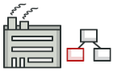
FACTORY METHOD PATTERN

Slide 58
Factory
Factory stands for a function, method or class that supposed to be producing something.
  They produce files, records in databases, etc.
Factory can be used to represent any one of the following:
  a function or method that creates Object
  A Static method that calls a class constructor in a certain way
  One of the creational design patterns.

Slide 59

SINGLETON PATTERN

Slide 60
Singleton
Intent
  A pattern which ensure that a class has only one instance and provide a global access point to this instance.
Problem
Ensures that a class has only a single instance.
  The most common reason for this is to control some shared resource, for example, database.
Provides global access point to that instance.

Slide 61
Solution
All singleton implementations share two common steps:
  Making the default constructor private.
  Creating a static creation method that will act as a constructor.
Singleton keeps the single instance production code in one place—inside the creation method of a Singleton class.
Any client code that has access to Singleton class gets the access to its creation method as well
  gives us a global access point to the Singleton instance

Slide 62
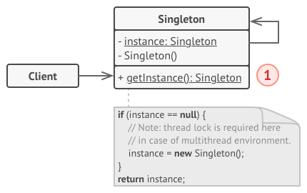

Slide 63
Singleton Pattern
Has Multiple Approach to implement
Use Cases
  Used for logging, driver objects, caching and thread pool.
  Used in other design patterns like Abstract Factory, Builder, Prototype, Facade etc.
  Singleton design pattern is used in core java classes
  java.lang.Runtime, java.awt.Desktop.
Common concept of different approaches of this Pattern
  private constructor to restrict instantiation from other classes.
  private static variable of the same class that is the only instance of the class.
  public static method that returns the instance of the class, this is the global access point for outer world

Slide 64
STRUCTURAL PATTERN

Slide 65
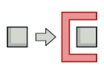
PROXY PATTERN

Slide 66
Proxy Pattern
  proxy pattern is used when we want to provide controlled access of a functionality.
used to represent a complex with a simpler one.
If creation of object is expensive, its creation can be postponed till the very need arises and till then, a simple object can represent it.
This simple object is called the “Proxy” for the complex object
The Proxy holds reference to the RealObject ,Clients interact with the realObject through the proxy .
Because both the proxy and RealObject implement the same interface .
The Proxy can be substituted where Subject can be requested

Slide 67
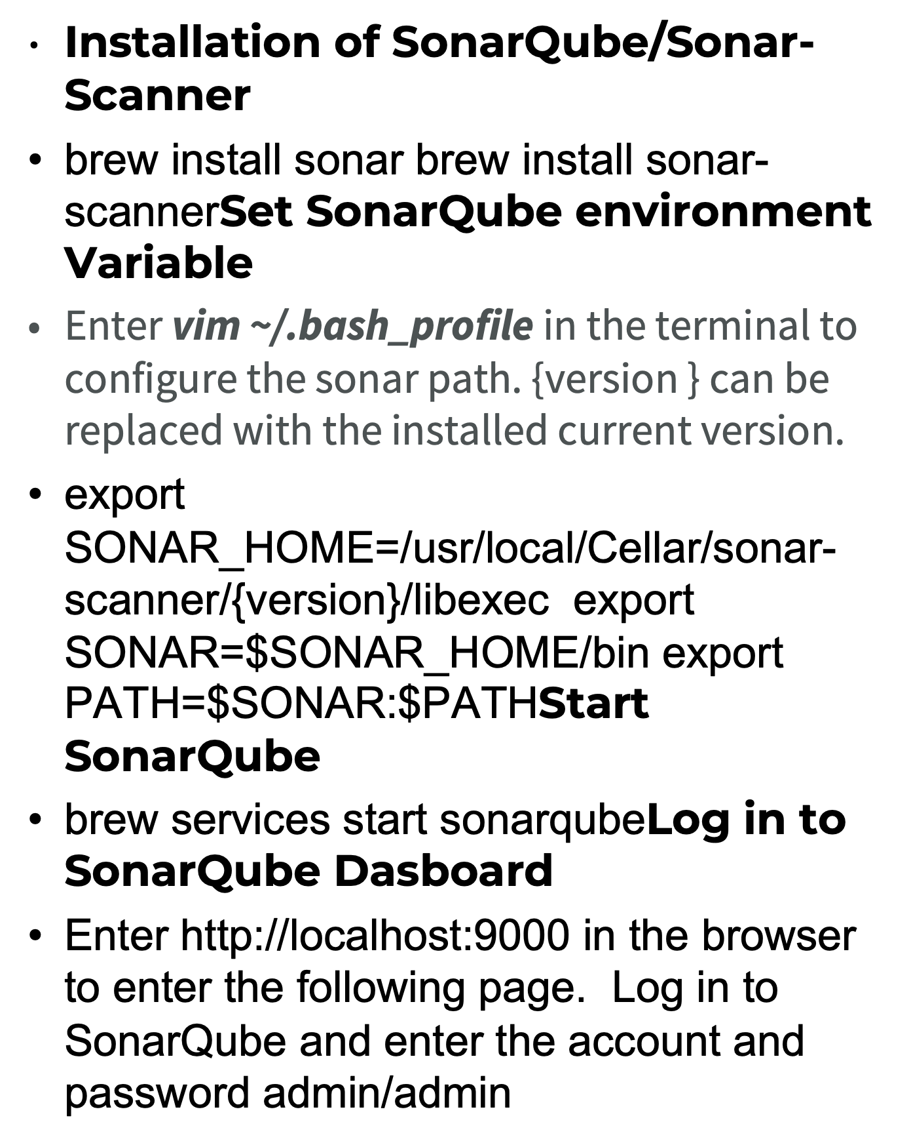

Slide 68
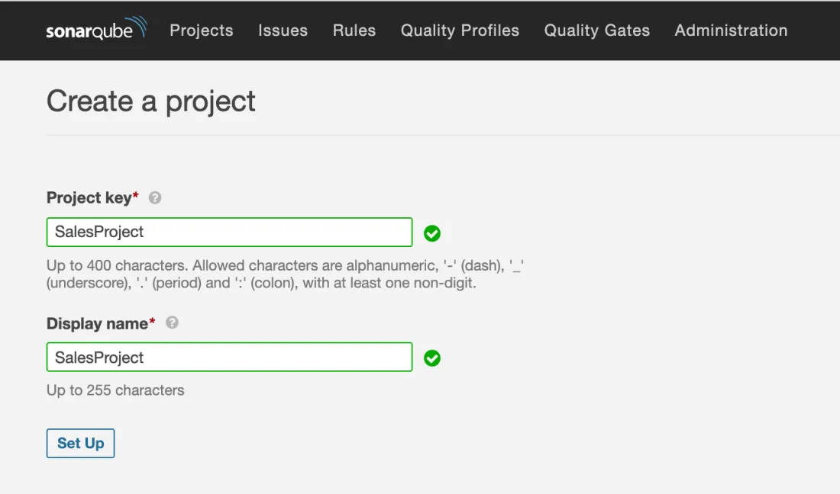

Slide 69
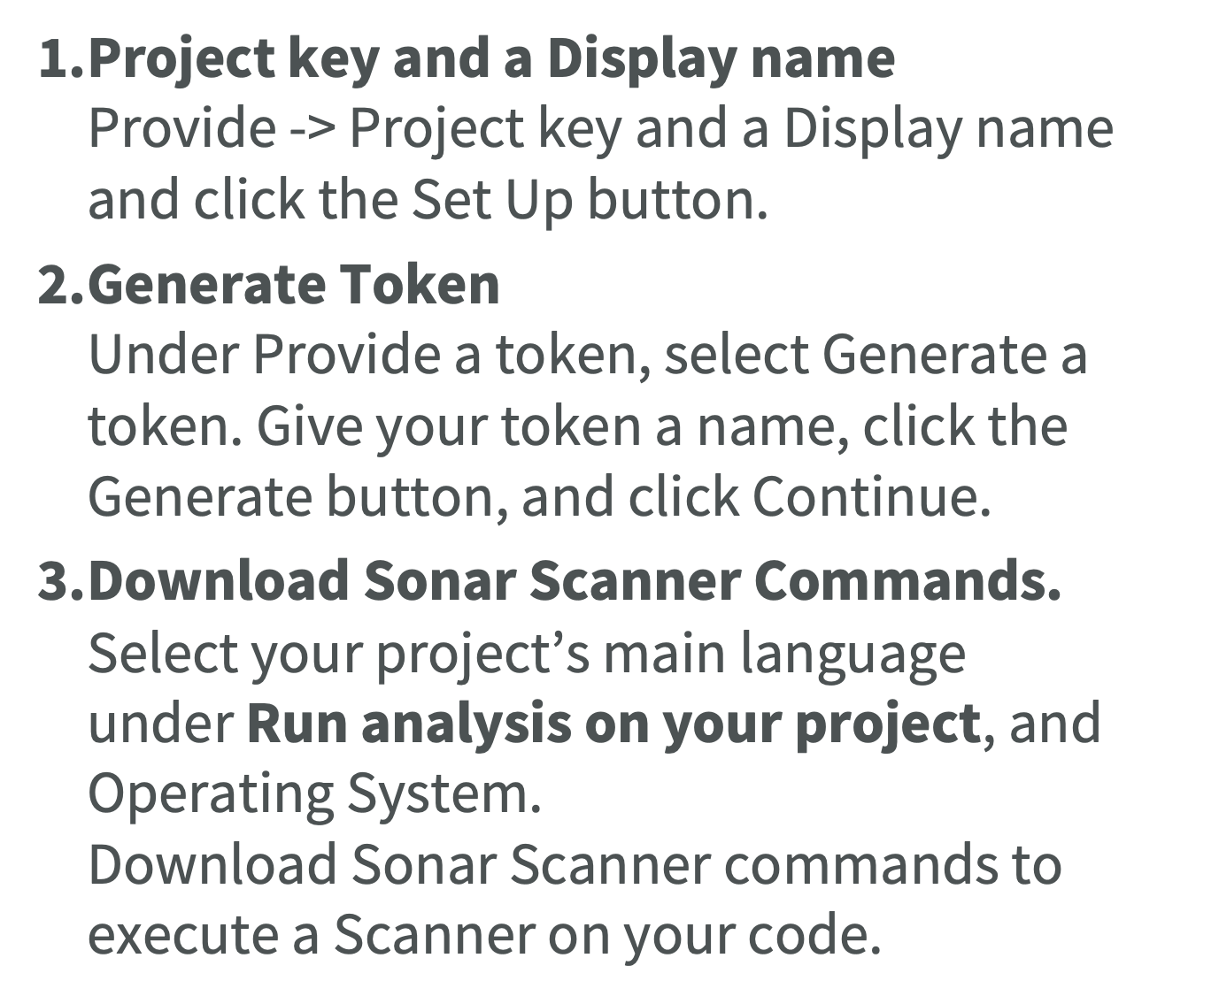

Slide 70
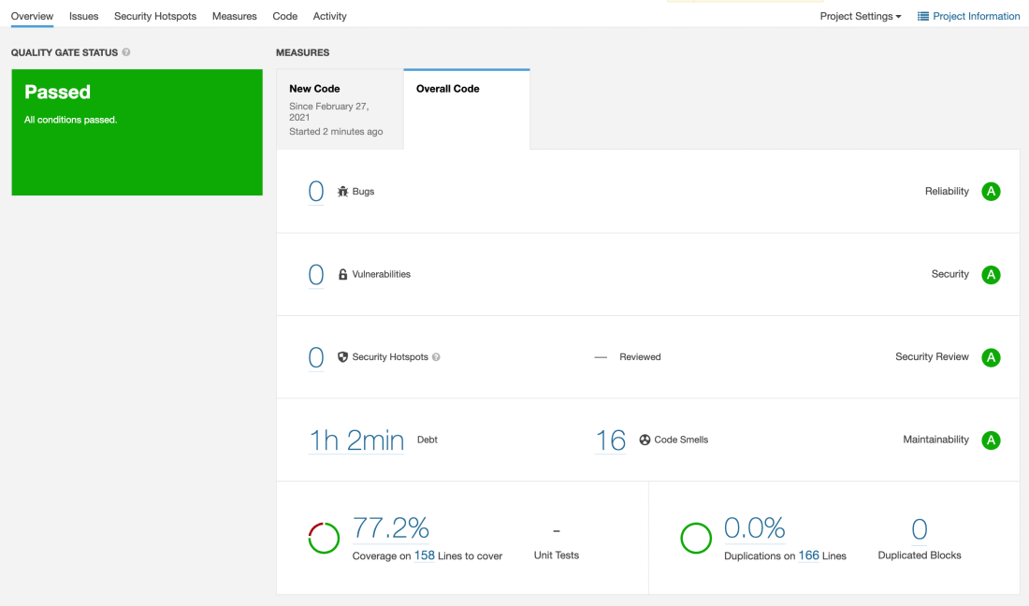

Slide 71

Installation of SonarQube/Sonar-Scanner
brew install sonar brew install sonar-scanner
Set SonarQube environment Variable
Enter vim ~/.bash_profile in the terminal to configure the sonar path. {version } can be replaced with the installed current version.
export SONAR_HOME=/usr/local/Cellar/sonar-scanner/{version}/libexec export SONAR=$SONAR_HOME/bin export PATH=$SONAR:$PATH
Start SonarQube
brew services start sonarqube
Log in to SonarQube Dasboard
Enter http://localhost:9000 in the browser to enter the following page. Log in to SonarQube and enter the account and password admin/admin
Create new project in SonarQube Dashboard
Create a new project.
Click -> Create a new project button.

Slide 72
Proxy Pattern
The participants classes in the proxy pattern are:
Subject
  Interface implemented by the RealSubject and representing its services.
  The interface must be implemented by the proxy as well so that the proxy can be used in any location where the RealSubject can be used.
Proxy
  Maintains a reference that allows the Proxy to access the RealSubject.
  Implements the same interface implemented by the RealSubject so that the Proxy can be substituted for the RealSubject.
  Controls access to the RealSubject and may be responsible for its creation and deletion.
  Other responsibilities depend on the kind of proxy.
RealSubject - the real object that the proxy represents.

Slide 73
BEHAVIORAL PATTERN

Slide 74
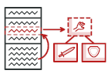
STRATEGY PATTERN

Slide 75
Strategy pattern
Intent
  Define a family of algorithms, encapsulate each one, and make them interchangeable.
  Strategy lets the algorithm vary independently from the clients that use it.
  Capture the abstraction in an interface, bury implementation details in derived classes
Also known as Policy Pattern.
Example :
Collections.sort() method that takes Comparator parameter.
Based on Comparators the Objects are getting sorted in different ways,

Slide 76
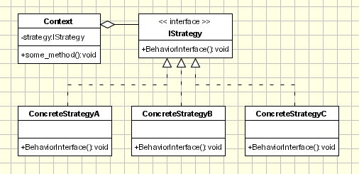
Strategy pattern

