Slide 1
HAMCREST

Slide 2
Hamcrest
Hamcrest is a framework for creating matcher objects.
An add-on of the Junit Framework.
Enables creating very specific, readable verification code.
Uses static methods to create an assertion grammar
  Easy to write and to understand.

Slide 3
Including Hamcrest
Add Hamcrest dependency to pom.xml
  <dependency>
  <groupId>org.hamcrest</groupId>
  <artifactId>hamcrest-library</artifactId>
  <version>2.2</version>
  <scope>test</scope>
  </dependency>

Slide 4
Matchers
Provides a library of static factory methods
  import static org.hamcrest.Matchers.*
These matcher classes can be used in test with JUnit.
assertThat
  A stylized sentence for making a test assertion.
  Base Method for assertions
  Takes value under test and the matcher predicate.
assertThat(valueUnderTest, matcher)
  assertThat(actual, equalTo(expected));

Slide 5
Is() Mather
is()
  Used to relay the result of its input matcher
assertThat(actual, is(equalTo(expected)));
  @Test
  public void test1 throws Exception {
  String myString = "hello";
  assertThat(myString, is(any(String.class)));
  }

Slide 6
Test Method
  import static org.hamcrest.Matchers.*;
  import static org.hamcrest.Matchers.hasItem;
  import static org.hamcrest.Matchers.instanceOf;
  import static org.hamcrest.Matchers.startsWith;
  import static org.hamcrest.Matchers.any;
  @Test
  @DisplayName("Test Using hamcrest Library")
  void test1() {
  double number =8;
  assertThat(number, is(greaterThan(50.0)));
  }

Slide 7
arrayContaining()
  @Test
  void test2() throws Exception {
  String[] strings = {"why", "hello", "there"};
  assertThat(strings, is(arrayContaining("why", "hello", "there")));
  }

Slide 8
hasEntry()
  @Test
  public void test3 () throws Exception {
  Integer testKey = 1;
  String testValue = "one";
  Map<Integer, String> testMap = new HashMap<>();
  testMap.put(testKey, testValue);
  assertThat(testMap, hasEntry(1, "one"));
  }

Slide 9
hasItem()
  @Test
  public void test4() throws Exception {
  List<Integer> testList = Arrays.asList(1,2,7,5,4,8);
  assertThat(testList, hasItem(4));
  assertThat(testList, hasItem(is(greaterThan(6))));
  }

Slide 10
hasKey()
  @Test
  public void test5() throws Exception {
  Map<String, String> testMap = new HashMap<>();
  testMap.put("hello", "there");
  testMap.put("how", "are you?");
  assertThat(testMap, hasKey("hello"));
  }

Slide 11
instanceOf()
  @Test
  public void test6() throws Exception {
  Object string = "Hello, World!";
  assertThat(string, instanceOf(String.class));
  }

Slide 12
hasProperty()
  @Test
  public void test7 () throws Exception {
  Book testBean = new Book ();
  testBean.setBookName(“Head First Java");
  assertThat(testBean, hasProperty(“bookName"));
  }

Slide 13
Popular Matchers
is - decorator to improve readability
not - matches if the wrapped matcher doesn’t match and vice versa
equalTo - test object equality using Object.equals
hasToString - test Object.toString
instanceOf, isCompatibleType - test type
notNullValue, nullValue - test for null
hasProperty - test JavaBeans properties

Slide 14
Popular Matchers
hasEntry, hasKey, hasValue - test a map contains an entry, key or value
hasItem, hasItems - test a collection contains elements
hasItemInArray - test an array contains an element
greaterThan, greaterThanOrEqualTo, lessThan, lessThanOrEqualTo - test ordering
equalToIgnoringCase - test string equality ignoring case
containsString, endsWith, startsWith - test string matching

Slide 15
SURE FIRE TEST REPORT

Slide 16
Configuring Reports
Maven has several reports that can be created to display the current state of the project.
These reports take the form of plugin goals
Can Create an HTML report for execution results of JUnit tests.
  Need to add latest version of maven-surefire-report-plugin into reporting section of pom.xml.

Slide 17
Sure Fire Test Report
  <reporting>
  <plugins>
  <plugin>
  <groupId>org.apache.maven.plugins</groupId>
  <artifactId>maven-surefire-report-plugin</artifactId>
  <version>3.0.0-M5</version>
  </plugin>
  </plugins>
  </reporting>

Slide 18
Creating Report
Need to run the JUnit tests with Surefire plugin
  It will generate the reports in plain-text and XML formats.
Generated files be placed into the following folder
  target/surefire-reports/TEST-*.xml
mvn site
  When mvn site is invoked, the report will automatically be included in the Project
mvn surefire-report:report
  Used to generate the standalone report
  HTML report generated
  Location and Name : /target/site/surefire-report.html.

Slide 19
Customizing the Report
  <plugin>
  <groupId>org.apache.maven.plugins</groupId>
  <artifactId>maven-surefire-report-plugin</artifactId>
  <version>2.22.2</version>
  <configuration>
  <outputName>Payment Service -JUnit--Report</outputName>
  </configuration>
  </plugin>
  Show only Failed Tests
  <configuration>
  <showSuccess>false</showSuccess>
  </configuration>

Slide 20
TESTING WITH DEPENDENCIES

Slide 21
Unit testing dependencies.
Unit tests check on the behavior of units.
Most of the classes must rely on dependencies to perform their tasks.
Tests for such classes should not use its real dependencies because if the dependencies have defects, the tests fail
  Even though the code inside the class may be perfectly fine.
Tests for such classes also may not have those dependencies available
  While doing unit test these dependency must be set up in the test

Slide 22
Test Doubles
Need to replace a production object for testing purpose
Test double is an object which is used in place of a real object during a test.
  public void testableMethod (Object a, Object b) {
  // does something that needs to be tested
  }
Testing Unit with dependencies
  Dummy
  Fakes
  Stubs
  Mocks

Slide 23
Need for Test Doubles
Help keep design decoupled
Check code’s usage of another object
Defer having to write a class
Test components in isolation from the rest of the system
Promote interface-based design

Slide 24
Types of Test Doubles
Dummy
  Used as an object to stand in place of a real object
  It will not have any business logic
  Its usually fill the parameter list, so that the code compiles
Fake
  These will have a complete working implementation in them.
  But the implementation is shortcut to help of unit testing
  These code cannot be used in production.
    Using In-memory database object not the real database object in production.

Slide 25
Types of Test Doubles
Stubs
  Stub object provides predefined answer to method executions made during the test
  The Behavior is hardcoded programmatically for a particular test
  Instead of calling external service , stub is called and it returns an expected response
Mocks
  Objects used for verification by checking whether methods were called on the object, with specific parameters.
  Mocks record method calls on it and verifies later that the recorded call match
  The assert and behavior verification is done at mock object

Slide 26
MOCKITO FRAMEWORK

Slide 27
Mocks
Mockito a popular Mocking framework in Java used in conjunction with JUnit.
  simplified way to create and configure mock objects
Can Mock away external dependencies and insert the mocks into the code under test
Mockito offers two equivalent ways of mocking:
  Using static methods
  Using annotations.

Slide 28
Mockito mock()
Used to create mock objects of a given class or interface.
The method is overloaded with different arguments.
<T> mock(Class<T> classToMock)
  Used to create mock objects of a concrete class or an interface.
  It takes a class or an interface name as a parameter.

Slide 29
Mockito when()
Used for stubbing methods
Used to mock and return specific values on method calls
<T> when(T methodCall)
  when(mock.someCode ()).thenReturn(5);

Slide 30
Fake Test Double with Mockito
    @Test
    void testFakeWithMockito() {
    InvoiceRepository repo = Mockito.mock(InvoiceRepository.class);
    InvoiceService service = new InvoiceService(repo);
    Invoice inv1 = new Invoice(901, "tom", 4848);
    Invoice inv2=new Invoice(902, "jerry", 5600);
    List<Invoice> list = new ArrayList<>();
    list.add(inv2);
    list.add(inv1);
    Mockito.when(repo.findAll()).thenReturn(list);
    assertEquals(2, service.findInvoiceCount());
  }

Slide 31
Stubbing With Mockito
  @Test
  public void testWithStub()
  {
  LinkedList mockedList = mock(LinkedList.class);
  //stubbing
  when(mockedList.get(0)).thenReturn("first");
  when(mockedList.get(1)).thenThrow(new RuntimeException());
  }

Slide 32
Verify
Mockito keeps track of all the method calls and their parameters to the mock object.
verify()
  method is used to check whether some specified methods are called or not.
  Can verify that a method has been called with certain parameters.
  validates the certain behavior happened in a test.
  Behavior testing does not check the result of a method call, but it checks that a method is called with the right parameters.

Slide 33
Verify Method
  @Test
  void testPrintAddition() {
  PrintInfo example = Mockito.mock(PrintInfo.class);
  example.printAddition(1, 2);
  Mockito.verify(example, times(1))
  .printAddition(1 , 2);
  }

Slide 34
Mock with Annotations
  public class TestWithMockitoAnnotation {
  @Mock
  InvoiceRepository repoMock;
  @InjectMocks
  InvoiceService service ;
  @Before
  public void setUp() {
  MockitoAnnotations.initMocks(this);
  }

Slide 35
Mock with Annotations
  @Test
  @DisplayName("This method verifies with Mockito Framework")
  public void testIvoiceAdd() {
  Invoice inv1 = new Invoice(201,"Naveen", 6000);
  Invoice inv2 = new Invoice(202,"Vignesh", 6000);
  service.addInvoice(inv1);
  Mockito.verify(repoMock, Mockito.times(1)).add(inv1);
  service.addInvoice(inv2);
  Mockito.verify(repoMock, Mockito.times(1)).add(inv2);
  }
  }

Slide 36
Invoice Class
  @Data
  @NoArgsConstructor
  @AllArgsConstructor
  @FieldDefaults(level = AccessLevel.PRIVATE)
  public class Invoice {
  int invoiceNumber;
  String customerName;
  double amount;
  }

Slide 37
Invoice Repository
  public interface InvoiceRepository {
  void add(Invoice invoice);
  }

Slide 38
Invoice Repository
  public class InvoiceService {
  private InvoiceRepository repo;
  public InvoiceService(InvoiceRepository repo) {
  super();
  this.repo = repo;
  }
  public void addInvoice(Invoice inv) {
  if(inv.getAmount() >5000)
  {
  repo.add(inv);
  }
  }
  }

Slide 39
Mocking
MockMVC
  Part of Spring MVC test framework
  Used for testing the controllers explicitly starting a Servlet container.
  Simulates HTTP requests and responses.
SpringBootTest
  Loads the Spring context for testing.

Slide 40
Mock Bean
@MockBean
  Creates a mock of the annotated class and injects it into the controller
  Used for Observing the behaviour with a real Spring Application
@Mock
  Creates a mock implementation for the class it is annotated with.
@InjectMocks
  Ceates the mock implementation of annotated type and injects the dependent mocks into it.
@WebMvcTest
  Disables full auto-configuration
  Applies only configuration relevant to MVC tests.
  Auto-configure MockMvc instance as well.

Slide 41
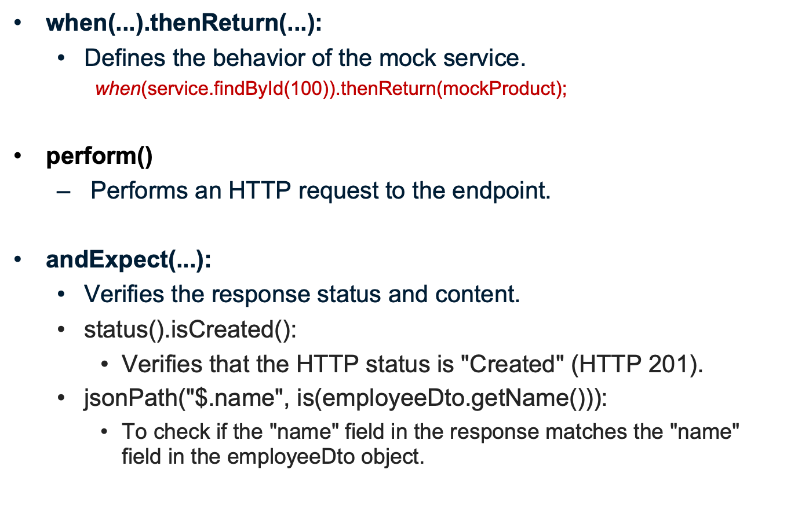
Result Matching

Slide 42
Behavior-driven development
Given-When-Then
Commonly used structure for writing user stories and acceptance criteria in BDD
Describes the desired behavior of a system in a clear, concise, and consistent manner.
  Given:
    Describes the initial state or context of the system.
    It sets the scene for the scenario being tested.
  When:
    Describes the action or event that occurs.
    Trigger for the scenario being tested.
  Then:
    Describes the expected outcome or result of the scenario.
    Acceptance criteria for the scenario being tested.
Example
  Given a user is on the login page
  When the user enters their username and password and clicks the login button
  Then the user should be directed to the home page.

Slide 43
BDD-Rest API
given()
  Specify request headers, body, cookies, and authentication.
when()
  Specify the HTTP method of the request.
then()
  Response to be validated.
    //given
    given(service.remove(productId)).willReturn(true);
    //when
    ResultActions response = mockMvc.perform(delete("/api/v1/products/{id}", productId));
    //then
    response.andExpect(status().isOk())

Slide 44
TESTING REST CONTROLLER

Slide 45
Service
  @Service
  public class GreetService {
  public String message() {
  return "Thanks visit Again";
  }
  }

Slide 46
Controller
  @RestController
  public class GreetController {
  @Autowired
  private GreetService service;
  @GetMapping("/hello")
  public String getMessage() {
  return "Hello World";
  }
  @GetMapping("/thanks")
  public String thanksNote() {
  return this.service.message();
  }
  }

Slide 47
Test Case
  @SpringBootTest
  public class TestGreetController {
  @Autowired
  private MockMvc mockMvc;
  @Mock
  private GreetService service;
  @InjectMocks
  private GreetController controller;

Slide 48
Test Case - 1
  @Test
  void testGet Message() throws Exception {
  mockMvc.perform(get("/hello"))
  .andExpect(status().isOk())
  .andExpect(content().string("Hello World"));
  }

Slide 49
Test Case - 2
  @Test
  void testThanksMessage() throws Exception {
  mockMvc.perform(get("/thanks"))
  .andExpect(status().isOk())
  .andExpect(content().string("Thanks visit Again"));
  }
  }

Slide 50
Testing Service
  @SpringBootTest
  @TestInstance(TestInstance.Lifecycle.PER_CLASS)
  public class TestBlooddonorService {
  @Autowired
  BloodDonorService service;
  @BeforeAll
  void setUp() {
  BloodDonor donor = new BloodDonor();
  donor.setFirstName("Raj");
  donor.setBloodGroup("bpos");
  donor.setDateLastDonated(LocalDate.now());
  donor.setMobileNumber(9444);
  service.add(donor);
  }

Slide 51
Test Cases
  @Test
  void testFindAll() {
  Assertions.assertFalse(service.findAll().isEmpty());
  }
  @Test
  void testFindById() {
  BloodDonor BloodDonor = service.findById(9444L).orElseThrow(EntityNotFoundException::new);
  Assertions.assertEquals("Raj", BloodDonor.getFirstName());
  }

Slide 52
Test Cases
  @Test
  void testUpdateBloodDonor() {
  BloodDonor donor = service.findById(9444L).orElseThrow(EntityNotFoundException::new);
  donor.setFirstName("Rajnath");
  BloodDonor updatedBloodDonor = service.update(donor);
  Assertions.assertEquals("Rajnath",
  updatedBloodDonor.getFirstName());
  }
  @AfterAll
  void tearDown() {
  service.delete(9444L);
  }
}

Slide 53
Imports
import static org.springframework.test.web.servlet.result.MockMvcResultMatchers.*;
import static org.springframework.test.web.servlet.request.MockMvcRequestBuilders.get;
import org.springframework.test.web.servlet.MockMvc;
import org.springframework.test.web.servlet.setup.MockMvcBuilders;
import static org.mockito.BDDMockito.*;

Slide 54
Rest Controller JSON- Testing with Mocks
  @SpringBootTest
  @AutoConfigureMockMvc
  class RestaurantInfoServiceApplicationTests {
  @Autowired
  MockMvc mockMvc;
  @Autowired
  ObjectMapper mapper;
  @MockBean
  RestaurantService service;

Slide 55
Test Data
  Restaurant RECORD1 = new Restaurant(101,"Kamat Hotel","chennai","veg",4.5);
  Restaurant RECORD2 = new Restaurant(102,"krishna Hotel","pune","veg",4.5);
  Restaurant RECORD3 =
  new Restaurant(103,"Kamat Residency","goa","veg",4.5);
    @Test
    public void getRestaurant_success() throws Exception {
    given(service.findById(RECORD_1.getId())).willReturn(java.util.Optional.of(RECORD_1));
    mockMvc.perform(MockMvcRequestBuilders
    .get("/restaurants/101")
    .contentType(MediaType.APPLICATION_JSON))
    .andExpect(status().isOk())
    .andExpect(jsonPath("$", notNullValue()))
    .andExpect(jsonPath("$.restaurantName", is("Kamat Hotel")));
    }

Slide 56
Test - 1
    @Test
void getAllRecords_success() throws Exception { List<Restaurant> records = new ArrayList<>(Arrays.asList(RECORD_1, RECORD_2, RECORD_3));
    given(service.findAll()).willReturn(records);
    mockMvc.perform(MockMvcRequestBuilders
    .get("/restaurants")
    .contentType(MediaType.APPLICATION_JSON))
    .andExpect(status().isOk())
    .andExpect(jsonPath("$", hasSize(3)))
    .andExpect(jsonPath("$[2].restaurantName", is("Kamat Hotel")));
    }

