Slide 1
Day -2 -Topics
Inheritance
Composition
Final Keyword
Interfaces
Abstract classes
Polymorphism
Exception Handling

Slide 2
INHERITANCE

Slide 3
Overview
A class can inherit from another class
Original class is the “superclass”
New class is called the “subclass”
Inheritance is a fundamental OO concept
Superclass
Car
Subclasses
SportsCar
Taxi
PoliceCar

Slide 4
Example of Inheritance
The Car class defines certain methods and variables
Taxi extends Car, and can:
Add new variables
Add new methods
Override methods of the Car class
Car
Taxi

Slide 5
Specifying Inheritance in Java
Inheritance is achieved by specifying which superclass the subclass “extends”
Taxi inherits all the variables and methods of Car
public class Car {
…
}
public class Taxi extends Car {
…
}

Slide 6
What Does an Object Look Like?
A subclass inherits all the instance variables of its superclass
Car object
public class Car {
String regNum;
int engineSize; …
}
regNum
engineSize
Taxi object
public class Taxi extends Car {
private int cabNum; …
}
regNum
engineSize
cabNum

Slide 7
Default Initialization
What happens when a subclass object is created?
If no constructors are defined:
No-arg constructor is called in superclass
No-arg constructor called in subclass
Taxi object
regNum
engineSize
Taxi taxi1 = new Taxi();
cabNum

Slide 8
Nondefault Initialization
Specific initialization can be performed as follows:
public class Car {
Car(String r, int e) {
regNum = r;
engineSize = e;
} …
public class Taxi extends Car {
Taxi(String r, int e, int c) {
super(r, e);
cabNum = c;
} …
Use super() to call superclass constructor

Slide 9
Specifying Additional Methods
The superclass defines methods that are applicable for all kinds of Car
The subclass can specify additional methods that are specific to Taxis
public class Car {
public int getReg()…
public void changeOwner()…
…
public class Taxi extends Car {
public void renewCabLicense()…
public boolean isBooked()…
…

Slide 10
Overriding Superclass Methods
A subclass inherits all the methods of its superclass
The subclass can override a method with a specialized version, if it needs to:
public class Car {
public String details() {
return "Reg:" + getReg();
}
public class Taxi extends Car {
public String details() {
return "Reg:" + getReg() + cabNum;
}

Slide 11
Overriding
When a sub-class defines a
“method with same method name, argument types, argument order and return type as a method in its super class, its called method overriding. “
Methods declared as final, static and private cannot be overridden.
An overriding method can be declared as final
The method can’t be less accessible
Public => only public
Protected => Both Public and Protected
Default => default, public and protected

Slide 12
Overriding with Compatible Return type
Arguments must be same and return type must be compatible
class Base
{
private int i = 5;
public Number getNumber()
{
return i;
}
}
class Derived extends Base
{
@Override
public Integer getNumber()
{
return new Integer(10);
}
}

Slide 13
Invoking Superclass Methods
If a subclass overrides a method, it can still call the original superclass method
Use super.method()to call a superclass method from the subclass
Though keyword super is used to refer super class, method call super.super.method() is invalid.
public class Car {
public String details() {
return "Reg:" + getReg();
}
public class Taxi extends Car {
public String details() {
return super.details() + cabNum;
}

Slide 14
super keyword
The keyword super refers to the base class
super( )
invokes the base class constructor
base class constructors are automatically invoked
super.method( )
invokes the specified method in the base class
super.variable
to access the specified variable in the base class
super must be the first statement in a constructor

Slide 15
Abstract Class
An abstract class is a shared superclass
Provides a high-level partial implementation of some concept
Cannot be instantiated
Use the abstract keyword to declare a class as abstract
Vehicle
Vehicle
Abstract superclass
Concrete subclasses
Car
Car
Truck

Slide 16
Defining Abstract Classes in Java
Use the abstract keyword to declare a method as abstract
Only provide the method signature
Class must also be abstract
Must be implemented by a concrete subclass
Each concrete subclass can implement the method differently
public abstract class Vehicle {
private String regNum;
public String getRegNum()…
public abstract boolean isRoadWorthy();
}
public class Car
extends Vehicle{
private int numSeats;
public void fitRack()…
public class Truck
extends Vehicle{
private int axles;
public void setLoad()…

Slide 17
Interfaces & Polymorphism

Slide 18
Interfaces
An interface is like a fully abstract class
All of its methods are public and abstract
No instance variables if present they are public static final
An interface defines a set of methods that other classes can implement
A class can implement many interfaces, but can extend only one class
Can extend other interfaces and extend multiple interfaces
Extends another sub interface inherits everything from super interface

Slide 19
Interface
Interfaces define types in an abstract form
An interface declaration allows the specification of a reference type without providing an implementation
The class that implements the interface decides how to implement
Interfaces describe an aspect of behavior that different classes can support
For example, any class that supports the “Steerable” interface can be steered:
Not Steerable

Slide 20
Defining an Interface in Java
Use interface keyword instead of class
package com.training.ifaces;
public interface Converter {
public double convert();
}

Slide 21
Implementing an Interface
public interface Steerable {
int maxTurn = 135;
void turnLeft(int deg);
void turnRight(int deg);
}
public class Car
extends Vehicle
implements Steerable {
public void turnLeft(int deg)
{…}
public void turnRight(int deg)
{…}

Slide 22
Partial Implementation of an Interface
Declare the class as abstract if the class does not implement all the methods of an interface
Implement the methods in the sub class level
Public abstract class Car
extends Vehicle
implements Steerable {
public void turnLeft(int deg)
{…}
}

Slide 23
Extending an Interface
One Interface can extend another Interface
public interface Steerable {
int maxTurn = 135;
void turnLeft(int deg);
void turnRight(int deg);
}
public interface Navigator
extends Steerable {
void calcSpeed(int distance);
}

Slide 24
Polymorphism
This OO Principle allows the programmer to program abstractly
Objects of a subclass can be treated as objects of its superclass
The base class of a hierarchy is usually an abstract class or an Interface
They define the common behavior (functionality)
Classes and Subclasses inherit this behavior and extend it according to their own properties by overriding the methods of the super class
Subclass objects can be treated as super class objects through references,
But, super class objects are not subclass objects

Slide 25
Polymorphism
Allows for hierarchies to be highly extensible
New classes can be introduced and can still be processed without changing other parts of the program
Same method can do different things, depending on the class that implements it.
Method invoked is associated with OBJECT and not with reference.
Types of Polymorphism -
Method Overloading.
Method Overriding.

Slide 26
Substitution of Object References in Method Calls
A subclass object can be passed into any method that expects a superclass object
The method that got invoked, is the version that's present in the object type and NOT the reference type.
public static void main(String[] args) {
Taxi t = new Taxi("ABC123", 2000, 79);
displayDetails(t);
public static void displayDetails(Car c) {
System.out.println(c.details());
}
Notes:
The same object reference (that is, an object reference of the same reference type) is capable of behaving differently at runtime, depending on the object that it points to.

Slide 27
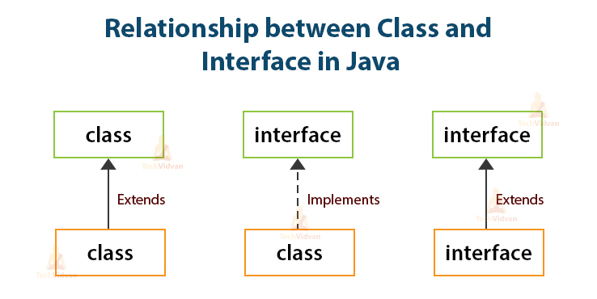

Slide 28
Exception handling

Slide 29
Exception Handling
java.lang.Object
java.lang.Throwable
java.lang.Error
java.lang.Exception
java.io.IOException
java.lang.RuntimeException
Notes:
The class Object is the root of the class hierarchy. Every class has Object as a superclass. All objects, including arrays, implement the methods of this class.
The Throwable class is the superclass of all errors and exceptions in the Java language. Only objects that are instances of this class (or of one of its subclasses) are thrown by the Java Virtual Machine or can be thrown by the Java throw statement. Similarly, only this class or one of its subclasses can be the argument type in a catch clause.
An Error is a subclass of Throwable that indicates serious problems that a reasonable application should not try to catch. Most such errors are abnormal conditions. The ThreadDeath error, though a "normal" condition, is also a subclass of Error because most applications should not try to catch it.
The class Exception and its subclasses are a form of Throwable that indicates conditions that a reasonable application might want to catch.
RuntimeException is the superclass of those exceptions that can be thrown during the normal operation of the Java Virtual Machine. A method is not required to declare in its throws clause any subclasses of RuntimeException that might be thrown during the execution of the method but not caught.
IOException signals that an I/O exception of some sort has occurred. This class is the general class of exceptions produced by failed or interrupted I/O operations.

Slide 30
Handle or Declare Rule
Handle the exception by using the try-catch-finally block.
try{
// some code
} catch(Exception e){
}
Declare that the code causes an exception by using the throws clause.
void trouble() throws IOException { ... }
void trouble() throws IOException, MyException { ... }
Other Principles
You do not need to declare runtime exceptions or errors.
You can choose to handle runtime exceptions

Slide 31
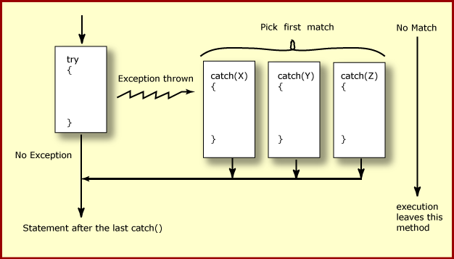
How try catch Work

Slide 32
Effective Exception Hierarchy
The exception classes are arranged in a hierarchy.
Catches for specific exceptions should always be written prior to the generic handler.
A generic handler for Exception would cover any missing situation.
try
{
}
catch (NumberFormatException e) {
}
catch (Exception ex2) {
}
try
{
}
catch (Exception e1) {
}
catch(NumberFormatException e2) {
}

Slide 33
Multiple Catch
try {
Object value = "twenty";
Integer number = (Integer) value;
String mark ="50";
Integer.parseInt(mark);
}
catch ( ClassCastException| NumberFormatException ex ) {
ex.printStackTrace();
}

Slide 34
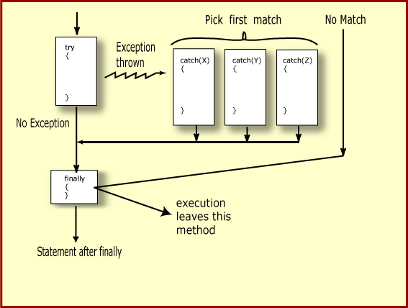
Finally Block

Slide 35
The try-with-resources Statement
A try statement that declares one or more resources.
A resource is an object that must be closed after the program is finished with it.
Ensures the resource is closed at the end of the statement.
Any object that implements java.lang.AutoCloseable, and java.io.Closeable, can be used as a resource.

Slide 36
The try-with-resources Statement
System.out.print("Enter an integer: ");
try(Scanner scan = new Scanner( System.in )) {
int num = scan.nextInt();
System.out.println("square" + num + "is" + num*num );
}
catch ( InputMismatchException ex ) {
System.err.println("You entered bad data." );
System.err.println("Run the program again." );
}
System.out.println("Good-bye" );
}

Slide 37
Re-throw Exception
Exception of the Catch Parameter type is the one that is rethrown
To intercept all exceptions and rethrow them
Can catch with super class Exception
Declare method as throwing an Exception.
"imprecise rethrow“
Throwing a general Exception type (instead of specific ones)

Slide 38
Re-Throw Exception
Can be more precise about the exception types being rethrown from a method.
Available from Java 7
This leads to improved checking for rethrown exceptions.
Can handle them a lot better at the calling side

Slide 39
Re-throw Exceptions
public static void myExample() throws ParseException,IOException {
try {
new SimpleDateFormat("yyyyMMdd").parse("date"); // Parse Exception
new FileReader("Abc.txt").read(); // IOException
} catch (Exception e) { //Generic Exception
throw e;
}
}

Slide 40
Method Overriding and Exceptions
The overriding method can throw:
No exceptions
One or more of the exceptions thrown by the overridden method
One or more subclasses of the exceptions thrown by the overridden method
The overriding method cannot throw:
Additional exceptions not thrown by the overridden method
Superclasses of the exceptions thrown by the overridden method

Slide 41
Overriding –When Method Has Exceptions
Any exceptions declared in overriding method must be of the same type as those thrown by the super class, or a subclass of that type.
class MyBase {
public void method1() throws Exception
{ }
public void method2() throws RuntimeException
{ }
}
class Sub extends MyBase
{
public void method1() throws Throwable {
}
public void method2() throws ArithmeticException {
}
}
This is compile Time Exception
This is Allowed

Slide 42
User Defined Exception
User Defined Exception must be a child of Throwable.
extend the Exception class
To create a checked exception that is automatically enforced by the Handle or Declare Rule
extend the RuntimeException class.
To create a runtime exception

