Slide 1
Web Component Development - Servlet

Slide 2

K.Srivatsan - vatsank@gmail.com
IT Trainer Since 1991
Conducting Java Training Since 2004
About 60+ Corporate Clients

Slide 3
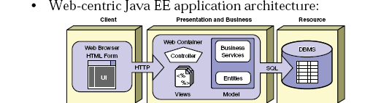
Role of Web Component JEE

Slide 4
Servlets
Java technology for serving HTTP requests.
Used for serving HTTP requests
Basic servlet functionalities implemented by the basic HTTP servlet classes have the features for accessing HTTP request data and managing cookies and sessions.
User interface or representation part is done with other technolgies.

Slide 5
Servlets Features
All server side frameworks share a common set of features:
  Read data submitted by the user
  Generate HTML dynamically based on user input
  Determine information about the client browser
  Access Database systems
  Exploit the HTTP protocol

Slide 6
Idea of Web Application
  Servlets, JSP pages, HTML files, utility classes, beans, tag libraries, etc. are bundled together in a single directory hierarchy or file
Access to content in the Web app is always through a URL that has a common prefix
  – http://host/webAppPrefix/abc
  Many aspects of Web application behavior controlled through deployment descriptor- web.xml

Slide 7
APPLICATION SERVER
A server computer on a computer network dedicated to running certain software applications
A software engine that delivers applications to client computers.
Should handle most, if not all, of the business logic and data access of the application.
Ease of application development and centralization.
Ex: Weblogic Server, WebSphere, JBOSS

Slide 8
Client calls a program
server returns the Response
Client
(Browser)
App
server
WEB
server
html
dB

Slide 9
Java Servlets
Released in 1997 , used to Create web pages with dynamic content
Standard, server-side Java application that extends the capabilities of a Web Server.
Mapped to URLs and Deployed in a Web container of an application server which provides a runtime environment for servlets.
Executed when the J2EE application server receives a client request that is passed to the Web container, which in turn invokes the servlet.
Platform and server independent

Slide 10
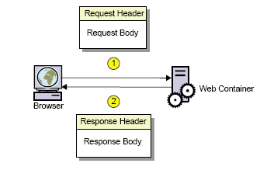
Request and Response

Slide 11
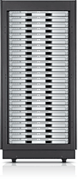

Web Apps with Servlets
GET …
Servlet
doGet()
…
…
HEADERS
BODY
Web Container

Slide 12
The Key Players
WebServer
  Gets the Response from the container
  Uses HTTP to talk to the Client Browser
  Knows how to forward to container
Container
  Find the Correct Servlet Using URL in DD
  Manages life cycle of the servlets
  Creates request and response objects just before starting the thread
  Starts a Servlet Thread and gives that to the Servlet
  Call the Service() Method and then doGet or doPost()
  Destroys the Request,Response Objects
Servlet
  Has a public class name
  Uses request Object to read the parameter from the user
  Dynamic content for the Client
  Uses response object to print a response

Slide 13
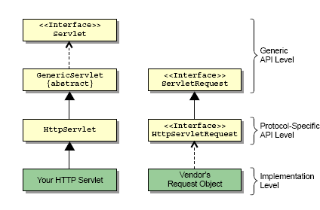
Servlet API

Slide 14
Servlet Interface
  All servlets implement Servlet interface either directly or more commonly, by extending a class that implements it such as HttpServlet
  The Servlet interface declares, methods that manage the servlet and its communications with clients.
  Servlet writers provide some or all of these methods when developing a servlet.

Slide 15
Steps for Java Servlets
Subclass of HttpServlet
2. Override doGet(....) method
3. HttpServletRequest
  read the request parameters
4. HttpServletResponse
  set Content Type
  get PrintWriter
  send text to client via PrintWriter

Slide 16
Web Deployment Descriptor
/WEB-INF/web.xml
  Part of the standard
  Defines servlets used in the web application
  Maps servlets to URLs
  A servlet can map to many URLs
Defines resources available to the web app
Defines security constraints
Can Define following too
  Welcome file list
  Session timeout
  Error page mapping

Slide 17
Web.xml
  <?xml version="1.0" encoding="UTF-8"?>
  <web-app xmlns:xsi="http://www.w3.org/2001/XMLSchema-instance" xmlns="http://java.sun.com/xml/ns/javaee" xsi:schemaLocation="http://java.sun.com/xml/ns/javaee http://java.sun.com/xml/ns/javaee/web-app_2_5.xsd" id="WebApp_ID" version="2.5">
  <display-name>FirstWebApp</display-name>
  <servlet>
  <servlet-name>FirtstServlet</servlet-name>
  <display-name>FirtstServlet</display-name>
  <servlet-class>com.training.FirtstServlet</servlet-class>
  </servlet>
  <servlet-mapping>
  <servlet-name>FirtstServlet</servlet-name>
  <url-pattern>/first</url-pattern>
  </servlet-mapping>
  </web-app>

Slide 18
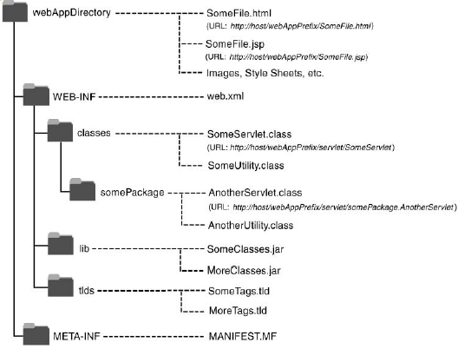
J2EE Web Directory Structure

Slide 19
Example -1
package com.training.servlet;
import java.io.IOException;
import javax.servlet.*;
import javax.servlet.http.*;
public class LibraryServlet extends HttpServlet {
private static final long serialVersionUID = 1L;
public LibraryServlet() {
super();
}
protected void doGet(HttpServletRequest request, HttpServletResponse response) throws ServletException, IOException {
RequestDispatcher dispatcher= request.getRequestDispatcher("/Welcome.jsp");
dispatcher.forward(request, response);
}
}

Slide 20
Inter-Servlet Communication
A process where two or more servlet communicates with each other to process the client request.
A servlet can forward the request to another servlet to process the client request.
A servlet can include the output of another servlet to process the client request.
Implemented using Request Dispatcher
Is an object of the javax.servlet.RequestDispatcher interface

Slide 21
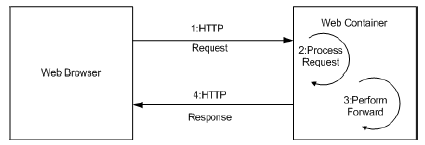
Using a Forward
With Forward the request is sent to another resource on the server, without informing the client that a different resource is going to process the request.
This process occurs completely within the web container

Slide 22
Welcome.jsp
<%@ page language="java" contentType="text/html; charset=ISO-8859-1 pageEncoding="ISO-8859-1"%>
<!DOCTYPE html PUBLIC "-//W3C//DTD HTML 4.01 Transitional//EN" "http://www.w3.org/TR/html4/loose.dtd">
  <html>
  <head>
  <meta http-equiv="Content-Type" content="text/html; charset=ISO-8859-1">
  <title>Nalanda Library</title>
  </head>
  <body>
  <h1>Nalanda Library</h1>
  </html>

Slide 23
ServletRequest interface
getParameter( )
Used to get the input from the request Object , Returns a String
getParameterValues( )
Used to get the input from the request Object , Returns a String Array
getParameterNames( )
Used to get the input from the Request Object ,Return an Enumeration

Slide 24
Using Request Parameter
  <form action="LibraryServlet" method="post">
  <label>Author Id</label>
  <input type="text" name="authorId" placeholder="Author Id to Search">
  <input type="submit" value="Search">
  </form>

Slide 25
Post Method
  protected void doPost(HttpServletRequest request, HttpServletResponse response) throws ServletException, IOException {
  String strAuthorId = request.getParameter("authorId");
  long authorId = Long.parseLong(strAuthorId);
  AuthorDao dao;
  Author author=null;
  try {
  dao = new AuthorDao();
  author =dao.findAuthor(authorId);
  } catch (Exception e) {
  e.printStackTrace();
  }
  }

Slide 26
Class Loaders
Tomcat load the application with separate ClassLoader hierarchies.
  This isolates all classes against other web applications
getContextClassLoader()
  returns the context ClassLoader of the Thread.
  It is provided by the creator of the thread
  Used by code running in the thread to loadi classes and resources.
  ClassLoader classLoader = Thread.currentThread().getContextClassLoader();
  InputStream input = classLoader.getResourceAsStream("DbConnection.properties");

Slide 27
Request Attributes –Request Dispatching
Stores data as attribute to the request object in the first servlet.
Forwards the request to the second servlet using the RequestDispatcher.
Retrieves the data from the request object and displays the result using the second servlet.
  request.setAttribute("foundAuthor", author);
  RequestDispatcher dispatcher= request.getRequestDispatcher("/ShowAuthor.jsp");
  dispatcher.forward(request, response);
The path is a String and can use relative addressing too.

Slide 28
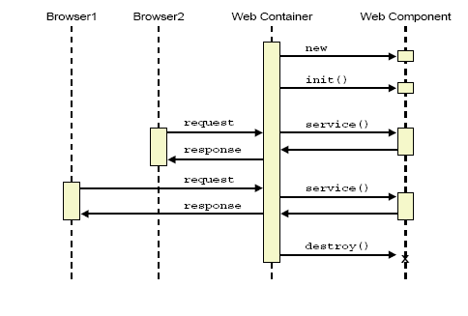
Life Cycle of a Servlet

Slide 29
The init() method
The init() method is called when the servlet is first requested by a browser request.
It is not called again for each request.
Used for one-time initialization.
The init() method is a good place to put any initialization variables

Slide 30
Service() Method
Each time the server receives a request for a servlet, the server spawns a new thread and calls the servlet’s service () method.
Browser
service()
Single Instance
of Servlet
Web Server
service()
Browser
service()
Browser

Slide 31
The Service Method
By default the service() method checks the HTTP Header.
Based on the header, service calls either doPost() or doGet().
doPost and doGet is where you put the majority of your code.
If your servlets needs to handle both get and post identically, have your doPost() method call doGet() or vice versa.

Slide 32
Death of a Servlet
Before a server shuts down, it will call the servlet’s destroy() method.
You can handle any servlet clean up here. For example:
  Updating log files.
  Closing database connections.
  Closing any socket connections.

Slide 33
Java Server Pages - JSP

Slide 34
Introduction to JSP Technology
JSP pages, by virtue of the separate placement of the static and dynamic content, facilitates both Web developers and the Web designer to work independently.
Facilitates the segregation of the work profiles of a Web designer and a Web developer.
  A Web designer can design and formulate the layout for a Web page by using HTML.
  A Web developer, working independently, can use Java code and other JSP specific tags to code the business logic.

Slide 35
JSP is also a Servlet
Jsp file is Written by the web page author
Jsp file is TRANSLATED to file.java by the container
File.java COMPILED to file.class container
File class is loaded by the container an initialized as Servlet
The container instantiates the servlet and cause the servlets is jspInit() method
The container creates a new thread to handle the clients request and the servlets _jspService() method runs

Slide 36
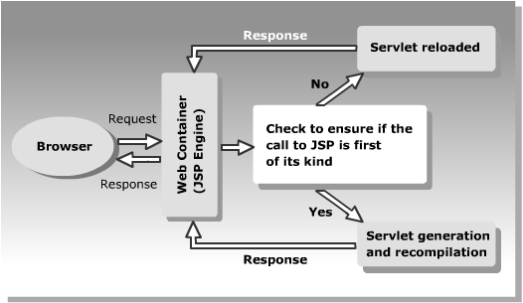
JSP Life Cycle

Slide 37
Jsp Scripting
Scriptlets
  Similar to code placed inside the service method
  <%
  out.println("Hello From Jsp Standard Scriptlet ");
  %>

Slide 38
Expressions & Declarations
  <%= code %>
Expressions begins with the JSP start tag followed by an equals sign
Does not end in a semicolon, unlike other Java Statements
Declarations
  <%! code %>
Used initialize variables and methods
Scriptlets, Expressions. Variables and methods created within Declaration elements are global

Slide 39
Declaration & Expression
  <html>
  <head>
  </head>
  <body>
  <%! public String showdata()
  {
  return "JSP Pages ";
  }
  %>
  <font size=2><b><%=showdata()%></b></font>
  <%! String str="welcome";
  int a=100;
  int b=a+200;
  %>
  The given string is <%=str%>
  The given integer is <%=a%>
  Computed integer is <%=b%>
  </body>
  </html>
Declaration
Expression

Slide 40
JSTL
Sun and JCP, initiated the JSP-Standard Tag Library (JSTL) project.
The tag libraries are very elegant and simple to use,
However non standard tags and there proliferation creates lot of confusion among the developers
JSTL was introduced in 2003, and now incorporated into JSP-2.
It helps in taking away Java code! From jsp page .
It also provide a standard implementation for typical application functionality
  Reusability
  Avoid reinventing the wheel

Slide 41
What Is the JSTL?
A collection of tag libraries implementing common JSP functionality
  Core functions
    Variables, I/O, conditionalization, iteration
  Formatting/I18n
    Message bundles, numbers, dates
  XML operations
    parsing, transformations
  Database operations
    SQL

Slide 42
Declaration of JSTL Tag Libraries
Core
  <%@ taglib prefix="c“ uri="http://java.sun.com/jsp/jstl/core" %>
XML
  <%@ taglib prefix="x" uri="http://java.sun.com/jsp/jstl/xml" %>
Internationalization (i18n)
  <%@ taglib prefix="fmt" uri="http://java.sun.com/jsp/jstl/fmt" %>
Database (SQL)
  <%@ taglib prefix="sql" uri="http://java.sun.com/jsp/jstl/sql" %>
Functions
  <%@ taglib prefix="fn" uri=http://java.sun.com/jsp/jstl/functions %>

Slide 43
JSTL Expression Language
Delimiters are “${” and “}”
The EL can only be used for specifying attribute values in JSTL tags
  <c:out value=”${firstName}”/>
Multiple expressions can be combined and mixed with static text (i.e., implicit string concatenation)
  <c:out value=”Hello ${firstName} ${lastName}!”/>

Slide 44
EL Identifiers
Identifiers are resolved against the four JSP scopes
  Using PageContext.findAttribute(name)
  Scopes are searched sequentially: page, request, session, application
Reserved identifiers for the 11 JSTL implicit objects:
  pageContext,
  pageScope,
  requestScope,
  sessionScope,
  applicationScope
  Param
  paramValues
  header
  headerValues
  initParam
  cookie

Slide 45
<c:out> & <c:set>
<%@ taglib uri="http://java.sun.com/jsp/jstl/core" prefix="c"%>
<c:set var="message" value="JSTL Programming " scope="page"/>
<c:out value="${message}"/>

Slide 46
The Form
<form action="Welcome.jsp">
Best Java Book:
<input type="text" name="bookName">
Best Java Student
<input type="text" name="studentName">
<input type="submit" value="CheckAnswer"/>
</form>

Slide 47
JSTL Implicit Object
<c:out value="${param.bookName}"/>
<br/>
<c:out value="${param.studentName}"/>
<c:set var="studName" value="${param.studentName}"
scope="page"/>

Slide 48
<c:if>
If the value of attribute is true the body is executed.
  With body
    <c:if test=“testCondition” var=“varName” scope=“{page|request|session| application}”/>
  Without body
    <c:if test=“testCondition” [var=“varName”] [scope=“{page|request|session|application}]”>
  body content
  </c:if>

Slide 49
Example
  <c:if test="${empty param.tname}“ var=“test” >
  <jsp:forward page="error.jsp" />
  </c:if>
  Hello ${param.tname}
  Test Result : ${test}
JSTLEx4

Slide 50
Decision and Iteration
  <c:if test="${studName eq 'Ramesh' }">
  <c:out value="Correct Answer"/>
  </c:if>
  <c:if test="${name.contains('a') }">
  <c:out value="${name}"></c:out>
  </c:if>

Slide 51
Decision and Iteration
  <c:if test="${!(name eq 'Umang') }">
  <c:out value="${name}"/>
  </c:if>
  <c:forEach var="n" begin="10" end="20" step="1">
  <c:out value="${n}"/>
  </c:forEach>

Slide 52
Iterate over Objects in Scope
<nt:setValue/>
<c:forEach var="name" items="${sessionScope.nameList}">
<c:out value="${name}"/>
</c:forEach>

Slide 53
JSP Implicit Objects
Pre-defined variables that can be included in JSP expressions and scriptlets.
Implemented from servlet classes and interfaces.
The out Object
  This is output stream is exposed to the JSP author through the implicit out object.
  The out object is an instantiation of a javax.servlet.jsp.JspWriter object.

Slide 54
Request Object
When a client requests a page a new object to represent that request.
Its an instance of javax.servlet.http.HttpServletRequest and is given parameters describing the request.
Stored in special name/value pairs that can be retrieved
  request.getParameter(name)
The request object also provides methods to retrieve header information and cookie data.
  request.getRequestURI() and
  request.getServerName() to identify the server).

Slide 55
Response Object
This object is used to represent the response to the client.
Its an javax.servlet.http.HttpServletResponse
Deals with the stream of data sent back to the client.
The out object is related to the response object.
Defines the interfaces that deals
  HTTP headers.
  cookies
  change the MIME content type of the page
  HTTP status codes

Slide 56
pageContext
This represent the entire JSP page.
Access information about the page
Stores references to the request and response objects for each request.
  The application, config, session,
  out objects are derived by accessing attributes of this object.
Contains information about the directives issued to the JSP page, including the buffering information, the errorPageURL, and page scope.
Performing work involved with the forward and include actions.
The pageContext object also handles uncaught exceptions.

Slide 57
PageContext to Set and get attributes
Setting the page-scoped attribute
  <% float one = new float(45.2) ; %>
  <%pageContext.setAttribute(“atname”,one); %>
  <%=pageContext.getAttribute(“atname”)%>
Using pageContext to set a Session-scoped attribute
  <% float two = new float(45.2) ; %>
  <%pageContext.setAttribute(“atname”,two,PageContext.SESSION_SCOPE); %>
  <%=pageContext.getAttribute(“atname”, PageContext.SESSION_SCOPE)%>
APPLICATION_SCOPE, PAGE_SCOPE,
REQUEST_SCOPE,SESSION_SCOPE

Slide 58
The session object
Used to track information about a particular client while using stateless connection protocols, such as HTTP.
Can be used to store arbitrary information between client requests.
Each session should correspond to only one client and can exist throughout multiple requests.
Sessions are often tracked by URL rewriting or cookies,
The session object is an instance of javax.servlet.http.HttpSession and behaves exactly the same way that session objects behave under Java Servlets.

Slide 59
Session – Set/Get Attribute
  <html>
  <head>
  </head>
  <body>
  <%if((session.getAttribute("validUser"))==null) {
  session.setAttribute("validUser","yes");
  %>
  <form action="Validate.jsp">
  user name
  <input type="text" name="username"/>
  <input type="submit" value="Register"/>
  </form>
  <%} else {%>out.println("Invalid Access-Try Again") <%} %>
  </body>
  </html>

Slide 60
Session – Set/Get Attribute
  <body>
  <% if((session.getAttribute("validUser"))!=null)
  {
  String sessAtt= (String)(session.getAttribute("validUser"));
  if(sessAtt.equalsIgnoreCase("yes"))
  { out.println("Valid Access");
  session.invalidate();
  } }
  else {
  out.println("Invalid Access"); %>
  <a href="Login.jsp">Login</a>
  <%} %>
  <p>Validate Page </p>
  </body>

Slide 61
Life Cycle of a Cycle of Session
The client request a resource from the server.
The server returns a valid session id that allows the client to be uniquely identified.The session id is sent in a cookie that will be returned by the client with every request.
The client issues any number of requests to the server. Every request must accompany the cookie.
The client logs out.
The session id will be removed from the cookie file.
This concludes the session.

Slide 62
Sending a Session Cookie
HttpSession session = request.getSession();
To Know whether the session exisits or new
  If(session.isNew()) {
  }
  Request.getSession(true)
  Returns a Session if the session preexist, or creates a new session and returns it
  Request.getSession(false)
  Return a preexisting session, or null if there was no session.

Slide 63
Directive Statement

Slide 64
Components of a JSP Page-Directives
A directive element in a JSP page provides global information about a particular JSP page and is of three types:
    page Directive
    taglib Directive
    include Directive
The syntax for defining a directive is:
<%@ directive attribute=”value” %>

Slide 65
Page Directive Attribute
Defines attributes that notify the Web container about the general settings of a JSP page.
The syntax of the page directive is:
  <%@ page attribute_list %>
  This can be used to import packages too – To import a single package
  <%@ page import=“java.io.*” %>
  To import multiple packages
  <%@ page import =“java.io.* , java.util.*” %>

Slide 66
Page Directive Attribute
errorPage
  Specifies that any un-handled exception generated will be directed to the URL.
isErrorPage
  Specifies that the current JSP page is an error page, if the attribute value is set to true. The default value of isErrorPage attribute is false.

Slide 67
Error Handling
<BODY>
  <form action="Validate.jsp">
  User Name :
  <input type="text" name="username"/>
  PassWord :
  <input type="password" name="password"/>
  <input type="submit" value="Register"/>
  </form>
</BODY>

Slide 68
Error Handling - Attribute - errorPage
<HEAD>
    <%@ page errorPage="MyExceptionHandler.jsp"%>
</HEAD>
  <BODY>
    <%
    String a = request.getParameter("username");
    int b = Integer.parseInt(a);
    %>
  </BODY>

Slide 69
Error Handling - Attribute -isErrorPage
<HEAD>
  <%@ page isErrorPage="true"%>
</HEAD>
  <BODY>
  Error Page
  <%=exception.getMessage()%>
  <%=exception.getClass()%>
  </BODY>

Slide 70
The include Directive
Specifies the names of the files to be inserted during the translation of the JSP page.
Creates the contents of the included files as part of the JSP page.
Inserts a part of the code that is common to multiple pages.
There are two include directive in JSP
    <%@ include file =“ “ %>
    <jsp:include page =“ “ />
Include directive happens at translation time and <jsp:include> happens at runtime.

Slide 71
<include> and <jsp:include>
<%@ include file=“Header.jsp %>
  It takes the contents of the Header.jsp and places it into the calling jsp BEFORE it does the translation of the jsp page
  This inserts the SOURCE of “header.jsp” at translation time
<jsp:include page=“Header.jsp />
  In case of the <jsp:include> the orginal header.jsp file is NOT inside the generated jsp page , but it’s a kind of runtime call
  This inserts the RESPONSE of the “Header.jsp” at run time.
Both the Include directlves are position sensitive.

Slide 72
<jsp:forward>
Can forward the request to another jsp page or servlet by using this tag
It can be based on condition also
  <jsp:forward page =“getvalues.jsp” />
  < %
  if (request.getParmeter(“username”)==null) { %>
  <jsp:forward page=“reenter.jsp”/>
  <%} %>
  Hello <%=request.getParameter(“userName”) %>
  <jsp:forward page=“user.jsp">
  <jsp:param name="p1" value="Invalid userid/password" />
  </jsp:forward>

Slide 73
Java Beans

Slide 74
JavaBeans in JSP
A JavaBean is a reusable and self-contained software component that take advantage of all the security and platform independent features of Java.
The programmer can create a JavaBean to access the database and develop data processing code in the bean, while the designer can design the user interface in the JSP page.
The JavaBean can be included in a JSP page to start the processing of user requests.
Java Beans run within the same Java Virtual Machine as the JSP’s generated servlet
JSP specification provides a special syntax to make it easier for non-programmers to create and access java Beans

Slide 75
Java Bean Requirements
Its a java class that may implement the serializable interface
Be in a named package
Define public no-argument Constructor
Expose properties, Methods and events as necessary
Optionally packaged into a JAR file
Public get and Set methods , or is for Boolean
The Setter arguments and getter return type must be identical

Slide 76
Java Bean -Class
  package com.training.FirstBean;
  public class SimpleBean implements java.io.Serializable{
  private String username;
  private int userId;
  public int getUserId() {
  return userId;
  }
  public void setUserId(int userId) {
  this.userId = userId;
  }
  public String getUsername() {
  return username;
  }
  public void setUsername(String username) {
  this.username = username;
  }
  public SimpleBean() {
  super();
  }
  }

Slide 77
Java Bean Features
A java Bean can expose three Kinds of Features
Properties :
  A property is defined by the existence of getter and setter methods
  Property names are case sensitive
  A read only property defines only getter methods
Methods ,
  Which expose behavior
Events :
  which let the Bean call back to the outside world
  Most bean used by JSP do not define events

Slide 78
Reflection and Introspection
Reflection lets a program enumerate the public features of any java class
During this process scans the method signatures of the class.
If the java class follows some simple naming conventions ,assumptions about the class can be made by using a process refereed to as introspection.
The process of simply looking at method signatures essentially defines the properties and accessor methods.

Slide 79
Including Bean Reference
<jsp:useBean> : to include a bean reference in your JSP page.
This tag creates an instance of the JavaBean and stores the bean reference in a variable.
The variable can then be used to access the JavaBean throughout the JSP page.
<jsp:useBean id=”Bean Name” scope=”ScopeName” class=”classname”/>

Slide 80
Scope of JavaBean in a JSP page
Page :
  Default scope is to page scope.
request:
  Specifies that the JavaBean object is available for the current request.
session:
  Specifies that the JavaBean object is available only for the current session.
application:
  Specifies that the JavaBean object is available for the entire Web application.

Slide 81
Setting Beans Properties- <jsp:setProperty>
The tag is used to set properties of Bean to specific values.
Can be defined inside <jsp:useBean> tag or anywhere in the JSP file after the declaration of <jsp:useBean> tag.
If the request parameter name and the property name match, the property attribute can be omitted:
  <jsp:setProperty name="mybean" property="username" value="<%=str1%>" />
  <jsp:setProperty name=“myBean" property=“userName" param=“userName"/>
  <jsp:setProperty name=“myBean" param=“userName" />

Slide 82
Setting Beans Properties- <jsp:setProperty>
  <body>
  <jsp:useBean id="simple" class="com.training.FirstBean.SimpleBean“/>
  <jsp:setProperty name="simple" property="userId" param="userId"/>
  <jsp:setProperty name="simple" property="username" param="username"/>
  Reading From Bean
  <jsp:getProperty name="simple" property="userId"/>
  <jsp:getProperty name="simple" property="username"/>
  </body>

Slide 83
Setting Beans Properties With “*”
SetProperty action has the ability to set the property attribute to asterisk:
  <jsp:setProperty id="beanName" property="*“/>
JSP engine goes through the request parameters sent to the JSP page.
Using introspection , tries to match each parameter to a settable property of the Bean.
It finds a match when the request name matches the name of a Bean property, and the type of the request value matches the type of the property value.
  <jsp:useBean id="vendor" class="com.training.Lesson3.Vendor" scope="session"/>
  <jsp:setProperty name="vendor" property="*"/>

Slide 84
Reading Bean Properties <jsp:getProperty>
Used to retrieve the value of a given property and print it.
Inserts property into the implicit out object.
The Bean specified by the required name attribute must have been defined previously.
The Bean property value is converted to a String using the toString () method of the specified object.
The getProperty action has only two attributes, both of which are required.
  <jsp:getProperty name=“myBean" property=“userName" />

Slide 85
Java Bean with Business Methods
    public class ValidatorBean {
    private String userName;
    private String passWord;
    private Connection con =null;
    public ValidatorBean(String userName, String passWord) {
    super();
    this.userName = userName;
    this.passWord = passWord;
    }
    set/get Methods
    }

Slide 86
Java Bean with Business Methods
    public boolean validate(){
    boolean validity = false;
    String sql = "select * from users where userName=? and passWord=?";
    try {
    con= MyOracleConnection.getOracleConnection();
    PreparedStatement pstmt = con.prepareStatement(sql);
    pstmt.setString(1, this.userName);
    pstmt.setString(2, this.passWord);
    ResultSet rs = pstmt.executeQuery();

Slide 87
Java Bean with Business Methods
    if(rs.next())
    {
    validity=true;
    }
    } catch (Exception e)
    {
    e.printStackTrace();
    }
    finally{
    try {
    con.close();
    } catch (SQLException e) {
    e.printStackTrace();
    }
    }
    return validity;
    }
    }

Slide 88
Calling Bean Class Methods
  <form action="Validate.jsp" method="post">
  <label>UserName </label>
  <input type="text" id="usrName" name="userName" value="" placeholder="Enter User Name" required="required" >
  <label>PassWord </label>
  <input type="password" name="passWord" value="" placeholder="Enter Pass Word" required="required"></td>
  <input type="submit" name="" value="Login" accesskey="l">
  </form>

Slide 89
Calling Bean Class Methods
  <jsp:useBean id="validator" class="com.training.beans.ValidatorBean" scope="session"/>
  <jsp:setProperty property="*" name="validator"/>
  <c:set value="${validator.validate()}" var="result"></c:set>
  <c:if test="${!result}">
  <jsp:forward page="Login.html"></jsp:forward>
  </c:if>
  <c:if test="${result}">
  <jsp:forward page="FindAuthor.jsp"></jsp:forward>
  </c:if>

