Slide 1
JAVA SCRIPT

Slide 2
Java Script
It’s a scripting language, to design interactive web page
it is interpreted by the browser engine while the page is loaded.
  HTML, gives structure to the web pages
  CSS, controls the appearance of web pages
  JavaScript gives the behavior for the page.
Created by Brendan Eich at Netscape and was first introduced in December 1995 under the name of LiveScript.
Its official name is ECMAScript,

Slide 3
Features of JavaScript
Syntax similar to C++ and Java
Loosely typed
Object-based language
  Programming Tool for interactive HTML pages
  Interpreted Language
  Saves time as validation is done on Client side
  Event-Driven Programming
  Detects Client browser, hence platform independent

Slide 4


JavaScript Execution
Other files
Server side code
HTML files
HTML file
JavaScript
Request
Web Server
Response
Client
Script executes locally and interacts with the browser
Server side code executes on the server and sends the response
So JavaScripts on client side executes faster than server-side code.

Slide 5
JAVA SCRIPT FUNCTIONS

Slide 6
Functions
JavaScript has a great many built-in functions like write(), alert(), getElementById(), random(), floor(), and several others.
JavaScript also gives you the option to craft your own functions.
A function is a way of packaging your JavaScript commands so you can easily reuse them every time you need the same piece of functionality implemented in your website.
This suggests that there are 2 distinct phases to a function:
The phase where the function is declared (created);
The phase where the function is called (used).

Slide 7
Function
A function can be defined inside <head> , <body> or in a external file and can be called from anywhere after it has been read.
Syntax
  function functionname(var1,var2,...,varX)
  {
  //some code
  }
Functions can be invoked by name of function()
  Function can take arguments (or parameters).
  Can have return statement too.

Slide 8
Functions
  <body>
  <script type="text/javascript”>
  function display(x)
  {
    if(x==null){
    x="Greetings";}
    alert(x) ;
  }
  function display1(){
  alert("Greet") ;
  }
  </script>
  </body>

Slide 9
Calling a function
The above function can be called as
  display();
  display(“hello”);
  Or display with any number of arguments
  function display(x){
  if(x==null)
  x=“Greetings”;
  alert(x) ;
  }
You can also pass values to a function that does not take any arguments!

Slide 10
Named function
var func1 =function(person,greeting){
var text=greeting+”-”+person};
Console.log(text);
;
}
func1(“ram”,”Hello’)

Slide 11
Window Object -Alert boxes
An alert box is a small window that pops up with a yellow warning sign and a (usually) important message.
With JavaScript we can either show a message to the user either before a page loads or in response to a user action.
  alert (“Welcome to the Test Site!”);

Slide 12
Confirm Boxes
Confirm box
User will have to click either "OK" or "Cancel" to proceed
  <form>
  <input type = ''button" value = “submit" onClick = "confirm(‘are u Sure to submit ' ) ; " >
  </form>
The onClick event handler means that when click on the button, a confirm box pops up.

Slide 13
Message input boxes
Prompt box
User will have to click either "OK" or "Cancel" to proceed after entering an input value
prompt("sometext","defaultvalue")
  var yourname = prompt('Type your name here');
  document.writeln("<center>Welcome, "+ yourname+"</center>");

Slide 14
EVENTS

Slide 15
Java Script Events
Events are occurrences taking place in the context of the interactions between web server, web browser, and web user.
Every element on a web page has certain events which can trigger invocation of event handlers
Attributes are inserted into HTML tags to define events and event handlers
  A mouse click
  A web page or an image loading
  Mouse over a hot spot on the web page
  Selecting an input box in an HTML form
  Submitting an HTML form
  A keystroke

Slide 16
Event Handling
Common events dealt in JavaScript are:
onLoad :triggered by the browser as the new web page content is loaded
onClick;
onSubmit (triggered by the user submitting a form);
onFocus / onBlur (triggered by a user as, for example, she clicks in a textbox or clicks away from a textbox respectively);
onMouseOver / onMouseOut (triggered by the user moving the mouse over or away from an HTML element respectively).

Slide 17
Event Handling
  var app ={};
  app.attachEvents = function(){
  var links = document.getElementsByTagName('a’);
  for(var i=0;i<links.length;i++)
  {
  links[i].addEventListener('click',function(event){
alert(this.getAttribute('href’));
  event.preventDefault();
  });
  }
  }

Slide 18
Validate Form Fields
  function validate()
  {
  var firstname =document.getElementById(“firstName”)
  var surName = document.getElementById(“surName”)
  if (firstName.value=="") {
  alert ("User Name should not be blank");
  return false;
  }
  if(surName.value=="") {
  alert("Password should not be blank");
  return false;
  }

Slide 19
Ajax – for Java Developers
Notes:
Welcoem to AJAX Basics Training , My Name is Srivatsan , I am a Freelance Corporate Trainer .

Slide 20
Overview of Ajax
Issues of Conventional Web Application
Rich Internet Applications
What is Ajax
Ajax, JavaScript, and DHTML
How Ajax Works
Overview of Ajax Technologies
Demo

Slide 21
Issues of Conventional Web Application
Interruption of user operation
  Users cannot perform any operation while waiting for a response
Loss of operational context during refresh
  Loss of information on the screen
  Loss of scrolled position
No instant feedback's to user activities
  A user has to wait for the next page
  Constrained by HTML
  Lack of useful widgets
Notes:
The conventional behavior of web application we talked in the
previous slide has several limitations. First of all, it is slow
both in terms of actual and especially in perceived
responsiveness because the user simply cannot do anything
until a response is received.
The second issue is loss of operational context during refresh.
Because the total page has to be refreshed, in a sense your
brain has to start from scratch in understanding each page.
Another example is loss of scrolled position. If you have a
page in which you have scrolled down, the next time the
same page get refreshed, you have to scroll it down again.
There is no instant feedback to user activities since the user
has to wait for the response from the server.
Now there have been several so called Rich Internet Application
technologies that addressed some of these problems.

Slide 22
Why AJAX?
Ajax a Rich Internet Application Is solution
Asynchronous communication replaces "synchronous request/response model.“
Intuitive and natural user interaction
  No clicking required
  Mouse movement is a sufficient event trigger
"Partial screen update" replaces the "click, wait, and refresh" user interaction model
Data-driven (as opposed to page-driven)
  UI is handled in the client while the server provides data
Notes:
As you have seen, AJAX based web applications allow more
intuitive and natural user interaction. For example, unlike
conventional web application, you don't need to do a click a link
or button to trigger an event. A mouse movement or typing a
character into a input form field could be a sufficient event
trigger.
Under AJAX-based application, partial screen update replaces
the old “click, wait a refresh the whole page” model. Partial
screen update means only the element that contain new
information is updated while the rest of the page remains the
same so that you do not lose the operational context.
Another aspect of AJAX is AJAX enables the interaction between the
client and server to be data-driven rather than page-driven. In other
words, the UI is handled by the client while the data is provided by
the server. This generally results in higher performance,reduced
bandwidth, reduced work load on the server, and a better end user
experience

Slide 23
Usage cases for AJAX
Real-time server-side input form data validation
  User IDs, serial numbers, postal codes
  Removes the need to have validation logic at both client side for user responsiveness and at server side for security and other reasons
Auto-completion
  Email address, name, or city name may be auto-completed as the user types
Master detail operation
  Based on a user selection, more detailed information can be fetched and displayed
Notes:
Some usage cases for AJAX interactions are the following:
* Real-Time Server side input form Data Validation: Form
data such as user IDs, serial numbers, postal codes, or even
special coupon codes that require server-side validation can
be performed through AJAX. Now in general, applications
have to have both client side validation and server side
validation, the former for the purpose of user responsiveness
and the latter due to security and other reasons such as the
validation has to use backend data. Now having validation
logic in two different places causes the maintenance problem
of the application. Now using AJAX, you removes the need to
have validation logic in two different places.
* Auto-completion: A specific portion of form data such as an
email address, name, or city name may be autocompleted as
a user types.
* Master Details Operations: Based on what a user selects,
more detailed information can be retrieved and displayed. For
example, if a user selects a product on a online shopping
page, detailed information on that product can be retrieved
and displayed without refreshing the page.

Slide 24
Usage cases for AJAX
Advanced GUI widgets and controls
  Controls such as tree controls, menus, and progress bars may be provided that do not require page refreshes
Refreshing data
  HTML pages may poll data from a server for up-to-date data such as scores, stock quotes, weather, or application-specific data
Simulating server side notification
  An HTML page may simulate a server-side notification by polling the server in the background
Notes:
This is the more example usage cases of AJAX technology.
* Advanced User Interface Controls: Controls such as tree
controls, menus, and progress bars may be provided that do
not require page refreshes.
* Refreshing Data on the Page: HTML pages may poll data
from a server for up-to-date data such as scores, stock
quotes, weather, or application-specific data.
* Server-side Notifications: An HTML page may simulate a
server-side notification by polling the server for event
notifications that may notify the client with a message, refresh
page data, or redirect the client to another page.

Slide 25
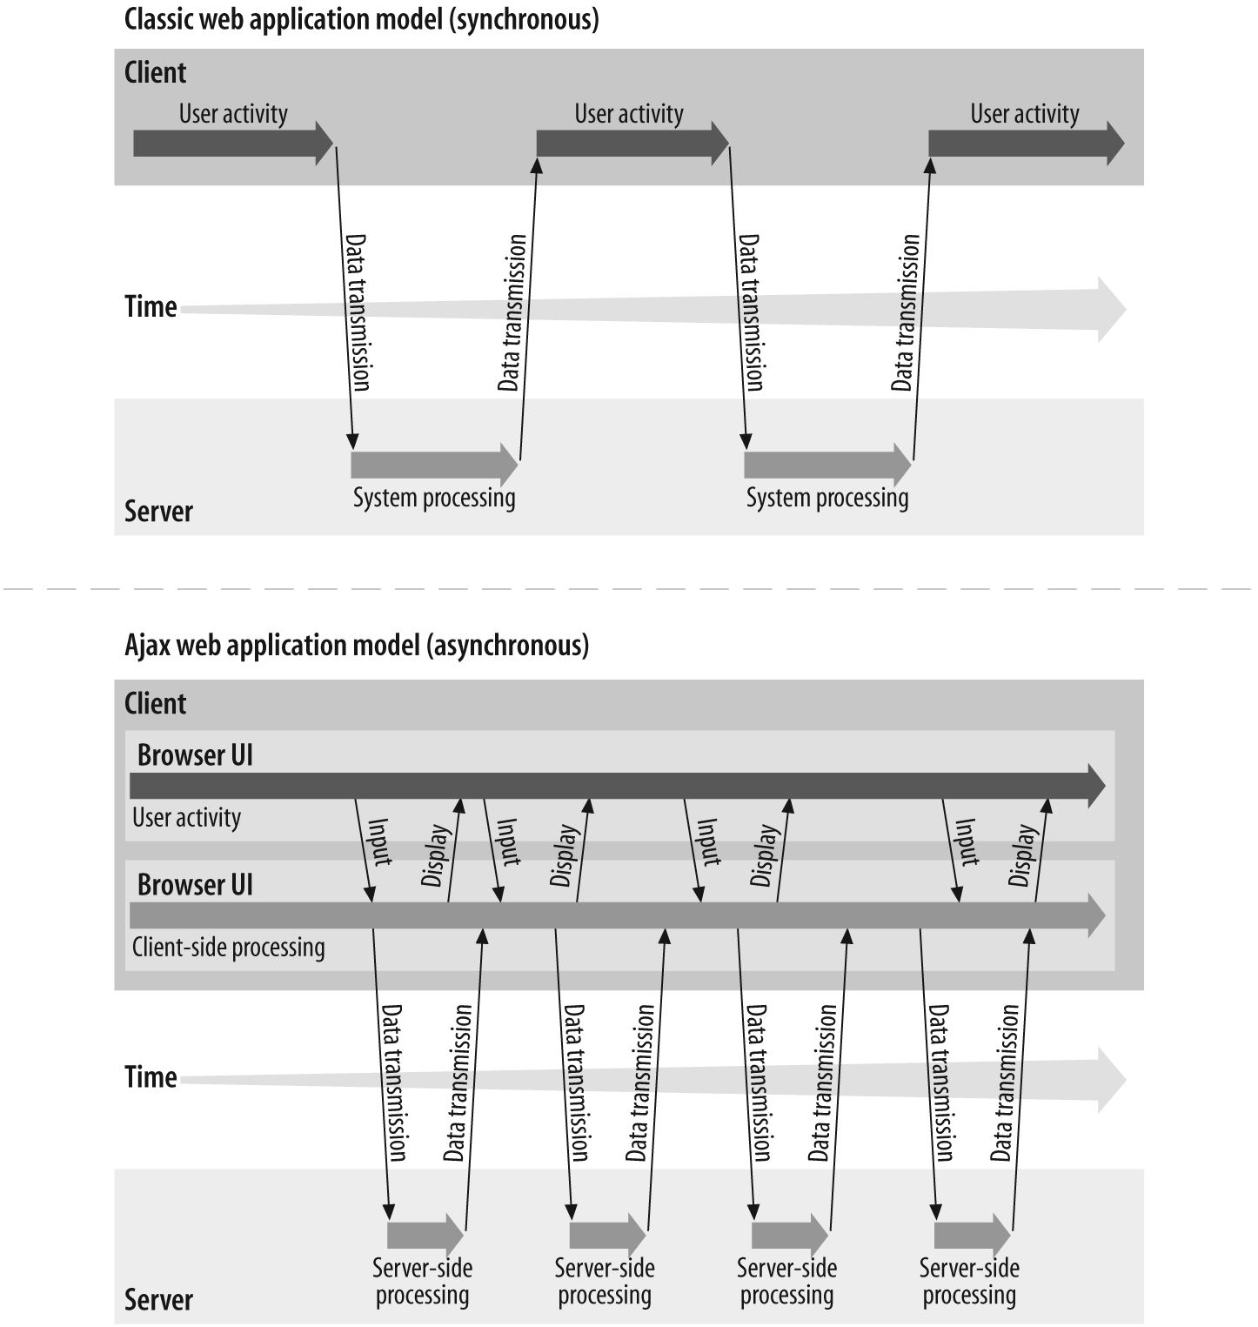
Ajax Interaction
Notes:
I assume some of you have seen this picture before. This picture
compares the user interaction models of conventional web
application in the top half of the slide against AJAX-fied web
application in the bottom part of the slide.
On the top, it is how a user interaction occurs when conventional
web application is used. Here a user has to stop and wait until a
response is received. What this means is that data fetching activity
interrupts the user operation.
The bottom picture shows how a user interaction occurs for AJAX
application. In this model, a user keeps operating since the data
fetching occurs in the background.

Slide 26
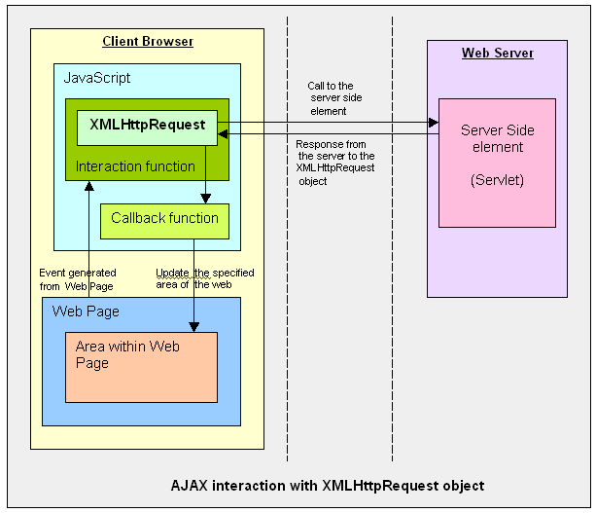

Ajax Interaction
Notes:
So how does AJAX application performs the asynchronous
communication with the server?
This slide also compares conventional web application and AJAX
application. In the left side, which shows the conventional web
application, HTTP request/response interaction occurs directly
between a browser and a backend web application.
In the right side, which shows AJAX based web application, within
a browser, there is AJAX engine, which is actually represented by a
JavaScript object called XMLHttpRequest which handles the HTTP
request/response interaction in an asynchronous fashion.

Slide 27
DOM
W3C definition
  The Document Object Model (DOM) is an application programming interface (API) for valid HTML and well-formed XML documents.
It is a way in which elements of HTML, XHTML and XML can be parsed, accessed and modified.
JavaScript provides API for DOM using which we can access HTML elements.

Slide 28
Nodes
Every element/tag is considered as a NODE.
A DOM tree can be built using the nodes.
Example:
  <html>
  <head>
  <title>DOMtree</title>
  </head>
  <body>
  <p> Hi</p>
  </body>
  </html>
html
head
body
title
p
DOMtree
Hi

Slide 29
getElementById
To create a section or division in HTML div tag is used.
div tag can be associated with an id.
document.getElementById(‘name’) can be used to get to the section referred to by the div.
(It can also be used on any html element which is associated with id like <input> tag etc.)
To change the content of div, innerHTML propery comes very handy.

Slide 30
  <body>
  Changing the below section:
  <div id="change">
  <p> This section is going to change</p>
  </div>
  <script>
  function f(){
  var name=prompt("enter your name","");
  var epara=document.getElementById('change');
  epara.innerHTML ="<p><b>Hello, "+ name+"</b></p>";
  epara.setAttribute('align',"center");
  }
  f();
  </script>
  </body>

Slide 31
XMLHttpRequest
JavaScript object
to exchange data with a server behind the scenes.
The XMLHttpRequest object is a developer's dream, because you can:
  Update a web page without reloading the page
  Request data from a server after the page has loaded
  Receive data from a server after the page has loaded
  Send data to a server in the background
Create an XMLHttpRequest Object
All modern browsers (IE7+, Firefox, Chrome, Safari, and Opera) have a built-in XMLHttpRequest object.
Syntax for creating an XMLHttpRequest object:
xmlhttp=new XMLHttpRequest();
Old versions of Internet Explorer (IE5 and IE6) use an ActiveX Object:
xmlhttp=new ActiveXObject("Microsoft.XMLHTTP");
Notes:
Now let's talk about XMLHttpRequest a bit. It is a JavaScript object,
which means it gets created within a JavaScript code.
The XMLHttpRequest JavaScript object is supported in most modern
browsers.
It is the AJAX engine that performs the HTTP request/response
interaction with the backend web application in asynchronous
fashion.

Slide 32
Server-Side AJAX Request Processing
Server programming model remains the same
  It receives standard HTTP GETs/POSTs
  Can use Servlet, JSP, JSF, ...
With minor constraints
  More frequent and finer-grained requests from client
  Response content type can be
    text/xml
    text/plain
    text/json
    text/javascript
Notes:
Now, how does server side web application handle the AJAX
interaction with the browser? Well as far as Server side code is
concerned, it is just another HTTP request that comes in. The server
side does not even know the browser is sending the HTTP request
in asynchronous fashion and it should not.
What this means is that the server side web application can use any
server side technology of its choice such as servlet, JSP, JSF,
Struts, or whatever.
The server side application however has minor constraints. First, it is
possible the client might send more frequent and finer grained
requests. The response type can be text/xml, text/plain, text/json, or
text/javascript.

Slide 33
Steps of AJAX Operation
A client event occurs
An XMLHttpRequest object is created
The XMLHttpRequest object is configured
The XMLHttpRequest object makes an async. request
The Servlet/JSP returns an XML document containing the result
The XMLHttpRequest object calls the callback() function and processes the result
The HTML DOM is updated

Slide 34
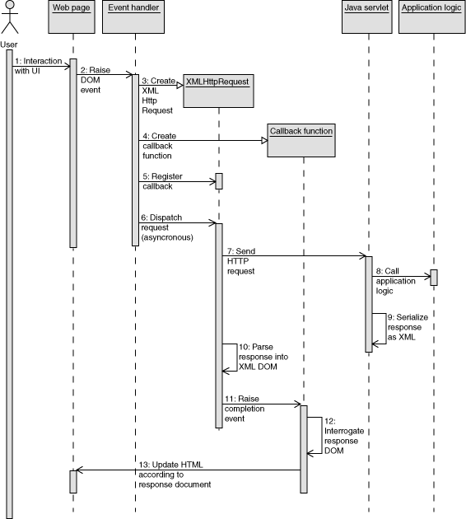
AJAX –SEQUENCE

Slide 35
Client event
A JavaScript function is called as the result of an event
  <input type="text“ size="20"
  id="userid“ name="id“ onkeyup="validateUserId();">
When the use types a character into a input text form field, whose id is set to “userid”.
This user triggered event is captured as JavaScript event called “onkeyup” , validateUserId() is then called as a result.

Slide 36
  A XMLHttpRequest Object gets created for IE and Mozilla in different ways
  var req;
  function initRequest() {
  req = new XMLHttpRequest();
  }
  }

Slide 37
An XMLHttpRequest object is configured with a callback function
CallBack Funcation Name
  function validateUserId() {
  initRequest();
  req.onreadystatechange = processRequest;
  if (!target) target = document.getElementById("userid");
  var url = "validate?id=" + escape(target.value);
  req.open("GET", url, true);
  req.send(null);
  }
True to indicate Async Call.
Post Data ,Always “null” for GET

Slide 38
XMLHttpRequest object makes an async. request
The “open” method of the XMLHttpRequest requires three parameters:
  HTTP method, which is GET or POST;
  URL of the server-side component to nteract with;
  Boolean indicating – the call is asynchronous or not.
Most cases, it is set to “true”, which means the HTTP request/response interaction occurs in asynchronous fashion.

Slide 39
function and processes the result
The XMLHttpRequest object was configured to call the processRequest() function when there is a state change to the readyState of the XMLHttpRequest object
  function processRequest() {
  if (req.readyState == 4) {
  if (req.status == 200) {
  var message = ...;
The combination of two things
  readyState value of the XMLHttpRequest is 4
  Status value is 200
indicates that the data from the server has been successfully received by the client.
Now the control is back to the client. Being a call back function

Slide 40
The HTML DOM is updated
The DOM API recommended way to gain a reference to an element i
document.getElementById("userIdMessage"),
Where "userIdMessage" is the ID attribute of an element appearing in the HTML document
JavaScript technology may now be used to modify the element's attributes; modify the element's style properties; or add, remove, or modify child elements

Slide 41
XMLHttpRequest Properties
onreadystatechange
  Set with an JavaScript event handler that fires at each state change
readyState – current status of request
  0 = uninitialized
  1 = loading
  2 = loaded
  3 = interactive (some data has been returned)
  4 = complete
status
  HTTP Status returned from server: 200 = OK

Slide 42
Ajax Example
<script type="text/javascript">
var xhr = new XMLHttpRequest();
function callBookService(){
xhr.open("GET","http://localhost:8080/api/v1/books/srch/pages/400",true);
xhr.onreadystatechange=processResponse;
xhr.send(null);
}

Slide 43
function processResponse(){
if(xhr.readyState == 4 && xhr.status == 200)
{
var element = document.getElementById("placeHolder");
element.innerHTML= xhr.responseText;
}
}
</script>
</head>

Slide 44
Continued
  <body>
  <h1>Local Library - Attached to Gandhi Library</h1>
  <div id="placeHolder"></div>
  <form action="#">
  <input type="file" id="file" name="menu">
  <input type="submit">
  </form>
  <script type="text/javascript">
  callBookService();
  </script>
  </body>
  </html>

