Slide 1
Java Programming

Slide 2
K.Srivatsan - vatsank@gmail.com
IT Trainer Since 1991
Java Training Since 2004
About 60+ Corporate Clients

Slide 3
History of Java
A General-purpose and Object-Oriented Programming language
Originally designed for interactive television,
Developed in the year 1991 at Sun Microsystems
Initially called as Oak
Platform-independent language
No limitation to any hardware or operating system.
It provides users the facility to ‘write once, run anywhere’.

Slide 4
Program structure
A program in Java consists of one or more class definitions
Java Compiler strictly requires source file with the .java extension.
Can also have other file type and execution methods
One of these classes must define a method main()
Program execution begin from here
There can be More than one Class Definition in a class
But Only One Public class
Source Filenames should match the name of the public class.
Compiler Efficiency, Organization and Readability, JVM Entry Point

Slide 5
Source File Layout
Basic syntax of a Java source file is:
[<package_declaration>]
<import_declaration>*
<class_declaration>+

Slide 6
Software Packages
Help manage large software systems.
Contain classes and sub-packages.
package <top_pkg_name>[.<sub_pkg_name>]*;
Specify the package declaration at the beginning of the source file.
Only one package declaration per source file.
If no package is declared, it is placed into the default package.
Names must be hierarchical and separated by dots.

Slide 7
The import Statement
import <pkg_name>[.<sub_pkg_name>]*.<class_name>;
import <pkg_name>[.<sub_pkg_name>]*.*;
import java.util.List;
import java.io.*;
import shipping.gui.reportscreens.*;
The import statement does the following:
Precedes all class declarations
Tells the compiler where to find classes

Slide 8
Comments
Java supports three forms of comments
// single line comments
/* multi
line
comment
*/
/** a
* Javadoc
* comment
*/

Slide 9
Example
package com.training;
public class Greeting {
public String getMessage() {
return "Welcome to Java Programming";
}
}

Slide 10
Example
package com.training;
public class Application{
public static void main(String[] args) {
Greeting grtObj = new Greeting();
System.out.println(grtObj.getMessage());
}
}

Slide 11
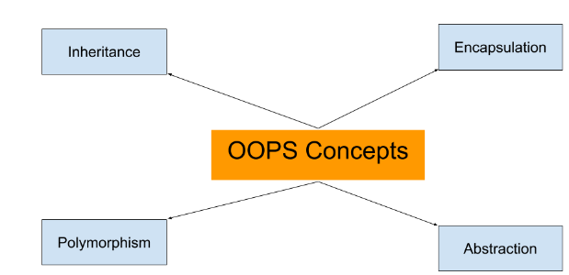
OOPS Concepts

Slide 12
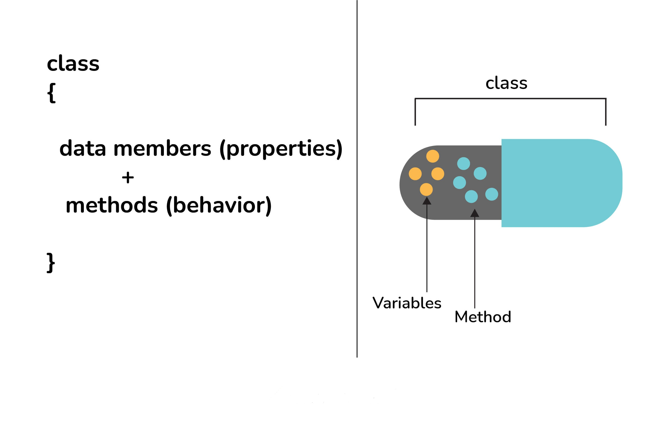
Encapsulation
Encapsulation - Enforces Modularity
Encapsulating the data and behavior into a single object is of primary importance in OO development.
A single object contains both its data and behaviors and can hide what it wants from other objects.

Slide 13
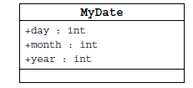
Information Hiding
Client code has direct access to internal data
(d refers to a MyDate object):
d.day = 32; // invalid day
d.month = 2; d.day = 30; // plausible but wrong
d.day = d.day + 1; // no check for wrap around

Slide 14
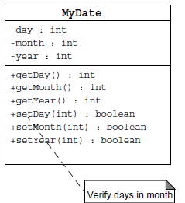
Encapsulation
Hides the implementation details of a class
Forces the user to use an interface to access data
Makes the code more maintainable

Slide 15
Declaring Java Technology Classes
Basic syntax of a Java class:
<modifier>* class <class_name> {
<attribute_declaration>*
<constructor_declaration>*
<method_declaration>*
}
Define an attribute:
<modifier>* <type> <name> [ = <initial_value>];

Slide 16
Classes
Top-level classes can be declared as
public
a public class is globally accessible.
a single source file can have only one public class or interface
abstract
an abstract class cannot be instantiated
final
a final class cannot be subclassed
Default
With any Modifier
They can’t be declared as protected and private

Slide 17
The 4 Access Levels and 3 Modifiers

Slide 18
Constructors
Have no return type
Have the same name as the class
If we don't’ put a constructor the compiler puts a default one
The default constructor has the same access modifier as the class.
The default constructor has no arguments.
The default constructor is always a no-arg constructor, but a no-arg constructor is not necessarily the default constructor
The default constructor includes a no-arg call to the super constructor (super()).
They are not inherited and hence they are not overridden
It can be Overloaded
It can have any of the Four Access Modifies
It cannot be synchronized
It can have throws clause

Slide 19
Instantiation with new
It is the process by which individual objects are created.
Class objectReference = new Constructor();
Declaration
Employee empObj;
Instantiation
empObj = new Employee()
Declaration and Instantiation
Employee empObj = new Employee()
new operator allocates memory for an object.

Slide 20
Variables and Methods
A variable, which corresponds to an attribute, is a named memory location that can store a certain type of value.
Variable is a kind of special container that can only hold objects of a certain type.
Primitive type Variable
Basic, built-in types that are part of the Java language
Two basic categories
boolean
Numeric
Integral - byte, short, int, long, char
Floating point - float, double

Slide 21
Instance Variables and Methods
Variables and methods can be associated either with objects or their classes
An object that is created using a class is said to be an instance of that class.
The variables that the object contains are called instance variables.
The methods that the object contains are called instance methods.
Instance Variable can have one of the four access levels
Three access modifies – private, public , protected
They have a default value
A class variable (or class method) is a variable (or method) that is associated with the class itself.

Slide 22
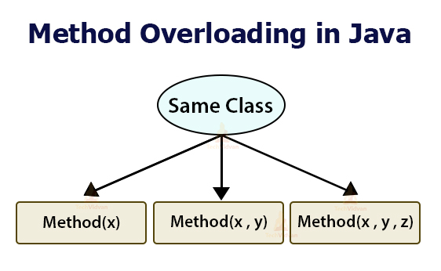

Slide 23
Method Overloading
Methods of a class have the same name but different signatures
Similar behavior but for different data types.
Signature
Name of the method and the number and types of formal parameters in particular order.
They are independent methods of a class
Can call each other just like any other method.
A method can be overloaded in the same class or in a subclass.

Slide 24
Overloading Methods
Overloaded methods MUST change the argument list.
Overloaded methods CAN change the return type.
Overloaded methods CAN change the access modifier.
Overloaded methods CAN declare new or broader checked exceptions.

Slide 25
Flow Control

Slide 26
Control Structures
To change the ordering of the statements in a program
Two types of Control Structures
decision control structures ,
allows us to select specific sections of code to be executed
if -- else , if – else if
switch -- case
repetition control structures
allows us to execute specific sections of the code a number of times
while
do -- while
for

Slide 27
Decision Control Structures
Types:
if-statement
if-else-statement
If-else if-statement
If Specifies that a statement or block of code will be executed if and only if a certain boolean statement is true.
if( boolean_expression )
statement;
or
if( boolean_expression ){
statement1;
statement2;
}
boolean_expression : can be an expression or variable.

Slide 28
if-else statement
if(age==12){
Statement(s)
} else {
Statement(s)
}
if(boolean_exp1 )
statement1;
else if(boolean_exp2)
statement2;
else
statement3;
if(str.equals(“ok”)){
Statement(s)
} else {
Statement(s)
}
For Comparison == used instead =
= being an assignment operator
equals Method Should Be Used for Objects comparison

Slide 29
switch-statement
Allows branching on multiple outcomes.
switch expression is an integer ,character expression or variable
case_selector1, case_selector2 and unique integer or character constants.
If none of the cases are satisfied, the optional default block if present is executed.
switch( switch_expression ){
case case_selector1:
Statement(s);
break;
case case_selector2:
Statement(s);
break;
default:
statement1;
}

Slide 30
Switch-Case Java 7.0
From In Java SE 7 and later, can use a String object in the switch statement's expression.
The String in the switch expression is compared with the expressions associated with each case label as if the String.equals method were being used.
Will Throw a Null pointer Expression if the expression is NULL
String color = "red";
switch (color) {
case "red":
System.out.println("Color is Red");
break;
default:
System.out.println("Color not found");
}

Slide 31
INHERITANCE

Slide 32
Overview
A class can inherit from another class
Original class is the “superclass”
New class is called the “subclass”
Inheritance is a fundamental OO concept
Superclass
Car
Subclasses
SportsCar
Taxi
PoliceCar

Slide 33
What Does an Object Look Like?
A subclass inherits all the instance variables of its superclass
Car object
public class Car {
String regNum;
int engineSize; …
}
regNum
engineSize
Taxi object
public class Taxi extends Car {
private int cabNum; …
}
regNum
engineSize
cabNum

Slide 34
Default Initialization
What happens when a subclass object is created?
If no constructors are defined:
No-arg constructor is called in superclass
No-arg constructor called in subclass
Taxi object
regNum
engineSize
Taxi taxi1 = new Taxi();
cabNum

Slide 35
Nondefault Initialization
Specific initialization can be performed as follows:
public class Car {
Car(String r, int e) {
regNum = r;
engineSize = e;
} …
public class Taxi extends Car {
Taxi(String r, int e, int c) {
super(r, e);
cabNum = c;
} …
Use super() to call superclass constructor

Slide 36
Specifying Additional Methods
The superclass defines methods that are applicable for all kinds of Car
The subclass can specify additional methods that are specific to Taxis
public class Car {
public int getReg()…
public void changeOwner()…
…
public class Taxi extends Car {
public void renewCabLicense()…
public boolean isBooked()…
…

Slide 37
Overriding Superclass Methods
A subclass inherits all the methods of its superclass
The subclass can override a method with a specialized version, if it needs to:
public class Car {
public String details() {
return "Reg:" + getReg();
}
public class Taxi extends Car {
public String details() {
return "Reg:" + getReg() + cabNum;
}

Slide 38
Overriding
When a sub-class defines a
“method with same method name, argument types, argument order and return type as a method in its super class, its called method overriding. “
Methods declared as final, static and private cannot be overridden.
An overriding method can be declared as final
The method can’t be less accessible
Public => only public
Protected => Both Public and Protected
Default => default, public and protected

Slide 39
Overriding with Compatible Return type
Arguments must be same and return type must be compatible
class Base
{
private int i = 5;
public Number getNumber()
{
return i;
}
}
class Derived extends Base
{
@Override
public Integer getNumber()
{
return new Integer(10);
}
}

Slide 40
Invoking Superclass Methods
If a subclass overrides a method, it can still call the original superclass method
Use super.method()to call a superclass method from the subclass
Though keyword super is used to refer super class, method call super.super.method() is invalid.
public class Car {
public String details() {
return "Reg:" + getReg();
}
public class Taxi extends Car {
public String details() {
return super.details() + cabNum;
}

Slide 41
super keyword
The keyword super refers to the base class
super( )
invokes the base class constructor
base class constructors are automatically invoked
super.method( )
invokes the specified method in the base class
super.variable
to access the specified variable in the base class
super must be the first statement in a constructor

Slide 42
Abstract Class
An abstract class is a shared superclass
Provides a high-level partial implementation of some concept
Use the abstract keyword to declare a class as abstract
Vehicle
Vehicle
Abstract superclass
Concrete subclasses
Car
Car
Truck

Slide 43
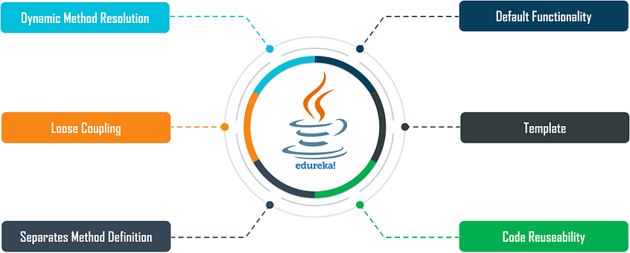
Need for Abstract Class

Slide 44
Defining Abstract Classes in Java
Use the abstract keyword to declare a method as abstract
Only provide the method signature
Class must also be abstract
Must be implemented by a concrete subclass
Each concrete subclass can implement the method differently
public abstract class Vehicle {
private String regNum;
public String getRegNum()…
public abstract boolean isRoadWorthy();
}
public class Car
extends Vehicle{
private int numSeats;
public void fitRack()…
public class Truck
extends Vehicle{
private int axles;
public void setLoad()…

Slide 45
Interfaces & Polymorphism

Slide 46
Interfaces
An interface is like a fully abstract class
All the methods are public and abstract- Till Java 8
No instance variables if present they are public static final
Defines a set of methods that other classes can implement
A class can implement many interfaces,
but can extend only one class
can extend other interfaces and extend multiple interfaces

Slide 47
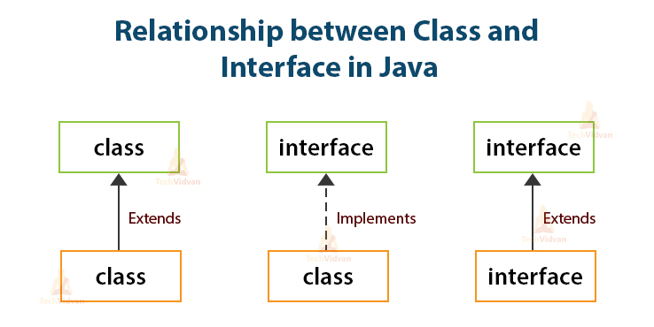

Slide 48
Example of Interfaces
Interfaces describe an aspect of behavior that different classes can support
Any class that supports the “Steerable” interface can be steered:
Steerable
Not Steerable

Slide 49
Interface
Interfaces define types in an abstract form
Allows the specification of a reference type without providing an implementation
The class that implements the interface decides how to implement
Use interface keyword instead of class
public interface Function {
public double apply(double arg);
}

Slide 50
Implement the Interface
public class CurrencyConverter implements Function {
@Override
public double apply(double arg) {
return arg * 45;
}
}
Function usdToInr = new CurrencyConverter();
System.out.println(usdToInr.apply(100));

Slide 51
Implementing an Interface
public interface Steerable {
int maxTurn = 135;
void turnLeft(int deg);
void turnRight(int deg);
}
public class Car
extends Vehicle
implements Steerable {
public void turnLeft(int deg)
{…}
public void turnRight(int deg)
{…}

Slide 52
Partial Implementation of an Interface
Declare the class as abstract if the class does not implement all the methods of an interface
Implement the methods in the sub class level
Public abstract class Car
extends Vehicle
implements Steerable {
public void turnLeft(int deg)
{…}
}

Slide 53
Using instanceof with Interfaces
The instanceof operator can be used to check if an object implements an interface
Downcasting can be used if necessary, to call methods defined in the interface
public void aMethod(Object obj) {
…
if (obj instanceof Steerable)
((Steerable)obj).turnLeft();
}

Slide 54
Extending an Interface
One Interface can extend another Interface
public interface Steerable {
int maxTurn = 135;
void turnLeft(int deg);
void turnRight(int deg);
}
public interface Navigator
extends Steerable {
void calcSpeed(int distance);
}

Slide 55
Polymorphism
This OO Principle allows the programmer to program abstractly
Objects of a subclass can be treated as objects of its superclass
The base class of a hierarchy is usually an abstract class or an Interface
They define the common behavior (functionality)
Classes and Subclasses inherit this behavior and extend it according to their own properties by overriding the methods of the super class
Subclass objects can be treated as super class objects through references,
But, super class objects are not subclass objects

Slide 56
Polymorphism
Allows for hierarchies to be highly extensible
New classes can be introduced and can still be processed without changing other parts of the program
Same method can do different things, depending on the class that implements it.
Method invoked is associated with OBJECT and not with reference.
Types of Polymorphism -
Method Overloading.
Method Overriding.

Slide 57
Polymorphism
public interface Conditional {
public boolean test();
}

Slide 58
Implementation -One
public class Professor implements Conditional {
private String qualification;
@Override
public boolean test() {
return this.qualification.equalsIgnoreCase("phd");
}
}

Slide 59
Implementation -Two
public class Student implements Conditional {
private double markScored;
@Override
public boolean test() {
return this.markScored>90;
}
}

Slide 60
Polymorphism
public static void print(Conditional poly) {
System.out.println(poly.test());
}
public static void main(String[] args) {
Student ramesh = new Student(101,"Ramesh",67);
Professor prof = new Professor(201, "manish", "ece", "phd");
print(ramesh);
print(prof);
}

Slide 61
Interface vs Abstract Class
A class may implement several interface
An interface cannot provide any code at all
Interfaces are often used to describe the peripheral abilities of a class, not its central identity,
A class may extend only one class
An abstract class can provide complete or partial code
An abstract class defines the core identity of its descendants.

Slide 62
Interface, Abstract Class,Subclass,Class
A plain class is designed when in doesn't pass the “is-a” test.
A Plain class is designed when its not extending any other class other than object class
Make a subclass , when it needs to extend a super class
Make a subclass, when it needs to override or add new behaviors
Make an abstract class , when there is a requirement for a kind of “template” for a group of subclasses, and there are some implementation in the class which the subclass can use .
Make an abstract class , to guarantee that nobody can make objects of that type.
Design an interface , to define a role that other classes can play, regardless of the inheritance tree,

Slide 63
final keyword
A final method or class is Java’s way of prohibiting inheritance and/or overriding
Final methods cannot be overridden by subclasses
All private methods are implicitly final
Final classes Cannot be extended and their methods are implicitly final
Can be applied to variables too
The value of a final variable cannot be altered
final int max_limit = 23
final void method( )
final class last_class

Slide 64
Math Class
The methods in the Math class don’t use any instance variable values
The Methods are “static” methods , and they don’t need to have an instance of the Math class
Some of the Methods in the class are
Math.random() – returna double number between 0.0 to 1.0
Math.abs() – absolute value of the argument
Math.round() – returns int or long based on float,double rounded to nearest integer value
Math.min() and Math.max() – maximum or minimum of two args
Math.sqrt() – return the sqaure root of the given argument

Slide 65
Exception handling

Slide 66
Exception Handling
An exception is a problem that arises during the execution of a program.
When an Exception occurs the normal flow of the program is disrupted and the program terminates abnormally, which is not recommended
Exceptions are to be handled.

Slide 67
Exceptions
checked exceptions
Conditions that can readily occur in a correct program
Includes all subtypes of Exception
Excluding classes that extend Runtime Exception.
Subject to the handle or declare rule
unchecked exceptions
Problems that reflect program bugs
Probable bugs are represented by the RuntimeException class.
Compiler doesn’t enforce the handle or declare rule.
Error
Fatal situations are represented by the Error class.

Slide 68
Handle or Declare Rule
Handle the exception by using the try-catch-finally block.
try{
// some code
} catch(Exception e){
}
Declare that the code causes an exception by using the throws clause.
void trouble() throws IOException { ... }
void trouble() throws IOException, MyException { ... }
Other Principles
You do not need to declare runtime exceptions or errors.
You can choose to handle runtime exceptions

Slide 69
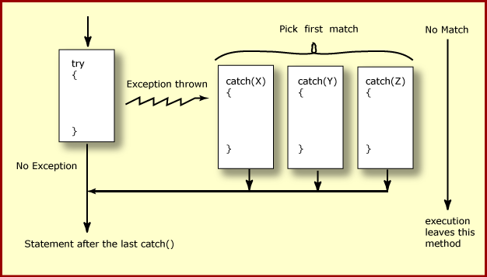
How try catch Work

Slide 70
Exception Handling
try {
Object value = "twenty";
Integer number = (Integer) value;
}
catch ( ClassCastException ex ) {
ex.printStackTrace();
}
System.out.println("Good-bye" );
}

Slide 71
Effective Exception Hierarchy
The exception classes are arranged in a hierarchy.
Catches for specific exceptions should always be written prior to the generic handler.
A generic handler for Exception would cover any missing situation.
try
{
}
catch (NumberFormatException e) {
}
catch (Exception ex2) {
}
try
{
}
catch (Exception e1) {
}
catch(NumberFormatException e2) {
}

Slide 72
Multiple Catch
try {
Object value = "twenty";
Integer number = (Integer) value;
String mark ="50";
Integer.parseInt(mark);
}
catch ( ClassCastException| NumberFormatException ex ) {
ex.printStackTrace();
}

Slide 73
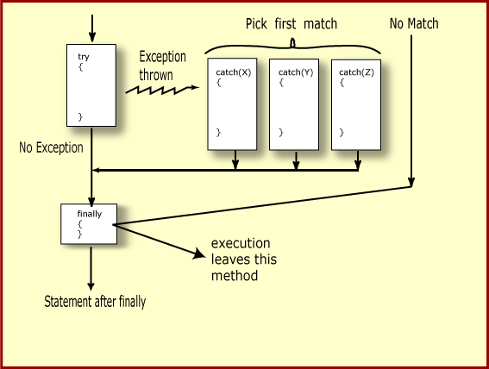
Finally Block

Slide 74
Throws Clause
A method is required to either catch or list all exceptions it might throw
Except for Error or RuntimeException, or their subclasses
If a method may cause an exception to occur but does not catch it, then it must say so using the throws keyword
Applies to checked exceptions only
<type> <methodName> (<parameterList>) throws <exceptionList>
{
<methodBody>
}

Slide 75
The try-with-resources Statement
A try statement that declares one or more resources.
A resource is an object that must be closed after the program is finished with it.
Ensures the resource is closed at the end of the statement.
Any object that implements java.lang.AutoCloseable, and java.io.Closeable, can be used as a resource.

Slide 76
Exception Handling- Closing the Resource
Scanner scan = new Scanner( System.in );
int num ;
System.out.print("Enter an integer: ");
try {
num = scan.nextInt();
System.out.println("The square of " + num + " is " + num*num );
}
catch ( InputMismatchException ex ) {
System.err.println("You entered bad data." );
System.err.println("Run the program again." );
}
System.err.println("Good-bye" );
scan.close();
}

Slide 77
The try-with-resources Statement
System.out.print("Enter an integer: ");
try(Scanner scan = new Scanner( System.in )) {
int num = scan.nextInt();
System.out.println("square" + num + "is" + num*num );
}
catch ( InputMismatchException ex ) {
System.err.println("You entered bad data." );
System.err.println("Run the program again." );
}
System.out.println("Good-bye" );
}

Slide 78
Throwing Exceptions
The throw Keyword
Java allows you to throw exceptions (generate exceptions)
throw <exception object>
An exception you throw is an object
You have to create an exception object in the same way you create any other object
Example:
throw new ArithmeticException(“testing...”);

Slide 79
Re-throw Exception
Exception of the Catch Parameter type is the one that is rethrown
To intercept all exceptions and rethrow them
Can catch with super class Exception
Declare method as throwing an Exception.
"imprecise rethrow“
Throwing a general Exception type (instead of specific ones)

Slide 80
Re-Throw Exception
Java 7, can be more precise about the exception types being rethrown from a method.
This leads to improved checking for rethrown exceptions.
Can handle them a lot better at the calling side

Slide 81
Re-throw Exceptions
public static void myExample() throws ParseException,IOException {
try {
new SimpleDateFormat("yyyyMMdd").parse("date");
new FileReader("Abc.txt").read();
} catch (Exception e) {
throw e;
}
}

Slide 82
Method Overriding and Exceptions
The overriding method can throw:
No exceptions
One or more of the exceptions thrown by the overridden method
One or more subclasses of the exceptions thrown by the overridden method
The overriding method cannot throw:
Additional exceptions not thrown by the overridden method
Superclasses of the exceptions thrown by the overridden method

Slide 83
Overriding –When Method Has Exceptions
Any exceptions declared in overriding method must be of the same type as those thrown by the super class, or a subclass of that type.
class MyBase {
public void method1() throws Exception
{ }
public void method2() throws RuntimeException
{ }
}
class Sub extends MyBase
{
public void method1() throws Throwable {
}
public void method2() throws ArithmeticException {
}
}
This is compile Time Exception
This is Allowed

Slide 84
User Defined Exception
User Defined Exception must be a child of Throwable.
To write a checked exception that is automatically enforced by the Handle or Declare Rule, need to extend the Exception class.
To write a runtime exception, need to extend the RuntimeException class.

Slide 85
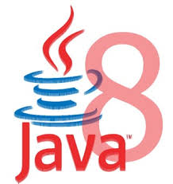
Functional Interfaces

Slide 86
Functional Programming
Java always remained Object first language.
Functions are not important for Java.
cannot live on their own in Java world.
JavaScript is one of the best example of an FP language.
There is no way of passing a method as argument or returning a method body
invList.forEach((inv)->{System.out.println(inv);});
Lambda expression adds that missing link of functional programming to Java.

Slide 87
Functional interface
An interface with only one method.
@FunctionalInterface
Used to enforce the intent of the interface
Existing interfaces are annotated with @FunctionalInterface
Adding another method to the interface definition, will not be functional and compilation process will fail.
Used with lambda expressions.

Slide 88
Built-in Functional Interfaces
Earlier Versions of Java has several functional interfaces
Prominent because of Lambda expressions
Existing functional interfaces
Comparator
Callable
Runnable
ActionListener
Collections API has been rewritten and new Stream API uses a lot of functional interfaces.
java.util.function
Consumer, Supplier, Function and Predicate.

Slide 89

lambdas

Slide 90
Benefits of Lambda Expression
Fewer Lines of Code
It reduced amount of code.
Sequential and Parallel Execution
Support by passing behavior in methods
Higher Efficiency
Utilizing Multicore CPU’s using Streams
Streams API
Handling Collection of data much efficiently

Slide 91
Where to use Lambda expressions
Lambda expressions can be used where there is a target type.
The following are the target type in Java
Variable declarations and assignments
Return statements
Method or constructor arguments

Slide 92
Lambda Expressions
Lambda Expressions are:
Anonymous
It doesn’t have an explicit name like a method
Function
Not associated with a particular class like a method
Has a list of parameters, a body, a return type, and list of exceptions that can be thrown.
Passed around
Can be passed as argument to a method or stored in a variable.
Concise
No need to write a lot of boilerplate like anonymous classes.

Slide 93
Lambda Expressions
A lambda expression is composed of three parts.
Argument List (int x, int y)
Arrow Token ->
Body x + y

Slide 94
Lambda – Argument List
Can have zero, one or more parameters.
(int x, int y)
Parameters can be explicitly declared or it can be inferred
(int a) is same as just (a)
Parameters are separated by commas.
(a, b) or (int a, int b) or (String a, int b, float c)
Empty parentheses to represent an empty set
() -> 42
It is not mandatory to use parentheses.
a -> return a*a

Slide 95
Lambda Expression - Body
The body of the lambda expressions can contain zero, one or more statements.
Lambdas may return a value.
The type of the return value will be inferred by compiler.
Body is evaluated like a method body
return statement returns control to the caller of the anonymous method.
The return statement is not required if the lambda body is just a one-liner.
If the return is an expression curly braces are required

Slide 96
Lambda with Built-in Functional Interface
public static void main(String[] args) {
Runnable task = () -> {
for(int i=0;i<10;i++) {
System.out.println("Hello World");
}
};
Thread t = new Thread(task);
t.start();
}

Slide 97
Custom Functional Interface
interface Converter<T,R>{
public R calculate(T frm);
}
public static void doConvert(Converter<Double,Double> conv,Double frm){
System.out.println(conv.calculate(frm));
}
public static void main(String[] args) {
Converter<Double,Double> currencyConverter = (val)->{return val * 45.0;};
doConvert(currencyConverter, 100.00);
Converter<Double,Double> farenToCel = (faren)->{return (faren-32) * 5/9;};
doConvert(farenToCel, 84.00);
}

Slide 98
Built-in Functional Interfaces

Slide 99
Need for Built In Functional Interfaces
Lambda expressions must correspond to one functional interface.
Java 8 also has new functional interfaces covering the most common scenarios usages.
Each developer need not define functional interface of types which are already in this package.
They are Defined with Generic types and are re-usable for specific use cases.

Slide 100
Built-in Functional Interfaces
Located inside the java.util.function package.
Predicate<T>
Consumer<T>
Function<T, R>
Supplier<T>
Where T and R represent generic types
T represents a parameter type
R the return type.

Slide 101
Predicate<T>
A predicate is a function that receives a value and evaluates it.
It has a method test(T obj) to evaluate and return a Boolean value.
It also has some default Methods
@FunctionalInterface public interface Predicate<T> { boolean test(T t); // Other default and static methods }

Slide 102
Predicate<T>
Using Anonymous Class
Predicate<String> startsWithA = new Predicate<String>() {
public boolean test(String t) { return t.startsWith("A"); } };
boolean result = startsWithA.test("Anand");
Using Lambda Expression
Predicate<String> testWithLambda = (name)->name.startsWith("A");
System.out.println(testWithLambda.test("Anand"));

Slide 103
Predicate<T>
public void usingPredicate(){
List<String> countries =
Arrays.asList("India","Nepal","srilanka","SouthAfrica","Indonesia");
Predicate<String> pref = (country)->country.startsWith("I");
countries.forEach((eachCountry)->{
if(pref.test(eachCountry)) {
System.out.println(eachCountry);
}
});
}

Slide 104
Files & IO

Slide 105
Overview
At its lowest level, all Java I/O involves a stream of bytes either entering or leaving memory
Packaged classes exist to make it easy for a program to read and write larger units of data.
Low-level stream class object are used to handle byte I/O
High-level stream class object will allow the program to read and write primitive data values and objects

Slide 106
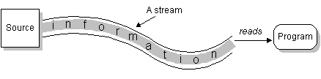
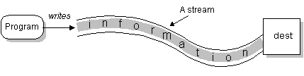
File Classes
Java views the data in files as a stream of bytes.
A stream of bytes from which data are read is called an input stream.
A stream of bytes to which data are written is called an output stream.
Java provides classes for connecting to and manipulating data in a stream.
The classes are defined in the package java.io and are organized in a large complex hierarchy.

Slide 107
File Class
This is an abstract representation file and directory pathnames
Not used to read and write data
Used for searching and deleting of files, creating directories and working with path and making directories
has methods for getting file/directory info.
cannot be used to read or write to a file.
To make a File object, there are three commonly used constructors File
File file1 = new File("C:\\Data\\myFile.dat");
public File(String directory, String filename)

Slide 108
File Class
The static File[] listRoots( )
returns an array containing the roots of the filesystem as File objects:
public boolean exists( )
returns true if the file named in this file object's path field exists or false if it doesn't:
Public boolean isFile( )
public boolean isDirectory( )
public boolean canRead( )
The canRead( ) method indicates whether the program can read from the file.
public boolean canWrite( )
The canWrite( ) method indicates whether the program can write into the file referred to by this File object.

Slide 109
File Class
To Make a New Directory
File dir = new File(“JavaIO”);
dir.mkdir();
public boolean createNewFile( ) throws IOException
checks to see whether the file exists and creates the file if it doesn't already exist.
It returns true if the file was created and false if it wasn't created, either because it couldn't be created or because the file already existed.
File f = new File("output.dat");
boolean success = f.createNewFile( );
if (success) { //... } else { //...

Slide 110
File Input
Reading Data from a Text File contains nothing but characters.
Java provides several ways to read characters from a file:
one character at a time, using the class InputStreamReader
one word at a time, using the class StreamTokenizer
one line at a time, using the class BufferedReader
If Files are Viewed and Created with Text Editors
A print writer for output
A stream tokenize for input
When the data type is known
use a data input stream for input
a data output stream for output

Slide 111
public static void read(){
InputStreamReader reader=null;
try {
reader =new InputStreamReader(new FileInputStream("TestList.txt"));
int i;
while((i= reader.read())!=-1)
{
char c=(char)i;
System.out.println(c);
}
} catch (Exception e) {
e.printStackTrace();
}

Slide 112
Classes in I/O Package
File Reader
Used to read characters from files
The read() method of this class is used to read characters
These are wrapped by BufferedReader to improve the performance
File Writer
Used to write character to files
The Write method() of this classes is used to write characters
Wrapped by BufferedWriter to improve the performance

Slide 113
FileWriter
Constructors:
FileWriter(File file)
FileWriter(File file, boolean append)
FileWriter(String fileName)
FileWriter(String fileName, boolean append)
Same methods of Writer
public void write(int c)
All constructors and methods throw IOException

Slide 114
FileReader
Constructors:
FileReader(File file) throws FileNotFoundException
FileReader(String fileName) throws FileNotFoundException

Slide 115
Classes in I/O Package
BufferedReader
Buffers give a temporary holding place to group until it reaches final place.
It helps in efficent reading of files
Reads a large amount of data from a file at once and keep that data in buffer
Minimizes the number of times of file access.
Provides a readLine() method , which reads a line of characters from the file
BufferedReader in =
new BufferedReader(new FileReader(“file.txt"));
BufferedWriter
Provides a newLine() method , which that creates line separators automatically

Slide 116
Handling file input and output
PrintWriter
Provides number of flexible and powerful methods to write data to files
Methods like format(),printf() and append() are used to work with data
print() or println() of this class take a single parameter of any data type
PrintWriter wraps the FileWriter
The resulting file can be read with a text editor or an input stream reader.

Slide 117
Write To File
public static void main(String args[]) {
try {
PrintWriter out = new PrintWriter(
new FileWriter("myAccount2.dat"));
out.println("srivatsan");
out.println("10099");
out.println(5000);
out.close();
}
catch (FileNotFoundException e){
}
catch (IOException e) {
}
}

Slide 118
Read From File
public static void main(String[] args) {
try {
FileReader fr = new FileReader("TextFile.txt");
BufferedReader br = new BufferedReader(fr);
String line=null;
try
{
while(( line=br.readLine()) !=null) {
System.out.println(line); }
}
catch (IOException e) {
e.printStackTrace();
}
}
catch (FileNotFoundException e) {
e.printStackTrace();
}
}

