Slide 1
Kubernetes

Slide 2
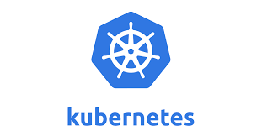
Kubernetes
An open-source system for automating deployment, scaling, and management of containerized applications.
It's Greek for Helmsman, the person who steers the ship.
It is written in Go-language and Released by 2015
Also called K8s
K ubernete s, 8 characters in the middle are removed.

Slide 3
Orchestration
Containers can create repeatable environments
Dev, staging, and prod all looked and functioned the same way.
They are light-weight ,drew resources from the host operating system.
Larger systems might consist many containers
Managing, scheduling , load balancing and distribution are a challenge to look into
Kubernetes does the Orchestration of all the container instances.

Slide 4
Need for K8
Developers expect to deploy new versions of applications several times a day.
Containerization helps package software enabling applications to be released and updated without downtime.
Kubernetes helps to make sure the containerized applications run and helps them find the resources and tools they need to work.
Used by many companies including Google, Amazon

Slide 5
Kubernetes Clusters
Works with a cluster of computers that are connected to work as a single unit.
Helps to deploy containerized applications to a cluster without tying them specifically to individual machines.
The applications needs to be containerized.
Hence its decoupled from individual hosts
Kubernetes automates the distribution and scheduling of application containers across a cluster in a more efficient way.
A Kubernetes cluster consists of two types of resources:
The Control Plane coordinates the cluster
Nodes are the workers that run applications

Slide 6
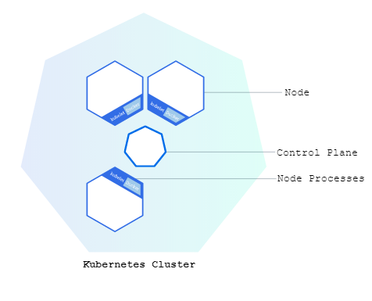
Kubernetes Clusters

Slide 7
Kubernetes Clusters
Control Plane
Responsible for managing the cluster and Nodes
Coordinates scheduling applications, maintaining applications' desired state, scaling applications, and rolling out new updates.
Node
Its VM or a physical computer that serves as a worker machine in a Kubernetes cluster.
Each node has a Kubelet, which is an agent for managing the node and communicating with the Kubernetes control plane.
The node has tools for handling container operations, such as Docker.

Slide 8
Nodes
Node
Worker machine may be either a virtual or a physical machine
A Pod always runs on a Node
Node can have multiple pods
Kubernetes Node runs the following:
Kubelet:
Process responsible for communication between the Kubernetes control plane and the Node;
Manages the Pods and the containers running on a machine.
A container runtime (Docker)
Responsible for pulling the container image from a registry, unpacking the container, and running the application.

Slide 9
Kubernetes Clusters
A Kubernetes cluster can be deployed on either physical or virtual machines.
The following command is used to get cluster information
kubectl cluster-info
kubectl get nodes

Slide 10
Kubernetes Deployments
Containerized Applications can be deployed on a running Kubernetes cluster
The Deployment instructs Kubernetes how to create and update instances of application.
Deployment Controller continuously monitors those instances.
Self Healing
If the Node hosting an instance goes down or is deleted, the Deployment controller replaces the instance with an instance on another Node in the cluster.

Slide 11
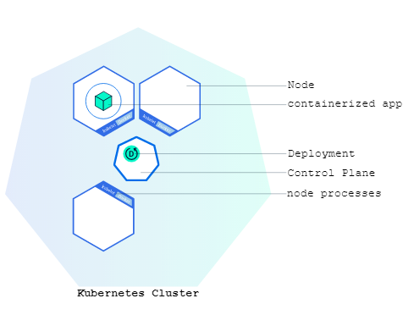
Deploying Application

Slide 12
kubectl
A command line program to interact with Clusters
Also used to deploy and manage applications on Clusters.
Check installation of kubectl
kubectl version

Slide 13
Kubernetes Pods
Pod represents a group of one or more application containers
Example : Docker
It also has some shared resources for those containers.
Share Resource are :
Shared storage, as Volumes
Networking, as a unique cluster IP address
Information about how to run each container, such as the container image version or specific ports to use
In case of a Node failure, identical Pods are scheduled on other available Nodes in the cluster.

Slide 14
Pods
A pod’s life-cycle has 3 stages:
Pending → Running → Succeeded/Failed
If a Pod died without completing his task, a new Pod will be created to replace the dead Pod.
The new pod’s IP and all other factors will be different from old one

Slide 15
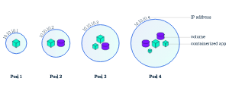
Pods

Slide 16
kubectl
kubectl commands:
kubectl get
Kubectl get deployments
list resources
kubectl describe
kubectl describe pods
show detailed information about a resource
kubectl logs
Kubectl logs k8s-training-57978f5f5d-xfk4n
print the logs from a container in a pod

Slide 17
Service
Services have own IP address and DNS which are stable.
They are High-level stable abstract point for multiple pods.
Service discover Pods by labels
Pods belong to a Service via labels.
It will append its endpoint list and add the pod to the list.

Slide 18
Services
The Services will Receive a Request
They then forward the request to a pod
Uses Round-Robin or Random method for forwarding to pod.
Will use only healthy pods, will do load balancing, roll-back of versions, etc.
Service decouples System components.

Slide 19
Types of Services
ClusterIP:
Exposes the service on a cluster-internal IP.
Makes the service only reachable from within the cluster.
This is the default ServiceType.
NodePort:
Exposes the service on each Node’s IP at a static port called as NodePort
A ClusterIP service, to which the NodePort service will route, is automatically created.
Can contact the NodePort service, from outside the cluster, by requesting <NodeIP>:<NodePort>.

Slide 20
Types of Services
LoadBalancer:
Exposes the service externally using a cloud provider’s load balancer.
NodePort and ClusterIP services,are automatically created.
Service Discovery
They are exposed to the outside world using the expose command

Slide 21
Deploy Service Using kubectl
create a spring-boot starter project => server.port =3535
Add a finalName to pom.xml
Test the application by invoking http://localhost:3535/<path>
Add a Docker File in the contextPath: Dockerfile
mvn clean package
Dockerizing
Create a repository in dockerhub -> vatsank/driver-service
docker build --tag vatsank/driver-service:1.0 .
docker run -it -p:2025:3535 vatsank/driver-service:1.0
docker push vatsank/driver-service:1.0

Slide 22
Kubectl Commands
kubectl get nodes
kubectl get pods
kubectl get services –o wide
kubectl get deployments
kubectl describe pod
kubectl delete service hello-node
kubectl delete deployment hello-node
kubectl scale deployment userapi --replicas=2

Slide 23
Deployment
Responsible for managing the lifecycle of application's Pods
Defines a desired state for application, and the Kubernetes controller ensures that the actual state matches that desire.
It guarantees a specified number of replica Pods are always running
If a Pod crashes or a Node fails, the Deployment controller automatically replaces it.
To scale the number of application replicas up or down, manually or automatically.
It ensures running and managing application workloads reliably.

Slide 24
Deployment With File
Deployment can also be done with file configurations
apiVersion
Version of the Kubernetes API using to create the object
kind
What kind of object to create
metadata
Data that helps uniquely identify the object, including a name string, UID, and optional namespace
spec
The state desired for the object

Slide 25
Resource Specificity
For a Pod
containers: Image names, environment variables, and resource limits.
volumes: Storage requirements.
For a Deployment
replicas: Number of pods should be running.
selector: Identify pods of current deployment.
template: The blueprint for the pods themselves
For a Service
ports: Port to listen on.
selector: Pods that receive the traffic.
type: ClusterIP or LoadBalancer
Notes:
n a Service:
n a Pod:

Slide 26
Labels and Selectors
template.metadata.labels
Value in the Deployment, defines the actual running Pods
io.kompose.service: loan-app.
spec.selector
Should match the "name tag.” in deployment
If names match the service is routed to the Pod managed by that Deployment.

Slide 27
Service Configurations
metadata.name: loan-app
Unique ID of the Service within cluster.
Used by other apps to talk to this service
spec.selector: io.kompose.service: loan-app
A bridge. Finds the Pod that has the label io.kompose.service: loan-app attached to it.
If the label doesn't match exactly, the Service won't find application.

Slide 28
Deployment With File
selector
specifies that as the matchLabels.
spec.selector.matchLabels must match the spec.template.metadata.labels.
replicas
The Number of pods to be created,
selector
The One which the controller will select the targeted pods.
label
is used to select the necessary pods using the matchLabels field.
template
Actual template for the pod.
Metadata that each pod will have with the specs

Slide 29
deployment.yaml
apiVersion: apps/v1
kind: Deployment
metadata:
name: teacher-k8s
spec:
selector:
matchLabels:
app: teacher-k8s
replicas: 2

Slide 30
Deployment.yaml
template:
metadata:
labels:
app: teacher-k8s
spec:
containers:
- name: teacher-service
image: vatsank/teacher-service:2.0
imagePullPolicy: IfNotPresent
ports:
- containerPort: 6065
kubectl apply -f deployment.yaml

Slide 31
Service
Service is networking and exposing application via a stable entry point.
Service
Logical set of Pods and a policy for accessing them.
A Service provides a stable, persistent IP address and DNS name.
It automatically load-balances incoming network requests across all the healthy Pods that match its defined label selector.
It can be discovered within the cluster

Slide 32
Service.yaml
apiVersion: v1
kind: Service
metadata:
name: loan-app-service # user defined service name
spec:
type: ClusterIP # Default;
selector:
app: loan-app # Must match the "app" label on Pods
ports:
- protocol: TCP
port: 8080
targetPort: 8080

Slide 33
PersistentVolumeClaim (PVC)
A virtual hard drive attached to database.
It ensures data persists
accessModes: ReadWriteOnce:
"Read/Write," but only by one node at a time.
Used to prevent data corruption.
resources.requests.storage: 100Mi:
Size of the hard dive
Can be increased later depending on usage
Request the cluster for 100Mi of space and cluster finds or creates a physical disk , pos claims it by name and mounts it to a folder
Mi stands for Mebibyte based on a Binary System

Slide 34
Kompose
brew install kompose
kompose convert -f compose.yaml
By default it creates separate yaml file for each resource service,deployment etc.,
Can use –o option to get one Consolidated File
kompose convert -f docker-compose.yaml -o output.yaml
kubectl apply -f . Look for the dot
Kubectl apply –f output.yaml

Slide 35
Kubectl commands
kubectl rollout restart deployment loan-app
kubectl logs -l io.kompose.service=loan-app --tail=20
kubectl delete deployment postgres
kubectl delete pvc postgres-data
kubectl get pods
kubectl describe pod <pod-name>
kubectl get all

