Slide 1
DevOps

Slide 2
Devops
'DevOps' is a combination of two words 'development' and 'operations.‘
A set of practices designed to overcome the gap between development, QA and Operations
Done by effective communication and collaboration, incorporating continuous integration process with automated deployment.
It helps to increase an organization’s speed to deliver applications and services.

Slide 3
Need for DevOps
The development and operation team worked in complete isolation.
Testing and Deployment were isolated activities done after design-build.
Hence they consumed more time than actual build cycles.
Manual code deployment leads to human errors in production
Coding & operation teams have their separate timelines and are not in synch causing further delays.

Slide 4
Life Cycle
Development
Software Development takes place constantly.
The entire development process is separated into small development cycles.
Helps to speed up software development and delivery process.
Testing
QA team use tools like Selenium to identify and fix bugs in the new piece of code.

Slide 5
Life Cycle
Integration
New functionality is integrated with the prevailing code,
Testing takes place.
Continuous development with integration and testing.
Deployment
Deployment process takes place continuously.
It is performed in such a manner that any changes made any time in the code, should not affect the functioning of high traffic application.
Monitoring
Operation team will take care of the inappropriate system behavior or bugs which are found in production.

Slide 6
Popular Tool for DevOps Automation
Git
Version Control System tool
Jenkins
Continuous Integration tool
Selenium
Continuous Testing tool
Puppet, Chef, Ansible
Configuration Management and Deployment tools
Nagios
Continuous Monitoring tool
Docker
Containerization tool

Slide 7

Continuous Integration

Slide 8
Continuous Integration
A development practice
developers are required to commit changes to source code in a shared repository several times a day.
Every commit is then built ,this allows the teams to detect problems early.
Has following benefits to software development:
Catch issues fast and nip them in the bud.
Everyone can see what’s happening.
Automate the build.
Leads to Continuous Deployment to deliver software more rapidly.

Slide 9
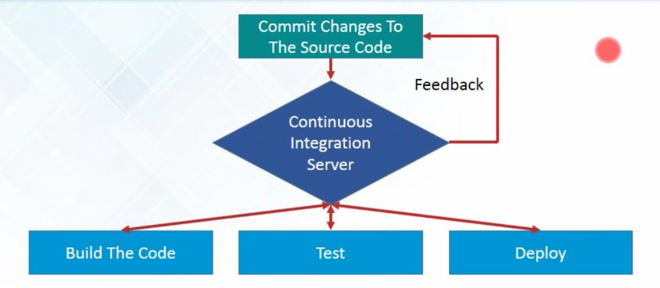
What is Continuous Integration...

Slide 10
What is Continuous Integration
In a large project with many developers, commits are made many times during a day. With each commit code is built and tested.
If the test is passed, build is tested for deployment.
If deployment is a success, the code is pushed to production.
This commit, build, test, and deploy is a continuous process and hence the name continuous integration/deployment.

Slide 11
Continuous Integration tools
Used to host, monitor, compile and test code, or code changes,
Continuous Integration Server
Jenkins, Bamboo, CruiseControl, TeamCity, and others
Source Control Tool
CVS, SVN, GIT, Mercurial, Perforce, ClearCase and others
Build tool
Make, ANT, Maven, Ivy, Gradle, and others
Automation testing framework
Selenium,, TestComplete, UFT, and others

Slide 12
Jenkins
Leading open source continuous integration tool.
Builds and tests software continuously
Monitors the execution and status of remote jobs
Easier for team members and users to regularly obtain the latest stable code.
Continuous Integration is done by the help of Plugins.
It provides support for over 1000 Plugins .

Slide 13
Advantages of using Jenkins
Jenkins is being managed by the community which is very open.
Created by a developer for developers.
As technology grows, so does Jenkins.
Has many plugins published in its plugins database.
With plugins, Jenkins becomes even more powerful and feature rich.
Jenkins also supports cloud-based architecture

Slide 14
Installing Jenkins
java -jar jenkins.war --httpPort=9090
Jenkins runs on Java, need latest version of Java Development Kit
Java –jar Jenkins.war
Java –jar Jenkins.war –httpPort=9090
Can be downloaded from https://jenkins.io/download/
Should select the required platform.
Unzip the downloaded package.
After completing the Jenkins installation process, a browser tab will pop-up asking for the initial Administrator password.
To access Jenkins, : http://localhost:8080

Slide 15
Installing Jenkins
The initial Administrator password should be found under the Jenkins installation path
initialAdminPassword
A file with the above can be found under C:\Program Files (x86)\Jenkins\secrets.
Customize Jenkins
Can customize with "Install suggested plugins button"
Jenkins will retrieve and install the essential plugins
After suggested plugins were installed
Use "Create First Admin User" panel to create users

Slide 16
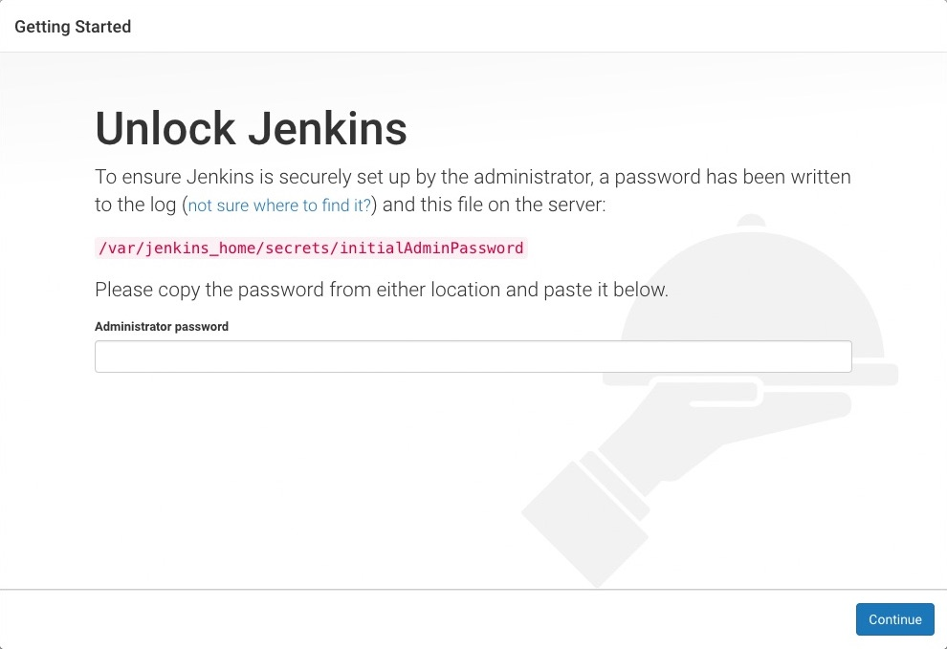
Unlocking Jenkins
Need to unlock Jenkins instance on first access
Should Enter an automatically-generated password.

Slide 17
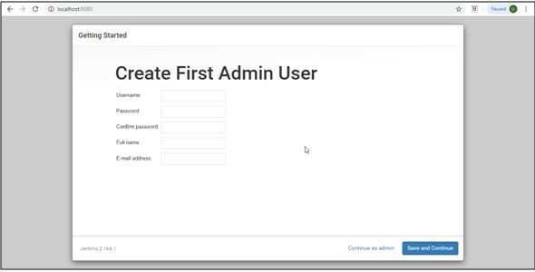
Creating Admin User

Slide 18
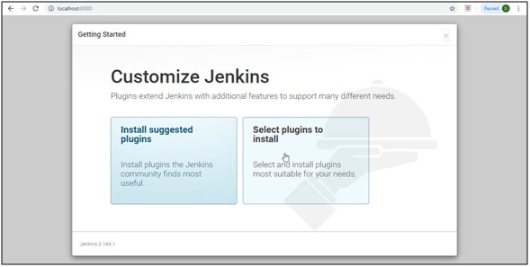
Customize Jenkins

Slide 19
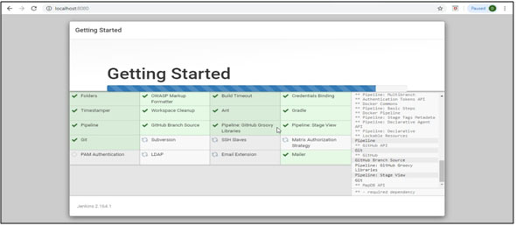
Customize Jenkins

Slide 20
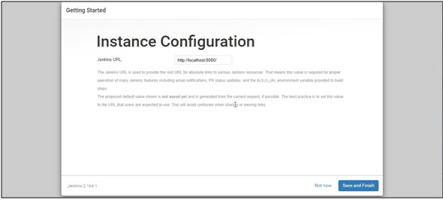
Instance Configurtion

Slide 21
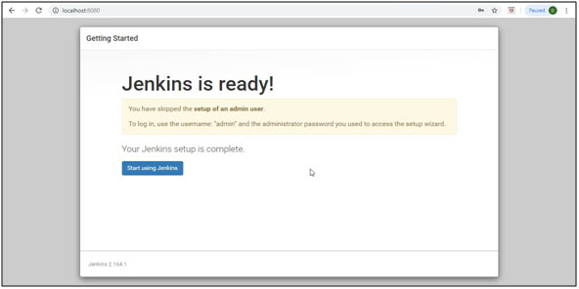
Jenkins Ready

Slide 22
Jenkins Dash Board
Jenkins dashboard is primary control point for interacting with Jenkins.
It includes controls for creating and running builds, inspecting build output, working with credentials and configuring Jenkins.
Can create Jenkins jobs from the Dash Board

Slide 23
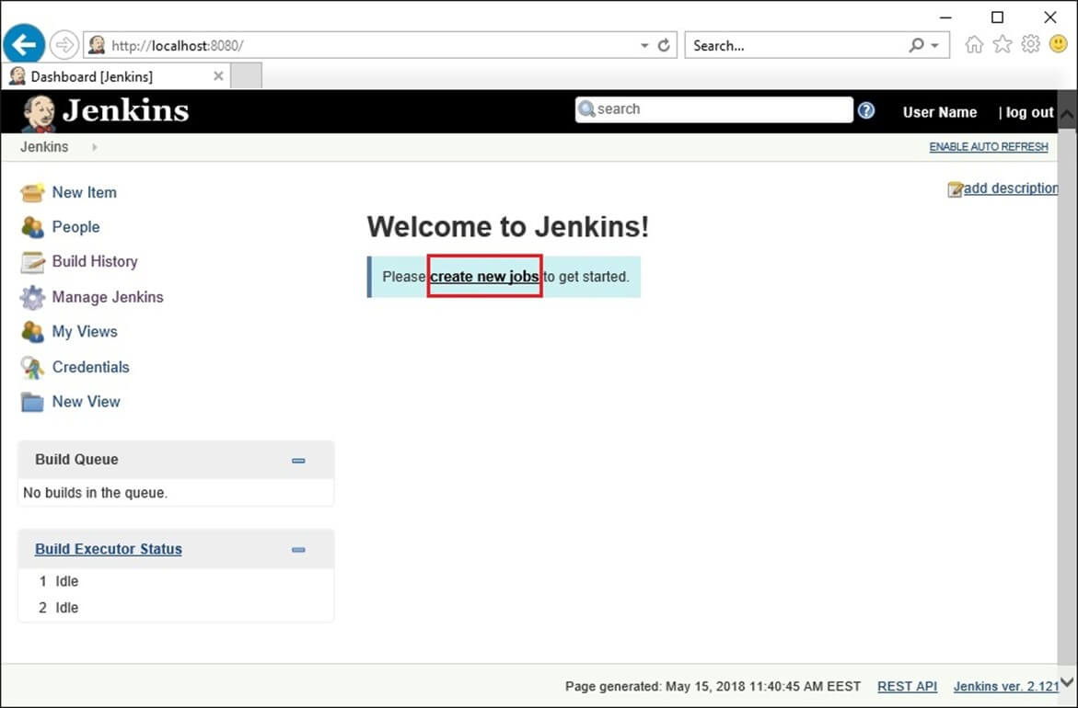
New Job

Slide 24
Simple Project
Begin by clicking the “New Item” link in the Jenkins dashboard.
Enter a name for the new project and select “Freestyle project”
Opens project configuration page
Can define various aspects of the build.
Select the “Build” section.
Choose “Add build step” button and add a step to “Execute window based command”.
In the “Command” box, enter a command that displays output and Save”
echo “Hello world”
From the project page click the “Build now” link.

Slide 25
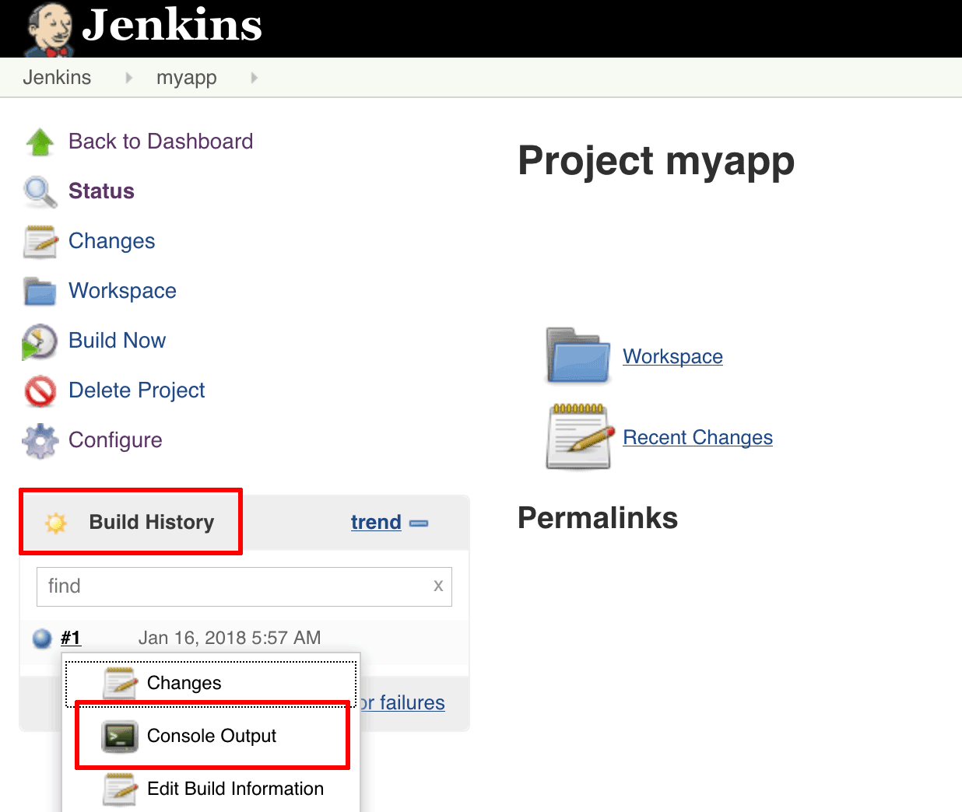
Building with Jenkins
Jenkins will build the project.
The “Build History” panel in the bottom left corner of the page will show you the status of the build
Blue indicates success, red indicates failure

Slide 26
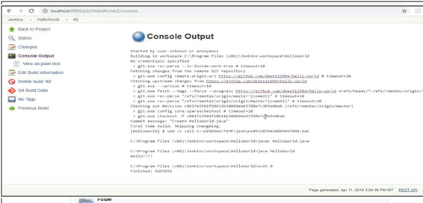

Slide 27
Jenkins Build Jobs
Freestyle job:
General-purpose build jobs with maximum flexibility and multiple configuration options.
Can be used for any project type.
Easy to Set up
Maven Project:
Specially designed for Maven projects.
Can use the POM files and project structures
Gathers information from the POM file to minimize the setup work for your project.

Slide 28
Jenkins Plugins
The default version of Jenkins comes with a limited set of features.
To integrate with version control tools like Git, need to install plugins.
Also Need to add tools and plugins for Maven, Docker etc
Jenkins May install these suggested plugins at the beginning itself.
Can also add it later

Slide 29
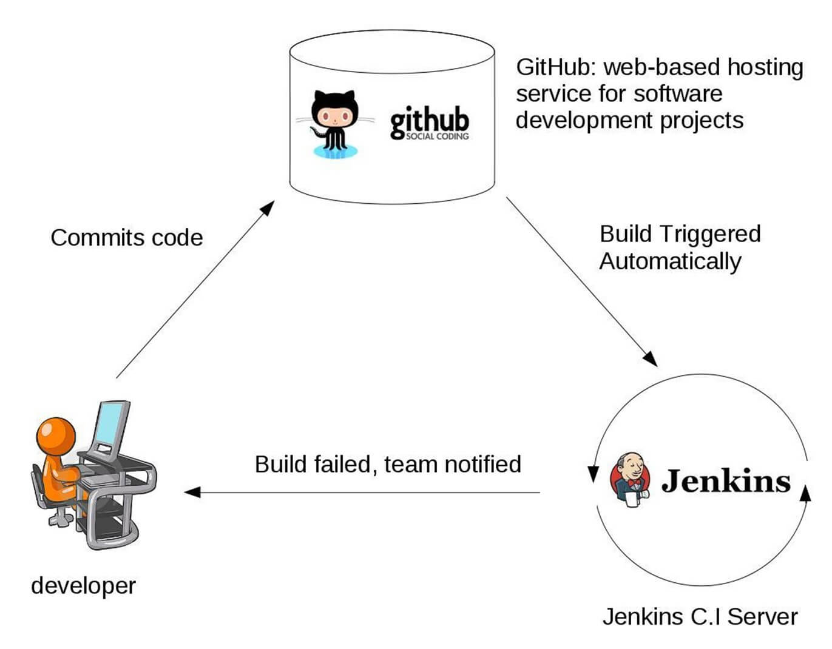
Working of Jenkins

Slide 30
Setting up Jenkins and Maven
Download Maven from Apache Maven.
Extract the files to the relevant application folder.
Navigate to the Jenkins dashboard
Select Manage Jenkins
Select ‘Configure System’
In the Configure system screen, scroll down to Maven section
Select ‘Add Maven’ button.
Uncheck the ‘Install automatically’ option.
Add name for the setting and the location of the M2_HOME.
Click on the ‘Save’ button at the end of the screen.

Slide 31
Build A Maven Project from GitHub
Can Build project stored in an external SCM, such as GitHub.
From the dashboard. Select the project
Choose the “Configure” button for the project.
In the project configuration page,
Choose “Source Code Management” section,
Choose “Git” as the option
Enter the clone URL for your GitHub repository.

Slide 32
Build A Project From GitHub
From the project configuration page select “Build” section
Add a new build step to “Invoke top-level Maven targets”.
In the “Maven Version” field, select the name of the Maven installation just created.
In the “Goals” field, specify the Maven goals as “clean package”.
Head back to the project page and click the “Build now” link.
Jenkins should clone GitHub repository and build it with Maven.
Once the build is complete, select the “Console Output” menu item to access detailed build information.

Slide 33
Jenkins Build
Status of the build is indicated in two ways, by a weather icon and by a colored ball.
The weather icon shows you a record of multiple builds in one image.
The sun represents that builds were successful.
The color of the ball gives us the status of that build,
Red shows failure.

Slide 34
Build trigger

Slide 35
Build Trigger
Trigger
Execute a job on an event occurrence.
This event is called a trigger.
Has list of build triggers

Slide 36
List of Build Triggers
Trigger build remotely:
The job is usually triggered by accessing a specified URL. This is convenient for scripts. With the URL, one needs to mention the authorization token as well.
Build after other projects are built:
As it reads, we need to mention the list of other projects, once those projects are built then the present job is executed.
Build periodically:
The build is triggered based on the mentioned time. A cron has to be mentioned here.
Poll SCM:
Configure Jenkins to poll the SCM for ant pushes or commits and then trigger the jobs.

Slide 37
Polling the SCM
Click on the “Configure” of the job created in the Jenkins dashboard.
Click on build triggers in the configure settings and select the Poll SCM.
Enter the desired cron to poll the SCM. Here we have given * * * * which means the Jenkins polls the SCM every minute.

Slide 38
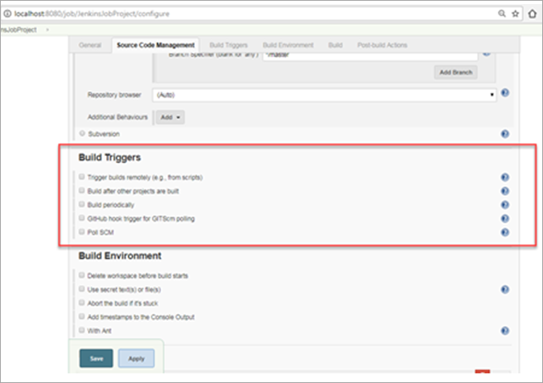
Build Triggers

Slide 39
CRON
CRON contains 5 places for each time entry
Minute (0-59)
tells at what minute of the hour the Job should build.
Hour (0-23 With 0 is the midnight)
tells at what hour the job should build in the 24-hour clock.
Day of the month (1-31)
- tells on which day of the month your job should build. e.g. 23rd of each month.
Month (1-12)
tells the month when your job should build. You can number or name the month as well I.e. April, May etc.
Day of the week (0-7 With 0 or 7 both being Sunday)
tells the day of the week when you want to build your job. It can also be a number or name like Mon etc.

Slide 40
CRON
Every day at 6 in the evening
0 18 * * *
After every 20 minutes
*0/20 * * * *
After every 4 hours
0 */4 * * *
This will run every Saturday (6) and Sunday (7) at 5 pm (17).
0 17 * * 6,7
To schedule your build every 5 minutes, this will do the job :
*/5 * * * *
To the job every 5min past every hour(5th Minute of every Hour)
5 * * * *

Slide 41
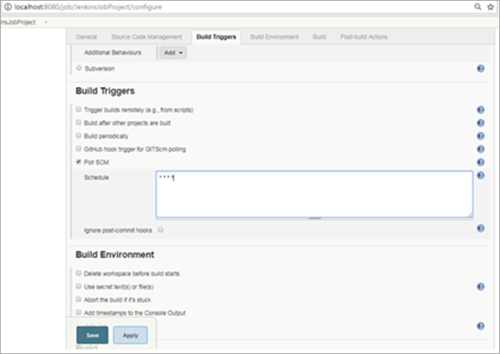
Adding CRON

Slide 42
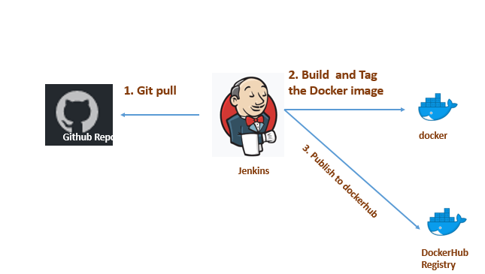
Jenkins –GIT Maven Docker Build

Slide 43
Jenkins pipeline

Slide 44
Jenkins Pipeline
Pipeline is a series of interlinked events or jobs.
Its a combination of plugins that support the integration and implementation of continuous delivery pipelines
It contains a group of states called build, deploy, test and release.
Every state has its events, which work in a sequence called a continuous delivery pipeline.
Every job or event has some sort of dependency on at least one or more events.
These events are interlinked with each other.

Slide 45
Why Use Jenkins Pipeline
Pipelines are robust.
Can run multiple jobs, and even use pipelines in a loop.
If server undergoes an unforeseen restart, the pipeline will be automatically resumed.
Can pause the pipeline process and make it wait to resume until there is an input from the user.
The scripted pipeline is stored in Jenkins webUI as a Jenkins file.
The end-to-end scripted pipeline script is written in Groovy.

Slide 46
Creating a Pipe Line
From the Jenkins home select “New Item”
Give a name, select “Pipeline” and click ok.
Scroll down to the Pipeline section, enter the pipeline code in the script section and save it.
Click “Build Now” and wait for the build to start.
While the job starts Can view each stage executing

Slide 47
Pipe Line Script from SCM
From the Jenkins home select “New Item”
Give a name, select “Pipeline” and click ok.
Scroll down to the Pipeline section
In the pipeline section -> Definition
Choose Pipeline Script from SCM
Enter the Repository URL https://github.com/vatsanTraining/training_jan_2026.git
In the script path entre the file name Jenkinsfile
Click “Build Now” and wait for the build to start.
While the job starts Can view each stage executing

Slide 48
Pipe Line Block
Pipeline code should be wrapped inside the pipeline block.
pipeline {
---<All Pipeline blocks go here>---
}
Tools Block
Can refer to the tools configured in the Jenkins Global tool configuration.
tools {
maven 'maven3'
}

Slide 49
Pipe Line Block
Stages:
Stages block contains multiple stages.
stages {
---<All Pipeline Stages Go Here>---
}
Stage Block:
A stage is a subset of stages.
Each stage has a steps block.
Steps Block:
In each steps block can define a set of operations to perform.

Slide 50
Jenkinsfile
pipeline {
agent any
environment {
DOCKER_PATH = '/usr/local/bin/docker'
APP_NAME = 'my-boot-app'
}
stages {
stage('Maven Build') {
tools {
maven 'M3_HOME'
}
steps {
dir('jenkins-with-boot') {
sh 'mvn clean install'
}
}
}

Slide 51
Jenkinsfile
stage('Docker Build') {
steps {
dir('jenkins-with-boot') {
script {
sh "export PATH=\$PATH:/usr/local/bin && ${DOCKER_PATH} build -t ${APP_NAME}:${BUILD_NUMBER} -t ${APP_NAME}:latest ."
}
}
}
}
stage('Deploy Local') {
steps {
script {
echo "App is Built"
}
}
}
}
}

Slide 52
Jenkins in Mac
brew install jenkins-lts
brew services start jenkins-lts
cat /Users/administrator/.jenkins/secrets/initialAdminPassword
% /usr/libexec/java_home
Mvn –version should display the maven home
Configure the details in tools
brew services start jenkins-lts

