Slide 1
Spring Security

Slide 2
Spring Security
Highly customizable authentication and access-control framework.
Focuses on providing both authentication and authorization
“Authentication”
The process of establishing a user, device or some other system which can perform an action in the application
“Authorization”
The process of deciding whether a principal is allowed to perform an action within the application.
authorization is done after authentication process.
Once the user is authenticated they may have one or more “roles”

Slide 3
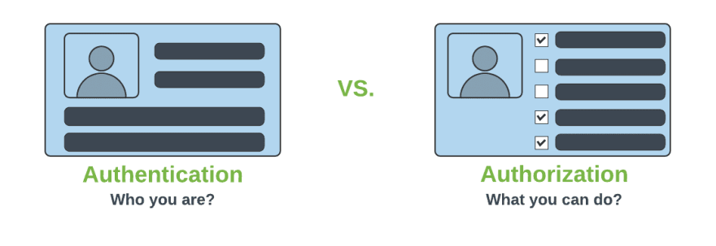
Authentication & Authorization

Slide 4
Add Spring Security Module
Update the pom.xml file with the following entry, can also add spring security while use starter project.
<dependency>
<groupId>org.springframework.boot</groupId>
<artifactId>spring-boot-starter-security</artifactId>
</dependency>

Slide 5
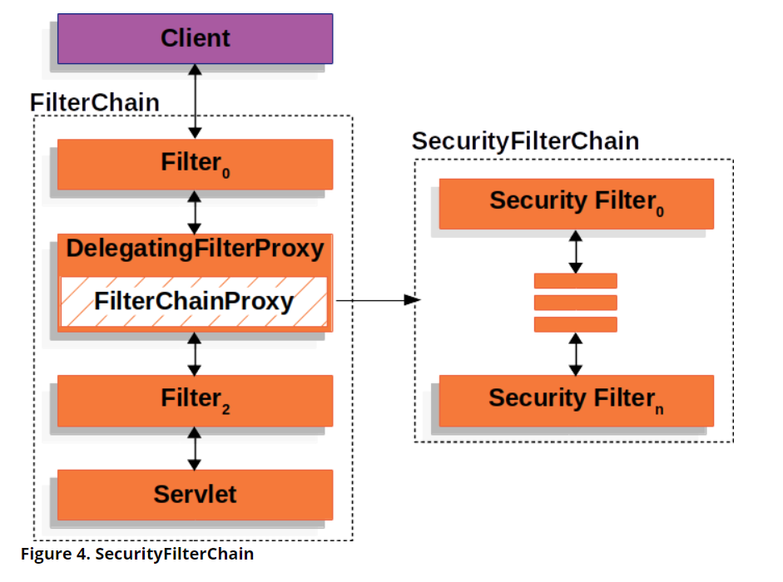
Spring Security Architecture

Slide 6
Spring Security Architecture
DelegatingFilterProxy
Servlet filter embedded in the spring context.
It delegates the incoming request to a bunch of filters
FilterChainProxy
A servlet filter which invokes the relevant filters that would work on the incoming request.
SecurityFilters
Contains a list of filters that need to be invoked before the controller can handle the request.
SecurityContextPersistenceFilter, HeaderWriterFilter, CsrfFilter, LogoutFilter, UsernamePasswordAuthenticationFilter etc.
FilterChainProxy queries this class to invoke each filter in a loop.

Slide 7
Authorizations
permitAll
No need of any authorization to access current page.
authenticated
Requires Login(username/password) and no authorization(role based access) is required.
hasAuthority
Requires that user should have both authentication and role based authorization access.
hasAnyAuthority
It represents that user should have authentication and multiple role based authorization access.

Slide 8
BCryptPasswordEncoder
An encryption class of Spring Security.
Spring provides a variety of encryption methods for passwords.
The official recommendation is to use BCryptPasswordEncoder, which uses the BCrypt strong hash function.
@Bean
PasswordEncoder passwordEncoder() {
return new BCryptPasswordEncoder();
}

Slide 9
HttpSecurity
HttpSecurity
Provides a Method authoriseRequests()
authorizeRequests()
To Define custom requirements for URLs
Can add multiple children to this method.
The matchers are considered in the order they were declared.
http.authorizeRequests()
.anyRequest().authenticated()
.and().httpBasic();

Slide 10
Entity and Repository
@Entity
@Table(name = "user")
public class UserEntity {
@Id
@GeneratedValue(strategy = GenerationType.IDENTITY)
private Long id;
private String username;
private String password;
private String role;
}
public interface UserRepository extends JpaRepository<UserEntity ,Long> {
Optional<UserEntity> findByUsername(String username);
}

Slide 11
User Details Service
Key Interface used for user authentication.
Has One Method
UserDetails loadUserByUsername(String username)
UserDetails
Encapsulates username, password, authorities (roles), and account status (enabled, locked, expired).
Called by AuthenticationProvider to obtain the necessary user information for authentication.
Method should throw a UsernameNotFoundException.

Slide 12
User Details Service
@Service
public class UserDetailServiceImpl implements UserDetailsService {
@AutoWired
private final UserRepository userRepository;
public UserDetails loadUserByUsername(String username) throws UsernameNotFoundException {
UserEntity user = userRepository.findByUsername(username)
.orElseThrow(() -> new UsernameNotFoundException("User not found"));
ArrayList<GrantedAuthority> authorites = new ArrayList<>();
authorites.add(() -> user.getRole());
return new User(user.getUsername(), user.getPassword(),authorites);
}
}
}
}

Slide 13
Security Filter chain
Takes an HttpSecurity object as an argument.
A builder that can be used configure HTTP security.
authorizeHttpRequests():
To configure authorization rules for HTTP requests.
requestMatchers("/public/": ).permitAll()`**:
Specifies that any request matching the /public/** pattern
anyRequest().authenticated():
Specifies that all other requests (not matching /public/**) require authentication.
permitAll():
Accessible without requiring authentication.
return http.build():
Returns the SecurityFilterChain object based on the configured HttpSecurity.

Slide 14
Security Config
import static org.springframework.security.config.Customizer.withDefaults;
@Configuration
@EnableWebSecurity
public class SecurityConfig {
private final UserDetailSecurity userDetailsService;
public SecurityConfig(UserDetailSecurity userDetailsService) {
this.userDetailsService = userDetailsService;
}

Slide 15
Security Config
@Bean
SecurityFilterChain securityFilterChain(HttpSecurity http) throws Exception {
http
.csrf(AbstractHttpConfigurer::disable)
.authorizeHttpRequests(
configurer -> configurer
.requestMatchers("/api/v1/unsecured/**").permitAll()
.anyRequest().authenticated()).httpBasic(Customizer.withDefaults());
return http.build();
}
}

Slide 16
Method Level Annoation
@EnableMethodSecurity
Restricting access to specific methods
To ensure that only authorized users can perform critical operations.
@PreAuthorize("hasRole('ROLE_GUEST’)”)
Access control is evaluated prior to method invocation.
It leverages Spring Expression Language (SpEL) expressions
Dynamically determine access permissions.

Slide 17
CSRF
Its a web security vulnerability that allows an attacker to induce users to perform actions that they do not intend to perform.
It allows an attacker to partly circumvent the same origin policy, which is designed to prevent different websites from interfering with each other.
Should be used for protecting any request that could be processed by a browser by normal users.
If a service is used by non-browser clients, CSRF protection can be disabled

Slide 18
Client Application
WebClient client = ctx.getBean(WebClient.class);
client.get().uri("http://localhost:8080/")
.header(HttpHeaders.AUTHORIZATION,
"Basic " + Base64.getEncoder()
.encodeToString("ramesh:@3456".getBytes()))
.retrieve()
.onStatus(HttpStatusCode::is4xxClientError, clientResponse ->
Mono.error(new RuntimeException("Exception-Check Credentials")))
.bodyToFlux(String.class).subscribe(System.out::println);

Slide 19
Json Web Token
A secure way to send information between a client and a server.
It is mainly used in web applications and APIs to verify users and prevent unauthorized access.
A JWT is JSON data secured with a cryptographic signature.
The signing can be done using these cryptographic methods:
HMAC (Hash-based Message Authentication Code)
RSA or ECDSA (Asymmetric cryptographic algorithms)

Slide 20
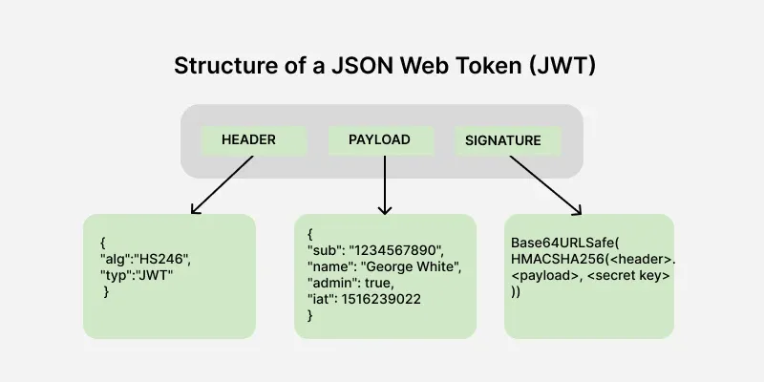

Slide 21
Part of JWT
Header:
Contains metadata about the token, such as the algorithm used for signing.
Payload:
Stores the claims, i.e., data being transmitted.
Signature:
Ensures the token's integrity and authenticity.
The header contains meta data about the token, including the signing algorithm and token type here metadata means data about data.
{ "alg": "HS256", "typ": "JWT" }
alg: Algorithm used for signing (e.g., HS256, RS256).
typ: Token type, always "JWT".

Slide 22
Payload
Information about the user known as a claim
The timestamp at which it was issued and the expiry time of the token.
{ "userId": 123, "role": "admin", "exp": 1672531199 }

Slide 23
Signature
To ensures token integrity and is generated using the header, payload, and a secret key.
Using HS256 algorithm
HMACSHA256( base64UrlEncode(header) + "." + base64UrlEncode(payload), secret )

Slide 24
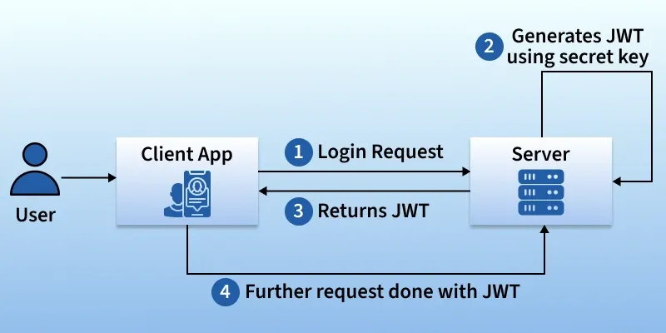

Slide 25
JWT Token
SecretKey :
A long, random string that acts like a password or digital signature key.
Used to sign the JWT. Only someone who knows this secret can verify that the token is authentic and hasn't been tampered with.
It must be kept private and secure.
private Key getSignInKey() {
byte[] keyBytes = Decoders.BASE64.decode(SECRET);
return Keys.hmacShaKeyFor(keyBytes);
}

Slide 26
JWT Token
The SECRET string is often encoded in a format called Base64.
Decoders.BASE64.decode(SECRET) converts the Base64 string back into its raw byte array format.
Keys.hmacShaKeyFor(keyBytes)
Create a secure Key object that the JWT library can use to perform the digital signature (HMAC-SHA).

Slide 27
Simple Code To Generate JWT
@Service
public class JwtService {
public static final String SECRET = "at34werthbasdfaestrjr67uywaewrqwegwerytjetgbvawefw46u45ytnbserfgw465u467irythqgergt3465u457ie45yw34tqq23rq23r2";
public String generateToken(String username) {
return Jwts.builder().issuer("myorg")
.subject("srivatsan")
.claim("name", "trainer srivatsan")
.claim("scope", "read ,write")
.signWith(getSignInKey()) .compact();
}

Slide 28
JWT Creation
private Key getSignInKey() {
byte[] keyBytes = Decoders.BASE64.decode(SECRET);
return Keys.hmacShaKeyFor(keyBytes);
}
}
System.out.println(ctx.getBean(JwtService.class).generateToken("ramesh"));

Slide 29
JWT Security Config
Used while using JWT, the client must send token with every request and it gets validated to determine identity and permissions.
sessionManagement(sess -> sess.sessionCreationPolicy(SessionCreationPolicy.STATELESS));
.sessionManagement(...):
To Configure sessions handling
sess -> sess.sessionCreationPolicy(...):
Method to set the session creation policy.
SessionCreationPolicy.STATELESS:
Will not create or use HTTP sessions to store security context

Slide 30
Keys.hmacShaKeyFor
this.key = Keys.hmacShaKeyFor(secret.getBytes());
To create a cryptographic Key object
Used with HMAC (Hash-based Message Authentication Code)
HS256 (HMAC using SHA-256)
HS384 (HMAC using SHA-384)
HS512 (HMAC using SHA-512)
With secret key as bytes generates a configured Key instance that can be passed to the JWT builder or parser for signing or verifying a JSON Web Token.

Slide 31
Validate JWT Token
@Value("${jwt.secret}")
private String secret;
private Key key;
@PostConstruct
public void init(){
this.key = Keys.hmacShaKeyFor(secret.getBytes());
}
private Claims getAllClaimsFromToken(String token) {
return Jwts.parserBuilder()
.setSigningKey(key)
.build()
.parseClaimsJws(token)
.getBody();
}

Slide 32
Validte JWT Token
public boolean isTokenExpired(String token) {
return this.getAllClaimsFromToken(token).getExpiration().before(new Date());
}
public boolean isTokenValid(String token) {
try {
this.getAllClaimsFromToken(token);
return !isTokenExpired(token);
} catch (Exception e) {
return false;
}
}
public String extractUsername(String token) {
return getAllClaimsFromToken(token).getSubject();
}

