Slide 1
Spring actuator

Slide 2
Spring Boot Actuator
Exposes REST endpoints that can be consumed to manage and monitor application.
Monitor application health, application bean details, version details, thread dumps, logger details etc
Can restrict these endpoints to be consumed by authorized users only and Spring provides easy way to secure your REST endpoints.

Slide 3
actuator End Point
actuator
It provides a hypermedia-based discovery page for the other endpoints.
By default it is sensitive and hence requires username/password for access or may be disabled if web security is not enabled.
Beans
It displays complete beans configured in the app.
Configprops
It displays a collated list of all @ConfigurationProperties.

Slide 4
actuator End Point
Health
It shows application health information
management.endpoint.health.show-details:=always
Info
It displays arbitrary application info.
Loggers
It shows and modifies the configuration of loggers in the application.
metrics:
It shows metrics information for the current application.
Mappings
It displays a collated list of all @RequestMapping paths.

Slide 5
Actuator Endpoints
health and info can be accessed
Other endpoints are disabled by default
management.endpoints.web.exposure.include=*.
Will enable all of them
Can also list endpoints which should be enabled
To expose all enabled endpoints except one (for example /loggers), we use:
management.endpoints.web.exposure.include=*
management.endpoints.web.exposure.exclude=loggers
management.security.enabled=false

Slide 6
Info Endpoint
info:
app:
name: ${spring.application.name}
build:
artificatId: '@project.artifactId@'
groupId: '@project.groupId@'
version: '@project.version@'
java:
version:@java.version@
management: info: java: enabled: true env: enabled: true

Slide 7
Health Endpoint
management:
endpoint:
health:
show-details: always

Slide 8
Logger Endpoint
http://localhost:8787/actuator/metrics
http://localhost:8787/actuator/loggers
To Change the Log level make a post request
http://localhost:8787/actuator/loggers/org.springframework.boot.SpringApplication
{ "configuredLevel": "trace“ }
To reset the logging level back to the original value
{ "configuredLevel": null }

Slide 9
Shut Down End Point
Endpoint is used to shut down the Spring Boot application
Need to enable by adding a property in the application.yml
Done By Making a POST call.
http://localhost:7070/actuator/shutdown
management:
endpoint:
shutdown:
enabled: true

Slide 10
Extending Info End Point
@Component
public class CustomInfoEndPoint implements InfoContributor {
@Autowired
private ConfigurableApplicationContext ctx;
@Override
public void contribute(Info.Builder builder) {
Map<String, Object> details = new HashMap<>();
details.put("bean-definition-count", ctx.getBeanDefinitionCount());
details.put("startup-date", ctx.getStartupDate());
builder.withDetail("context", details);
}
}

Slide 11
Spring cloud config server

Slide 12
Move configuration away from application
Cloud Applications requires a way to maintain and distribute the Configuration data to all services
Auditing changes:
Look at the history of what changes were done by whom and when they were applied.
Approval of changes:
Lot of issues are caused by the wrong configuration.
Changes should be approved by some one
Resiliency:
Issues related to configuration tool being not available
Synchronization:
Way to know that there is a change in the configuration

Slide 13
Spring-cloud-config
Server
Pulls configuration for remote clients from various sources.
Repositories can resolve the Environment that applies for a specific application, profile, and label.
There are different implementations to pull ,that can connect to Git, SVN, or Vault.
Client
The client which will connect to the server through HTTP.
It adds a PropertySourceLocator that will call the server to load up the applicable configuration.

Slide 14
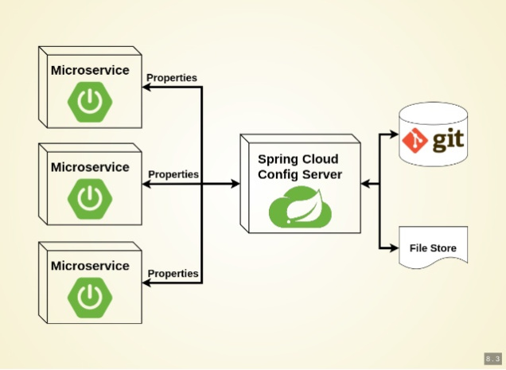
Working of Configuration Server

Slide 15
Types of Configuration
Global Configuration
By Using application.yml or application.propeties
Application-Specific Configuration
Serving only to a specific app.
[APP-NAME].yml or [APP-NAME].properties
. Profile-Specific Configuration
[APP-NAME]-[PROFILE-NAME].yml or [APP-NAME]-[PROFILE-NAME].properties

Slide 16
Git Repository
Can store the properties in git repository
Create or update a git repository.
Can Create and place the external property files
Micro Service will be using external configuration of properties.
Can maintain same property name for different environment
It can be details of urls, credentials, database details etc.

Slide 17
Git Repository Directory Structure
https://github.com/vatsanTraining/spring-cloud-config
customer-service
application.yml
payment-service
application.yml

Slide 18
Config Server
Spring Cloud Config Server provides an HTTP resource-based API for external configuration
@EnableConfigServer
The server is embeddable in a Spring Boot application
@SpringBootApplication
@EnableConfigServer
public class ConfigServer {
public static void main(String[] args) { SpringApplication.run(ConfigServer.class, args);
}
}

Slide 19
Spring Cloud Configuration Server
searchPaths
Repository can also optionally store config files in sub-directories, and patterns to search for those directories can be specified as
spring:
cloud:
config:
server:
git:
uri: https://github.com/vatsank/spring-cloud-config
search-paths:
- '{application}’
http://localhost:8888/actuator/default

Slide 20
Config Client Configuration
spring:
application:
name: customer-service
config:
import: configserver:http://localhost:8888
management:
endpoints:
web:
exposure:
include:
- "*“
http://localhost:8080/actuator/configprops

Slide 21
Refresh Scope
@RefreshScope
Can do dynamic configuration of properties by reloading.
If a property is modified in the configuration server,
Spring Boot will automatically reload the new values without needing to restart it.
Need to make a POST request to the “/actuator/refresh” endpoint
POST: localhost:8080/actuator/refresh

Slide 22
Reactive spring

Slide 23
Introduction
A programming paradigm that promotes
asynchronous, non-blocking, event-driven approach to data processing.
Thread per request model to more requests with few number of threads
Prevent threads from blocking while waiting for I/O operations to complete

Slide 24
Subscription
Subscription made by the subscriber
With the publisher
To fetch data.
public interface Subscription {
public void request(long n);
public void cancel();
}

Slide 25
Subscriber
Represents the consumer of the stream data.
public interface Subscriber<T> {
public void onSubscribe(Subscription s);
public void onNext(T t);
public void onError(Throwable t);
public void onComplete();
}

Slide 26
Publisher
Represents the data source
database, external service, etc.
public interface Publisher<T> {
public void subscribe(Subscriber<? super T> s);
}

Slide 27
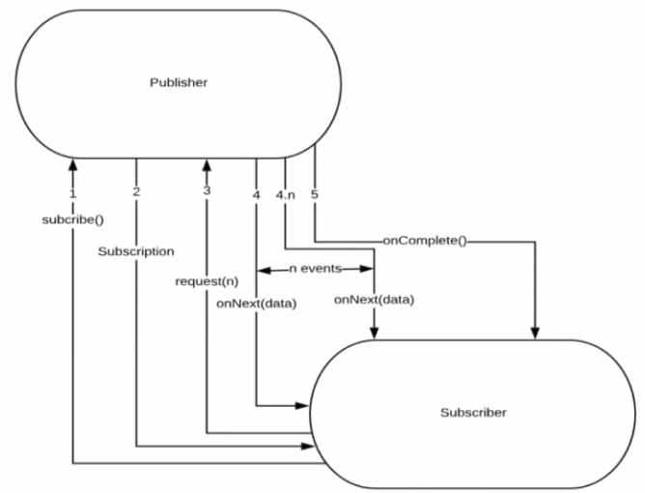
Flow Between Publisher and Subscriber

Slide 28
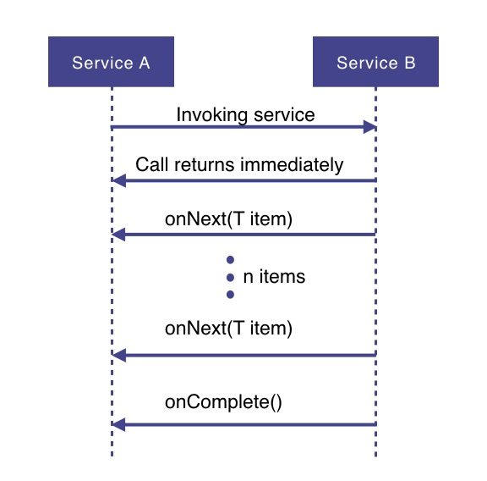
How Does it Work

Slide 29
How Does it Work
Service A wants to retrieve some data from service B.
Service A will make a request to service B which returns immediately
Non-blocking and asynchronous.
Data requested will be made available to service A as a data stream,
Service B will publish an onNext-event for each data item one by one.
When all the data has been published
onComplete event is fired
In case of an error, an onError event would be published
Items would not be emitted.

Slide 30
Project reactor

Slide 31
PROJECT REACTOR
Spring Framework supports reactive programming since version 5.
That support is build on top of Project Reactor.
WebFlux, Spring's reactive-stack web framework, requires Reactor as a core dependency.
Suited for Microservices Architecture
Offers backpressure-ready network engines for HTTP (including Websockets), TCP, and UDP.
Built and maintained by Pivotal
Recommended Library to work with Spring Boot
Runs on Java 8 and above.

Slide 32
Setting up a Project
Spring Boot application using Spring Initializr.
Add Spring Reactive Web as dependecy
The spring-boot-starter-webflux dependency is added
It will bring in the reactor-core dependency.
The reactor-test has been added as a dependency.
Spring Webflux
A reactive-stack web framework
Runs on Netty, and Servlet 3.1+ containers.

Slide 33
Types of Publishers
Spring Webflux uses two Publishers
Mono
To publish 0..1 element
Mono is like the Optional type provided in Java 8.
Mono to return a single object or VOid
Flux
To publish 0..N element.
Used to return lists.

Slide 34
Flux and Mono
They are both terminated either by a completion signal or an error
They call a downstream Subscriber's onNext, onComplete and onError methods.
Both provide a set of operators to support transformations, filtering, and error handling.

Slide 35
Creating Flux
Just (T... data)
Overloaded method
Create a new Flux that will only emit a single element then onComplete.
Returns a new Flux
Flux<String> fluxColors = Flux.just("red", "green", "blue");
fluxColors.subscribe(System.out::println);

Slide 36
Spring webclient

Slide 37
WebClient
Introduced from Spring 5
Its a non-blocking client with support for Reactive Streams.
It’s a replacement for RestTemplate .
Its more functional and is fully reactive.
It's included in the spring-boot-starter-weblux dependency

Slide 38
Load Balancing
A distributed system may consist of many services running on different computers.
When the number of users is large, a service is created multiple replicas.
Each replica runs on a different computer.
A Load Balancer” helps to distribute incoming traffic equally among servers.

Slide 39
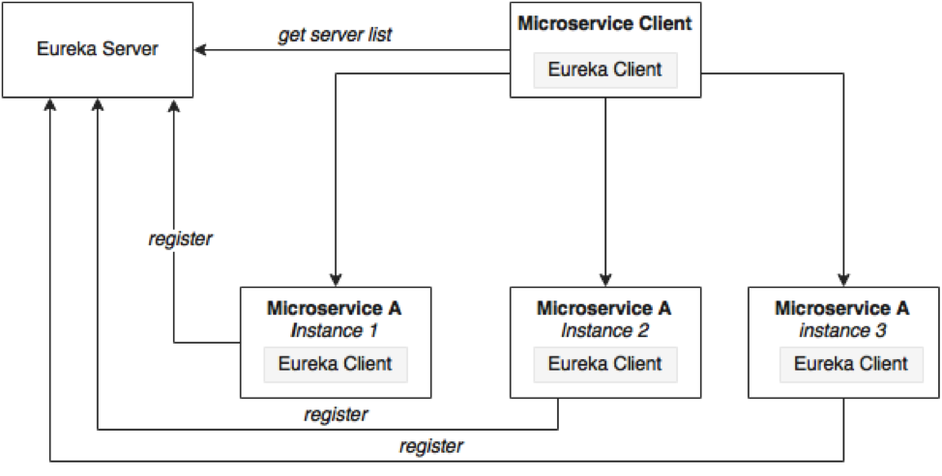
Load Balancing

Slide 40
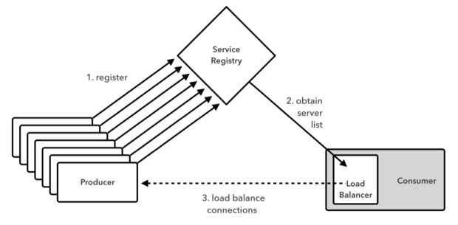
Working of Load Balancer

Slide 41
Load Balancing on Server Side
Load Balancers are components placed at the Server Side.
When the requests come from the Client, they will go to the load balancer, and the load balancer will designate a Server for the request.
It may use algorithm like random designation.
Most load balancers are hardware, integrated with software to control load balancing.
Need a separate server to host the load balancer instance which has the impact on cost and maintenance.

Slide 42
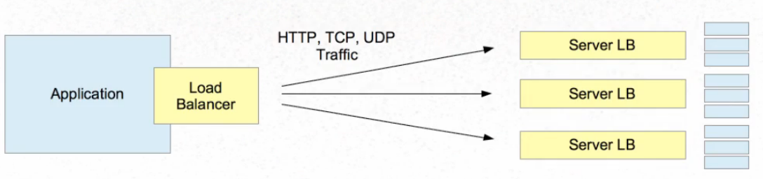
Server Side and Client Side

Slide 43
Load Balancing with Web Client
Add spring-cloud-starter-load balancer dependencies
Web Client can be configured to work with Load Balancer client
WebClient.Builder
Used to create a load-balanced WebClient
Add the @Bean annotation

Slide 44
Load Balancing with Web Client
@Bean
@LoadBalanced
WebClient.Builder loadBalanced(){
return WebClient.builder();
}
@Bean
WebClient client(WebClient.Builder builder) {
return builder.build();
}

Slide 45
To Register Multiple Instances
server:
port: ${port:0}
eureka:
instance:
instance-id:
${spring.application.name}:
${spring.application.instance_id:${random.value}}

Slide 46
Get the Instance’s Port Number
@Service
@Getter
@Slf4j
public class ServerPortService {
private int port;
@EventListener
public void onApplicationEvent(ServletWebServerInitializedEvent event) {
log.info("Server Port :="+event.getWebServer().getPort());
}
}

Slide 47
Reactive Load Balancer
ReactiveLoadBalancer
The Implementation of the interface uses a Round-Robin
It gets instance from reactive ServiceInstanceListSupplier
It retrieves available instances from Service Discovery using a Discovery Client available in the classpath.
@LoadBalanced
Need to have a load balancer implementation in the classpath.
If the Spring Cloud LoadBalancer is in the class path Then, ReactiveLoadBalancer is used
Helps to use "logical identifiers" for the URLs passed

Slide 48
Http Methods
get()
indicates that we are making a GET request.
We know that the response will be a single object, so we're using a Mono as explained before.
client.get()
Client.post()

Slide 49
WebClient
client.get().uri("lb://PRODUCT-SERVICE/api/v1/items")
URI
Takes a service name => lb://PRODUCT-SERVICE
The “lb“ in the “uri” will use the LoadBalancerClient
Load Balancer Client will resolve to an actual host and port
Replaces the URI

Slide 50
Rest Client - Controller
@RestController
public class ClientController {
@Autowired
private WebClient client;
@GetMapping(path = "/hotels")
public Flux<String> getAllHotels(){
return client.get()
.uri("lb://HOTEL-SERVICE/api/v1/hotels")
.retrieve()
.bodyToFlux(String.class);
}
}

Slide 51
Rest Client - Controller
@PostMapping(path = "/hotels")
public Mono<HotelDto> create(@RequestBody HotelDto dto)
{
return client.post()
.uri("lb://HOTEL-SERVICE/api/v1/hotels/{id}")
.body(Mono.just(dto), HotelDto.class)
.retrieve()
.bodyToMono(HotelDto.class);
}

Slide 52
Rest Client - Controller
@DeleteMapping(path = "/hotels/{id}")
public Mono<Void> removeHotelById(@PathVariable("id") int id){
return client.delete()
.uri("lb://HOTEL-SERVICE/api/v1/hotels/{id}" ,id)
.retrieve()
.bodyToMono(Void.class);
}
}

Slide 53
Rest Client - Controller
@GetMapping(path = "/hotels/{id}")
public Mono<String> getHotelById(@PathVariable("id") int id){
return client.get()
.uri("lb://HOTEL-SERVICE/api/v1/hotels/{id}",id)
.retrieve()
.bodyToMono(String.class);
}

Slide 54
Zipwhen
Used to Wait for the result from first mono,
uses it to create a second mono provided by rightGenerator
when both sources complete Returns a new combined Mono
Combine both results into defined by the provided combinator function.
Mono.zipWhen(
Function<First, Mono<? extends Second>> rightGenerator,
BiFunction<First,Second, ResponseDto> combinator)

Slide 55
ZipWhen
@GetMapping(path = "/srch/{id}")
public Mono<ResponseDto> getDetails(@PathVariable("id") int id){
return client.get()
.uri("http://localhost:4042",uriBuilder -> uriBuilder.path("/api/v1/customers/{id}")
.build(id)).retrieve().bodyToMono(Customer.class)
.zipWhen(custResp -> client.get()
.uri("http://localhost:3042" ,uriBuilder -> uriBuilder.path("/api/v1/payments/{name}")
.build(custResp.getCustomerName())).retrieve().bodyToMono(Payment.class), (custResp,payResp) -> {
dto.setCustomer(custResp);
dto.setPayment(payResp);
return dto;
});}

Slide 56
Spring cloud circuit breaker

Slide 57
Circuit Breaker
Used to stop the communication to the application may slow down or fail
It interrupts the current flow after a fault is detected
When it is is reset (manually or automatically), it can resume its normal operation.
Services will fail fast and have some fallback functionality.
It prevents the failure from cascading and giving the failing service time to recover.

Slide 58
Spring Cloud Circuit Breaker
Spring Cloud Circuit Breaker
An abstraction API for adding circuit breakers to your application.
There are few supported implementations:
Resilience4J
Resilience4J Reactive
Spring Retry

Slide 59
Resilience4j
Fault tolerance library designed for Java 8 and functional programming.
It is lightweight, modular and fast.
resilience4j-circuitbreaker
resilience4j-ratelimiter
resilience4j-bulkhead
resilience4j-retry
resilience4j-cache
Fault Tolerance
The ability of a system to operate properly in case of the failure of some of its components.
Done at all levels and also in subsystems as a part of the design.

Slide 60
Circuit Breaker
Wrap a protected function call in a circuit breaker object
Circuit Breaker will monitor for failures.
Once the failures reach a certain threshold, the circuit breaker trips,
All further calls to the circuit breaker return with an error, without the protected call being made at all.

Slide 61
Need For Circuit Breaker
In case we have serviceB down, serviceA should still try to recover from this and try to do one of the followings:
Custom fallback:
Try to get the same data from some other source. If not possible, use its own cache value.
Fail fast:
If serviceA knows that serviceB is down, there is no point waiting for the timeout and consuming its own resources. It should return ASAP “knowing” that serviceB is down
Don’t crash:
As we saw in this case, serviceA should not have crashed.
Heal automatic:
Periodically check if serviceB is working again.
Other APIs should work:
All other APIs should continue to work.

Slide 62
Configuring Circuit Breaker
public class OrderController {
private WebClient client;
private ReactiveResilience4JCircuitBreakerFactory cbFactory;
private ReactiveCircuitBreaker circuitBreaker;
// Two Args Constructor
public OrderController(
WebClient client,
ReactiveResilience4JCircuitBreakerFactory cbFactory) {
this.client = client
this.cbFactory = cbFactory;
this.circuitBreaker = cbFactory.create(“orderService");
}

Slide 63
Configuring With Web Client
@GetMapping(path = "/order")
public Mono<String> slow() {
return circuitBreaker.run(
client.get()
.uri("lb://ORDER-SERVICE/orders")
.retrieve()
.bodyToMono(String.class),
throwable -> Mono.just("fallback"));
} }
Can also add timeout : timeout(Duration.ofMinutes(5));

Slide 64
Configuring With Web Client
import org.springframework.cloud.circuitbreaker.resilience4j.*;
@Bean
public Customizer<ReactiveResilience4JCircuitBreakerFactory> defaultCustomizer(){
return factory -> factory.configureDefault(id -> new Resilience4JConfigBuilder(id)
.circuitBreakerConfig(CircuitBreakerConfig.ofDefaults()).build());
}
In order to override the default configuration, we need to specify our own beans and properties
a Customizer<CircuitBreakerFactory> bean.

Slide 65
Stages of Circuit Breaker
Circuit Breaker has the following three stages:
Closed
Open
Half-Open

Slide 66
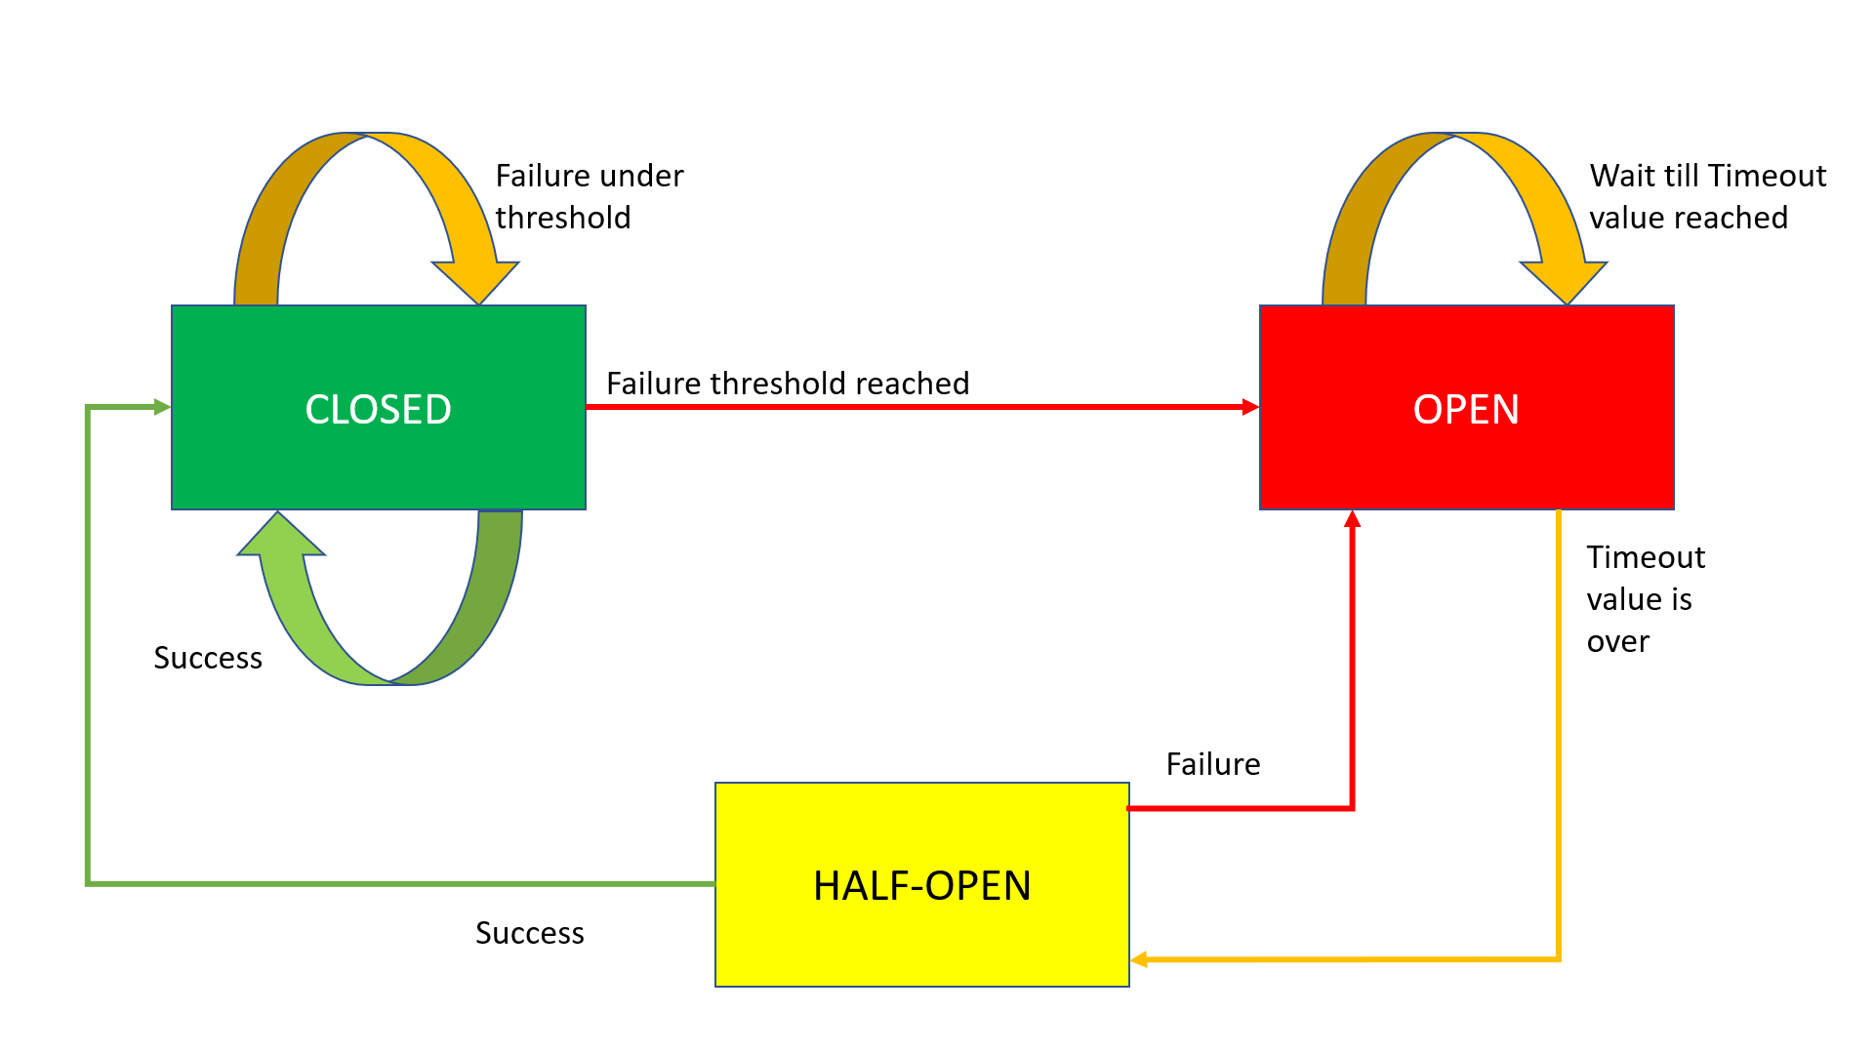
Circuit Breaker Working

Slide 67
Closed State
The Circuit Breaker enters a CLOSED state and waits for Client Requests.
In the CLOSED state, it does the following things:
It receives Client Requests and makes a call to the Service
If it succeeds and receives the response from that Service, it will reset the failure count to 0 and send that response back to the end user.
If it fails to receive the response from that Service, it will increment the failure count by one and check whether that count is greater than the predefined failure threshold
If the failure count is greater than the failure threshold, then that Circuit Breaker component trips or enters into the OPEN state
CLOSED state means flow goes as expected,

Slide 68
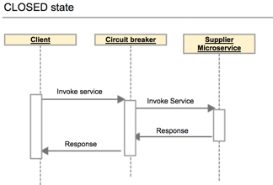
Closed State

Slide 69
OPEN state
In the OPEN state, it does the following things:
Enters into this state when the failure count is greater than the failure threshold
It does not make a call to the Service
If the Client sends any requests to it, it won’t make a call to the Service; it just sends an Exception and waits for some time
i.e. the Timeout value specified
Once the Timeout value expires, it will enter into the HALF-OPEN state
OPEN means situation is not good and moving to fallback mode

Slide 70
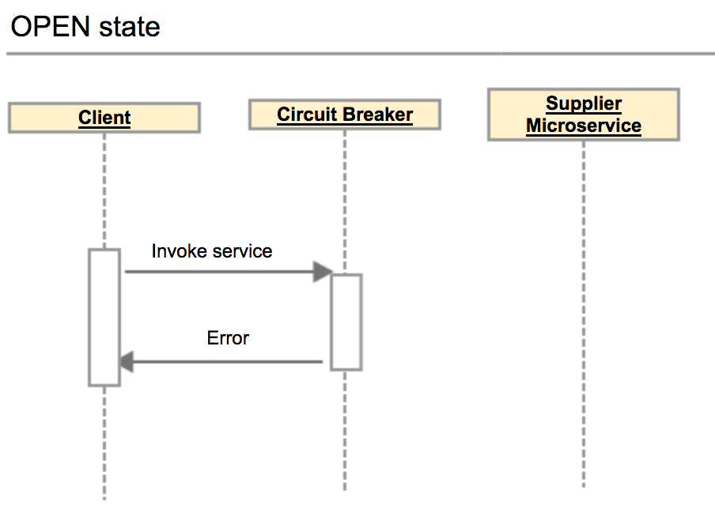
Open State

Slide 71
HALF-OPEN state
In the HALF-OPEN state, it does the following things:
Enters into this state when it finishes the predefined waiting time.
It sends the first request to the Service.
If it receives a success response, then it will enter into the CLOSED state to process further Client Requests. Before picking up the first client request, it will reset the failure count to 0 again.
If it receives a failure response, then it will re-trip to the OPEN state and wait for a predefined Timeout value to expire.

Slide 72
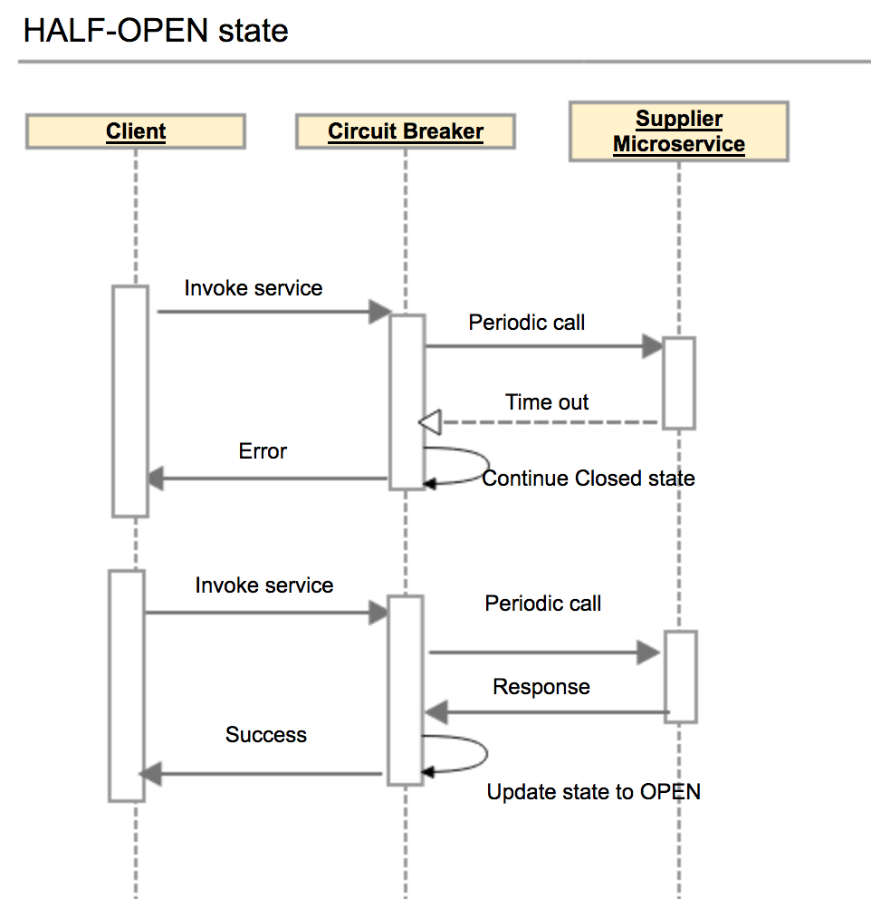
Half Open State

Slide 73
Configuring Circuit Breaker
failureRateThreshold:
Failure threshold value of 50 which means if the 50 requests are failing in the 100 requests, keep the circuit breaker in CLOSED state.
permittedNumberOfCallsInHalfOpenState
Default Value : 10
Configures the number of permitted calls when the CircuitBreaker is half open.

Slide 74
Configuring Circuit Breaker
slidingWindowType : COUNT_BASED
Used to store and count the results of calls
Circuit breaker always keeps the total number of invoke equals to slidingWindowSize.
COUNT_BASED:
The last slidingWindowSize calls are recorded and aggregated.
TIME_BASED:
The calls of the last slidingWindowSize seconds recorded and aggregated
slidingWindowSize
Default value is100
Deciding the number of calls to decide when closing a circuit breaker.

Slide 75
Failure rate formula
Count based sliding window
FailureRate = numberOfFailureInvoke / totalNumber X 100%.
Total number =Number of failures invoke + number of successes invoke.
The total number of invoke never exceed the slidingWindowSize .
If the slidingWindowSize is 10 and the number of successes invoke is Nine.
If the 10th invoke is a failure invoke, then circuit breaker will decrease the number of successes invoke by one, and increases the number of failures invoke by one.
Circuit breaker always keeps the total number of invoke equals to slidingWindowSize.

Slide 76
Configuring Circuit Breaker
waitDurationInOpenState:
The time in millisecond that breaker should wait before transitioning from open to half-open
Default value is 60000 (1 Minute)
automaticTransitionFromOpenToHalfOpenEnabled
True: CircuitBreaker will automatically transition from open to half-open state and no call is needed to trigger the transition.
A thread is created to monitor all the instances of CircuitBreakers to transition them to HALF_OPEN once waitDurationInOpenState passes.
False : the transition to HALF_OPEN only happens if a call is made, even after waitDurationInOpenState is passed.
The advantage here is no thread monitors the state of all CircuitBreakers

Slide 77
Configuring Circuit Breaker
minimumNumberOfCalls Default :100
Used for failure rate calculation.
If minimumNumberOfCalls is 10, then at least 10 calls must be recorded, before the failure rate can be calculated.
If only 9 calls have been recorded the CircuitBreaker will not transition to open even if all 9 calls have failed.

Slide 78
circuitbreaker
resilience4j:
circuitbreaker:
instances:
orderService:
registerHealthIndicator: true
automaticTransitionFromOpenToHalfOpenEnabled: false
failureRateThreshold: 50
minimumNumberOfCalls: 3
permittedNumberOfCallsInHalfOpenState: 2
slidingWindowSize: 10
waitDurationInOpenState: 5s
slidingWindowType: COUNT_BASED

Slide 79
circuitbreaker
management:
endpoints:
web:
exposure:
include:
- "*"
endpoint:
health:
show-details: always
circuitbreakers:
enabled: true
health:
circuitbreakers:
enabled: true

Slide 80
Actuator Endpoints
http://localhost:6565/actuator/circuitbreakerevents
http://localhost:8080/actuator/health
http://localhost:6565/actuator/circuitbreakers
http://localhost:6565/actuator/metrics/resilience4j.circuitbreaker.calls

Slide 81
Spring cloud gateway

Slide 82
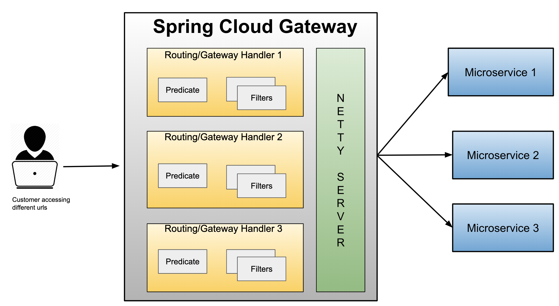
Spring cloud gateway

Slide 83
Gateway
Micro Services require a unified interface to the consumers.
Services are split into small composable apps
It shouldn’t be visible to users
Should have less development effort.
Gateway handles requests to multiple backing services.
It provides a unified “front door”
Browser, Mobile Application or other user interface can consume services from multiple hosts
Can mange the cross-origin resource sharing and authentication

Slide 84
Cloud Gateway
Gateway is an intermediate layer between the users and services.
Eureka server solved the problem of giving names to services instead of hard coding their IP addresses.
It Maps between a prefix path and a service or more than one service running on different ports
Can Use Eureka server to route the requested service.
Load balances instances
Can filter requests, add authentication, etc.

Slide 85
Spring Cloud Gateway
Provides a simple and effective way to route incoming requests to the appropriate destination using Gateway Handler Mapping.
Uses Netty server to provide non-blocking asynchronous request processing.
Route configuration
Programmatically
Using Spring RouteLocator.
Properties
application.yml

Slide 86
Enable Discovery Locator
Can configure routes to the services registered with eureka
Can skip creating API Gateway routes manually.
spring:
application:
name: api-gateway
cloud:
gateway:
discovery:
locator:
enabled: true
lower-case-service-id: true
To access a service with “serviceId” PRODUCT_SERVICE
http://localhost:8080/product-service/api/v1/items

Slide 87
application.yml
spring:
cloud:
gateway:
routes:
- id: review-module
uri: lb://REVIEW-SERVICE
predicates:
- Path=/api/v1/reviews/**
application:
name: cloud-gateway
Invoke the service :
http://localhost:8080/api/v1/reviews

Slide 88
For Version 6.0 onwards
spring:
application:
name: api-gateway
cloud:
gateway:
server:
webflux:
routes:
- id: book-service
uri: lb://BOOK-SERVICE
predicates:
- Path= /api/v1/books/**
- id: review-service
uri: lb:REVIEW-SERVICE
predicates:
- Path= /api/v2/reviews/**

Slide 89
Actuator Endpoints
Base Path :
/actuator/gateway
/actuator/gateway/routefilters
Displays the list of global filters applied to the routes.
/actuator/gateway/routes
Displays the list of routes defined in the gateway.
/actuator/gateway/routes/{id}
Displays information about a particular route.

Slide 90
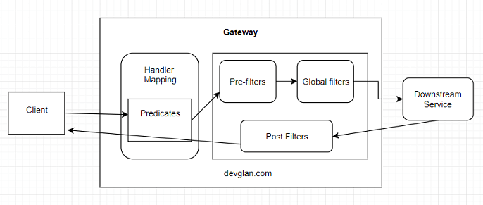
Cloud Gateway Filters

Slide 91
Global Filters
Created by implementing the Interface GlobalFilter with one Method filter()
public Mono<Void> filter(ServerWebExchange exchange, GatewayFilterChain chain)
ServerWebExchange
Contract for an HTTP request-response interaction.
Provides access to the HTTP request and response
Exposes Properties for server-side processing
GatewayFilterChain
An inteface that allows a WebFilter to delegate to the next in the chain.

Slide 92
Global Filters- Pre Filter
@Component
public class MyGlobalFilter implements GlobalFilter {
public Mono<Void> filter(ServerWebExchange exchange, GatewayFilterChain chain) {
boolean result =
exchange.getRequest().getURI().
getRawPath().contains("reviews");
if(result) {
exchange.getResponse().setStatusCode(HttpStatus.UNAUTHORIZED);
return exchange.getResponse().setComplete();
}
return chain.filter(exchange);
}
}

Slide 93
Global Filter – Post Filter
@Bean
public GlobalFilter postGlobalFilter() {
return (exchange, chain) -> {
return chain.filter(exchange)
.then(Mono.fromRunnable(() -> {
log.info("Global Post Filter executed");
}));
};

Slide 94
Gateway Routing
Has Three Main parts
Route:
The Destination of a particular request.
It will have destination URI
It has a condition to be satisfied
It has one or more filters.
Predicate
A condition to match like an “if” condition.
Java 8 Function Predicate
Filter:
Instances of Spring Framework WebFilter.
Can modify request or response.
Spring Provides many WebFilters

Slide 95
Route Locator Builder
Gateway configuration can also be done using java route api
RouteLocatorBuilder
Used to configure related routing information
To add predicates and filters
Provides a Static Method Builder()
Builder() method is used to construct routes and return a RouteLocator

Slide 96
RouteLocator
RouteLocator
public interface RouteLocator {
Flux<Route> getRoutes();
}
@Bean
public RouteLocator gatewayRoutes(RouteLocatorBuilder builder) {
}

Slide 97
Routing Object
Route
Defines the routes information such as route assertions, filters, routing addresses, and route priorities.
When the request arrives, it is processed by the Gateway filter
And then its forwarded to the proxy service.
public class Route implements Ordered {
private final String id;
private final URI uri;
private final int order;
private final AsyncPredicate<ServerWebExchange> predicate;
private final List<GatewayFilter> gatewayFilters;
}

Slide 98
Configuring Route Locator
@Configuration
public class MyRouteConfig {
@Bean
public RouteLocator gatewayRoutes(RouteLocatorBuilder builder) {
return builder.routes()
.route(p -> p.path("/api/v1/reviews/**")
.filters(f -> f.addResponseHeader("Hello", "World"))
.uri("lb://REVIEW-SERVICE") )
.route(p -> p.path("/api/v1/choices/**")
.uri("http://localhost:7575/"))
.build();
}
}

Slide 99
Gateway Filter
@Component
public class LoggingFilter implements GatewayFilter {
@Override
public Mono<Void> filter(ServerWebExchange exchange, GatewayFilterChain chain) {
ServerHttpRequest request = exchange.getRequest();
Log.info(request.getPath().toString());
return chain.filter(exchange);}
}

Slide 100
Filters With Java Configuration
@Bean
public RouteLocator gatewayRoutes(RouteLocatorBuilder builder,LoggingFilter logger) {
return builder.routes()
.route(p -> p.path("/api/v1/restaurants/**")
.filters(f -> f.filter(logger, 0))
.uri("lb://RESTAURANT-INFO-SERVICE") )
.route(p -> p.path("/accounts/**")
.uri("lb://ACCOUNT-SERVICE"))
.build();
}

Slide 101
Filter with Circuit Breaker
@Bean
public RouteLocator myRoutes(RouteLocatorBuilder routeBuilder) {
return routeBuilder.routes().
route(p->p
.path("/api/v1/payments")
.filters(f->f.circuitBreaker(
c->c.setName("custom").setFallbackUri("/default") ))
.uri("http://localhost:3050"))
.build();
}

Slide 102
Filter with Circuit Breaker
@Bean
public Customizer<ReactiveResilience4JCircuitBreakerFactory> defaultCustomizer(){
return factory -> factory.configureDefault(id -> new Resilience4JConfigBuilder(id)
.circuitBreakerConfig(CircuitBreakerConfig.ofDefaults())
.timeLimiterConfig(TimeLimiterConfig.custom()
.timeoutDuration(Duration.ofSeconds(20)).build()).build());
}

Slide 103
Rest Controller
@GetMapping(path = "/default")
public String message() {
return "Default Message";
}

Slide 104
Global Filter
@Component
public class AuthFilter implements GlobalFilter {
@Override
public Mono<Void> filter(ServerWebExchange exchange, GatewayFilterChain chain) {
if (!exchange.getRequest().getHeaders().containsKey(HttpHeaders.AUTHORIZATION)) {
throw new RuntimeException("Missing authorization information");
}

Slide 105
Global Filter
List<String> authorization = exchange.getRequest().getHeaders().get("Authorization");
if(exchange.getRequest().getHeaders().get(HttpHeaders.AUTHORIZATION).get(0)!=null) {

Slide 106
Global Filter
ServerHttpRequest modifiedRequest = exchange.getRequest().mutate().
header("Authorization", authorization.get(0)).build();
return chain.filter(exchange.mutate().request(modifiedRequest).build());
} else {
return chain.filter(exchange);
}
}
}
curl -u india:india http://localhost:8080/driver-service/api/v1/drivers

Slide 107
Retry
Service may fail due to various reasons such as a network outage, server being down, network glitch, rate limit, etc.
Can try to retry the operation a few times before sending an error response to the client.
Retries increase the chance of getting a response back from a remote service when it’s momentarily overloaded or unresponsive.

Slide 108
Retry
Limit the number of retries:
Do not retry indefinitely.
If the API call is still failing after the set number of retries, it’s better to communicate the failure.
Retry only for transient/server-side errors:
Transient errors are temporary and are most likely resolved by retrying a few times.
Do not retry for failures caused by invalid data or authentication errors since retries would not help here.
Watch out for time spent:
We must remember to balance resilience and user experience. You don’t want users to wait too long while retrying the request behind the scenes.

Slide 109
Retry Configuration
Retry Configuration | What does it do?
webClient.get().retrieve() .bodyToMono(String.class); | No retry
webClient.get().retrieve().bodyToMono(String.class).retry(); | Retry indefinitely
.retry(3); | Retry 3 times before failing
.retryWhen(Retry.max(3).doBeforeRetry(…))); | Perform an action before each retry
.retryWhen(Retry.fixedDelay(3, Duration.ofSeconds(2))); | Retry 3 times, and add a delay of 2 seconds before 2nd and 3rd retries.
.retryWhen(Retry.backoff (3, Duration.ofSeconds(2))) | Retry 3 times with each retry attempt with a growing delay
.retryWhen(Retry.backoff(3, Duration.ofSeconds(2)).jitter(0.75)); | Add random delay with Jitter which prevents replicas from retrying simultaneously
.retryWhen(Retry.backoff(3, Duration.ofSeconds(2)) .onRetryExhaustedThrow(…)); | Throw an Exception once the retry limit is reached.
webClient.get().retrieve().onStatus(…) .bodyToMono(String.class) .retryWhen(Retry.backoff(3, Duration.ofSeconds(2)) .filter(ex -> ex instanceof ServiceException)); | Retry on a specific exception

Slide 110
Retry
return webClient.get()
.retrieve()
.bodyToMono(String.class)
.retryWhen(Retry.max(3)
.doBeforeRetry(x -> logger.info("Retrying " + x.totalRetries()))) }
return client.get().uri("http://localhost:4040/info") .retrieve() .bodyToMono(String.class) .retry(5).log();

Slide 111
Retry
return client.get().uri("http://localhost:4040/info") .retrieve(). bodyToMono(String.class).log().timeout(Duration.ofSeconds(50)) .onErrorResume( ConnectTimeoutException.class,e -> Mono.just("Fallback"));
return webClient.get() .retrieve()
.bodyToMono(String.class)
.timeout(Duration.ofSeconds(2))
.retryWhen(Retry.backoff(3, Duration.ofSeconds(2)));

