Slide 1
MICROSERVICES WITH REST API

Slide 2
Topics
Webservices / REST Services
  Understanding HTTP Protocol and verbs
  HTTP Request and Response Headers
  URL Patterns and defining End Points
Java Implementation of REST, Jax-RS and Spring boot
  Java Implementation of REST
  Creating REST Services using Spring boot
  Creating End points
  Working With Data – Spring DATA JPA
  Handling Various Response types [JSON, XML]
  Passing files in the request and Getting files as Response

Slide 3
Topics
Microservices
  Monolithic vs Microservice Implementation
  Overview of Microservice Design patterns
  REST Services as microservices
  Security Considerations and implementations
REST Clients
  Implementing Rest client using spring boot Rest Template
Testing Rest Services
  POSTMAN
  Testing automation using postman.
  REST Assured Library, testing rest services.
Containerization and Running Rest Services as Docker Containers

Slide 4
Web Services
A way for two machines to communicate with each other over a network.
A client and server applications that communicate over HTTP or HTTPS
  A standard means of interoperating between software applications running on a variety of platforms and frameworks.
  Can be combined in a loosely coupled way to achieve complex operations.

Slide 5
Types of Web Services
A service is a software component provided through a network-accessible endpoint.
The service consumer and provider use messages to exchange request and response
  Done by a self-containing documents with very few assumptions about the technological capabilities of the receiver.
Can be implemented as
“big” web services and “RESTful” web services.

Slide 6
“Big” Web Services
Also known as SOAP Web Services
Uses XML messages that follow the Simple Object Access Protocol
JAX-WS provides the functionality
Contains a machine-readable description of the operations offered by the service
  Web Services Description Language (WSDL), an XML language for defining interfaces syntactically.

Slide 7


System Flow (HTTP)
Server
<Envelope>
<Header>
<transId>1234</transId>
</Header>
<Body>
<Add>
<a>3</a>
<b>4</b>
</Add>
</Body>
</Envelope>
Request
<Envelope>
<Header>
<transId>1234</transId>
</Header>
<Body>
<AddResponse>
<c>7</c>
</AddResponse>
</Body>
</Envelope>
Response
Client

Slide 8

REST WebService
Roy Thomas Fielding

Slide 9
REST
Introduced and defined in 2000 by Roy Fielding
Defines a set of architectural principles to design Web services
  Focusses system’s resources
  How resource states are addressed
  How its transferred over HTTP
  Clients written in different languages.
A predominant Web service design model.
Displaced SOAP- and WSDL-based interface design because of its simpler style to use.

Slide 10
RESTful Web Service
RESTful web services are services that are built to work best on the web.
Representational State Transfer (REST)
  Architectural style
  Specifies constraints, such as the uniform interface
  Has feature that enable services to work best on the Web.

Slide 11
API
API
  Set of rules that allow two applications to communicate with each other.
URI
  URL which specifies the location of a resource on the internet,
  URN identifies a resource by name rather than by location.
  Endpoint is a specific URL representing a specific API resource or action.
  The root-endpoint of Github’s API is https://api.github.com

Slide 12
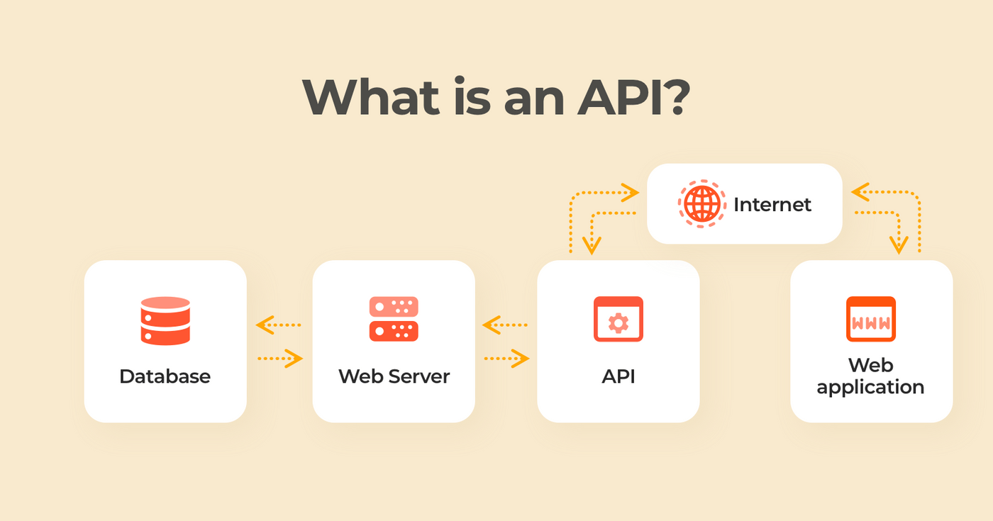
API

Slide 13
API Specifications
  A very clear business operation it will perform
  The API URL or interface
  HTTP protocol and methods
  Request structure and individual fields
  Response structure and individual fields
  Valid values for fields in request, where it is applicable
  Any mechanism for filtering and sorting the data
  Any authentication/authorization information
  The possible success and error codes
  https://restfulapi.net/. => Refer for More Details

Slide 14
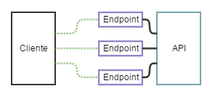
API and Endpoint

Slide 15
API vs Web Service
Not all APIs are accessible over the network
Web Services must always be accessed through a network.
REST APIs are a type of Web Service APIs.

Slide 16
RESTful Web Service
Data and functionality are considered resources
  Resources are accessed using Uniform Resource Identifiers (URIs), typically links on the web.
In the REST architecture style, clients and servers exchange representations of resources using a standardized interface and protocol.
RESTful applications are simple, lightweight, and have high performance.
Service are mapped to the four main HTTP methods
  create, retrieve, update, and delete.

Slide 17
RESTful Principles
RESTful applications are simple, lightweight, and fast
Resource identification through URI
  A RESTful web service exposes a set of resources that identify the targets of the interaction with its clients.
  Resources are identified by URIs, which provide a global addressing space for resource and service discovery.
  A URI is of the following format
    http://localhost:8080/hotelmanagement/rest/hotels

Slide 18
Designing a URI
Use Plural Noun
  Use plural noun to define resources.
Avoid using spaces
  Use underscore (_) or hyphen (-) when using a long resource name.
Use lowercase letters
  Good practice to keep the url in lower case letters only.
Use HTTP Verb
  HTTP Verb like GET, PUT and DELETE to do the operations on the resource.
  It is not good to use operations name in the URI.

Slide 19
RESTful Principles
Uniform interface:
  Resources are manipulated using a fixed set of four create, read, update, delete operations:
  PUT, GET, POST, and DELETE.
  GET retrieves the current state of a resource in some representation.
  POST transfers a new state onto a resource.

Slide 20
RESTful Principles
Self-descriptive messages
  Resources are decoupled from their representation
  Resource content can be accessed in a variety of formats, such as HTML, XML, plain text, PDF, JPEG, JSON, and others.
  Metadata about the resource is made available and used
    Caching, Errors, negotiate the appropriate representation format, and perform authentication or access control.

Slide 21
RESTful Principles
Stateful interactions through hyperlinks
  Every interaction with a resource is stateless
  Request messages are self-contained.
  Stateful interactions are based on the concept of explicit state transfer.
  Several techniques exist to exchange state, such as URI rewriting, cookies, and hidden form fields.
  State can be embedded in response messages to point to valid future states of the interaction.

Slide 22
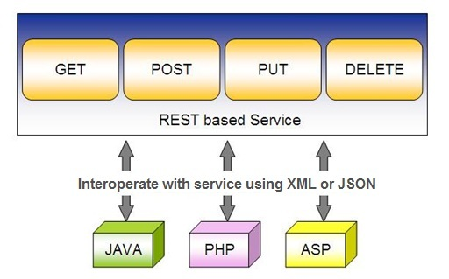
REST Service

Slide 23
JAX-RS
JAVA API for RESTful Web Services.
  JAVA based programming language API and specification
  Provides support for creating RESTful Web Services.
  Uses annotations to simplify the development and deployment.
  Provides Supports for creating clients for RESTful Web Services.
  Coordinates with the web server or container to make resources available via URLs
  Convert the HTTP requests into Java objects, and to convert Java object resource representations into HTTP responses.
    Marshalling and unmarshalling requests and responses,

Slide 24
Jersey
Jersey is the open source, production quality, JAX-RS
Reference Implementation for building RESTful Web services.
Can be integrated with a number of different containers and HTTP servers.
Can be combined with the Project Grizzly HTTP server.
  Can also be integrated Tomcat, WebLogic, or WebSphere.

Slide 25
JERSEY
Provides both server-side and Client side API and implementation
Includes support for XML serialization of JAXB bean
Can use JSON as a wire format for request and response entities.
It is hosted in a Maven repository but can be used without using Maven.
Jersey and Grizzly are under active development, so you will probably find newer versions of these jars available

Slide 26
Grizzly HTTP Server
A multi-protocol framework built on top of Java NIO.
Simplifies the development of robust and scalable servers.
Jersey enables support for using Grizzly as a plain vanilla HTTP container
Starting a Grizzly server is one of the most lightweight and easy ways how to expose a functional RESTful services application.

Slide 27
DEVELOPING JAX-RS APPLICATION

Slide 28
Resource
Resource are classes , simple POJOs annotated with @Path
  Can also have method annotated with @Path
The annotation's value is a relative URI path.
Resource methods
  Methods of a resource class annotated with a resource method designator.
  Method designator with annotation such as @GET, @PUT, @POST, @DELETE

Slide 29
Maven Project
Create a New Maven Project
In the Filter type jersey-quickstart-grizzly
Fill in the required details and a project is created
In the pom.xml uncomment the jersey-media support dependency
Can Execute as a Stand alone Java Application
Can also use the maven goal exec:java

Slide 30
REST Request
A request is made up of four things:
  The endpoint
  The method
  The headers
  The data (or body)
  root-endpoint/?

Slide 31
Main Class
  public class Main {
  public static HttpServer startServer() {
  public static final String BASE_URI = "http://localhost:8080/";
  ResourceConfig rc = new ResourceConfig().packages("com.example.demo.");
  GrizzlyHttpServerFactory.createHttpServer(URI.create(BASE_URI), rc);
  }
  public static void main(String[] args) throws IOException {
  HttpServer server = startServer();
  System.in.read();
  server.stop();
  }
  }

Slide 32
Send a JSON Response
import javax.json.Json;
import javax.json.JsonObject;
  @GET
  @Path("/user")
  @Produces(MediaType.APPLICATION_JSON)
  public String getMessage(){
  JsonObject map = Json.createObjectBuilder().add("ram",40).build();
  return map.toString();
  }

Slide 33
Response Builder
Used to build Response instances that contain metadata instead of or in addition to an entity.
Obtained via static methods of the Response class,
public abstract Response build()
  Create a Response instance from the current ResponseBuilder.
  The builder is reset to a blank state equivalent to calling the ok method.

Slide 34
@PathParam
Annotation is used to access Value of the variable on request method as a parameter
Binds the value of a path segment to a resource method parameter.
Used to inject values from the URL into a method parameter.
getCustomerById(@PathParam("customerId") int id)
Its invoked as
http://localhost:2020/RestExample/webapi/customer/101

Slide 35
@Produces Annotation
@Produces(MediaType.TEXT_PLAIN[, more-types])
  Used to specify the MIME media types or representations a resource can produce and send back to the client.
  Can be Applied Both at the Class and Method Level
Class level
  All the methods in a resource can produce the specified MIME types by default.
Method Level
  Overrides any @Produces annotations applied at the class level.
406 Not Acceptable
  Returned when methods matching MIME type is not found in a client request,

Slide 36
Server Response
A server response in REST can be one of the following
JSON (JavaScript Object Notation).
  Easy to parse in JavaScript clients and in other languages, too).
CSV (comma-separated values)
  CSV is more compact;
XML
  XML is easy to expand (clients should ignore unfamiliar fields) and is type-safe;
HTML
  Response is a human-readable document;

Slide 37
The @Consumes Annotation
@Consumes(type[, more-types])
  used to specify which MIME media types of representations a resource can accept, or consume, from the client.
Class level
  All the response methods accept the specified MIME types by default.
Method level
  overrides @Consumes annotations applied at the class level.
HTTP 415 (“Unsupported Media Type”) .
  Returned when methods can not respond to the requested MIME type

Slide 38
Model
  public class Menu {
  private Long id;
  private String name;
  }

Slide 39
Menu Service
  public class MenuService {
  private static MenuService instance = new MenuService();
  private static HashSet menus;
  private MenuService() {
  menus = new HashSet<>();
  menus.add(new Menu(1L, "Menu One"));
  }
  public static MenuService getInstance() {
  return instance;
  }

Slide 40
Add and Find All
  public void add(Menu menu) {
  menus.add(menu);
  }
  public List getAll() {
  return new ArrayList(menus);
  }

Slide 41
Read
  public Menu get(Long id) throws Exception {
  Iterator it = menus.iterator();
  while (it.hasNext()) {
  Menu curr = (Menu) it.next();
  if (curr.getId() == id)
  return curr;
  }
  throw new Exception("Object not found");
  }

Slide 42
Delete
  public boolean delete(Long id) throws Exception {
  Iterator it = menus.iterator();
  while (it.hasNext()) {
  Menu curr = (Menu) it.next();
  if (curr.getId() == id) {
  it.remove();
  return true;
  }
  }
  throw new Exception("Object not found");
  }

Slide 43
Update
  public Menu update(Long id, String update) throws Exception {
  Iterator it = menus.iterator();
  while (it.hasNext()) {
  Menu curr = (Menu) it.next();
  if (curr.getId() == id) {
  curr.setName(update);
  return curr;
  }
  }
  throw new Exception("Object not found");
  }

Slide 44
Resource
  @Path("/rest")
  public class MenuResource {
  MenuService service = MenuService.getInstance();
  @GET
  @Path("/menus")
  @Produces("application/json")
  public List<Menu> getMenus() {
  return service.getAll();
  }

Slide 45
Read
  @GET
  @Path("/menus/{menu_Id}")
  @Produces("application/json")
  public Response getMenu(@PathParam("menu_Id") Long menuId) {
  try {
  return Response.ok(service.get(menuId)).build();
  } catch (Exception e) {
  return Response.serverError().status(HttpStatus.BAD_REQUEST_400.getStatusCode(), e.getMessage()).build();
  }
  }

Slide 46
Save
  @POST
  @Path("/menus")
  @Produces("application/json")
  public Response add(Menu entity) {
  service.add(entity);
  return Response.ok(entity).status(HttpStatus.CREATED_201.getStatusCode(), "Created").build();
  }

Slide 47
Update
  @PUT
  @Path("/menus/{menu_Id}")
  @Produces("application/json")
  public Response update(@PathParam("menu_ID") Long menuId, Menu entity) {
  try {
  return Response.ok(service.update(menuId,entity.getName())).build();
  } catch (Exception e) {
  return Response.serverError().status(HttpStatus.BAD_REQUEST_400.getStatusCode(), e.getMessage()).build();
  }
  }

Slide 48
Delete
  @DELETE
  @Path("/menus/{menu_Id}")
  @Produces("application/json")
  public Response delete(@PathParam("menu_Id") Long menuId) {
  try {
  service.delete(menuId);
  return Response.ok().status(HttpStatus.OK_200.getStatusCode()).build();
  } catch (Exception e) {
  return Response.serverError().status(HttpStatus.BAD_REQUEST_400.getStatusCode(), e.getMessage()).build();
  }
  }

