Slide 1
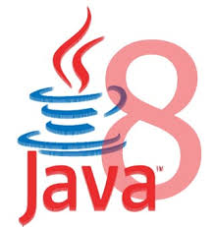

Slide 2
Java 8 – Significant New Features
Java SE 8 is a revolutionary release of the development platform
Lambda expression
  Adds functional processing capability to Java.
Method references
  Using functions as parameter.
  Referencing functions by their names instead of invoking them directly
Default method
  Interfaces to have default method implementation.
Date Time API
  Improved date time API.

Slide 3
FUNCTIONAL INTERFACES

Slide 4
Functional interface
An interface with only one method.
@FunctionalInterface
  Used to enforce the intent of the interface
  Existing interfaces are annotated with @FunctionalInterface
    Adding another method to the interface definition, will not be functional and compilation process will fail.
Used with lambda expressions.

Slide 5
Built-in Functional Interfaces
Earlier Versions of Java has several functional interfaces
  Prominent because of Lambda expressions
Existing functional interfaces
  Comparator
  Callable
  Runnable
  ActionListener
Collections API has been rewritten and new Stream API uses a lot of functional interfaces.
java.util.function
  Consumer, Supplier, Function and Predicate.

Slide 6

LAMBDAS

Slide 7
Functional vs Object Oriented Programming
Functional Programming
  Composing functions rather than objects.
Functions are first class.
  Passed around, dynamically created, stored in data structures
Use pure functions.
  A pure function is a function with no side effects.
  An increase in modularity which makes code easier to test, reuse, parallelize, generalize, and reason about.

Slide 8
Functional Programming
Java always remained Object first language.
Functions are not important for Java.
  cannot live on their own in Java world.
JavaScript is one of the best example of an FP language.
There is no way of passing a method as argument or returning a method body
invList.forEach((inv)->{System.out.println(inv);});
Lambda expression adds that missing link of functional programming to Java.

Slide 9
Benefits of Lambda Expression
Fewer Lines of Code
  It reduced amount of code.
Sequential and Parallel Execution
  Support by passing behavior in methods
Higher Efficiency
  Utilizing Multicore CPU’s using Streams
Streams API
  Handling Collection of data much efficiently

Slide 10
Where to use Lambda expressions
Lambda expressions can be used where there is a target type.
The following are the target type in Java
  Variable declarations and assignments
  Return statements
  Method or constructor arguments

Slide 11
Lambda Expressions
Lambda Expressions are:
Anonymous
  It doesn’t have an explicit name like a method
Function
  Not associated with a particular class like a method
  Has a list of parameters, a body, a return type, and list of exceptions that can be thrown.
Passed around
  Can be passed as argument to a method or stored in a variable.
Concise
  No need to write a lot of boilerplate like anonymous classes.

Slide 12
Lambda Expressions
A lambda expression is composed of three parts.
  Argument List (int x, int y)
  Arrow Token ->
  Body x + y

Slide 13
Lambda – Argument List
Can have zero, one or more parameters.
  (int x, int y)
Parameters can be explicitly declared or it can be inferred
  (int a) is same as just (a)
Parameters are separated by commas.
  (a, b) or (int a, int b) or (String a, int b, float c)
Empty parentheses to represent an empty set
  () -> 42
It is not mandatory to use parentheses.
  a -> return a*a

Slide 14
Lambda Expression - Body
  The body of the lambda expressions can contain zero, one or more statements.
Lambdas may return a value.
The type of the return value will be inferred by compiler.
  Body is evaluated like a method body
  return statement returns control to the caller of the anonymous method.
The return statement is not required if the lambda body is just a one-liner.
If the return is an expression curly braces are required

Slide 15
Lambda with Built-in Functional Interface
    public static void main(String[] args) {
    Thread t1 =new Thread( () -> {
      for(int i=0;i<10;i++)
      {
      System.out.println("Hello World");
      }
    }
    );
  t1.start();
  }
    }

Slide 16
Functional Interfaces and Lambda
  public interface GenericFunction<T> {
  public void showValues(List<T> t);
  }
  GenericFunction<Invoice> funcRef = (list) -> {
  list.forEach(
  (eachElement)->System.out.println(eachElement));
  };
  funcRef.showValues(getCustomers());

Slide 17
Scope in Lambda
Lambdas are allowed to capture static and instance variables
  But they are effectively final.
  Can also be explicitly declared final
Effectively Final.
  A n effectively final variable is one whose value does not change after it is first assigned.

Slide 18
Effectively Final
  @FunctionalInterface
  public interface EFConverter<T,R> {
  public R convertToString(T from);
  }
  int num = 1;
  EFConverter<Integer, String> stringConverter =
  (from) -> String.valueOf(from + num);
  String result = stringConverter.convertToString(new Integer(45));
  // num++;
  System.out.println(result.length());

Slide 19
Restrictions on local variables
Instance variables are stored on the heap, whereas local variables live on the stack.
Lambdas have access to Local Variable from Threads ,
  Thread could try to access the variable after the thread that allocated the variable had de allocated it.
Java implements access to a free local variable as access to a copy of it rather than access to the original variable.
If the local variable is assigned only once – the problem cease to exist

Slide 20
When NOT to Use Lambda
Lambdas may not be considered for the following criteria
Size
  The larger a lambda gets, the more difficult it makes it to follow the logic surrounding it.
Repetition
  It's better to create a named function for repeated logic, although it's okay to repeat very simple lambdas that are spread apart.
Nesting
  Nested lambdas are really, really hard to read.
Software is easily changed. Write both ways and see which is easier to read.

Slide 21
BUILT-IN FUNCTIONAL INTERFACES

Slide 22
Need for Built In Functional Interfaces
Lambda expressions must correspond to one functional interface.
Java 8 also has new functional interfaces covering the most common scenarios usages.
  Each developer need not define functional interface of types which are already in this package.
  They are Defined with Generic types and are re-usable for specific use cases.

Slide 23
Built-in Functional Interfaces
Located inside the java.util.function package.
  Predicate<T>
  Consumer<T>
  Function<T, R>
  Supplier<T>
  UnaryOperator<T>
Where T and R represent generic types
  T represents a parameter type
  R the return type.

Slide 24
Built-in Functional Interfaces
It also provides specializations for primitive type (int, long, double, and boolean )
  IntPredicate
  LongConsumer
  BooleanSupplier
There are also versions, which take two parameters
  BiPredicate<L, R>
  BiConsumer<T, U>
  BiFunction<T, U, R>
  BinaryOperator<T>
T and U represent parameter types
R the return type

Slide 25
Predicate<T>
A predicate is a function that receives a value and evaluates it.
  It has a method test(T obj) to evaluate and return a Boolean value.
  It also has some default Methods
@FunctionalInterface
public interface Predicate<T> {
boolean test(T t);
// Other default and static methods
}

Slide 26
Predicate<T>
Using Anonymous Class
Predicate<String> startsWithA = new Predicate<String>() {
public boolean test(String t) {
return t.startsWith("A");
} };
boolean result = startsWithA.test("Anand");
Using Lambda Expression
  Predicate<String> testWithLambda = (name)->name.startsWith("A");
  System.out.println(testWithLambda.test("Anand"));

Slide 27
Predicate<T>
  public void usingPredicate(){
  List<String> countries =
  Arrays.asList("India","Nepal","srilanka","SouthAfrica","Indonesia");
  Predicate<String> pref = (country)->country.startsWith("I");
  countries.forEach((eachCountry)->{
  if(pref.test(eachCountry)) {
    System.out.println(eachCountry);
    }
  });
  }

Slide 28
Predicate<T> Default Methods
negate()
  returns a predicate that represents the logical negation of the predicate.
Predicate<String> predicate = (s) -> s.length() > 0;
  System.out.println(predicate.test("Ramesh"));
  System.out.println(predicate.negate().test("Ramesh"));

Slide 29
Predicate<T> Methods
Can combine predicates
Predicate<String> startsWithA = t -> t.startsWith("A");
Predicate<String> endsWithA = t -> t.endsWith("A");
boolean result = startsWithA.and(endsWithA).test("Hi");
static <T> Predicate<T> isEqual(Object targetRef)
  Returns a Predicate that tests if two arguments are equal according to Objects.equals(Object, Object).

Slide 30
Function<T,R>
Represents a function that accepts one argument and produces a result
Object of a particular type is the input, an operation is performed on it and object of another type is returned as output,
  Can be used without the need to define a new functional interface every time.
R apply(T t)
  Applies this function to the given argument (T t)
  Returns the function result

Slide 31
Function<T,R>
  Function<Integer, String> function = (t) -> {
  if (t % 2 == 0) {
  return t+ " is even number";
  }
  else {
  return t+ " is odd number";
  }
  };
  System.out.println(function.apply(5));
  System.out.println(function.apply(8));

Slide 32
Comparator<T>
Comparator<T>
  Compares its two arguments for order.
  int compareTo(T o1, T o2)
    Returns a negative integer, zero, or a positive integer as the first argument is less than, equal to, or greater than the second.
  ArrayList<Invoice> invList =new ArrayList<Invoice>();
  invList.add(new Invoice(101,"Ramesh",4500));
  invList.add(new Invoice(201,"Rakesh",4500));
  Collections.sort(invList,(inv1, inv2)->{
  return inv1.getInvoiceNumber().compareTo(inv2.getInvoiceNumber());
  });

Slide 33
Supplier<T>
Represents a supplier of results.
It does not take any arguments.
Used for lazy generation of values.
T get():
  Does not accept any argument
  Returns newly generated values, T, in the stream.
  No requirement that new or distinct results be returned each time the supplier is invoked.

Slide 34
Supplier<T>
  public void usingSupplier(){
  Supplier<Invoice> invSupplier = ()->{
  return new Invoice(200,"Rakesh",7888);
  };
  Invoice inv = invSupplier.get();
  System.out.println(inv);
  }

Slide 35
Consumer<T>
Represents an operation that accepts a single input and returns no result
It has one Method void accept(T t)
  Performs operation on the given argument (T t)
Lambda passed to the List.forEach method implements Consumer
  public static void printNames(String name){
  System.out.println(name);
  }
  public void usingConsumer(){
  Consumer<String> consumer = Example::printNames;
  consumer.accept("Ramesh");
  consumer.accept("Suresh");
  consumer.accept("Maghesh");
  }

Slide 36
DEFAULT METHODS IN INTERFACES

Slide 37
Need for default Methods
When a interface has one or multiple implementations
Adding one or more methods to the interface
  All the implementations will be forced to implement them too.
  If not the design will break down.
Default interface methods allows to add new methods to an interface that are automatically available in the implementations.
  Thus, there’s no need to modify the implementing classes.
Backward compatibility is neatly preserved without having to refactor the implementers.

Slide 38
Default Method
Default methods are implicitly public
They are declared with the default keyword
They provide an implementation.
Default methods in interfaces helps to incrementally provide additional functionality to a given type without breaking down the implementing classes.
Can be used to provide additional functionality around an existing abstract method:

Slide 39
METHOD REFERENCES

Slide 40
Method References
Used to store a reference on the function
  But don't want to invoke it right away.
Lambda expressions are for passing parameter to an instance method
Points to existing methods by their names.
  Described using :: (double colon) symbol.
When Used With Lambdas expressions, creates a compact and concise code.

Slide 41
Method References
List names = new ArrayList();
  names.add("Mahesh");
  names.add("Suresh");
names.forEach((e)->System.out.println(e));
  Passes parameter as an argument to the println method
names.forEach(System.out::println);
  Can replace the pass-through lambda with a method reference.
  A method reference names the method to which the parameter is passed

Slide 42
Method References
Common Parts are removed to Change Lambda to a Method reference
  The parameter
  The argument
  Dot is replaced with a colon on the method call.
  String[] nameList =
  { "Ramesh", "anand", "Suresh", "Anand", "Magesh" };
  Arrays.sort(nameList, String::compareToIgnoreCase);
  for(String name:nameList) {
  System.out.println(name);
  }

Slide 43
STREAMS

Slide 44
Streams
An Interface defined in java.util.stream package.
Streams are a sequence of elements from a source that supports aggregate operations.
  filter, map, reduce, find, match, sort.
  Operations can be executed in series or in parallel.
The source can be a Collection, IO Operation or Arrays
Java collections has methods that return Stream.
  These Methods are added as default methods.

Slide 45
Characteristics of Streams
Not related to InputStreams, OutputStreams, etc.
These are NOT data structures
  Wrappers around Collection that carry values from a source through a pipeline of operations.
More powerful, faster and more memory efficient than Lists
Designed for lambdas
Employ lazy evaluation
Streams are parallelizable

Slide 46
Collections vs Streams
Collections are in-memory data structures which hold elements within it.
  Each element in the collection is computed before it actually becomes a part of that collection.
  On the other hand Streams are fixed data structures which computes the elements on-demand basis.
Streams are lazily constructed Collections, where the values are computed when user demands for it.
Collections are eagerly computed values

Slide 47
Streams
The Streams also support Pipelining and Internal Iterations.
Streams operations returns Streams only.
  Helps creating chain of various stream operations.
  This is called as pipelining.
The pipelined operations looks similar to a sql query.
In Java, we traditionally use for loops or iterators to iterate through the collections.
  These iterations are called as external iterations and they are clearly visible in the code.
Java 8 Stream uses internal Iterations which are not visible in the code

Slide 48
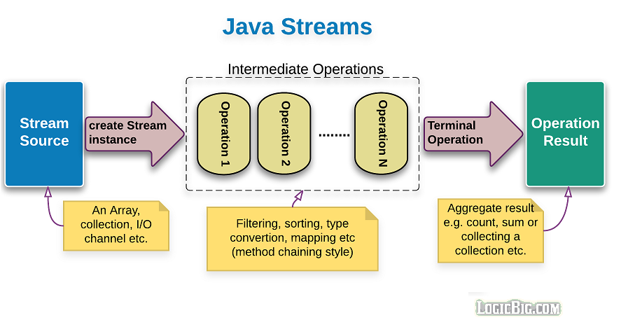
Structure of Java 8 Stream Operations
The three important components to make it work.
  A source
  one or more intermediate operations
  A terminal operation.
The three are pipelined in a sequence to make a stream work.

Slide 49
Intermediate operations
  intermediate operations are lazy.
    They will not be invoked until the terminal operation is invoked.
    Streams become accessible when intermediate operations were called.
  Return streams and can create pipeline of operations.
    map, filter, and limit

Slide 50
Terminal Operations
Streams end with a terminal operation.
They produce a result or side effect, marking the end of a stream.
Examples:
  forEach,
  collect,
  count,
  min, max

Slide 51
Filter()
Takes predicate as an argument
Applies to the whole stream and returns a filtered stream
  Containing elements which match the Predicate.
  List<Customer> filteredList= customerList.stream().filter((Customer cust ) -> cust.getCustomerId() >200).collect(toList());
  System.out.println("After applying filter method");
  filteredList.forEach(System.out::println);

Slide 52
collect()
A terminal operation
It accepts an argument of the type Collector
Predefined collectors for most common operations.
Collectors.toList()
  Used for collecting all Stream elements into a List instance.
Collectors.toSet()
  Used for collecting all Stream elements into a Set instance.

Slide 53
Map()
Takes an instance of Function <T, R> as parameter
Converts the type of elements in the stream from the current type T to the new type R.
Returns as output a stream of type R or Stream<R>
  List<Customer> customerList = HandleCustomers.getCustomers();
  List<Long> phoneBook = customerList.stream().
  map((eachCust)->eachCust.getPhoneNumber()).collect(toList());
  phoneBook.forEach(System.out::println);

Slide 54
Max , Min ,Count
count()
  returns the count of elements of a stream.
max()
  returns the maximum element of a stream according to the provided Comparator.
min()
  returns the minimum element of a stream according to the provided Comparator.

Slide 55
OPTIONAL CLASS

Slide 56
Java.util.Optional Class
It is a public final class used to deal with NullPointerException
A container object used to contain not-null objects.
Optional object is used to represent null with absent value.
Has methods to handle values as ‘available’ or ‘not available’ instead of checking null values
The class does not define any constructors.

Slide 57
Java.util.Optional Class
Optional.empty()
  Used to create an empty Optional
Optional<String> emptyString = Optional.empty();
get()
  To obtain a value present in an Optional instance.
  If doesn’t contain a value, the method would throw NoSuchElementException.
Optional.ofNullable()
  To create an optional that can accept null.
  Integer x = null;
  Optional<Integer> optional = Optional.ofNullable(x);

Slide 58
Java.util.Optional Class
orElse(defaultValue)
  returns the value if present
  otherwise returns the default value provided as parameter.
isPresent()
  determine if a value is present
  returns boolean value true or false.
ifPresent()
  performs given action if the given Optional object is non-empty.
  Otherwise it returns false.

Slide 59
Example
  public static Object getStringObject(int key)
  {
  switch (key) {
  case 1:
  return new String("Vannila String");
  case 2:
  return new StringBuffer("Buffer String");
  case 3:
  return new StringBuilder("Builder String");
  default:
  return null;
  }
  }

Slide 60
Example
  Optional<Object> obj = Optional.ofNullable(getStringObject(2));
  Object strType= obj.orElse("Invalid Choice");
  System.out.println("String :="+strType.toString());
  obj.ifPresent((o)->{System.out.println( o.toString().toUpperCase() );});
  if(obj.isPresent()) {
  System.out.println("Value is present");
  } else {
  System.out.println("Value is absent");
  }

Slide 61
Example
  String[] names = new String[10];
  Optional<String> checkNull = Optional.ofNullable(names[4]);
  if(checkNull.isPresent()) {
  System.out.println(checkNull.get());
  } else {
  System.out.println("No Such Element");
  }
  checkNull.ifPresent(System.out::println);

Slide 62
Min
  List<Product> catalog = new ArrayList<>();
  Comparator<Product> priceComparator = Comparator.comparing(Product::getRatePerUnit);
  String itemType="TV";
  Optional<Product> minresult = catalog.stream().
  filter((Product prod ) -> prod.getProductName().equalsIgnoreCase(itemType)).
  min(priceComparator);
  double leastPriced=0;
  if(minresult.isPresent())
  {
  leastPriced= minresult.get().getRatePerUnit();
  }

Slide 63
Max
  Optional<Product> maxresult= catalog.stream().
  filter((Product prod ) -> prod.getProductName().equalsIgnoreCase(itemType)).
  max(priceComparator);
  double highPriced=0;
  if(maxresult.isPresent())
  {
  highPriced= maxresult.get().getRatePerUnit();
  }
  System.out.println("Highest Priced :="+itemType + highPriced);

Slide 64
Count()
  long countresult= catalog.stream().
  filter((Product prod ) -> prod.getProductName().equalsIgnoreCase(itemType)).count();
  System.out.println(countresult);

Slide 65
Sorted
sorted()
  Sorts the elements using natural ordering.
  The element class must implement Comparable interface.
  List<Customer> sortedList = customerList.stream().sorted().collect(toList());
sorted(Comparator<? super T> comparator)
  Sorted using an instance of Comparator using lambda expression.
Comparator.comparing
  A static function that accepts a sort key Function
  Returns a Comparator for the type which contains the sort key:

Slide 66
Sorted
Comparator.comparing
  List<Customer> slist = customerList.stream().sorted(Comparator.comparing(Customer::getCustomerId)).collect(toList());
reversed()
  To reverse the natural ordering Comparator
  List<Customer> revrseList = customerList.stream().sorted(Comparator.reverseOrder()).collect(toList());
thenComparing()
  To set up lexicographical ordering of values by provisioning multiple sort keys in a particular sequence.

Slide 67
collect()
Collectors.toCollection()
  To use a custom implementation
  List<String> result = givenList.stream()
  .collect(toCollection(LinkedList::new))
Collectors.toMap()
  Used to collect Stream elements into a Map instance.
  Map<Long, String> map = customerList.stream()
  .collect(Collectors.toMap(Customer::getPhoneNumber, Customer::getCustomerName));
  map.forEach((x, y) -> System.out.println("Key: " + x +", value: "+ y));

Slide 68
PARALLEL STREAMS

Slide 69
Parallel Streams
The Stream API can be used create parallel streams
  Takes advantage of multi-core architectures
Parallel stream are created in two ways
  parallelStream() on a collection
  parallel() on a stream
Should be with stateless and associative operations
Stateless operation : State of one element does not affect another element
Associative : The result is not affected by the order of operands

Slide 70
Parallel Streams
Parallel streams use a common ForkJoinPool
The size of the underlying thread-pool is dependent on the amount of available physical CPU cores:
  ForkJoinPool commonPool = ForkJoinPool.commonPool();
  System.out.println(commonPool.getParallelism());
It can decreased or increased by JVM parameter:
  -Djava.util.concurrent.ForkJoinPool.common.parallelism=5
Using parallel stream with operations like reduce and collect need combine operations.

Slide 71
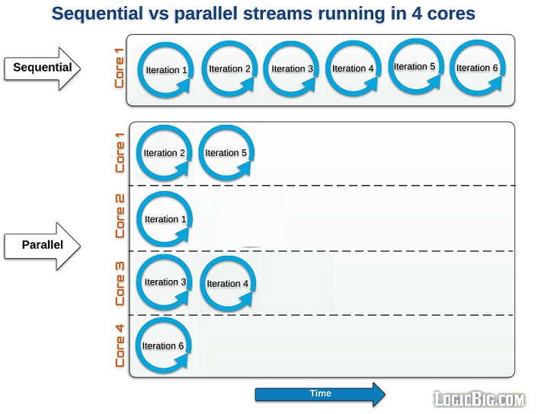
Parallel Stream Working
Stream are sequential by default
When a stream executes in parallel, the Java runtime partitions the stream into multiple sub-streams.
Aggregate operations iterate over and process these sub-streams in parallel and then combine the results.

Slide 72
Creating Parallel Streams
  Stream.of("Ramesh", "Suresh", "Ganesh", "Magesh", "Rajesh", "Sudan", "Jagan", "Madan").
  parallel().
  forEach(System.out::println);
  Stream parallelStream = Arrays.asList("Ramesh", "Suresh", "Ganesh", "Magesh", "Rajesh", "Sudan", "Jagan", "Madan").
  parallelStream().
  forEach(System.out::println);
Serial stream the order is guaranteed.
Parallel Stream the order is not guaranteed

