Slide 1
Astra Zeneca
Day -1

Slide 2

K.Srivatsan - vatsank@gmail.com
IT Trainer Since 1991
Conducting Java Training Since 2004
About 60+ Corporate Clients

Slide 3
Object Oriented Programming
A Method of organizing software in the form of objects that contain both data and the behavior of these objects.
  Programs are divided into Objects (abstracted into class)
  Data, is given the priority.
  Data and functions are packed into a single unit
  Objects communicate through functions or methods

Slide 4
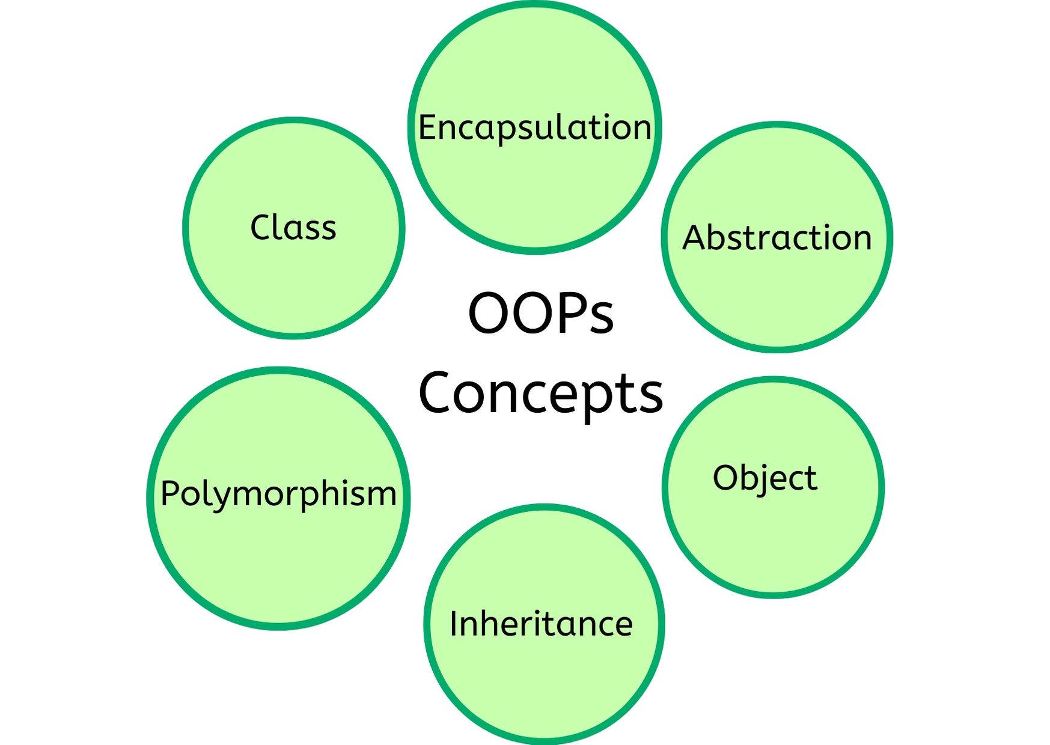
OOPS Concepts

Slide 5
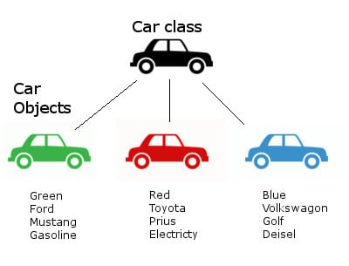
Class and Objects

Slide 6
Objects
It has an identity, state and behavior
  Actions are directed to It
Models real-world objects or abstract concepts
  E.g. dog, bicycle, queue
Real-world objects have states and behaviors
  Dogs' states: name, color, breed, hungry
  Dogs' behaviors: barking, fetching, sleeping

Slide 7
Objects
Software objects implement real-world objects
  Use variables/data to implement states
  Use methods/functions to implement behaviors
Creating an object from a class is called instantiation
An object is a concrete instance of a particular class

Slide 8
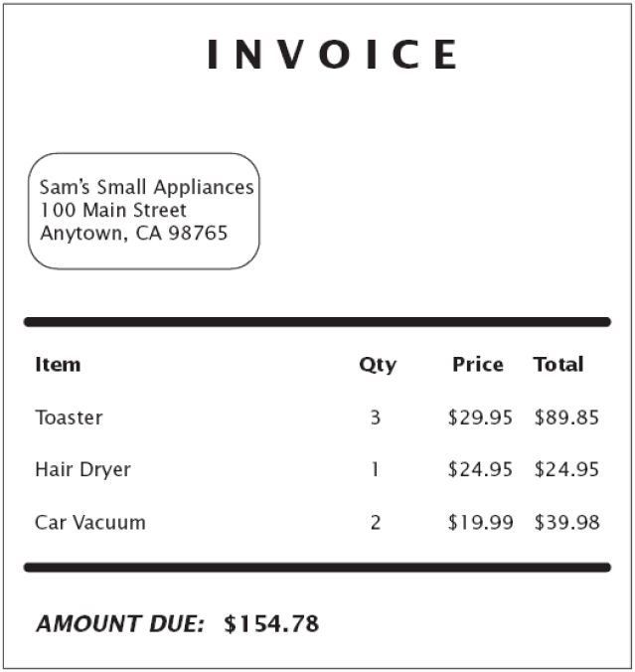
Example: Invoice

Slide 9
Candidates for classes
Tangible things referred to by common nouns in requirements spec
  I.e., cookie, factory, triangle
Events with associated information (i.e., flight, game).
Abstract data stores (i.e., buffer, tree, hash table)
Note: verbs can also be classes!
  Parsing -> Parser, Scanner as a subclass of String
  Proper nouns are instances of classes, not classes
  If there is no state but just multiple operations
    Math class with static methods in Java

Slide 10
CLASS DIAGRAM

Slide 11
Class Diagrams
Most widely used diagram of UML
Models the static design view of a system
Also Used to specify the structure, interfaces and relationships between classes
Primary diagram for generating codes from UML models

Slide 12
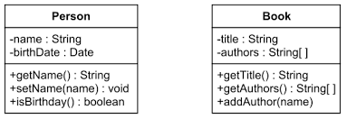
Class Notation
Basic notation:
  Solid-outline rectangle with three compartments
    Separated by horizontal lines.
Three compartments:
  Top compartment holds the class name and other general properties of the class
  Middle compartment holds a list of attributes
  Bottom compartment holds a list of operations

Slide 13
Adding Visibility
Scope of access allowed to a member of a class
applies to attributes and operations
UML visibility maps to OO visibilities:
  private scope: within a class (-)
  package scope: within a package (~)
  public scope: within a system (+)
  protected scope: within an inheritance tree (#)

Slide 14


OOP with Java

Slide 15
Objective
Describe the key features of Java technology
Write, compile, and run a simple Java application
Describe the function of the Java Virtual Machine
Define garbage collection

Slide 16
History of Java
Conceived as Programming language for embedded systems like microwave ovens, televisions etc
One of the first projects developed using Java
    personal hand-held remote control named Star 7.
The original language was called Oak
It was developed in the year 1991 at Sun Microsystems
Notes:
Java was conceived by a team of engineers in Sun Microsystems in 1991 as a part of a research project, which was led by James Gosling and Patrick Naughton. It took 18 months to develop the first working version. This language was initially called “Oak” but was renamed as “Java” in 1995.
Modeled after C++, the Java language was designed to be small, simple, and portable across platforms and operating systems, both at the source and at the binary level, which means that Java programs (applets and applications) can run on any machine that has the Java virtual machine installed.

Slide 17
Primary Goals of Java
Provides an easy-to-use language by:
  Avoiding many pitfalls of other languages
  Being object-oriented
  Enabling users to create streamlined and clear code
Provides an interpreted environment for:
  Improved speed of development
  Code portability
  Enables users to run more than one thread of activity
  Loads classes dynamically; that is, at the time they are actually needed
  Supports changing programs dynamically during runtime by loading classes from disparate sources

Slide 18
Features of Java
Features that fulfill the goals:
  The Java Virtual Machine (JVM)
  Garbage collection
  The Java Runtime Environment (JRE)
  JVM tool interface

Slide 19
The Java Virtual Machine
Executes instructions that a Java compiler generates.
A runtime environment, embedded in web browsers, servers, and operating systems
Imaginary machine that is implemented by emulating software on a real machine
Reads compiled byte codes that are platform-independent
Bytecode
  a special machine language that can be understood by the JVM independent of any particular computer hardware,
  Java Runtime Environment (JRE) is an implementation of the JVM”.
  “JVM becomes an instance of JRE at runtime”.
    A runtime instance of JVM will born when .class file starts its execution

Slide 20
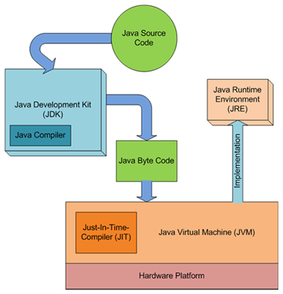
JDK,JVM and JRE

Slide 21
JVM Tasks
Loads code
  Loads all classes necessary for the execution of a program
  Maintains classes of the local file system in separate namespaces
Verifies code (Bytecode Verifier)
  The code adheres to the JVM specification.
  The code does not violate system integrity.
  The parameter types for all operational code are correct.
  No illegal data conversions have occurred.

Slide 22
Class Loader
Bootstrap Class Loader
  Responsible for loading classes from bootstrap classpath
  JAVA_HOME/jre/lib directory.
  Highest priority will be given to this loader.
Extension Class Loader
  This loader is child of Boorstrap class loader.
  It loads classes from JAVA_HOME/jre/lib/ext
  Can be specified by the java.ext.dirs system property.
Application Class Loader
  This loader is child of Extension class loader
  Responsible for loading classes from application level classpath.
  It uses Environment Variable which is mapped to java.class.path.

Slide 23
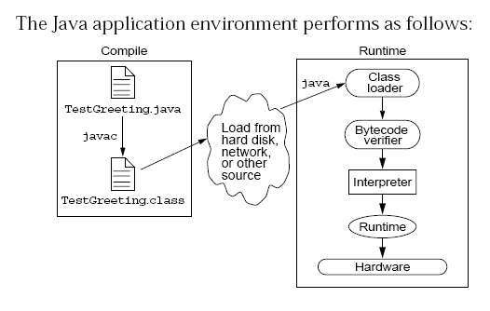
Java Run Time Environment

Slide 24
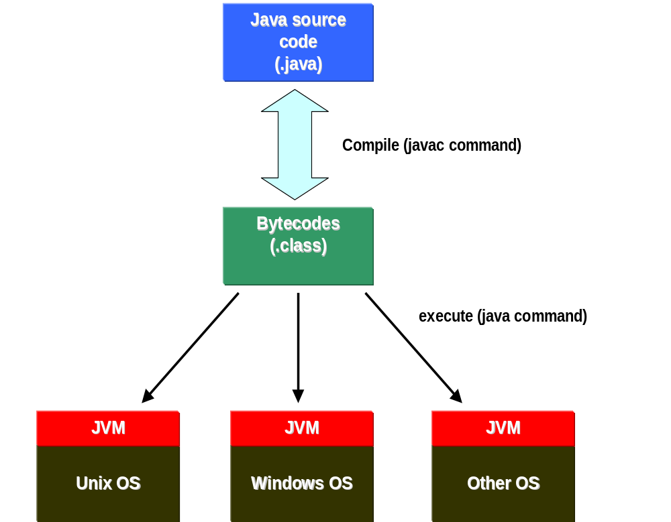

Slide 25
Integrated Development Environments
An IDE is the high-productivity tool
Used to edit, compile, and test programs, manage projects, debugging, building GUI interfaces, etc.
IDE provides extensive programming support for editing and project management,
The Popular IDE’s
  Eclipse
  IntelliJ
  NetBeans

Slide 26
Java language syntax

Slide 27
Objectives
Identify the basic parts of a Java program
Differentiate among Java literals, primitive data types,
variable types ,identifiers and operators
Develop a simple valid Java program using the concepts learned in this chapter

Slide 28
Program structure
A program in Java consists of one or more class definitions
One of these classes must define a method main(), which is where the program starts running
Java programs should always end with the .java extension.
There can be More than one Class Definition in a class ,but only one public class
Source Filenames should match the name of the public class.

Slide 29
Source File Layout
Basic syntax of a Java source file is:
[<package_declaration>]
<import_declaration>*
<class_declaration>+

Slide 30
Software Packages
Packages help manage large software systems.
Packages can contain classes and sub-packages.
package <top_pkg_name>[.<sub_pkg_name>]*;
Specify the package declaration at the beginning of the source file.
Only one package declaration per source file.
If no package is declared, then the class is placed into the default package.
Package names must be hierarchical and separated by dots.

Slide 31
The import Statement
import <pkg_name>[.<sub_pkg_name>]*.<class_name>;
import <pkg_name>[.<sub_pkg_name>]*.*;
import java.util.List;
import java.io.*;
import shipping.gui.reportscreens.*;
The import statement does the following:
  Precedes all class declarations
  Tells the compiler where to find classes

Slide 32
Example 1.1
  package com.training;
  public class Greeting {
  public String getMessage() {
  return "Welcome to Java Programming";
  }
  }

Slide 33
Example 1.1 (contd)
  package com.training;
  public class TestGreetings {
  public static void main(String[] args) {
  Greeting grtObj = new Greeting();
  System.out.println(grtObj.getMessage());
  }
  }

Slide 34
The System Class
Its part of the java.lang package
The classes in this package are available without the need for an import statement
This class contains several useful class fields and methods.
It can’t be Instantiated
It also Provides facilities for
  Standard Input
  Standard Output
  Error Output Streams
  Access to externally defined properties

Slide 35
Declaring Java Technology Classes
Basic syntax of a Java class:
  <modifier>* class <class_name> {
  <attribute_declaration>*
  <constructor_declaration>*
  <method_declaration>*
  }
Define an attribute:
<modifier>* <type> <name> [ = <initial_value>];

Slide 36
Declaring Methods
Basic syntax of a method:
<modifier>* <return_type> <name> ( <argument>* ) {
<statement>*
}
  public int getWeight() {
  return weight;
  }
  public void setWeight(int newWeight) {
  if ( newWeight > 0 ) {
  weight = newWeight;
  }
  }

Slide 37
Accessing Object Members
The dot notation is: <object>.<member>
  used to access object members, including attributes and methods.
d.setWeight(42);
d.weight = 42; // only permissible if weight is public

Slide 38
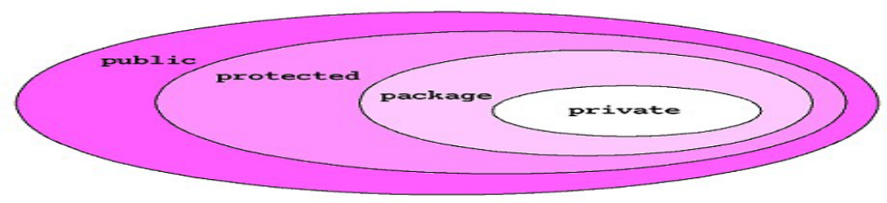
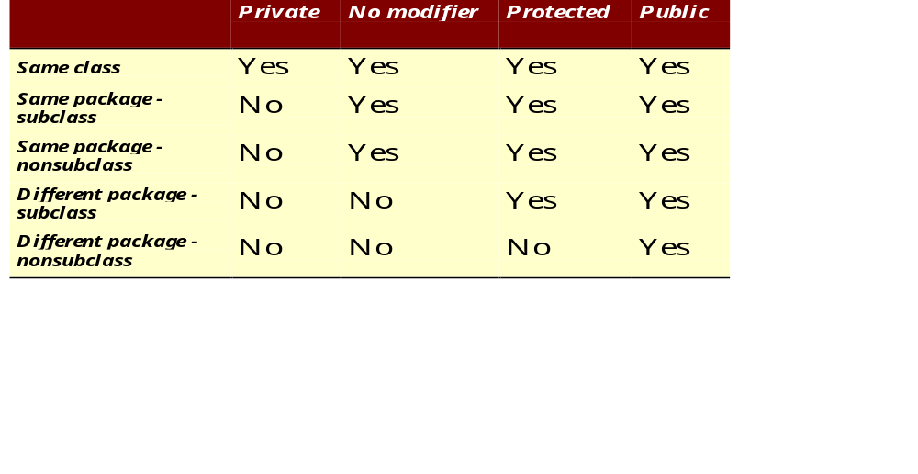
The 4 Access Levels and 3 Modifiers

Slide 39
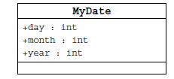
Information Hiding
Client code has direct access to internal data
(d refers to a MyDate object):
d.day = 32; // invalid day
d.month = 2; d.day = 30; // plausible but wrong
d.day = d.day + 1; // no check for wrap around

Slide 40
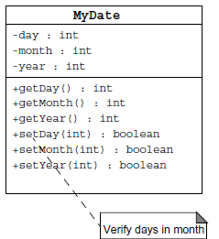
Encapsulation
Hides the implementation details of a class
Forces the user to use an interface to access data
Makes the code more maintainable

Slide 41
Classes
Top-level classes can be declared as
  public
    a public class is globally accessible.
    a single source file can have only one public class or interface
  abstract
    an abstract class cannot be instantiated
  final
    a final class cannot be subclassed
  Default
    With any Modifier
They can’t be declared as protected and private

Slide 42
Constructors
Have no return type
Have the same name as the class
If we don't’ put a constructor the compiler puts a default one
  The default constructor has the same access modifier as the class.
  The default constructor has no arguments.
  The default constructor is always a no-arg constructor, but a no-arg constructor is not necessarily the default constructor
  The default constructor includes a no-arg call to the super constructor (super()).
They are not inherited and hence they are not overridden
It can be Overloaded
It can have any of the Four Access Modifies
It cannot be synchronized
It can have throws clause

Slide 43
Instantiation with new
It is the process by which individual objects are created.
  Class objectReference = new Constructor();
Declaration
  Employee empObj;
Instantiation
  empObj = new Employee()
Declaration and Instantiation
  Employee empObj = new Employee()
  new operator allocates memory for an object.

Slide 44
Constructor Overloading
One constructor can call another overloaded constructor of the same class by using this keyword.
this() is used to call a constructor from another overloaded constructor in the same class
The call to this() can be used only in a constructor ,and must be the first statement in a constructor
A constructor can call its super class constructor by using the super keyword.
A constructor can have a call to super() or this() but never both

Slide 45
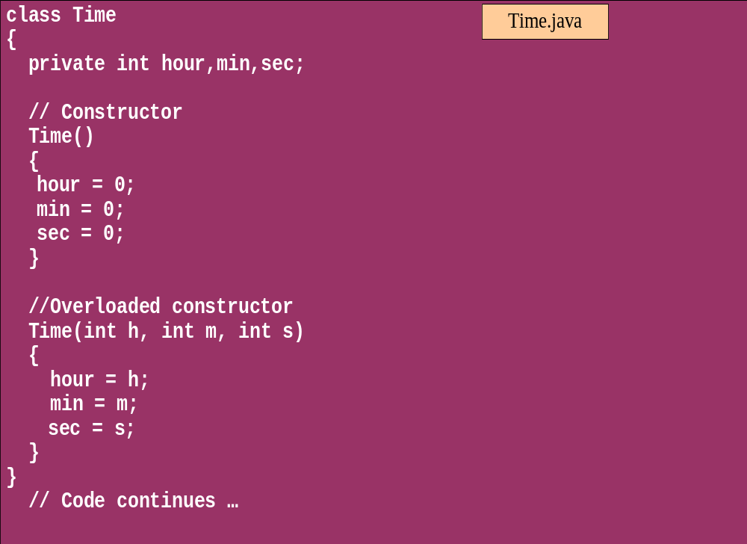
Overloaded Constructor

Slide 46
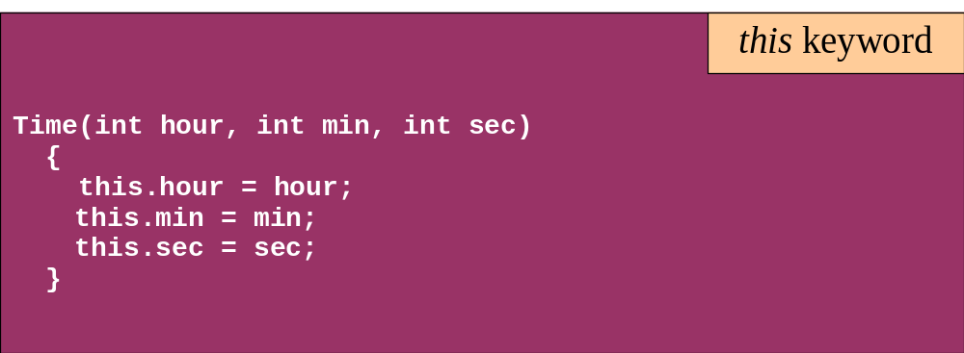
this keyword
Is a reference to the object from which the method was invoked

Slide 47
Comments
Java supports three forms of comments
  // single line comments
  /* multi
    line
    comment
    */
  /** a
    * Javadoc
    * comment
    */

Slide 48
Variables and Methods
A variable, which corresponds to an attribute, is a named memory location that can store a certain type of value.
Variable is a kind of special container that can only hold objects of a certain type.
Primitive type Variable
    Basic, built-in types that are part of the Java language
    Two basic categories
      boolean
      Numeric
        Integral - byte, short, int, long, char
        Floating point - float, double

Slide 49
Instance Variables and Methods
Variables and methods can be associated either with objects or their classes
An instance variable and instance method belongs to an object.
They can have any one of the four access levels
  Three access modifies – private, public , protected
They have a default value
A class variable (or class method) is a variable (or method) that is associated with the class itself.

Slide 50
Example for Variables
  public class VariableTypes {
  private int inst_empid;
  private static String cls_empName
  public void getData() { }
  public static void getSalary() { }
  public void showData(int a)
  {
  int localVariable ;
  }
  }
Instance Variable
Class Variable
Parameter Variable
Local Variable

Slide 51
Identifiers
Identifiers are used to name variables, methods, classes and interfaces
Identifiers
  start with an alphabetic character
  can contain letters, digits, or “_”
  are unlimited in length
Examples
  answer, total, last_total, relativePoint, gridElement, person, place, stack, queue

Slide 52
Local Variable needs to Be Initialized
  public class LocalVariable {
  private String name;
  public void display()
  {
  int age;
  System.out.println("Age"+age);
  System.out.println("Name"+name);
  }
Age Should be Initialized before Use

Slide 53
Instance Variable have Default Values
class Values
{
private int a;
private float b;
private String c;
public void display()
{
System.out.println("integer"+a);
System.out.println("float"+b);
System.out.println("String"+c);
}
public class DefaultVales {
public static void main(String[] args) {
Values v = new Values();
v.display();
}
}

Slide 54
Assignment of reference variables
int x = 7;
int y = x;
String s = “Hello”;
String t = s;
x
y
s
t
7
7
0x01234
0x01234
Hello

Slide 55
Pass-by-Value
The Java programming language only passes arguments by value for primitive data types.
When an object instance is passed as an argument to a method, the value of the argument is a reference to the object
The contents of the object can be changed in the called method, but the object reference is never changed
For primitives, you pass a copy of the actual value.
For references to objects, you pass a copy of the reference
You never pass the object. All objects are stored on the heap.

Slide 56

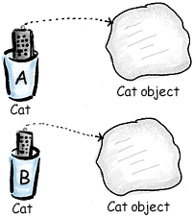
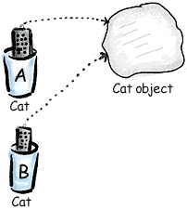
Pass By Value

Slide 57
Casting Primitive Types
Casting creates a new value and allows it to be treated as a different type than its source
JVM can implicitly promote from a narrower type to a wider type
To change to a narrow type explicit casting is required
Byte -> short -> int -> long -> float -> double

Slide 58
Casting Primitive Types
  public static void main (String [] args){
  int x = 99;
  double y = 5.77;
  x = (int)y; //Casting
  System.out.println("x = "+ x);
  double y1 = x; //No Casting
  int i =42;
  byte bt;
  bt= (byte)i;
  System.out.println("The Short number"+ bt);
  }

Slide 59
Wrapper Classes
Primitives have no associated methods
Wrapper Classes are used encapsulate primitives
They also provide some static utility methods to work on them
Primitive Type | Wrapper class
-boolean | Boolean
-byte | Byte
-char | Character
-double | Double
-float | Float
-int | Integer
-long | Long
short | Short

Slide 60
Wrapping Primitives
Wrapping a value
  int i = 288
  Integer iwrap = new Integer(i);
unWrapping a value
  int unwrapped = iwrap.intValue();
Methods In Wrapper Class
  parseXxx()
  xxxValue()
  valueOf()

Slide 61
Wrapper Class Method
Convert String to Numbers
public static void main(String args[])
{
int ino=Integer.parseInt(args[0]);
float fno = Float.parseFloat(args[1]);
double dno = Double.parseDouble(args[2]);
Long lno = Long.parseLong(args[3]);
System.out.println("Integer value" +ino );
String strIno = Integer.toString(ino);
System.out.Println(“String Value”+strIno);
}
}

Slide 62
Auto Boxing
Java 5.0 provided autoboxing
Integer n = new Integer(123) Int m = n.intValue() m++; n=new Integer(m); System.out.println(n); | Integer n = new Integer(123); n++; System.out.println(n);

Slide 63
Auto Boxing
public class ABoxing {
  public void show(int a, float b)
  {
  System.out.println("Integer"+a*2);
  System.out.println("Float"+b*2);
  }
  public static void main(String[] args) {
  ABoxing abObj =new ABoxing ();
  Integer a = 10;
  Float b =20f;
  abObj.show(a,b);
  }
  }

Slide 64
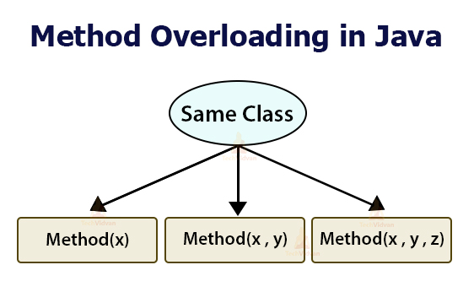

Slide 65
Method Overloading
Methods of a class have the same name but different signatures
  Similar behavior but for different data types.
Signature
  Name of the method and the number and types of formal parameters in particular order.
They are independent methods of a class
  Can call each other just like any other method.
A method can be overloaded in the same class or in a subclass.

Slide 66
Overloading Methods
Overloaded methods MUST change the argument list.
Overloaded methods CAN change the return type.
Overloaded methods CAN change the access modifier.
Overloaded methods CAN declare new or broader checked exceptions.

Slide 67
Overloading and AutoBoxing
public class Overloading {
public Integer add(Integer a , Integer b)
{
Integer c = a+b;
return c+100;
}
public int add(int a , int b)
{
return a+b;
}

Slide 68
Application
  public static void main(String[] args) {
  Overloading olObj = new Overloading();
  System.out.println(olObj.add(45, 55));
  }
  Output will be 100 and Not 200

Slide 69
Static Variables and Methods
A static method belongs to a class and not to its instance objects and hence they are shared between Objects
Static Methods can not be overridden
They can only call other static methods
They can access only static variables and not instance Variables
They cannot refer to this or super
Instance variable : 1 per instance and Static variable : 1 per class
Static final variables are constants
main( ) is defined to be a static method so as to be invoked directly

Slide 70
Static Method access only static
  public class StatClass {
  private int id;
  private static String name;
  private void instMethod()
  {
  staticMethod();
  System.out.println(id);
  System.out.println(name);
  }
  private static void staticMethod()
  {
  System.out.println(id);
  System.out.println(name);
  instMethod();
  }
  }
Can Access Static from Instance Method
Cannot Access Instance Variable From Static
Cannot Access Instance Method From Static

Slide 71
java.util.Scanner Class
A simple text scanner which can parse primitive types and strings using regular expressions.
A Scanner breaks its input into tokens using a delimiter pattern, which by default matches whitespace.
The resulting tokens may then be converted into values of different types using the various next methods.
  Scanner sc = new Scanner(System.in);
  int i = sc.nextInt();
  sc.close();

Slide 72
java.util.Scanner Class
  Scanner sc = new Scanner(System.in);
  System.out.println("Enter The Number");
  int number = sc.nextInt();
  System.out.println("Enter the Name");
  String name = sc.next();
  System.out.println(number + ":"+name);

Slide 73
java.util.Scanner Class
  public static void main(String[] args) {
  String line="Java,is,in,OOP,Language";
  Scanner sc1 = new Scanner(line);
  sc1.useDelimiter(",");
  while (sc1.hasNext())
  {
  System.out.println(sc1.next());
  }
  }

Slide 74
Flow Control

Slide 75
Control Structures
To change the ordering of the statements in a program
Two types of Control Structures
decision control structures ,
  allows us to select specific sections of code to be executed
    if -- else , if – else if
    switch -- case
repetition control structures
  allows us to execute specific sections of the code a number of times
    while
    do -- while
    for

Slide 76
Decision Control Structures
Types:
  if-statement
  if-else-statement
  If-else if-statement
If Specifies that a statement or block of code will be executed if and only if a certain boolean statement is true.
      if( boolean_expression )
      statement;
    or
      if( boolean_expression ){
      statement1;
      statement2;
      }
boolean_expression : can be an expression or variable.

Slide 77
if-else statement
if( boolean_exp ){
Statement(s)
}
else {
Statement(s)
}
  if(boolean_exp1 )
  statement1;
  else if(boolean_exp2)
  statement2;
  else
  statement3;
For Comparison == used instead =
= being an assignment operator
equals Method Should Be Used for Objects comparison

Slide 78
switch-statement
Allows branching on multiple outcomes.
switch expression is an integer ,character expression or variable
case_selector1, case_selector2 and unique integer or character constants.
If none of the cases are satisfied, the optional default block if present is executed.
    switch( switch_expression ){
    case case_selector1:
    Statement(s);
    break;
    case case_selector2:
    Statement(s);
    break;
    default:
    statement1;
    }

Slide 79
switch-statement
When a switch is encountered,
  evaluates the switch_expression,
  jumps to the case whose selector matches the value of the expression.
  executes the statements in order from that point on until a break statement is encountered
  break statement stops executing statements in the subsequent cases, it will be last statement in a case.
  Used to make decisions based only on a single integer or character value.
  The value provided to each case statement must be unique

Slide 80
switch-statement
  public double CalculateDiscount(int pCode)
  {
  double discountPercentage=0.0d;
  switch(pCode)
  {
  case 1:
  discountPercentage=0.10d;
  break;
  case 2:
  discountPercentage=0.15d;
  break;
  case 3:
  discountPercentage=0.20d;
  break;
  default:
  discountPercentage=0.0;
  }
  return discountPercentage;
  }

Slide 81
Switch-Case in a Method
Can have Either Return or Break if present inside a Method, but should provide a default Value
    public String switchExample(int key) {
    switch (key) {
    case 1:
    return "Good Morning";
    case 2:
    return "Good AfterNoon";
    case 3:
    return "Good Evening";
    default:
    return "Good Night";
    }

Slide 82
Switch-Case Java 7.0
From In Java SE 7 and later, can use a String object in the switch statement's expression.
The String in the switch expression is compared with the expressions associated with each case label as if the String.equals method were being used.
Will Throw a Null pointer Expression if the expression is NULL
  String color = "red";
  switch (color) {
  case "red":
  System.out.println("Color is Red");
  break;
  default:
  System.out.println("Color not found");
  }

Slide 83
Repetition Control Structures
while-loop
  The statements inside the while loop are executed as long as the Boolean expression evaluates to true
do-while loop
  statements inside a do-while loop are executed several times as long as the condition is satisfied, the statements inside a do-while loop are executed at least once
Watch this
  while(boolean_expression){
  statement1;
  statement2;
  }
do{
statement1;
statement2;
}while(boolean_expression);

Slide 84
Arrays

Slide 85
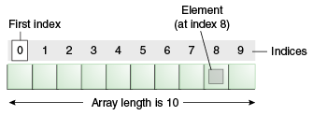
Introduction to Arrays
Array is one variable is used to store a list of data and manipulate
This type of variable is called an array.
It stores multiple data items of the same data type, in a contiguous block of memory, divided into a number of slots.
The new keyword to create an array object.
Need to tell the compiler how many elements will be stored in it.

Slide 86
Creating Arrays
There are three steps to creating an array,
declaring
  int[] k;
  float[] yt;
  String[] names;
allocating
  k = new int[3];
  yt = new float[7];
  names = new String[50];
initializing
  int[ ] k = {1, 2, 3};
  float[ ] yt = {0.0f, 1.2f, 3.4f, -9.87f, 65.4f, 0.0f, 567.9f};

Slide 87
Enhanced For Loop
The enhanced for loop, simplifies looping through an array or a collection.
Instead of having three components, the enhanced for has two.
for(data_type variable : array | collection){}
int [] a = {1,2,3,4};
for(int n : a)
System.out.print(n);.

Slide 88
Array Bounds
All array subscripts begin with 0 and ends with n-1
In order to get the number of elements in an array, can use the length field of an array.
The length field of an array returns the size of the array.
  int list [] = new int[10];
  for (int i = 0; i< list.length; i++)
  {
    System.out.println(list[i]);
    }
There is no array element arr[n]! This will result in an array-index-out-of bounds exception.
Notes:
Special care should be taken while accessing an array element, using the length variable of array objects. In the example shown above list.length gives 10, and if we try to access list[10], we will get an exception.

Slide 89
Array of Objects
  public static void displaybooks(Book[] bks)
  {
  for(int i=0;i<bks.length;i++)
  {
  System.out.println("Book Number :="+bks[i].getBookno());
  System.out.println("Book Name :="+bks[i].getBookname());
  }
  }
  public static void main(String args[])
  {
  Book[] bk = new Book[2];
  Book b1 = new Book(100,"java");
  Book b2= new Book(101,"j2ee");
  bk[0]=b1;
  bk[1]=b2;
  ArrayofObject obj= new ArrayofObject();
  displaybooks(bk);
  }

Slide 90
2D Array
double[][] marksByYear = {{90,80,50},{40,50,60},{87,50,67}};
  for(double[] inner :marksByYear) {
  double markTotal =0;
  for(double value:inner) {
  markTotal+=value;
  }
  System.out.println(markTotal);
  }

Slide 91
Copying Arrays
System.arraycopy()
  can be used to efficiently copy data from one array into another:
public static void arraycopy(Object src, int srcPos, Object dest, int destPos, int length)
The two Object arguments
  the array to copy from and the array to copy to.
The three int arguments
  starting position in the source array,
  starting position in the destination array,
  number of array elements to copy.

Slide 92
STRINGS

Slide 93
Strings
Many characters join together to form a string.
  Collection of characters bound by double quotes (“”).
String are created in two ways
  Direct Initialization
    String message1= "Hello World";
    String message2 =“Hello World
No new objects are created.
  When the second line is executed the message2 instance points to the message1 object which was declared before.

Slide 94
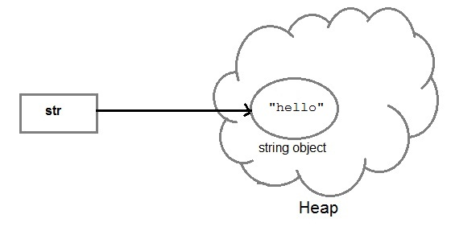
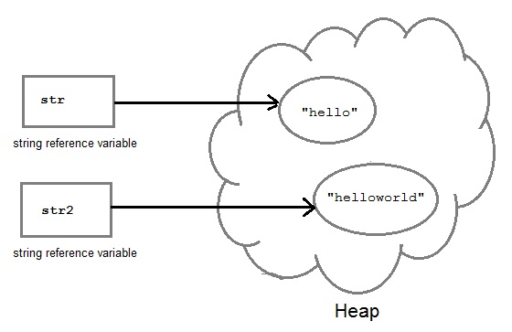
String Creation
String str= "Hello";
String str2=str;

Slide 95
Strings
  String a = "abcd";
  String b = "abcd";
  System.out.println(a == b); // True
  System.out.println(a.equals(b)); // True

Slide 96
Strings
Using constructor
  String myString = new String("Hello World")
A new space is allocated in heap regardless of the object exists in pool or not.
  JVM is forced to create a new string every time its executed
  String c = new String("abcd");
  String d = new String("abcd");
  System.out.println(c == d); // False
  System.out.println(c.equals(d)); // True

Slide 97
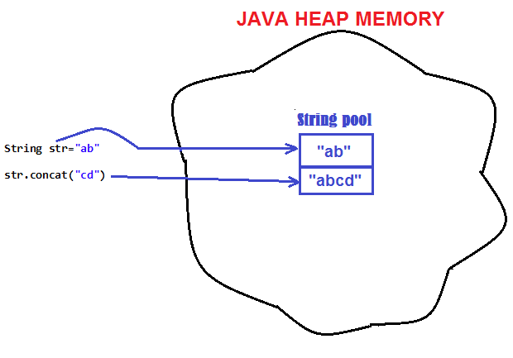
String are Immutable
Java String objects are immutable.
  Unmodifiable or unchangeable.
Once string object is created its data or state can't be changed
  A new string object is created.

Slide 98
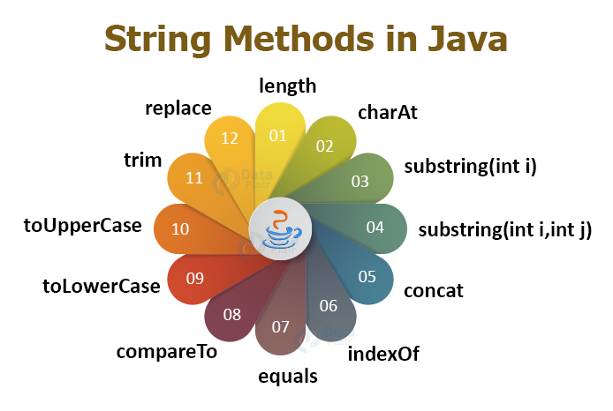

Slide 99
New Method in String
isBlank()
  Introduced in Java 11
  Instance method that return a boolean value
  Returns true if it has no characters or only white spaces in it.
  Returns false, characters other than white spaces are present in the string.
  "" is blank - true
  " " is blank - true
  "h i " is blank - false

Slide 100
strip()
strip()
  Removes all leading and trailing white space and returns a new string.
  String input = " ramesh ";
  System.out.println("Input string length : " + input.length());
  String stripStr = input.strip();
  System.out.println("Stripped string length : " + stripStr.length());
stripLeading() and stripTrailing to remove from beginning and ending of the word.
  String input = " ramesh ";
  System.out.println("Input string length : " + input.length());
  String stripStr = input.stripLeading();

Slide 101
String s = "test string\u205F";
String striped = s.strip();
System.out.printf("'%s'%n", striped);//'test string'
String trimmed = s.trim();
System.out.printf("'%s'%n", trimmed);//'test string '

Slide 102
trim
  Available since the early release of JDK (JDK1.0).
  It eliminates the leading and trailing white space,
    Space is defined as any character whose codepoint is less than or equal to 'U+0020’
      U+0020 - Space character.
  Always allocates a new String object.

Slide 103
strip
  Added in the JDK 11 release.
  It also eliminates the leading and trailing white space character
    Uses Character.isWhitespace(int) method to determine a white space character.
  Optimizes stripping to an empty String by returning an interned String constant.

Slide 104
Example
  String str1 = " training.com ";
  System.out.println(str1.trim().equals(str1.strip())); // return --> true
  String str2 = "training.com \u2000"; // Unicode of white-space
  System.out.println(str2.trim().equals(str2.strip())); // return --> false
  String str3 = "\t training.com \r";
  System.out.println(str3.trim().equals(str3.strip())); // return --> true
  String str4 = "\u2000";
  System.out.println(str4.trim().equals(str4.strip())); // return --> false

Slide 105
INHERITANCE

Slide 106
Overview
  A class can inherit from another class
    Original class is the “superclass”
    New class is called the “subclass”
Inheritance is a fundamental OO concept
Superclass
Car
Subclasses
SportsCar
Taxi
PoliceCar

Slide 107
Example of Inheritance
  The Car class defines certain methods and variables
  Taxi extends Car, and can:
    Add new variables
    Add new methods
    Override methods of the Car class
Car
Taxi

Slide 108
Specifying Inheritance in Java
  Inheritance is achieved by specifying which superclass the subclass
  “extends”
Taxi inherits all the variables and methods of Car
public class Car {
…
}
public class Taxi extends Car {
…
}

Slide 109
What Does an Object Look Like?
A subclass inherits all the instance variables of its superclass
Car object
public class Car {
String regNum;
int engineSize; …
}
regNum
engineSize
Taxi object
public class Taxi extends Car {
private int cabNum; …
}
regNum
engineSize
cabNum

Slide 110
Default Initialization
  What happens when a subclass object is created?
  If no constructors are defined:
  No-arg constructor is called in superclass
    No-arg constructor called in subclass
Taxi object
regNum
engineSize
Taxi taxi1 = new Taxi();
cabNum

Slide 111
Nondefault Initialization
Specific initialization can be performed as follows:
public class Car {
Car(String r, int e) {
regNum = r;
engineSize = e;
} …
public class Taxi extends Car {
Taxi(String r, int e, int c) {
super(r, e);
cabNum = c;
} …
Use super() to call superclass constructor

Slide 112
Specifying Additional Methods
  The superclass defines methods that are applicable for all kinds of Car
  The subclass can specify additional methods that are specific to Taxis
public class Car {
public int getReg()…
public void changeOwner()…
…
public class Taxi extends Car {
public void renewCabLicense()…
public boolean isBooked()…
…

Slide 113
Overriding Superclass Methods
  A subclass inherits all the methods of its superclass
  The subclass can override a method with a specialized version, if it needs to:
public class Car {
public String details() {
return "Reg:" + getReg();
}
public class Taxi extends Car {
public String details() {
return "Reg:" + getReg() + cabNum;
}

Slide 114
Overriding
When a sub-class defines a
  “method with same method name, argument types, argument order and return type as a method in its super class, its called method overriding. “
Methods declared as final, static and private cannot be overridden.
An overriding method can be declared as final
The method can’t be less accessible
  Public => only public
  Protected => Both Public and Protected
  Default => default, public and protected

Slide 115
Overriding with Compatible Return type
Arguments must be same and return type must be compatible
  class Base
  {
  private int i = 5;
  public Number getNumber()
  {
  return i;
  }
  }
  class Derived extends Base
  {
  @Override
  public Integer getNumber()
  {
  return new Integer(10);
  }
  }

Slide 116
Invoking Superclass Methods
  If a subclass overrides a method, it can still call the original superclass method
  Use super.method()to call a superclass method from the subclass
  Though keyword super is used to refer super class, method call super.super.method() is invalid.
public class Car {
public String details() {
return "Reg:" + getReg();
}
public class Taxi extends Car {
public String details() {
return super.details() + cabNum;
}

Slide 117
super keyword
The keyword super refers to the base class
  super( )
    invokes the base class constructor
    base class constructors are automatically invoked
  super.method( )
    invokes the specified method in the base class
  super.variable
    to access the specified variable in the base class
Super
  must be the first statement in a constructor

