Slide 1
Multi Threads

Slide 2
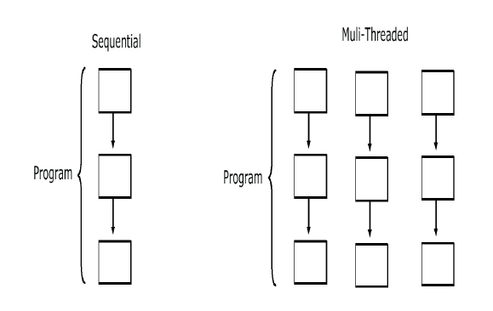
Why threads
Need to handle concurrent processes
Definition
  Single sequential flow of control within a program
Threads are like a processes executed by a program
Example:
  Operating System
  HotJava web browser

Slide 3
Multi-threading in Java Platform
Java Application start with just one thread, called the main thread.
  This thread has the ability to create additional threads
When a new thread is started , a new stack materializes and methods called from that thread run in a call stack that’s separate from the main() call stack.
That second new call stack runs concurrently with the main thread
A thread of execution is an individual process (a “lightweight” process) that has its own call stack.
one thread per call stack—one call stack per thread.

Slide 4
The Main Thread
Every java program has at least one thread called main thread
Thread.currentThread().getName()
  Returns the name current thread
  setName() is used to set the name for the thread

Slide 5
Making a Thread
Done by extend the java.lang.Thread class
  To have specialized version of a thread class.
  That class can’t extend another class
Done By Implementing the Runnable interface
  Leaves class free to extend from some other class
  Define behavior that will be run by a separate thread.
  Thread Class is created with a Runnable argument.
  The Runnable object is the target of the thread.
    .

Slide 6
Making a Thread
A thread begins as an instance of java.lang.Thread.
public void run()
  Has the Code that needs to be run in a separate thread
  It can call other methods,
  The thread of execution begins with the call to this method

Slide 7
Example
  public class NumberService {
  public NumberService() {
  super();
  }
  public void sumNumbers(int countTo) {
  int count =0;
  for(int i=0;i<=countTo;i++) {
  count =count +i;
  }
  System.out.println( " Sum of Number upto" + countTo +"Is ="+count +"Done By"+Thread.currentThread().getName());
  }
  }

Slide 8
Implementing java.lang.Runnable
  public class NumberAddingService implements Runnable{
  private int countTo;
  private NumberService service;
  public NumberAddingService(int countTo,String name) {
  this.countTo = countTo;
  this.service = new NumberService();
  Thread t1 = new Thread(this,name);
  t1.start();
  }
  @Override
  public void run() {
  this.service.sumNumbers(countTo);
  }
  }

Slide 9
Starting a Thread
start()
  Creates a new thread and makes it runnable
  A new thread of execution starts (with a new call stack).
  The thread moves from the new state to the runnable state.
  When the thread gets a chance to execute, its target run() method will run.

Slide 10
Starting Multiple Thread
  public static void main(String[] args) {
  new NumberAddingService(50,"Fifty Count");
  new NumberAddingService(500,"Five Hundred Count");
  new NumberAddingService(5000,"Five Thousand Count");
  try {
  System.out.println("Enter the Number");
  int ch =System.in.read();
  System.out.println(ch);
  } catch (IOException e) {
  e.printStackTrace();
  }
  }

Slide 11
The Thread Scheduler
The thread scheduler is the part of the JVM
Any thread in the runnable state can be chosen by the scheduler to be the one and only running thread.
java.lang.Thread Class
  public static void sleep(long millis) throws InterruptedException
  public final void join()
java.lang.Object Class
  public final void wait()
  public final void notify()
  public final void notifyAll()

Slide 12
Thread States
New
  When the Thread has been instantiated
    The start() method has not been invoked on the thread.
  It is a live Thread object, but not yet a thread of execution.
  At this point, the thread is considered not alive.
Runnable
  The state a thread is in when it’s eligible to run,
  Scheduler has not selected it to be the running thread.
  A thread first enters the runnable state when the start() method is invoked
  A thread can also return to the runnable state after either running or coming back from a blocked, waiting, or sleeping state.
  When the thread is in the runnable state, it is considered alive.

Slide 13
Thread States
Running
  This is the state a thread is in when the thread scheduler selects it from the runnable pool to be the currently executing process.
  A thread can transition out of a running state for several reasons, including because “the thread scheduler felt like it.”
Waiting/blocked/sleeping
  The thread is still alive, but is currently not eligible to run.
  A thread may be blocked waiting for a resource
  A thread may be sleeping because the thread’s run code tells it to sleep for some period of time
  waiting, because the thread’s run code causes it to wait

Slide 14
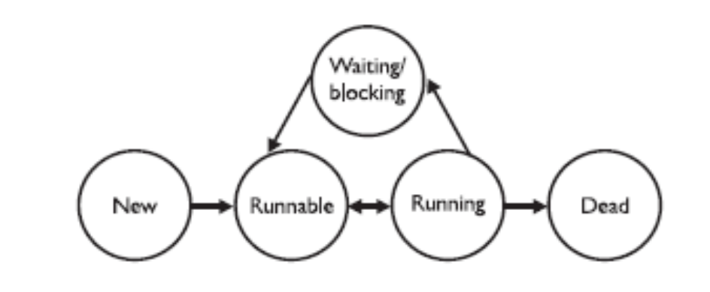
Thread States
Dead
A thread is considered dead when its run() method completes.
It may still be a viable Thread object, but it is no longer a separate thread of execution. Once a thread is dead, it can never be brought back to life
A runtime exception will be thrown

Slide 15
Leave the running state
sleep()
Guaranteed to cause the current thread to stop executing
  Duration is specified in milli seconds
  It might be interrupted before its specified time
join()
Guaranteed to cause the current thread to stop executing until the thread it joins with the thread it calls wait on completes.
Leave the Running State:
Following scenarios
  The thread’s run() method completes..
  A thread can’t acquire the lock on the object whose method code it’s attempting to run

Slide 16
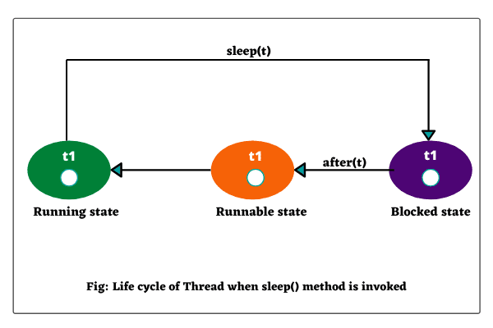
The sleep() method
Static method of Thread Class
Can be Placed anywhere in the Code
Throws a Checked Exception – Interrupted Exception
  try {
Thread.sleep(5*60*1000); // Sleep for 5 minutes
} catch (InterruptedException ex) { }

Slide 17
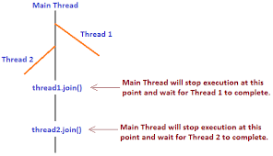
The Join() Method
The non-static join() method of class Thread lets one thread “join onto the end” of another thread.
The thread class join method waits until a thread is finished executing or waiting for a thread to die before returning .

Slide 18
Joining Thread
  public class TaskForJoin implements Runnable {
  public void run() {
  System.out.println("Reading");
  try {
  System.in.read( );
  } catch (java.io.IOException ex) {
  }
  System.out.println("Thread Finished.");
  }
  }

Slide 19
Joining Thread
  public class ParentThread {
  public static void main(String[] args) {
  System.out.println("Starting");
  TaskForJoin task = new TaskForJoin();
  Thread t = new Thread(task);
  t.start( );
  System.out.println("Joining");

Slide 20
Joining Thread
    try {
    t.join( );
    } catch (InterruptedException ex) {
    ex.printStackTrace();
    }
    System.out.println("Main Finished.");
    }
    }

Slide 21
Synchronizing Code
Threads can share resources.
Sometimes it is desirable that only one thread at a time has access to a shared resource.
Achieved by using the keyword: synchronized, Only methods can be synchronized, not variables.
Protects access to code, not to data
  Make data members private
  Synchronize accessor methods
A lock can be associated with a shared resource. Threads gain access to a shared resource by first acquiring the lock associated with the resource.
one thread can hold the lock and thereby have access to the shared resource.

Slide 22
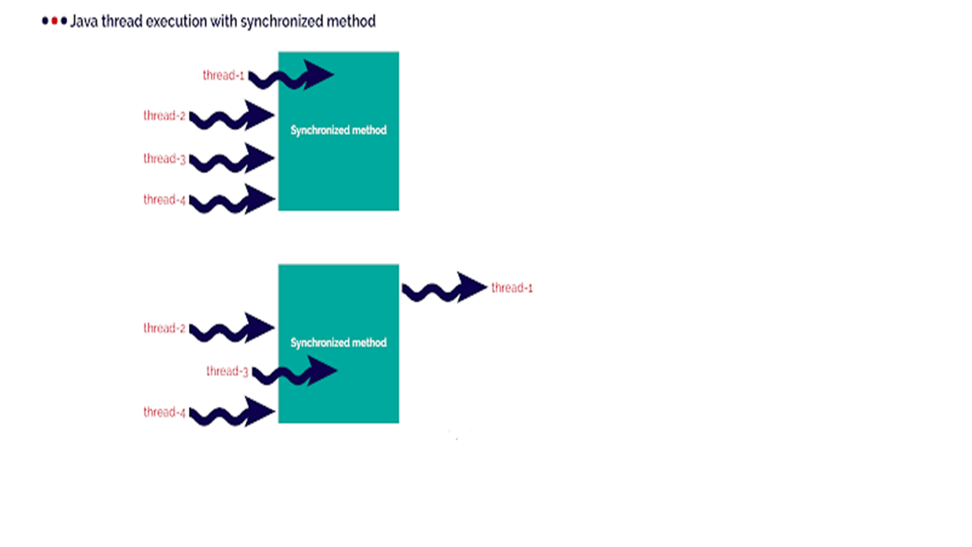
Synchronizing Code

Slide 23
Synchronizing Code
A class can have both synchronized and no synchronized methods.
If a class has both synchronized and nonsynchronized methods, multiple threads can still access the nonsynchronized methods of the class!
A thread can acquire more than one lock.
A thread can enter a synchronized method, thus acquiring a lock, and then immediately invoke a synchronized method on a different object, thus acquiring that lock as well.
As the stack unwinds, locks are released again.

Slide 24
Thread Synchronization
  class TwoStrings {
  synchronized static void print(String str1, String str2) {
  System.out.print(str1);
  try {
  Thread.sleep(500);
  } catch (InterruptedException ie)
  {
  ie.printStackTrace();
  }
  System.out.println(str2);
  }
  }

Slide 25
Thread Synchronization
  class PrintStringsThread implements Runnable {
  String str1, str2;
  PrintStringsThread(String str1, String str2) {
  this.str1 = str1;
  this.str2 = str2;
  Thread thread = new Thread(this);
  thread.start();
  }
  public void run() {
  TwoStrings.print(str1, str2);
  }
  }

Slide 26
Thread Synchronization
  public class Test {
  public static void main(String args[])
  {
  new PrintStringsThread("Hello ", "there.");
  new PrintStringsThread("How are ", "you?");
  new PrintStringsThread("Thank you ","very much!");
  new PrintStringsThread("Bye ","Bye!");
  }
  }
  Output- May be in Different Order
  Hello there
  How are you
  Thank you very much
  Bye,Bye

Slide 27
Thread Interaction
The java.lang.Object class has three methods—wait(), notify(), and notifyAll()—that help threads communicate
wait(), notify(), and notifyAll() must be called from within a synchronized context!
If many threads are waiting on the same object, only one will be chosen (in no guaranteed order) to proceed with its execution.
If there are no threads waiting, then no particular action is taken

Slide 28
Java Collections Framework

Slide 29
Java Collection Framework
Provides tools to maintain data container of object
Alternative to the creation of custom data structures
Consists of interfaces and classes within the java.util package
java.util.Collection is the root interface for most of the Java collections
  There is no direct implementation
  Sub-interfaces are Set and List.
  Used to pass collections around and manipulate them

Slide 30
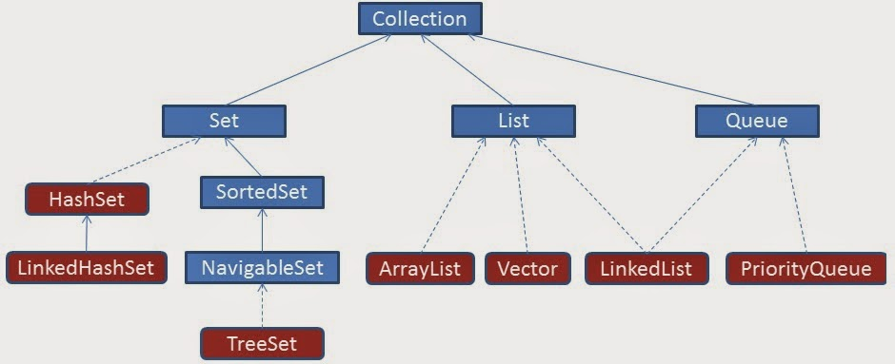
Collection Hierarchy

Slide 31
Collection categories
Ordered Collection
  The objects within the collection are maintained in a particular order or not
  When an object is added or removed from an ordered collection , the order is automatically maintained
Duplicate Elements
  Whether or not the collection allows duplicate objects
  Collection will automatically reject an attempt to add an object
Mapping of Key & Value
  Whether or not the collection maps a key to a particular object .
  This provides a means of quickly locating the object.
  Such collections do not allow duplicate objects

Slide 32
Collections
Lists
  List of things
  Classes that implement List Interface
Sets
  Unique things
  Classes that implement Set Interface
Maps
  Things with unique id
  Classes that implement Map Interface
Queues
  Things arranged in order
  Classes that implement Queue Interface

Slide 33
Methods in List Interface
void add(object o)
void addAll(Collection c)
void clear()
boolean contains(object)
Object get(int index)
int indexOf(object o)
ListIterator listIterator()
Object set (int index, Object element)

Slide 34
List Implementations
Array List
  a resizable-array implementation
    unsynchronized
Linked List
  a doubly-linked list implementation
  if elements frequently inserted/deleted within the List
    May provide better performance than ArrayList
  For queues and double-ended queues (deques)
Vector
  a synchronized resizable-array implementation of a List with additional "legacy" methods.

Slide 35
ArrayList
Permits all elements, including null.
  Dynamically add objects in the List.
  By default, creates an array of size 10.
  Adding or removing elements will automatically adjust the size
ArrayList()
  Constructs an empty list with an initial capacity of ten.
ArrayList(int initialCapacity)
  Constructs an empty list with the specified initial capacity.

Slide 36
Generics
Introduced in Java 5.0
Can put any Object in to Collections, because they hold Just Objects
  Type-safe Collections are created ,ensuring type-safety at compile time rather than run-time
Type erasure Applied For :
  Stronger type checks at compile time.
  Elimination of casts.
  The bytecode, contains only ordinary classes, interfaces, and methods.
  Type erasure ensures that no new classes are created for parameterized types;
    Generics incur no runtime overhead.

Slide 37
Generics
Creating an Instance of Classes of Generic Type
  ArrayList<Employee> alist=new ArrayList<Employee>();
    Employee ramesh = new Employee(101,”Ramesh”);
  alist.add(ramesh);
Stronger type checks at compile time.
A Java compiler applies strong type checking to generic code and issues errors if the code violates type safety.
Fixing compile-time errors is easier than fixing runtime errors, which can be difficult to find.

Slide 38
Two Schemes of Traversing Collections
for-each
  The for-each construct allows you to concisely traverse a collection or array using a for loop
for (Object o: collection)
  System.out.println(o);
Iterator
  An Iterator is an object that enables you to traverse through a collection and to remove elements from the collection selectively, if desired

Slide 39
ArrayList – Enhanced For Loop
  public void printElements()
  {
  for(Employee employee :list)
  {
  System.out.println(employee .getEmpname());
  System.out.println(employee .getEmpno());
  }
  }

Slide 40
The Iterator Interface
Provides for the one-way traversal of a Set or SortedSet collection (forward only)
Has several required methods but the most frequently used are:
Method
Usage
hasNext()
Returns true if the iteration has more elements
next()
Returns the next element in the iteration (as a generic Object)

Slide 41
Array List –with Iterator
public void dispalyArrayList()
{
Iterator<Employee> itr = alist.iterator();
while(itr.hasNext())
{
Employee empObj = itr.next();
System.out.println(empObj.getEmpname());
System.out.println(empObj.getEmpno());
}
}

Slide 42
Array List
When to use ArrayList
  To fetch data frequently
  Adding data is not so frequent activity.
When not to use ArrayList
  When the list is updated frequently

Slide 43
The ListIterator Interface
Extends the Iterator interface to provide for the two-way traversal of a List collection (forward and backward)
The most frequently used are:
Method | Usage
haxNext() | Returns true if this list iterator has more elements when traversing the list in the forward direction
hasPrevious() | Returns true if this list iterator has more elements when traversing the list in the backward direction
next() | Returns the next element in the list (as a generic Object)
previous() | Returns the previous element in the list (as a generic Object)

Slide 44
The Four Methods
Collections depends on :
  equals,
  compare
  compareTo,
  hashCode
Collection with some sort of membership test uses equals
Collection that depends on sorting requires larger/equal/smaller comparisons (compare or compareTo)
Collection that depends on hashing requires both equality testing and hash codes
While implementing hashCode, implement equals too.

Slide 45
Natural Ordering
Comparable implementations provide a natural ordering for a class, which allows objects of that class to be sorted automatically
If the List consists of String elements, it will be sorted into alphabetical order
String class implements the Comparable interface.
If the elements do not implement Comparable, Collections.sort(list) will throw a ClassCastException.

Slide 46
Comparable Interface
Implementing Comparable interface requires to implement the method compareTo()
Imposes a total ordering on the objects of each class that implements it.
The class's compareTo method is referred to as its natural comparison method.
public int compareTo(Object o)
  Compares this object with the specified object for order.
  Returns a negative integer, zero, or a positive integer as this object is less than, equal to, or greater than the specified object.

Slide 47
Implementing Comparable
  public class Book implements Comparable<Book>{
  private int bookno;
  private String bookname;
  private String author;
  public int compareTo(Book otherbook) {
  if(this.bookno<otherbook.bookno) return -1;
  if(this.bookno>otherbook.bookno) return 1;
  return 0;
  }
}
To Sort the ArrayList Using Comaprable the static method in the Collectins class is invoked
  Collections.sort(arrList);

Slide 48
Using a separate Comparator
Can put the comparison method in a separate class that implements Comparator instead of Comparable
The more flexible Comparator can also be used
Comparator is in java.util, not java.lang
Comparable requires a definition of compareTo but Comparator requires a definition of compare

Slide 49
Implementing Comparator
  import java.util.Comparator;
  public class BookNumberComp implements Comparator<Book>
  {
  public int compare(Book obj1, Book obj2) {
  if(obj1.getBookno()<obj2.getBookno())return -1;
  if(obj1.getBookno()>obj2.getBookno())return 1;
  return 0;
  }
  }

Slide 50
Implementing Multiple Comparators
  public class BookNumberComp implements Comparator<Book>
  {
  public int compare(Book obj1, Book obj2) {
  if(obj1.getBookno()<obj2.getBookno())return -1;
  if(obj1.getBookno()>obj2.getBookno())return 1;
  return 0;
  }
  }
  public class BookNameComp implements Comparator<Book>
  {
  public int compare(Book obj1, Book obj2) {
  String bk1 = obj1.getBookname();
  String bk2 = obj2.getBookname();
  return bk1.compareTo(bk2);
  }
  }

Slide 51
Collections.Sort() with Comparator
public static void main(String[] args) {
ArrayList<Book> bkList = new ArrayList<Book>();
Book bk1 = new Book(23,"java","kathy sierra");
Book bk2 = new Book(101,"j2ee","james gosling");
Book bk3 = new Book(11,"struts","haffzel manning");
bkList.add(bk1);
bkList.add(bk2);
bkList.add(bk3);
BookComparators bc = new BookComparators();
Collections.sort(bkList, bc);
for(Book bk:bkList)
{
System.out.println(bk.getBookno());
}
}

Slide 52
When to use each
The Comparable interface is simpler and less work
  The Object of the class implements Comparable
  A public int compareTo(Object o) method is overriden
  When no argument constructor is used in TreeSet or TreeMap
The Comparator interface is more flexible but slightly more work
  Many different classes that implement Comparator
  Sorting the TreeSet or TreeMap differently with each comparator
  TreeSet or TreeMap are Constructed using the comparator

Slide 53
Interface Set
Extends Collection
An unordered collection of objects
  can grow as needed
  easy to add/delete
  API independent of implementation (HashSet, TreeSet)
  Elements have no positions
  Duplicate entries not allowed

Slide 54
TreeSet
A balanced binary tree implementation
Imposes an ordering on its elements
The elements in the TreeSet are sorted in ascending element order, sorted according to the natural order of the elements
It can be sorted by the comparator provided at set creation time
TreeSet instance performs all key comparisons using its compareTo (or compare) method,

Slide 55
Hash Set
Non Duplicate
Un-Ordered
Internally uses HashMap.
  Adds a value in 'map' by calling put(E,o);
  They Key E is the element passed in add
  'o' as the value which is a dummy Object created by doing Object o = new Object;
    Its common for all key's entered in HashMap 'map’.
Checks the Key is already present by calling the equals method of 'element'.

Slide 56
equals” operation of “Set” Interface
Set also adds a stronger contract on the behavior of the equals and hashCode operations,
Set instances to be compared meaningfully even if their implementation types differ
Two Set instances are equal if they contain the same elements
The equality is determined by equals and hashcode Implementation

Slide 57
Hash Set – Duplicates Not Allowed
  public static void main(String args[]) {
  HashSet<Book> hs = new HashSet<Book>();
  Book b1= new Book(100,"java","herbert");
  Book b2 = new Book(101,"j2ee","kathy siera");
  Book b3 = new Book(101,"j2ee","kathy siera");
  hs.add(b1);
  hs.add(b2);
  for(Book bk:hs)
  {
  System.out.println(bk.getBookno());
  System.out.println(bk.getBookname());
  }
  }

Slide 58
Tree Set With Comparators
Tree Set Class overloaded constructors one without argument and another one which takes comparator as arguments.
  BookComparators bc = new BookComparators();
  TreeSet<Book> tscomp = new TreeSet<Book>(bc);
  Book bk1 = new Book(23,"java","kathy sierra");
  Book bk2 = new Book(101,"j2ee","james gosling");
  Book bk3 = new Book(11,"struts","haffzel manning");
  tscomp.add(bk1);
  tscomp.add(bk2);
  tscomp.add(bk3);
  }

Slide 59
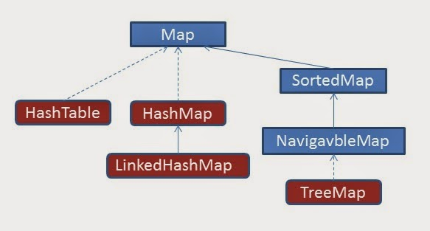
Collection Hierarchy- Map

Slide 60
Why Map is not Extending Collection
Maps work with key/value pairs
  They map keys to values.
Its content can be viewed
  As a set of keys,
  A collection of values
  A set of key-value mappings.
Mappings are not collections and collections are not mappings.
Maps can be viewed as Collections of keys, values, or pairs
It has Collection view operations
  keySet, entrySet, and values

Slide 61
Map
interface Map (does not extend Collection)
An object that maps keys to values
Ordering may be provided by implementation class, but not guaranteed
Methods to Add and Get Objects
  Object put( Object key, Object value)
  Object get( Object key)
Iterators for keys, values, (key, value) pairs

Slide 62
Map Implementations
Hash Map
  A hash table implementation of Map
  Supports null keys & values
  Not Ordered
Tree Map
  A balanced binary tree implementation
  Imposes an ordering on its elements based on comparable/compartor
Hash table
  Synchronized hash table implementation of Map interface.
  Doesn't support null keys and values

Slide 63
Hash Map
Works on the principal of hashing.
It stores values in the form of key-value pair
  Access a value by providing the key.
The 'key' element should implement equals() and hashcode() method.
HashMap stores key-value pair in Map.Entry static nested class implementation.

Slide 64
Working of Hash Map
put()
  Invoked by passing key-value pair,
  The Entry is stored in the LinkedList, so if there is an already existing entry, it uses equals() method to check if the passed key already exists, if yes it overwrites the value else it creates a new entry and stores this key-value Entry.
get()
  Invoked by passing Key,
  It uses the hashCode() to find the index in the array and then use equals() method to find the correct Entry and return its value.

Slide 65
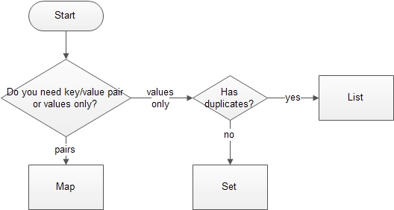
Deciding the Collection Interface

Slide 66

JDBC
JDBC is a standard interface for connecting to relational databases from Java.
The JDBC classes and interfaces are in the java.sql package.
JDBC 1.22 is part of JDK 1.1; JDBC 2.0 is part of Java 2
Notes:
About Java Database Connectivity (JDBC)
The java.sql package contains a set of interfaces that specify the JDBC API. This package is part of Java 1.1.7 and Java 2, and is supported by JDeveloper. Database vendors implement these interfaces in different ways, but the JDBC API itself is standard.
Using JDBC, you can write code that:
Connects to one or more data servers
Executes any SQL statement
Obtains a result set so that you can navigate through query results
Obtains metadata from the data server
Instructor Note
JDBC 1.22 is part of JDK 1.1; JDBC 2.0 is part of Java 2.

Slide 67

Database Connectivity
  JDBC Architecture:
    Provides the mechanism to translate Java statements into SQL statements.
    Can be classified into two layers:
      JDBC application layer
      JDBC driver layer

Slide 68
JDBC Drivers
JDBC
Type I
“Bridge”
ODBC
ODBC
Driver
Type II
“Native”
CLI (.lib)
Type III
“Middleware”
Middleware
Server
Type IV
“Pure”
Notes:
Copyright © 1997 Alex Chaffee

Slide 69

Type -4 Native Protocol Pure Java Driver

Slide 70
Type -4 Native Protocol Pure Java Driver
Advantages
  They Don't translate the requests into an intermediary format (such as ODBC),
  No need for a middleware layer to service requests.
  The JVM can manage all aspects of the application-to-database connection facilitating debugging.
Disadvantages
  Clients require a separate driver for each database.
  Drivers are database dependent.

Slide 71
Java.sql packages.
The commonly used classes and interfaces in the JDBC API are:
    DriverManager class: Loads the driver for a database.
    Driver interface: Represents a database driver. All JDBC driver classes must implement the Driver interface.
    Connection interface: Enables you to establish a connection between a Java application and a database.
    Statement interface: Enables you to execute SQL statements.
    ResultSet interface: Represents the information retrieved from a database.
    SQLException class: Provides information about the exceptions that occur while interacting with databases.

Slide 72
Querying a Database With JDBC
Connect
Register the driver
Query
Connect to the database
Process
results
Close

Slide 73
Loading a Driver Programmatically:
forName()
    In the java.lang.Class class.
    Loads the JDBC driver and registers the driver with the driver manager.
Class.forName("oracle.jdbc.driver.OracleDriver");
Required before Java 6
  Not required after Java 6 and JDBC 4.0 API
Need to place the Product Specific JAR file with JDBC 4.X driver in class path.
  Java automatically detects the Driver class and loads it.

Slide 74
Driver Manager
DriverManager
  Provides the getConnection() method to create a Connection object.
getConnection()
  Connection getConnection (
        String <url>,
        String <username>,
        String <password>
        )

Slide 75
URL
The format of the connection URL:
  protocol//[hosts][/database]
  jdbc:mysql://localhost:3306/test
protocol
  jdbc:mysql: is for basic JDBC connections.
hosts
  The hosts part may consist of a host name,
  jdbc:mysql://localhost:3306/
database
  The default database or catalog to open.
  jdbc:mysql://localhost:3306/test

Slide 76
Data Base Connection Property
src/resources/DbConnection.properties
datasource.url=jdbc:mysql://localhost:3306/test
datasource.username=root
datasource.password=srivatsan
datasource.driverClassName=com.mysql.jdbc.Driver

Slide 77
Connection Utility
  public static Connection getMySqlConnection() {
  Connection con = null;
  try {
  String fileName = "resources/DbConnection.properties";
  Properties props=new Properties();
  InputStream inStream=
  DataBaseConnection.class.getClassLoader().
  getResourceAsStream(fileName);

Slide 78
Connection Utility
  props.load(inStream);
  con=DriverManager.getConnection(
  props.getProperty("datasource.url"),
  props.getProperty("datasource.username"),
  props.getProperty("datasource.password"));
  } catch (SQLException | IOException e) {
  e.printStackTrace();
  }
  return con;
  }

Slide 79
Statements- Statement
Statement
  Used to execute string-based SQL queries
  Code becomes less readable because of concatenation of SQL strings
  Query is passed with inline values to the database.
    Because of which query optimization is not possible
  Prevents cache usage.
  Suitable for DDL queries like CREATE, ALTER, and DROP

Slide 80
Statements - PreparedStatement
PreparedStatement extends the Statement interface.
Provides methods to bind various object types
Code becomes easy to understand:
Uses pre-compilation.
  As soon as the database gets a query, it will check the cache before pre-compiling the query.
Used for statements that is called more than once.
Suitable for DML queries like Insert,Update and Delete
Notes:
Prepared Statements
PreparedStatement is inherited from Statement; the difference is that a PreparedStatement holds precompiled SQL statements.
If you execute a Statement object many times, its SQL statement is compiled each time. PreparedStatement is more efficient because its SQL statement is compiled only once, when you first prepare the PreparedStatement. After that, each time you execute the SQL statement in the PreparedStatement, the SQL statement does not have to be recompiled.
Therefore, if you need to execute the same SQL statement several times within an application, it is more efficient to use PreparedStatement than Statement.
PreparedStatement Parameters
A PreparedStatement does not have to execute exactly the same query each time. You can specify parameters in the PreparedStatement SQL string and supply the actual values for these parameters when the statement is executed.
The following slide shows how to supply parameters and execute a PreparedStatement.

Slide 81
Statements - PreparedStatement
String sqlAdd = "insert into emp values(?,?,?)";
  PreparedStatement pstmt = con.prepareStatement(sqlAdd);
  pstmt.setInt(1, empid);
  pstmt.setString(2, empname);
  pstmt.setDouble(3, salary);
  int n = pstmt.executeUpdate();

Slide 82
Executing JDBC Statements
Can Use SQL statements to send requests to a database to retrieve results.
The Following methods are used to send static SQL statements to a database:
  ResultSet executeQuery(String str)
  int executeUpdate(String str)
  boolean execute(String str)

Slide 83
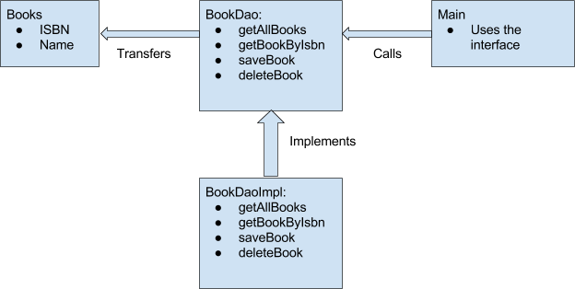
Dao Pattern

Slide 84
Dao Interface
  public interface DataAccess<T> {
  public boolean add(T t);
  public List<T> findAll();
  public boolean remove(T t);
  public int update(int key,T t);
  public T findById(int key);
  }

Slide 85
DAO Implementation
  public class InvoiceDaoImpl implements DataAccess<Invoice> {
  private Connection connection;
  public InvoiceService(Connection connection) {
  super();
  this.connection = connection;
  }

Slide 86
DAO Implementation
  public boolean add(Invoice t) {
  String sql = "insert into invoice values(?,?,?)";
  int rowAdded =0;
  try (PreparedStatement pstmt = connection.prepareStatement(sql)) {
  pstmt.setInt(1, t.getInvoiceNumber());
  pstmt.setString(2, t.getCustomerName());
  pstmt.setDouble(3, t.getAmount());
  rowAdded = pstmt.executeUpdate();
  } catch (SQLException e) {
  e.printStackTrace();
  }
  return rowAdded==1?true:false;
  }

Slide 87
DAO Implementation
  public List<Invoice> findAll() {
  String sql = "select * from invoice ";
  List<Invoice> invoiceList = new ArrayList<>();
  try (PreparedStatement pstmt = connection.prepareStatement(sql)) {
  ResultSet result = pstmt.executeQuery();
  while(result.next()) {
  int invoiceNumber =result.getInt("invoiceNumber");
  String customerName = result.getString("customerName");
  double amount = result.getDouble("amount");

Slide 88
DAO Implementation
  Invoice invoice = new Invoice(invoiceNumber, customerName, amount);
  invoiceList.add(invoice);
  }
  } catch (SQLException e) {
  e.printStackTrace();
  }
  return invoiceList;
  }

Slide 89
DAO Implementation
  public boolean remove(Invoice t) {
  String sql = "delete from invoice where invoiceNumber=?";
  int rowDeleted =0;
  try (PreparedStatement pstmt = connection.prepareStatement(sql)) {
  pstmt.setInt(1, t.getInvoiceNumber());
  rowDeleted = pstmt.executeUpdate();
  } catch (SQLException e) {
  e.printStackTrace();
  }
return rowDeleted==1?true:false;
}

Slide 90
DAO Implementation
  public void closeConnection() {
  try {
  this.connection.close();
  } catch (SQLException e) {
  e.printStackTrace();
  }
  }

Slide 91
DAO Implementation
  public Invoice findById(int key) {
  String sql = "select * from invoice where invoiceNumber=?";
  Invoice foundInvoice =null;
  try (PreparedStatement pstmt = connection.prepareStatement(sql)) {
  pstmt.setInt(1, key);
  ResultSet result = pstmt.executeQuery();

Slide 92
DAO Implementation
  if(result.next()) {
  int invoiceNumber =result.getInt("invoiceNumber");
  String customerName = result.getString("customerName");
  double amount = result.getDouble("amount");
  foundInvoice = new Invoice(invoiceNumber, customerName, amount);
  }
  } catch (SQLException e) {
  e.printStackTrace();
  }
  return foundInvoice;
}

Slide 93
Local Date to java.sql Date
  LocalDate date = LocalDate.of(2021, 8, 17);
  Date sqlDate = Date.valueOf(date);

Slide 94
Using Joins
  public class CourseList {
  private String courseName;
  private List<Student> studList;
  }
  public class Student {
  private long studentNumber;
  private String studentName;
  }

Slide 95
Using Joins
  public CourseList queryByCourse(String courseName) throws Exception{
  String sql="SELECT Mystudent.studentNumber, MyStudent.studentName, MyCourse.courseName from MyStudent LEFT OUTER JOIN MyCourse on Mystudent.coursecode = Mycourse.coursecode where mycourse.courseName =?";
  PreparedStatement pstmt = con.prepareStatement(sql);
  pstmt.setString(1, courseName);

Slide 96
Using Joins
    List<Student> studList = new ArrayList<>();
    ResultSet rs = pstmt.executeQuery();
    while(rs.next())
    {
    studList.add(new Student(rs.getLong(1),rs.getString(2)));
    }
    CourseList course = new CourseList();
    course.setCourseName(courseName);
    course.setStudList(studList);
    return course;
    }

Slide 97
Transaction
  Is a set of one or more SQL statements that are executed as a single unit.
  Is complete only when all the SQL statements in a transaction execute successfully.
  Maintains consistency of data in a database.

Slide 98
Managing Database Transactions
  JDBC API provides support for transaction management.
  The database transactions can be committed in two ways in the JDBC applications:
    Implicit: The Connection object uses the auto-commit mode to execute the SQL statements implicitly.
    Explicit: The auto-commit mode is set to false to commit the transaction statement explicitly. The method call to set the auto-commit mode to false is:
    con.setAutoCommit(false);

Slide 99
Save Point
Used to save the current state of the database
  Can be rolled-back afterwards to that state of the database.
  Similar to the SQL Transactions and are generally to rollback if something goes wrong within the current transaction.
connection.setSavepoint()
  Used to create an object which references a current state of the database within the transaction.

Slide 100
Managing Database Transactions
  try {
  con.setAutoCommit(false);
  String sqlOne = "insert into invoice values(?,?,?)";
  String sqlTwo = "inseert into customer values(?,?,?)";
  PreparedStatement pstmt =null;
  PreparedStatement pstmt2 =null;
  pstmt =con.prepareStatement(sqlOne);
  pstmt.setInt(1, 879);
  pstmt.setString(2, "Kale");
  pstmt.setDouble(3, 4949);
  pstmt.executeUpdate();
  point1 = con.setSavepoint("point1");

Slide 101
Managing Database Transactions
    pstmt2 =con.prepareStatement(sqlTwo);
    pstmt2.setInt(1, 996);
    pstmt2.setString(2, "Chennai");
    pstmt2.setString(3, "kale@abc.com");
    pstmt2.executeUpdate();
    con.commit();
    } catch (SQLException e) {
    try {
    con.rollback(point1);
    con.commit();
    System.out.println("Rolling Back");
    } catch (SQLException e1) {
    e1.printStackTrace();
    }

