Slide 1
Abstract Class
An abstract class is a class that is declared abstract
  It may or may not include abstract methods.
Abstract classes cannot be instantiated
  They can be subclassed.
  They Cannot be final
  They Can have constructors
Vehicle
Vehicle
Abstract superclass
Concrete subclasses
Car
Car
Truck

Slide 2
Use case for abstract classes
Share code among several closely related classes.
Provides a template for subclasses to extend
Override the abstract methods
Can declare an abstract method protected
  To restrict its access to the class and its subclasses.

Slide 3
Defining Abstract Classes in Java
  Use the abstract keyword to declare a method as abstract
    Only provide the method signature
    Class must also be abstract
  Must be implemented by a concrete subclass
    Each concrete subclass can implement the method differently
public abstract class Vehicle {
private String regNum;
public String getRegNum()…
public abstract boolean isRoadWorthy();
}
public class Car
extends Vehicle{
private int numSeats;
public void fitRack()…
public class Truck
extends Vehicle{
private int axles;
public void setLoad()…

Slide 4
The Abstract Class-Super Class
Note
this
  public abstract class BankAccount {
  public abstract void deposit(double amount);
  public abstract void withdraw(double amount);
  public void sayHello() {
  System.out.println("Thanks-Come Again");
  }
  }

Slide 5
Child Class –Its alsoAbstract
  public abstract class Savingaccount extends BankAccount {
  public abstract void getDetails();
  }

Slide 6
The Concrete Class
  public class Supersavings extends Savingaccount {
  private double balance,amount ;
  private String custname;
  private int accno;
  public void deposit(double amt)
  {
  balance+=amt;
  }
  public void withdraw(double amt)
  {
  balance-=amt;
  }
  public void getDetails()
  {
  System.out.println(custname);
  System.out.println(accno);
  System.out.println(amount);
  System.out.println(balance);
  }
  }

Slide 7
Interfaces & Polymorphism

Slide 8
Interfaces
  An interface is like a fully abstract class
    All the methods are public and abstract- Till Java 8
      No instance variables if present they are public static final
  Defines a set of methods that other classes can implement
    A class can implement many interfaces,
      but can extend only one class
      can extend other interfaces and extend multiple interfaces

Slide 9
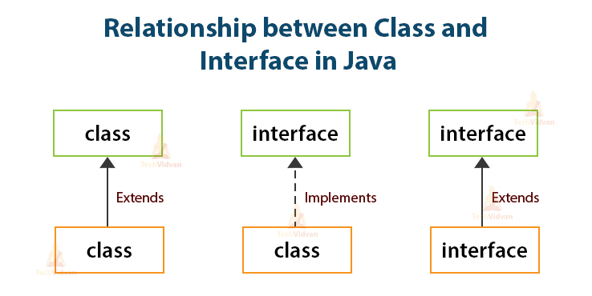

Slide 10



Example of Interfaces
  Interfaces describe an aspect of behavior that different classes can support
    Any class that supports the “Steerable” interface can be steered:
Steerable
Not Steerable

Slide 11
Interface
Interfaces define types in an abstract form
  Allows the specification of a reference type without providing an implementation
  The class that implements the interface decides how to implement
  Use interface keyword instead of class
  public interface Function {
  public double apply(double arg);
  }

Slide 12
Implement the Interface
  public class CurrencyConverter implements Function {
  @Override
  public double apply(double arg) {
  return arg * 45;
  }
  }
  Function usdToInr = new CurrencyConverter();
  System.out.println(usdToInr.apply(100));

Slide 13
Implementing an Interface
public interface Steerable {
int maxTurn = 135;
void turnLeft(int deg);
void turnRight(int deg);
}
public class Car
extends Vehicle
implements Steerable {
public void turnLeft(int deg)
{…}
public void turnRight(int deg)
{…}

Slide 14
Partial Implementation of an Interface
Declare the class as abstract if the class does not implement all the methods of an interface
Implement the methods in the sub class level
Public abstract class Car
extends Vehicle
implements Steerable {
public void turnLeft(int deg)
{…}
}

Slide 15
Using instanceof with Interfaces
  The instanceof operator can be used to check if an object implements an interface
  Downcasting can be used if necessary, to call methods defined in the interface
public void aMethod(Object obj) {
…
if (obj instanceof Steerable)
((Steerable)obj).turnLeft();
}

Slide 16
Extending an Interface
One Interface can extend another Interface
public interface Steerable {
int maxTurn = 135;
void turnLeft(int deg);
void turnRight(int deg);
}
public interface Navigator
extends Steerable {
void calcSpeed(int distance);
}

Slide 17
Polymorphism
This OO Principle allows the programmer to program abstractly
Objects of a subclass can be treated as objects of its superclass
The base class of a hierarchy is usually an abstract class or an Interface
  They define the common behavior (functionality)
Classes and Subclasses inherit this behavior and extend it according to their own properties by overriding the methods of the super class
Subclass objects can be treated as super class objects through references,
  But, super class objects are not subclass objects

Slide 18
Polymorphism
Allows for hierarchies to be highly extensible
New classes can be introduced and can still be processed without changing other parts of the program
Same method can do different things, depending on the class that implements it.
Method invoked is associated with OBJECT and not with reference.
Types of Polymorphism -
  Method Overloading.
  Method Overriding.

Slide 19
Polymorphism
  public interface Conditional {
  public boolean test();
  }

Slide 20
Implementation -One
  public class Professor implements Conditional {
  private String qualification;
  @Override
  public boolean test() {
  return this.qualification.equalsIgnoreCase("phd");
  }
  }

Slide 21
Implementation -Two
  public class Student implements Conditional {
  private double markScored;
  @Override
  public boolean test() {
  return this.markScored>90;
  }
  }

Slide 22
Polymorphism
  public static void print(Conditional poly) {
  System.out.println(poly.test());
  }
  public static void main(String[] args) {
  Student ramesh = new Student(101,"Ramesh",67);
  Professor prof = new Professor(201, "manish", "ece", "phd");
  print(ramesh);
  print(prof);
  }

Slide 23
Exception handling

Slide 24
Exception Handling
An exception is an event that arises during the execution of a program.
  It makes the normal flow of the program disrupt
  The program terminates abnormally, which is not recommended
  Exceptions are to be handled.

Slide 25
Exception Class Hierarchy
java.lang.Object
java.lang.Throwable
java.lang.Error
java.lang.Exception
java.io.IOException
java.lang.RuntimeException
Notes:
The class Object is the root of the class hierarchy. Every class has Object as a superclass. All objects, including arrays, implement the methods of this class.
The Throwable class is the superclass of all errors and exceptions in the Java language. Only objects that are instances of this class (or of one of its subclasses) are thrown by the Java Virtual Machine or can be thrown by the Java throw statement. Similarly, only this class or one of its subclasses can be the argument type in a catch clause.
An Error is a subclass of Throwable that indicates serious problems that a reasonable application should not try to catch. Most such errors are abnormal conditions. The ThreadDeath error, though a "normal" condition, is also a subclass of Error because most applications should not try to catch it.
The class Exception and its subclasses are a form of Throwable that indicates conditions that a reasonable application might want to catch.
RuntimeException is the superclass of those exceptions that can be thrown during the normal operation of the Java Virtual Machine. A method is not required to declare in its throws clause any subclasses of RuntimeException that might be thrown during the execution of the method but not caught.
IOException signals that an I/O exception of some sort has occurred. This class is the general class of exceptions produced by failed or interrupted I/O operations.

Slide 26
Exceptions
checked exceptions
  Conditions that can readily occur in a correct program
  Includes all subtypes of Exception
  Excluding classes that extend Runtime Exception.
  Subject to the handle or declare rule
unchecked exceptions
  Problems that reflect program bugs
  Probable bugs are represented by the RuntimeException class.
  Compiler doesn’t enforce the handle or declare rule.
error
  Fatal situations are represented by the Error class.

Slide 27
Handle or Declare Rule
Handle
  Using the try-catch block.
  try{
  // some code
  } catch(Exception e){
  // exception handling code
  }
Declare
  Using the throws clause.
  void trouble() throws IOException { ... }
  void trouble() throws IOException, MyException { ... }

Slide 28
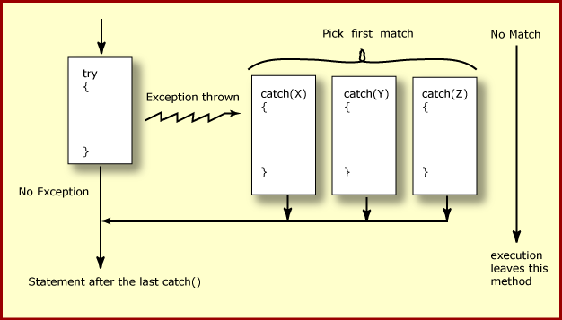
How try catch Work

Slide 29
Exception Handling
  try {
    Object value = "twenty";
    Integer number = (Integer) value;
  }
  catch ( ClassCastException ex ) {
  ex.printStackTrace();
  }
  System.out.println("Good-bye" );
  }

Slide 30
Nested Try Catch
  try {
  Object value = "twenty";
  Integer number = (Integer) value;
    try {
    String mark ="50";
    Integer.parseInt(mark);
    } catch (NumberFormatException e) {
    e.printStackTrace();
    }
  }
  catch ( ClassCastException ex ) {
  ex.printStackTrace();
  }

Slide 31
Catching Exception –Multiple Catch
  try {
  Object value = "twenty";
  Integer number = (Integer) value;
  String mark ="50";
  Integer.parseInt(mark);
  }
  catch ( ClassCastException ex ) {
  ex.printStackTrace();
  }
  catch (NumberFormatException e) {
  e.printStackTrace();
  }

Slide 32
Effective Exception Hierarchy
The exception classes are arranged in a hierarchy.
Catches for specific exceptions should always be written prior to the generic handler.
A generic handler for Exception would cover any missing situation.
  try
  {
  }
  catch (NumberFormatException e) {
  }
  catch (Exception ex2) {
  }
  try
  {
  }
  catch (Exception e1) {
  }
  catch(NumberFormatException e2) {
  }

Slide 33
Multiple Catch
  try {
  Object value = "twenty";
  Integer number = (Integer) value;
  String mark ="50";
  Integer.parseInt(mark);
  }
  catch ( ClassCastException| NumberFormatException ex ) {
  ex.printStackTrace();
  }

Slide 34
Multiple Catch
  try {
  } catch (RangeCheckException | RuntimeException e) {
  }
  try {
  } catch (RangeCheckException | Exception e) {
  }

Slide 35
Finally block
Its optional and will always be invoked,
  whether an exception in the corresponding try is thrown or not,
  whether a thrown exception is caught or not.
finally-will-always-be-called except if the JVM shuts down.
  When the try or catch blocks may call System.exit();
Finally Block is always executed despite of different scenarios:
  Forced exit occurs using a return, a continue or a break statement
  Normal completion
  Caught exception thrown
  Exception was thrown and caught in the method
  Uncaught exception thrown
  Exception thrown was not specified in any catch block in the method

Slide 36
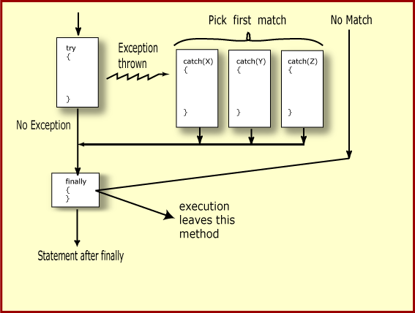
Finally Block

Slide 37
Finally Block
  public static String tryblkWithReturn(String data ) {
  try {
  int no = Integer.parseInt(data);
  }
  catch (NumberFormatException e) {
  System.out.println("Entering Catch Block");
  return "Hello";
  }
  finally {
  System.out.println("Inside finally");
  }
  System.out.println("I am back");
  return "Hi";
  }

Slide 38
Finally Block
  public static String tryblkWithNewException(String data ) throws Exception {
  try {
  int no = Integer.parseInt(data);
  }
  catch (NumberFormatException e) {
  System.out.println("Entering Catch Block");
  throw new Exception();
  }
  finally {
  System.out.println("Inside finally");
  }
  System.out.println("I am back");
  return "Hi“;
  }

Slide 39
Throws Clause
The Method that may cause an exception to occur
  Must catch it,
  Else it must say so using the throws keyword
  Except for Error or RuntimeException, or their subclasses
  public void trouble() throws IOException, MyException { ... }

Slide 40
The try-with-resources Statement
A try statement that declares one or more resources.
resource
  An object that must be closed after the program is finished with it.
  Any object that implements java.lang.AutoCloseable, and java.io.Closeable,
    try(Scanner scan = new Scanner( System.in )) {
    //some code
    }
    catch(Exception e ){
    // Exception handling code
    }

Slide 41
Exception Handling- Closing the Resource
  Scanner scan = new Scanner( System.in );
  int num ;
  System.out.print("Enter an integer: ");
  try {
  num = scan.nextInt();
  System.out.println("The square of " + num + " is " + num*num );
  }
  catch ( InputMismatchException ex ) {
    System.err.println("You entered bad data." );
    System.err.println("Run the program again." );
  }
  System.err.println("Good-bye" );
  scan.close();
  }

Slide 42
The try-with-resources Statement
  System.out.print("Enter an integer: ");
  try(Scanner scan = new Scanner( System.in )) {
  int num = scan.nextInt();
  System.out.println("square" + num + "is" + num*num );
  }
  catch ( InputMismatchException ex ) {
    System.err.println("You entered bad data." );
    System.err.println("Run the program again." );
  }
  System.out.println("Good-bye" );
  }

Slide 43
Throwing Exceptions
throw
  Allows to throw exceptions or generate exceptions
  Exceptions are object
  Need to create an exception object
  public void method1(){
  // some code
    throw new ArithmeticException(“testing...”);
  }

Slide 44
User Defined Exception
  User Defined Exception must be a child of Throwable.
extend the Exception class
    To create a checked exception that is automatically enforced by the Handle or Declare Rule
    extend the RuntimeException class.
    To create a runtime exception

Slide 45
Overview
At its lowest level, all Java I/O involves a stream of bytes either entering or leaving memory
Packaged classes exist to make it easy for a program to read and write larger units of data.
Low-level stream class object are used to handle byte I/O
High-level stream class object will allow the program to read and write primitive data values and objects

Slide 46


File Handling
  Java views the data in files as a stream of bytes.
  A stream of bytes from which data are read is called an input stream.
  A stream of bytes to which data are written is called an output stream.
  Java provides classes for connecting to and manipulating data in a stream.
  The classes are defined in the package java.io and are organized in a large complex hierarchy.

Slide 47
Accessing File
Two ways to access files in the Java I/O API:
  File class
  Path interface.
File
  Abstract representation of file and directory pathnames
  Not used to read and write data
  Used for searching and deleting of files
  Used for creating directories and working with path
  File file1 = new File("C:\\Data\\myFile.dat");

Slide 48
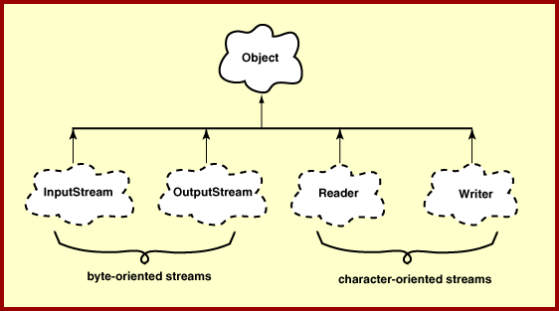
Hirearchy of IO Package

Slide 49
FileWriter
Used to write character to files
The Write method() of this classes is used to write characters
Wrapped by BufferedWriter to improve the performance
FileWriter(File file)
FileWriter(File file, boolean append)
All constructors and methods throw IOException

Slide 50
Print Writer
PrintWriter wraps the FileWriter
Has flexible and powerful methods to write data to files
format(),printf() and append() are used to work with data
print() or println() take a single parameter of any data type

Slide 51
FileReader
Used to read characters from files
The read() method of this class is used to read characters
These are wrapped by BufferedReader to improve the performance
Constructors:
FileReader(File file) throws FileNotFoundException
FileReader(String fileName) throws FileNotFoundException

Slide 52
Buffering
BufferedReader
  Buffers give a temporary holding place to group until it reaches final place.
  It helps in efficent reading of files
  Reads a large amount of data from a file at once and keep that data in buffer
  Minimizes the number of times of file access.
  Provides a readLine() method , which reads a line of characters from the file
  BufferedReader in =
    new BufferedReader(new FileReader(“file.txt"));
BufferedWriter
  Provides a newLine() method , which that creates line separators automatically

Slide 53
Write To File
  public boolean writeToTextFile(Professor prof,File file) {
  boolean result = false;
  try (PrintWriter writer = new PrintWriter(new FileWriter(file,true))){
  writer.println(prof);
  result =true;
  } catch (IOException e) {
  e.printStackTrace();
  }
  return result;
  }

Slide 54
Read From File
  public Professor[] readFromTextFile(File file) {
  Professor[] list = new Professor[4];
  String line =null;
  try(BufferedReader reader = new BufferedReader(new FileReader(file))){
  int i = 0;

Slide 55
Read From File
    while( (line = reader.readLine())!=null) {
    String[] values = line.split(",");
    Professor prof = new Professor(Integer.parseInt(values[0]),
    values[1],values[2], values[3]);
    list[i]= prof;
    i++;
    }
    }catch(IOException e) {
    e.printStackTrace();
    }
    return list;
    }

Slide 56
Serialization
What is Serialization
What is preserved when an object is serialized
transient keyword
Process of serialization
Process of deserialization
Version control

Slide 57
Serializing
Creating the sequence of bytes from an object ,and Recreating the object from the above generated bytes
Ability to read or write an object to a stream
  Process of "flattening" an object
Used to save object to some permanent storage
  Its state should be written in a serialized form to a file such that the object can be reconstructed at a later time from that file
Used to pass on to another object via the OutputStream class
  Can be sent over the network

Slide 58
To use serialization
Most Java classes are serializable
Classes need to implement the serializable interface.
  Serializable interface is marker interface
  Class should also provide a default constructor with no args
Objects of some system-level classes are not serializable
  Because the data they represent constantly changes
  Reconstructed object will contain different value anyway
A NotSerializableException is thrown if you try to serialize non-serializable objects

Slide 59
To use serialization
Objects are written using an ObjectOutputStream and read using an ObjectInputStream.
Only the object's data are preserved, Methods and constructors are not part of the serialized stream ,the class information is included
Marking a field with the transient keyword
  The transient keyword prevents the data from being serialized
  All non-transient fields are considered part of an object
Have access to the no-argument (or default) constructor of its first nonserializable superclass (or supersuperclass, supersupersuper class)
Serializability is inherited

Slide 60
Process of Serialization and Deserialization
public final void writeObject(Object obj) throws IOException
  where, obj is the object to be written to the stream
public final Object readObject() throws IOException, ClassNotFoundException
  readObject method of the ObjectInputStream class
  When an object is deserialized, its constructors are not called.
The Object type returned should be type casted to the appropriate class name before methods on that class can be executed

Slide 61
Serialization
  public static void main(String[] args)
  {
  try {
  ObjectOutputStream out =
  new ObjectOutputStream (
  new FileOutputStream(new File("abc.ser"));
  Employee eObj = new Employee(100,"ramesh",4500);
  out.writeObject(eObj);
  System.out.println("Object Serialized in abc.ser");
  } catch (FileNotFoundException e) {
  e.printStackTrace();
  } catch (IOException e) {
  e.printStackTrace();
  } }

Slide 62
DeSerialization
public static void main(String[] args) {
try
{
ObjectInputStream inObj=
new ObjectInputStream(
new FileInputStream("abc.ser"));
Employee eObj = (Employee) inObj.readObject();
System.out.println(eObj.getEmpId());
}
catch(ClassNotFoundException e)
{
e.printStackTrace();
}
catch(Exception e)
{
e.printStackTrace();
}

Slide 63
Path Interface
Introduced in Java SE 7,
Part of the Java NIO2 API.
Fixes drawbacks of the File class
  Methods of the File class do not throw exceptions when they fail,
  Lacks for support for metadata like file permissions, file owner, and other security attributes.
  Using the File class is not recommended anymore.

Slide 64
Path
A Path instance reflects the underlying platform.
  Path can use the Solaris syntax (/home/joe/foo)
  Can also use Windows syntax (C:\home\joe\foo).
  Path file =Paths.get("names.txt");
  Path file = Paths.get("C:/", "temp", “names.txt");
  Path fileToStore =Files.createFile(file);

Slide 65
Demo
  Path file =Paths.get("names.txt");
  Path file = Paths.get("C:/", "temp", “names.txt");
  Path fileRef =Files.createFile(file);
  Files.writeString(fileRef,"Hello Chennai\n",StandardOpenOption.APPEND);
  Files.readString(fileRef);

Slide 66
ANNOTATIONS

Slide 67
Annotations
Adding META-DATA to the Java Elements.
Can be applied to several elements.
Tools will read and interpret the Annotations and add lot of functionalities
What Can be Annotated
  Class, Interface,
  Method, Constructor, Field,
  Method parameter
  Local Variable declaration

Slide 68
Annotations Use Cases
Used in EJB, Web Services and other Java Frame Works
  Replace or supplement descriptors with annotations
  Annotated Web Service implementation to generate Servlet binding, JAX-RPC interfaces, etc.
  JavaBeans, Logger utilities, Debugging classes, etc.
  Test methods
  AOP crosscuts

Slide 69
Simple Annotations
Override annotation:
  To Ensure the annotated method is used to override the method in the super class.
  The compiler will generate a error if there is improper Overriding.
Deprecated annotation:
  To warn when using the deprecated element of the program.
Suppresswarning annotation:
  To ensure that the compiler will shield the warning message in the annotated elements and also in all of its sub-elements

Slide 70
Defining Annotations
Start with the symbol @ followed by keyword interface and annotation name.
Method declaration should not throw any exception.
Method declaration should not contain any parameter.
Method using annotations should return a value or an collection of one of the types given below:
  String
  Primitive
  Enum
  Object

Slide 71
Example
  @interface MyAnnotation {
  String stringValue();
  int intValue();
  }
  public class MainClass {
  @MyAnnotation(stringValue = "Annotation Example", intValue = 100)
  public static void myMethod() {
  }
  }

Slide 72
Annotation Types
Three types of annotations
  Marker, Simple Values, Multiple Values
Marker:
  Like the marker interface, they do not contain any elements except the name itself.
  @Override and @Deprecated are marker annotations.
  public @interface Example{
  }
  @Example
  public void anymethod() {
  }

Slide 73
Annotation Type
Single-value:
  Provides only single value.
  Represented with the data and value pair
  We can provide the default value also.
  public @interface Example{
  String showSomething();
  }
  @Example ("Hello Wolrd")
  public void anymethod(){
  }

Slide 74
Annotation Type
Multi-value or Full-value:
  The annotations can have multiple data members.
  Used to pass the values to all the data members.
  public @interface Example{
  String showSomething();
  int num();
  String name();
  }
  @Example (showSomething = “Hello World", num=15, name=“ramesh" )
  public void anymethod {
  // code here
  }

Slide 75
META -Annotations
Target annotation:
  specifies the elements of a class to which annotation is to be applied.
@Target(ElementType.TYPE)
  applicable to any element of a class.
@Target(ElementType.FIELD)
  applicable to field or property.
@Target(ElementType.PARAMETER)
  applicable to the parameters of a method.

Slide 76
META -Annotations
@Target(ElementType.LOCAL_VARIABLE)
  applicable to local variables.
@Target(ElementType.METHOD)
  applicable to method level annotation.
@Target(ElementType.CONSTRUCTOR)
  applicable to constructors.

Slide 77
Example
  @Target(ElementType.METHOD)
  public @interface Example{
  public String show();
  }
  @Example(show="Hello World")
  public void show() {
  System.out.printf(“Using Method annotation");
  }
  public class Test_Annotations {
  public static void main(String arg[]) {
  new Test_Annotations().show();
  }

Slide 78
Retention Annotation
These annotation specify where and how long annotation with this types are to be retained.
RetentionPolicy.SOURCE:
  This type of annotation will be retained only at source level and the compiler will ignore them.
RetentionPolicy.CLASS:
  This type of annotation will be retained at the compile time the virtual machine (VM) will ignore them.
RetentionPolicy.RUNTIME:
  Virtual machine will retain the annotation of this type and they can be read only at run-time.

Slide 79
Annotation processing
Introspections
  process runtime-visible annotations of their own program elements
  use reflection and read annotations with RUNTIME retention
Byte code analyzers
  process annotations in .class files
  e.g. stub generators
Source code analyzers
  process annotations in Java source code
  e.g. compilers, documentation generators, class browsers

Slide 80
Example
  import java.lang.annotation.Retention;
  import java.lang.annotation.RetentionPolicy;
  import java.lang.reflect.Method;
  @Retention(RetentionPolicy.RUNTIME)
  @interface Example{
  String str() default "Testing";
  int val() default 9000;
  }

Slide 81
Example
  @Example()
  public static void myMeth() { }
  Demo ob = new Demo();
  Class c = ob.getClass();
  Method m = c.getMethod("myMeth");
  MyAnno anno = m.getAnnotation(Example.class);
  System.out.println(anno.str() + " " + anno.val());

Slide 82
Reading All the Annotations
  MainClass ob = new MainClass();
  Method m = ob.getClass( ).getMethod("myMethod");
  Annotation[] annos = m.getAnnotations();
  System.out.println("All annotations for myMeth:");
  for(Annotation a : annos)
  System.out.println(a);
  }

Slide 83
Annotation
  import static java.lang.annotation.ElementType.TYPE;
  import static java.lang.annotation.RetentionPolicy.RUNTIME;
  import java.lang.annotation.Retention;
  import java.lang.annotation.Target;
  @Retention(RUNTIME)
  @Target(TYPE)
  public @interface DataTable {
  String tableName() ;
  }

Slide 84
Annotations
  @DataTable(tableName=“PersonalLoan")
  public class PersonalLoan {
  }
  Class<?> c =loan.getClass();
  DataTable ano = (DataTable) c.getAnnotation(DataTable.class);
  String tableName = ano.tableName();
  String sql = "insert into " +tableName + " values (?,?,?,?)";

