Slide 1

Spring
Aspect Oriented Programming

Slide 2
Aspect Oriented Programming
Programming technique that promotes separation of concerns within a software system
  Not a replacement for Object Oriented Programming.
  A way of organizing Program Structure
Cross Cutting Concerns
  Transaction management
  Security
  Auditing
  Event handling

Slide 3
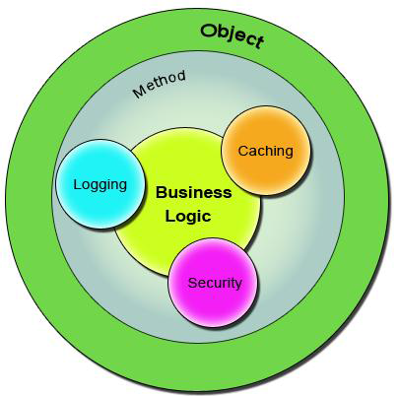
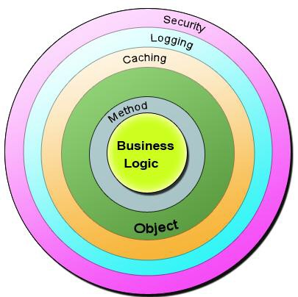
Cross Cutting Concerns

Slide 4
Sample Code
  public class Account {
  public long deposit(long depositAmount){
  newAmount = existingAccount + depositAccount;
  currentAmount = newAmount;
  return currentAmount;
  }
  public long withdraw(long withdrawalAmount){
  if (withdrawalAmount <= currentAmount){
  currentAmount = currentAmount – withdrawalAmount;
  }
  return currentAmount;
  }
  }

Slide 5
Aspect
  public void deposit(){
  // Transaction Management
  // Logging
  // Checking for the Privileged User
  // Actual Deposit Logic comes here
  }
  An Aspect is a functionality or a feature that cross-cuts over objects.
  Advice is the code that implements the Aspect.
  Aspect defines the functionality in a more abstract manner.
Advice provides a Concrete code Implementation for the Aspect.
  Logging and Transaction Management are the aspects.

Slide 6
Joint Point
Join Points defines the various Execution Points where an Aspect can be applied.
  Represents a method execution.
  public void someBusinessOperation(BusinessData data){
  //Method Start - > Possible aspect code here like logging.
  try{
  // Original Business Logic here.
  } catch(Exception exception) {
  // Exception -> Aspect code here when some exception is raised. }
  finally{
  // Finally -> Aspect code at this point too.
  }
  // Method End -> Aspect code here in the end of a method.
  }

Slide 7
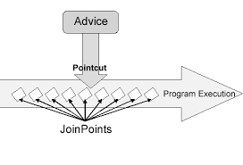
Pointcut
A Pointcut will exactly tell on which Join Points the Aspects will be applied.

Slide 8
Advices
  Before advice :@Before
  Executes before a join point,
  Does not have the ability to prevent execution flow proceeding to the join point (unless it throws an exception).
After returning advice : @AfterReturning
  Executed after a join point completes normally:
After throwing advice : @AfterThrowing
  Executed if a method exits by throwing an exception.
  After advice :@After
  Executed when normal or exceptional return by which a join point exits
  Around advice : @Around
  Advice that surrounds a join point

Slide 9
Around Advice
Represented by org.aopalliance.intercept.MethodInterceptor.
Provides finer control whether the target method must be called or not.
Around Advice can even change the return type, thereby returning a brand-new object of other type if needed.
Can be used to check arguments and execute rather than having it in the actual method implementation.

Slide 10

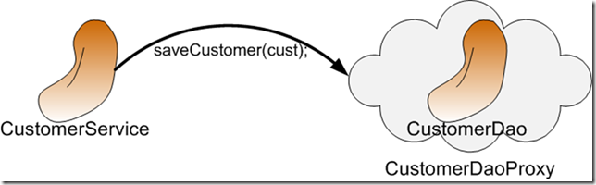
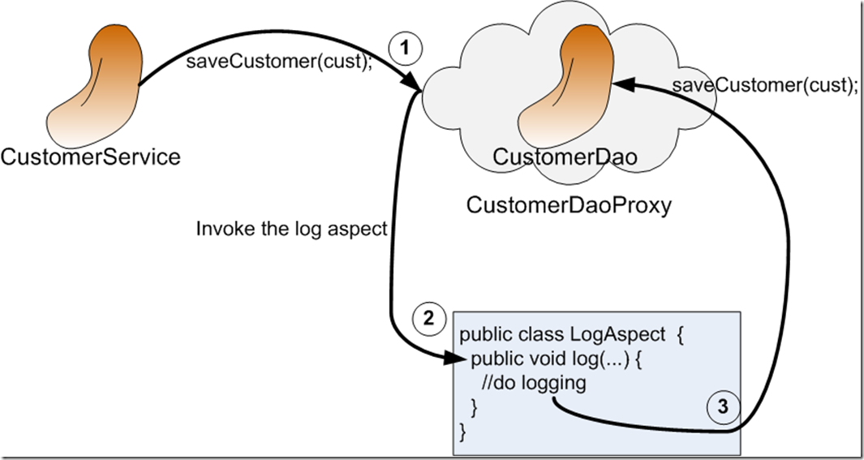
AOP Proxy Mechanism

Slide 11
Dependency
  <dependency>
  <groupId>org.springframework.boot</groupId>
  <artifactId>spring-boot-starter-aop</artifactId> </dependency>

Slide 12
Format of an execution expression
execution(
  modifiers-pattern
  returning-type-pattern
  declaring-type-pattern
  name-pattern(param-pattern)
  throws-pattern
)
execution(public * *(..)) or within(com.xyz.service.*)
execution – for matching method execution join points

Slide 13
Declaring a pointcut
execution(public * *(..))
the execution of any public method:
execution(* set*(..)) -
the execution of any methods beginning with "set":
execution(* com.xyz.service.AccountService.*(..))
the execution of any method defined by the named interface:
execution(* com.xyz.service.*.*(..))
the execution of any method defined in the service package:

Slide 14
Logging Aspect
  @Aspect
  @Component
  public class AroundAspect {
  private final Logger log = LoggerFactory.getLogger(this.getClass());
  @Around("execution(* com.example.demo.services.DemoService.*(..))")
  public Object logging(ProceedingJoinPoint pjp) throws Throwable{
  log.info("Before ");
  Object obj = pjp.proceed();
  log.info("After ");
  return obj;
  }
  }

Slide 15
JPA

Slide 16
Spring Data JPA
A library / framework that adds an three layers of abstraction on the top of JPA provider.
Spring Data JPA
  provides support for creating JPA repositories by extending the Spring Data repository interfaces.
Spring Data Commons
  provides the infrastructure that is shared by the datastore specific
Spring Data projects.
  The JPA Provider implements the Java Persistence API.

Slide 17
Primary Key Generation
Has Four different primary key generation strategies
Added to the Primary Key property
@Id
@GeneratedValue(strategy = GenerationType.AUTO)
Selects a generation strategy based on the database specific dialect.
  For most popular databases, GenerationType.SEQUENCE

Slide 18
Primary Key Generation
AUTO
  Selects the generation strategy based on the used dialect,
IDENTITY
  Relies on an auto-incremented database column to generate the primary key,
SEQUENCE
  Requests the primary key value from a database sequence,
TABLE
  Uses a database table to simulate a sequence.

Slide 19
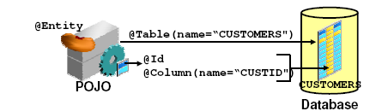
JPA Entity

Slide 20
A simple Entity- Customer.java
  @Entity
  @Table(name=“CUSTOMERS")
  public class Customer {
  @Id
  private long customerId;
  private String name;
  }

Slide 21
@Repository
There are three repository in Spring Data
CrudRepository
  Extends Repository
  provides CRUD functions
PagingAndSortingRepository
  Extends CrudRepository
  provides methods to do pagination and sort records
JpaRepository
  Extends PagingandSortingRepository
  Provides Methods such as flushing the persistence context and delete records in a batch
  Querying methods return List's instead of Iterable's

Slide 22
Creating Spring Data Application
  Create a repository interface and extend one of the repository interfaces provided by Spring Data.
  If required add custom query methods to the created repository interface
  Inject the repository interface to another component and use the implementation that is provided automatically by Spring.

Slide 23
CRUD Repository
An interface extends Repository interface.
  public interface BookRepository extends CrudRepository<Book, Long> {}
Need NOT create an implementation class
  Spring will automatically create its implementation class at runtime.
The Repository class will be auto detected if suitably placed in the scan path

Slide 24
CrudRepository Interface
  <S extends T> S save(S entity)
  <S extends T> Iterable<S> saveAll(Iterable<S> entities);
  Optional<T> findById(ID primaryKey)
  Iterable<T> findAll()
  void delete(T entity)
  long count()
  boolean existsById(ID id);

Slide 25
Custom Repository Method
  public interface BookRepository extends CrudRepository<Book, Long> {
  List<Book> findByAuthor(String author);
  List<Book> findDistinctByCategory(String category);
  List<Book> findByAuthorAndCategory(String author, String category);
  }

Slide 26
JPQL
JPQL queries are defined based on domain model.
JPA implementation handles the different database dialects so that the JPQL query is database agnostic.
JPQL only supports a subset of the SQL standard.
  Not a great fit for complex queries.
Spring Data JPA provides the required JPA code to execute that query.
  @Query("FROM Author WHERE firstName = ?1")
  List<Author> findByFirstName(String firstName);

Slide 27
@Query
Used to write the more flexible query to fetch data.
Supports both JPQL and native SQL queries.
By default will be using JPQL to execute the queries.
  Using normal SQL queries, would get the query syntax error exceptions.
Can use native SQL queries by setting nativeQuery flag to true.
  Pagination and dynamic sorting for native queries are not supported in spring data jpa.

Slide 28
Custom Query Method
  @Query(value = "select name,author,price from Book b where b.price>?1 and b.price<?2")
  List<Book> findByPriceRange(long price1, long price2);
  @Query(value = "select name,author,price from Book b where b.name = :name AND b.author=:author AND b.price=:price")
  List<Book> findByNamedParam(@Param("name") String name, @Param("author") String author, @Param("price") long price);
  @Query(value = "select * from Book b where b.name=?1", nativeQuery = true)
  List<Book> findByName(String name);

Slide 29
Using CRUD Repository
  @Repository
  public class BookService {
  @Autowired
  private BookRepository repo;
  public Iterable<Book> getBooks(){
  return repo.findAll();
  }
  public Book addBook(Book book) {
  return repo.save(book);
  }
  }

Slide 30
Properties
spring.datasource.url=jdbc:mysql://localhost:3306/test
spring.datasource.username=root
spring.datasource.password=srivatsan
spring.jpa.properties.hibernate.format_sql = true
spring.jpa.hibernate.ddl-auto: update
logging.level.org.hibernate.SQL=DEBUG
logging.level.org.hibernate.type.descriptor.sql.BasicBinder=TRACE

Slide 31
SPRING BOOT MVC

Slide 32
Spring MVC
Web application framework that takes advantage of design principles of Spring framework
Flexible and extensible via component’s
Simplified form handling through its parameter binding
Can do validation and error handling

Slide 33
MVC Architecture
Controller
  Designed around a DispatcherServlet
Model
  Can use any object as a command or form object.
  Data binding is highly flexible.
View
  View resolution is extremely flexible.
  View name resolution is configurable
  Can use properties file to configure views

Slide 34
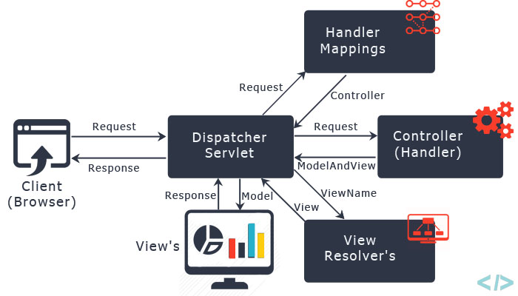
The requesting processing workflow

Slide 35
@RequestMapping
Used to map URLs onto a class or a particular method.
Class-level annotation maps a specific request path or pattern to a controller
Method-level annotations are used to narrow the primary mapping
  HTTP "GET"/"POST“ methods.
  @Controller
  @RequestMapping("/api")
  public class SecondController {
  }

Slide 36
@RequestMapping
  @Controller
  @RequestMapping("/api")
  public class SecondController {
  @RequestMapping(value=“/hello” method = RequestMethod.GET)
  public String greet()
  {
  return “Hello User";
  }
  }
  http://localhost:8080/api/hello

Slide 37
Model
A map object used to store attribute value pairs
Its created before invoking a handler method if the method has an argument type Model.
  Stores attribute values to render dynamic views such as JSP.
addAttribute(String name, Object obj)
  Used to map attribute names to object as attribute vales.
  public String init(Model model) {
  model.addAttribute("majHeading", "Jeevan Blood Bank");
  return "index";
  }

Slide 38
Controller
  @Controller
  public class WelcomeController {
  @RequestMapping("/welcome")
  public String showLoginPage() {
  return "welcome";
  }
  }

Slide 39
View Resolver
InternalResourceViewResolver
  Used to map the logical view names to view files
  spring.mvc.view.prefix=/WEB-INF/pages/
  spring.mvc.view.suffix=.jsp

Slide 40
Welcome.jsp
  src/main/webapp/WEB-INF/pages
  <%@ page language="java" contentType="text/html; charset=ISO-8859-1"
  pageEncoding="ISO-8859-1"%>
  <!DOCTYPE html>
  <html>
  <head>
  <meta charset="ISO-8859-1">
  </head>
  <body>
  <h2>MVC Configured Successfully</h2>
  </body>
  </html>

Slide 41
Dependency Required
Update the pom.xml with following Dependencies
The Entries can be picked from the Effective Pom.
  <dependency>
  <groupId>org.apache.tomcat.embed</groupId>
  <artifactId>tomcat-embed-jasper</artifactId>
  </dependency>
  <dependency>
  <groupId>javax.servlet</groupId>
  <artifactId>jstl</artifactId>
  </dependency>

Slide 42
ModelAndView object
Encapsulates both model and view that is to be used to render model
Model is represented as a java.util.Map
Objects can be added to without name:
  addObject(String, Object) – added with explicit name
  addObject(Object) – added using name generation (Convention over Configuration)
View is represented by String or View object
Analogous to Struts Action

Slide 43
Controller
  @Controller
  public class FirstController {
  @RequestMapping("/first")
  public ModelAndView execute()
  {
  String message = "Welcome to Spring!";
  return new ModelAndView("Success", “msg",message);
  }
  }

Slide 44
Controller-Model and View
  @Controller
  public class SecondController {
  @RequestMapping("/second")
  public ModelAndView getMessage() {
  ModelAndView mdl=new ModelAndView();
  mdl.setViewName("Second");
  mdl.addObject("msg","Hello India");
  return mdl;
  } }

Slide 45
@RequestParam
Use to bind request parameters to a method parameter in the controller.
  @RequestMapping ("/find")
  public String get ( @RequestParam ("custId") int id, Model model) {
  Customer cust =dao.findByCustomerId(id);
  System.out.println("Inside GET Method"+ cust);
  model.addAttribute("foundCustomer",cust);
  return "Display";
  }
Can also do return new ModelAndView("redirect:RedirectPage.htm");

Slide 46
@ModelAttribute
When Used as method parameter, maps a model attribute to the specific, annotated method parameter
The controller gets a reference to the object holding the data entered in the form.
When used at method level provides reference data for the model
The @ModelAttribute annotated methods are executed before the chosen @RequestMapping annotated handler method.
This helps in pre-populating the implicit model with specific attributes,

Slide 47
Model
  @Data
  @AllArgsConstructor
  @NoArgsConstructor
  @ToString
  public class TripDetail {
  private long tripId;
  private String source;
  private String destination;
  private double amount;
  }

Slide 48
Controller
  @Controller
  public class TripController {
  @Autowired
  TripDetail detail;
  @GetMapping("/")
  public String init() {
  return "index";
  }
  @ModelAttribute("location")
  public String[] loadPlaces() {
  return new String[]{"Bessy Beach","Mahabs","Mayajal"};
  }

Slide 49
Controller
    @GetMapping("/addTrip")
    public String initForm(Model model) {
    model.addAttribute("command",detail);
    return "addTripDetails";
    }
    @PostMapping("/addTrip")
    public String onSubmit(@ModelAttribute("data") TripDetail details) {
    System.out.println(details);
    return "success";
    }
    }

Slide 50
Using Spring's form tag library
Spring's form tag library gives the tags access to the command object and reference data of the controller
The form tag library comes bundled in spring-webmvc.jar.
The library descriptor is called spring-form.tld.
<%@ taglib prefix="form" uri="http://www.springframework.org/tags/form" %>
A Form tag puts the command object in the PageContext

Slide 51
View
  <form:form action="/addTrip" method="post">
  <form:input path="tripId"/>
  <form:select path="source" items="${location}">
  </form:select>
  <form:input path="destination"/>
  <form:input path="amount"/>
  <input type="submit" value="Add">
  </form:form>

Slide 52
Spring Validation
JSR-303 Bean Validation API is used by Spring.
The standardized validation constraint declaration and metadata
Annotate domain model properties with declarative validation constraints and the runtime enforces them.
Can define own custom constraints.
To trigger validation of a @Controller input, Input arguments are annotated with @Valid
Using Hibernate Validator in the classpath, Spring will detect it and automatically support across all Controllers

Slide 53
Maven Dependency
  <dependency>
  <groupId>javax.validation</groupId>
  <artifactId>validation-api</artifactId>
  <version>2.0.0.Final</version>
  </dependency>
  <dependency>
  <groupId>org.hibernate</groupId>
  <artifactId>hibernate-validator</artifactId>
  <version>5.4.0.Final</version>
  </dependency>

Slide 54
Hibernate inbuilt Validation
@AssertFalse
@AssertTrue
@Email
@Length
@Range

Slide 55
Model
  public class BloodDonor {
  private int id;
  @Length(min = 3,max = 8)
  private String name;
  @DateTimeFormat(pattern = "yyyy-MM-dd")
  private LocalDate dateOfBirth;
  private String bloodGroup;
  }

Slide 56
Controller - @Valid annotation
  @RequestMapping(“/donors")
  public String initAddDonorForm(Model model) {
  model.addAttribute("command",donor);
  return "addDonor";
  }
  @PostMapping(path="/donors")
  public String greetingSubmit(@Valid @ModelAttribute("command") BloodDonor donor, BindingResult result) {
  if(result.hasErrors()) {
  return "addDonor";
  } else {
  return "result";
  }
  }

Slide 57
Validation Input Jsp Page
  <<form:form method="post" action=" donors" >
  ID: <form:input path=“id" />
  <form:errors path=“id" />
  Name : <form:input path=“name" />
  <form:errors path=“name" />
  <input type="submit" value="Submit" />

