Slide 1
SPRING ACTUATOR

Slide 2
Spring Boot Actuator
Exposes REST endpoints that can be consumed to manage and monitor application.
Monitor application health, application bean details, version details, thread dumps, logger details etc
Can restrict these endpoints to be consumed by authorized users only and Spring provides easy way to secure your REST endpoints.

Slide 3
actuator End Point
actuator
  It provides a hypermedia-based discovery page for the other endpoints.
  By default it is sensitive and hence requires username/password for access or may be disabled if web security is not enabled.
Beans
  It displays complete beans configured in the app.
Configprops
  It displays a collated list of all @ConfigurationProperties.

Slide 4
actuator End Point
Health
    It shows application health information
  management.endpoint.health.show-details:=always
Info
  It displays arbitrary application info.
Loggers
  It shows and modifies the configuration of loggers in the application.
metrics:
  It shows metrics information for the current application.
Mappings
  It displays a collated list of all @RequestMapping paths.

Slide 5
Actuator Endpoints
health and info can be accessed
  Other endpoints are disabled by default
management.endpoints.web.exposure.include=*.
  Will enable all of them
  Can also list endpoints which should be enabled
To expose all enabled endpoints except one (for example /loggers), we use:
  management.endpoints.web.exposure.include=*
  management.endpoints.web.exposure.exclude=loggers
  management.security.enabled=false

Slide 6
Info and Health Endpoint
Reads the Information from the pom.xml
  info:
  app:
  name: ${spring.application.name}
  build:
  artificatId: '@project.artifact@'
  groupId: '@project.groupId@'
  version: '@project.version@'
  java:
  version:@java.version@
info:
env:
enabled: true

Slide 7
Health Endpoint
  management:
  endpoint:
  health:
  show-details: always

Slide 8
Logger Endpoint
http://localhost:8787/actuator/metrics
http://localhost:8787/actuator/loggers
To Change the Log level make a post request
  http://localhost:8787/actuator/loggers/org.springframework.boot.SpringApplication
  { "configuredLevel": "trace“ }
To reset the logging level back to the original value
  { "configuredLevel": null }

Slide 9
Shut Down End Point
Endpoint is used to shut down the Spring Boot application
Need to enable by adding a property in the application.yml
Done By Making a POST call.
  http://localhost:7070/actuator/shutdown
  management:
  endpoint:
  shutdown:
  enabled: true

Slide 10
Extending Info End Point
  @Component
  public class CustomInfoEndPoint implements InfoContributor {
  @Autowired
  private ConfigurableApplicationContext ctx;
  @Override
  public void contribute(Info.Builder builder) {
  Map<String, Object> details = new HashMap<>();
  details.put("bean-definition-count", ctx.getBeanDefinitionCount());
  details.put("startup-date", ctx.getStartupDate());
  builder.withDetail("context", details);
  }
  }

Slide 11
Extending Health Point
  @Component
  public class CustomHealthInfoEndPoint implements HealthIndicator {
  private final OrderRepository repository;
  @Override
  public Health health() {
  try {
  long number = this.repository.count(); return Health.status("UP").withDetail("DB Service", "DB service is UP").build();
  } catch (Exception exception){
  return Health.outOfService().withDetail("DB Service", "DB service is DOWN").build();
  }
  }
  }

Slide 12
Custom End Points
Created by Adding one of the following annotations
  @EndPoint
  @WebEndPoint
  @JmxEndPoint
Can Add Methods for Read ,Write and Delete Operations with following annotations
  @ReadOperation
  @WriteOperation
  @DeleteOperation

Slide 13
SPRING SECURITY

Slide 14
Spring Security
Highly customizable authentication and access-control framework.
Focuses on providing both authentication and authorization
“Authentication”
  The process of establishing a user, device or some other system which can perform an action in the application
“Authorization”
  The process of deciding whether a principal is allowed to perform an action within the application.
  authorization is done after authentication process.
  Once the user is authenticated they may have one or more “roles”

Slide 15
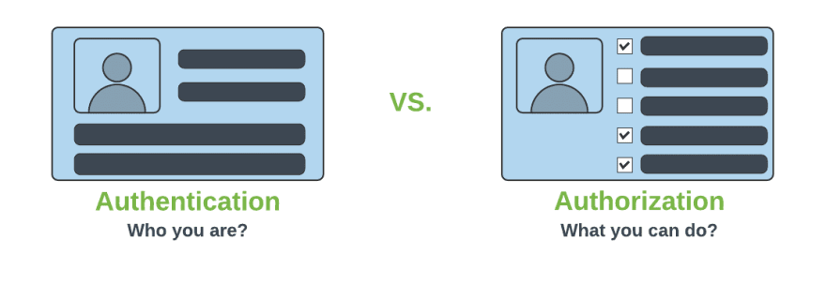
Authentication & Authorization

Slide 16
Add Spring Security Module
  Update the pom.xml file with the following entry, can also add spring security while use starter project.
  <dependency>
  <groupId>org.springframework.boot</groupId>
  <artifactId>spring-boot-starter-security</artifactId>
  </dependency>

Slide 17
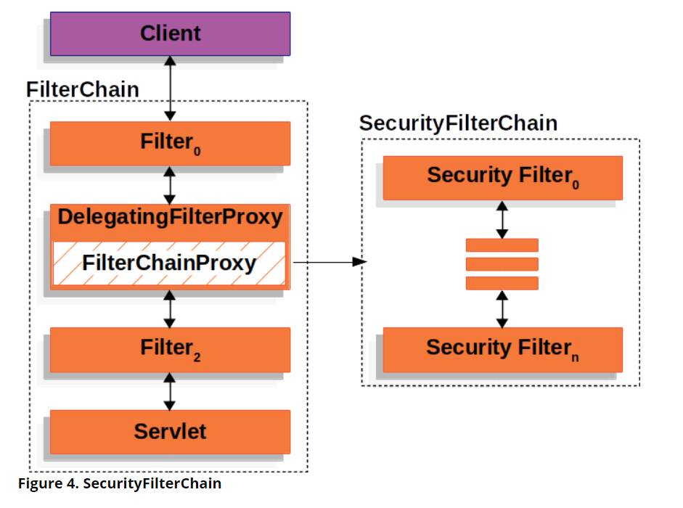
Spring Security Architecture

Slide 18
Spring Security Architecture
DelegatingFilterProxy
  Servlet filter embedded in the spring context.
  It delegates the incoming request to a bunch of filters
FilterChainProxy
  A servlet filter which invokes the relevant filters that would work on the incoming request.
SecurityFilters
  Contains a list of filters that need to be invoked before the controller can handle the request.
  SecurityContextPersistenceFilter, HeaderWriterFilter, CsrfFilter, LogoutFilter, UsernamePasswordAuthenticationFilter etc.
  FilterChainProxy queries this class to invoke each filter in a loop.

Slide 19
Configuring Security
Can Configure the default username, password and role in application.properties
  spring.security.user.name=india
  spring.security.user.password=india

Slide 20
Controller
  @RestController
  public class ProjectController {
  @GetMapping("/first")
  public String getSecuredMessage() {
  return "Welcome to Secured Page";
  }
  }

Slide 21
Authorizations
permitAll
  No need of any authorization to access current page.
authenticated
  Requires Login(username/password) and no authorization(role based access) is required.
hasAuthority
  Requires that user should have both authentication and role based authorization access.
hasAnyAuthority
  It represents that user should have authentication and multiple role based authorization access.

Slide 22
BCryptPasswordEncoder
An encryption class of Spring Security.
Spring provides a variety of encryption methods for passwords.
The official recommendation is to use BCryptPasswordEncoder, which uses the BCrypt strong hash function.
  @Bean
  PasswordEncoder passwordEncoder() {
  return new BCryptPasswordEncoder();
  }

Slide 23
HttpSecurity
HttpSecurity
  Provides a Method authoriseRequests()
authorizeRequests()
  To Define custom requirements for URLs
  Can add multiple children to this method.
  The matchers are considered in the order they were declared.
  http.authorizeRequests()
  .anyRequest().authenticated()
  .and().httpBasic();

Slide 24
In-memory UserDetailsService
The AuthenticationProvider uses UserDetailsService that implements the user management responsibility.
It finds a user by its username from the cache or underlying storage.
UserDetailsService is always associated with a PasswordEncoder that encodes a supplied password and verifies if the password matches an existing encoding.
It stores credentials in the memory, which can then be used by Spring Security to authenticate an incoming request.

Slide 25
Spring Boot Application
  @SpringBootApplication
  public class SpringSecurityApplication {
  public static void main(String[] args) {
  SpringApplication.run(SpringSecurityApplication.class, args);
  }
  @Bean
  BCryptPasswordEncoder encoder() {
  return new BCryptPasswordEncoder();
  }
  }

Slide 26
Security Configuration
  @Configuration
  public class SecurityConfig {
  @Autowired
  private BCryptPasswordEncoder encoder;
  @Bean
  public UserDetailsManager details() {
  UserDetails indiaUser = User.withUsername("india")
  .password(encoder.encode("india")).authorities("ADMIN").build();
  UserDetails nepalUser = User.withUsername("nepal")
  .password(encoder.encode("nepal")).authorities("USER").build();
  return new InMemoryUserDetailsManager(indiaUser,nepalUser);
  }

Slide 27
CSRF
  Its a web security vulnerability that allows an attacker to induce users to perform actions that they do not intend to perform.
  It allows an attacker to partly circumvent the same origin policy, which is designed to prevent different websites from interfering with each other.
Should be used for protecting any request that could be processed by a browser by normal users.
If a service is used by non-browser clients, CSRF protection can be disabled

Slide 28
Security Configuration
  @Bean
  public SecurityFilterChain filterChain(HttpSecurity http) throws Exception {
  http.csrf().disable().
  authorizeHttpRequests().antMatchers("/second").permitAll()
  .and()
  .authorizeHttpRequests().antMatchers("/first")
  .authenticated().and().httpBasic();
  return http.build();
  }

Slide 29
JDBC SECURITY

Slide 30
Sql Statements
  CREATE TABLE users( `username` varchar(50) NOT NULL, `password` varchar(200) NOT NULL, `enabled` tinyint(1) NOT NULL, PRIMARY KEY (`username`))
  CREATE TABLE authorities ( `username` varchar(50) NOT NULL, `authority` varchar(50) NOT NULL, KEY `fk_authorities_users` (`username`), CONSTRAINT `fk_authorities_users` FOREIGN KEY (`username`) REFERENCES `users` (`username`))

Slide 31
SQL Statements
  insert into users (username, password,enabled) values ('india','$2a$10$P.9MaemE6x38wnZer4qauO8Dl9pixQEZ27.yEQglTtyjdmJBRtTFS',true);
  insert into authorities (username, authority) values ('india', 'ROLE_USER');
  insert into test.users (username, password, enabled) values ('nepal','$2a10$t4kkrerTgJlcvTj7QresWuBqAsnxVxMxaJ6UzlXCaP/HSdDraO5QC',true);
  insert into authorities (username, authority) values ('nepal', 'ROLE_ADMIN');

Slide 32
Application.properties
  spring.datasource.url=jdbc:mysql://localhost:3306/test
  spring.datasource.username=root
  spring.datasource.password=srivatsan
  spring.datasource.driver-class-name=com.mysql.cj.jdbc.Driver

Slide 33
Pass Word Encoder
  public static void main(String[] args) {
  BCryptPasswordEncoder encoder = new BCryptPasswordEncoder();
  String encoded = encoder.encode("india");
  System.out.println(encoded);
  encoded = encoder.encode("nepal");
  System.out.println(encoded);
  }

Slide 34
Security Config
  @Configuration
  public class SecurityConfiguration {
  @Autowired
  private DataSource dataSource;
  @Bean
  public BCryptPasswordEncoder encoder() {
  return new BCryptPasswordEncoder();
  }

Slide 35
Security Config
  @Bean
  public UserDetailsService jdbcUserDetailsService(DataSource dataSource) {
  String usersByUsernameQuery = "select username, password, enabled from users where username = ?";
  String authsByUserQuery = "select username, authority from authorities where username = ?";
  JdbcUserDetailsManager mgr = new JdbcUserDetailsManager(dataSource);
  mgr.setUsersByUsernameQuery(usersByUsernameQuery);
  mgr.setAuthoritiesByUsernameQuery(authsByUserQuery);
  return mgr;
  }

Slide 36
REST TEMPLATE WITH SECURITY

Slide 37
Using Rest Template-With Security
  @Bean
  public BasicAuthenticationInterceptor interceptor() {
  return new BasicAuthenticationInterceptor("india", "india");
  }
  @Bean
  public RestTemplate template() {
  RestTemplate template = new RestTemplate();
  template.getInterceptors().add(interceptor());
  return template;
  }

Slide 38
Using Rest Template-With Security
  @Bean
  public HttpHeaders headers() {
  HttpHeaders headers = new HttpHeaders();
  headers.setAccept(Arrays.asList(MediaType.APPLICATION_JSON));
  return headers;
  }
  @Bean
  public HttpEntity entity() {
  HttpEntity <String> entity = new HttpEntity<String>(headers());
  return entity;
  }

Slide 39
Using Rest Template-With Security
  public String useGetAll() {
  return this.template.exchange(url,HttpMethod.GET,entity,String.class).getBody();
  }

Slide 40
SSL CONFIGURATION

Slide 41
Https
HTTP
  Basic protocol used to transmit data between a web browser.
TLS/SSL
  Used to secure the communication and protect user data,
  Transport Layer Security (TLS) or Secure Sockets Layer (SSL) is used on top of HTTP protocol.
HTTPS
  This combination of SSL/TSL with
  Hypertext Transfer Protocol Secure
  It is the secured version of HTTP protocol.

Slide 42
SSL
Secure Sockets Layer.
  Standard protocol for keeping an internet connection secure
  Safeguarding all sensitive data that is being sent between two systems,
  Preventing hackers from reading and modifying any information transferred.
When a web browser contacts secured website, the SSL certificate enables an encrypted connection

Slide 43
SSL Certificate
Issued to hostnames that includes machine names (like XYZ-SERVER-04) or domain names (like www.example.com).
When a client sends the request, the browser will verify the server certificate to ensure the legitimacy of the web host.
SSL server certificate primary purposes:
  It affirms the identity of the server before authenticating it.
  It establishes an encrypted channel for communication between the server (the website) and the client (the end user’s browser that connects to it).

Slide 44
Certificate Format
Spring Boot application can use one of the following formats
PKCS12
  Popular password-protected format that can store multiple certificates and keys.
  Public Key Cryptographic Standards
JKS
  Java KeyStore which is more popular in Java world with similar features.
  Java Key Store
The keytool which is available in JRE/JDK

Slide 45
Working of SSL
In order to provide a high degree of privacy, SSL encrypts data that is transmitted across the web.
This means that anyone who tries to intercept this data will only see a garbled mix of characters that is nearly impossible to decrypt
A web browser reaching the server validates that the SSL server certificate is authentic.
  That tells the user that their interaction with the website has no eavesdroppers, and that the website is representing exactly who they claim they are..

Slide 46
HTTPS
Truststore and Keystore
  Used to store SSL certificates in Java
  Trust store is used to store public certificates
  Keystore is used to store private certificates of client or server.

Slide 47
Getting SSL Certificate
SSL digital certificate can be obtained in two ways
  Can be obtained from certification authority(CA)
  Can create self-signed certificate generated by java keytool command.
    Need to use the keytool -genkey command
The command to use
keytool -genkeypair -alias local_ssl -keyalg RSA -keysize 2048 -storetype PKCS12 -keystore local-ssl.p12 –validity 365 -ext san=dns:localhost

Slide 48
Getting SSL Certificate
genkey
  keytool command to generate the certificate
-alias
  The alias of the certificate, which is used by SSL/TLS layer
-keyalg
  The crypto algorithm, keysize and certificate validity.
  Number of days, size of each key in bits
-keypass
  Passwords of our truststore and keystore
-keystore
  Keystore where the certificate and public/private key will be stored.
  JKS fromat – Java Key Store

Slide 49
Getting SSL Certificate
-ext san=dns:
  localhost: includes an X.509 extension for Subject Alternate Name (SAN)
  SAN is required so the certificate will be trusted by browsers on localhost
keytool -list -keystore ssl-server.jks : to view the keystore

Slide 50
Using SSL
Generate spring boot project
Add dependencies Web and Rest Repositories.
Add REST endpoint
Copy the generated keystore file into the resources folder
Update application.yml.
  ssl:
  enabled: true
  key-alias: localhost_ssl
  key-store: classpath:localhost-ssl.p12
  key-store-type: PKCS12
  key-store-password: password

Slide 51
Install Self-Signed Certificate
Now you have to generate a certificate file from the keystore file. Use the keytool program with this command:
  keytool -export -keystore local-ssl.p12 -alias local-ssl -file local-cert.crt
This command exports a digital certificate from the specified keystore file.
  Need to provide password

Slide 52
Install Self-Signed Certificate
keytool export certificate
Right click on the Certificate File and select Install
  local-cert.crt file
Choose Certificate Import Wizard, click Next.
Click Browse, and choose Trusted Root Certification Authorities:
Finish to complete the Certificate Import wizard.
Restart browser and reload https://localhost URL,
Should see a security padlock in the URL

Slide 53
Redirect HTTP requests to HTTPS
Can use optional redirect HTTP traffic to HTTPS, so that the full site becomes secured.
Add HTTP connector at 8080 port and then we need to set redirect port 8443.
Any request in 8080 through http, it would be automatically redirected to 8443 and https.
  private Connector redirectConnector() {
  Connector connector = new Connector("org.apache.coyote.http11.Http11NioProtocol");
  connector.setScheme("http");
  connector.setPort(8080);
  connector.setSecure(false);
  connector.setRedirectPort(8443);
  return connector;
  }

Slide 54
Redirect HTTP requests to HTTPS
  @Bean
  public ServletWebServerFactory servletContainer() {
  TomcatServletWebServerFactory tomcat = new TomcatServletWebServerFactory() {
  @Override
  protected void postProcessContext(Context context) {
  SecurityConstraint securityConstraint = new SecurityConstraint();
  securityConstraint.setUserConstraint("CONFIDENTIAL");
  SecurityCollection collection = new SecurityCollection();
  collection.addPattern("/*");
  securityConstraint.addCollection(collection);
  context.addConstraint(securityConstraint);
  }
  };
  tomcat.addAdditionalTomcatConnectors(redirectConnector());
  return tomcat;
  }

Slide 55
keytool -genkeypair -alias localhost_ssl -keyalg RSA -keysize 2048 -storetype PKCS12 -keystore localhost-ssl.p12 –validity 365 -ext SAN=dns:localhost
keytool -export -keystore localhost-ssl.p12 -alias localhost_ssl -file localhost-cert.crt

