Slide 1
REST SERVICE USING SPRING DATA JPA

Slide 2
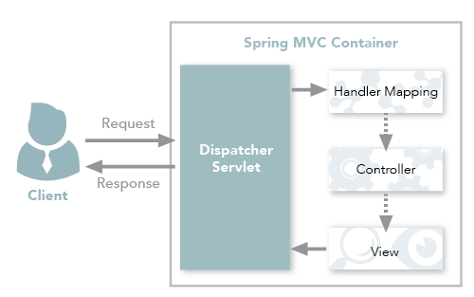
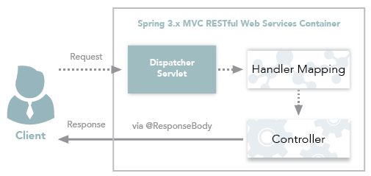
Spring MVC and Spring REST

Slide 3
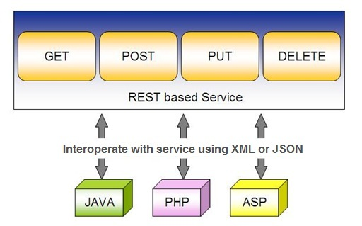
Spring RESTful Services
REST does not require the client to know anything about the structure of the API.
Server needs to provide whatever information the client needs to interact with the service.

Slide 4
Using appropriate Request Methods
GET :
  Should not update anything.
  Should be idempotent (same result in multiple calls).
  Possible Return Codes 200 (OK) + 404 (NOT FOUND) +400 (BAD REQUEST)
POST :
  Should create new resource.
  Ideally return JSON with link to newly created resource.
  Same return codes as get possible.
  In addition : Return code 201 (CREATED) is possible.

Slide 5
Using appropriate Request Methods
PUT :
  Update a known resource. ex: update client details.
  Possible Return Codes : 200(OK)
DELETE :
  Used to delete a resource.
  Possible Return Codes : 200(OK) or a 204 - no content

Slide 6
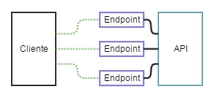
API and Endpoint

Slide 7
SPRING DATA REST WITH JPA

Slide 8
Spring RESTful Services
A RESTful architecture may expose multiple representations of a resource.
From Spring 4 @RestController annotation is added to controller
  A combination of @Controller and @ResponseBody
A Rest Controller method returns a domain object instead of a view.

Slide 9
REST Stereotypes
@RestController
  An implicit @ResponseBody is being added to the methods.
  Allows Spring to render the returned HttpEntity and its payload, directly to the response.
@GetMapping
  To map HTTP GET requests onto specific handler methods.
  Composed annotation for @RequestMapping(method = RequestMethod.GET).

Slide 10
REST Stereotypes
@PathVariable
  Indicates that the Method parameter should be bound to a URI template variable.
  @GetMapping("/members/{id}")
  public String getById(@PathVariable String id) { }
@PostMapping
  Combined shortcut for @RequestMapping(method = RequestMethod.POST).
  @PostMapping("/members“)
  public void addMember(@RequestBody Member member) { }

Slide 11
@RequestBody
Used to map the HttpRequest body to a transfer or domain object
  Spring automatically deserializes the JSON into a Java type
  The type of @RequestBody annotation must correspond to the JSON sent from client-side
HttpMessageConverter
  Internally Used by Spring to perform Serialization/deserialization
@Valid
  To perform automatic validation by adding to method argument

Slide 12
Post and Put Mapping
  @PostMapping(path = "/api/v1/invoices")
  public Invoice add(@RequestBody Invoice entity
  ,HttpServletResponse response) {
  response.setStatus(201);
  return this.service.add(entity);
  }
@ResponseStatus(HttpStatus.CREATED)
  @PostMapping(path = "/api/v1/invoices")
  public Invoice add(@RequestBody Invoice entity) {
  return this.service.add(entity);
  }

Slide 13
ResponseEntity
Represents Complete HTTP response, gives more flexibility
  May be required in some special cases
  Can be used to send Status Code,Response Body,Location to the resource which was altered
  @GetMapping(path = "/api/v1/invoices")
  public ResponseEntity<Invoice> getInvoices() {
  HttpHeaders responseHeaders = new HttpHeaders();
  return ResponseEntity.ok().headers(responseHeaders).body(dao.findAll());
  }

Slide 14
Response Entity
  @PostMapping(“/invoices)
  public ResponseEntity<Object> addInfo(@RequestBody Invoice entity){
  URI location=
  ServletUriComponentsBuilder
  .fromCurrentRequest()
  .path("/{id}")
  .buildAndExpand(entity.getId())
  .toUri();
  return ResponseEntity.created(location).body(entity);
  }

Slide 15
Put Mapping
@PutMapping(path = "/api/v1/invoice")
  public Invoice update(@RequestBody Invoice entity) {
  return this.service.add(entity);
  }
  @PatchMapping(path = "/api/v1/invoice")
  public ResponseEntity<String> updateAmount() {
  return ResponseEntity.status(HttpStatus.CREATED)
  .body("Updated Amount:="+this.service.updateAmount());
  }

Slide 16
Remove Method in Service
  public Invoice remove(Invoice entity) {
  Optional<Invoice> optional = Optional.empty();
  if(this.repository.existsById(entity.getId())) {
  this.repository.delete(entity);
  optional = Optional.of(entity);
  }
return optional;
}

Slide 17
Delete Mapping in Controller
  @DeleteMapping(path = "/api/v1/invoice")
  public ResponseEntity<Invoice> remove(@RequestBody Invoice entity) {
  Invoice invoice = this.service.removeInvoice(entity).orElseThrow(()-> new RuntimeException("Element NOT FOUND"));
  return ResponseEntity.ok().body(invoice);
  }

Slide 18
@RestControllerAdvice
Used for Exception handling in Rest API’s
Used to handle exceptions across the whole application
Like an interceptor of exceptions thrown by methods annotated with @RequestMapping or one of the shortcuts.
It’s a combination of @ContollerAdvice and @ResponseBody.
@ExceptionHandler
  Annotation for handling exceptions in specific handler classes and/or handler methods.

Slide 19
@RestControllerAdvice
  @RestControllerAdvice
  public class ErrorHandler {
  @ExceptionHandler(value = Exception.class)
  public ErrorDetails handleAllExceptions(Exception ex, WebRequest request){
  return new ErrorDetails(LocalDateTime.now(),
  ex.getMessage(), request.getDescription(false));
  }
  }
  request.getDescription(false):
  Whether to include client-specific information like session id and user name

Slide 20
application.yml
  logging:
  level:
  org.hibernate.sql: debug
  org.hibernate.type.descriptor.sql.BasicBinder: trace

Slide 21
DOCUMENTING REST API

Slide 22
Documentation
Essential part of building REST APIs
Open Api Documentation
  Standard, programming language-agnostic interface description for REST APIs,
  Allows both humans and computers to discover and understand the capabilities of a service
  No need to access source code,
  Can add additional documentation, or inspect network traffic

Slide 23
Spring Documentation
  A tool that simplifies the generation and maintenance of API docs
  Based on the OpenAPI 3 specification, for Spring Boot 1.x and 2.x applications.
  Required dependency are added to pom.xml:
  <dependency>
  <groupId>org.springdoc</groupId>
  <artifactId>springdoc-openapi-ui</artifactId>
  <version>1.3.0</version>
  </dependency>

Slide 24
<dependency>
<groupId>org.springdoc</groupId>
<artifactId>springdoc-openapi-starter-webmvc-ui</artifactId>
<version>2.1.0</version>
</dependency>

Slide 25
View the Documentation
Can be viewed after executing the application
Its rendered in the browser in JSON format by default.
Default Path : http://localhost:8080/v3/api-docs/
Can be Customised using application.properties file:
  springdoc.api-docs.path=/api-docs
Custom Path : http://localhost:8080/api-docs/

Slide 26
Swagger
  springdoc-openapi is integrated with Swagger UI
  Access from the folowing URL
  http://localhost:8080/swagger-ui.html
Can be customized using application.properties
  springdoc.swagger-ui.path=/swagger-ui-custom.html

Slide 27
Best practices
Use Nouns for Resource Identification
Use Proper Http Headers for Serialization formats
Get Method and Query Parameter should not alter the state
Always use plurals when you name resources.
Use Appropriate Http Response Status Codes
Field Name casing Conventions
Provide Searching, Sorting and Pagination
Use Versioning of API
Provide Links for Navigating through API – Hateos
Handle Error Properly
Using DTO to Handle the Request and Response

Slide 28
PAGING AND SORTING

Slide 29
PagingAndSortingRepository
findAll(Pageable pageable)
    Pageable object with following properties
      Page size
      Current page number
      Sorting
      findAll(Sort sort)
        Sort Object with the Property on Which the sorting is to be done
        Sort.by(propName)

Slide 30
Entity
@Data
@AllArgsConstructor
@NoArgsConstructor
@Entity
@Table(name = "STATEDOCTOR")
public class Doctor {
@Id
private int doctorCode;
private String doctorName;
private String specialization;
private long handPhone;
private String location;
private String qualification;
}

Slide 31
Repository
@Repository
public interface DoctorRepository extends PagingAndSortingRepository<Doctor,Integer> {
Iterable<Doctor> findAll(Sort sort);
Page<Doctor> findAll(Pageable pageable);
}

Slide 32
Service
@Service
public class DoctorService {
@Autowired
private DoctorRepository repo;
public Iterable<Doctor> findAll(String propName){
Sort sortBy = Sort.by (propName);
return this.repo.findAll (sortBy);
}

Slide 33
Service
public List<Doctor> findByPage(int page, int size, String propName){
Pageable paging =
PageRequest.of(page,size,Sort.by(propName).ascending ());
Page<Doctor> pagedResult = repo.findAll(paging);
if(pagedResult.hasContent()) {
return pagedResult.getContent();
} else {
return new ArrayList<Doctor> ();
}
}
}

Slide 34
Rest Controller
@RestController
public class DoctorController {
@Autowired
private DoctorService service;
@GetMapping("/doctor/sort/{prop}")
public Iterable<Doctor> findAll(@PathVariable("prop") String prop){
return this.service.findAll (prop);
}

Slide 35
Rest Controller
@GetMapping("/doctor/paging/{page}/{size}/{propName}")
public List<Doctor> findByPage(@PathVariable("page") int page, @PathVariable("size") int size, @PathVariable("propName") String propName){
return this.service.findByPage (page,size,propName);
}
}

