Slide 1
MIDDLEWARE

Slide 2
Middleware
A Redux middleware is a function that can intercept actions and act before it reaches the reducer.
  A place for abstracting REST calls, business logic etc.,
Benefits of a Redux middleware
  Reusable pieces of Logic can live outside React
  Keep the components clean
Two Popular middleware are redux-thunk and Saga.

Slide 3
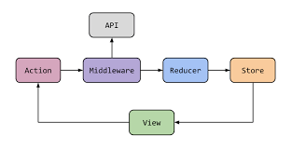
Middleware

Slide 4
Two types of Action in Redux
Synchronous Action
  Returns a plain Java Script object from action creators
  No Need to make any Ajax Calls.
  The reducer will return the next state.
Asynchronous Action
  Inside the function Ajax calls to REST APIs,
  May have delay in the dispatch of an action
  Data is not fetched on the Component

Slide 5
Configure the Middleware
createSlice
  A function available via the redux toolkit library.
createAsyncThunk
  Used to handle asynchronous requests.
  Produces a definitive Redux thunk action creator.

Slide 6
Redux-thunk
A “thunk” is uncommon word for a function
  It’s a function that’s returned by another function
  function wrapperFunction() {
    return function thunk() {
    console.log('do some thing now');
    };
  }
Invoked as wrapperFunction()();

Slide 7
thunk as middleware
“actions” are plain objects and “reducers” are pure functions
  can’t do any API calls or dispatch actions inside them
“thunk” function
  Can move API calls like actions to live inside this function.
  Looks at every action that passes through the system
  If there is a function Call then its Invoked.

Slide 8
createSlice
A single global store is broken up into slices
Creating all actions and reducers with a single slice
It’s a function that accepts three required arguments
  initial state,
  Object of reducer functions,
  "slice name",
Generates action creators and action types
  Mapping to the reducers and state.

Slide 9
Configuring Thunk
Generates promise lifecycle action types using name as a prefix:
  export const getTransactions = createAsyncThunk('payment/getTransactions',async()=>{
  let response = await axios.get("http://localhost:5000/payments")
  return response.data
  })

Slide 10
extrareducers
  Used to handle Actions made by createAction or createAsyncThunk
    Can also handle actions generated in other slices
createAsyncThunk generates three different action types
  pending, fulfilled, and rejected.
  Representing the lifecycle of the asynchronous operation
  These actions are handled in extraReducers section
  [fetchUsers.pending]: (state, action) => {
  state.loading = true;
  }

Slide 11
Configuring Slice
  const sliceOptions ={
  name: "payment",
  initialState:{data:[],loading:false,error:null},
  reducer:{},
  extraReducers: (builder)=>{
  builder.addCase(getTransactions.pending,(state,action)=>{
  if(state.loading){
  state.loading = true
  }
  })

Slide 12
Configuring Slice
  builder.addCase(getTransactions.fulfilled,(state,action)=>{
  if(!state.loading){
  state.data =action.payload;
  state.loading =false
  }
  })
  builder.addCase(getTransactions.rejected,(state,action)=>{
  if(state.loading){
  state.error = action.error.message
  state.loading =true
  }
  })
  },
  }
  const PaymentSlice = createSlice(sliceOptions)
  export default PaymentSlice.reducer;

Slide 13
Store
  import { configureStore } from "@reduxjs/toolkit";
  import paymentReducer from "./PaymentSlice"
  const store = configureStore({
  reducer: {
  payment: paymentReducer
  }
  })
  export default store;

Slide 14
Component
  import { useDispatch, useSelector } from 'react-redux'
  import { getTransactions } from './PaymentSlice'
  const ShowPayments=() => {
  const dispatch = useDispatch()
  const { data, loading, error } = useSelector((state) => state.payment)
  useEffect(() => {
  dispatch(getTransactions())
  }, [dispatch] )

Slide 15
Component
  return(
  <>
  {
  data.map((item)=>{
  return(
  <TableRow key={item.txnId} item={item}/>
  )
  })
  }
  </>
  )
  }
  export default ShowPayments

Slide 16
Create Action
  export const addTransactions= createAsyncThunk(
  "addtxn",
  async (data, { rejectWithValue }) => {
  const response = await axios.put(
  url,data)
  }
  retrun response.data
  );
  );

Slide 17
Extra Reducers
  [addTransactions.pending]: (state) => {
  state.loading = true;
  },
  [addTransactions.fulfilled]: (state, action) => {
  state.data.push(action.payload);
  state.loading = false;
  },
  [addTransactions.rejected]: (state, action) => {
  state.loading = false;
  state.error = action.payload.message;
  }

Slide 18
Create Component
  const [data, setData] = useState({});
  const navigate = useNavigate();
  const dispatch = useDispatch();
  const fetch = (e) => {
  setData({ ...data, [e.target.name]: e.target.value });
  };

Slide 19
Create Component
  const handleSubmit = (e) => {
  e.preventDefault();
  dispatch(createUser(users));
  navigate('/read');
  };
  ,<form className='form' onSubmit={handleSubmit}>
  <input type='text' name='name' onChange={getUserData}/>
  </form>

Slide 20
GENERATORS

Slide 21
Generators
Generators, are functions that can be paused and resumed
  function returns an iterator
Used for Two purposes
  Implementing iterables
  Blocking on asynchronous function calls
It return a generator Object ready to begin execution of function body
Executes on the first invocation of next() on the generator object itself.

Slide 22
Promise vs Generators
  fetch(url).then( (val) =>{console.log(value)})
  let val = yield fetch(url);
  console.log(val)

Slide 23
Generators
  function* genFour() {
  yield 1;
  yield 2;
  yield 3;
  return 4;
  }
let four = genFour();
Suspends on every yield and allows other code to run until the next time it resumes

Slide 24
REDUX SAGA

Slide 25
Introduction
It’s “redux for making HTTP requests.”
  A saga is an action dispatched to the API.
  Upon return, the value is reduced
  Used to update state.
Saga is implemented as a middleware to coordinate and trigger asynchronous actions (side-effects).
The Multiple Call backs in “thunk” is eliminated
Individual saga can be defined under sagas/saga.js

Slide 26
Working of Saga
Helps to dispatch events asynchronously without having to wait until data is returned.
When data comes works with a reducer to update the application state
Uses yield to pause and resume a generator function.
Fetching and reducing return values is a two step process:
  yield call
    executes the API call.
  yield put
    Takes the fetched data and sends to reducer.
    The reducer then updates the state.

Slide 27
Installation
  "dependencies": {
  "react": "^16.8.6",
  "react-dom": "^16.8.6",
  "react-scripts": "3.0.0",
  "react-redux": "^7.0.3",
  "redux": "^4.0.1",
  "redux-saga": "^1.0.2",
  "redux-logger": "^3.0.6"
  },

Slide 28
Saga Event System
Two different types of events
  saga events and reducer events.
Saga events
  Primary events that will dispatch manually from React components.
  But when a saga action returns it will fetch return value from the API.
  Fetched return value is then passed to a reducer.
Reducer events
  A reducer event that simply mirrors a given saga event.
  Common strategy is to use a postfix or prefix:
  Used to finalize the UI view.

Slide 29
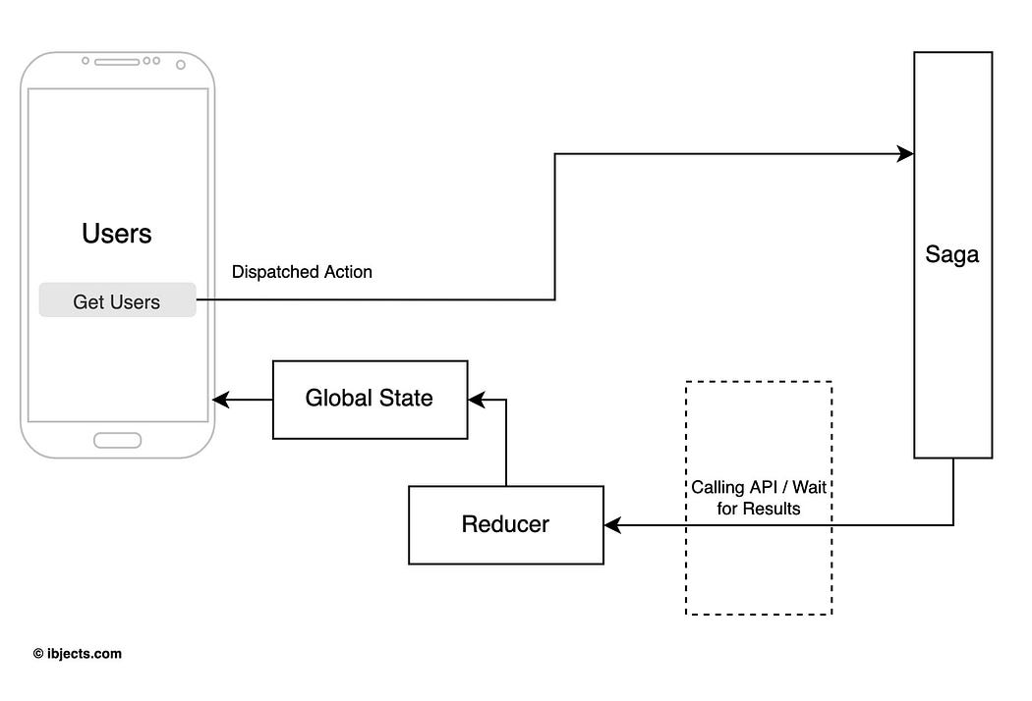

Slide 30
Declarative Effects
A sagas job is to watch for dispatched actions With Effects
Effect
  An object that has information to be interpreted by the middleware.
    Invoke asynchronous function, dispatch an action to the store
  function* actionWatcher() {
  yield takeLatest('GET_USERS', fetchUsers)
  }

Slide 31
Saga Effects
takeLatest
  Spawns a new saga on each dispatched action.
  It will be sent to the Store that matches the pattern provided.
  It will also cancel any previous saga tasks started if they are still running. and run again with the latest data available.
  takeEvery
  Spawns a saga on each action dispatched to the Store that matches pattern.
  allows concurrent actions to be handled

Slide 32
Saga Effects
Put
  Instead of dispatching an action inside the generator,
  returns an object with instructions for the middleware to dispatch the action.
  yield put({type:'ADD_ITEM_ASYNC',value:1})

Slide 33
Reducer
  import { createReducer } from "@reduxjs/toolkit";
  const initialState = {};
  const myReducer = createReducer(initialState, (builder) => {
  builder
  .addCase('GET_USERS_SUCCESS', (state, action) => {
  state.users = action.users;
  })
  .addCase('GET_USERS_FAILURE', (state, action) => {
  state.error = action.error;
  })
  .addDefaultCase((state, action) => {});
  });
  export default myReducer;

Slide 34
Sagas
  async function userFetch() {
  return axios
  .get("https://jsonplaceholder.typicode.com/users")
  .then((res) => {
  return res.data;
  })
  .catch((err) => {
  throw err;
  });
  }

Slide 35
Sagas
  function* getUsers() {
  try {
  const users = yield call(userFetch);
  yield put({ type: 'GET_USERS_SUCCESS', users });
  } catch (error) {
  yield put({ type: 'GET_USERS_FAILURE', error });
  }
  }
  function* mySaga() {
  yield takeEvery('GET_USERS_FETCH', getUsers);
  }
  export default mySaga;

Slide 36
Configure Saga Middleware
  const sagaMiddleware = createSagaMiddleware();
  const rootReducer = combineReducers({ myReducer });
  const store = configureStore({
  reducer: rootReducer,
  middleware: [sagaMiddleware]
  });
  sagaMiddleware.run(mySaga);

Slide 37
Provide the Store
  <Provider store={store}>
  <App />
  </Provider>

Slide 38
Component
  const myDispatch = useDispatch();
  const retrivedData = useSelector((state) => {
  return state.myReducer;
  });
  <button onClick={() => myDispatch({type:'GET_USERS_FETCH'})}>Call API</button>
  {retrivedData?.users &&
  retrivedData.users.map((user) => (
  <div key={user.id}>{user.name}</div>
  ))}

Slide 39
Create User
  async function addUser(user) {
  return axios
  .post("https://jsonplaceholder.typicode.com/users",user)
  .then((res) => {
  return res.data;
  })
  .catch((err) => {
  throw err;
  });
  }

Slide 40
Component
  import { all, put, call, takeEvery } from "redux-saga/effects";
  export default function* addPostSaga() {
  yield takeEvery('ADD_POST', addPost);
  }
  function* addPost(action) {
  console.log(action)
  try {
  const postResponse = yield call(addUser, action.payload);
  yield put({ type: 'ADDED_POST', payload: postResponse });
  } catch (err) {
  console.log(err);
  }
  }

Slide 41
Multiple Calls with Redux -saga
  function* fetchItemAsync(){
  const list = yield fetch('https://jsonplaceholder.typicode.com/users').then(resp=> resp.json());
  const posts =yield fetch('https://jsonplaceholder.typicode.com/posts').then(resp=>resp.json());
  yield put ({type:'FETCH_USERS_ASYNC',users:[list,posts]});
  }

