Slide 1
INTRODUCTION TO SOAP WEB SERVICES

Slide 2
Web Services
A way for two machines to communicate with each other over a network.
A client and server applications that communicate over HTTP or HTTPS
  A standard means of interoperating between software applications running on a variety of platforms and frameworks.
  Can be combined in a loosely coupled way to achieve complex operations.

Slide 3
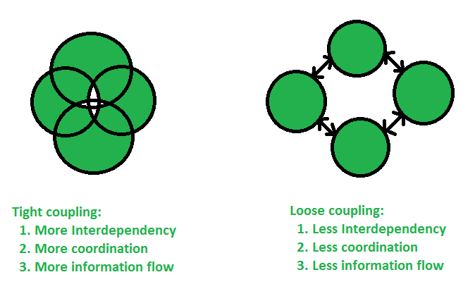
Coupling

Slide 4
Types of Web Services
A service is a software component provided through a network-accessible endpoint.
The service consumer and provider use messages to exchange request and response
  Done by a self-containing documents with very few assumptions about the technological capabilities of the receiver.
Can be implemented as
“big” web services and “RESTful” web services.

Slide 5
“Big” Web Services
Also known as SOAP Web Services
Uses XML messages that follow the Simple Object Access Protocol
JAX-WS provides the functionality
Contains a machine-readable description of the operations offered by the service
  Web Services Description Language (WSDL), an XML language for defining interfaces syntactically.

Slide 6
XML MESSAGING-SOAP

Slide 7
Simple Example
<Envelope>
<Header>
<transId>1234</transId>
</Header>
<Body>
<Add>
<a>3</a>
<b>4</b>
</Add>
</Body>
</Envelope>
c = Add(a, b)

Slide 8


System Flow (HTTP)
Server
<Envelope>
<Header>
<transId>1234</transId>
</Header>
<Body>
<Add>
<a>3</a>
<b>4</b>
</Add>
</Body>
</Envelope>
Request
<Envelope>
<Header>
<transId>1234</transId>
</Header>
<Body>
<AddResponse>
<c>7</c>
</AddResponse>
</Body>
</Envelope>
Response
Client

Slide 9
Actual SOAP Request
<SOAP-ENV:Envelope
xmlns:SOAP-ENV=“http://schemas.xmlsoap.org/soap/envelope/”
SOAP-ENV:encodingStyle="http://schemas.xmlsoap.org/soap/encoding/”>
<SOAP-ENV:Header>
<t:transId xmlns:t=“http://a.com/trans”>1234</t:transId>
</SOAP-ENV:Header>
<SOAP-ENV:Body>
<m:Add xmlns:m=“http://a.com/Calculator”>
<a xsi:type=“integer”>3</a>
<b xsi:type=“integer”>4</b>
</m:Add>
</SOAP-ENV:Body>
</SOAP-ENV:Envelope>

Slide 10
Actual SOAP Response
<SOAP-ENV:Envelope
xmlns:SOAP-ENV=“http://schemas.xmlsoap.org/soap/envelope/”
SOAP-ENV:encodingStyle="http://schemas.xmlsoap.org/soap/encoding/”>
<SOAP-ENV:Header>
<t:transId xmlns:t=“http://a.com/trans”>1234</t:transId>
</SOAP-ENV:Header>
<SOAP-ENV:Body>
<m:AddResponse xmlns:m=“http://a.com/Calculator”>
<c xsi:type=“integer”>7</c>
</m:AddResponse>
</SOAP-ENV:Body>
</SOAP-ENV:Envelope>

Slide 11

REST WebService
Roy Thomas Fielding

Slide 12
REST
Introduced and defined in 2000 by Roy Fielding
Defines a set of architectural principles to design Web services
  Focusses system’s resources
  How resource states are addressed
  How its transferred over HTTP
  Clients written in different languages.
A predominant Web service design model.
Displaced SOAP- and WSDL-based interface design because of its simpler style to use.

Slide 13
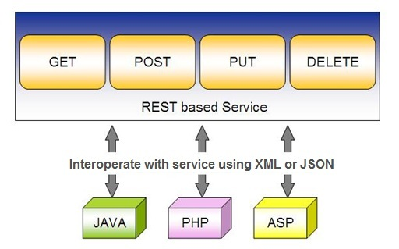
REST Service

Slide 14
RESTful Web Service
RESTful web services are services that are built to work best on the web.
Representational State Transfer (REST)
  Architectural style
  Specifies constraints, such as the uniform interface
  Has feature that enable services to work best on the Web.

Slide 15
RESTful Web Service
Data and functionality are considered resources
  Resources are accessed using Uniform Resource Identifiers (URIs), typically links on the web.
In the REST architecture style, clients and servers exchange representations of resources using a standardized interface and protocol.
RESTful applications are simple, lightweight, and have high performance.
Service are mapped to the four main HTTP methods
  create, retrieve, update, and delete.

Slide 16
RESTful Principles
RESTful applications are simple, lightweight, and fast
Resource identification through URI
  A RESTful web service exposes a set of resources that identify the targets of the interaction with its clients.
  Resources are identified by URIs, which provide a global addressing space for resource and service discovery.
  A URI is of the following format
    http://localhost:8080/hotelmanagement/rest/hotels

Slide 17
Designing a URI
Use Plural Noun
  Use plural noun to define resources.
Avoid using spaces
  Use underscore (_) or hyphen (-) when using a long resource name.
Use lowercase letters
  Good practice to keep the url in lower case letters only.
Use HTTP Verb
  HTTP Verb like GET, PUT and DELETE to do the operations on the resource.
  It is not good to use operations name in the URI.

Slide 18
RESTful Principles
Uniform interface:
  Resources are manipulated using a fixed set of four create, read, update, delete operations:
  PUT, GET, POST, and DELETE.
  GET retrieves the current state of a resource in some representation.
  POST transfers a new state onto a resource.

Slide 19
RESTful Principles
Self-descriptive messages
  Resources are decoupled from their representation
  Resource content can be accessed in a variety of formats, such as HTML, XML, plain text, PDF, JPEG, JSON, and others.
  Metadata about the resource is made available and used
    Caching, Errors, negotiate the appropriate representation format, and perform authentication or access control.

Slide 20
RESTful Principles
Stateful interactions through hyperlinks
  Every interaction with a resource is stateless
  Request messages are self-contained.
  Stateful interactions are based on the concept of explicit state transfer.
  Several techniques exist to exchange state, such as URI rewriting, cookies, and hidden form fields.
  State can be embedded in response messages to point to valid future states of the interaction.

Slide 21
JAX-RS
JAVA API for RESTful Web Services.
  JAVA based programming language API and specification
  Provides support for creating RESTful Web Services.
  Uses annotations to simplify the development and deployment.
  Provides Supports for creating clients for RESTful Web Services.
  Coordinates with the web server or container to make resources available via URLs
  Convert the HTTP requests into Java objects, and to convert Java object resource representations into HTTP responses.
    Marshalling and unmarshalling requests and responses,

Slide 22
Jersey
Jersey is the open source, production quality, JAX-RS
Reference Implementation for building RESTful Web services.
Can be integrated with a number of different containers and HTTP servers.
Can be combined with the Project Grizzly HTTP server.
  Can also be integrated Tomcat, WebLogic, or WebSphere.

Slide 23
JERSEY
Provides both server-side and Client side API and implementation
Includes support for XML serialization of JAXB bean
Can use JSON as a wire format for request and response entities.
It is hosted in a Maven repository but can be used without using Maven.
Jersey and Grizzly are under active development, so you will probably find newer versions of these jars available

Slide 24
Grizzly HTTP Server
A multi-protocol framework built on top of Java NIO.
Simplifies the development of robust and scalable servers.
Jersey enables support for using Grizzly as a plain vanilla HTTP container
Starting a Grizzly server is one of the most lightweight and easy ways how to expose a functional RESTful services application.

Slide 25
DEVELOPING JAX-RS APPLICATION

Slide 26
Resource
Resource are classes , simple POJOs annotated with @Path
  Can also have method annotated with @Path
The annotation's value is a relative URI path.
Resource methods
  Methods of a resource class annotated with a resource method designator.
  Method designator with annotation such as @GET, @PUT, @POST, @DELETE

Slide 27
Maven Project
Create a New Maven Project
In the Filter type jersey-quickstart-grizzly
Fill in the required details and a project is created
In the pom.xml uncomment the jersey-media support dependency
Can Execute as a Stand alone Java Application
Can also use the maven goal exec:java

Slide 28
Main Class
  public class Main {
  public static HttpServer startServer() {
  public static final String BASE_URI = "http://localhost:8080/";
  ResourceConfig rc = new ResourceConfig().packages("com.example.demo.");
  GrizzlyHttpServerFactory.createHttpServer(URI.create(BASE_URI), rc);
  }
  public static void main(String[] args) throws IOException {
  HttpServer server = startServer();
  System.in.read();
  server.stop();
  }
  }

Slide 29
Send a JSON Response
import javax.json.Json;
import javax.json.JsonObject;
  @GET
  @Path("/user")
  @Produces(MediaType.APPLICATION_JSON)
  public String getMessage(){
  JsonObject map = Json.createObjectBuilder().add("ram",40).build();
  return map.toString();
  }

Slide 30
Send Image
  @GET @Produces("image/jpeg")
  @Path("/menus/image")
  public File getImageRepresentation() {
  return new File( “e://Pictures//menu.jpg");
  }
Jersey takes the returned File object and uses its contents as the response entity which it marks as image/jpeg.
Don't have to write code to read the contents of files and return them as byte arrays or strings.

Slide 31
Response Builder
Used to build Response instances that contain metadata instead of or in addition to an entity.
Obtained via static methods of the Response class,
public abstract Response build()
  Create a Response instance from the current ResponseBuilder.
  The builder is reset to a blank state equivalent to calling the ok method.

Slide 32
@PathParam
Annotation is used to access Value of the variable on request method as a parameter
Binds the value of a path segment to a resource method parameter.
Used to inject values from the URL into a method parameter.
getCustomerById(@PathParam("customerId") int id)
Its invoked as
http://localhost:2020/RestExample/webapi/customer/101

Slide 33
@Produces Annotation
@Produces(MediaType.TEXT_PLAIN[, more-types])
  Used to specify the MIME media types or representations a resource can produce and send back to the client.
  Can be Applied Both at the Class and Method Level
Class level
  All the methods in a resource can produce the specified MIME types by default.
Method Level
  Overrides any @Produces annotations applied at the class level.
406 Not Acceptable
  Returned when methods matching MIME type is not found in a client request,

Slide 34
Server Response
A server response in REST can be one of the following
JSON (JavaScript Object Notation).
  Easy to parse in JavaScript clients and in other languages, too).
CSV (comma-separated values)
  CSV is more compact;
XML
  XML is easy to expand (clients should ignore unfamiliar fields) and is type-safe;
HTML
  Response is a human-readable document;

Slide 35
The @Consumes Annotation
@Consumes(type[, more-types])
  used to specify which MIME media types of representations a resource can accept, or consume, from the client.
Class level
  All the response methods accept the specified MIME types by default.
Method level
  overrides @Consumes annotations applied at the class level.
HTTP 415 (“Unsupported Media Type”) .
  Returned when methods can not respond to the requested MIME type

Slide 36
Model
  public class Menu {
  private Long id;
  private String name;
  }

Slide 37
Menu Service
  public class MenuService {
  private static MenuService instance = new MenuService();
  private static HashSet menus;
  private MenuService() {
  menus = new HashSet<>();
  menus.add(new Menu(1L, "Menu One"));
  }
  public static MenuService getInstance() {
  return instance;
  }

Slide 38
Add and Find All
  public void add(Menu menu) {
  menus.add(menu);
  }
  public List getAll() {
  return new ArrayList(menus);
  }

Slide 39
Read
  public Menu get(Long id) throws Exception {
  Iterator it = menus.iterator();
  while (it.hasNext()) {
  Menu curr = (Menu) it.next();
  if (curr.getId() == id)
  return curr;
  }
  throw new Exception("Object not found");
  }

Slide 40
Delete
  public boolean delete(Long id) throws Exception {
  Iterator it = menus.iterator();
  while (it.hasNext()) {
  Menu curr = (Menu) it.next();
  if (curr.getId() == id) {
  it.remove();
  return true;
  }
  }
  throw new Exception("Object not found");
  }

Slide 41
Update
  public Menu update(Long id, String update) throws Exception {
  Iterator it = menus.iterator();
  while (it.hasNext()) {
  Menu curr = (Menu) it.next();
  if (curr.getId() == id) {
  curr.setName(update);
  return curr;
  }
  }
  throw new Exception("Object not found");
  }

Slide 42
Resource
  @Path("/rest")
  public class MenuResource {
  MenuService service = MenuService.getInstance();
  @GET
  @Path("/menus")
  @Produces("application/json")
  public List<Menu> getMenus() {
  return service.getAll();
  }

Slide 43
Read
  @GET
  @Path("/menus/{menu_Id}")
  @Produces("application/json")
  public Response getMenu(@PathParam("menu_Id") Long menuId) {
  try {
  return Response.ok(service.get(menuId)).build();
  } catch (Exception e) {
  return Response.serverError().status(HttpStatus.BAD_REQUEST_400.getStatusCode(), e.getMessage()).build();
  }
  }

Slide 44
Save
  @POST
  @Path("/menus")
  @Produces("application/json")
  public Response add(Menu entity) {
  service.add(entity);
  return Response.ok(entity).status(HttpStatus.CREATED_201.getStatusCode(), "Created").build();
  }

Slide 45
Update
  @PUT
  @Path("/menus/{menu_Id}")
  @Produces("application/json")
  public Response update(@PathParam("menu_ID") Long menuId, Menu entity) {
  try {
  return Response.ok(service.update(menuId,entity.getName())).build();
  } catch (Exception e) {
  return Response.serverError().status(HttpStatus.BAD_REQUEST_400.getStatusCode(), e.getMessage()).build();
  }
  }

Slide 46
Delete
  @DELETE
  @Path("/menus/{menu_Id}")
  @Produces("application/json")
  public Response delete(@PathParam("menu_Id") Long menuId) {
  try {
  service.delete(menuId);
  return Response.ok().status(HttpStatus.OK_200.getStatusCode()).build();
  } catch (Exception e) {
  return Response.serverError().status(HttpStatus.BAD_REQUEST_400.getStatusCode(), e.getMessage()).build();
  }
  }

Slide 47
DEVELOPING CLIENT FOR JAX-RS APPLICATION

Slide 48
Jax-RS Client Module
Client Builder
  Main entry point to the client API used to bootstrap Client instances.
Client
  Client is the main entry point to the fluent API used to build and execute client requests in order to consume
  Object that Manage the client-side communication infrastructure.
  Client client = ClientBuilder.newClient();

Slide 49
Web Target
Obtained through the reference of the Client
  Its represents a resource target identified by the resource URI.
Client Object contains overloaded target(...) methods
  These methods are used for creation of WebTarget instance.
  Takes the uri of the target web resource passed as a String
  WebTarget webTarget =
  client.target("http://localhost:8080/user")
  .path("guest");

Slide 50
Invoking HTTP Request
InvocationBuilder
  Used to start building a new HTTP request invocation
  Created using one of the request(...) methods that are available on WebTarget.
  It can define the media type of the requested resource.
  Takes the request specific parameters.
  Can also setup headers
  Invocation.Builder invocationBuilder = webTarget.request(MediaType.APPLICATION_JSON);
  Response response = invocationBuilder.get();

Slide 51
Get From REST API
  Client client = ClientBuilder.newClient();
  WebTarget webTarget = client.target("http://localhost:8080/user").path("guest");
  Invocation.Builder invocationBuilder = webTarget.request(MediaType.APPLICATION_JSON);
  Response response = invocationBuilder.get();
  User user = response.readEntity(User.class);
  System.out.println(user);

Slide 52
Posting To Rest API
  Client client = ClientBuilder.newClient();
  WebTarget webTarget = client.target("http://localhost:8080/users").path(“guest");
  Invocation.Builder invocationBuilder = webTarget.request(MediaType.APPLICATION_JSON);
  User user = new User(1, "Darshan");
  Response response = invocationBuilder.post(Entity.entity(user, MediaType.APPLICATION_JSON));
  System.out.println(response.getStatus());
  System.out.println(response.readEntity(String.class));

Slide 53
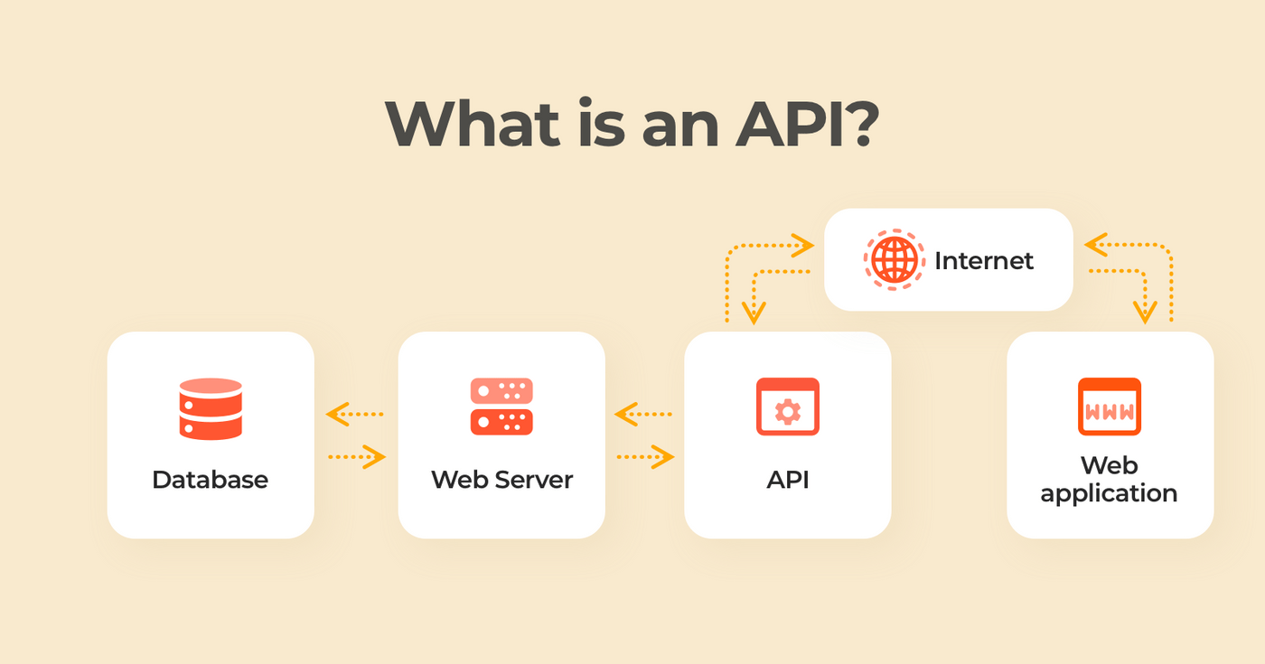
API

