Slide 1
DOCKER

Slide 2
Docker
Designed to create, deploy, and run applications
  Written in the Go programming language
Packages an application and all its dependencies together in the form of containers.
Application will run on any other machine
  Even if the settings could differ from the machine used for writing and testing the code.
  Takes advantage of several features of the Linux kernel to deliver its functionality.

Slide 3
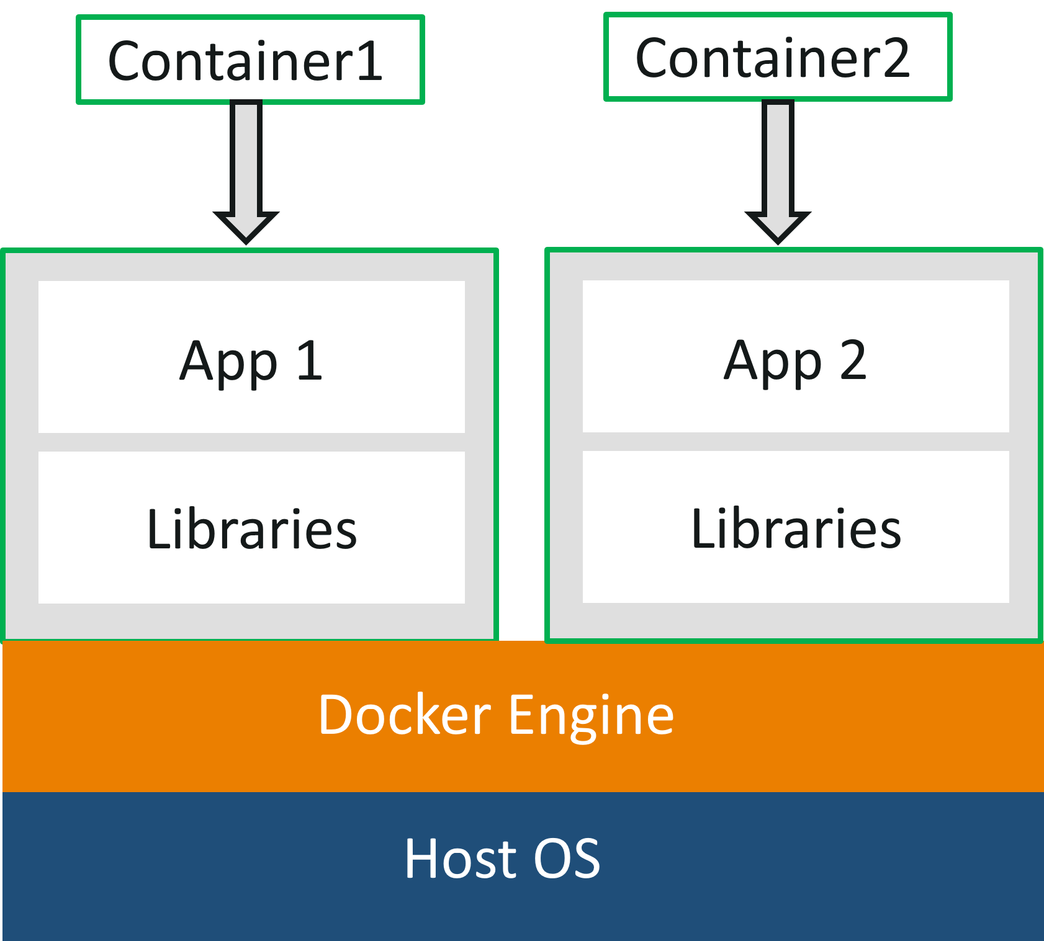
Docker Container

Slide 4
Containerization
  Each application runs on separate containers has its own set of dependencies & libraries has all the parts it needs
  Each application is independent of other applications
  Developers can build applications that will not interfere with one another.
  QA team would only need to run the container to replicate the developer’s environment.

Slide 5
Need for Containers
Containers have No guest OS and use the host’s operating system.
  They share relevant libraries & resources as and when needed.
Processing and execution of applications are very fast since applications specific binaries and libraries of containers run on the host kernel.
Booting up a container takes only a fraction of a second
Containers are lightweight and faster than Virtual Machines.

Slide 6
Need For Containers
Benefits both developers and system administrators.
Developers
  Focus on writing code without worrying about the system that it will ultimately be running on.
  Can use thousands of Applications already designed to run in a Docker container as a part of their application.
Operations
  Flexibility and reduces the number of systems needed because of its small footprint and lower overhead.

Slide 7
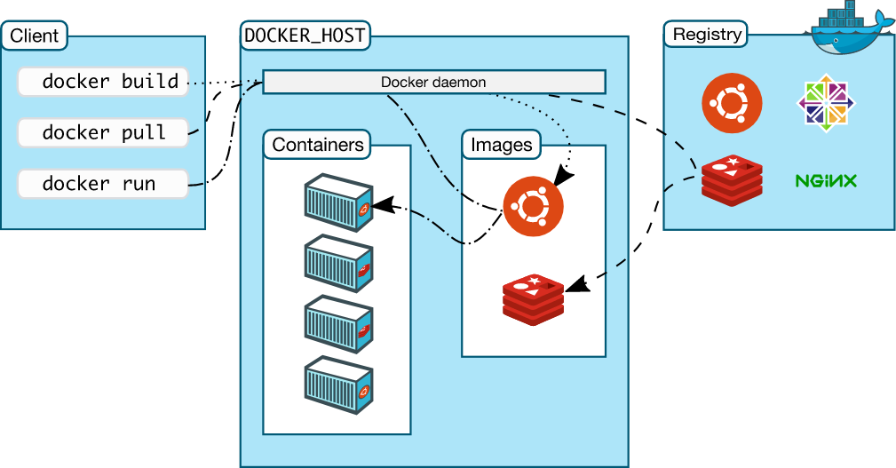
Docker architecture

Slide 8
Docker architecture
Uses a namespaces to provide the isolated workspace called the container.
  When a container is run , it creates a set of namespaces for that container.
  Namespaces provide a layer of isolation.
  Its access is limited to that namespace.
The Docker daemon
  Listens for Docker API requests and manages Docker objects
    Images, containers, networks, and volumes.
  It can also communicate with other daemons to manage Docker services.

Slide 9
Docker architecture
The Docker client
  Users interact with Docker.
  The Docker client can communicate with more than one daemon.
  Docker daemon, does the heavy lifting of building, running, and distributing Docker containers.
  Docker Compose is a special type of Docker client that work with applications consisting of a set of containers.

Slide 10
Docker architecture
Docker Desktop
  Easy-to-install application to build and share containerized applications and microservices.
  Includes the Docker daemon ,the Docker client, Docker Compose, Docker Content Trust, Kubernetes, and Credential Helper.
Docker objects
  Images, Containers, networks, volumes, plugins are different objects.

Slide 11
Docker architecture
Docker registries
  Stores Docker images.
  Docker Hub is a public registry
  Docker is configured to look for images on Docker Hub by default.
  Docker can pull/push/run the required images from configured registry.

Slide 12
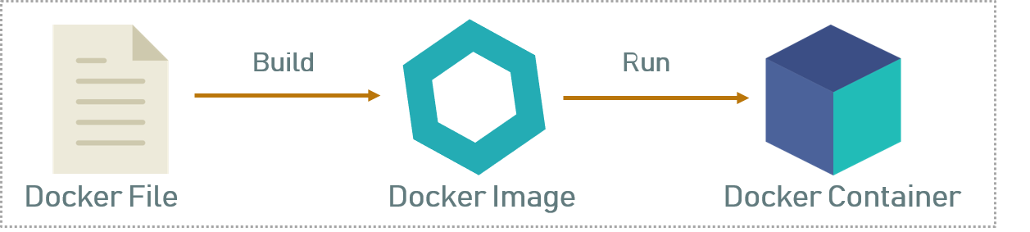
Docker architecture

Slide 13
Dockerfile
A text file without any extension
Used To write the instruction to build new docker image
  Docker reads the instruction and builds images automatically
Will have commands to build image using a simple syntax

Slide 14
Image
Image is a read-only template with instructions for creating a Docker container.
Each instruction in a Dockerfile creates a layer in the image.
  When Dockerfile changes and while rebuilding, only those layers which have changed are rebuilt.
  Makes images lightweight, small, and fast, when compared to other virtualization technologies.
An image may be based on another image, with some additional customization.
Can create custom images with those created by others and published in a registry.

Slide 15
Docker Containers
Runnable instance of an image.
Runs on top of the docker platform.
  Contains only the executable package of the application, libraries and dependent software/servers that are required to run the application.
  They do not have separate OS installations running
  Can create, start, stop, move, or delete a container using the Docker API or CLI.
  Can connect a container to one or more networks, attach storage to it, or even create a new image based on its current state.

Slide 16
Installation
Installation method change time to time.
  Especially for windows and Mac.
Docker desktop for Windows
  Available for free download
  Windows 10 Professional
  Windows Enterprise 64-bit
  Windows 10 Home 64-bit with WSL 2.
Can check docker is installed by the following command
docker --version

Slide 17
Docker Hub
https://hub.docker.com/
A repository that contains the published docker images.
Can create docker image of application and publish it here for later use or someone else to use.
It also has official docker image of many popular application

Slide 18
Docker Container and Image
docker run <image-name> : docker run hello-world
docker:
  Docker engine used to run docker program.
run:
  Used to create and run a docker container.
hello-world:
  It is a image or name of an Image
  This image will be loaded into the container.

Slide 19
Running an Image from DockerHub
docker images hello-world
  List the named docker Image
docker images
  List the docker images on the machine
    Shows Repository,tag,size,created and imageId
docker images --format "{{.ID}}: {{.Repository}}"
  Command to run the image from the terminal

Slide 20
Running a Docker Image
  Docker platform first check whether the requested image is already available in the local registry.
  If it is locally available, then it will run the local image.
  If the image is not available, then it will retrieve the image from the Docker Hub and run.

Slide 21
DockerFile
FROM
  creates a layer from Docker image.
  FROM java:8
ARG <name>[=<default value>]
  Defines a variable that users can pass at build-time to the builder
  ARG JAR_FILE=target/firstExample.jar

Slide 22
DockerFile
ENTRYPOINT
  To configure a container that will run as an executable.
  ENTRYPOINT ["java","-jar","app.jar"]
WORKDIR
  Sets the working directory for any RUN, CMD, ENTRYPOINT, COPY and ADD instructions
  If the WORKDIR doesn’t exist, it will be created

Slide 23
Dockerfile
  FROM java:8
  ARG JAR_FILE=target/firstExample.jar
  COPY ${JAR_FILE} app.jar
  ENTRYPOINT ["java","-jar","app.jar"]

Slide 24
DockerFile with Java 11
  FROM adoptopenjdk:11-jre-hotspot
  ARG JAR_FILE=*.jar
  COPY ${JAR_FILE} application.jar
  ENTRYPOINT ["java", "-jar", "application.jar"]

Slide 25
Docker Core Java Project
Create a Maven Project
choose maven-archetype-quickstart
Update the pom.xml file
Can Optionally add build>finalName>customer-service
Add the Configuration ,archieve,manifest and main class
Create Dockerfile in the context Path
Update the Dockerfile with build entries
Maven build the project mvn clean package

Slide 26
Maven Java Plugin
  <plugin>
  <groupId>org.apache.maven.plugins</groupId>
  <artifactId>maven-jar-plugin</artifactId>
  <version>3.2.0</version>
  <configuration>
  <archive>
  <manifest>
  <mainClass>com.training.Application</mainClass>
  </manifest>
  </archive>
  </configuration>
  </plugin>

Slide 27
Build Docker Image
The docker build command builds Docker images from a Dockerfile
  Navigate to directory where DockerFile is present
docker build .
  Specifies that the PATH is .
  and so all the files in the local directory to Docker daemon
docker build --tag firstexample:1.0 .
  Can add a tag in the ‘name:tag’ format
docker run Image[:tag] =>docker run firstexample:1.0
  Used to specify a version of an image to run
docker rmi -f <imageId>

Slide 28
Docker Commands
  docker info
  List system-wide information regarding the Docker installation,
  Including statistics and resources (CPU & memory) available
docker container ls
  List the containers on machine,
docker ps
    running containers will be displayed)
docker ps -a
    show all containers

Slide 29
Docker commands
docker rmi <image-id>
  Used to remove an image
  docker rmi -f <image-id>
    Force remove an image
docker start <container-id>
  Start the Stopped Container
docker stop <container-id>
  stop running container

Slide 30
Dockerize Spring Boot Application
Create a Spring Boot Application
Optionally Update the server.port =4040
Create the dockerFile in the context Path
Dockerfile
  FROM java:8
  ARG JAR_FILE=target/customer-service.jar
  COPY ${JAR_FILE} app.jar
  ENTRYPOINT ["java","-jar","app.jar"]
  Can also use the mvn spring-boot:build-image goal

Slide 31
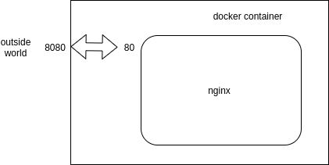
Docker Port Binding
Docker identifies every port the Dockerfile exposes
  Entry with --expose parameter.
Docker does not expose ports by default, you have to configure every exposed port yourself!
Docker ps – a
docker container port *insert containerid*
  80/tcp -> 0.0.0.0:32768

Slide 32
Docker run
docker run -it -p8080:4040 customer-service:1.0
  4040: => from server.port in application.properties
  8080 -> any port which is not in use
Run a command in a new container
  Creates a writeable container layer over the specified image
  Then starts it using the specified command.
-p <port-on-host>:<port-on-container>
  publishes port 4040 in the container to port 8080 on the host.
-it
  Run a container interactively

Slide 33
Pushing to Docker Hub
Can push an image to Docker Hub
Local Image should be named using
  Docker Hub username and the repository name created through Docker Hub on the web.
Can add multiple images to a repository by adding a specific tag
  docs/base:testing
If it’s not specified, the tag defaults to latest.

Slide 34
Pushing Image to DockerHub
Local Images can be named by one of these methods:
  While building
    using docker build -t <hub-user>/<repo-name>[:<tag>]
After Build
  By re-tagging an existing local image
  docker tag <existing-image> <hub-user>/<repo-name>[:<tag>]
docker tag spring-boot vatsank/vatsan-quick-start:1.0
docker login
docker push vatsank/vatsan-quick-start:1.0

Slide 35
DOCKER COMPOSE

Slide 36
Dockerize Dependent Applications
  Comes with an own build-file in YAML format
  It contains details about the services, networks, and volumes for setting up the application.
  Compose to create separate containers, host them and get them to communicate with each other.
  Each container will expose a port for communicating with other containers.
  Used for managing multiple containers.
    To start or stop a composite of services in one command,
    To Merge the logging output of multiple services together

Slide 37
Dockerfile
  FROM java:8
  COPY . /app
  EXPOSE 8080
  ADD ./target/user-service.jar user-service.jar
  ENTRYPOINT ["java","-jar","user-service.jar"]

Slide 38
Docker-compose Commands
version:
  Specifies which format version should be used.
    Mandatory field.
services:
  Each object in this key defines a service,
  Like a container.
    Mandatory section
build:
  Specifies the location of our Dockerfile
  “.” represents the directory where the docker-compose.yml file is located.

Slide 39
Docker-compose Commands
image:
  The Name it be given to the image when build-features are used.
  It will be searching for this image in the library or remote-registry
depends_on:
  Used to inform Docker to start a service only, if the listed services have started successfully.
restart:
    always restarts containers that exit with zero ( success ) exit code.
  ports:
    Used to map the container’s ports to the host machine.

Slide 40
Docker-compose Commands
docker-compose up
  to start up a container
docker-compose down
  To take down container
docker-compose build
  To rebuild discarding old images with the newer one
docker-compose ps:
  This command list all the containers in the current docker-compose file. They can then either be running or stopped.

Slide 41
Docker-compose Spring Boot App
  version: '3'
  services:
  myspringapp:
  image: tour-app
  build:
  context: ./
  ports:
  - "8080:3030“
  docker-compose up
  http://localhost:8080/api/v1/tours

Slide 42
Docker-compose push
  version: '3'
  services:
  myspringapp:
  image: vatsank/tour-app:1.0
  build:
  context: ./
  ports:
  - "8080:3030"
docker login
docker-compose push
docker-compose up

Slide 43
Docker-compose multiple Application
  version: '3'
  services:
  student-service:
  build:
  context: ./dockerize-spring-service
  dockerfile: ./Dockerfile
  ports:
  - "8080:6060"
  client-service:
  build:
  context: ./dockerize-spring-service-client
  dockerfile: ./Dockerfile
  ports:
  - 8085:6070
  depends_on:
  - student-service

Slide 44
Using Rest Template
  @Autowired
  RestTemplate template;
  @GetMapping(path = "/client/students")
  public String getStudents() {
  return template.getForObject("http://student-service:6060/students", String.class);
  }

Slide 45
Environment configurations
Used in the Spring Boot project application.properties file.
Configurations connect and authenticate the API service
  environment:
  SPRING_DATASOURCE_URL=jdbc:postgresql://mypostgres:5432/mydb
  SPRING_DATASOURCE_USERNAME=postgres
  SPRING_DATASOURCE_PASSWORD=password
  SPRING_JPA_HIBERNATE_DDL_AUTO=update

Slide 46
Docker-compose with postgress
  version: '3'
  services:
  myspringapp:
  image: myapplication
  build:
  context: ./
  ports:
  - "8080:8080"
  depends_on:
  - mypostgres

Slide 47
Docker-compose with postgress
  environment:
  - SPRING_DATASOURCE_URL=jdbc:postgresql://mypostgres:5432/mydb
  - SPRING_DATASOURCE_USERNAME=postgres
  - SPRING_DATASOURCE_PASSWORD=password
  - SPRING_JPA_HIBERNATE_DDL_AUTO=update
  mypostgres:
  image: postgres
  ports:
  - "5432:5432"
  environment:
  - POSTGRES_PASSWORD=password
  - POSTGRES_USER=postgres
  - POSTGRES_DB=mydb

Slide 48
Docker-compose Eureka Registry-Client
  version: '3'
  services:
  eureka-service:
  build:
  context: ./eureka-registry
  dockerfile: ./Dockerfile
  ports:
  - "8761:8761"
  environment:
  - eureka.client.serviceUrl.defaultZone= http://eureka-service:8761/eureka
  - eureka.client.fetchRegistry= false
  - eureka.client.registerWithEureka=false

Slide 49
Docker-compose Eureka Registry-Client
  student-service:
  build:
  context: ./dockerize-spring-service
  dockerfile: ./Dockerfile
  ports:
  - 8080:6060
  depends_on:
  - eureka-service
  environment:
  - eureka.client.serviceUrl.defaultZone=http://eureka-service:8761/eureka
  - spring.application.name=student-service

Slide 50
Docker-compose Eureka Registry-Client
  client-service:
  build:
  context: ./dockerize-spring-service-client
  dockerfile: ./Dockerfile
  ports:
  - 8085:6070
  depends_on:
  - student-service
  - eureka-service
  environment:
  - eureka.client.serviceUrl.defaultZone=http://eureka-service:8761/eureka
  - spring.application.name=student-client

Slide 51
Client
  @Bean
  @LoadBalanced
  public RestTemplate template() {
  return new RestTemplate();
  }
  template.getForObject("http://student- service:6060/students", String.class);

Slide 52
Deploying a War File
Create a maven-archetype-webapp project
Add the required Servlets and JSP to the project
Build the project using “mvn package”
Update the Dockerfile
  FROM tomcat:9.0-alpine
  COPY target/webapplication.war /usr/local/tomcat/webapps/
  EXPOSE 8080
  CMD ["catalina.sh", "run"]
  Docker build the image docker build –tag webapp:1.0 .
  Run the container docker run –p8080:8080 webapp:1.0

