Slide 1
REST SERVICE USING SPRING DATA JPA

Slide 2
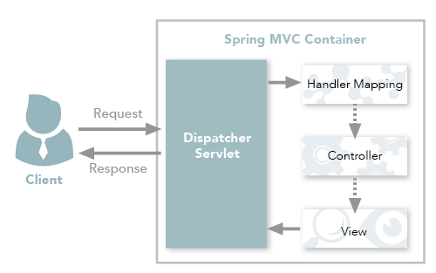
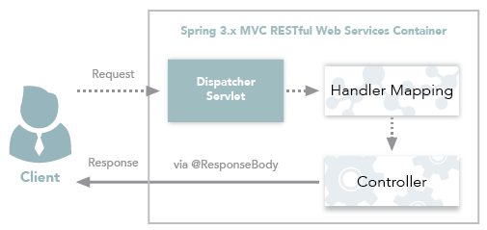
Spring MVC and Spring REST

Slide 3
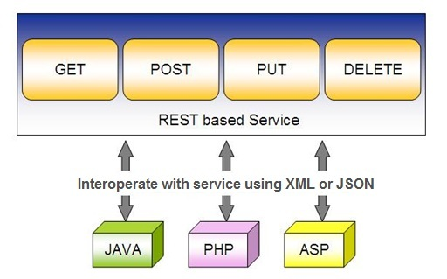
Spring RESTful Services
REST does not require the client to know anything about the structure of the API.
Server needs to provide whatever information the client needs to interact with the service.

Slide 4
Using appropriate Request Methods
GET :
  Should not update anything.
  Should be idempotent (same result in multiple calls).
  Possible Return Codes 200 (OK) + 404 (NOT FOUND) +400 (BAD REQUEST)
POST :
  Should create new resource.
  Ideally return JSON with link to newly created resource.
  Same return codes as get possible.
  In addition : Return code 201 (CREATED) is possible.

Slide 5
Using appropriate Request Methods
PUT :
  Update a known resource. ex: update client details.
  Possible Return Codes : 200(OK)
DELETE :
  Used to delete a resource.
  Possible Return Codes : 200(OK) or a 204 - no content

Slide 6
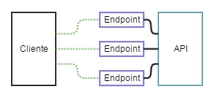
API and Endpoint

Slide 7
SPRING DATA REST WITH JPA

Slide 8
Spring RESTful Services
A RESTful architecture may expose multiple representations of a resource.
From Spring 4 @RestController annotation is added to controller
  A combination of @Controller and @ResponseBody
A Rest Controller method returns a domain object instead of a view.

Slide 9
REST Stereotypes
@RestController
  An implicit @ResponseBody is being added to the methods.
  Allows Spring to render the returned HttpEntity and its payload, directly to the response.
@GetMapping
  To map HTTP GET requests onto specific handler methods.
  Composed annotation for @RequestMapping(method = RequestMethod.GET).

Slide 10
REST Stereotypes
@PathVariable
  Indicates that the Method parameter should be bound to a URI template variable.
  @GetMapping("/members/{id}")
  public String getById(@PathVariable String id) { }
@PostMapping
  Combined shortcut for @RequestMapping(method = RequestMethod.POST).
  @PostMapping("/members“)
  public void addMember(@RequestBody Member member) { }

Slide 11
@RequestBody
Used to map the HttpRequest body to a transfer or domain object
  Spring automatically deserializes the JSON into a Java type
  The type of @RequestBody annotation must correspond to the JSON sent from client-side
HttpMessageConverter
  Internally Used by Spring to perform Serialization/deserialization
@Valid
  To perform automatic validation by adding to method argument

Slide 12
Post Mapping
  @PostMapping(path = "/api/v1/invoices")
  public Invoice add(@RequestBody Invoice entity
  ,HttpServletResponse response) {
  response.setStatus(201);
  return this.service.add(entity);
  }
@ResponseStatus(HttpStatus.CREATED)
  @PostMapping(path = "/api/v1/invoices")
  public Invoice add(@RequestBody Invoice entity) {
  return this.service.add(entity);
  }

Slide 13
ResponseEntity
Represents Complete HTTP response, gives more flexibility
  May be required in some special cases
  Can be used to send Status Code,Response Body,Location to the resource which was altered
  @GetMapping(path = "/api/v1/invoices")
  public ResponseEntity<Invoice> getInvoices() {
  HttpHeaders responseHeaders = new HttpHeaders();
  return ResponseEntity.ok().headers(responseHeaders).body(dao.findAll());
  }

Slide 14
Response Entity
  @PostMapping(“/invoices)
  public ResponseEntity<Object> addInfo(@RequestBody Invoice entity){
  URI location=
  ServletUriComponentsBuilder
  .fromCurrentRequest()
  .path("/{id}")
  .buildAndExpand(entity.getId())
  .toUri();
  return ResponseEntity.created(location).body(entity);
  }

Slide 15
@Repository
There are three repository in Spring Data
CrudRepository
  Extends Repository
  provides CRUD functions
PagingAndSortingRepository
  Extends CrudRepository
  provides methods to do pagination and sort records
JpaRepository
  Extends PagingandSortingRepository
  Provides Methods such as flushing the persistence context and delete records in a batch
  Querying methods return List's instead of Iterable's

Slide 16
Creating Spring Data Application
  Create a repository interface and extend one of the repository interfaces provided by Spring Data.
  If required add custom query methods to the created repository interface
  Inject the repository interface to another component and use the implementation that is provided automatically by Spring.
Need NOT create an implementation class
  Spring will automatically create its implementation class at runtime.
The Repository class will be auto detected if suitably placed in the scan path

Slide 17
CrudRepository Interface
Extends Repository Interface and has the following Methods
  <S extends T> S save(S entity)
  <S extends T> Iterable<S> saveAll(Iterable<S> entities);
  Optional<T> findById(ID primaryKey)
  Iterable<T> findAll()
  void delete(T entity)
  long count()
  boolean existsById(ID id);

Slide 18
PagingAndSortingRepository
  Extends CrudRepository Interface and has the following Methods
findAll(Pageable pageable)
    Pageable object with following properties
      Page size
      Current page number
      Sorting
      findAll(Sort sort)
        Sort Object with the Property on Which the sorting is to be done
        Sort.by(propName)

Slide 19
JpaRepository
Extends PagingAndSortingRepository
Can also optionally extend QueryByExampleExecutor
  List<T> findAllById(Iterable<ID> ids);
  <S extends T> S saveAndFlush(S entity);
  void deleteInBatch(Iterable<T> entities);
  void deleteAllInBatch();
  T getOne(ID id);
  void flush();

Slide 20
SAMPLE CODE-DEMO

Slide 21
Entity
  @Entity
  @Table(name = "demo_invoice")
  @Data
  @AllArgsConstructor
  @NoArgsConstructor
  @FieldDefaults(level = AccessLevel.PRIVATE)
  public class Invoice {
  @Id
  long id;
  String customerName;
  @DateTimeFormat(iso = DateTimeFormat.ISO.DATE)
  LocalDate invoiceDate;
  double amount;
  }

Slide 22
Repository
  @Repository
  public interface InvoiceRepository extends JpaRepository<Invoice, Long>{
  }

Slide 23
Service
  @Service
  public class InvoiceService {
  @Autowired
  private InvoiceRepository repo ;
  public List<Invoice> findAll(){
  return repo.findAll();
  }
  public Invoice findById(int id) {
  Optional<Invoice> optInvoice=repo.findById(id);
  return optInvoice.orElseThrow(() -> new
  RunTimeException(“Invoice not found"));
  }

Slide 24
Controller
  @RestController
  public class InvoiceController {
  @Autowired
  private InvoiceService service ;
  @GetMapping(path = "/api/v1/invoices")
  public List<Invoice> findAll() {
  List<Invoice> details = service.findAll();
  return details;
  }

Slide 25
@RequestBody
Used to map the HttpRequest body to a transfer or domain object
  Spring automatically deserializes the JSON into a Java type
  The type of @RequestBody annotation must correspond to the JSON sent from client-side
HttpMessageConverter
  Internally Used by Spring to perform Serialization/deserialization
@Valid
  To perform automatic validation by adding to method argument

Slide 26
Post and Put Mapping
  @PostMapping(path = "/api/v1/invoices")
  public Invoice add(@RequestBody Invoice entity
  ,HttpServletResponse response) {
  response.setStatus(201);
  return this.service.add(entity);
  }
@ResponseStatus(HttpStatus.CREATED)
  @PostMapping(path = "/api/v1/invoices")
  public Invoice add(@RequestBody Invoice entity) {
  return this.service.add(entity);
  }

Slide 27
ResponseEntity
Represents Complete HTTP response, gives more flexibility
  May be required in some special cases
  Can be used to send Status Code,Response Body,Location to the resource which was altered
  @GetMapping(path = "/api/v1/invoices")
  public ResponseEntity<Invoice> getInvoices() {
  HttpHeaders responseHeaders = new HttpHeaders();
  return ResponseEntity.ok().headers(responseHeaders).body(dao.findAll());
  }

Slide 28
Put Mapping
@PutMapping(path = "/api/v1/invoice")
  public Invoice update(@RequestBody Invoice entity) {
  return this.service.add(entity);
  }
  @PatchMapping(path = "/api/v1/invoice")
  public ResponseEntity<String> updateAmount() {
  return ResponseEntity.status(HttpStatus.CREATED)
  .body("Updated Amount:="+this.service.updateAmount());
  }

Slide 29
Remove Method in Service
  public Invoice remove(Invoice entity) {
  Optional<Invoice> optional = Optional.empty();
  if(this.repository.existsById(entity.getId())) {
  this.repository.delete(entity);
  optional = Optional.of(entity);
  }
return optional;
}

Slide 30
Delete Mapping in Controller
  @DeleteMapping(path = "/api/v1/invoice")
  public ResponseEntity<Invoice> remove(@RequestBody Invoice entity) {
  Invoice invoice = this.service.removeInvoice(entity).orElseThrow(()-> new RuntimeException("Element NOT FOUND"));
  return ResponseEntity.ok().body(invoice);
  }

Slide 31
@RestControllerAdvice
Used for Exception handling in Rest API’s
Used to handle exceptions across the whole application
Like an interceptor of exceptions thrown by methods annotated with @RequestMapping or one of the shortcuts.
It’s a combination of @ContollerAdvice and @ResponseBody.
@ExceptionHandler
  Annotation for handling exceptions in specific handler classes and/or handler methods.

Slide 32
@RestControllerAdvice
  @RestControllerAdvice
  public class ErrorHandler {
  @ExceptionHandler(value = Exception.class)
  public ErrorDetails handleAllExceptions(Exception ex, WebRequest request){
  return new ErrorDetails(LocalDateTime.now(),
  ex.getMessage(), request.getDescription(false));
  }
  }
  request.getDescription(false):
  Whether to include client-specific information like session id and user name

Slide 33
application.yml
  spring:
  datasource:
  url: jdbc:mysql://localhost:3306/test
  username: root
  password: srivatsan
  driver-class-name: com.mysql.cj.jdbc.Driver
  jpa:
  show-sql: true
  hibernate:
  ddl-auto: update
  naming:
  physical-strategy: org.hibernate.boot.model.naming.PhysicalNamingStrategyStandardImpl

Slide 34
application.yml
  logging:
  level:
  org.hibernate.sql: debug
  org.hibernate.type.descriptor.sql.BasicBinder: trace

Slide 35
QUERY DSL

Slide 36
Query DSL
Domain Specific Language
  Extension of a programming language to address a domain.
  Enhancing Java to be better suited at creating and working with JPA queries.
  A Powerful, flexible and customizable based on JPA entity
  Framework checks the validity of queries when application starts up
  Have been in use in scripted language

Slide 37
Query Method Syntax
Methods are defined in JPA repository that Spring Data JPA will auto-implement
  The query parser will look for methods that start with find, query, read, count, or get.
Prefixes can be enhanced with other keywords until it gets to the B-Y, or By, of the method name.
findByAgeLike(Integer age);

Slide 38
Query Method Syntax
findByAgeLike(Integer age);
find
  Method starts with find so that the query parser understands that it needs to implement this query contract.
By
  Following the find keyword,
  Signaling that the criteria information will be coming next in the method name.
Age
  Matches the attribute name age JPA entity, and age is of data type Integer.

Slide 39
Query Method Syntax
findByAgeLike(Integer age);
Like
  final keyword tells the implementation to create a Like query
  Need to pass variable that the query implementation should use as the actual filter criteria.
  It's of type Integer because data type of age in entity is of type Integer.

Slide 40
Custom Repository Methods
Can add custom methods to the interface
Methods are Derived by two main parts separated by the find By keyword
Equality Condition Keywords
  List findByNameEquals(String name);
  List findByNameIsNot(String name);
Similarity Condition Keywords
  List findByNameStartingWith(String prefix);
  List findByNameContaining(String infix);

Slide 41
Custom Repository Methods
  Comparison Condition Keywords
  List findByAgeLessThan(Integer age);
  List findByAgeLessThanEqual(Integer age);
  List findByAgeGreaterThan(Integer age);
Multiple Condition Expressions
  List findByNameOrBirthDate(String name, ZonedDateTime birthDate);
  List findByNameOrBirthDateAndActive(String name, ZonedDateTime birthDate, Boolean active);
Sorting the Results
  List findByNameOrderByName(String name);
  List findByNameOrderByNameAsc(String name);

Slide 42
Custom Repository Methods
findByStartDateBetween
findByStartDateAfter
findByAgeOrderByLastnameDesc.
To Return Just the two properties Name and email
  public interface ProjectNameAndEmail {
  String getName();
  String getEmail();
  }
  List<ProjectNameAndEmail> findAllById(int id);

Slide 43
@Query
Used to write the more flexible query to fetch data.
Supports both JPQL and native SQL queries.
By default will be using JPQL to execute the queries.
  Using normal SQL queries, would get the query syntax error exceptions.
Can use native SQL queries by setting nativeQuery flag to true.
  Pagination and dynamic sorting for native queries are not supported in spring data jpa.

Slide 44
@Query
Used to write the more flexible query to fetch data.
Supports both JPQL and native SQL queries.
By default will be using JPQL to execute the queries.
  Using normal SQL queries, would get the query syntax error exceptions.
Can use native SQL queries by setting nativeQuery flag to true.
  Pagination and dynamic sorting for native queries are not supported in spring data jpa.

Slide 45
@Modifying
@Query
  Can also be used for queries that add, change, or remove records in database.
@Modifying
  Indicates a query method should be considered as modifying query as that changes the way it needs to be executed.
  Not applied on custom implementation methods or queries derived from the method name
  Those methods already have control over the underlying data access APIs or specify if they are modifying by their name.

Slide 46
@Modifying
Method annotated with @Modifying also requires @Transactional
By default, CRUD methods on repository instances are transactional.
  For read operations, the transaction configuration readOnly flag is set to true.
  For other operations are configured with a plain @Transactional
  We need to add @Transactional annotation with required attribute values.

Slide 47
@Query - Example
  @Repository
  public interface TourGuideRepository extends JpaRepository<TouristGuide, Integer> {
  public TouristGuide findByFirstName(String name);
  @Query(value = "SELECT * FROM tourguides WHERE first_name = :firstName", nativeQuery = true)
  List<TouristGuide> findGuideByFirstName(@Param("firstName") String firstName);

Slide 48
@Query - Example
  @Query("FROM TouristGuide WHERE firstName = :firstName AND lastName = :lastName")
  List<TouristGuide> findByFirstAndLastName(@Param("firstName") String firstName, @Param("lastName") String lastName);
  @Query("UPDATE TouristGuide SET firstName = :prefix || firstName")
  @Modifying
  @Transactional
  void updatePrefix(@Param("prefix") String prefix);
  }

Slide 49
Application.yml
  server:
  port: 2525
  spring:
  datasource:
  username: root
  password: srivatsan
  driver-class-name: com.mysql.cj.jdbc.Driver
  url: jdbc:mysql://localhost:3306/test
  jpa:
  hibernate:
  ddl-auto: update
  naming:
  physical-strategy: org.hibernate.boot.model.naming.PhysicalNamingStrategyStandardImpl
  show-sql: true

Slide 50
DOCUMENTING REST API

Slide 51
Documentation
Essential part of building REST APIs
Open Api Documentation
  Standard, programming language-agnostic interface description for REST APIs,
  Allows both humans and computers to discover and understand the capabilities of a service
  No need to access source code,
  Can add additional documentation, or inspect network traffic

Slide 52
Spring Documentation
  A tool that simplifies the generation and maintenance of API docs
  Based on the OpenAPI 3 specification, for Spring Boot 1.x and 2.x applications.
  Required dependency are added to pom.xml:
  <dependency>
  <groupId>org.springdoc</groupId>
  <artifactId>springdoc-openapi-ui</artifactId>
  <version>1.3.0</version>
  </dependency>

Slide 53
View the Documentation
Can be viewed after executing the application
Its rendered in the browser in JSON format by default.
Default Path : http://localhost:8080/v3/api-docs/
Can be Customised using application.properties file:
  springdoc.api-docs.path=/api-docs
Custom Path : http://localhost:8080/api-docs/

Slide 54
Swagger
  springdoc-openapi is integrated with Swagger UI
  Access from the folowing URL
  http://localhost:8080/swagger-ui.html
Can be customized using application.properties
  springdoc.swagger-ui.path=/swagger-ui-custom.html

Slide 55
Custom Configuration
  Documenting at the Class Level
  @SpringBootApplication
  @OpenAPIDefinition( info = @Info(title = “Invoice Service")
  )
  Can also Document at the Method Level
  @Operation(description = "Method to Add Invoice")
  Can also Document at the Model Class
  Using JSR 303 Annotations

Slide 56
Best practices
Use Nouns for Resource Identification
Use Proper Http Headers for Serialization formats
Get Method and Query Parameter should not alter the state
Always use plurals when you name resources.
Use Appropriate Http Response Status Codes
Field Name casing Conventions
Provide Searching, Sorting and Pagination
Use Versioning of API
Provide Links for Navigating through API – Hateos
Handle Error Properly
Using DTO to Handle the Request and Response

Slide 57
SPRING REST CLIENT-REST TEMPLATE

Slide 58
Consuming REST with REST Template
REST web service can be comsumed programmatically.
Spring convenient template class is called RestTemplate.
  one-line that can bind the data to custom domain types.
It leverages the same marshallers that the server uses.
Can use JAXB marshaller,as well as JSON marshaller

Slide 59
Rest Template
Rest Template is used to create applications that consume REST
Its Autowired to the controller class.
exchange()
  Returns ResponseEntity containing an object mapped from the response body
  Can Communicate with any HTTP Method
  Takes the following arguments
    URL,
    HttpMethod,
    Return type for Exchange() method.

Slide 60
Rest Template
  getForObject(url, java.lang.Class<T>)
    Retrieve a representation by doing a GET on the specified URL.
    Class<T> is the response class Type
getForEntity(url, java.lang.Class<T>)
  Retrieve a representation by doing a GET on the URL
  Class<T> is the response class Type

Slide 61
Rest Template
headForHeaders() :
  Retrieves all headers
delete()
  Deletes the resources at the given URL.
put()
  Creates the new resource for the given URL.
postForEntity():
  Creates a news resource using HTTP POST method.

Slide 62
Rest Template -Exchange
  HttpHeaders headers = new HttpHeaders();
  headers.setAccept(Arrays.asList(MediaType.APPLICATION_JSON));
  HttpEntity <String> entity = new HttpEntity<String>(headers);
  restTemplate.exchange(" http://localhost:8080/products",
  HttpMethod.GET, entity, String.class).getBody();

Slide 63
getForObject
  @Autowired
  RestTemplate restTemplate;
  String obj =
  restTemplate.getForObject("http://localhost:4040/person/all", String.class);
  System.out.println(obj);

Slide 64
PostForObject
Used to create a new Resource
postForObject()
  Returns the Resource itself.
RestTemplate restTemplate = new RestTemplate();
HttpEntity<Book> request = new HttpEntity<>(new Book(“Java"));
Book bk = restTemplate.postForObject(url, request,Book.class);

Slide 65
Post For Entity
  HttpHeaders headers = new HttpHeaders();
  headers.setContentType(MediaType.APPLICATION_JSON);
  Map<String, Object> map = new HashMap<>();
  map.put("rollNumber", 210);
  map.put("studentName", "Yash");
  map.put("markScored", 88);
  HttpEntity<Map<String, Object>> entity = new HttpEntity<>(map, headers);
  ResponseEntity<String> response2 = template.postForEntity("http://localhost:4040/api/v1/students", entity, String.class);
  System.out.println(response2.getBody());
  System.out.println("Status Code:="+ response2.getStatusCodeValue());
  System.out.println("Location:="+response2.getHeaders().get("location"));

Slide 66
Put
  RestTemplate restTemplate = new RestTemplate();
  String url = "http://localhost:8080/spring-rest/data/putdata/{id}/{name}";
  Map<String, String> map = new HashMap<String, String>();
  map.put("id", "100"); map.put("name", "Ram");
  Address address = new Address(“Tiurpur,”TN");
  restTemplate.put(url, address, map);

Slide 67
Delete
Used to remove an existing Resource
  String url = "http://localhost:8080/spring-rest/data/delete/{name}/{village}";
  Map<String, String> map = new HashMap<String, String>();
  map.put("name", "Mahesh");
  map.put("village", “Madipakkam");
  restTemplate.delete(url, map);

Slide 68
PAGING AND SORTING

Slide 69
PagingAndSortingRepository
findAll(Pageable pageable)
    Pageable object with following properties
      Page size
      Current page number
      Sorting
      findAll(Sort sort)
        Sort Object with the Property on Which the sorting is to be done
        Sort.by(propName)

Slide 70
Entity
@Data
@AllArgsConstructor
@NoArgsConstructor
@Entity
@Table(name = "STATEDOCTOR")
public class Doctor {
@Id
private int doctorCode;
private String doctorName;
private String specialization;
private long handPhone;
private String location;
private String qualification;
}

Slide 71
Repository
@Repository
public interface DoctorRepository extends PagingAndSortingRepository<Doctor,Integer> {
Iterable<Doctor> findAll(Sort sort);
Page<Doctor> findAll(Pageable pageable);
}

Slide 72
Service
@Service
public class DoctorService {
@Autowired
private DoctorRepository repo;
public Iterable<Doctor> findAll(String propName){
Sort sortBy = Sort.by (propName);
return this.repo.findAll (sortBy);
}

Slide 73
Service
public List<Doctor> findByPage(int page, int size, String propName){
Pageable paging =
PageRequest.of(page,size,Sort.by(propName).ascending ());
Page<Doctor> pagedResult = repo.findAll(paging);
if(pagedResult.hasContent()) {
return pagedResult.getContent();
} else {
return new ArrayList<Doctor> ();
}
}
}

Slide 74
Rest Controller
@RestController
public class DoctorController {
@Autowired
private DoctorService service;
@GetMapping("/doctor/sort/{prop}")
public Iterable<Doctor> findAll(@PathVariable("prop") String prop){
return this.service.findAll (prop);
}

Slide 75
Rest Controller
@GetMapping("/doctor/paging/{page}/{size}/{propName}")
public List<Doctor> findByPage(@PathVariable("page") int page, @PathVariable("size") int size, @PathVariable("propName") String propName){
return this.service.findByPage (page,size,propName);
}
}

Slide 76
SPRING SECURITY

Slide 77
Spring Security
Highly customizable authentication and access-control framework.
Focuses on providing both authentication and authorization
“Authentication”
  The process of establishing a user, device or some other system which can perform an action in the application
“Authorization”
  The process of deciding whether a principal is allowed to perform an action within the application.
  authorization is done after authentication process.
  Once the user is authenticated they may have one or more “roles”

Slide 78
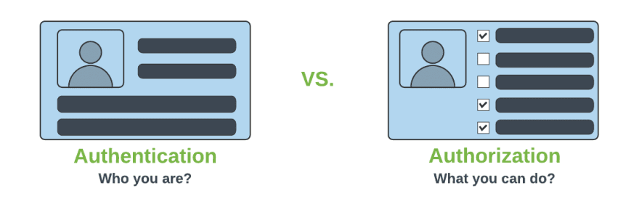
Authentication & Authorization

Slide 79
@EnableWebSecurity
Can be Added to the Class annotated with @Configuration or @SpringApplication
  Can Create a Class of of type WebSecurityConfigurerAdapter
  Spring finds bean with @Configuration and automatically apply Security

Slide 80
WebSecurityConfigurerAdapter
A base class for creating a WebSecurityConfigurer instance.
Can do customization by overriding methods
configure(HttpSecurity)
  Defines the mapping of secured URLs or path that will determine if the user can access specific pages.
configure(AuthenticationManagerBuilder).
  Defines how the security will handle the retrieval of user information commonly in the database.

Slide 81
configure(HttpSecurity)
HttpSecurity
  Provides a Method authoriseRequests()
authorizeRequests()
  To Define custom requirements for URLs
  Can add multiple children to this method.
  The matchers are considered in the order they were declared.
  http.authorizeRequests()
  .anyRequest().authenticated()
  .and().httpBasic();

Slide 82
configure(AuthenticationManagerBuilder).
AuthenticationManagerBuilder
  Used to create an Authentication Manager
Authentication Manager
  Used to authenticate the passed Authentication object,
  Allows building in memory authentication
  Can also use LDAP authentication
  Can also use JDBC based authentication,

Slide 83
Security Config
  @Configuration
  public class SecurityConfig extends WebSecurityConfigurerAdapter {
  @AutoWire
  BcryptaPasswordEncoder encoder;
  @Override
  protected void configure(HttpSecurity http) throws Exception {
  http.authorizeRequests().antMatchers("/first").authenticated().and().httpBasic();
  }
  @Override
  protected void configure(AuthenticationManagerBuilder auth) throws Exception {
  auth.inMemoryAuthentication().withUser("ramesh").password(encoder.encode("ramesh")).roles("USER");
  }

Slide 84
Controller
  @RestController
  public class ProjectController {
  @GetMapping("/first")
  public String getSecuredMessage(Principal user) {
  return "Welcome to Secured Page"+user.getName();
  }
  @GetMapping("/second")
  public String getUnSecuredMessage() {
  return "Welcome to UN-Secured Page";
  }
  }

Slide 85
CSRF
  Its a web security vulnerability that allows an attacker to induce users to perform actions that they do not intend to perform.
  It allows an attacker to partly circumvent the same origin policy, which is designed to prevent different websites from interfering with each other.
Should be used for protecting any request that could be processed by a browser by normal users.
If a service is used by non-browser clients, CSRF protection can be disabled

Slide 86
Sql Statements
  CREATE TABLE users( `username` varchar(50) NOT NULL, `password` varchar(200) NOT NULL, `enabled` tinyint(1) NOT NULL, PRIMARY KEY (`username`))
  CREATE TABLE authorities ( `username` varchar(50) NOT NULL, `authority` varchar(50) NOT NULL, KEY `fk_authorities_users` (`username`), CONSTRAINT `fk_authorities_users` FOREIGN KEY (`username`) REFERENCES `users` (`username`))

Slide 87
SQL Statements
  insert into users (username, password,enabled) values ('india','$2a$10$P.9MaemE6x38wnZer4qauO8Dl9pixQEZ27.yEQglTtyjdmJBRtTFS',true);
  insert into authorities (username, authority) values ('india', 'ROLE_USER');
  insert into test.users (username, password, enabled) values ('nepal','$2a10$t4kkrerTgJlcvTj7QresWuBqAsnxVxMxaJ6UzlXCaP/HSdDraO5QC',true);
  insert into authorities (username, authority) values ('nepal', 'ROLE_ADMIN');

Slide 88
Application.properties
  spring.datasource.url=jdbc:mysql://localhost:3306/test
  spring.datasource.username=root
  spring.datasource.password=srivatsan
  spring.datasource.driver-class-name=com.mysql.cj.jdbc.Driver

Slide 89
Pass Word Encoder
  public static void main(String[] args) {
  BCryptPasswordEncoder encoder = new BCryptPasswordEncoder();
  String encoded = encoder.encode("india");
  System.out.println(encoded);
  encoded = encoder.encode("nepal");
  System.out.println(encoded);
  }

Slide 90
Security Config
  @Configuration
  public class SecurityConfiguration extends WebSecurityConfigurerAdapter {
  @Autowired
  private DataSource dataSource;
  @Bean
  public BCryptPasswordEncoder encoder() {
  return new BCryptPasswordEncoder();
  }

Slide 91
Security Config
  @Override
  public void configure(AuthenticationManagerBuilder auth) throws Exception{
  auth.jdbcAuthentication()
  .dataSource(dataSource)
  .usersByUsernameQuery(
  "SELECT username, password, enabled from users where username = ?")
  .authoritiesByUsernameQuery(
  "SELECT u.username, a.authority " +
  "FROM authorities a, users u " +
  "WHERE u.username = ? " +
  "AND u.username = a.username"
  )
  .passwordEncoder(new BCryptPasswordEncoder());
  }

Slide 92
Using Rest Template-With Security
  @Bean
  public BasicAuthenticationInterceptor interceptor() {
  return new BasicAuthenticationInterceptor("india", "india");
  }
  @Bean
  public RestTemplate template() {
  RestTemplate template = new RestTemplate();
  template.getInterceptors().add(interceptor());
  return template;
  }

Slide 93
Using Rest Template-With Security
  @Bean
  public HttpHeaders headers() {
  HttpHeaders headers = new HttpHeaders();
  headers.setAccept(Arrays.asList(MediaType.APPLICATION_JSON));
  return headers;
  }
  @Bean
  public HttpEntity entity() {
  HttpEntity <String> entity = new HttpEntity<String>(headers());
  return entity;
  }

Slide 94
Using Rest Template-With Security
  public String useGetAll() {
  return this.template.exchange(url,HttpMethod.GET,entity,String.class).getBody();
  }

Slide 95
SPRING AOP

Slide 96
Aspect Oriented Programming
It’s a Programming technique that promotes separation of concerns within a software system
It is not a replacement for Object Oriented Programming.
AOP is another way of organizing Program Structure
An aspect of a program which affect (crosscut) other concerns.
Cross Cutting Concerns
  Transaction management
  Security
  Auditing
  Event handling

Slide 97
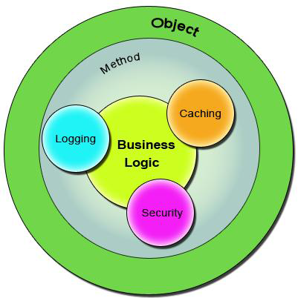
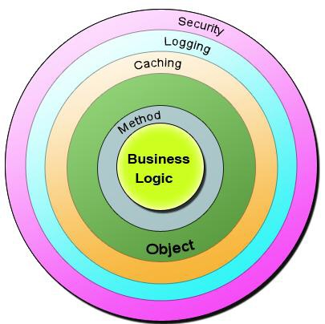
Bean in Spring container

Slide 98
Sample Code
  public class Account {
  public long deposit(long depositAmount){
  newAmount = existingAccount + depositAccount;
  currentAmount = newAmount;
  return currentAmount;
  }
  public long withdraw(long withdrawalAmount){
  if (withdrawalAmount <= currentAmount){
  currentAmount = currentAmount – withdrawalAmount;
  }
  return currentAmount;
  }
  }

Slide 99
The Challenge ?
Requirment -1
  Add security to the Account class - only users with BankAdmin privilege is allowed to do the operations.
Requirement-2
  Account class is to provide some kind of Logging
Requirement-3
Account class need to provide Transaction Management Facility.
New requirements forces the methods and the logic to change a lot which is against the Software Design.
The code has to undergo the Software Development Lifecycle of Development, Testing, Bug Fixing, Development, Testing,

Slide 100
The Solution !
public void deposit(){
// Transaction Management
// Logging
// Checking for the Privileged User
// Actual Deposit Logic comes here
}
public void withdraw(){
// Transaction Management
// Logging
// Checking for the Privileged User
// Actual Withdraw Logic comes here
}
The above logic that cross-cuts or overlaps the existing business logic as Concerns or Cross-Cutting Concerns.
These cross-cutting concerns from the application code can be modularized as different entities.

Slide 101
AOP Terminologies-Aspect
An Aspect is a functionality or a feature that cross-cuts over objects.
Logging and Transaction Management are the aspects.
public void businessOperation(BusinessData data)
{
// Logging logger.info("Business Method Called");
// Transaction Management Begin transaction.begin();
// Do the original business operation here transaction.end();
}

Slide 102
AOP Terminologies-Joint Point
Join Points defines the various Execution Points where an Aspect can be applied.
In Spring AOP, a join point always represents a method execution.
  public void someBusinessOperation(BusinessData data){
  //Method Start - > Possible aspect code here like logging.
  try{
  // Original Business Logic here.
  } catch(Exception exception) {
  // Exception -> Aspect code here when some exception is raised. }
  finally{
  // Finally -> Even possible to have aspect code at this point too.
  }
  // Method End -> Aspect code here in the end of a method.
  }

Slide 103
AOP Terminologies-JoinPoints
Points in the execution of the program
  Start of the Method,
  End of the Method,
  Exception Block,
  Finally Block
In these points an Aspect can be made to execute.
These Execution Points embedding Aspects are called Join Points.
An Aspect need not be applied to all the possible Join Points.

Slide 104
AOP Terminologies-Pointcut
Join Points refer to the Logical Points wherein a particular Aspect or a Set of Aspects can be applied.
A Pointcut or a Pointcut Definition will exactly tell on which Join Points the Aspects will be applied.
pointcut method_start_end_pointcut(){
// This point cut applies the aspects, logging and transaction, before the beginning and the end of the method.
}
pointcut catch_and_finally_pointcut(){
// This point cut applies the aspects, logging and transaction, in the catch block (whenever an exception raises) and the finally block.
}

Slide 105
Advice
Advice is the code that implements the Aspect.
Aspect defines the functionality in a more abstract manner.
Advice provides a Concrete code Implementation for the Aspect.
Creating Advices in Spring
Spring provides support only for Method Aspect and not for Field Aspect

Slide 106
Advices
  Before advice :@Before
  Executes before a join point,
  Does not have the ability to prevent execution flow proceeding to the join point (unless it throws an exception).
After returning advice : @AfterReturning
  Executed after a join point completes normally:
After throwing advice : @AfterThrowing
  Executed if a method exits by throwing an exception.
  After advice :@After
  Executed when normal or exceptional return by which a join point exits
  Around advice : @Around
  Advice that surrounds a join point

Slide 107

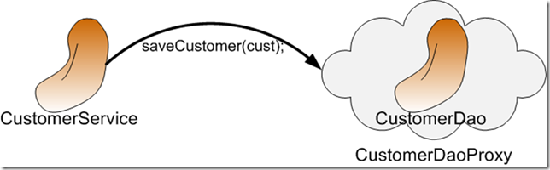
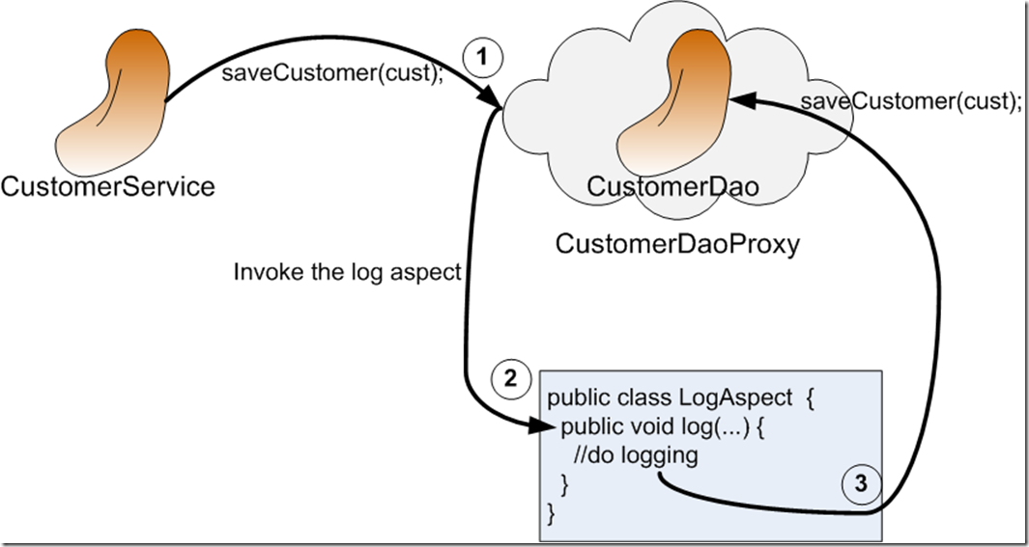
AOP Proxy Mechanism

Slide 108
Using Auto Proxy
Can create proxies automatically for selected bean definitions.
Built on Spring "bean post processor" infrastructure,
Need for ProxyFactoryBean is eliminated
  @Configuration
  @EnableAspectJAutoProxy
  public class AppConfig { }

Slide 109
Format of an execution expression
execution(
  modifiers-pattern
  returning-type-pattern
  declaring-type-pattern
  name-pattern(param-pattern)
  throws-pattern
)
execution(public * *(..)) or within(com.xyz.service.*)
execution – for matching method execution join points

Slide 110
Declaring a pointcut
execution(public * *(..))
the execution of any public method:
execution(* set*(..)) -
the execution of any methods beginning with "set":
execution(* com.xyz.service.AccountService.*(..))
the execution of any method defined by the named interface:
execution(* com.xyz.service.*.*(..))
the execution of any method defined in the service package:

Slide 111
Currency Converter
  public class CurrencyConverter implements MyInterface {
  public double dollorToRupess(double dlrAmt) {
  return dlrAmt * 49.0d;
  }
  public double dollorToEuro(String dlrAmt)
  {
  double val =Double.parseDouble(dlrAmt);
  return val * 70.00d;
  }

Slide 112
@Around Advice
@Aspect
public class MyAroundAdvice {
@Around("execution(* com.training.CurrencyConverter.*(..))")
public Object aroundLog(ProceedingJoinPoint pjp) throws Throwable {
System.out.println("Called Before Method Invocation");
Object ret =pjp.proceed();
System.out.println("I am Around ");
return ret;
}
}

Slide 113
After returning advice
  @Aspect
  public class BankAspect {
  @AfterReturning( pointcut="execution(* get*(..))",
  returning="retVal")
  public void logAfter(JoinPoint joinPoint, Object retVal) {
  //to do something
  }
  }

Slide 114
Before advice
  @Aspect
  public class BankAspect {
  @Pointcut("execution(public * * (..))")
  public void anyPublicMethod() {}
  @Before("anyPublicMethod()")
  public void logBefore(JoinPoint joinPoint) {
  //to do something
  }
  }

Slide 115
After throwing advice
  @Aspect
  public class BankAspect {
  @AfterThrowing(
  pointcut = "execution(* bank..*ServiceImpl.add*(..))",
  throwing = "exception")
  public void afterThrowing(Exception exception) {
  //to do something
  }
  }

