Slide 1
DevOps

Slide 2
Devops
'DevOps' is a combination of two words 'development' and 'operations.‘
A set of practices designed to overcome the gap between development, QA and Operations
  Done by effective communication and collaboration, incorporating continuous integration process with automated deployment.
It helps to increase an organization’s speed to deliver applications and services.

Slide 3
Need for DevOps
The development and operation team worked in complete isolation.
Testing and Deployment were isolated activities done after design-build.
  Hence they consumed more time than actual build cycles.
  Manual code deployment leads to human errors in production
  Coding & operation teams have their separate timelines and are not in synch causing further delays.

Slide 4
Life Cycle
Development
  Software Development takes place constantly.
  The entire development process is separated into small development cycles.
  Helps to speed up software development and delivery process.
Testing
  QA team use tools like Selenium to identify and fix bugs in the new piece of code.

Slide 5
Life Cycle
Integration
  New functionality is integrated with the prevailing code,
  Testing takes place.
  Continuous development with integration and testing.
Deployment
  Deployment process takes place continuously.
  It is performed in such a manner that any changes made any time in the code, should not affect the functioning of high traffic application.
Monitoring
  Operation team will take care of the inappropriate system behavior or bugs which are found in production.

Slide 6
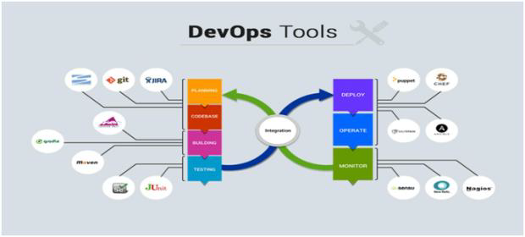
Life Cycle

Slide 7
Popular Tool for DevOps Automation
Git
  Version Control System tool
Jenkins
  Continuous Integration tool
Selenium
  Continuous Testing tool
Puppet, Chef, Ansible
  Configuration Management and Deployment tools
Nagios
  Continuous Monitoring tool
Docker
  Containerization tool

Slide 8
Working of Tools
Developers develop the code and this source code is managed by Version Control System tools like Git etc.
Developers send this code to the Git repository and any changes made in the code is committed to this Repository.
Jenkins pulls this code from the repository using the Git plugin and builds it using tools like Ant or Maven.

Slide 9
Working of Tools
Configuration management tools like puppet deploys & provisions testing environment and then Jenkins releases this code on the test environment on which testing is done using tools like selenium.
Once the code is tested, Jenkins send it for deployment on the production server (even production server is provisioned & maintained by tools like puppet).
After deployment It is continuously monitored by tools like Nagios.
Docker containers provides testing environment to test the build features

Slide 10
DevOps Principles
Customer-Centric Action
  DevOps team must take customer-centric action
  Invest in products and services.
End-To-End Responsibility
  DevOps team need to provide performance support until they become end-of-life.
  This enhances the level of responsibility and the quality of the products engineered.
Continuous Improvement
  DevOps culture focuses on continuous improvement to minimize waste.
  It continuously speeds up the improvement of product or services offered.

Slide 11
DevOps Principles
Automate everything
  Automation is a vital principle of DevOps process.
  Both software development and infrastructure
Work as one team
  In the DevOps culture role of the designer, developer, and tester are already defined.
  All they needed to do is work as one team with complete collaboration.
Monitor and test everything
  It is very important for DevOps team to have a robust monitoring and testing procedures.

Slide 12
GIT
Configuration Management

Slide 13
Topics
Basics of Software Configuration Management
Basics of Version Control System
  Centralized version control system
  Distributed/Decentralized version control system
How to install, configure and create repository
Working copy and check out
Review, Commit & Update
How to merge code and avoid conflict

Slide 14
Software Configuration Management
Multiple people have to work on software that is changing
More than one version of the software has to be supported:
    Released systems
    Custom configured systems (different functionality)
    System(s) under development
    Software on different machines & operating systems
Need for coordination
Software Configuration Management
  manages evolving software systems
  controls the costs involved in making changes to a system.

Slide 15
All Software Has Multiple Versions
Different releases of a product
Variations for different platforms
    Hardware and software
Versions within a development cycle
    Test release with debugging code
    Alpha, beta of final release
Every time when the program is edited

Slide 16
Version Control
Version control tracks multiple versions
In particular, allows
  old versions to be recovered
  multiple versions to exist simultaneously
  can recreate project history
Can revert a file or project to a previous version, track modifications and modifying individuals, and compare changes.

Slide 17
Centralized Version Control
A single server storing all changes and file versions
Can be accessed by various clients.
Knowledge of team members activities with certain files
Administrators can control privileges.

Slide 18
GIT
Git is a Distributed Version Control System that stores data in a file system made up of snapshots.
Creates a snapshot of the file and stores a reference to it.
When changes are saved its called commit
If the file has not changed, stores a reference to the already-stored identical version of it.

Slide 19
History of Git
Git traces its roots to the open source software project Linux kernel.
Linus Torvalds, the chief architect of the Linux kernel, began creating Git.
Since its inception in 2005, Git has become one of the most utilized Version Control Systems in the world.

Slide 20
Local Operations
Git mostly relies on local operations because most necessary information can be found in local resources.
Projects history resides on the local disk, eliminating the need to fetch history information from the server
Can continue work on a project even when not online or on a VPN.

Slide 21
GIT-Features
Tracking Changes
  Every single change applied to any file or directory is tracked by Git.
States
  Files in Git can reside in three main states: committed, modified and staged.
  Committed
    Data is securely stored in a local database
  Modified
    File has been changed but not committed to the database
  Staged
    Flagged a file changed version to be committed in the next snapshot

Slide 22
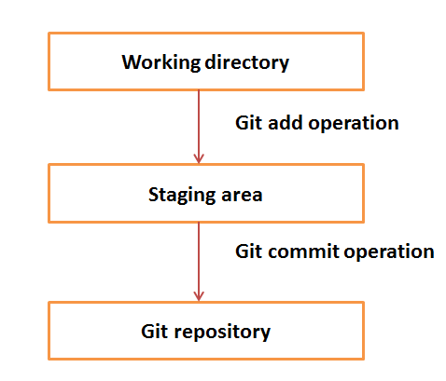
Working Directory and Staging Area

Slide 23
Download GIT
Git can be installed by downloading
Git Website
http://git-scm.com/download/win
GitHub
Install Git as part of the GitHub for Windows install.
http://windows.github.com

Slide 24
Eclipse GIT
Git commands like staging, commit, merge, rebase, pull and push, can be performed from IDE’s
IDE distributions from Eclipse already contain support for Git.
  No additional installation is required.
Identity Setting
Can set the user name and email address, to be used for every Git commit.
  Select the Window->Preferences->Version Control> Git-> Configuration -> user Settings .
    Add the user.name as key and give the value
    Add user.email key and give the value

Slide 25
Setting up a Git Repository
Can Create a new local Git repository via the Eclipse IDE.
  By Convention Git repositories should be outside the Eclipse workspace.
    It helps in separating Git repository from any additional meta-data which Eclipse might create. By default,
Open the Git Repositories view
  Window-> Show View-> Other->Git-> Git Repositories
Using the toolbar, select the Create a new Git repository
  By convention, this directory is a subdirectory in the git folder of the users home directory.

Slide 26
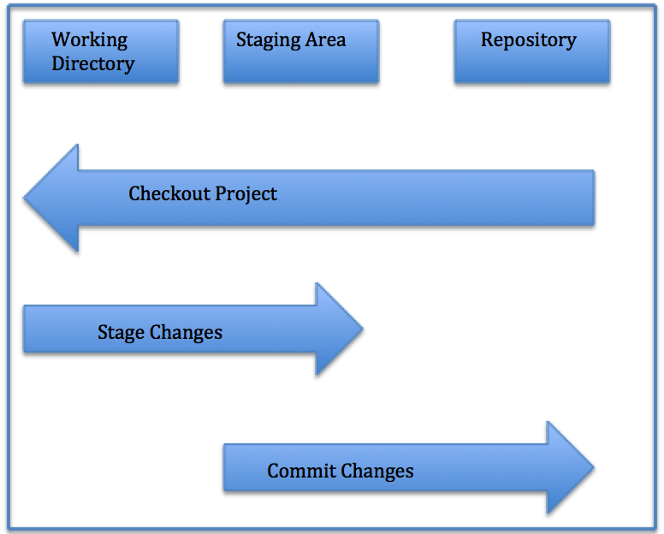
Local Repository Structure
The local Git repository has three components:
Working Directory: The actual files reside here.
Index: The area used for staging
Head: Points to the most recent commit

Slide 27
Add Projects to Git
Projects can be put to Git
  Right-click on project->Team->Share Project-> Git
  Select existing Git repository from the drop-down list and press the Finish button.
  Project is now moved to your Git repository.

Slide 28

Continuous Integration

Slide 29
Topics
Continuous Integration.
Jenkins - an Introduction.
Installing and Configuring Jenkins.
Creating a job with Jenkins.

Slide 30
Continuous Integration
A development practice
  developers are required to commit changes to source code in a shared repository several times a day.
  Every commit is then built ,this allows the teams to detect problems early.
Has following benefits to software development:
  Catch issues fast and nip them in the bud.
  Everyone can see what’s happening.
  Automate the build.
  Leads to Continuous Deployment to deliver software more rapidly.

Slide 31
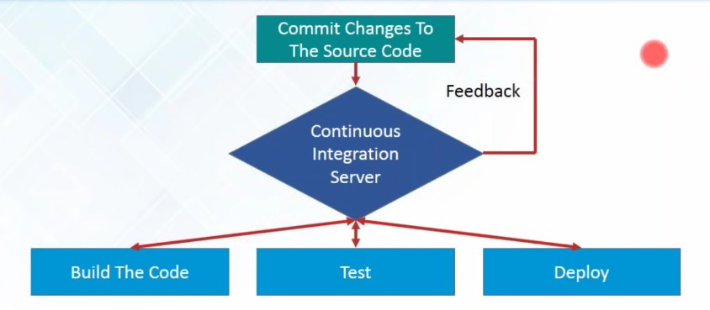
What is Continuous Integration...

Slide 32
What is Continuous Integration
In a large project with many developers, commits are made many times during a day. With each commit code is built and tested.
  If the test is passed, build is tested for deployment.
  If deployment is a success, the code is pushed to production.
  This commit, build, test, and deploy is a continuous process and hence the name continuous integration/deployment.

Slide 33
Continuous Integration tools
Used to host, monitor, compile and test code, or code changes,
Continuous Integration Server
  Jenkins, Bamboo, CruiseControl, TeamCity, and others
Source Control Tool
  CVS, SVN, GIT, Mercurial, Perforce, ClearCase and others
Build tool
  Make, ANT, Maven, Ivy, Gradle, and others
Automation testing framework
  Selenium,, TestComplete, UFT, and others

Slide 34
Jenkins
Leading open source continuous integration tool.
  Builds and tests software continuously
  Monitors the execution and status of remote jobs
  Easier for team members and users to regularly obtain the latest stable code.
Continuous Integration is done by the help of Plugins.
  It provides support for over 1000 Plugins .

Slide 35
Advantages of using Jenkins
  Jenkins is being managed by the community which is very open.
  Created by a developer for developers.
  As technology grows, so does Jenkins.
  Has many plugins published in its plugins database.
  With plugins, Jenkins becomes even more powerful and feature rich.
  Jenkins also supports cloud-based architecture

Slide 36
Installing Jenkins
java -jar jenkins.war --httpPort=9090
Jenkins runs on Java, need latest version of Java Development Kit
  Java –jar Jenkins.war
  Java –jar Jenkins.war –httpPort=9090
Can be downloaded from https://jenkins.io/download/
  Should select the required platform.
  Unzip the downloaded package.
After completing the Jenkins installation process, a browser tab will pop-up asking for the initial Administrator password.
To access Jenkins, : http://localhost:8080

Slide 37
Installing Jenkins
The initial Administrator password should be found under the Jenkins installation path
initialAdminPassword
  A file with the above can be found under C:\Program Files (x86)\Jenkins\secrets.
Customize Jenkins
  Can customize with "Install suggested plugins button"
  Jenkins will retrieve and install the essential plugins
After suggested plugins were installed
Use "Create First Admin User" panel to create users

Slide 38
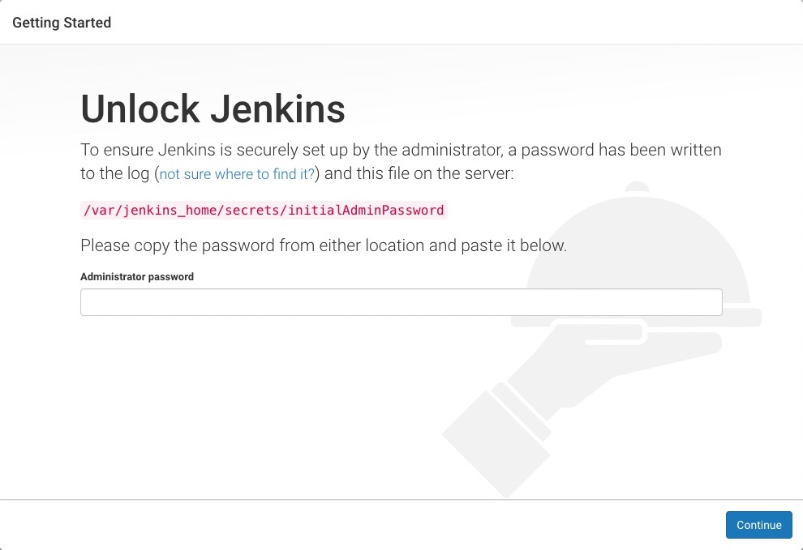
Unlocking Jenkins
Need to unlock Jenkins instance on first access
  Should Enter an automatically-generated password.

Slide 39
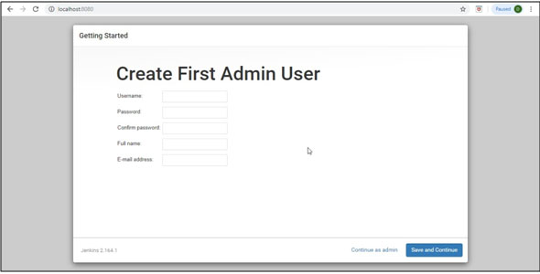
Creating Admin User

Slide 40
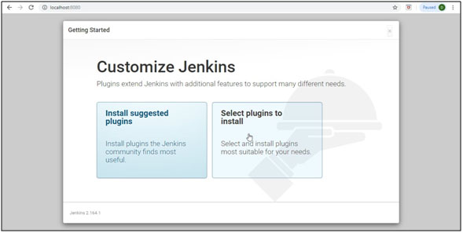
Customize Jenkins

Slide 41
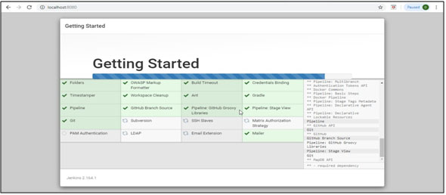
Customize Jenkins

Slide 42
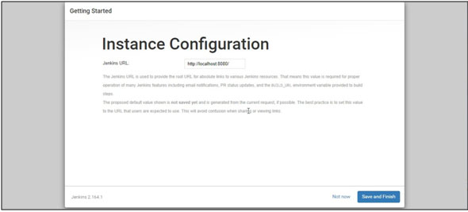
Instance Configurtion

Slide 43
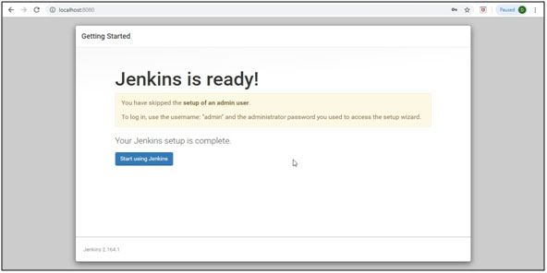
Jenkins Ready

Slide 44
Jenkins Dash Board
Jenkins dashboard is primary control point for interacting with Jenkins.
It includes controls for creating and running builds, inspecting build output, working with credentials and configuring Jenkins.
Can create Jenkins jobs from the Dash Board

Slide 45
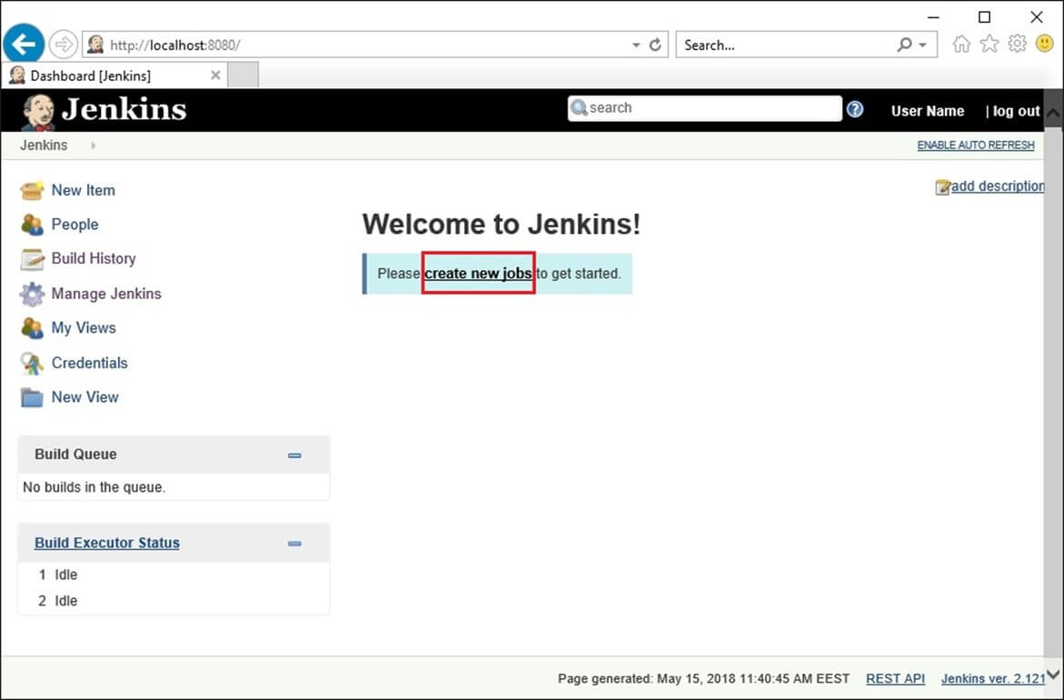
New Job

Slide 46
Simple Project
Begin by clicking the “New Item” link in the Jenkins dashboard.
Enter a name for the new project and select “Freestyle project”
Opens project configuration page
  Can define various aspects of the build.
Select the “Build” section.
Choose “Add build step” button and add a step to “Execute window based command”.
In the “Command” box, enter a command that displays output and Save”
  echo “Hello world”
From the project page click the “Build now” link.

Slide 47
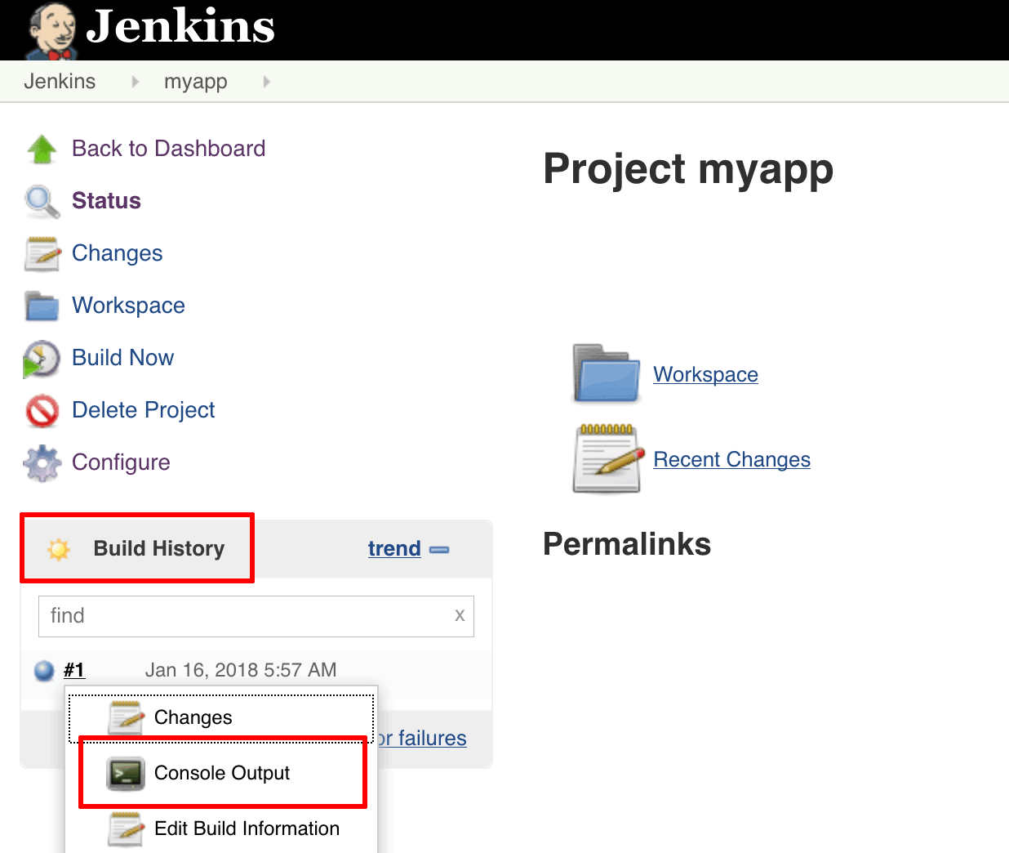
Building with Jenkins
Jenkins will build the project.
The “Build History” panel in the bottom left corner of the page will show you the status of the build
Blue indicates success, red indicates failure

Slide 48
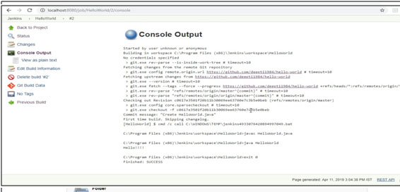

Slide 49
Jenkins Build Jobs
Freestyle job:
  General-purpose build jobs with maximum flexibility and multiple configuration options.
  Can be used for any project type.
  Easy to Set up
Maven Project:
  Specially designed for Maven projects.
  Can use the POM files and project structures
  Gathers information from the POM file to minimize the setup work for your project.

Slide 50
Jenkins Plugins
The default version of Jenkins comes with a limited set of features.
To integrate with version control tools like Git, need to install plugins.
Also Need to add tools and plugins for Maven, Docker etc
Jenkins May install these suggested plugins at the beginning itself.
  Can also add it later

Slide 51
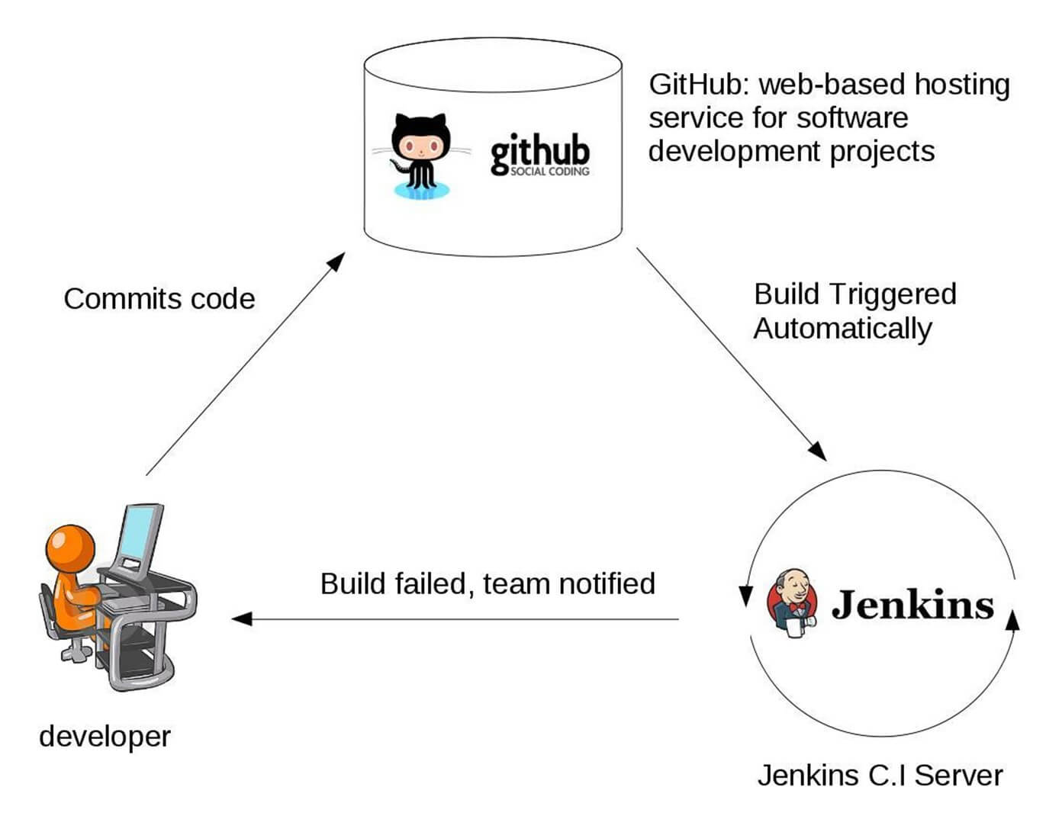
Working of Jenkins

Slide 52
Setting up Jenkins and Maven
Download Maven from Apache Maven.
Extract the files to the relevant application folder.
Navigate to the Jenkins dashboard
Select Manage Jenkins
Select ‘Configure System’
In the Configure system screen, scroll down to Maven section
  Select ‘Add Maven’ button.
Uncheck the ‘Install automatically’ option.
Add name for the setting and the location of the M2_HOME.
Click on the ‘Save’ button at the end of the screen.

Slide 53
Build A Maven Project from GitHub
Can Build project stored in an external SCM, such as GitHub.
From the dashboard. Select the project
Choose the “Configure” button for the project.
In the project configuration page,
  Choose “Source Code Management” section,
  Choose “Git” as the option
  Enter the clone URL for your GitHub repository.

Slide 54
Build A Project From GitHub
From the project configuration page select “Build” section
  Add a new build step to “Invoke top-level Maven targets”.
  In the “Maven Version” field, select the name of the Maven installation just created.
  In the “Goals” field, specify the Maven goals as “clean package”.
Head back to the project page and click the “Build now” link.
Jenkins should clone GitHub repository and build it with Maven.
Once the build is complete, select the “Console Output” menu item to access detailed build information.

Slide 55
Jenkins Build
Status of the build is indicated in two ways, by a weather icon and by a colored ball.
  The weather icon shows you a record of multiple builds in one image.
  The sun represents that builds were successful.
  The color of the ball gives us the status of that build,
  Red shows failure.

Slide 56
BUILD TRIGGER

Slide 57
Build Trigger
Trigger
  Execute a job on an event occurrence.
  This event is called a trigger.
  Has list of build triggers

Slide 58
List of Build Triggers
Trigger build remotely:
  The job is usually triggered by accessing a specified URL. This is convenient for scripts. With the URL, one needs to mention the authorization token as well.
Build after other projects are built:
  As it reads, we need to mention the list of other projects, once those projects are built then the present job is executed.
Build periodically:
  The build is triggered based on the mentioned time. A cron has to be mentioned here.
Poll SCM:
  Configure Jenkins to poll the SCM for ant pushes or commits and then trigger the jobs.

Slide 59
Polling the SCM
Click on the “Configure” of the job created in the Jenkins dashboard.
Click on build triggers in the configure settings and select the Poll SCM.
Enter the desired cron to poll the SCM. Here we have given * * * * which means the Jenkins polls the SCM every minute.

Slide 60
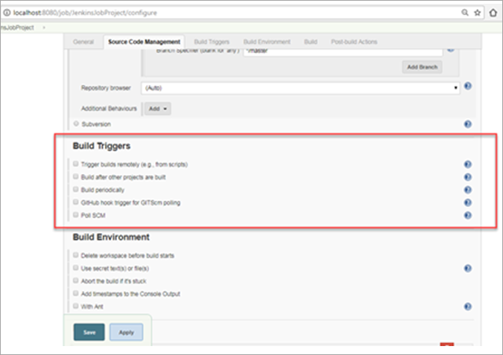
Build Triggers

Slide 61
CRON
CRON contains 5 places for each time entry
Minute (0-59)
  tells at what minute of the hour the Job should build.
Hour (0-23 With 0 is the midnight)
  tells at what hour the job should build in the 24-hour clock.
Day of the month (1-31)
  - tells on which day of the month your job should build. e.g. 23rd of each month.
Month (1-12)
  tells the month when your job should build. You can number or name the month as well I.e. April, May etc.
Day of the week (0-7 With 0 or 7 both being Sunday)
  tells the day of the week when you want to build your job. It can also be a number or name like Mon etc.

Slide 62
CRON
Every day at 6 in the evening
  0 18 * * *
After every 20 minutes
  *0/20 * * * *
After every 4 hours
  0 */4 * * *
This will run every Saturday (6) and Sunday (7) at 5 pm (17).
  0 17 * * 6,7
To schedule your build every 5 minutes, this will do the job :
  */5 * * * *
To the job every 5min past every hour(5th Minute of every Hour)
  5 * * * *

Slide 63
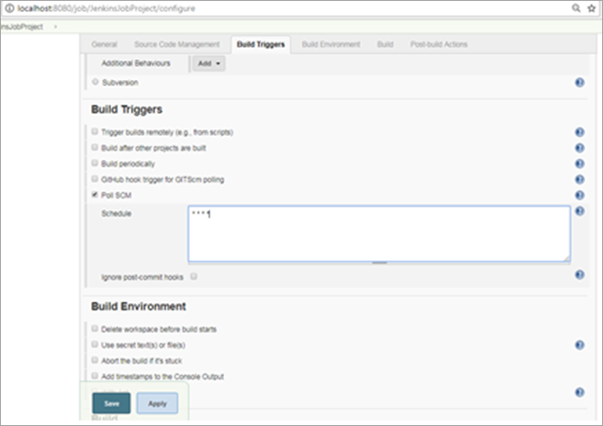
Adding CRON

Slide 64
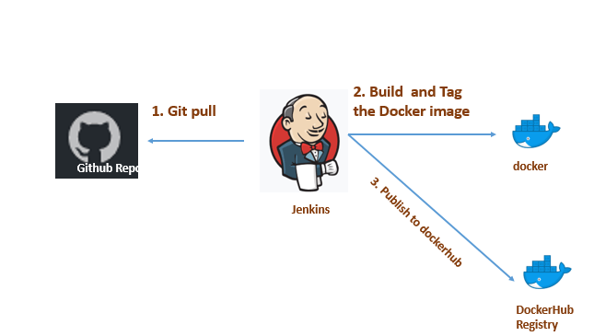
Jenkins –GIT Maven Docker Build

Slide 65
Docker Plugin
Configure Jenkins Server With Docker Plugin
Select Jenkins Dashboard –> Manage Jenkins –> Manage Plugins.
From the Available tab, search for “Docker”
Add the following pluggins
  Cloud bees docker
  Docker-pipeline
  Docker-pluggin
  Docker-buildstep

Slide 66
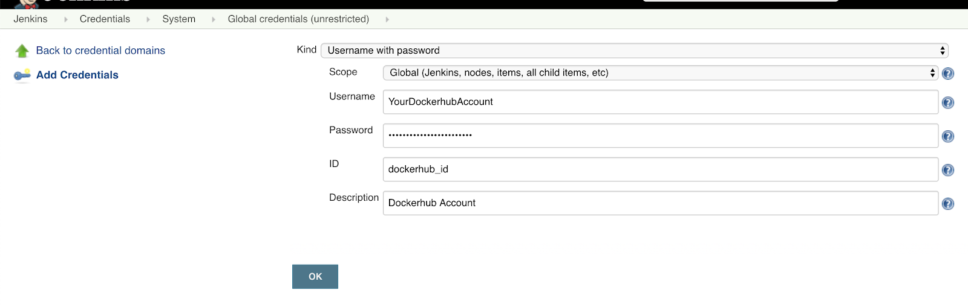
Docker Credentials
Need to create a new credential Docker Hub account details.
Select Credentials → Global → Add credentials
  Fill out the form with your username and password.

Slide 67
Docker
Create a Project with Dockerfile
Commit to the github repository
Select freestyle/maven Build project
Check build publish option in build section
Click on configure add build set/docker build
Set Repository name username/jarname
Registry credentials
Select the build goal as docker build and publish
Add the repo name vatsank/example
Add the repo credentials
Save
Build the project

Slide 68
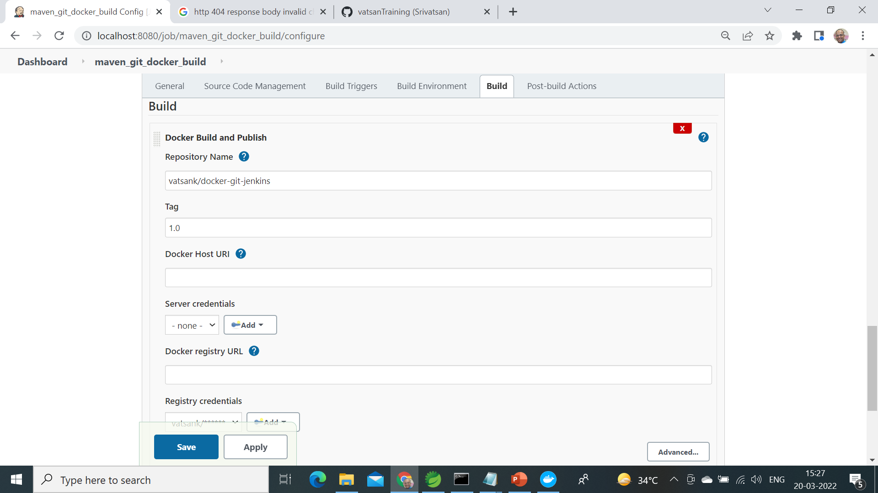

Slide 69
JENKINS PIPELINE

Slide 70
Jenkins Pipeline
Pipeline is a series of interlinked events or jobs.
Its a combination of plugins that support the integration and implementation of continuous delivery pipelines
It contains a group of states called build, deploy, test and release.
  Every state has its events, which work in a sequence called a continuous delivery pipeline.
Every job or event has some sort of dependency on at least one or more events.
  These events are interlinked with each other.

Slide 71
Why Use Jenkins Pipeline
Pipelines are robust.
  Can run multiple jobs, and even use pipelines in a loop.
  If server undergoes an unforeseen restart, the pipeline will be automatically resumed.
  Can pause the pipeline process and make it wait to resume until there is an input from the user.
  The scripted pipeline is stored in Jenkins webUI as a Jenkins file.
  The end-to-end scripted pipeline script is written in Groovy.

Slide 72
Creating a Pipe Line
From the Jenkins home select “New Item”
Give a name, select “Pipeline” and click ok.
Scroll down to the Pipeline section, enter the pipeline code in the script section and save it.
Click “Build Now” and wait for the build to start.
While the job starts Can view each stage executing

Slide 73
Simple Pipe Line
  pipeline {
  agent any
  stages {
  stage('build') {
  steps {
  echo 'build phase called'
  }
  }
  stage('test') {
  steps {
  echo 'test phase called'
  }
  }

Slide 74
Simple Pipe Line
  stage('deploy') {
  steps {
  echo 'deploy phase called'
  }
  }
  }
  }

Slide 75
Pipe Line Block
Pipeline code should be wrapped inside the pipeline block.
  pipeline {
  ---<All Pipeline blocks go here>---
  }
Tools Block
  Can refer to the tools configured in the Jenkins Global tool configuration.
  tools {
  maven 'maven3'
  }

Slide 76
Pipe Line Block
Stages:
  Stages block contains multiple stages.
  stages {
  ---<All Pipeline Stages Go Here>---
  }
Stage Block:
  A stage is a subset of stages.
  Each stage has a steps block.
Steps Block:
  In each steps block can define a set of operations to perform.

Slide 77
SCM Pipe Line
  pipeline {
  agent any
  tools {
  maven "M2_HOME"
  }
  stages {
  stage('Build') {
  steps {
  git 'https://github.com/vatsanTraining/docker-git-jenkins.git'
  dir('docker-git-jenkins'){
  bat "mvn package"
  }
  }

Slide 78
SCM Pipe Line
  post {
  success {
  archiveArtifacts 'docker-git-jenkins/target/*.jar'
  }
  }
  }
  }
  }

