Slide 1
SPRING SECURITY

Slide 2
Spring Security
Highly customizable authentication and access-control framework.
Focuses on providing both authentication and authorization
“Authentication”
  The process of establishing a user, device or some other system which can perform an action in the application
“Authorization”
  The process of deciding whether a principal is allowed to perform an action within the application.
  authorization is done after authentication process.
  Once the user is authenticated they may have one or more “roles”

Slide 3
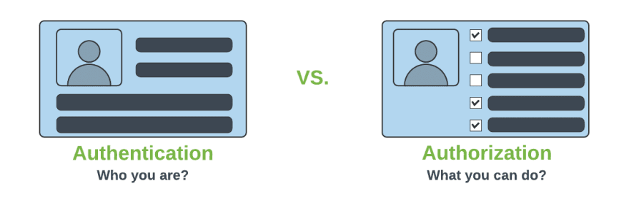
Authentication & Authorization

Slide 4
@EnableWebSecurity
Can be Added to the Class annotated with @Configuration or @SpringApplication
  Can Create a Class of of type WebSecurityConfigurerAdapter
  Spring finds bean with @Configuration and automatically apply Security

Slide 5
Spring Security Modules
  <dependency>
    <groupId>org.springframework.boot</groupId>
    <artifactId>spring-boot-starter-security</artifactId>
  </dependency>
  <dependency>
    <groupId>org.springframework.security</groupId>
    <artifactId>spring-security-test</artifactId>
    <scope>test</scope>
  </dependency>

Slide 6
Disabling the Auto-Configuration
Can discard the security auto-configuration and add custom Configuration
  @SpringBootApplication(exclude = { SecurityAutoConfiguration.class })
  public class SpringBootSecurityApplication {
  public static void main(String[] args) {
  SpringApplication.run(SpringBootSecurityApplication.class, args);
  }
  }

Slide 7
WebSecurityConfigurerAdapter
A base class for creating a WebSecurityConfigurer instance.
Can do customization by overriding methods
configure(HttpSecurity)
  Defines the mapping of secured URLs or path that will determine if the user can access specific pages.
configure(AuthenticationManagerBuilder).
  Defines how the security will handle the retrieval of user information commonly in the database.

Slide 8
configure(HttpSecurity)
HttpSecurity
  Provides a Method authoriseRequests()
authorizeRequests()
  To Define custom requirements for URLs
  Can add multiple children to this method.
  The matchers are considered in the order they were declared.
  http.authorizeRequests()
  .anyRequest().authenticated()
  .and().httpBasic();

Slide 9
configure(AuthenticationManagerBuilder).
AuthenticationManagerBuilder
  Used to create an Authentication Manager
Authentication Manager
  Used to authenticate the passed Authentication object,
  Allows building in memory authentication
  Can also use LDAP authentication
  Can also use JDBC based authentication,

Slide 10
Form Login
  @Configuration
  public class SecurityConfig extends WebSecurityConfigurerAdapter {
  @Override
  protected void configure(HttpSecurity http) throws Exception {
  http.authorizeRequests().antMatchers("/first").authenticated().and().formLogin();
  }
  @Override
  protected void configure(AuthenticationManagerBuilder auth) throws Exception {
  auth.inMemoryAuthentication().withUser("ramesh").password("{noop}ramesh").roles("USER");
  }

Slide 11
Controller
  @RestController
  public class ProjectController {
  @GetMapping("/first")
  public String getSecuredMessage(Principal user) {
  return "Welcome to Secured Page"+user.getName();
  }
  @GetMapping("/second")
  public String getUnSecuredMessage() {
  return "Welcome to UN-Secured Page";
  }
  }

Slide 12
CSRF
  Its a web security vulnerability that allows an attacker to induce users to perform actions that they do not intend to perform.
  It allows an attacker to partly circumvent the same origin policy, which is designed to prevent different websites from interfering with each other.
Should be used for protecting any request that could be processed by a browser by normal users.
If a service is used by non-browser clients, CSRF protection can be disabled

Slide 13
Sample Security Config
  http.authorizeRequests()
  .antMatchers("/","/*.html","/h2/**")
  .permitAll().
  antMatchers("/first")
  .authenticated().and()
  .httpBasic().and()
  .csrf().
  disable();

Slide 14
Sample Security Configurations
  http.authorizeRequests()
  .antMatchers("/","/*.html","/h2/**")
  .permitAll().
  antMatchers("/first")
  .authenticated().and()
  .formLogin().and().logout().logoutSuccessUrl("/first")
  .invalidateHttpSession(true)
  .deleteCookies("JSESSIONID").and().csrf().
  disable();

Slide 15
Method Level Security
Spring Security supports authorization semantics at the method level.
Service layer can be secured by which roles are able to execute a particular method – and test it using dedicated method-level security test support.

Slide 16
Method Level Security
  @Configuration
  @EnableGlobalMethodSecurity( securedEnabled = true)
  public class SecurityConfig extends WebSecurityConfigurerAdapter {
  protected void configure(HttpSecurity http) throws Exception {
  // required configurations
  }
  protected void configure(AuthenticationManagerBuilder auth) throws Exception {
  // required configurations
  }
  }

Slide 17
@Secured
Used to specify a list of roles on a method.
  User with only role can access that method
  @GetMapping(“/srch")
  @Secured("ROLE_ADMIN")
  public String message() {
  return "Hello, World!";
  }
  }

Slide 18
Example
  @RestController
  @RequestMapping("book")
  public class BookController {
  @GetMapping("anonymous")
  @Secured("ROLE_ANONYMOUS")
  public String anonymously() { return "Hello, World!"; }

Slide 19
Method Security
@RolesAllowed
  is a standard annotation
  @Secured
  is spring security only.
  @PermitAll
  public String anonymously() {
  return "Hello, World!"; }
  @RolesAllowed({"ROLE_ADMIN"})
  public String hasRole() {
  return "Hello, World!";
  }

Slide 20
Calling Secured Service
  @FeignClient(name = "myclient",url = "http://localhost:6060/api/v1/customers",
  configuration = ClientConfiguration.class)
  public interface MyFeignClient {
  @GetMapping(path = "/")
  public String getAll();
  }

Slide 21
Security Configuration
  public class ClientConfiguration {
  @Bean
  public BasicAuthRequestInterceptor interceptor() {
  return new BasicAuthRequestInterceptor("guest", "guest");
  }
  }

Slide 22
Rest Controller
  @RestController
  public class FeignController {
  @Autowired
  private MyFeignClient loadBalancer;
  @GetMapping(value = "/client")
  public String getCustomers() {
  return this.loadBalancer.getAll();
  }
  }

Slide 23
Main Application
  @SpringBootApplication
  @EnableFeignClients
  public class SecuredServiceFeignClientApplication {
  public static void main(String[] args) {
  SpringApplication.run(SecuredServiceFeignClientApplication.class, args);
  }
  }

Slide 24
Using Rest Template-With Security
  @Bean
  public RestTemplate template() {
  RestTemplate template = new RestTemplate();
  template.getInterceptors().add(interceptor());
  return template;
  }
  @Bean
  public BasicAuthenticationInterceptor interceptor() {
  return new BasicAuthenticationInterceptor("india", "india");
  }

Slide 25
Using Rest Template-With Security
  @Bean
  public HttpHeaders headers() {
  HttpHeaders headers = new HttpHeaders();
  headers.setAccept(Arrays.asList(MediaType.APPLICATION_JSON));
  return headers;
  }
  @Bean
  public HttpEntity entity() {
  HttpEntity <String> entity = new HttpEntity<String>(headers());
  return entity;
  }

Slide 26
Using Rest Template-With Security
  @Bean
  public MedicalServiceClient client() {
  return new MedicalServiceClient();
  }
  @Bean
  public Medicine medicine() {
  return new Medicine(899L,"Glycomet",45.00,35);
  }
  }

Slide 27
Using Rest Template-With Security
  public class MedicalServiceClient {
  @Autowired
  private RestTemplate template;
  @Autowired
  private HttpEntity entity;
  @Autowired
  private Medicine medicine;
  private final String url = "http://localhost:8080/medicines";

Slide 28
Using Rest Template-With Security
  public String useGetAll() {
  return this.template.exchange(url,HttpMethod.GET,entity,String.class).getBody();
  }
  public Medicine usePostMethod() {
  return this.template.postForEntity(url,medicine,Medicine.class).getBody();
  }

Slide 29
SECURITY USING JDBC

Slide 30
Sql Statements
  CREATE TABLE users( `username` varchar(50) NOT NULL, `password` varchar(200) NOT NULL, `enabled` tinyint(1) NOT NULL, PRIMARY KEY (`username`))
  CREATE TABLE authorities ( `username` varchar(50) NOT NULL, `authority` varchar(50) NOT NULL, KEY `fk_authorities_users` (`username`), CONSTRAINT `fk_authorities_users` FOREIGN KEY (`username`) REFERENCES `users` (`username`))

Slide 31
SQL Statements
  insert into users (username, password,enabled) values ('india','$2a$10$P.9MaemE6x38wnZer4qauO8Dl9pixQEZ27.yEQglTtyjdmJBRtTFS',true);
  insert into authorities (username, authority) values ('india', 'ROLE_USER');
  insert into test.users (username, password, enabled) values ('nepal','$2a10$t4kkrerTgJlcvTj7QresWuBqAsnxVxMxaJ6UzlXCaP/HSdDraO5QC',true);
  insert into authorities (username, authority) values ('nepal', 'ROLE_ADMIN');

Slide 32
Application.properties
  spring.datasource.url=jdbc:mysql://localhost:3306/test
  spring.datasource.username=root
  spring.datasource.password=srivatsan
  spring.datasource.driver-class-name=com.mysql.cj.jdbc.Driver

Slide 33
Pass Word Encoder
  public static void main(String[] args) {
  BCryptPasswordEncoder encoder = new BCryptPasswordEncoder();
  String encoded = encoder.encode("india");
  System.out.println(encoded);
  encoded = encoder.encode("nepal");
  System.out.println(encoded);
  }

Slide 34
Rest Controller
  @RestController
  public class ProjectController {
  @GetMapping("/first")
  public String getSecuredMessage(Principal user) {
  return "Welcome to Secured Page"+user.getName();
  }
  }
  }

Slide 35
Security Config
  @Configuration
  public class SecurityConfiguration extends WebSecurityConfigurerAdapter {
  @Autowired
  private DataSource dataSource;
  @Bean
  public BCryptPasswordEncoder encoder() {
  return new BCryptPasswordEncoder();
  }

Slide 36
Security Config
  @Override
  public void configure(AuthenticationManagerBuilder auth) throws Exception{
  auth.jdbcAuthentication()
  .dataSource(dataSource)
  .usersByUsernameQuery(
  "SELECT username, password, enabled from users where username = ?")
  .authoritiesByUsernameQuery(
  "SELECT u.username, a.authority " +
  "FROM authorities a, users u " +
  "WHERE u.username = ? " +
  "AND u.username = a.username"
  )
  .passwordEncoder(new BCryptPasswordEncoder());
  }

Slide 37
Security Configuration
  @Override
  protected void configure(HttpSecurity http) throws Exception {
  http.authorizeRequests()
  .antMatchers("/api/v1/hospital/**")
  .authenticated().and().httpBasic().and().csrf().disable();
  }

Slide 38
SECURITY OAUTH2

Slide 39
OAuth
OAuth is a secure authorization protocol
  Provides authorization flows for web ,desktop and mobile applications.
  Used for authorization of third party application to access the user data without exposing their password.

Slide 40
OAuth2 Roles
Client
  A Third-Party Application
  An application making protected resource requests on behalf of the Resource Owner and with its authorization
Resource Server
  Component that manages users resources.
  To allow a client to access the resources, the Resource Server requires a valid access token.
  Client uses the access token to call resources in this server by adding it in the HTTP request headers.

Slide 41
OAuth2 Roles
The Authorization Server
  The server that presents the interface where the user approves or denies the request.
  May be the same server as the API server, but often built as a separate component.
Resource Owner
  Is the User
  Is the Resource Owner
  Person who is giving access to some portion of their account.

Slide 42
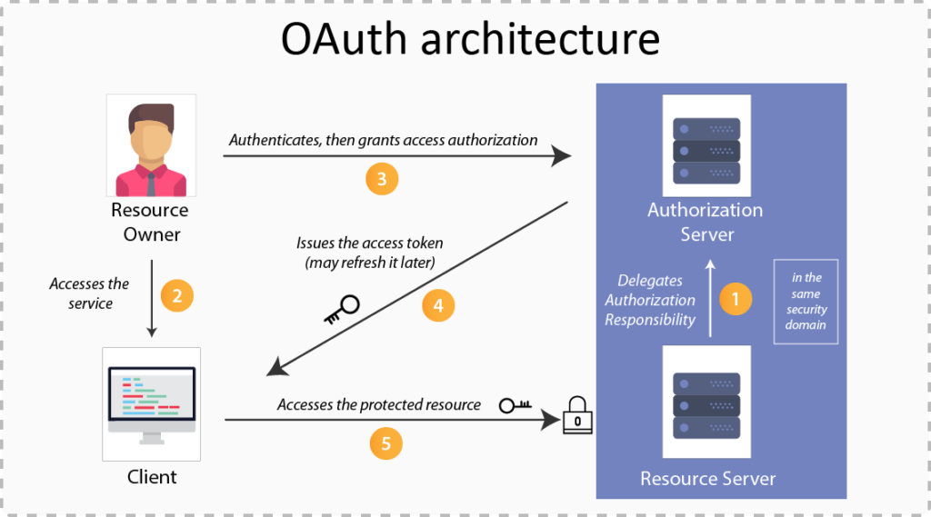

Slide 43
OAuth2 Grant Types
There are Different grant type flows defined and described to perform authorizations tasks.
  Authorization Code
  Client Credentials
  Device Code
  Refresh Token

Slide 44
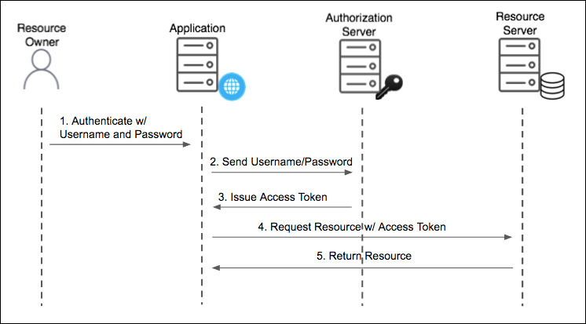
Resource Owner Password Grant Type
Used For Native Mobile and Desktop apps
  Used for highly trusted apps where resource owners share their credentials directly with the app.

Slide 45
Password Grant
Simplest OAuth grants
The application presents a traditional username and password login form to collect the user’s credentials
Uses that data and makes a POST request to the server and gets an access token.
The Post request has following parameters
  Grant-type
  userName
  Password
  Client Id
  Client Secret
  Scope

Slide 46
Password Grant Request Parameters
grant_type=password
  To denote the usage of Password grant type
Username
  The user’s username that they entered in the application
Password
  The user’s password that they entered in the application
client_id
  Public identifier of the application that the developer obtained during registration
client_secret (optional)
  If the application is a “confidential client” (not a mobile or JavaScript app), then the secret is included as well.
scope (optional)
  If the application is requesting a token with limited scope

Slide 47
OAuth2 Tokens
Tokens are implementation specific random strings, generated by the authorization server.
Access Token
  Sent with each request, usually valid for about an hour only.
Refresh Token
  It is used to get new access token, not sent with each request, usually lives longer than access token.
  Allows clients to continue to have a valid access token without further interaction with the user.

Slide 48
Access Token
Access token in the same format for all grant types.
  {
  "access_token": "MTQ0NjOkZmQ5OTM5NDE9ZTZjNGZmZjI3",
  "token_type": "bearer",
  "expires_in": 3600,
  "scope": "create"
  }

Slide 49
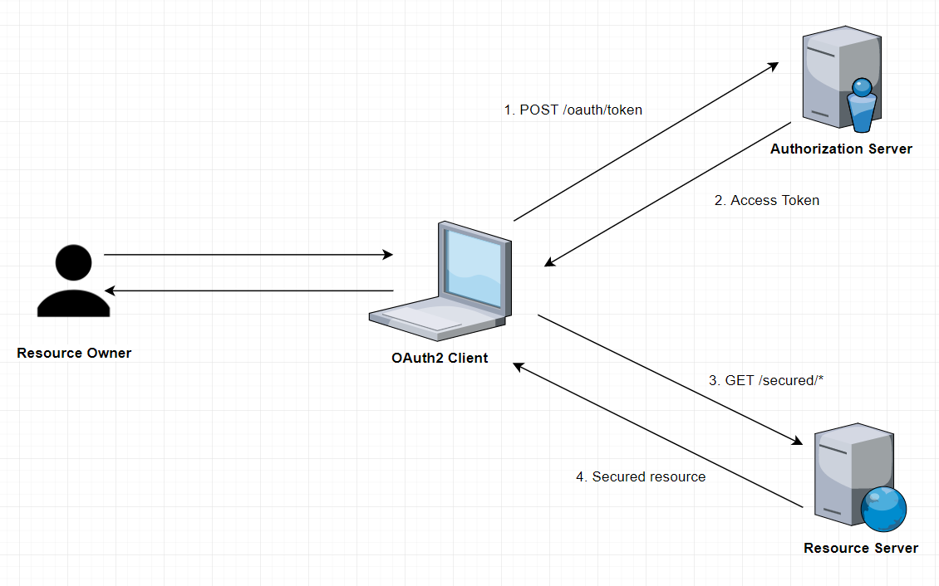
How it Works

Slide 50
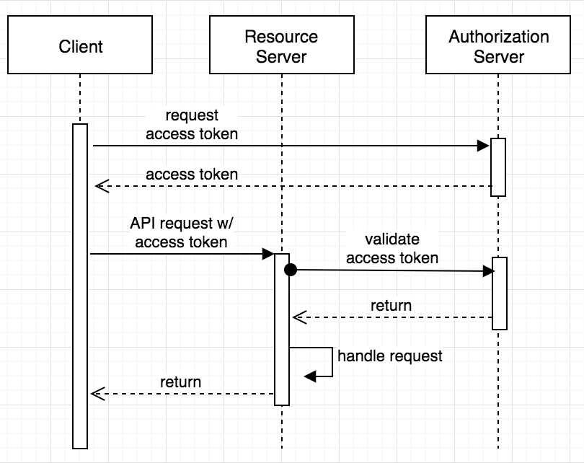
Sequence Diagram

Slide 51
Pom.xml
<dependency>
<groupId>org.springframework.boot</groupId>
<artifactId>spring-boot-starter-oauth2-resource-server</artifactId>
</dependency>
<dependency>
<groupId>org.springframework.boot</groupId>
<artifactId>spring-boot-starter-web</artifactId>
</dependency>
<dependency>
<groupId>org.springframework.cloud</groupId>
<artifactId>spring-cloud-starter-oauth2</artifactId>
</dependency>

Slide 52
Resource
    @RestController
    public class HospitalController {
    @GetMapping(path = "/hospital")
    public String getDetails() {
    return "Malar Hospitals";
    }
    }

Slide 53
@EnableResourceServer
Enables application to behave as a Resource Server by configuring an OAuth2AuthenticationProcessingFilter and required components.
The annotation creates a WebSecurityConfigurerAdapter with predefined configuration and order 3, it also takes care of the following
    Access rules
    Paths that are protected by OAuth2 security.
It enables a Spring Security filter that authenticates requests via an incoming OAuth2 token

Slide 54
Resource Server - Secured
  @SpringBootApplication
  @EnableResourceServer
  public class FlowerHospitalServicePasswordGrantApplication {
  public static void main(String[] args) {
  SpringApplication.run(FlowerHospitalServicePasswordGrantApplication.class, args);
  }
  }

Slide 55
Authentication
AuthenticationManager
  An interface with authenticate() method
Authenticate method does one of the following :
  Return an Authentication with authenticated=true if valid principal.
  Throw an AuthenticationException if there is a invalid principal.
  Return null if it cannot decide.
AuthenticationManagerBuilder
  A helpers to set up authentication
  Can be configured to work with in-memory, JDBC, or LDAP

Slide 56
Endpoints
/oauth/authorize
  The user is responsible for securing the Authorization Endpoint
  Spring Security features are used for this
/oauth/token
  The Token Endpoint will be automatically secured using HTTP Basic authentication on the client's credentials.

Slide 57
WebSecurityConfigurerAdapter
  @Configuration
  public class SecurityConfig extends WebSecurityConfigurerAdapter {
  @Autowired
  private PasswordEncoder encoder;
  @Override
  protected void configure(HttpSecurity http) throws Exception {
  http
  .authorizeRequests()
  .antMatchers("/login").permitAll()
  .antMatchers("/oauth/authorize")
  .authenticated();
  }

Slide 58
WebSecurityConfigurerAdapter
  @Override
  protected void configure(AuthenticationManagerBuilder auth) throws Exception {
  auth.inMemoryAuthentication()
  .withUser("india").password(encoder.encode("india"))
  .roles("USER");
  }
  @Bean
  @Override
  public AuthenticationManager authenticationManagerBean() throws Exception {
  return super.authenticationManagerBean();
  }

Slide 59
Authorization Server
@EnableAuthorizationServer
  Used for enabling an Authorization Server
AuthorizationServerConfigurerAdapter
  Adapter class for AuthorizationServerEndpointsConfigurer
  Configure the properties and enhanced functionality of the Authorization Server endpoints
  @Configuration
  @EnableAuthorizationServer
  public class AuthServerConfiguration extends
  AuthorizationServerConfigurerAdapter {
  }

Slide 60
Checking Tokens
Spring Security OAuth exposes two endpoints for checking tokens
  These are not exposed by default- they are "denyAll()".
/oauth/check_token
/oauth/token_key
To Verify the tokens with this endpoint they are exposed with condition.
  security.tokenKeyAccess("isAuthenticated()")
  .checkTokenAccess("isAuthenticated()"

Slide 61
ClientDetailsServiceConfigurer
.withClient(“client”)
  consumes client_id from request body
.authorizedGrantTypes(grant_types)
  Sets specific grant types
scopes(“read”)
secret(yourClientSecret)
  clients.inMemory().withClient("myclient")
  .authorizedGrantTypes("password")
  .secret(encoder().encode("pass123"))
  .scopes("read","write")
  .redirectUris("http://localhost:4046/flower/login/oauth2/code/myclient");

Slide 62
Redirect URI
The path in the application that the end-user's user-agent is redirected back to after they have authenticated
The default redirect URI template is
{baseUrl}/login/oauth2/code/{registrationId}.
  The registrationId is a unique identifier for the ClientRegistration.
autoApprove(true)
  To kill default radiobox approval page

Slide 63
Authorization Server
  @Configuration
  @EnableAuthorizationServer
  public class AuthServerConfiguration extends AuthorizationServerConfigurerAdapter {
  @Autowired
  private AuthenticationManager authenticationManager;
  @Override
  public void configure(AuthorizationServerSecurityConfigurer security) throws Exception {
  security.tokenKeyAccess("isAuthenticated()")
  .checkTokenAccess("isAuthenticated()") ;
  }

Slide 64
Authorization Server
  @Override
  public void configure(ClientDetailsServiceConfigurer clients) throws Exception {
  clients
  .inMemory()
  .withClient("myclient")
  .authorizedGrantTypes("password")
  .secret(encoder().encode("pass123"))
  .scopes("read","write")
  .redirectUris(
  "http://localhost:4046/flower/login/oauth2/code/myclient");
  }

Slide 65
Authorization Server
  @Override
  public void configure(AuthorizationServerEndpointsConfigurer endpoints) throws Exception {
  endpoints.authenticationManager(authenticationManager);
  }
  @Bean
  public BCryptPasswordEncoder encoder() {
  return new BCryptPasswordEncoder();
  }
    }

Slide 66
Testing with Postman
Make a post call to the url http://localhost:4040/oauth/token
Select Authorization , and basic authentication
  Add the UserName : myclient
  Add the password : pass123
Select Body form-url-endcoded and key and values ,
  grant_type : password
  Username : india
  Password : india
Will get the Token

Slide 67
Testing with Postman
  Access resource using uri
    Select params tab and add access_token as a parameter
  http://localhost:4040/api/customers/customer/1?access_token=37ec591b-bae9-46ac-8e5a-573e82cb0630

Slide 68
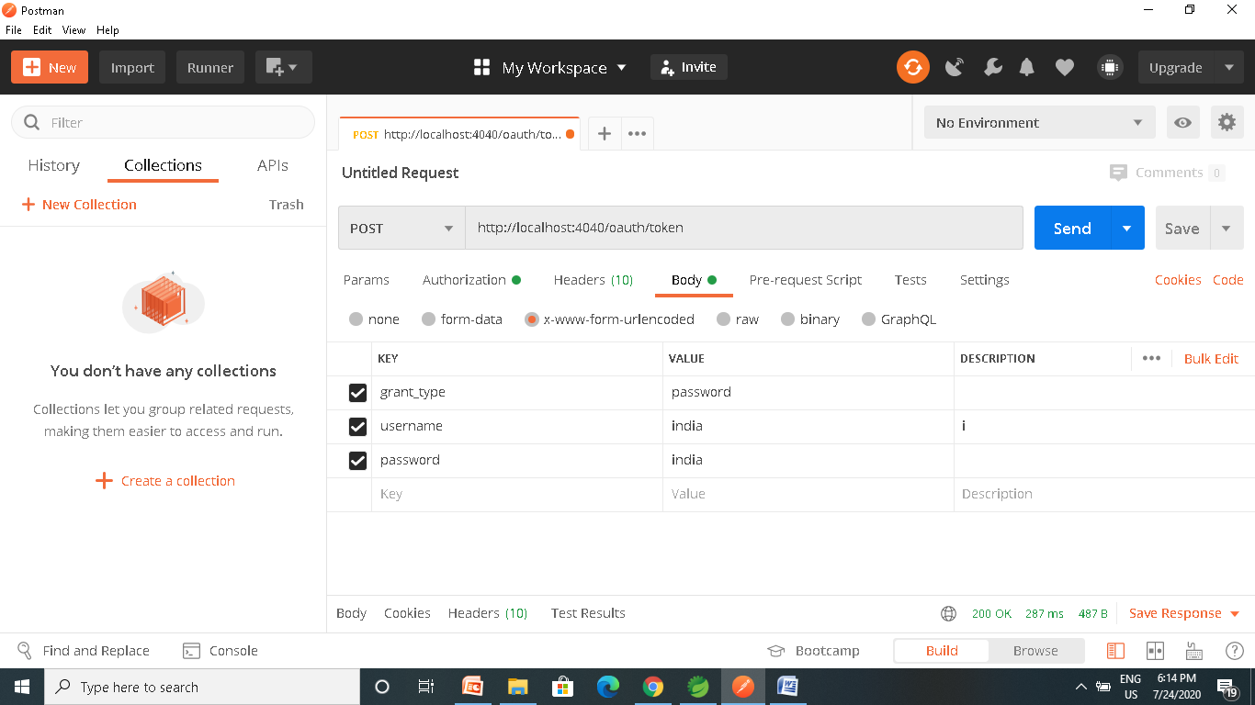
Testing with Postman

Slide 69
Testing with Postman

Slide 70
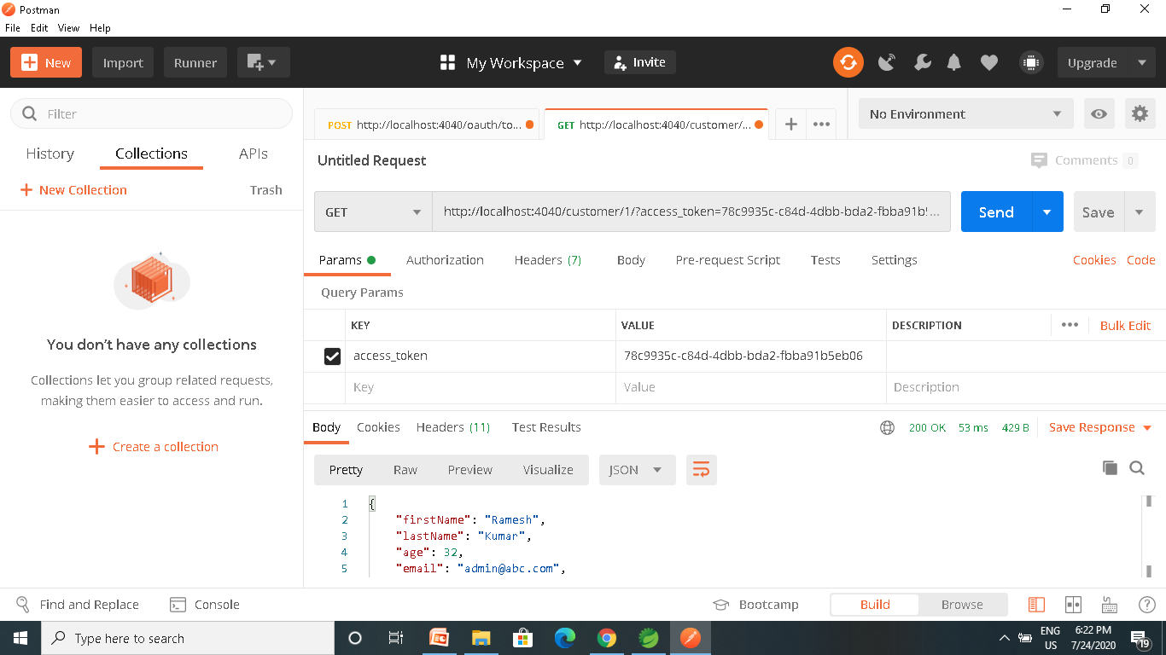

Slide 71
OAuth2RestTemplate
  @Bean
  public OAuth2RestTemplate template() {
  ResourceOwnerPasswordResourceDetails details = new ResourceOwnerPasswordResourceDetails();
  details.setAccessTokenUri("http://localhost:4040/oauth/token");
  details.setClientId("ourclient");
  details.setClientSecret("pass345");
  details.setUsername("india");
  details.setPassword("india");
  details.setGrantType("password");
  OAuth2RestTemplate template = new OAuth2RestTemplate(details);
  return template;
  }

Slide 72
OAuth2Template
  OAuth2RestTemplate template = ctx.getBean(OAuth2RestTemplate.class);
  String resp =
  template.getForObject("http://localhost:4040/api/v1/hospitals/2", String.class);
  System.out.println(resp)

Slide 73
Password Grant Type
Requires that the application collect the user’s password.
  OAuth was created to avoid .
Can be Used for service’s own application to ask the user to enter their password.
It lets the application take advantage OAuth provides around access tokens and token lifetimes.
Instead of storing the user’s password on the device, the application only has to touch the user’s password for as long as it takes to get the access token, then it can store and use the access token instead.

Slide 74
CLIENT CREDENTIALS

Slide 75
Client Credentials Grant Types
Has the following roles:
Application
  A client that makes protected requests using the authorization of the resource owner.
Authorization Server
  The server that issues access tokens to client apps after successfully authenticating the resource owner.
Resource Server
  The server that hosts protected resources and accepts and responds to protected resource requests using access tokens. Apps access the server through APIs.

Slide 76
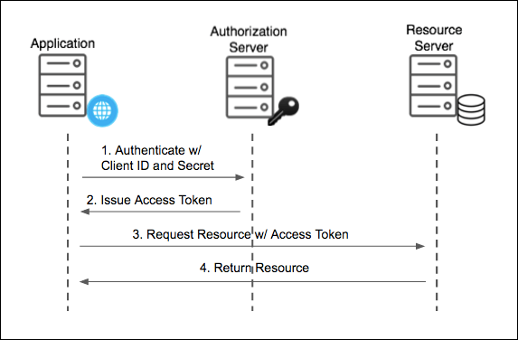
Client Credentials Grant Types

Slide 77
Resource Server
  @SpringBootApplication
  @EnableResourceServer
  public class FlowerHospitalServiceApplication {
  public static void main(String[] args) {
  SpringApplication.run(FlowerHospitalServiceApplication.class, args);
  }

Slide 78
Rest Controller
  @RestController
  public class HospitalController {
  @GetMapping(path = "/hospitals")
  public String getDetails() {
  return "Hello Details From Hospitals";
  }
  }

Slide 79
AuthorizationServerConfigurerAdapter
  @Configuration
  @EnableAuthorizationServer
  public class AuthServerConfiguration extends AuthorizationServerConfigurerAdapter {
  @Autowired
  private AuthenticationManager authenticationManager;
  @Override
  public void configure(AuthorizationServerEndpointsConfigurer endpoints) throws Exception {
  endpoints.authenticationManager(authenticationManager);
  }
  @Bean
  public BCryptPasswordEncoder encoder() {
  return new BCryptPasswordEncoder();
  }

Slide 80
AuthorizationServerConfigurerAdapter
  @Override
  public void configure(ClientDetailsServiceConfigurer clients) throws Exception {
  clients.inMemory()
  .withClient("myclient")
  .authorizedGrantTypes("client_credentials")
  .secret(encoder().encode("pass123"))
  .scopes("read","write")
  .redirectUris("http://localhost:4043/login/oauth2/code/myclient");
  }

Slide 81
Web Security ConfigurerAdapter
  @Configuration
  public class SecurityConfig extends WebSecurityConfigurerAdapter {
  @Override
  protected void configure(HttpSecurity http) throws Exception {
  http
  .authorizeRequests()
  .antMatchers("/login").permitAll()
  .antMatchers("/oauth/authorize")
  .authenticated();
  }

Slide 82
Web Security ConfigurerAdapter
  @Bean
  @Override
  public AuthenticationManager authenticationManagerBean() throws Exception {
  return super.authenticationManagerBean();
  }

Slide 83
OAuth2Template
  public OAuth2RestTemplate template2() {
  ClientCredentialsResourceDetails details = new ClientCredentialsResourceDetails();
  details.setAccessTokenUri("http://localhost:3030/oauth/token");
  details.setClientId("ourclient");
  details.setClientSecret("pass123");
  details.setGrantType("client_credentials");
  OAuth2RestTemplate template = new OAuth2RestTemplate(details);
  return template;
  }

Slide 84
Comparison
Password Grant
Needs Front End
Needs Backend
Has User Interaction
Needs Client Secret
Client Credentials
Doesn't Need Front End
Needs Backend
Doesn’t Need User Interaction
Need Client Secret

Slide 85
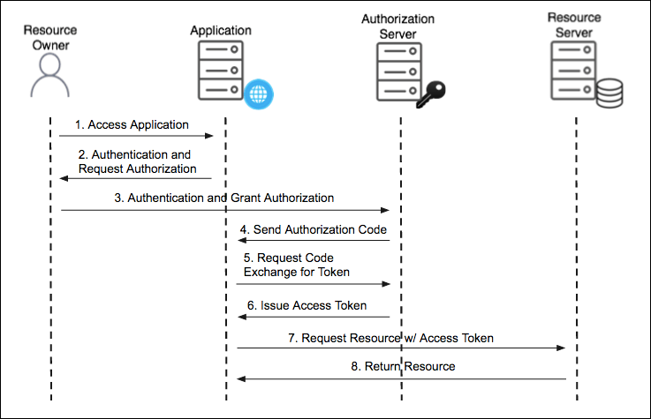
Authorization Code Grant Type

Slide 86
Authorization Code Grant Type
Used by confidential and public clients to exchange an authorization code for an access token.
  After the user returns to the client via the redirect URL, the application will get the authorization code from the URL and use it to request an access token.
The GitHub API uses the OAuth Authorization Code grant type
It needs five piece of information
Client ID
Client Secret
Callback URL
Authorization URL
Access Token URL: :

Slide 87
Social Login
Social logins using Oauth2 have become an industry standard.
Facebook, LinkedIn and Github are OAuth2 login providers
It has revolutionized the way sites share data
Users can quickly access new applications without having to create a new set of credentials.

Slide 88
How Social Login Works
Authorization Server
  Client Application can use the authorization code grant to obtain an access token from GitHub
Resource Server
  It uses the access token to ask GitHub for permitted personal details like login ID and name.
  It Decodes the token checking if it gives the app permission to access the user’s details.
  Inserts the user details into the Spring Security context

Slide 89
Git Hub Social Login
Navigate to https://github.com/settings/developers
create a New OAuth app under the OAuth Apps left menu.
Fill in the Authorization callback URL field to include the redirect URI to your app: http://<your-domain>/login/oauth2/code/github
Click on Register Application
Copy the client ID and client secret to be used Later

Slide 90
OAuth2 Client
  <dependency>
  <groupId>org.springframework.boot</groupId>
  <artifactId>spring-boot-starter-oauth2-client</artifactId>
  <version>2.3.3.RELEASE</version>
  </dependency>

Slide 91
Controller
  @RestController
  public class AppController {
  @GetMapping("/")
  public String home() {
  return "home";
  }
  @GetMapping("/secured")
  public String classified() {
  return "Secured Resource";
  }
  }

Slide 92
Security Config
oauth2Login()
  similar to httpBasic() and formLogin()
  Will be used to display an auto-generated login page for login provider
  public class SecurityConfig extends WebSecurityConfigurerAdapter {
  protected void configure(HttpSecurity http) throws Exception {
  http.authorizeRequests()
  .antMatchers("/","/actuator")
  .permitAll().antMatchers("/secured").authenticated().anyRequest()
  .authenticated().and().oauth2Login();
  }
  }

Slide 93
Security Configuration
Client credentials to the application.properties file.
  Properties are prefixed with
    spring.security.oauth2.client.registration
  This is followed by the client name
    spring.security.oauth2.client.registration.github
  The name of the client property follows next
spring.security.oauth2.client.registration.github.client-id=c1c7fb187a46dea59fbe
spring.security.oauth2.client.registration.github.client-secret=53f1d9de1d00d4f00e9ab6bc276e5166c492f45c

Slide 94
ELK

Slide 95
Why Log Analysis
In cloud-based environment infrastructures, performance, and isolation is very important.
The performance of virtual machines in the cloud may vary based on the specific loads, environments, and number of active users in the system.
Reliability and node failure can become a significant issue.
Log management helps DevOps engineers, system admin to make better business decisions.
Log analysis via Elastic Stack or similar tools is important.

Slide 96
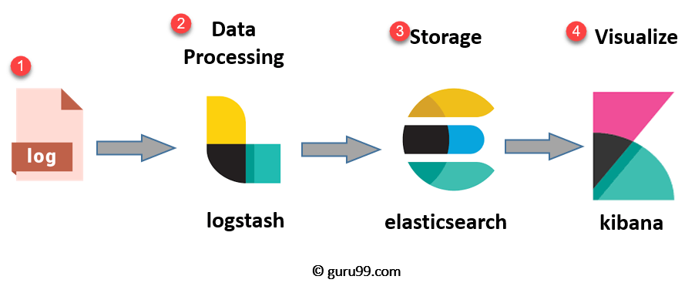
ELK Stack Architecture
Netflix, LinkedIn, Tripware, Medium all are using ELK stack for their business
Used when logs from various Apps of an enterprise converge into a single ELK instance

Slide 97
ELK
Logstash
  Collect logs and events data.
  Parses and transforms data
ElasticSearch
  The transformed data from Logstash is Stored, Search, and indexed.
Kibana
  Uses Elasticsearch DB to Explore, Visualize, and Share
Beats.
  Component for Data collection
This led Elastic to rename ELK as the Elastic Stack.

Slide 98
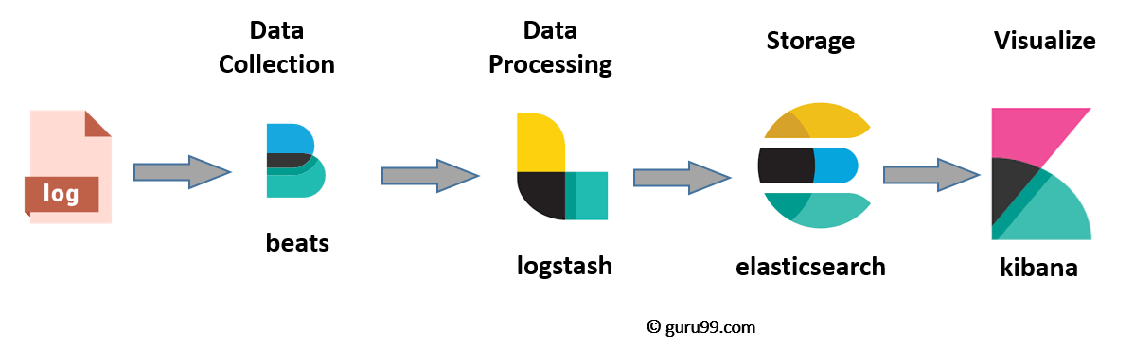
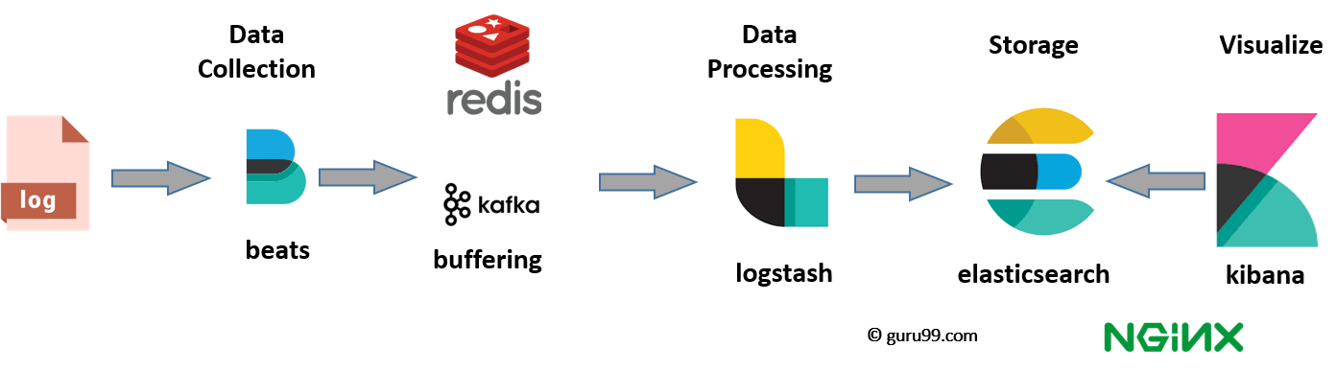
ELK stack el e

Slide 99
Elasticsearch
A NoSQL database.
Based on Lucene search engine
Has built in RESTful APIS.
Simple deployment, maximum reliability, and easy management.
Can do advanced queries and perform detail analysis
Stores all the data centrally.
It is helpful for executing a quick search of the documents.

Slide 100
Features of Elastic search:
Open source search server is written using Java
Used to index any kind of heterogeneous data
Full-Text Search
Sharded, replicated searchable, JSON document store
  Sharding is database partitioning
  Separates very large databases the into smaller, faster, more easily managed parts called data shards
Multi-language & Geolocation support

Slide 101
Elastic Search
A cluster is a collection of nodes which together holds data and provides joined indexing and search capabilities.
Node
  A node is an elasticsearch Instance.
  It is created when an elasticsearch instance begins.

Slide 102
Elastic Search
Index
  An index is a collection of documents which has similar characteristics.
  e.g., customer data, product catalog.
  It is very useful while performing indexing, search, update, and delete operations.
  It allows you to define as many indexes in one single cluster.

Slide 103
Elastic Search
Document
  It is the basic unit of information which can be indexed. It is expressed in JSON (key: value) pair. '{"user": "nullcon"}'. Every single Document is associated with a type and a unique id.
Shard
  Every index can be split into several shards to be able to distribute data.
  The shard is the atomic part of an index, which can be distributed over the cluster if you want to add more nodes.

Slide 104
LOGSTASH

Slide 105
Logstash
  Logstash is the data collection pipeline tool.
  Collects data inputs and feeds into the Elasticsearch.
  Gathers all types of data from the different source and makes it available for further use.
  Used unify data from disparate sources and normalize the data into your desired destinations.
  It allows to cleanse and democratize all your data for analytics and visualization of use cases.

Slide 106
Components of Logstash
Input:
  passing logs to process them into machine understandable format
Filters
  It is a set of conditions to perform a particular action or event
Output
  : Decision maker for processed event or log

Slide 107
Features of Logstash
Events are passed through each phase using internal queues
Allows different inputs for logs
Filtering/parsing for your logs
Advantage of Logstash
  Offers centralize the data processing
  It analyzes a large variety of structured/unstructured data and events
  Offers plugins to connect with various types of input sources and platforms

Slide 108
Kibana
Data visualization which completes the ELK stack.
Can perform advanced data analysis and visualize data in a variety of tables, charts, and maps with Elasticsearch documents
Has dashboard which
  interactive diagrams
  geospatial data
  graphs to visualize complex queries

Slide 109
Search Types
Free text searches
  It is used for searching a specific string
Field-level searches
  It is used for searching for a string within a specific field
Logical statements
  It is used to combine searches into a logical statement.
Proximity searches
  It is used for searching terms within specific character proximity.

Slide 110
Executing KLK Stack
Run the elasticsearch.bat using the command prompt.
  Elasticsearch can then be accessed at localhost:9200
Modify the kibana.yml to point to the elasticsearch instance.
Uncomment the kibana.yml
  elasticsearch.url: "http://localhost:9200"
Run the kibana.bat using the command prompt.
  kibana UI can then be accessed at localhost:5601

Slide 111
Executing KLK Stack
Run logstash using the command
  logstash -f .\..\config\logstash.conf
logstash –f logstash-custom-config.conf
http://localhost:9200/_cat/indices
GET /_cat/indices/<index>
GET /_cat/indices
http://localhost:9200/logstash-2020.12.19-000001?pretty
http://localhost:9200/logstash-2020.12.19-000001/_search?pretty

Slide 112
Configuring Logstash
Logstash Configuration file consists of three section: input, filter and output.
Each section contains plugins that do relevant part of the processing
  Should be saved into logstash.conf config file.
Once the config file is in place and Elasticsearch is running, can run Logstash

Slide 113
Logstash-conf file
  input {
  file {
  type => "java"
  path => "C:/elk/*.log"
  codec => multiline {
  pattern => "^%{YEAR}-%{MONTHNUM}-%{MONTHDAY} %{TIME}.*"
  negate => "true"
  what => "previous"
  }
  }
  }

Slide 114
Logstash-conf file
pattern
  That should match what is to be an indicator that the field is part of a multi-line event.
what
  previous or next and indicates the relation to the multi-line event.
negate
  true or false (defaults to false).
  If true, a message not matching the pattern will constitute a match of the multiline filter and the what will be applied.
Any line not starting with a timestamp should be merged with the previous line.

Slide 115
Logstash-conf file
  output {
  stdout {
  codec => rubydebug
  }
  elasticsearch {
  hosts => ["localhost:9200"] } }
  Start logstash using the command prompt
  logstash -f logstash.conf

